Slide 1
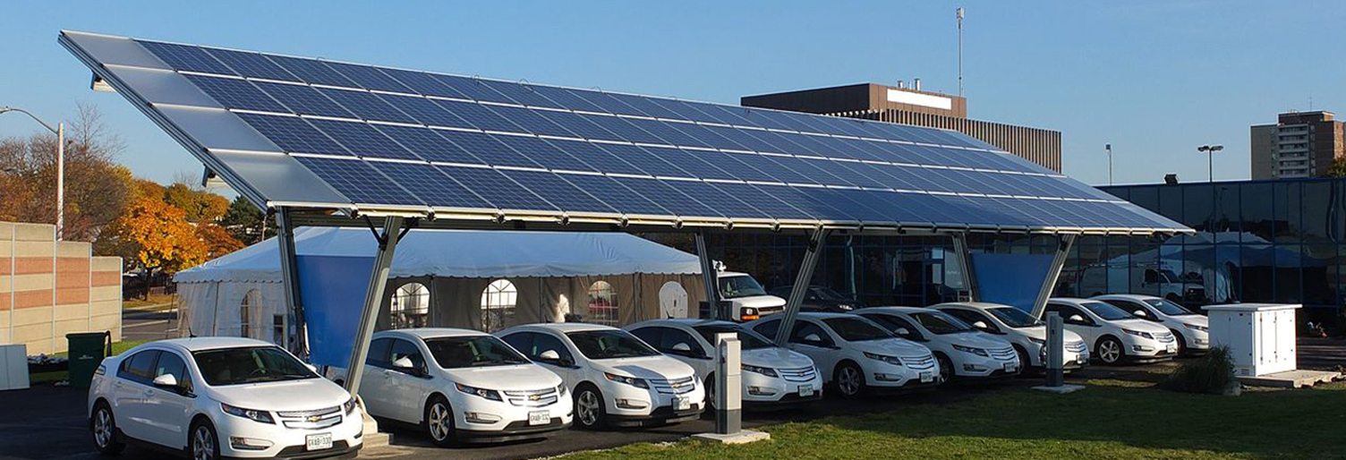
The Community Microgrid Initiative:
The path to resilience and sustainability
Matt Renner
Director, Development and Strategic Partnerships
Clean Coalition
510-517-1343 mobile
matt@clean-coalition.org

Slide 2
Clean Coalition (nonprofit) mission
To accelerate the transition to renewable energy and a modern grid through
technical, policy, and project development expertise
Notes:
2

Slide 3
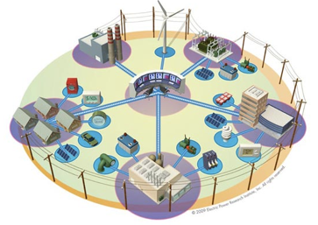


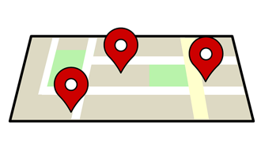
Expertise areas
Community Microgrid Projects
Program and Policy Design
Grid Modeling & Optimization
Analysis & Planning
Full cost and value accounting for DER; siting analysis
PG&E
PSEG
SCE
Powerflow modeling; DER optimization
PG&E
PSEG
SCE
Grid planning, procurement, and interconnection
LADWP, Fort Collins, PSEG
City of Palo Alto (FIT and solar canopy RFP)
RAM, ReMAT
Rule 21 & FERC
Design and implementation
San Francisco, CA
Long Island, NY
Montecito, CA
U.S. Virgin Islands
Notes:
3

Slide 4
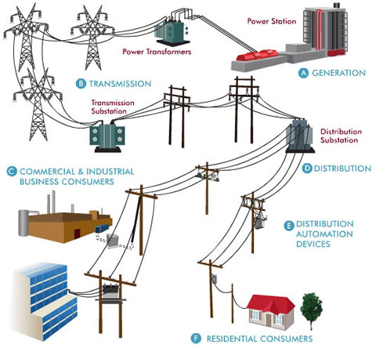
Traditional microgrids focus on single customers
Source: Oncor Electric Delivery Company
Notes:
4

Slide 5
Community Microgrids serve up to thousands of customers
Source: Oncor Electric Delivery Company
Notes:
5

Slide 6
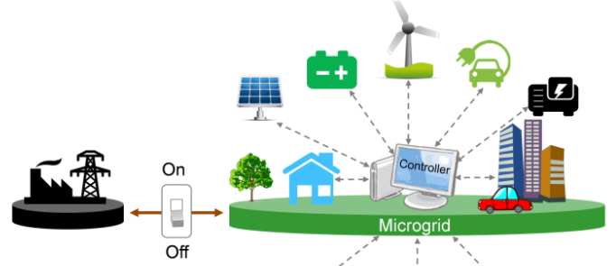
Community Microgrid defined
A modern approach for designing and operating the electric grid, stacked with local renewables and staged for resilience.
“Islanding” from the grid: A coordinated local grid area that can separate from the main grid and operate independently.
Components: Solar PV, energy storage, demand response, and monitoring, communications, & control
Clean local energy: Community Microgrids facilitate optimal deployment of distributed energy resources (DER).
Resilient: Ongoing, renewables-driven backup power for critical and prioritized loads.
Replicable: A solution that can be readily extended
and replicated throughout any utility service territory.
Notes:
Image: Berkeley Labs
Lowers customer and system costs: Reduces the most expensive peak periods and associated energy and infrastructure costs.
Increases local investments: Increases critical economic investment in local communities, enabling targeted environmental justice considerations.
Improves grid performance: Replaces onsite and centralized fossil fuel generators and transmission infrastructure, reduces the complexities and costs of centralized balancing
Delivers resilience and security: Provides ongoing power to critical and priority loads in communities and can withstand multiple disaster and/or cyberattack scenarios
Creates a replicable and scalable model: Covers entire substation areas; can be scaled and deployed in any community

Slide 7
Community Microgrid enabling policies lead to rapid proliferation of distributed energy resources
Policies and programs to support development:
Feed-in Tariff 2.0
  Provides some certainty for developers and financiers, lowering costs
  Features market-responsive pricing
    Includes dispatchability and preferred location adders
    Can support resilience and environmental justice/equity goals
Streamlined interconnection of in-front-of-the-meter distributed energy resources
Transmission Access Charges
    Charges for transmission should no longer apply to distribution-connected generation, leading to lower transmission costs for load serving entities that choose clean local energy
    Currently a massive market distortion in California and elsewhere
Distribution System Operator (DSO)
    Local balancing, local markets
    Provides grid services with aggregated DER portfolio
    Manages “ducklings” at local level instead of one giant “duck curve”

Slide 8
Opportunity: Untapped commercial and industrial (C&I) parking and rooftops
    Largest rooftops and parking lots — most generation potential
    Largest daytime loads — matching peak solar production hours
    Largest utility bills, including demand charges — motivated customers
    Best solution for grid — system peak reduction, strong feeders already in place
    Most carbon emissions within cities
Solar on 25% of commercial and industrial rooftops = 25%+ annual energy use

Slide 9

North Bay Community Resilience Initiative
Objective: make energy abundant, affordable, resilient, and sustainable
Rebuild fire-destroyed areas with high levels of sustainability in homes, buildings, and the electric grid, enabling a modern, distributed, and low-carbon system that delivers substantial economic, environmental, and resilience benefits.
Establish a blueprint for rebuilding disaster-destroyed areas in a timely and cost-effective manner that also maximizes the economic and resilience value of energy as a critical resource to ratepayers, property owners, and municipalities.
Provide a model for operating a modern distribution grid that incorporates optimal distributed energy resources, full interaction with the transmission system, and local energy markets — with resulting benefits across both grid operations and economics.
Ensure that building codes are advanced to achieve more resilient, safer, and cleaner building stock and communities.
Lower ratepayer costs: DER will be utilized to defer or avoid substantial costs including peak energy procurement and transmission & distribution (T&D) infrastructure investments.
Notes:
9

Slide 10

North Bay Community Resilience Initiative
  Team
  Clean Coalition
  Sonoma Clean Power
  PG&E
  Rebuild North Bay
  Center for Climate Protection
  County of Sonoma, Energy & Sustainability Division
  Regional Climate Protection Authority
  Bay Area Air Quality Management District
  Design AVEnues, LLC — EE/ZNE expert Ann Edminster
  Stone Edge Farm Microgrid
Stone Edge Farm Microgrid
Notes:
10

Slide 11
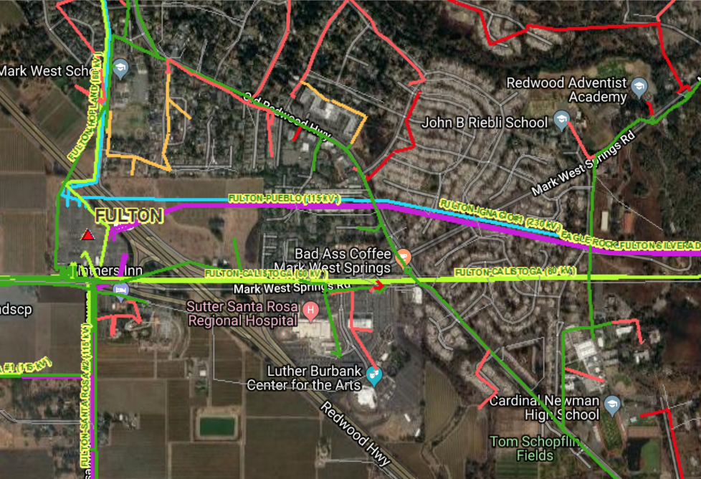
North Bay Community Resilience Initiative:
**Example location only**
  Larkfield and the Old Redwood Highway Corridor – ideal for Community Microgrid
  Served by single substation, Fulton.
Fire-damaged area
Notes:
ICA map shows feeders and substations in the area.
PG&E has not yet identified a location for a Community Microgrid deployment but this is in process.
11

Slide 12
North Bay Community Resilience Initiative
  Example key sites:
  critical, priority, large roofs & parking, etc.
  Larkfield and the Old Redwood Highway Corridor
  Sutter Santa Rosa Regional Hospital
  Luther Burbank Center for the Arts
  Cardinal Newman High School
  Mark West School and area
  Larkfield Shopping Center
  Molsberry Markets
  John B Riebli School
  St. Rose School
Notes:
12

Slide 13

Example: Larkfield and Old Redwood Highway Area
Community Resilience block diagram
Larkfield Shopping Center
Tier 2 & 3 Loads
Tier 2 & 3 Loads
Tier 2 & 3 Loads
FULTON 1107
Fulton Substation
North of Mark West Springs Rd
Transmission
South of Mark West Springs Rd
Sutter
Santa Rosa Hospital
Medical Offices
Luther Burbank Ctr for Arts
Cardinal Newman High School
Tier 2 & 3 Loads
Diagram Elements
Autonomously Controllable Microgrid
Relay/Switch (open, closed)

Slide 14

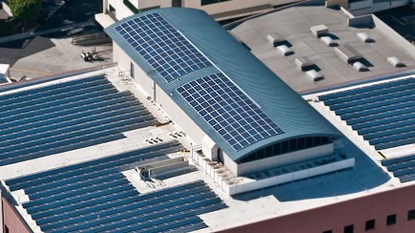
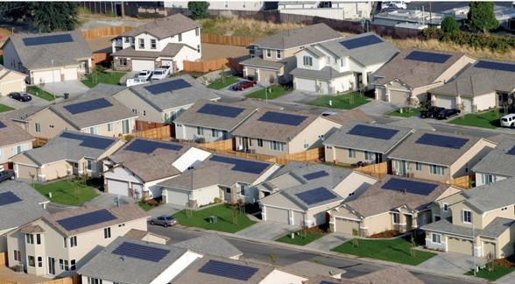
North Bay Community Resilience Initiative:
Homes and buildings as grid partners
Well-designed and well-situated ZNE homes become a valuable part of the resource mix when combined with larger PV arrays on commercial and industrial structures.
Notes:
14

Slide 15
Advanced Energy Rebuild for Homes
  Support for Rebuild
  Sonoma Clean Power (SCP), Pacific Gas and Electric Company (PG&E), and Bay Area Air Quality Management District have joined efforts to help homeowners affected by the firestorms to rebuild energy-efficient, sustainable homes.
  The program is an enhancement to PG&E’s long-standing California Advanced Homes Program, and offers two incentive packages tailored to Sonoma and Mendocino Counties.
  Each package has a flexible performance pathway or a simple prescriptive menu.
Notes:
Source: https://sonomacleanpower.org/advancedenergyrebuild/
For questions about the program, please e-mail programs@sonomacleanpower.org.
15

Slide 16
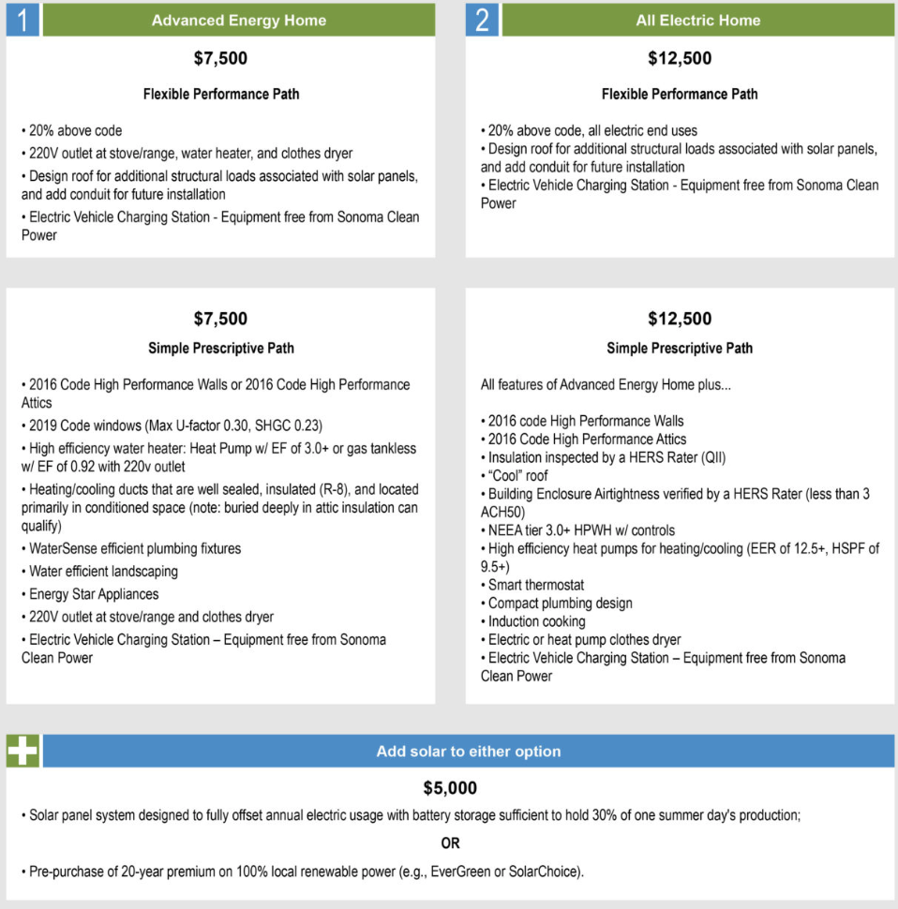
Advanced Energy Rebuild for Homes
Notes:
16

Slide 17



North Bay Community Resilience Initiative: Resilience, economic, and environmental benefits
Example target: 30 MW Solar PV
Benefits over 20 years
Resilience
$50M: Avoided transmission costs
$20M: Avoided power interruptions
Economic
$120M: New regional impact
$60M: Added local wages
1,000 job-years: New near-term and ongoing employment
$6M: Site leasing income
Environmental
46M pounds: Annual reductions in GHG emissions
10M gallons: Annual water savings
225: Acres of land preserved
Example: Large rooftop
System size = 714 kW
Example: Large parking lot
System size = 567 kW
Example: 50 avg. rooftops
Avg. system size = 5 kW
Commercial: 18 MW
Parking lots: 2 MW
Residential: 10 MW
Notes:
ENERGY BENEFITS
Cost Parity via 20-year LCOE:
14.9¢/kWh solar vs. $15.3¢/kWh new combined cycle natural gas, LCOE. Modeling performed with NREL System Advisor Modeling (SAM) and PVWatts system design, using the mid-case scenario. For more details, see detailed LCOE slide later in deck.
Local Energy Spend
Based on 20 year average of $2,619,260 per year from avg output of 1484kWh/yr over that period
$52M over 20 years per 10MW
Avoided transmission access charges (TAC):
Calculated from CAISO 2013 TAC schedule and infrastructure projections. Note that the reductions in TAC are included in the LCOE comparison.
Avoided Costs from New Transmission Capacity:
Each 10 MW of added PV DG capacity will reduce the need for added transmission capacity investment by 0.05% relative to CAISO BAU projections and the related growth in TAC ratesResults in 0.0012¢/kWh reduction TAC rates applied to virtually all of the 254,000 GWh consumed within CAISO transmission system electricity by 2020
Avoided Line Losses
Based on PG&E Bay Area reported line loss rates, combined avoided line losses from transmission and distribution due to distributed generation average 5%, or 789 MWh per year for each 10 MW of PV DG installed. At an average current retail value of 15¢/kWh, the value of avoided losses is $118,350 per year, totaling $2,367,000 over 20 years.
Note that avoided lines losses are included in LCOE comparison.
Avoided Costs in Local Power System Interruptions:
Based on PG&E figures for Hunters Point outages, 10 MW of local DG would result in a 10% reduction in annual outages alone, or $304,000 per year, or $6M over a 20 year period. 50 MW would equal five times that, or $30M over 20 years. Source: PG&E 2012 Reliability Annual Report, DOE Interruption Cost Calculator - http://www.icecalculator.com/
ECONOMIC BENEFITS
Private Investment + Operations & Maintenance:
$200M investment over 20 years is comprised of near-term plus ongoing operations and maintenance as follows:
1. $165M represents the private investment amount for a 50MW PV system over 20 Years, as follows:
Installation & Construction: $137M ($27.5M per 10 MW)
Dynamic Grid Solutions @ 20% = $27,500
Total = $165K
O&M: $35M represents the O&M costs for a 50MW PV system over 20 years, as follows:
O&M adds $1.48M annually, or $29.7M over 20 years
plus 20% or $5.9M for Dynamic Grid Solutions
Total = $35.6M over 20 years.
Local Employment and Economic Impact:
Specific to MTA – Metropolitan Region.
Refers to PV installed in San Francisco at an average installed cost of $2.75/W(dc) (before taxes and incentives).
Local economic output is calculated as the value of expenditures on goods and services resulting from the project and captured within the study area, and excludes expenditures outside the region, such as to module manufacturers. During operating years local economic output is comprised of payments made by project owners, including the portion of project debt payments made to lenders located within the local analysis area. Payments including incentives, refunds, or revenues to project owners from the sale of energy produced by installed facilities are not included.
Economic activity in input-output models is assessed in three categories:
Salaries and wages for the project on-site labor and direct professional services
Local supply chain revenue related to materials acquisition, manufacture and services, including the local share of revenues from project financing and investment
Induced impacts in the local economy that result from workers salaries and wages
The model’s “output” is the sum of the above three categories for construction and for operations. State-specific multipliers and personal spending patterns are used to derive the results.
Near-term Job years of regional local employment from construction and installation. Ongoing job years in operation and maintenance over 25 years of operation.
Local wages in construction & installation.
The SF successor RDA estimates that 50% of the jobs and economic output will be captured within the boundaries of the city
Equipment and material sales will generate tax revenue as indicated.
NREL's JEDI models classify the first category of results—on-site labor and professional services results—as dollars spent on labor from companies engaged in development and on-site construction and operation of power generation and distribution. These results include labor only—no materials.
Econ impact
NREL JEDI model version PV 10.17.11
NREL JEDI Scenario model PVS 4.5.13
PV PPA pricing
NREL System Advisor Model (SAM) v. 2013.9.20
CEC Cost of Generation Model v.2
ENVIRONMENTAL BENEFITS
GHG Reductions:
Assuming PV replaces Combined Cycle Natural Gas (CCNG) generation in contributing to California’s Renewable Portfolio Standard (RPS), avoided emissions from displaced CCNG facilities equal:
CO₂: 16,630,000 lbs (7461 Metric tons)
NO_{X}: 30,700 lbs
Mercury (Hg): 0.016 lbs
Source: NREL Emissions Health Calculator, PG&E service territory
Water Use:
Thermal generation, including both fossil and nuclear facilities requires significant water use for cooling. NGCC facilities with cooling towers consume 0.7 cubic meters of water per MWh through evaporation.
A 10 MW PV facility would save:
11,050 cubic meters of water per year, or nearly 3 Million gallons, or 3,900 cubic feet.
This is equivalent to the average annual water use of 75 San Francisco residents.
Source: DOE 2009
Land saved, acres
DG avoids land impacts vs. conventional generation because it is typically deployed as a secondary use on existing structures, parking lots or otherwise already disturbed land. Each 10MW of DG preserves 75 acres of land. This does not include savings for adding transmission lines as well. Source: Civil Society Institute – “Hidden Costs of Electricity” (Sep 2012)

Slide 18
Value of Resilience
How much does resilience cost and what is its value?

Slide 19
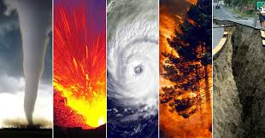
What does lack of resilience cost?
$119 billion: Annual cost of power outages to the U.S.
$20 - $55 billion: Annual cost to Americans of extreme weather and related power outages
$243 billion - $1 trillion: Potential cost of a cyber attack that shuts down New York and D.C. areas
Notes:
- Major power outages due to extreme weather now cost Americans between $20 and $55 billion annually. https://www.earthnetworks.com/blog/weather-related-power-outages-utility-companies-need-know/
- Cost of Power Interruptions to Electricity Customers in the United States, LBLN, Feb 2006: https://emp.lbl.gov/sites/all/files/report-lbnl-58164.pdf
- Economic Benefits of Increasing Electric Grid Resilience to Weather Outages, U.S. DOE, Aug 2013: https://energy.gov/sites/prod/files/2013/08/f2/Grid%20Resiliency%20Report_FINAL.pdf
- Business Blackout: The insurance implications of a cyber attack on the US power grid, Lloyd’s of London and University of Cambridge Centre for Risk Studies, May 2015: https://www.lloyds.com/news-and-risk-insight/risk-reports/library/society-and-security/business-blackout

Slide 20

Resilience provided by Community Microgrids has tremendous value during a disaster
Powers critical loads until utility services are restored
  Eliminates need to relocate vulnerable populations (infirm, elderly, and disadvantaged)
Ensures continued critical services
  Water supply, medical and elder-care facilities, grocery stores, gas stations, shelters, communications centers
  Avoids the cost of emergency aid logistics
Provides power for essential recovery operations
  Lighting for buildings, communications, water pumps for firefighting and flood control, emergency shelters, food refrigeration
Reduces dependence on diesel generators
  Diesel can be expensive and difficult to
  deliver in emergencies
  Ongoing diesel maintenance requires
  regular operation with onsite air pollution
Keeps businesses open
  Serves the community and maintains
  revenue streams
Notes:
Includes advanced inverters + DER: Capable of riding through events that would cause older systems to shut down, and of responding to voltage and frequency excursions to mitigate these events
20

Slide 21
But how do we determine the monetary value of resilience?
Factors to consider
Consequence of disaster | Resilience assessment metric
Unavailable electrical service | - Cumulative customer-hours of outages - Cumulative customer energy demand not served - Average percentage of customers experiencing an outage in a specified time period
Grid restoration | - Time to recovery - Cost of recovery
Monetary impact | - Loss of utility revenue - Cost of grid repair and replacement - Cost of recovery - Avoided outage cost - Lost business revenue
Community impact | - Critical services without power
Cost of outages: Varies by location, population density, facility type. Can include lost output and wages, spoiled inventory, delayed production, damage to the electric grid
Cost of storage: Varies by size of electric load and size of critical load
Cost of islanding: 3% - 21% of non-islandable solar+storage cost (figures from NREL)
Notes:
Source: Grid Modernization Laboratory Consortium, 2017

Slide 22
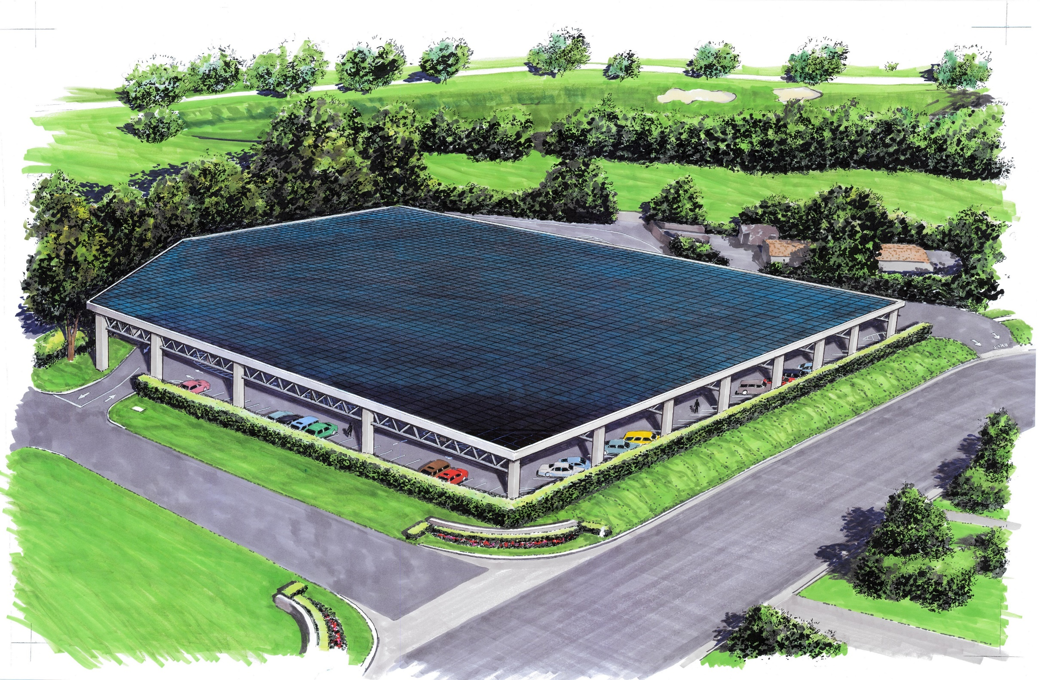
Value of Resilience:
$2,808/kW of critical load per year
Annually, resilience is worth $2,808 per kilowatt of critical load in the US
Based on real-world scenarios run through the Clean Coalition VOR model
Tier 1 = Critical load, usually 10% of total load — life-sustaining or crucial to keep facility operational during a grid outage
  Tier 2 = Priority load (15%) — important but not necessary to keep operational during an outage
  Tier 3 = Discretionary load (75%) — the remainder of the total load
Based on keeping critical load
online for one day on the worst-
case solar day
  If outage spans days with greater
  solar resource, may be able to
  keep Tier 2 or even Tier 3 loads
  online

Slide 23






Valuing resilience:
The Clean Coalition Value of Resilience (VOR) Model
  The size of your load: How much electricity do you use per year?
  The size of your critical load: What percentage of your electrical load is essential to keep running during an extended outage? For many facilities, this is 10%.
  The length of outage you want to prepare for: Do you want to prepare for short outages of a few minutes, or prepare for outages lasting several days or more?
  The cost of an outage: How much revenue or productivity do you lose per hour during an outage? If you don’t have this figure, you can use the national average of $117 per kilowatt-hour, based on data from the Department of Energy’s National Renewable Energy Lab (NREL).
  Your energy storage system: The minimum and maximum state of charge you’d like to allow for your battery; the initial state of charge at the time of an outage; and your battery cost (including cost/benefit analysis for demand charge reduction), capacity, and round-trip efficiency.
  The amount of sunshine in your area: Average amount of sunshine in your area, as well as the amount of sunshine on the worst 5 solar days of the year.
Notes:
Length of outage: Do you want to prepare for short outages of a few minutes, or prepare for outages lasting several days or more?

Slide 24
Clean Coalition Value of Resilience Model outputs
The tool calculates:
The minimum battery capacity you need for resilience
The total cost for a system at your site to monetize demand charge reduction
Your total system cost, based on the required battery capacity
Resilience cost: The total system cost for the resilience portion of your system
Resilience value: The annual value of resilience provided by your system
Notes:
Resilience cost:
Using information about your critical load, solar resource in your area, and your energy storage system, we calculate the battery size and other Community Microgrid elements you need for resilience. That gives us the total resilient system cost.
Using information about your site and the solar resource in your area, we calculate the battery size you need for demand charge reduction. That gives us the cost/benefit values for the demand charge portion of your system.
We subtract the demand charge reduction value from the total system cost to get the cost for the resilience portion of your system.
Resilience value:
Using information about the cost of an outage, your critical load, and the length of outage to prepare for, we get your annual value of resilience.
Your value of resilience will be higher if:
Your cost of outage is higher than the national average of $117 per kilowatt-hour
You want to prepare for outages lasting longer than one day

Slide 25
Value of resilience for a Community Microgrid:
One building at a corporate campus
Cost of resilience
Item | Inputs | Units | Inputs |  | Calculation
Inverters | 250 | [kW] | $1,062 | [$/kW] | $265,500
Battery for resilience | 308 | [kWh] | $ 256 | [$/kWh] | $78,887
System islanding | 2 | controllers | $30,000 |  | $60,000
Total system cost |  |  |  |  | $404,387
System cost offset by demand charge reduction |  |  |  |  | -$803,100
Total cost for resilience |  |  |  |  | -$398,713
Value of resilience
Item | Calculation | Units | Notes
Cost of outage | $117 | [$/kWh] | $117 is nationwide average for surveyed customers
Size of critical load | 12 | [kW]
Value of lost load per hour | $1,404 |  | Cost of outage per kilowatt-hour x size of critical load
Days of outage to prepare for | 1
Annual value of resilience | $33,696
Cost of resilience = -$33,226 per kW of critical load
Annual value of resilience = $2,808 per kW of critical load
Break-even point = immediate
Notes:
Negative cost of resilience indicates that the needed capacity for demand charge reduction is sufficient for the required resilience goals. Therefore, by installing batteries for demand charge management for this particular load, the customer would get one day of resilience for their critical load for free.

Slide 26
Value of resilience for a Community Microgrid:
Medium-sized installation at large corporate campus
Cost of resilience
Item | Inputs | Units | Inputs |  | Calculation
Inverters | 1,000 | [kW] | $1,062 | [$/kW] | $1,062,000
Battery for resilience | 12,203 | [kWh] | $ 256 | [$/kWh] | $3,124,038
System islanding | 9 | controllers | $30,000 |  | $270,000
Total system cost |  |  |  |  | $4,456,038
System cost offset by demand charge reduction |  |  |  |  | -$2,674,800
Total cost for resilience |  |  |  |  | $1,781,238
Value of resilience
Item | Calculation | Units | Notes
Cost of outage | $117 | [$/kWh] | $117 is nationwide average for surveyed customers
Size of critical load | 253 | [kW]
Value of lost load per hour | $29,601 |  | Cost of outage per kilowatt-hour x size of critical load
Days of outage to prepare for | 1
Annual value of resilience | $710,424
Cost of resilience = $7,040 per kW of critical load
Annual value of resilience = $2,808 per kW of critical load
Break-even point = 2.5 years

Slide 27
Value of resilience for a Community Microgrid:
Campus-wide installation at large corporate campus
Cost of resilience
Item | Inputs | Units | Inputs |  | Calculation
Inverters | 1,750 | [kW] | $1,062 | [$/kW] | $1,858,500
Battery for resilience | 17,760 | [kWh] | $ 256 | [$/kWh] | $4,546,459
System islanding | 18 | controllers | $30,000 |  | $540,000
Total system cost |  |  |  |  | $6,944,959
System cost offset by demand charge reduction |  |  |  |  | -$4,008,900
Total cost for resilience |  |  |  |  | $2,936,059
Value of resilience
Item | Calculation | Units | Notes
Cost of outage | $117 | [$/kWh] | $117 is nationwide average for surveyed customers
Size of critical load | 375 | [kW]
Value of lost load per hour | $43,875 |  | Cost of outage per kilowatt-hour x size of critical load
Days of outage to prepare for | 1
Annual value of resilience | $1,053,000
Cost of resilience = $7,829 per kW of critical load
Annual value of resilience = $2,808 per kW of critical load
Break-even point = 2.8 years

Slide 28
Backup slides

Slide 29
The future of energy is distributed…
California’s distributed solar and efficiency saves $2.6 billion on power lines
In March 2018, California’s grid operator signed off on the state’s 2017-2018 Transmission Plan, which approved 17 new transmission projects combined at a cost of nearly $271 million.
20 transmission projects were canceled and 21 were revised due to energy efficiency and residential solar power altering local area load forecasts.
The projected savings from these changes is estimated to be $2.6 billion.
Notes:
Source: https://pv-magazine-usa.com/2018/03/27/distributed-solar-and-efficiency-saves-california-2-6-billion-on-power-lines/

Slide 30
The future of energy is distributed…
Sacramento Utility Pushes All-Electric Homes: “California Is Wasting Money to Build Homes With Gas”
On June 1, the Sacramento Municipal Utility District (SMUD) launched an incentive program to provide rebates promoting electrification in both retrofitted and new homes.
SMUD’s electrification rebate packages are worth up to $5,000 for new homes and up to $13,750 for gas-to-electric conversions in existing homes.
10% of California’s GHG emissions come from burning fossil fuels for space and water heating in buildings. SMUD’s electrification initiative helps achieve its 2050 GHG reduction target.
Notes:
Source: https://www.greentechmedia.com/articles/read/sacramento-utility-pushes-all-electric-homes

Slide 31
The future of energy is distributed…
Canada plan promises to transform cities and communities
“Build Smart ─ Canada’s Buildings Strategy” plan commits Ottawa to develop — and the provinces and territories to adopt — a series of model building codes requiring increasingly higher levels of energy efficiency.
Under the plan, by 2030, every new building being built in the country will be required to meet a net-zero-energy-ready level of performance.
In other words, in just over a dozen years or so, new buildings will be so well-designed and carefully built that they should be able to meet all of their energy needs with renewable energy either generated on-site or nearby.
Notes:
Source: https://www.nrcan.gc.ca/sites/www.nrcan.gc.ca/files/emmc/pdf/Building_Smart_en.pdf

Slide 32
The future of energy is distributed…
Vermont utility Green Mountain Power now pays customers over $30 per month to use their battery systems as a load-offsetting resource.
Helps address the steep transmission access charge assessed by ISO New England. That charge more than doubled from $3 per kilowatt per month in 2016 to over $7 in 2017, and is expected to increase to over $9 in 2018.
As more solar is installed on the distribution grid, access to locally generated and stored solar energy at times when electricity from transmission is the most expensive is a grid benefit that can save money for utilities and customers.
Notes:
Source: http://www.qatargreenleaders.com/news/sustainability-news/1668-unlocking-the-distributed-grid-with-flexibility-management-software

Slide 33
The future of energy is distributed…
Illinois is now "transforming the regulatory compact" to embrace performance-based policy goals
Illinois team at RMI eLab Accelerator, featuring utility ComEd, are devising four broad policy goals for future legislation and compensation:
  Power sector decarbonization
  100% renewables
  Community development and equity
  Beneficial electrification of other sectors, e.g EVs
Illinois now supports shared utility + customer microgrids. Joe Svachula, VP Engineering & Smart Grid Technology at ComEd: “It’s an important step forward in our effort to develop a more secure, resilient, and reliable distribution system in the future.”
Notes:
source: https://www.utilitydive.com/news/13-projects-from-the-leading-edge-of-the-utility-transformation/524099/
33

Slide 34
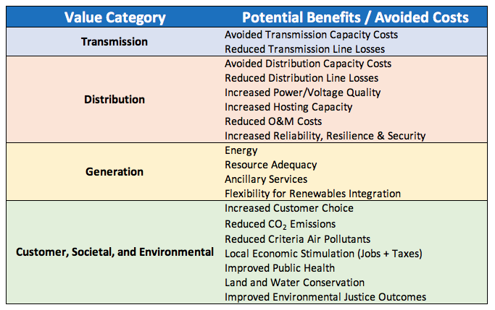
The advantages of distribute energy resources
Sources: Newport Consulting Group, ICF Consulting
Notes:
34

Slide 35
Restoration times for gas vs. electric service after a major urban earthquake
(Data source: San Francisco Lifeline Council Interdependency Study, 2014)
Notes:
the vast majority of Palo Alto's carbon footprint now comes from gasoline for transportation and natural gas for space heating and hot water.
fuel-switching is extremely slow; paced primarily by new construction
restoration times for electric service are an order of magnitude faster than for gas service
Restoration for gas takes 10 times longer than for electricity

Slide 36
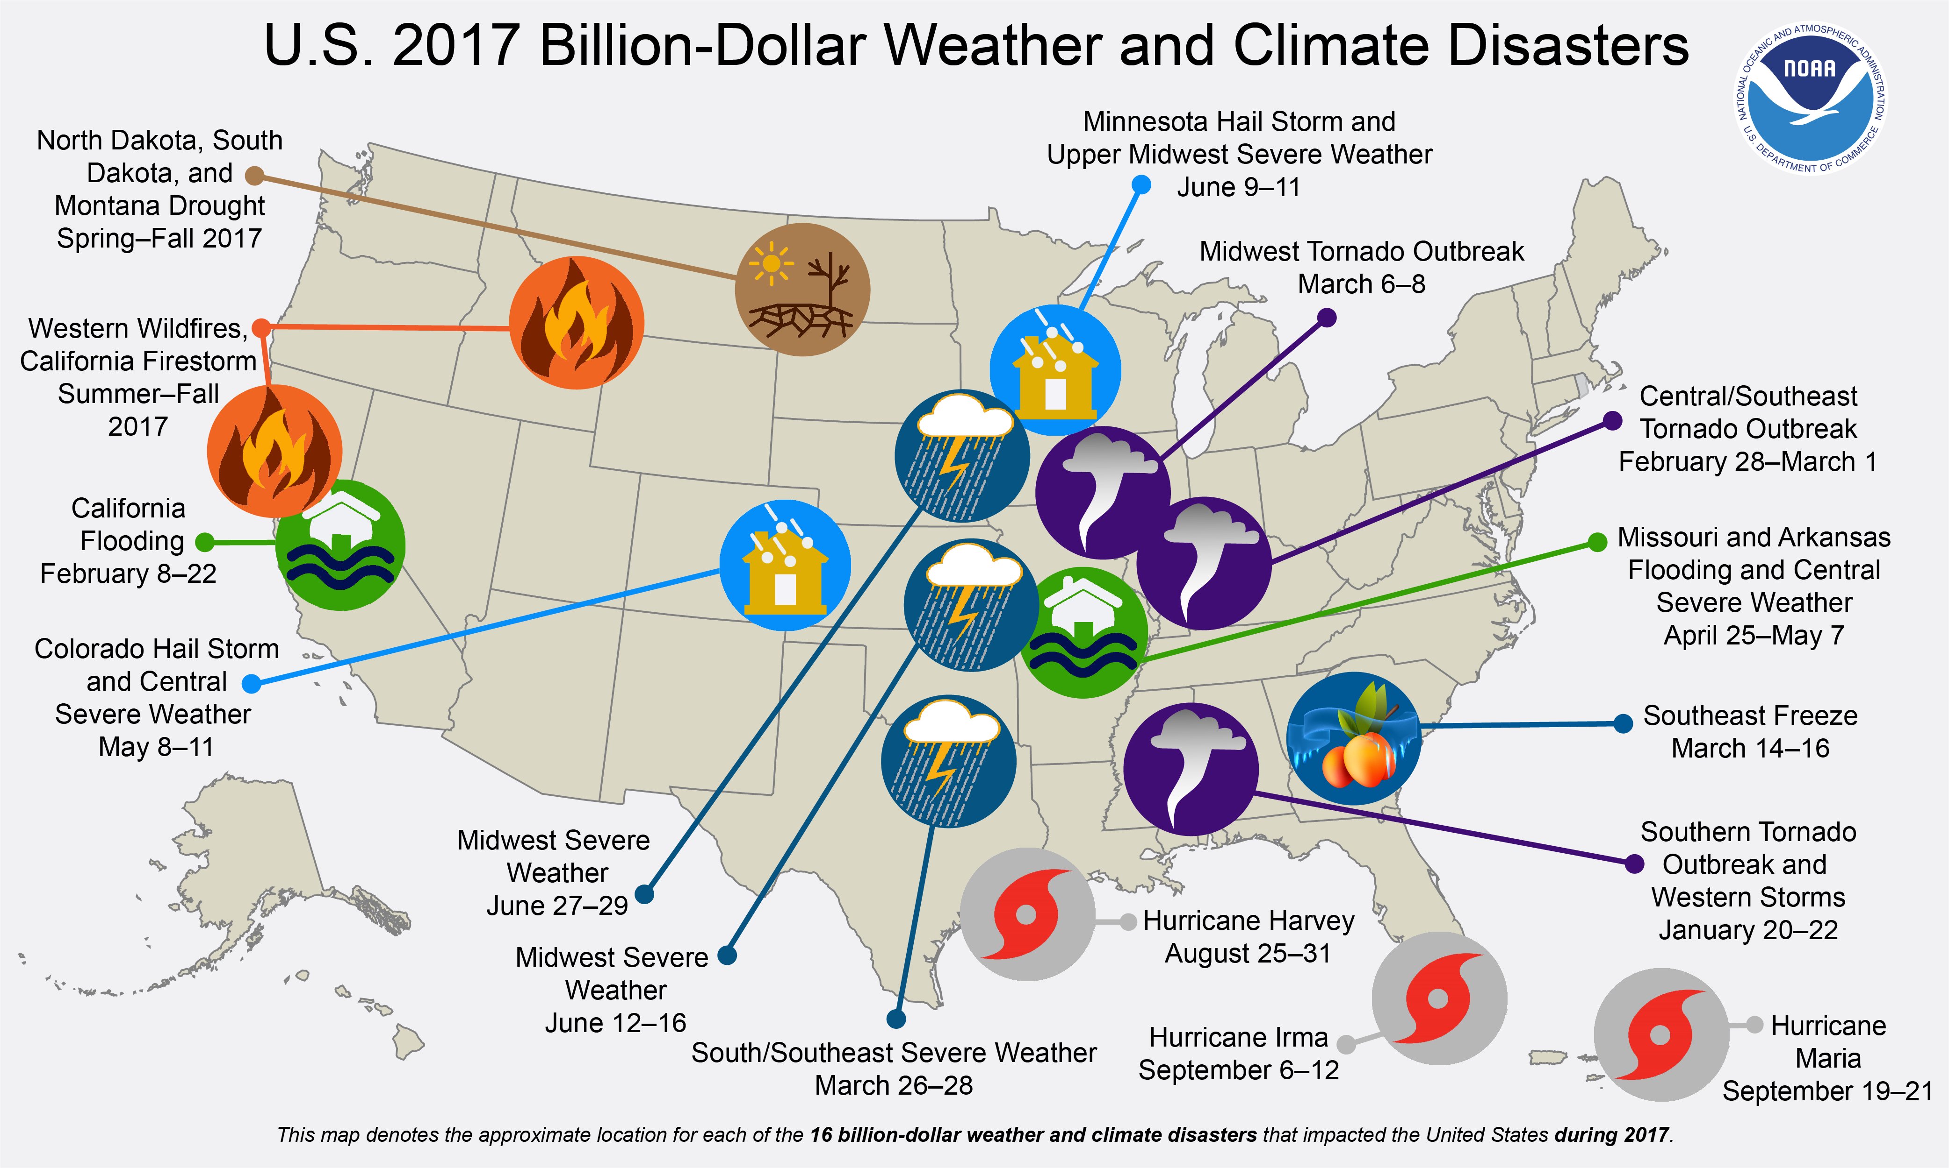
$1B+ weather events in U.S. Jan – Sept 2017
Source: National Oceanic and Atmospheric Administration
Notes:
36

