Slide 1

Community Microgrids:
The Path to Resilience & Sustainability
Greg Thomson
Director, Community Microgrid Initiative Clean Coalition
415-845-3872 mobile greg@clean-coalition.org
Making Clean Local Energy Accessible Now

Slide 2

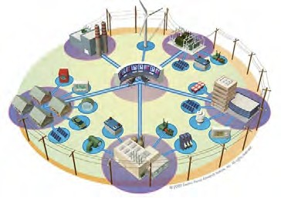


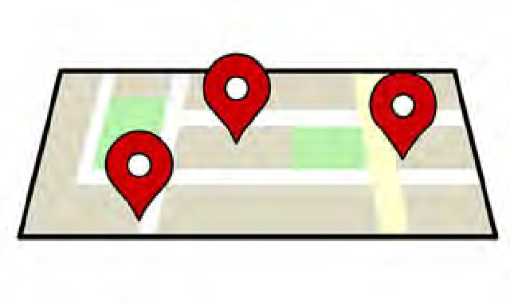
Community Microgrids: The Path to Resiliency
Greg Thomson
Director, Community Microgrid Initiative
415-845-3872 mobile greg@clean-coalition.org
Community Microgrid Projects
Grid Modeling & Optimization
Program Design
Analysis & Planning
Full cost and value accounting for DER; siting analysis
Powerflow modeling; DER optimization
Procurement and interconnection
Design and implementation
PG&E
PSEG
SCE
LADWP, Fort Collins, PSEG
City of Palo Alto (FIT and solar canopy RFP)
RAM, ReMAT
Rule 21 & FERC
San Francisco, CA
Long Island, NY
U.S. Virgin Islands
PG&E
PSEG
SCE

Slide 3
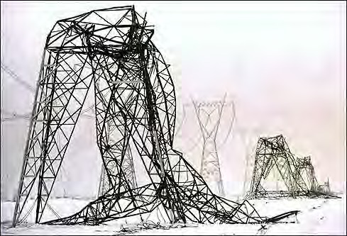

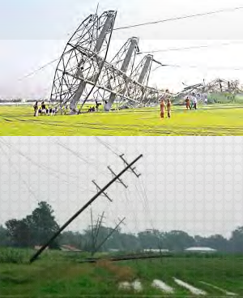

Introduction: Energy is critical infrastructure
Energy is critical infrastructure.
And yet, our legacy, centralized energy architecture carries multiple critical risks.
This architecture is costly, aging, inefficient, and a highly vulnerable security risk
Extreme weather events are occurring more frequently, further demonstrating the vulnerability and high cost
Cyber attacks are a growing risk, and an attack on a centralized system can affect millions
To accomplish both local and national security, we must move more quickly to a new solution
Community Microgrids:
Cleaner, More Reliable & Resilient, More Affordable

Slide 4

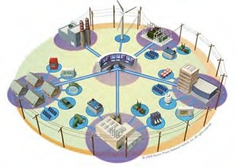
Why Community Microgrids?
A Community Microgrid delivers four combined benefits to communities.
These benefits are not provided by today’s centralized energy system.
Lower Costs: By optimizing local clean energy, energy storage, and other DER, the cost of electricity is reduced by eliminating expensive peak periods and all associated costs
Cleaner Energy: High penetrations of local clean energy not only replaces fossil fuels, it also provides clean energy for local transportation – and at lower delivery costs
Resilience & Security: Delivering ongoing, clean power to critical & priority loads in communities, while able to withstand multiple disaster scenarios
A Replicable Solution: Covering an entire substation area, this solution can be deployed in any community around the world – and also increases local economic investment

Slide 5

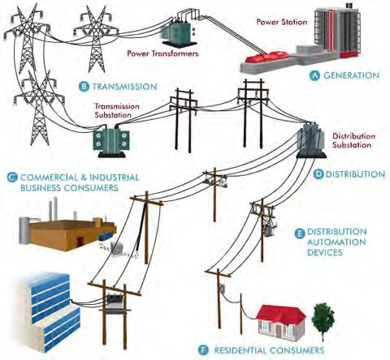

Traditional Microgrids focus on single customers
Source: Oncor Electric Delivery Company

Slide 6

Community Microgrids serve thousands of customers
Source: Oncor Electric Delivery Company

Slide 7

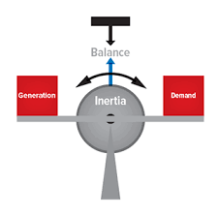

Community Microgrids feature “Local Balancing”
Local Balancing gives us a more efficient way to operate the grid
Flattens and lowers load shapes across entire community areas, thereby reducing system-wide peaks and thus the most costly energy and grid infrastructure
Manages variability/volatility locally, rather than exporting volatility as an aggregated issue up to the centralized system
Provides energy resiliency & security to cities and communities via power generated, delivered, and consumed locally
The distribution & transmission grids become equal partners in grid operations and efficiencies.

Slide 8


Local Balancing offers multiple economic benefits
The six economic benefits of Local Balancing via Community Microgrids
Cost Reductions Due to Peak Management: Protection against the high cost of peak energy
Cost Reductions Due to Demand Charges: Protection against additional fees charged by utilities for peaks
Cost Reductions Due to Rate Management: Protection against future rate changes, e.g. evening ramp
Cost Reductions Due to Investment Deferrals: Deferral of substantial costs for centralized infrastructure
Cost Certainty: Keeping rates and costs constant for consumers as well as grid operators.
Increased Economic Investment in Communities
These Cost Issues Are Caused by Our Mostly Centralized System

Slide 9
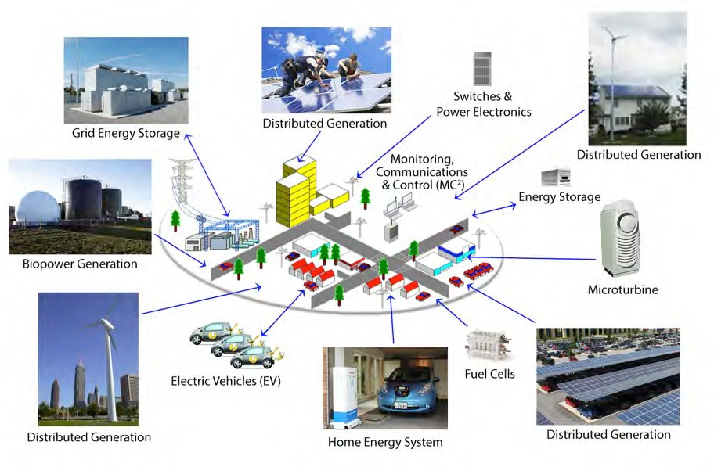
Community Microgrid

Slide 10
Community Microgrid design steps
Step 1 – Goals
Save ratepayers money by deferring substantial investments in centralized infrastructure through Local Balancing – local clean energy at optimal locations, energy storage for peak reduction and generation firming, and load shifting & shaping
Improve grid reliability, resilience, and security by utilizing local clean energy and energy storage to provide ongoing backup power to critical and prioritized loads in the area
Modernize grid operations to support and automate the above, helping enable utilities to take a much-needed step forward
Feature energy efficiency and home improvements/ZNE, as key additional cost, health, and energy performance improvements
10

Slide 11
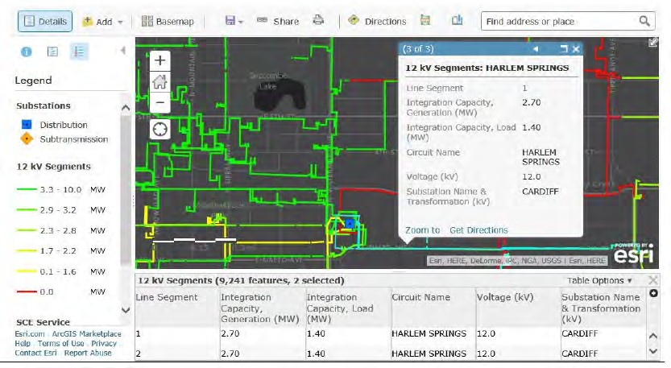
Community Microgrid design steps
Step 2: Baseline Grid Analysis
Determine the ability of the grid to accommodate new DER: Inventory of the existing grid including load profiles, voltage regulation, feeder and transformer capacities, and existing generation

Slide 12
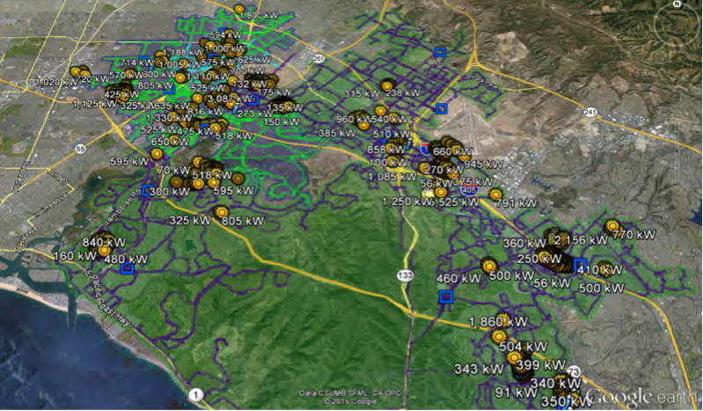
Community Microgrid design steps
Step 3: Local Clean Energy Survey
Comprehensive assessment of the local clean energy generation potential in the target area, specific to local resources and site characteristics

Slide 13
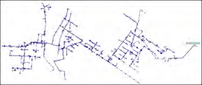









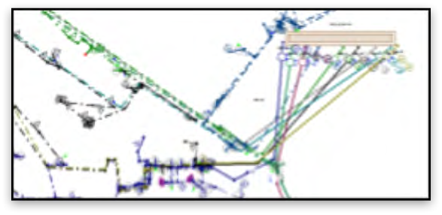



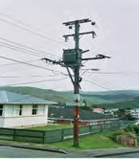



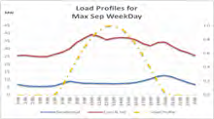

Community Microgrid design steps
Step 4: DER Optimization
The DER Wheel of Fortune! Unlocking optimal and most cost-effective DER portfolios.
Derived In combination with the other optimizations
More reliable,
cost- predictable,
cleaner
Optimal feeder locations
Local Market Value –
e.g. Rates
Locally connected feeders
Helps achieve local balance
Also extends to system-
wide avoided
costs
Local avoided grid upgrades
Local load shapes and forecasts
Unlocks optimal customers and DER

Slide 14
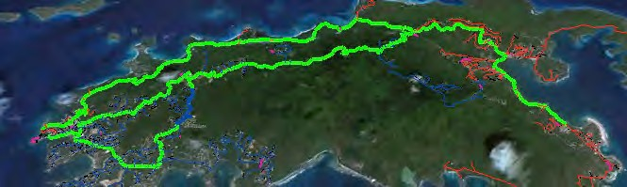
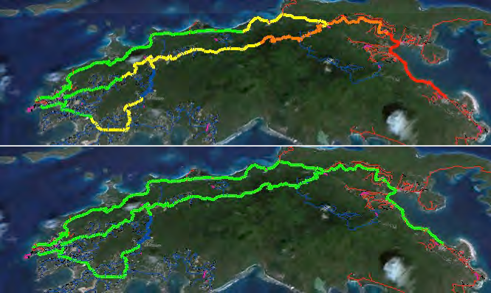
DER Optimization: advanced inverters
1. 6AM:
No PV impact
2. Noon:
20MW PV causes overvoltage
3. Noon:
20MW PV with advanced inverters set at
0.9 power factor stabilizes voltage

Slide 15


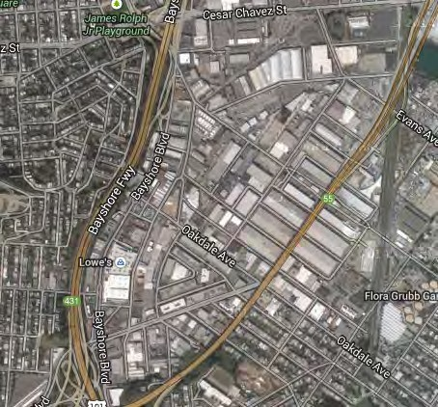
DER Optimization: Commercial & Industrial (C&I)
C&I customers are typically the largest electricity users and emitters of GHG. Guess what? They also match well with solar.
Most Generation: Larger roof & parking spaces generate more energy
Lowest System Costs: Larger PV systems reduce overall costs
Best Grid Locations: Large loads served by robust feeder segments
Matching Load Profiles: Larger daytime loads match solar generation
Financially Motivated: Larger bills including demand charges, plus roof and parking lease opportunities

Slide 16




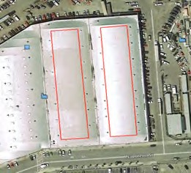
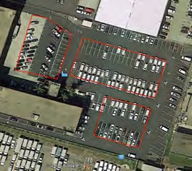
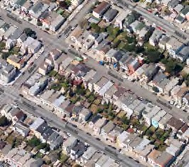
Community Microgrid design steps
Step 5: Benefits Analysis
Hunters Point Example – 50 MW PV over 20 yrs.
Energy
Economic
Environmental
Cost Parity:
Solar vs. NG, LCOE
$200M:
$100M:
New regional impact Added local wages
78M lbs.: Annual reductions in GHG emissions 15M Gallons: Annual water savings
375: Acres of land preserved
$260M:
Spent locally vs. remote
$80M:
$30M:
Avoided transmission costs Avoided power
1,700 Job-Years: New near- term and ongoing employment
interruptions
$10M:
Site leasing income
Example: 180 Napolean St.
• PV Sq. Ft = 47,600
System size = 714 kW
Example: 1485 Bay Shore
• PV Sq. Ft = 37,800
System size = 567 kW
Example: 50 avg. rooftops
Avg. PV Sq. Ft = 343
Avg. system size = 5 kW
Commercial: 18 MW
Parking Lots: 2 MW
Residential & MDU: 10 MW

Slide 17
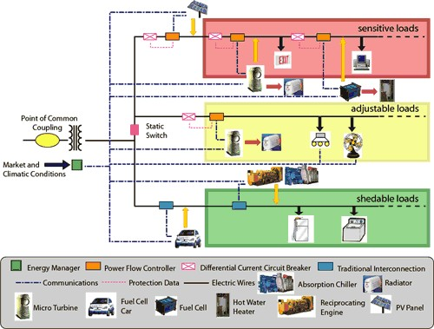
Community Microgrid design steps
Step 6: Deployment Plan
Final system design and operational plan for the Community Microgrid. Includes sizing for energy storage based on local generation, overall loads, and critical load requirements. Also includes targeted EE, load shifting, EV charging, etc. Features financial model and streamlined/bulk deployment plan.

Slide 18
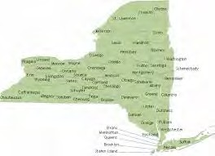
Examples: New York – inefficiencies
New York State uses peak power only 100 hours each year. This costs ratepayers $1.7 billion – to serve less than 1% of the system’s needs.
The bulk power system, designed to meet a peak demand 75 percent higher than most of America, is underutilized most of the day
New Yorkers have been paying some of the highest electrical bills in the nation, so that their air conditioners can have power during the hottest summer days
New York’s antiquated infrastructure was in trouble long before hurricane Sandy
Hurricane Sandy revealed the vulnerabilities of the low- lying Atlantic state’s grid
Source: Renewable Energy World.com, June 2015

Slide 19


Examples: NY – new initiative
On Jan 2, 2018, New York Gov. Andrew Cuomo announced that the state is launching an initiative to deploy 1,500 MW of energy storage by 2025.
State energy agencies and authorities will generate a pipeline of storage projects
NY Green Bank to commit at least $200 million for storage-related investments
The New York State Energy Research and Development Authority will invest at least $60M in storage pilots
Includes utility procurements, changes in utility rates and wholesale energy markets, and storage for large scale renewable procurements

Slide 20
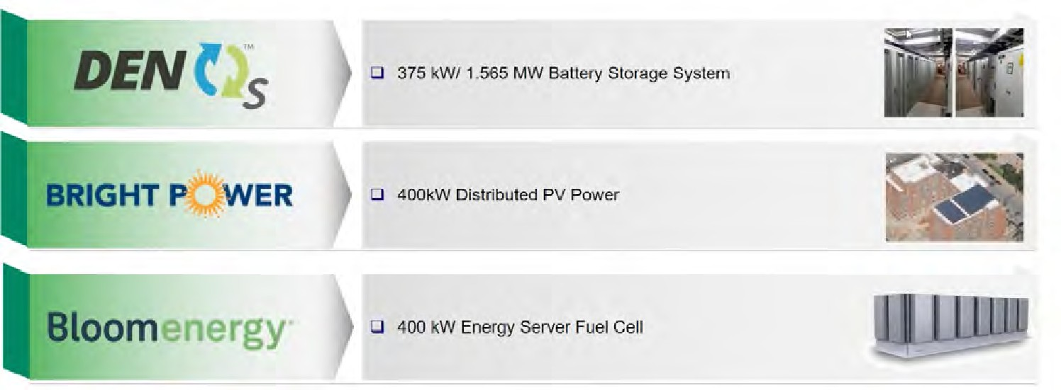
Examples: NY – project
The Marcus Garvey affordable housing complex in Brooklyn, NY uses a solar+storage microgrid system to cut costs, improve grid reliability, and provide resilient backup power for tenants
Leverages the Brooklyn Queens Demand Management program, a commission- approved $200M fund that helps defer a substation upgrade estimated at costing approximately $1.2B
Also provides a framework for future, market-based, “non wires alternatives” such as microgrids
Source: https://www.cleanegroup.org/ceg-projects/resilient-power-project/featured-installations/marcus-garvey-apartments/

Slide 21

Examples: NY – financing
The Marcus Garvey project is financed by the New York City Energy Efficiency Corporation (NYCEEC), a non-profit, specialty finance company for clean energy
Develops financing solutions to enable projects that save energy or reduce greenhouse gases
Their custom-tailored solutions close financing gaps for buildings and clean energy project developers
Originally focused only on the state of NY, the organization is now looking to
finance projects up and down the East Cost – from Maryland to Maine
Source: https://www.cleanegroup.org/ceg-projects/resilient-power-project/featured-installations/marcus-garvey-apartments/

Slide 22
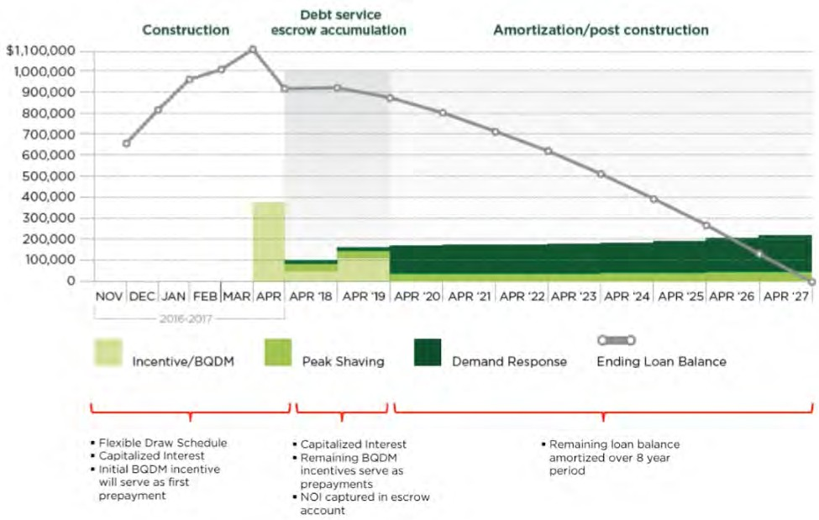
Examples: NY – template
NYCEEC’s successful financing at Marcus Garvey serves as a template
Payoff is in approximately 10.5 years, based on the three revenue streams: BQDM incentives, Peak Shaving, and Demand Response
Source: https://www.cleanegroup.org/ceg-projects/resilient-power-project/featured-installations/marcus-garvey-apartments/

Slide 23



Examples: Long Island Community Microgrid Project
“NY Prize” Community Microgrid grant award
Collaboration with PSEG Long Island, Long Island Power Authority (LIPA), and NYSERDA covering a substation in East Hampton, NY that serves thousands of customers
Combines 15 MW of local solar (via Feed-In Tariff) with a 5 MW / 25 MWh battery system and targeted load management
Reaches almost 50% of total annual energy from local renewables. Minimizes the use of existing fossil generators including local diesel peakers and diesel backup generators.
Provides ongoing power backup to multiple critical facilities as well as other priority loads across the area

Slide 24
Examples: Long Island Community Microgrid Project
LICMP Economic Analysis highlights
The LICMP would avoid $29-38 Million of new transmission capacity resulting in a net cost benefit for all PSEG-LI utility ratepayers.
The local generation capacity provided by the LICMP PV and storage facilities will also reduce NYISO capacity charges by $6 Million through 2022, and at a rate exceeding $1 Million annually thereafter.
In addition, the energy storage will allow the utility to shift wholesale power purchases from daily peak pricing periods to off peak periods, realizing net savings in energy purchases of $2.5 Million by 2022 and more than $500,000 annually thereafter.
These savings would be reflected in lower electric rates for all PSEG-LI utility customers.

Slide 25

































Long Island Community Microgrid Configuration
F
Solar
Solar
F
Solar
Solar
Tier 1: OV Pump Station
Tier 1:
ES
Springs Fire Station
ES
Tier 2 Loads
Diesel
Diesel
Solar
9EU-4N7
(Bank 4)
Solar
Transmission
S
Solar
Solar
ES
Tier 3 Loads
F
EH GT Substation
Tier 1: BH Pump Station
ES
Tier 2 Loads
Diesel
9EU-4N8
(Bank 4)
Diesel
U
Solar
MC² Control Level
Other Diagram Elements
ISO
F
Facility, autonomous capable
Autonomously Controllable Microgrid
S
Substation, autonomous capable
Relay/Switch (open, closed) Meter
Tier 3 Loads
U Utility
ISO
Independent System Operators

Slide 26

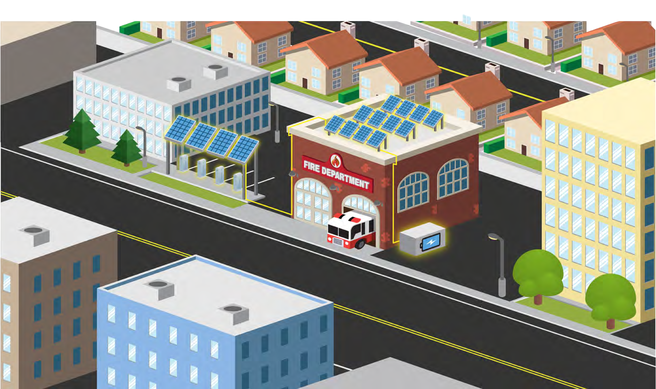
Community Microgrids provide resilience

Slide 27

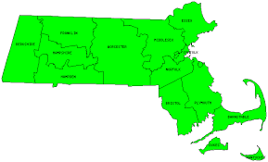
Examples: Massachusetts
Similarly, Massachusetts has announced a new model for community-scale energy systems called SMART (Solar Massachusetts Renewable Target).
Fully compensates solar PV for the total output of a system rather than relying on net metering, which only accounts for net bill savings
Thus, a large warehouse roof or shopping center parking lot can be fully compensated for all the solar generated on that site, regardless of the amount of electricity used onsite
As an example specific to the Commercial & Industrial sector, 250kW – 1,000kW solar systems would receive an incentives of
$0.16 - $0.18/kWh over a term of 20 years.
This method is commonly referred to as a Feed-In-Tariff – or CLEAN program – and has been deployed successfully in other locations such as Germany to deploy more local clean energy systems.
Source: http://www.qatargreenleaders.com/news/sustainability-news/1668-unlocking-the-distributed-grid-with-flexibility-management-software

Slide 28

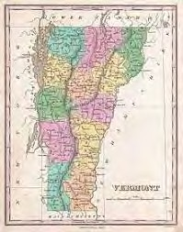
Examples: Vermont
Vermont utility Green Mountain Power now pays customers a little over $30 per month to utilize their battery systems as a load-offsetting capacity resource.
Makes investments in battery-based backup systems more attractive for customers.
For Green Mountain Power, access to the batteries helps address the steep transmission access charge assessed by ISO New England. That charge more than doubled from $3 per kilowatt per month in 2016 to over $7 in 2017. The charge is expected to increase to over $9 in 2018.
And, as more solar is installed on the distribution grid, access to that local solar at times when electricity from transmission is the most expensive is a grid benefit that can save a utility money.
Source: http://www.qatargreenleaders.com/news/sustainability-news/1668-unlocking-the-distributed-grid-with-flexibility-management-software

Slide 29

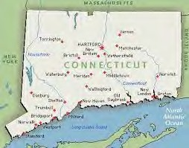
Examples: Connecticut
A new group of microgrids has been proposed to help support Connecticut’s critical facilities in the event of emergencies
Funding opportunities under the state’s Department of Energy and Environmental Protection (DEEP) microgrid program
New focus on the growing movement to provide resilient power to essential buildings during emergency situations
Includes a proposal for Westbrook, CT middle school and high schools, which have recently been designated as emergency/evacuation shelter and support areas
Another proposal for Coventry, CT would island a circuit loop for nine critical facilities in the town, including schools, a communication tower, and a senior care center
Source: http://www.renewableenergyworld.com/articles/2018/01/this-is-what-microgrids-for-resilience-in-emergencies-look-like.html
29

Slide 30

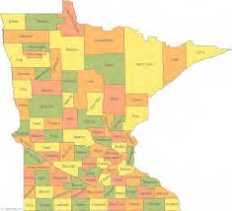


Examples: Minnesota
Largest Community Solar program in the country; helping double the solar generation across the state.
More than doubled the community solar capacity in 2017, now to 211 megawatts in operation today, demonstrating the awareness and accelerating success
Provides monthly bill credits to those who subscribe. Any customer can participate.
Beginning to offer predictability and transparency due to a mature process and the experience and hard work from all stakeholders
The need for grid transparency has been heard by the commission and Xcel Energy, the utility. The most effective program strides have been made in access to interconnection information.
source: https://www.greentechmedia.com/articles/read/xcel-energy-community-solar-program-turns-three#gs.rPWCafg

Slide 31

Examples: Minnesota
This program has been transformative to the Minnesota energy market.
Starting point for a major overhaul of the state interconnection standards
Brought about city and county solar ordinances and
permitting advancements, thereby reducing costs
Encouraged customers to think about their energy mix and ask for better options from their utilities
Giving customers the option of subscribing to clean, local energy has been incredibly popular – with individuals and organizations
One pilot project will pair energy-efficiency improvements with community solar, and there is now a push for this model to be expanded across Xcel’s service territory
source: https://www.greentechmedia.com/articles/read/xcel-energy-community-solar-program-turns-three#gs.rPWCafg

Slide 32
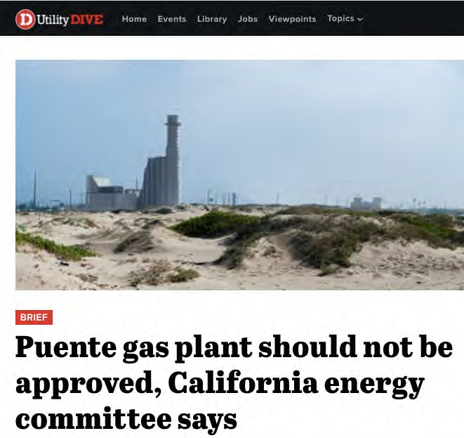
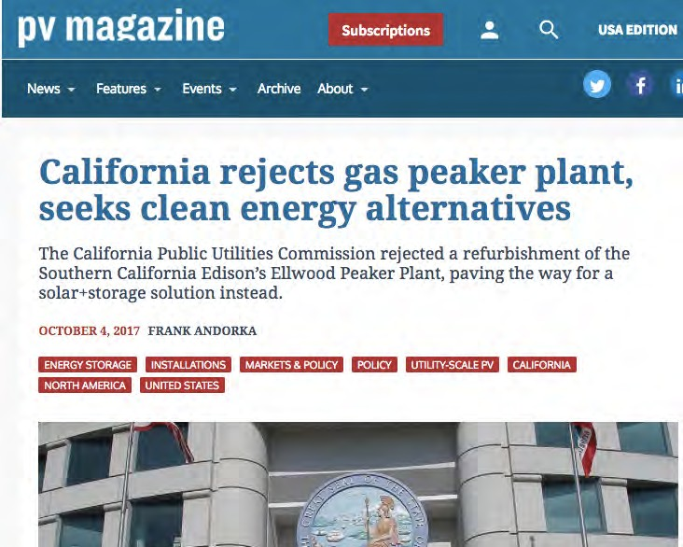
Examples: California
Setting a precedent: Community Microgrids eliminate gas peakers
Thanks in part to Clean Coalition cost analysis, the California Public Utility Commission is now rejecting new peaker plants, such as Puente in Oxnard, CA, in favor of solar + storage
As part of this substantial change, in Jan 2018 the CPUC also announced that PG&E will be required to use renewables and storage instead of gas-fired plants run by Calpine
This appears to be “the first time a utility will procure energy storage to replace existing gas plants for local capacity needs.”
Leveraging this important analysis can prevent future new gas plants across the country
Source: https://www.greentechmedia.com/articles/read/pge-must-solicit-energy-storage-ders-to-replace-three-existing-gas- plants?utm_source=Daily&utm_medium=email&utm_campaign=GTMDaily#gs.biWkmDY

Slide 33

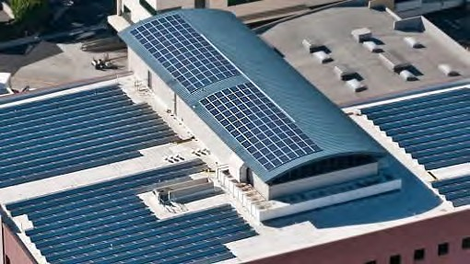
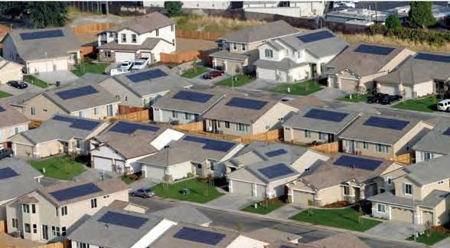
Homes & buildings are grid partners
Well-designed and well-situated ZNE homes
are a valuable part of the DER resource mix in combination with larger PV arrays on commercial & industrial structures

Slide 34
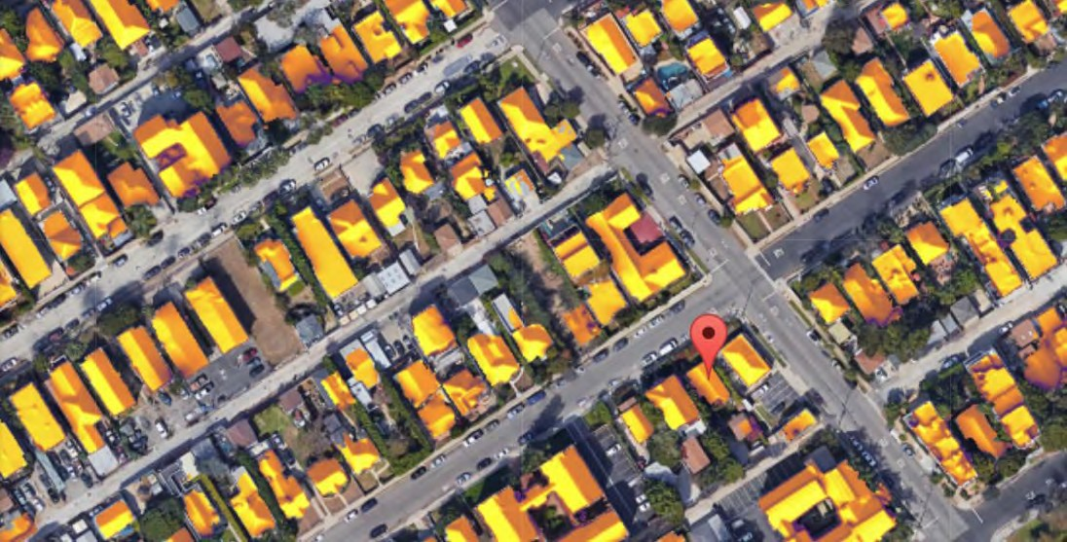
Homes & buildings are grid partners
Residential PV arrays in a community microgrid
can be sized for optimum contribution and fair compensation to owners regardless of their site-specific demand through a CCA + PPA approach

Slide 35
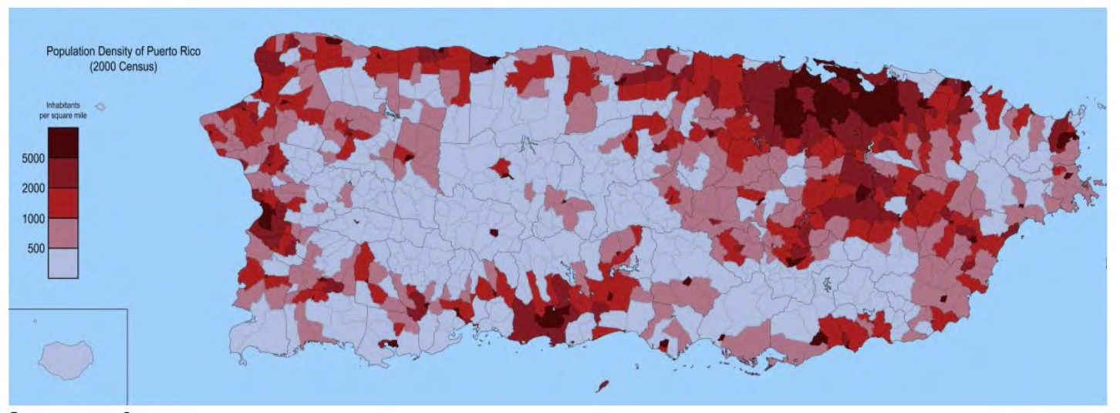
Moving Forward: Puerto Rico
Puerto Rico Re-build Highlights – the “Build Back Better” Plan
Puerto Rico is a unique opportunity to rebuild and update the power system to 21st century technologies and best practices, enabling the rethinking of how power is generated and distributed.
Hurricanes Maria and Irma decimated T&D lines across the island and caused widespread wind and flooding damage to substations, generation, and distribution facilities
Damage from the hurricanes resulted in the longest duration power outage in US history

Slide 36








Moving Forward: Puerto Rico
Puerto Rico Re-build Highlights – the “Build Back Better” Plan
Team: Features major grid and energy experts including: NY Power Authority, Con Ed, Edison International, EPRI, PSE&G Long Island, DOE, SEPA, Puerto Rico Electric Power Authority, Navigant Consulting, NREL, PNNL, Grid Modernization Lab Consortium
Goal: Implement resiliency and hardening measures that are designed to increase the capability of Puerto Rico’s electric power grid to withstand future storms
Recommendation: use modern grid technologies and control systems, renewable energy resources, and new technologies such as energy storage and microgrids to enable energy to become abundant, affordable, resilient, and sustainable. Ensures continuity of service while lowering PREPA’s dependence on large central generating stations.
This modern power system design will set a model for the industry while promoting private investments in the use of clean energy for a low carbon future

Slide 37
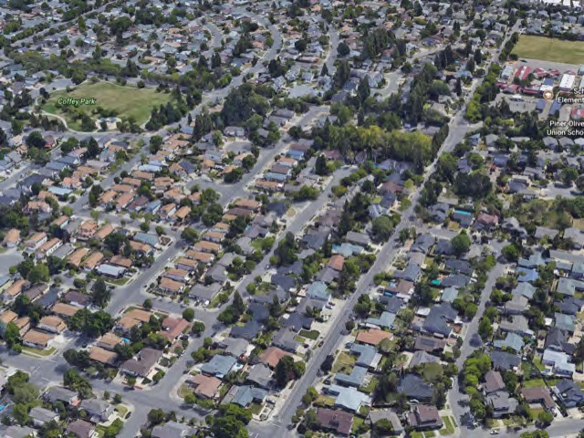
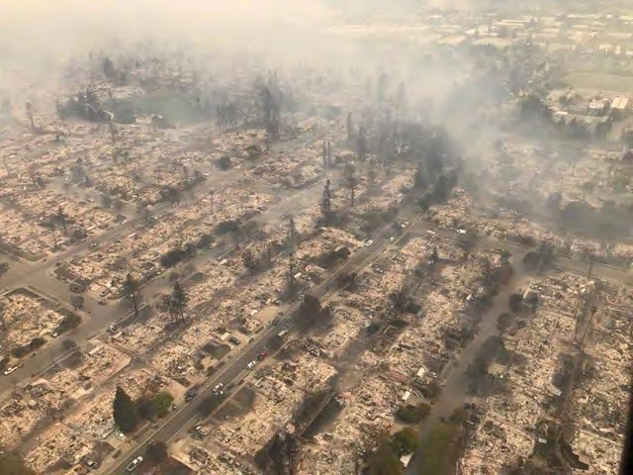
Moving Forward: Sonoma Initiative
Coffey Park area of Santa Rosa – before and after fires

Slide 38
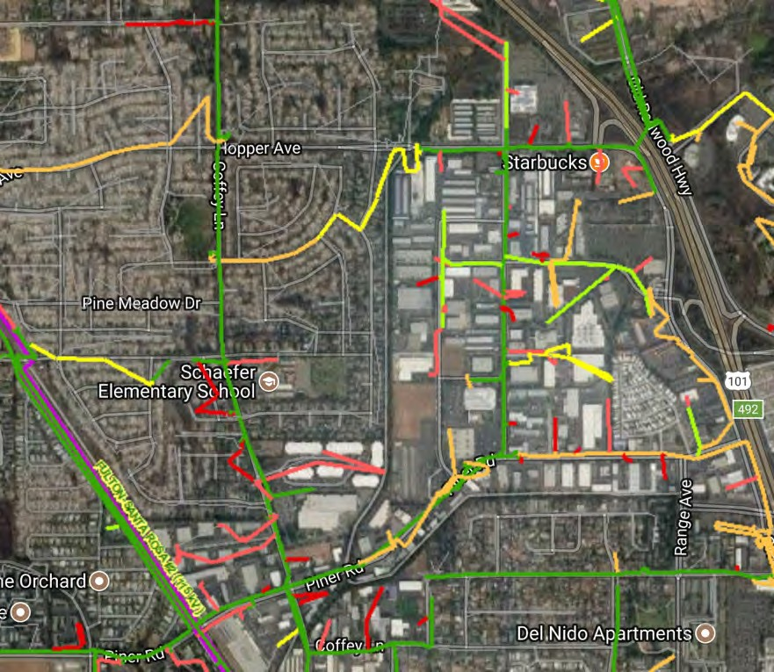

Moving Forward: Sonoma Initiative
PG&E Feeder Map – Coffey Park and adjacent C&I area – ideal for Community Microgrid
Fire-damaged area

Slide 39

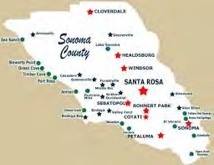
Sonoma Community Microgrid Initiative
Objective: make energy abundant, affordable, resilient, and sustainable
Re-build fire-destroyed areas with high levels of resilience and sustainability in both the building stock and the grid, enabling a modern, distributed, and carbon free system that delivers substantial economic, environmental, and resilience benefits.
Establish a blueprint for re-building disaster-destroyed areas in a timely and cost-effective manner that also maximizes the economic and resilience value of energy as a critical resource to ratepayers, property owners, and municipalities.
Provide a model for operating a modern distribution grid covering an entire substation area that incorporates optimal distributed energy resources, cost-effective local balancing, full interaction with the transmission system, and local energy markets – with resulting benefits across both grid operations and economics.
Ensure that building codes are advanced to achieve more resilient, safer, and cleaner building stock and communities.

