Slide 1
California Biopower Policy
The Good, the Bad, and the Ugly
Craig Lewis
Executive Director
Clean Coalition
650-204-9768 office
650-796-2353 mobile
craig@clean-coalition.org
10 October 2012
Notes:
(ac_1, 15Sept2011)

Slide 2
Clean Coalition – Mission and Advisors
Mission To accelerate the transition to local energy systems through innovative policies and programs that deliver cost-effective renewable energy, strengthen local economies, foster environmental sustainability, and enhance energy security
Clean Coalition – Mission and Advisors
Board of Advisors
Jeff Anderson Co-founder and Former ED, Clean Economy Network
Josh Becker General Partner and Co-founder, New Cycle Capital
Jeff Brothers CEO, Sol Orchard
Jeffrey Byron Vice Chairman National Board of Directors, Cleantech Open; Former California Energy Commissioner (2006-2011)
Rick DeGolia Senior Business Advisor, InVisM, Inc.
Mark Fulton Managing Director, Global Head of Climate Change Investment Research, DB Climate Change Advisors, a member of the Deutsche Bank Group
John Geesman Former Commissioner, California Energy Commission
Patricia Glaza Principal, Arsenal Venture Partners; Former Executive Director, Clean Technology and Sustainable Industries Organization
Amory B. Lovins Chairman and Chief Scientist, Rocky Mountain Institute
L. Hunter Lovins President, Natural Capitalism Solutions
Dan Kammen Director of the Renewable and Appropriate Energy Laboratory at UC Berkeley; Former Chief Technical Specialist for Renewable Energy and Energy Efficiency, World Bank
Fred Keeley Treasurer, Santa Cruz County, and Former Speaker pro Tempore of the California State Assembly
Felix Kramer Founder, California Cars Initiative
Ramamoorthy Ramesh Founding Director, U.S. Department of Energy SunShot Initiative
Governor Bill Ritter Director, Colorado State University’s Center for the New Energy Economy, and Former Colorado Governor
Terry Tamminen Former Secretary of the California EPA and Special Advisor to CA Governor Arnold Schwarzenegger
Jim Weldon CEO, Solar Junction
R. James Woolsey Chairman, Woolsey Partners, and Venture Partner, Lux Capital; Former Director of Central Intelligence
Kurt Yeager Vice Chairman, Galvin Electricity Initiative; Former CEO, Electric Power Research Institute
Notes:
(cl_04a, 12 Jan 2012)
2

Slide 3
Clean Coalition Vision = DG+DR+ES+EV+MC2
Notes:
(bd_1, 26Jan2012)
To lay the groundwork, this slide represents the ultimate Clean Coalition vision.
This is what a smart energy future looks like.
The key components will be:
Distributed Generation + Demand Response + Energy Storage + Electrical Vehicle + overall Monitoring Communications and Controls or MC2 for short.
The Clean Coalition envisions a future where these components are no longer treated as independent silos. These components will work seamlessly together, using information technology to locally control, create and balance supply and demand of electricity.
What this slide also shows is the huge market opportunity for the transition. There is a $6 trillion dollar energy market AND it will transition to a smart energy future – and there are three key drivers behind that:
Economic sensibility
Energy security
Environmental sustainability
Regardless of your political affiliation, one of these drivers or a combination there of, will take us to this future.
The only question is how painful will this transition be, how fast will it happen, and who’s going to win all the economic benefits.
3

Slide 4
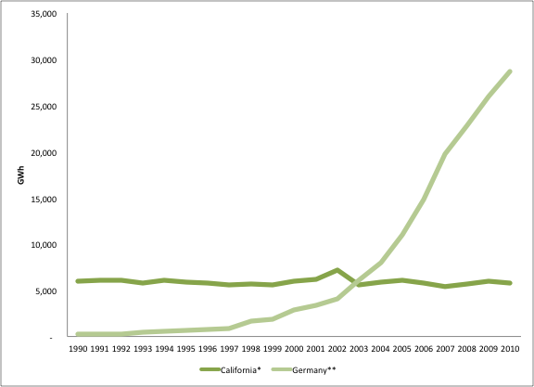
Biopower in CA: way behind
Comparing Germany and California biopower markets (sources: CA Energy Commission; Germany’s BDEW).
Other jurisdictions, particularly Germany, are leading the way with effective programs
A number of CA programs exist for biopower and CHP, but they’re generally ineffective
Notes:
Did the CPUC indicate that they have the authority to expand the SB32 program size or that it must be expanded through legislation?
> they suggested they could do it without new legislation (TURN was quick to disagree)
2) Please provide the source document for the table so that I can have Johnathon get a cleaner version of the barchart; the current one is quite blurry.
> I’ve added a non-blurry version

Slide 5
California Biopower Programs & Critical Issues
Feed-In Tariff
AB 1613 (price ~7 cents/kWh)
AB 1969 (price ~10 cents/kWh, interconnection)
SB 32, SB 1122, SB 1332 (TBD on price and PPA, Resource Adequacy, Deliverability, Interconnection)
Request for Offer
CHP RFO (only attracting massive projects ~40 MW and larger)
Self Generation
SGIP (impossible milestone timing, departing load charges 1-2.2 cents/kWh)
Interconnection, Resource Adequacy, and Deliverability are critical issues for all Wholesale Distributed Generation (WDG) projects
Notes:
5

Slide 6
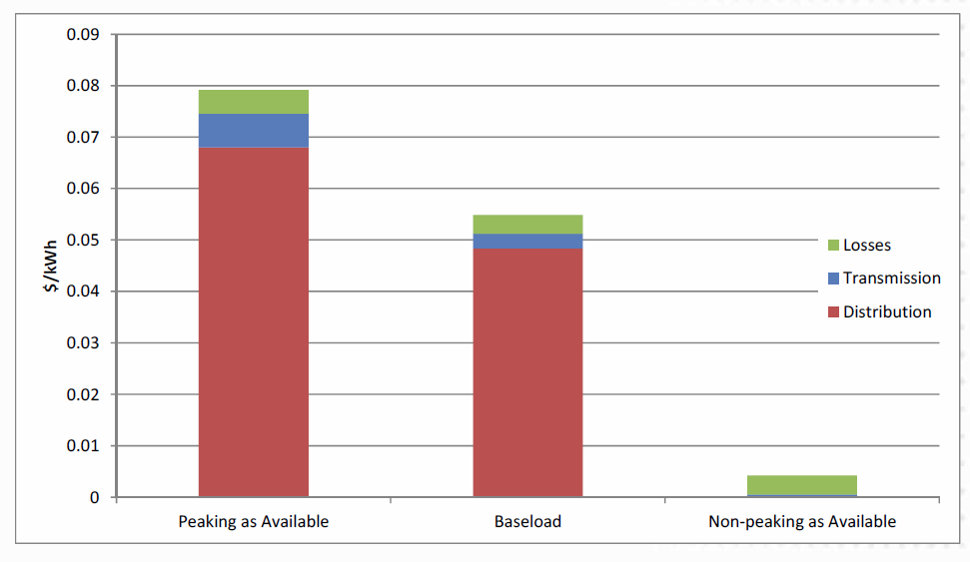
SB 32 all-renewables feed-in tariff
Provides a feed-in tariff for any kind of RPS-eligible renewable technology up to 3 MW per project
Slated to go live early 2013
Prices will start at 8.923 c/kWh and will adjust up or down based on market interest
Will be a small program initially. Only about 200 MW is available because the previous AB 1969 directly decreases the SB 32 MW allocation
CPUC has suggested that the program cap may be expanded in the future
Projects must interconnect to the distribution grid and any network upgrades required must be less than $300k
Clean Coalition is still working to include Locational Benefits in pricing, which was in the CPUC staff proposal but removed in the final decision
CPUC analysis by E3 showing solar PV locational benefits at a sample SCE location, Sep2011.
Notes:
Did the CPUC indicate that they have the authority to expand the SB32 program size or that it must be expanded through legislation?
> they suggested they could do it without new legislation (TURN was quick to disagree)
2) Please provide the source document for the table so that I can have Johnathon get a cleaner version of the barchart; the current one is quite blurry.
> I’ve added a non-blurry version

Slide 7
SB 1122 modifies SB 32
SB 1122 passed into law just last month
Adds a 250 MW biopower tranche to the existing 750 MW feed-in tariff program
Also allocates the 250 MW between specific biopower technologies
CPUC must implement by June 1, 2013
We don’t anticipate that this will lead to a delay in the SB 32 program (slated to be operational by Q1 2013), but it may
A good step in the right direction, but we have FAR more potential than this
Comparing Germany and California biopower markets (sources: CA Energy Commission; Germany’s BDEW).

Slide 8
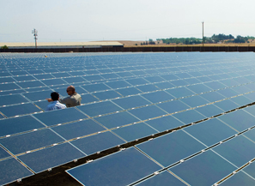
SB 1332 also modifies SB 32
SB 1332 also passed into law just last month
This was a “clean up” bill sponsored by the Clean Coalition
Requires that public utilities (rather than investor-owned utilities) implement SB 32 by July 1, 2013
There was previously no date for compliance so a lot of POUs have simply ignored it
The bill also requires that “locational benefits” of SB 32 projects be considered in developing the contract price
This is a potential game changer for Wholesale DG in CA
Sacramento MUD (SMUD) is a leader in solar and energy efficiency AND has low rates

Slide 9
SB 1122 modifies SB 32
SB 1122 requires the following allocation of the 250 additional MW for biopower technologies:
110 MW from wastewater treatment, municipal organic waste, food processing and codigestion
90 MW from dairy and other agricultural bioenergy
50 MW from byproducts of sustainable forest management
Must be in areas designated by the Dept. of Forestry and Fire Protection
Comparing Germany and California biopower markets (sources: CA Energy Commission; Germany’s BDEW).

Slide 10
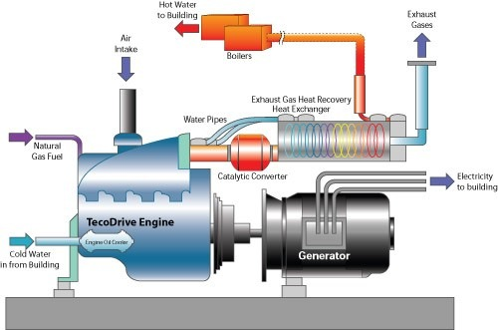
AB 1613 Cogen (CHP) feed-in tariff
Cogeneration is where useable heat and electricity are produced by the same facility
AB 1613 provides a limited feed-in tariff for cogen-produced electricity (also known as combined heat and power or CHP)
Pricing formula is complicated but it will generally be about 5-7 c/kWh
Also provides a 10% adder for projects located in areas with local capacity requirements
CAISO posts local capacity info here: http://www.caiso.com/planning/Pages/ReliabilityRequirements/LocalCapacityRequirements.aspx
Was the subject of lengthy litigation at the CPUC and FERC
It’s still not clear whether this pricing level is sufficient to support new projects
NO AB 1613 contracts have been signed yet
Notes:
Where is AB1613 in the implementation process? Is it accessible to projects right now?
> it’s available now. Here’s PG&E’s website: http://www.pge.com/b2b/energysupply/qualifyingfacilities/welcome/
2) What is meant by local capacity requirements and how is a project determined to be eligible for the 10% local capacity adder?
> a few areas of the state like San Diego and SF have local capacity requirements, which means they need extra generation to reduce congestion. CAISO posts local capacity areas here: http://www.caiso.com/planning/Pages/ReliabilityRequirements/LocalCapacityRequirements.aspx

Slide 11
Self-Generation Incentive Program (SGIP)
Designed to promote on-site generation of various types
Recent changes under SB 412 allow SGIP projects to be any size
But incentives only apply for the first 3 MW of any single project
Incentives drop by half for the 2nd MW and again by half for the 3rd MW
An example:
3 MW Biogas ICE
$2.50 ($2 biogas plus $.5 ICE) per watt for the first MW, $1.25 for the 2nd, $.625 for the 3rd MW
Total = $4.375 million total rebate
$5 million maximum incentive per project
Can elect to export up to 25% of annual production to the grid (“excess sales”)
Can be coupled with net-metering for the 1st MW of output
Technology Type | Incentive ($/W)
Renewable and Waste Heat Capture
Wind Turbine | $1.25
Bottoming-Cycle CHP | $1.25
Pressure Reduction Turbine | $1.25
Conventional Fuel-Based CHP
Internal Combustion Engine – CHP | $0.50
Microturbine – CHP | $0.50
Gas Turbine – CHP | $0.50
Emerging technologies
Advanced Energy Storage | $2.00
Biogas | $2.00
Fuel Cell – CHP or Electric Only | $2.25
Table 1 from CPUC D.11-09-015, Sep2011
Notes:
In order to couple SGIP and NEM, is an SGIP project limited to 1MW? If not, please explain how a larger SGIP project works with NEM.
> The project can be any size but only the first MW of output is net-metered. This means that if more than 1 MW at any given moment is going to the grid no compensation is provided for the excess.
2) Is the Fuel Cell eligible for $2.25/W even if fed by pipeline natural gas? Are Fuel Cells eligible for the $2/W biogas adder to achieve a total rebate of $4.25/W?
> strangely, the decision doesn’t answer this question. I believe the answer is that fuel cells can use either biogas or NG
3) How does the PBI work with the upfront rebate? If too cumbersome to include in slide bullets, please place the explanation in the slide notes field.
> the rebate is now structure such that 50% is received up front and the other 50% in PBI payments over 5 years, in what the decision calls a hybrid rebate system
4) How is SGIP funded and to what level? How does one access a funding allocation and what happens when the funding is depleted?
> the program was suspended at the end of 2010 and the utilities have not yet released new funding availability data (end of 2010 is the latest available), at which time there was about $150 available for projects statewide. I’m not sure yet if that’s a final number or if queued projects will reduce that substantially.

Slide 12
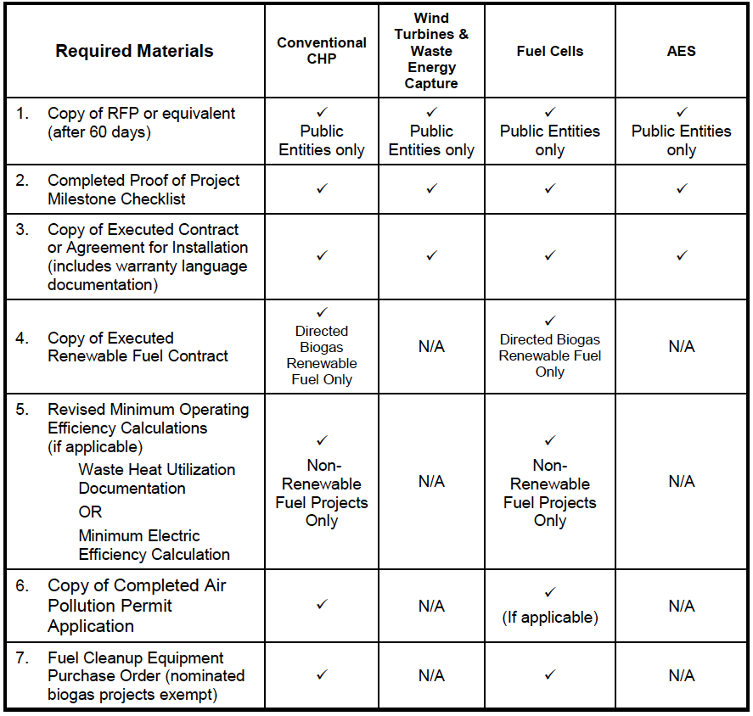
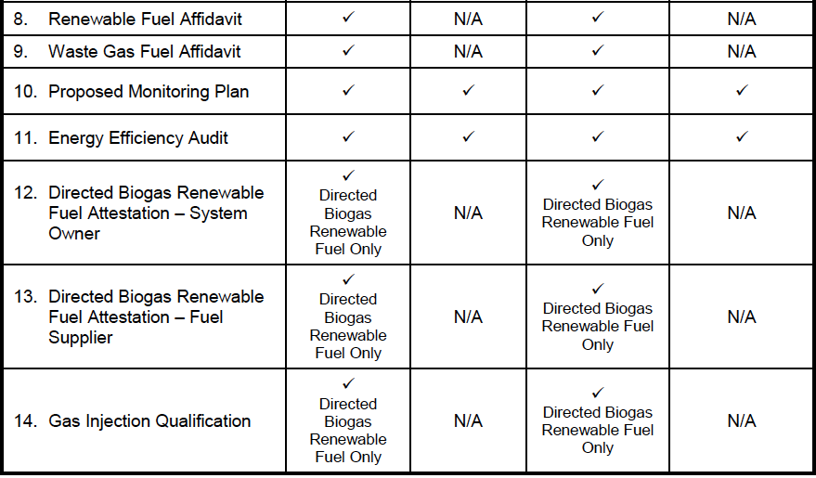
Self-Generation Incentive Program (SGIP)
Proof of Project Milestone for SGIP can be a problem:
14 items have to submitted to the utility 60 days after a (non-public entity) project is awarded an SGIP Conditional Reservation Letter:
Some of these documents and contracts won’t generally be completed that soon, so this can be a major problem
In particular, the Executed Contract or Agreement for Installation will not generally be ready 60 days after a conditional reservation is provided b/c no project can proceed very far at all until it receives the Conditional Reservation Letter
Similarly, the Air Pollution Permit Application may not be ready this fast
Table 1 from CPUC D.11-09-015, Sep2011
Notes:
In order to couple SGIP and NEM, is an SGIP project limited to 1MW? If not, please explain how a larger SGIP project works with NEM.
> The project can be any size but only the first MW of output is net-metered. This means that if more than 1 MW at any given moment is going to the grid no compensation is provided for the excess.
2) Is the Fuel Cell eligible for $2.25/W even if fed by pipeline natural gas? Are Fuel Cells eligible for the $2/W biogas adder to achieve a total rebate of $4.25/W?
> strangely, the decision doesn’t answer this question. I believe the answer is that fuel cells can use either biogas or NG
3) How does the PBI work with the upfront rebate? If too cumbersome to include in slide bullets, please place the explanation in the slide notes field.
> the rebate is now structure such that 50% is received up front and the other 50% in PBI payments over 5 years, in what the decision calls a hybrid rebate system
4) How is SGIP funded and to what level? How does one access a funding allocation and what happens when the funding is depleted?
> the program was suspended at the end of 2010 and the utilities have not yet released new funding availability data (end of 2010 is the latest available), at which time there was about $150 available for projects statewide. I’m not sure yet if that’s a final number or if queued projects will reduce that substantially.

Slide 13
New CHP program for 5 MW and over
This is a relatively new CHP program that began in 2012
For example, PG&E is procuring 1,387 MW of new CHP, preferably from low GHG sources
First target is 630 MW
Projects must be 5 MW or larger
A bonus is available proportionate to GHG reduction, effectively a “biogas adder” similar to that in SGIP

Slide 14
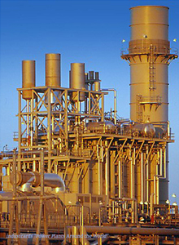
New CHP program for 5 MW and over
Annual RFOs, first in Feb. 2012, next in Feb. 2013
Track I, which is the first RFO, is for facilities that are already interconnected
Track II, in 2013, will be for new facilities
PG&E has only one new contract so far, for 280 MW, but for an existing facility
561 MW Los Medanos CHP facility was built in 2001, in Pittsburg, CA, and supplies process heat to a steel mill and a chemical processing facility
Half of this power will be sold to PG&E once the CPUC approves the contract; other half to SCE

Slide 15
New CHP program for 5 MW and over
SCE has contracted for over 700 MW of CHP from existing facilities, including the other half of the Los Medanos site (four have been posted on SCE’s website so far):
SCE will, as with PG&E, issue their Track II proposal in 2013

Slide 16
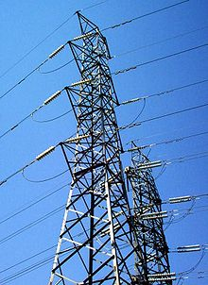
Departing Load issues
Non-bypassable charges are assessed for departing load in many circumstances
Various exceptions apply for renewables, including biogas
Biogas NBCs can in theory be reduced to about 1 c/kWh
However, you have to go through a process with the IOU to determine eligibility for reduced NBCs
Net-metered solar avoid most NBCs for the 1st MW and this should be the same for biogas
Clean Coalition is working on legislative solutions

Slide 17
Solutions to Ramping Biopower in Californai
Clean Local Energy Accessible Now (CLEAN) Programs
Standard offer must-take procurement
Resource Adequacy (RA) preference for close-to-load and near-term projects
Deliverability preference for close-to-load and near-term projects
Streamlined interconnection with cost-averaging, and for superior sites, utility-paid upgrades on the distribution grid
Self-Gen 2.0
Equal treatment on either side of the meter: PPA rate, interconnection, and importantly, unlinking of PPA rate to retail rate
Removes all issues associated with Net Metering, Departing Load Charges,
Clean Energy Now
5 GW CLEAN Program including Self-Gen 2.0 features and Location Bonuses
Fixed price contracts with Volumetric Price Adjustment on future contracts to ensure market responsiveness
Streamlined PPA contract to provide necessary terms but preempt gratuitous complexity
Provision for voltage regulation with appropriate compensation
Fulfills Governor Brown’s goal for 12 GW of clean local energy, in highest value locations
Completely replaces the energy and voltage regulation lost from the failed San Onofre Nuclear Generating Station (SONGS), which is delivering zero energy, or other benefits, while costing California ratepayers $54 million per month
For updates on Clean Energy Now, register at www.clean-coalition.org
Notes:
17

