Slide 1
DG in California
What’s holding us back?
Ted Ko
Associate Executive Director
Clean Coalition
ted@clean-coalition.org
8 December 2011
Notes:
(ac_1, 15Sept2011)

Slide 2
Clean Coalition – Mission and Advisors
Mission To implement policies and programs that transition the world to cost-effective clean energy now while delivering unparalleled economic benefits.
Clean Coalition – Mission and Advisors
Board of Advisors
Jeff Anderson ED, Clean Economy Network
Josh Becker General Partner, New Cycle Capital
Jeff Brothers CEO, Sol Orchard
Jeffrey Byron Former Commissioner, California Energy Commission
Rick DeGolia Executive Chairman, InVisM, Inc.
Mark Fulton Managing Director, Global Head of Climate Change Investment Research, DB Climate Change Advisors, a member of the Deutsche Bank Group
Felix Kramer Founder, California Cars Initiative
Governor Bill Ritter Director, Colorado State University’s Center for the New Energy Economy, and Former Colorado Governor
Terry Tamminen Former Secretary of the California EPA and Special Advisor to CA Governor Arnold Schwarzenegger
Jim Weldon CEO, Solar Junction
R. James Woolsey Chairman, Woolsey Partners, and Former Director of the CIA
Kurt Yeager ED, Galvin Electricity Initiative
John Geesman Former Commissioner, California Energy Commission
Patricia Glaza ED, Clean Technology & Sustainable Industries
L. Hunter Lovins President, Natural Capitalism Solutions
Dan Kammen Chief Technical Specialist for Renewable Energy and Energy Efficiency, World Bank
Fred Keeley Treasurer, Santa Cruz County, and Former Speaker pro Tempore of the California State Assembly
Notes:
(ac_2, 3Oct2011)

Slide 3
California Leadership?
Solar Markets: Germany vs California (RPS + CSI + other)
Sources: CPUC, CEC, SEIA and German equivalents.
Germany added 28 times more solar than California in 2010.
Even though California’s solar resource is 70% better!!!
Notes:
(jf_1, 15Sept2011)

Slide 4
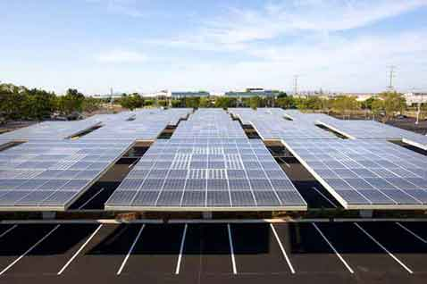
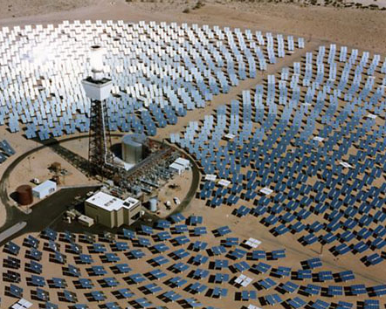
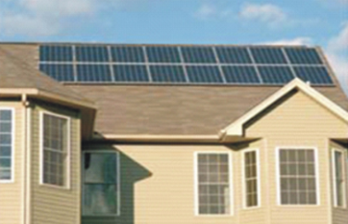
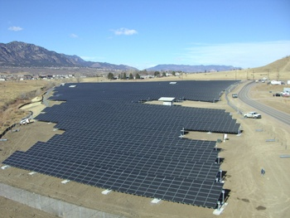
Market Segments
Size
Central Station, Transmission-Interconnected
~20 MW-and-larger
Wholesale DG, Distribution-Interconnected
<20 MW
Retail DG
<1 MW
Segment
Urban and
Distribution grid
Rural and
Transmission grid
Notes:
(ac_1, 15Sept2011)

Slide 5
German Solar Capacity is Small WDG
Source: Paul Gipe, March 2011
Governor’s DG Goal in context:
Germany installed 12,000 MW of just solar over the last 3 years
California recently celebrated reaching 1,000 MW
Notes:
(jf_1, 15Sept2011)

Slide 6
Market Segments Comparison
Governor’s Goal = 12,000 MW of DG & 8,000 MW of Central Station
Goal was part of the Clean Energy Jobs Plan
Meeting the 33% RPS with a DG CLEAN Program vs baseline reference case
3x more jobs
$50 Billion in additional private investment
$1.7 Billion in additional state revenues
DG provides more energy and more jobs, more quickly, with less risk
How will the 12,000 MW break down?
Retail DG, Wholesale DG, State Lands
Regional targets?
Scaling challenges for retail DG
Retail DG is not designed for owners of commercial and multi-tenant properties
Annual on-site energy use generally caps retail DG project size
Policy challenges for wholesale DG
Procurement programs are limited
Interconnection (Grid Access) reform
Notes:
Investment needs to be future-proofed to allow significant penetrations of clean local energy
Confidentiality rules need to change to allow proper regulatory oversight of these massive ratepayer investments

Slide 7
Clean Local Energy Accessible Now (CLEAN)
CLEAN = Feed-in Tariff + interconnection
CLEAN Features:
Standard and guaranteed contract between the utility and a renewable energy facility owner
Predictable and streamlined distribution grid interconnection
Predefined and financeable fixed rates for long durations
CLEAN Benefits:
Removes the top three barriers to renewable energy
The vast majority of renewable energy deployed in the world has been driven by CLEAN Programs
Allows any party to become a clean energy entrepreneur
Attracts private capital, including vital new sources of equity
Drives local employment and generates tax revenue at no cost to government
Notes:
(ac_1, 15Sept2011)

Slide 8
Policy Topics for DG
Not a question of net-metering vs CLEAN
Renewable Portfolio Standard (RPS)
“Sticker price” mindset
“Off ramps”
“Ceiling, not a floor”
Wholesale DG Procurement
SB 32 FIT – only 750 MW
Renewable Auction Mechanism – not really DG
IOU PV Programs
Retail DG
CSI success – what’s next?
Net-metering cap / Network usage charge
RPS double-counting
Notes:
Investment needs to be future-proofed to allow significant penetrations of clean local energy
Confidentiality rules need to change to allow proper regulatory oversight of these massive ratepayer investments

Slide 9
The D-Grid and Interconnection
We need a new Vision for the Distribution Grid (D-Grid)
The D-Grid was not designed for high penetrations of DG
75% of California IOU capital expenditures are made on the distribution grid (D-grid) and California ratepayers deserve maximized returns on their MASSIVE investments (2007 IEPR)
Germany and Spain are excellent proxies for California’s D-grid accommodating significant penetrations of clean local energy (May 2011 CEC/KEMA report)
Currently, developers are responsible for 100% of D-grid upgrade costs
Wholesale Interconnection (Grid Access) in CA is Broken
Need: Fair, Timely, Transparent, Predictable
Currently: Capricious, Lengthy process, Black Hole, Unknown Liability
Germany connected 12,000 MW of solar PV without major issues

Slide 10
California Leadership?
Solar Markets: Germany vs California (RPS + CSI + other)
Sources: CPUC, CEC, SEIA and German equivalents.
Germany added 28 times more solar than California in 2010.
Even though California’s solar resource is 70% better!!!
Notes:
(jf_1, 15Sept2011)

