Slide 1
Avoiding Transmission and Fossil Backup
Maximizing Ratepayer Value
Craig Lewis
Executive Director
Clean Coalition
650-204-9768
craig@clean-coalition.org
11 April 2012
Notes:
(ac_1, 15Sept2011)

Slide 2
Avoided Transmission in CA = $80 Billion over 20 yrs
Business as Usual Year-20 TAC (TAC₂₀ ) = 2.7
2.7
Business As Usual TAC Growth
Current TAC
Rate (TAC₀) = 1.2
TAC₀ O&M Level
Business as Usual TAC Growth TAC₀ Depreciation + O&M Avoided TAC Opportunity from DG
Notes:
(cl_06 10 April 2012)

Slide 3
Avoided Fossil Backup = Funds for Superior Solutions
Frequency Regulation
Stabilizes grid at 60 Hz.
Commonly provided by natural gas powered generators, but all fossil sources are slow ramping.
Energy Storage and Demand Response are nearly instantaneous while providing a multitude of additional benefits.
60
50
40
30
20
10
0
GW
Too Much Demand
Too Much Supply
12a 6a 12p 6p 12a
Time of day
Notes:
(cl_06 10 April 2012)
Over the course of the day the average demand for power is fairly smooth. However, if we zoom in on a section of the curve, we can see that the actual demand fluctuates wildly. This poses a problem for big power plants, which cannot ramp up and down quickly enough to compensate for these fluctuations. Too much demand causes the frequency to slow down, while too much supply causes the frequency to speed up, both of which are undesirable. A specialized service called frequency regulation works to balance these fluctuations. Frequency regulation is what stabilizes the grid on a second-to-second and minute-to-minute basis.

Slide 4
Back-Up Slides
Back-Up Slides
Notes:
(sw 2, 19 Jan 2012)
4

Slide 5
Clean Coalition Vision = DG+DR+ES+EV+MC2
Notes:
..

Slide 6
CLEAN Programs Deliver Cost-Effective Scale
Solar Markets: Germany vs California (RPS + CSI + other)
Cumulative MW
Sources: CPUC, CEC, SEIA and German equivalents.
Germany added nearly 15 times more solar than California in 2011,
even though California’s solar resource is 70% better!!!
Notes:
(jf_05, 7 Mar 2011)
Beyond the obvious details on this slide, see the notes below.
CLEAN = Clean Local Energy Acceccible Now and CLEAN Programs are the new name for feed-in tariffs in the United States.
Rooftop solar in Germany today is priced at the California-equivalent of 12 cents/kWh, which would be the most cost-effective solar that has ever been deployed in California -- even more cost-effective than ground-based solar projects deployed in California to date. Ground-based solar projects typically generate about 25% more kWh/W than rooftop projects, because they use tracking, which allows the panels to follow the sun throughout the day. The net result is that ground-based projects are generally about 20% more cost-effective than rooftop projects. The difference between the 25% and the 20% is that the O&M costs for ground-based projects are a bit higher due to their moving parts.

Slide 7
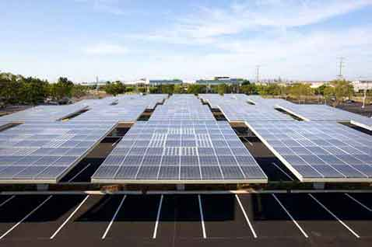
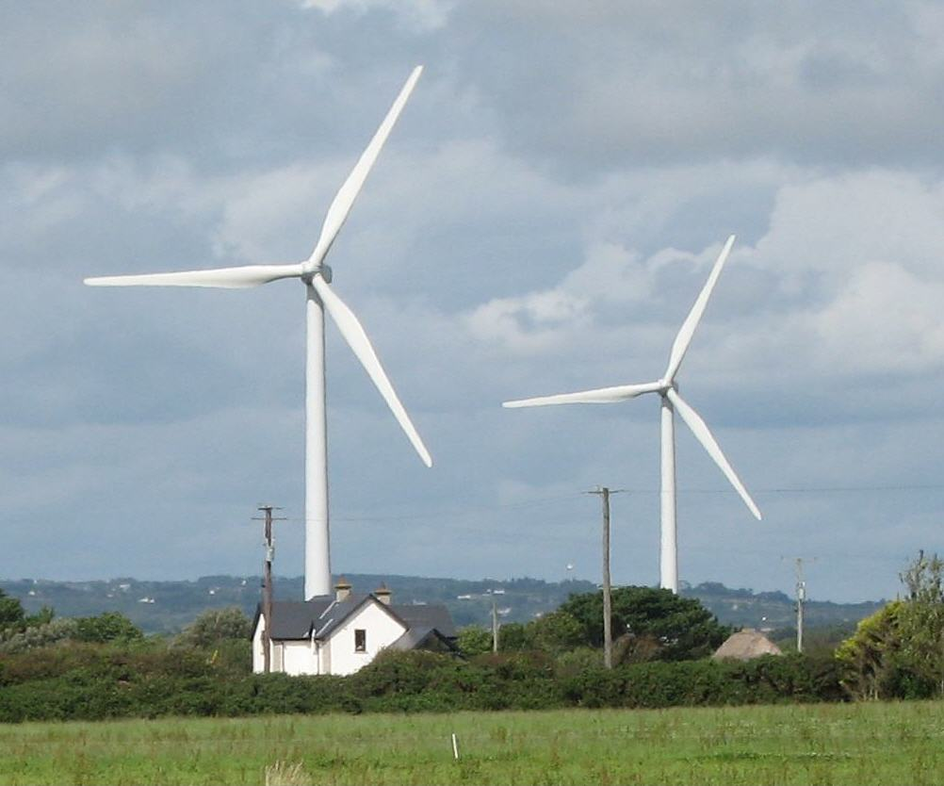
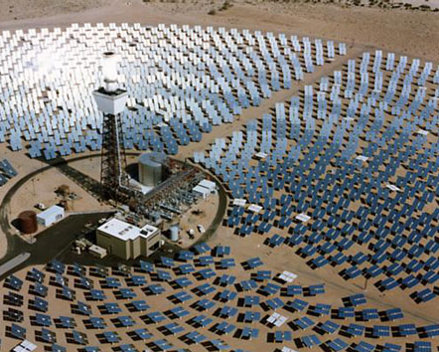
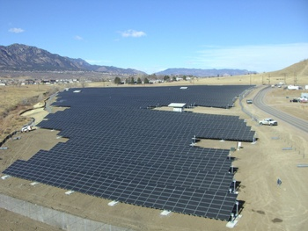
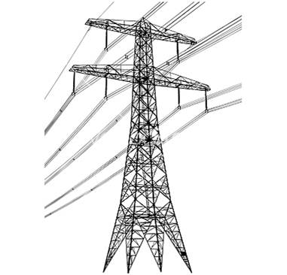
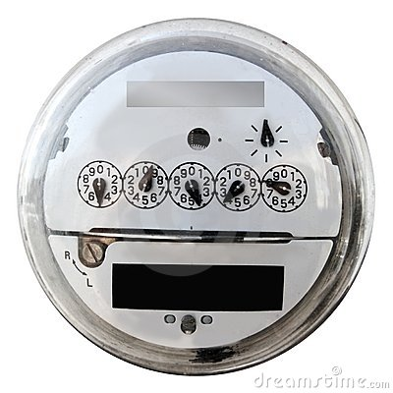
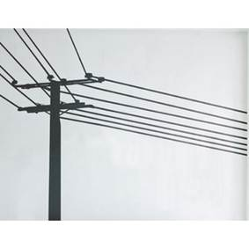
Wholesale DG is the Critical & Missing Segment
Project Size
Central Generation
~20 MW-and-larger
Wholesale DG,
<20 MW
Retail DG
<1 MW
Behind the
Meter
Distribution
Grid
Transmission
Grid
Notes:
(jf 01, 30 March 2012)

Slide 8
German Solar Capacity is Small WDG (Rooftops)
26%
23.25%
22.5%
19%
9.25%
Source: Paul Gipe, March 2011
Germany’s solar deployments are almost entirely <2 MW rooftop projects interconnected to the distribution grid (not behind-the-meter)

Slide 9
Wholesale DG has Superior Value
Total Ratepayer Cost of Solar
 | Distribution Grid |  |  |  |  | T-Grid
PV Project size and type | 100kW roof | 500kW roof | 1 MW roof | 1 MW ground | 5 MW ground | 50 MW ground
Required PPA Rate | 15¢ | 14¢ | 13¢ | 12¢ | 11¢ | 10¢
T&D costs | 0¢ | 0-1¢ | 1¢ | 1¢ | 1-2¢ | 2-4¢
Ratepayer cost per kWh | 15¢ | 14-15¢ | 14¢ | 13¢ | 12-13¢ | 12-14¢
Sources: CAISO, CEC, and Clean Coalition, July 2011; see full analysis at www.clean-coalition.org/studies
The most cost-effective solar is ground-based WDG, not central station as commonly thought; due to immense transmission costs

Slide 10
Connecting-the-Dots to Reform
75% of California IOU capital expenditures are made on the distribution grid (D-grid) and California ratepayers deserve maximized returns on their MASSIVE investments (2007 IEPR)
Investment needs to be future-proofed to allow significant penetrations of clean local energy
Confidentiality rules need to change to allow proper regulatory oversight of these massive ratepayer investments
Germany and Spain are excellent proxies for assuring that California’s existing D-grid can accommodate significant penetrations of clean local energy (May 2011 CEC/KEMA report)
MPR is determined at point-of-interconnect and Wholesale Distributed Generation (WDG) and a Locational Benefits (LBs) adder is needed to compensate for extra value of WDG
Average extra LBs value of DG is in the neighborhood of 25% (Transmission Access Charges of 1.5 cents/kWh plus 10% for transmission line/congestion losses)
The LBs adder should be handled just like the Time-of-Delivery (TOD) adder
Ratepayers currently get massive free value from WDG in the form of uncompensated LBs
Notes:
(ac_1, 15Sept2011)

Slide 11
Connecting-the-Dots to Reform (continued)
Currently, developers are responsible for 100% of D-grid upgrade costs without any opportunity for reimbursement, EVER
This is different than transmission upgrade costs that are ALWAYS borne by the ratepayer
Recommendation for the 50% of the D-grid where LBs value is above average, utilities pay for D-grid upgrades and recover through the rate-base.
Ratepayers currently get massive free value from WDG in the form of uncompensated D-grid upgrade costs
Wholesale Distributed Generation (WDG) interconnections need to be far more timely and transparent
WDG interconnection processes in IOU D-grids are expected to require an average of 2 years
WDG interconnection processes in the SMUD D-grid requires 6 months
Interconnection studies for 100 MW of WDG projects in its Feed-In Tariff program were completed in 2 months (performed by 2 guys)
100 MW of WDG in SMUD territory is equivalent to 2,500 MW of WDG statewide
TWO GUYS for TWO MONTHS should be an achievable benchmark for all utilities
Notes:
(ac_1, 15Sept2011)

