Slide 1
Clean Local Energy
Why it Matters and Making it Happen in a Big Way
Craig Lewis
Executive Director
Clean Coalition
650-204-9768 office
650-796-2353 mobile
craig@clean-coalition.org
12 February 2013
Notes:
(ac_1, 15Sept2011)

Slide 2
Clean Coalition – Mission and Advisors
Mission
To accelerate the transition to local energy systems through innovative policies and programs that deliver cost-effective renewable energy, strengthen local economies, foster environmental sustainability, and enhance energy security
Clean Coalition – Mission and Advisors
Board of Advisors
Jeff Anderson
Co-founder and Former ED, Clean Economy Network
Josh Becker
General Partner and Co-founder, New Cycle Capital
Jeff Brothers
CEO, Sol Orchard
Jeffrey Byron
Vice Chairman National Board of Directors, Cleantech Open; Former California Energy Commissioner (2006-2011)
Rick DeGolia
Senior Business Advisor, InVisM, Inc.
Mark Fulton
Managing Director, Global Head of Climate Change Investment Research, DB Climate Change Advisors, a member of the Deutsche Bank Group
John Geesman
Former Commissioner, California Energy Commission
Patricia Glaza
Principal, Arsenal Venture Partners; Former Executive Director, Clean Technology and Sustainable Industries Organization
Amory B. Lovins
Chairman and Chief Scientist, Rocky Mountain Institute
L. Hunter Lovins
President, Natural Capitalism Solutions
Dan Kammen
Director of the Renewable and Appropriate Energy Laboratory at UC Berkeley; Former Chief Technical Specialist for Renewable Energy and Energy Efficiency, World Bank
Fred Keeley
Treasurer, Santa Cruz County, and Former Speaker pro Tempore of the California State Assembly
Felix Kramer
Founder, California Cars Initiative
Ramamoorthy Ramesh
Founding Director, U.S. Department of Energy SunShot Initiative
Governor Bill Ritter
Director, Colorado State University’s Center for the New Energy Economy, and Former Colorado Governor
Terry Tamminen
Former Secretary of the California EPA and Special Advisor to CA Governor Arnold Schwarzenegger
Jim Weldon
CEO, Solar Junction
R. James Woolsey
Chairman, Woolsey Partners, and Venture Partner, Lux Capital;
Former Director of Central Intelligence
Kurt Yeager
Vice Chairman, Galvin Electricity Initiative; Former CEO, Electric Power Research Institute
Notes:
(cl_04a, 12 Jan 2012)
2

Slide 3
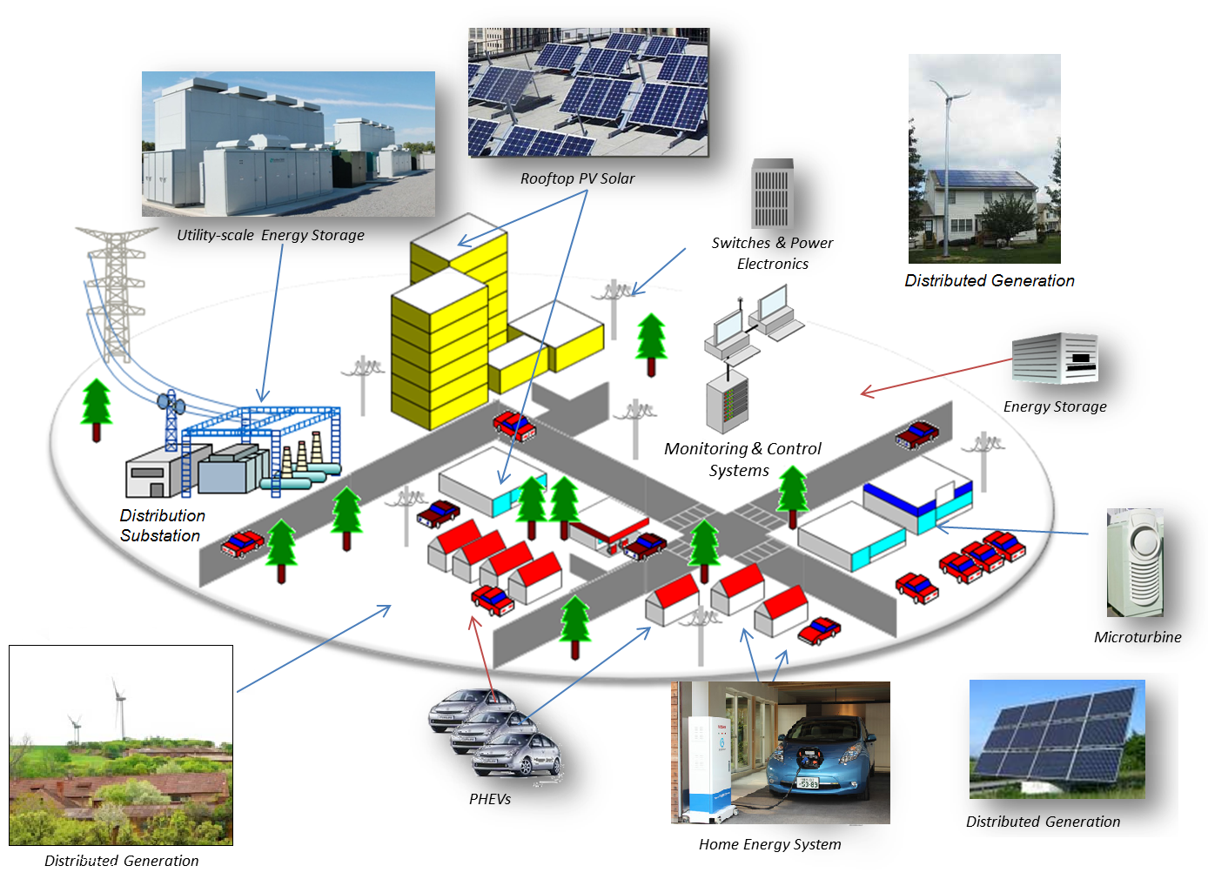
Clean Coalition Vision = DG+DR+ES+EV+MC2
Notes:
(bd_1, 26Jan2012)
To lay the groundwork, this slide represents the ultimate Clean Coalition vision.
This is what a smart energy future looks like.
The key components will be:
Distributed Generation + Demand Response + Energy Storage + Electrical Vehicle + overall Monitoring Communications and Controls or MC2 for short.
The Clean Coalition envisions a future where these components are no longer treated as independent silos. These components will work seamlessly together, using information technology to locally control, create and balance supply and demand of electricity.
What this slide also shows is the huge market opportunity for the transition. There is a $6 trillion dollar energy market AND it will transition to a smart energy future – and there are three key drivers behind that:
Economic sensibility
Energy security
Environmental sustainability
Regardless of your political affiliation, one of these drivers or a combination there of, will take us to this future.
The only question is how painful will this transition be, how fast will it happen, and who’s going to win all the economic benefits.
3

Slide 4
Clean Coalition Overarching Objectives
From 2020 onward, at least 50% of all new electricity generation in the United States will be from local sources.
  Locally generated electricity does not travel over high voltage transmission lines to get from the location it is generated to the area it is consumed.
From 2020 onward, at least 80% of all new electricity generation in the United States will be from renewable sources.
By 2020, policies and programs are well established for ensuring successful fulfillment of the other two objectives.
  Policies reflect the full value of local renewable energy.
  Programs prove the superiority of local energy systems in terms of economics, environment, and resilience.
Notes:
(04_cl, 20 Dec 2012)
4

Slide 5
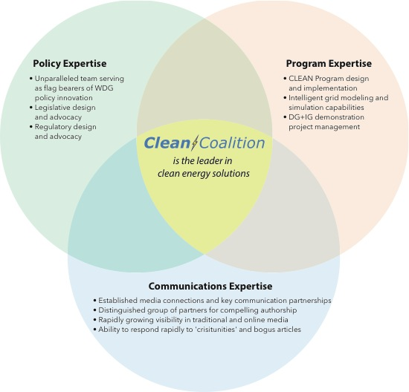
Clean Coalition = Policy + Engineering + Advocacy

Slide 6
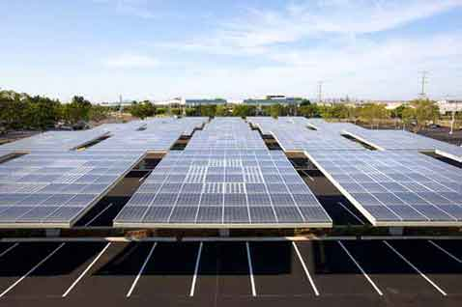
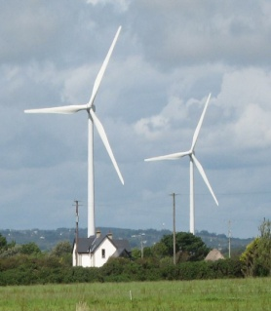
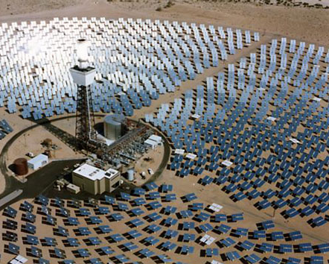
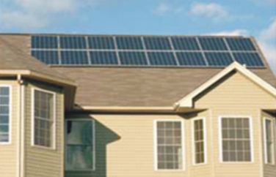
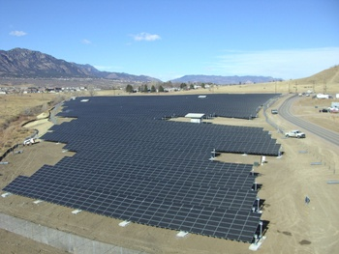
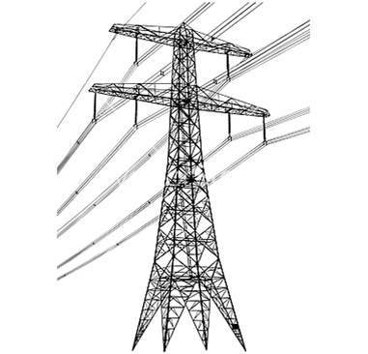
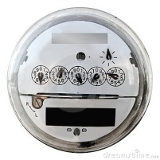
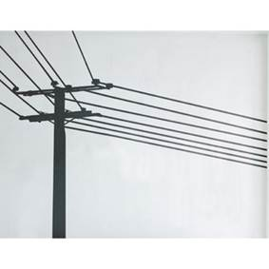
Wholesale DG is the Critical & Missing Segment
Project Size
Central Generation
Serves Remote Loads
Wholesale DG
Serves Local Loads
Retail DG
Serves Onsite Loads
Behind the
Meter
Distribution
Grid
Transmission
Grid
Notes:
(jf 01, 30 March 2012)

Slide 7
Wholesale DG has Superior Value
Total Ratepayer Cost of Solar
 | Distribution Grid |  |  |  |  | T-Grid
PV Project size and type | 100kW roof | 500kW roof | 1 MW roof | 1 MW ground | 5 MW ground | 50 MW ground
Required PPA Rate | 16¢ | 15¢ | 13¢ | 9-11¢ | 8-10¢ | 7-9¢
T&D costs | 0¢ | 0¢ | 0¢ | 0¢ | 0¢ | 2-4¢
Ratepayer cost per kWh | 16¢ | 15¢ | 13¢ | 9-11¢ | 8-10¢ | 9-13¢
Sources: CAISO, CEC, and Clean Coalition, Nov2012; see full original analysis from Jul2011 at www.clean-coalition.org/studies
The most cost-effective solar is large WDG, not central station due to significant hidden T&D costs
Notes:
7

Slide 8
CLEAN Programs Defined
CLEAN = Clean Local Energy Accessible Now
CLEAN Features:
  Procurement: Standard and guaranteed contract between the utility and a renewable energy facility owner
  Interconnection: Predictable and streamlined distribution grid access
  Financing: Predefined and financeable fixed rates for long durations
CLEAN Benefits:
  Removes the top three barriers to renewable energy
  The vast majority of renewable energy deployed in the world has been driven by CLEAN Programs
  Allows any party to become a clean energy entrepreneur
  Attracts private capital, including vital new sources of equity
  Drives local employment and generates tax revenue at no cost to government
Notes:
(04_cl, 13 Apr 2012)
--CLEAN Programs are responsible for 45% of all wind energy and 75% of all solar PV capacity installed in the world before 2008 (National Renewable Energy Laboratory)
--CLEAN Programs are responsible for 86% of the solar capacity deployed in the world in 2009 (Navigant Consulting, Meister Consultants Group)

Slide 9
CLEAN Programs Deliver Cost-Effective Scale
Solar Markets: Germany vs California (RPS + CSI + other)
Cumulative MW
Sources: CPUC, CEC, SEIA and German equivalents.
Germany added nearly 15 times more solar than California in 2011,
even though California’s solar resource is 70% better!!!
Notes:
(jf_05, 7 Mar 2011)
Beyond the obvious details on this slide, see the notes below.
CLEAN = Clean Local Energy Acceccible Now and CLEAN Programs are the new name for feed-in tariffs in the United States.
Rooftop solar in Germany today is priced at the California-equivalent of 12 cents/kWh, which would be the most cost-effective solar that has ever been deployed in California -- even more cost-effective than ground-based solar projects deployed in California to date. Ground-based solar projects typically generate about 25% more kWh/W than rooftop projects, because they use tracking, which allows the panels to follow the sun throughout the day. The net result is that ground-based projects are generally about 20% more cost-effective than rooftop projects. The difference between the 25% and the 20% is that the O&M costs for ground-based projects are a bit higher due to their moving parts.

Slide 10
German Solar Capacity is Small WDG (Rooftops)
26%
23.25%
22.5%
19%
9.25%
Source: Paul Gipe, March 2011
Germany’s deployed solar capacity is essentially 100% WDG
and about 90% is on rooftops
Notes:
(cl_04a, 12 Jan 2012)

Slide 11
German Solar Pricing Translates to 7 cents/kWh
Project Size | Euros/kWh | USD/kWh | California Effective Rate $/kWh
Under 10 kW | 0.195 | 0.2470 | 0.0993
10 kW to 40 kW | 0.185 | 0.2344 | 0.0942
40.1 kW to 1 MW | 0.165 | 0.2091 | 0.0841
1.1 MW to 10 MW | 0.135 | 0.1711 | 0.0688
Source: http://solarindustrymag.com/e107_plugins/content/content.php?content.10624, June 2012
Conversion rate for Euros to Dollars is €1:$1.27
California’s effective rate is reduced 40% due to tax incentives and then an additional 33% due to the superior solar resource
Replicating German scale and efficiencies would yield rooftop solar at only between 7 and 10 cents/kWh to California ratepayers

Slide 12
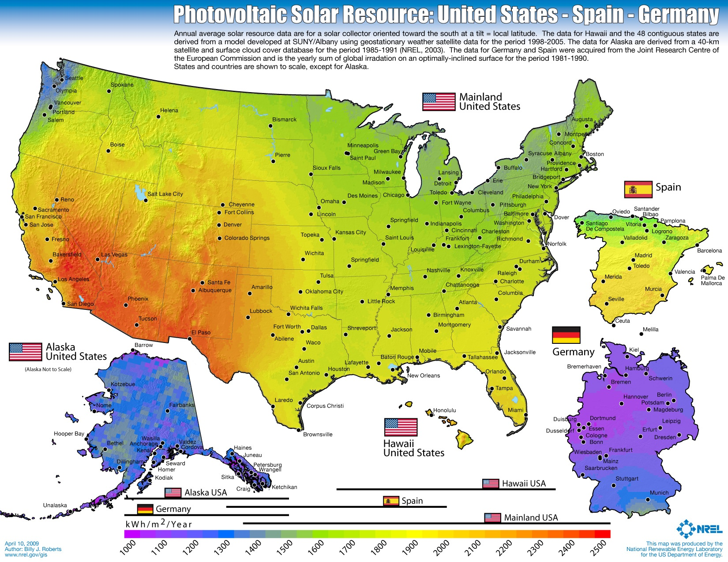
US has far better solar resource than Germany

Slide 13
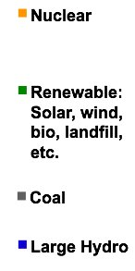
CLEAN Delivers Ontario’s Goals
On track to replace 100% of coal power by 2014
Created tens of thousands of jobs, and on track to create 50,000 jobs
Attracted over $20 billion in private-sector investment to Ontario
More than 30 companies are currently operating or plan to build, solar and wind manufacturing facilities in Ontario
6 GW
Coal
Power
Notes:
(ssw_1, 12 April 2012)
The Canadian Province of Ontario had 31 GW of peak electric capacity in 2009.
The source of the economic data is the Ontario Economic Ministry’s Feed-in Tariff Two Year Review Report (March 2012)

Slide 14
SMUD Proves CLEAN is Superior for California
CLEAN = FIT + streamlined distribution grid interconnection:
Interconnection of wholesale distributed generation projects to California investor owned utility distribution grids takes an average of 2 years.
In contrast, interconnection to Sacramento Municipal Utility District’s (SMUD) distribution grid takes an average of 6 months.
Two SMUD staff members completed
interconnection studies for 100 MW
CLEAN Program projects in 2 months.
SMUD maximized transparency by
publishing online interconnection maps.
100 MW of WDG projects were built
in 2 years with no ratepayer impact.
This is equivalent to 2.5 GW of cost-
neutral WDG across California.
Notes:
CLEAN Programs work in the U.S.

Slide 15
CLEAN-Gainesville Starts a US Solar Revolution
Notes:
CLEAN Programs work in the U.S.

Slide 16

CLEAN Streamlines Procurement for Utilities
"Several aspects of the CLEAN Program have proven to simplify and streamline the process.
First, there is a standard set of "bright line" rules for a project to qualify, demanding no staff analysis or interpretations.
Second, there is a clear method for assigning capacity to qualifying projects… There is no staff time wasted with evaluating RFPs…
Third, each project… signs a short, standard offer contract and interconnection agreement.
There is no valuable staff time wasted in negotiations and legal disputes.”
- John Crider, GRU Strategic Planning
Notes:
CLEAN Programs work in the U.S.

Slide 17
CLEAN Avoids Hidden Transmission Costs
“Palo Alto CLEAN will expand clean local energy production while only increasing the average utility bill by a penny per month” -- Yiaway Yeh, Mayor of Palo Alto
Notes:
CLEAN Programs work in the U.S.

Slide 18
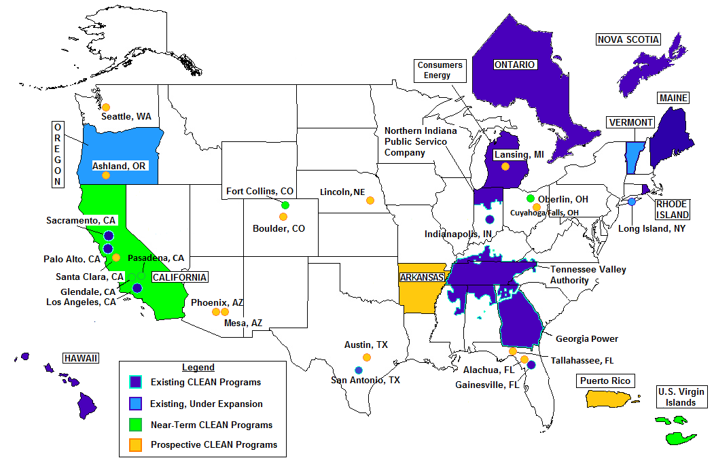
The Clean Coalition is Working All Over the U.S.
Notes:
New CC Powerpoint Template (05_zf, 8 Jan 2013)

Slide 19

Local CLEAN Program Guide
Free download: http://www.clean-coalition.org/local-action
Contact us: LocalGuide@Clean-Coalition.org
Modules of the Guide:
Overview & Key Considerations
Establishing CLEAN Contract Prices
Evaluating Avoided Costs
Determining Program Size & Cost Impact
Estimating CLEAN Economic Benefits
Designing CLEAN Policies & Procedures
Gaining Support for a CLEAN Program
Notes:
(05_ssw, 16 Apr 2012)

Slide 20
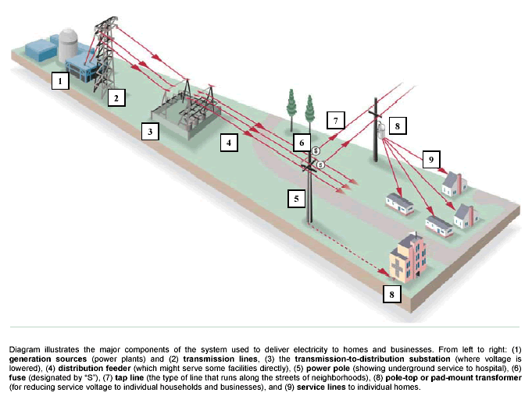
DG+IG Initiative = Proving Feasibility of High DG
Work with five utilities across the US to deploy a DG+IG demonstration project at each by yearend-2014
Prove viability of Distributed Generation (DG) providing at least 25% of total electric energy consumed within a single substation grid area
Integrate Intelligent Grid (IG) solutions to ensure that grid reliability is maintained or improved from original level
  IG solutions include diversity and Energy Storage for sure, and potentially, advanced inverters, forecasting & curtailment, and/or Demand Response
Notes:
(cl, 18 Dec 2012)

Slide 21
DG+IG Initiative = Proving 50% Local Energy Goal
Notes:
(cl_04a, 12 Jan 2012)
To lay the groundwork, this slide represents the ultimate Clean Coalition vision.
This is what a smart energy future looks like.
The key components will be:
Distributed Generation + Demand Response + Energy Storage + Electrical Vehicle + overall Monitoring Communications and Controls or MC2 for short.
The Clean Coalition envisions a future where these components are no longer treated as independent silos. These components will work seamlessly together, using information technology to locally control, create and balance supply and demand of electricity.
What this slide also shows is the huge market opportunity for the transition. There is a $6 trillion dollar energy market AND it will transition to a smart energy future – and there are three key drivers behind that:
Economic sensibility
Energy security
Environmental sustainability
Regardless of your political affiliation, one of these drivers or a combination there of, will take us to this future.
The only question is how painful will this transition be, how fast will it happen, and who’s going to win all the economic benefits.
21

Slide 22

Benefits of DG+IG
Reliability benefits
  Increased customer satisfaction
  Improved equipment longevity
Potential Resiliency/Security benefits
  Sustained vital services
  Avoided transmission dependencies
  From imported energy to local energy
Economic benefits
  Large private-sector investment
  Significant local job creation
  Fixed electricity prices for 20+ years
  Localized energy spending
Environmental benefits
  Utilizing built-environments and disturbed lands for generation projects
  Preserving pristine environments from transmission lines and other infrastructure

Slide 23
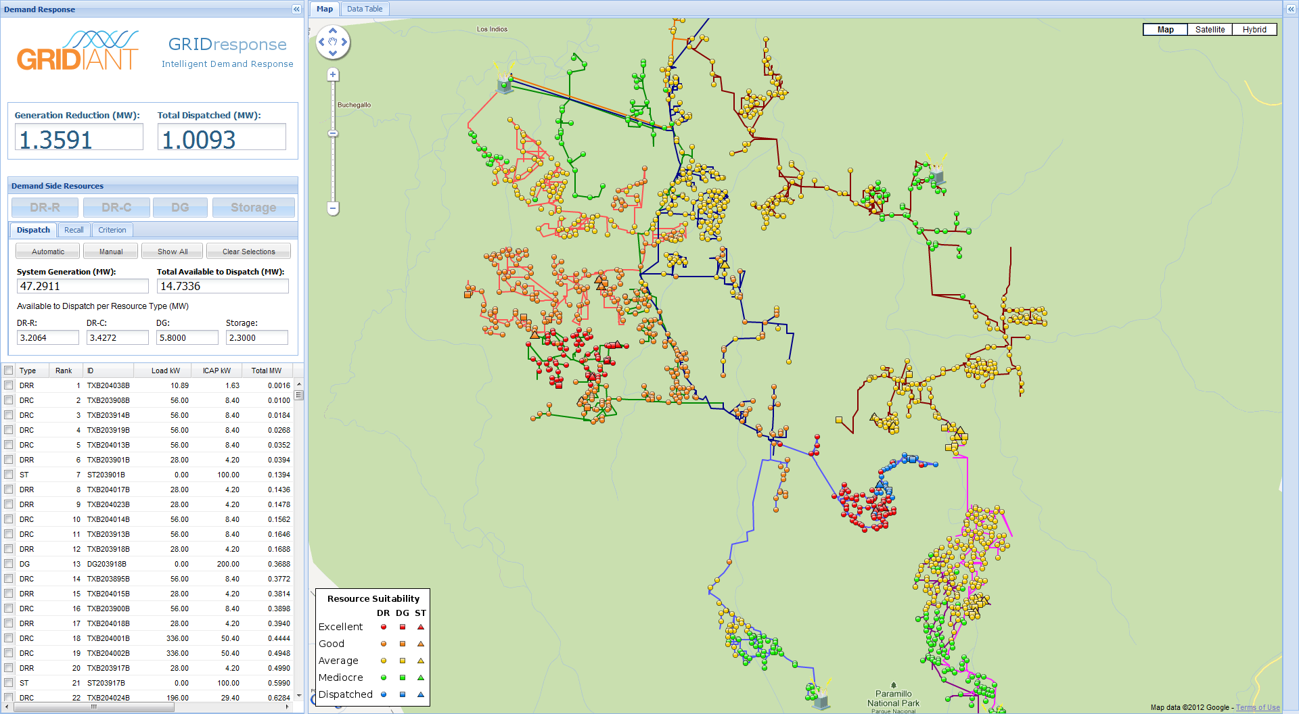
DG+IG Projects Begin with Grid Modeling & Simulation
Notes:
(cl, Aug2012)

Slide 24
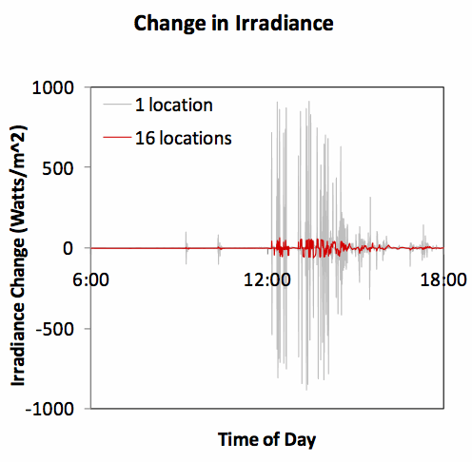
DG Diversity Greatly Reduces Variability
Source: Clean Energy Maui, Feb 2011

Slide 25
Power Factor Benefits need to be Compensated
Example (0.85 PF):
S = 1 MVA
P = 0.85 MW
Q = 0.5 MVAr
P/S = 0.85 = Power Factor
NOTE: A 15% reduction in real power leads to 50% of reactive power.
Sourcing (or sinking) reactive power at the inverter can provide control of local voltage levels – a significant locational benefit not incentivized by current policy.
Policy must be updated to reward the full range of locational benefits that distributed energy resources can provide.
P: “Real Power” consumed by load, used by utility billing and solar PPA
Q: “Reactive Power” used to induce magnetic fields for inductive loads (motors, compressors, etc.)
S: Apparent Power must be generated and distributed to support the total Real and Reactive loads
REACTIVE
50% potential Q
S
Q
P
REAL
15% P loss

Slide 26
Sizing Energy Storage
Feeder | Avg Load | Solar Nameplate | ES Power | Estimated Cost (millions)
 | MW AC | MW DC | MW AC | 15 min | 30 min | 60 min
Feeder 7E | 3.5 | 4.9 | 2.0 | $2.4 | $3.6 | $5.58
Feeder 9E | 4.8 | 6.7 | 3.0 | $3.6 | $5.5 | $8.37
Water Plant | 2.1 | 2.9
Feeder 7E & 9E | 8.3 | 11.6 | 4.0 | $4.8 | $7.28 | $11.16
Feeders 7E, 9E & WP | 10.4 | 14.4 | 5.0 | $4.8 | $9.1 | $13.95

Slide 27
DG+IG Backup Slides
DG+IG
Backup Slides
Notes:
(sw 2, 19 Jan 2012)
27

Slide 28
Advanced Inverters can Play a Significant Role
Research has shown that advanced inverters can dramatically increase PV penetration levels
  EPRI report (2011) modeled actual distribution circuits to understand the effect reactive power support might have on distributed generation (DG) penetrations
    PV penetrations were limited by system voltage impacts
    When PV inverters were given autonomous volt/VAR control, “an additional 25-100% in PV power was found to be incorporated into a distribution circuit.”
  Thomson et al (2009) modeled reactive power control to manage local voltages
    “The addition of high penetrations of micro generation could raise voltages beyond the upper limit… reactive power capabilities of the inverters associated with micro generators could be an effective means of bringing the voltage back down to acceptable levels. Thus the distributed automatic voltage control facilitates a very high penetration of micro generation.”
Standards (such as IEEE 1547) undergoing updating to reflect advanced inverter capabilities (1547.8)
Sources:
EPRI, 2011. “Advanced Voltage Control Strategies for High Penetration of Distributed Generation.” Product ID: 1020155.
Thomson et al, 2009. “Distributed Automatic Voltage Control (DAVC).” CIRED 20th International Conference on Electricity Distribution.

Slide 29
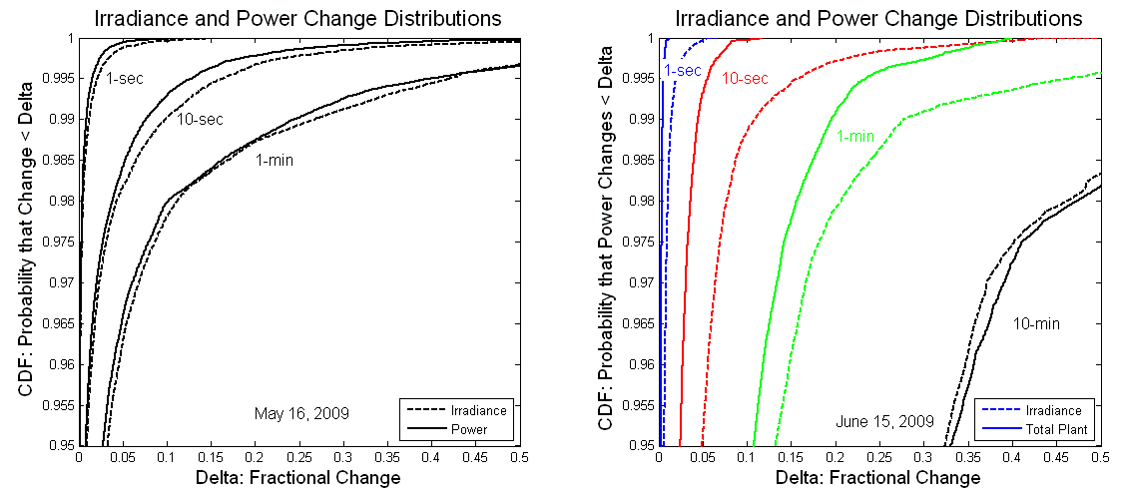
Power Output Varies Slower than Irradiance
Figure 4. Cumulative distributions (95th to 100th percentiles) of irradiance and PV power changes over various time periods during a single day from a 30-kW PV system (left) and a multi-MW PV
Source: Mills, et al, LBNL, Understanding Variability and Uncertainty of Photovoltaics for Integration with the Electric Power System

Slide 30
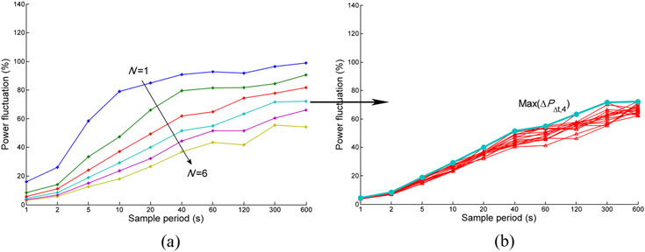
Maximum Power Fluctuations Decrease as the Number of Systems Increases
Figure 7. (a) Maximum power fluctuations ΔPΔt,N, registered during a year for all possible combinations for N=1…six plants (all at Navarra). (b) Maximum power fluctuation observed for all the 15 possible combinations of N= 4 during a year.
Source: Marcos, et al, Smoothing of PV power fluctuations by geographical dispersion

Slide 31
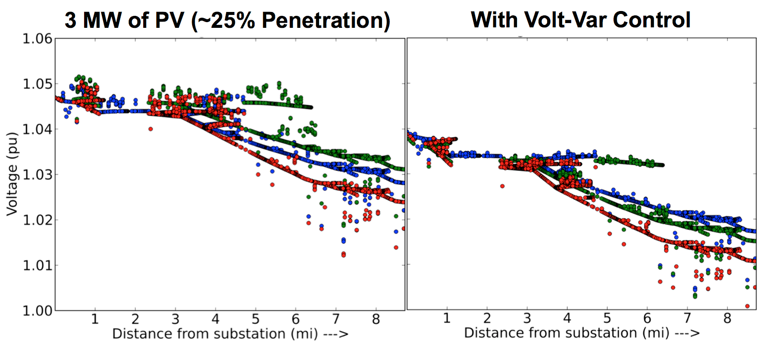
Smart Inverters – Voltage Support Capabilities
Lower feeder voltages → significant energy savings (CVR)
Source: EPRI, 2011

Slide 32
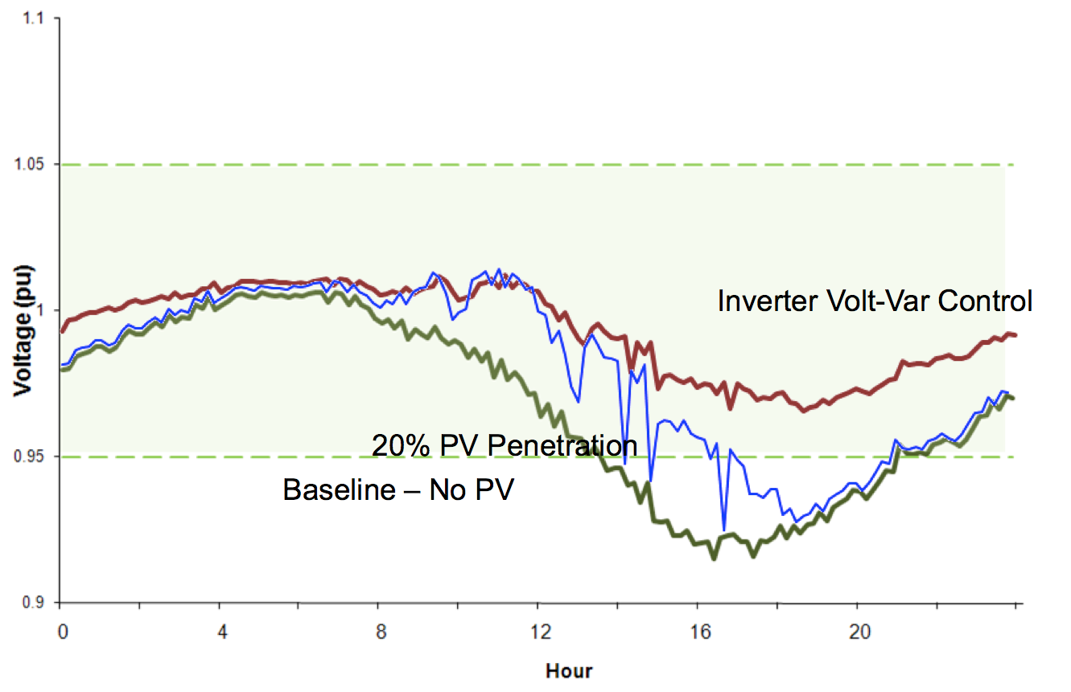
Smart Inverters – Voltage Support Capabilities
Smart inverters support nominal voltage bounds
Source: EPRI, 2011

Slide 33
General Backup Slides
General
Backup Slides
Notes:
(sw 2, 19 Jan 2012)
33

Slide 34
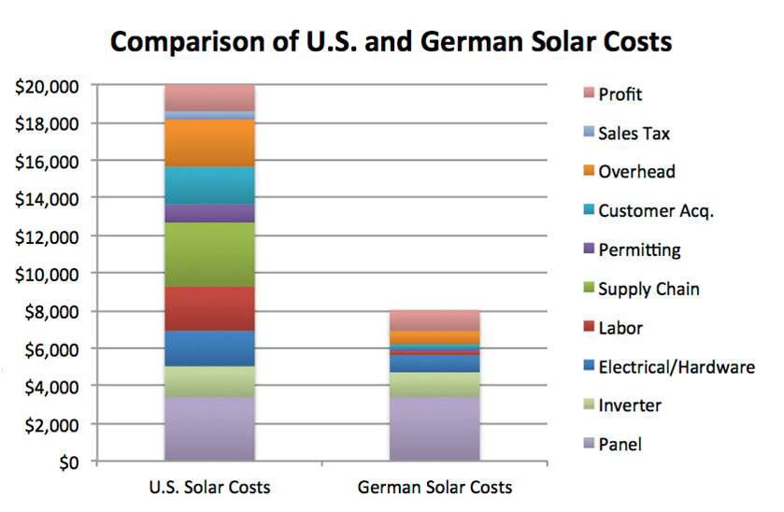
Installed PV Costs in US vs Germany
Rooftop solar project installation costs are roughly 2.5 times higher in the US than in Germany
Sources: LBNL, PwC, and Forbes; Sep2012
Notes:
(01_sa, 5 September 2011)

Slide 35
Avoided Transmission in CA = $80 Billion over 20 yrs
Business as Usual Year-20 TAC (TAC₂₀ ) = 2.7
2.7
Business As Usual TAC Growth
Current TAC
Rate (TAC₀) = 1.2
TAC₀ O&M Level
Business as Usual TAC Growth TAC₀ Depreciation + O&M Avoided TAC Opportunity from DG

Slide 36
Plan the Work and Work the Plan
This is the general timeline for the adoption of a CLEAN Program by a municipal utility.
Secure Approval by City Council or Utility Board
Identify Key Players
Secure Local Advocate(s)
Design Program
T - 0
6 Months
12 Months
18 Months

Slide 37
Process for getting Palo Alto CLEAN (1 of 2)
1) Clean Coalition meets with individual City Council Members to discuss CLEAN policies and implementation.
3) CPAU staff draft & revise the Utilities Strategic Plan & Long-term Electric Acquisitions Plan, incorporating feedback from the UAC and community members.
4) Based on a Clean Coalition presentation and a presentation by City staff on the feasibility of a Palo Alto CLEAN Program, UAC Commissioners express support for moving forward with a CLEAN Program.
Spring 2010
April-May 2010
July 2010-Jan. 2011
February 2011
2) Mayor, Vice Mayor and two City Council Members send a memo to City Council requesting the full Council direct the UAC, supported by CPAU staff, to do a comprehensive review of the CPAU energy efficiency and renewable procurement strategy. City Council directs CPAU staff and the UAC to make recommendations to the Council for a comprehensive energy efficiency and renewables procurement strategy.

Slide 38
Process for getting Palo Alto CLEAN (2 of 2)
5) CPAU staff research CLEAN Programs & bring a proposal to the UAC which recommends the City Council approve of the proposed CLEAN Program.
7) City Council approves the proposed CLEAN Program’s Policies & Guidelines.
9) Palo Alto’s CLEAN Program launces!
March-June 2011
June 2011
August 2011
Oct.-Dec. 2011
March 2012
6) The City Council’s Finance Committee recommends City Council approve of the proposed CLEAN Program’s Policies & Guidelines.
8) Development and City Council approve the CLEAN Program’s pricing & design.

