Slide 1
Community Microgrids
Maximizing Local Renewables, Energy Storage, and other Distributed Energy Resources
Craig Lewis
Executive Director
Clean Coalition
650-796-2353 mobile
craig@clean-coalition.org
17 June 2015
Notes:
This presentation will focus on integrating renewables with cost-effective intelligent grid solutions, including demand response, storage, and advanced inverters. The presentation will show how to address grid reliability challenges (steep ramps, over-generation, voltage control, and minute-to-minute fluctuations) with preferred resources.

Slide 2
Community Microgrid = Pathway to DER Future
Community Microgrid definition
  A coordinated local grid area served by one or more distribution substations and supported by high penetrations of local renewables and other Distributed Energy Resources (DER). Community Microgrids reflect a new approach for grid operations that achieve a more sustainable, secure, and cost-effective energy system while generally providing long-term power backup for prioritized loads. The substation-level foundation of a Community Microgrid facilitates cost-effective replication for optimizing grid operations and customer satisfaction across utility service territories.

Slide 3
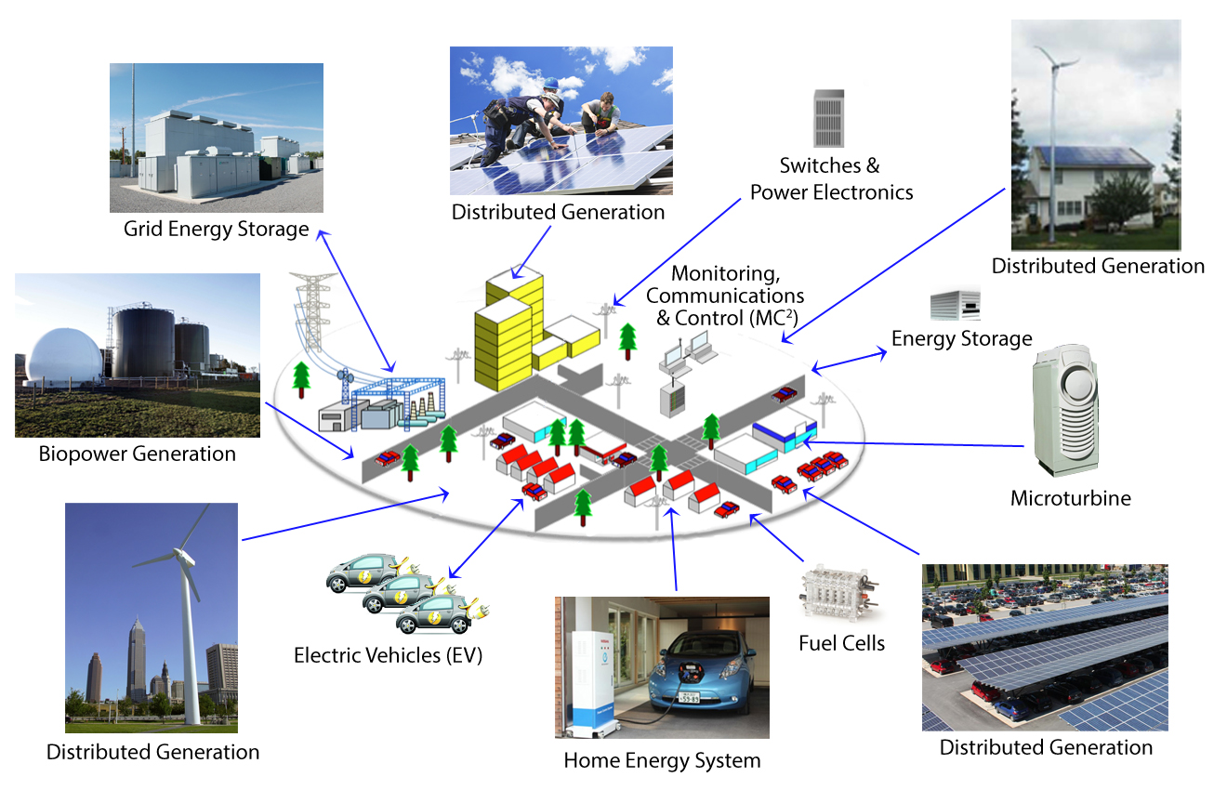
Community Microgrid in a Visual
Notes:
(cl_04a, 12 Jan 2012)
To lay the groundwork, this slide represents the ultimate Clean Coalition vision.
This is what a smart energy future looks like.
The key components will be:
Distributed Generation + Demand Response + Energy Storage + Electrical Vehicle + overall Monitoring Communications and Controls or MC2 for short.
The Clean Coalition envisions a future where these components are no longer treated as independent silos. These components will work seamlessly together, using information technology to locally control, create and balance supply and demand of electricity.
What this slide also shows is the huge market opportunity for the transition. There is a $6 trillion dollar energy market AND it will transition to a smart energy future – and there are three key drivers behind that:
Economic sensibility
Energy security
Environmental sustainability
Regardless of your political affiliation, one of these drivers or a combination there of, will take us to this future.
The only question is how painful will this transition be, how fast will it happen, and who’s going to win all the economic benefits.
3

Slide 4
Clean Coalition Mission and Advisors
Mission
To accelerate the transition to renewable energy and a modern grid through technical, policy, and project development expertise.
Board of Advisors
Jeff Anderson
Co-founder and Former ED, Clean Economy Network
Josh Becker
General Partner and Co-founder, New Cycle Capital
Pat Burt
CEO, Palo Alto Tech Group;
Councilman & Former Mayor, City of Palo Alto
Jeff Brothers
CEO, Sol Orchard
Jeffrey Byron
Vice Chairman National Board of Directors, Cleantech Open; Former Commissioner, CEC
Rick DeGolia
Senior Business Advisor, InVisM, Inc.
John Geesman
Former Commissioner, CEC
Eric Gimon
Independent Energy Expert
Patricia Glaza
Principal, Arsenal Venture Partners
Mark Z. Jacobson
Director of the Atmosphere/Energy Program & Professor of Civil and Environmental Engineering, Stanford University
Dan Kammen
Director of the Renewable and Appropriate Energy Laboratory at UC Berkeley; Former Chief Technical Specialist for RE & EE, World Bank
Fred Keeley
Treasurer, Santa Cruz County, and Former Speaker pro Tempore of the California State Assembly
Felix Kramer
Founder, California Cars Initiative
Amory B. Lovins
Chairman and Chief Scientist, Rocky Mountain Institute
L. Hunter Lovins
President, Natural Capitalism Solutions
Ramamoorthy Ramesh
Founding Director, DOE SunShot Initiative
Governor Bill Ritter
Director, Colorado State University’s Center for the New Energy Economy, and Former Colorado Governor
Terry Tamminen
Former Secretary of the California EPA and Special Advisor to CA Governor Arnold Schwarzenegger
Jim Weldon
Technology Executive
R. James Woolsey
Chairman, Foundation for the Defense of Democracies; Former Director of Central Intelligence (1993-1995)
Kurt Yeager
Vice Chairman, Galvin Electricity Initiative; Former CEO, Electric Power Research Institute
Notes:
4

Slide 5
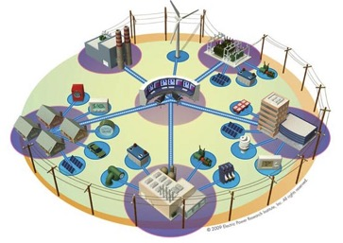


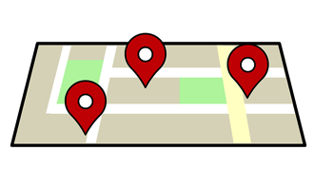
Expertise Supporting Utilities & Communities
Community Microgrid Projects
Program Design
Grid Modeling & Optimization
Analysis & Planning
DG siting surveys; full DER cost and value analysis
PG&E
PSEG
SCE
Powerflow modeling; DER optimization
PG&E
PSEG
Procurement and interconnection
LADWP, Fort Collins, PSEG
City of Palo Alto (FIT and solar canopy RFP)
RAM, ReMAT
Rule 21 & FERC
Design and implementation
San Francisco, CA
Long Island, NY
U.S. Virgin Islands
Notes:
5

Slide 6

Dynamic Grid Council
The Dynamic Grid Council (DGC) establishes policy and market structures that modernize the distribution grid through Distributed Energy Resources (DER) like Local Renewables; Energy Storage; Advanced Inverters; Demand Response; Monitoring, Communications & Control (MC²), Forecasting & Curtailment; and “Grid Hardening”
The DGC also establishes DER market opportunities at full value.
Notes:
(cl_04a, 12 Jan 2012)
To lay the groundwork, this slide represents the ultimate Clean Coalition vision.
This is what a smart energy future looks like.
The key components will be:
Distributed Generation + Demand Response + Energy Storage + Electrical Vehicle + overall Monitoring Communications and Controls or MC2 for short.
The Clean Coalition envisions a future where these components are no longer treated as independent silos. These components will work seamlessly together, using information technology to locally control, create and balance supply and demand of electricity.
What this slide also shows is the huge market opportunity for the transition. There is a $6 trillion dollar energy market AND it will transition to a smart energy future – and there are three key drivers behind that:
Economic sensibility
Energy security
Environmental sustainability
Regardless of your political affiliation, one of these drivers or a combination there of, will take us to this future.
The only question is how painful will this transition be, how fast will it happen, and who’s going to win all the economic benefits.
6

Slide 7
Electricity Systems have 3 Vital Grid Services
Service | Key to Delivering Service
Power Balancing | Capacity of real power (W)
Voltage Balancing | Location of reactive power (VAr)
Frequency Balancing | Speed of ramping real power (W)
The Duck Chart only addresses Power Balancing but Distributed Energy Resources deliver unparalleled location and speed characteristics
Notes:
7

Slide 8
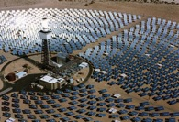
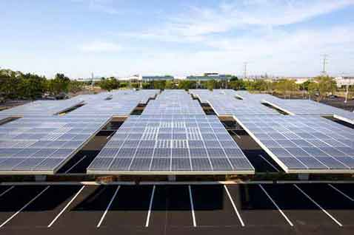



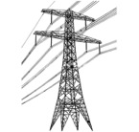

Wholesale DG is the Critical & Missing Segment
Project Size
Central Generation
Serves Remote Loads
50+ MW
Wholesale DG
Serves Local Loads
500 kW
Retail DG
Serves Onsite Loads
5 kW
Behind the Meter
Distribution Grid
Transmission Grid
Notes:
Wholesale Distributed Generation or WDG is the market segment that makes this transition possible. The retail DG – behind the meter – and central generation renewables – out in the desert, most of the time – are both part of the equation, but WDG has enough potential and uses economies to scale that will really change the game.
When we refer to DG, we mean a generating resource that is located on the distribution grid and the generated electricity does not feed back onto the transmission grid. WDG, therefore, is DG that sells all of its generation to the utility (or other purchaser). In future slides, I will refer to the distribution grid as the d-grid.
*National policies focus on removing barriers for large-scale renewable power facilities and infrastructure.
*State and local net-metering policies promote small-scale renewables:
---Net-metering is designed to reduce a utility customer’s electric bills
---Net-metering is not designed for owners of commercial and multi-tenant properties (where tenants pay the utility bills)
---Annual on-site energy use generally caps net-metering project size
---Investors and lenders find a utility customer’s energy savings from net-metering far less attractive than a revenue stream from a stable utility
(03_gp, 28 May 2013)

Slide 9
WDG Delivers Scale & Cost-Effectiveness Fast
Solar Markets: Germany vs California (RPS + CSI + other)
Cumulative MW
Sources: CPUC, CEC, SEIA and German equivalents.
Germany has deployed over 10 times more solar than California in the last decade despite California’s 70% better solar resource!!!
Notes:
Germany is the best example we currently have to show the efficacy of CLEAN Programs and the WDG market. If there is any confusion, Germany is in green and California—known as the leading market it the U.S.–is in red. It is astonishing that Germany is adding 11 times more solar than California even though California has a 70% better resource.
Rooftop solar in Germany today is priced at the California-equivalent of 7-10 cents/kWh, which would be the most cost-effective resource deployed in California.
Ground-based solar projects typically generate about 25% more kWh/W than rooftop projects, because they use tracking, which allows the panels to follow the sun throughout the day. The net result is that ground-based projects are generally about 20% more cost-effective than rooftop projects. The difference between the 25% and the 20% is that the O&M costs for ground-based projects are a bit higher due to their moving parts.
(07_gp, 23 Sep 2013)

Slide 10
German Solar Capacity is Small WDG (Rooftops)
26%
23.25%
22.5%
19%
9.25%
Source: Paul Gipe, March 2011
Germany’s solar deployments are almost entirely sub-2 MW projects on built-environments and interconnected to the distribution grid (not behind-the-meter)
Notes:
(cl_04a, 12 Jan 2012)

Slide 11
German WDG Solar is 5 to 7 cents/kWh today
Project Size | Euros/kWh | USD/kWh | California Effective Rate $/kWh
Under 10 kW | 0.145 | 0.1903 | 0.0762
10 kW to 40 kW | 0.138 | 0.1805 | 0.0722
40.1 kW to 1 MW | 0.123 | 0.161 | 0.0644
1.1 MW to 10 MW | 0.101 | 0.1317 | 0.0527
Source: http://www.wind-works.org/cms/index.php?id=92, 10 September 2013
Conversion rate for Euros to Dollars is €1:$1.309
California’s effective rate is reduced 40% due to tax incentives and then an additional 33% due to the superior solar resource
Replicating German scale and efficiencies would yield rooftop solar today at only between 5 and 7 cents/kWh to California ratepayers
Notes:
Critics of Germany’s CLEAN Program tend to say that they are paying too much for renewable energy generation, but this chart shows that – using the appropriate conversion – they are paying less for solar than we pay for electricity almost anywhere in the U.S. This conversion uses the U.S. tax incentives and solar resource.

Slide 12
Community Microgrids in Six Steps
1. Goals:
Desired goals and performance metrics of the target grid area based on local resources and known or anticipated grid issues.
Includes renewables penetration goals, grid reliability & power quality performance targets, and power backup requirements.
2. Baseline Grid Analysis:
Inventory of the existing grid assets including load profiles, voltage regulation, feeder and transformer capacities, and existing generation.
Includes identifying prioritized services that require backup power during outages.
3. Renewable Siting Survey:
Comprehensive survey of the renewable energy potential in the target grid area specific to local resources & site characteristics.
Informs other requirements such as energy storage capacity needs and control system functionality.
4. DER Optimization:
Design of optimal DER portfolios combining renewables, energy storage, and demand response.
Incorporates Baseline Grid Analysis and Renewables Survey to achieve optimal outcomes based on local resources and grid assets.
5. Economic Analysis:
Full analysis of the cost- benefits and net value including reductions in T&D investments, ratepayer benefits, and local job creation.
Includes bulk procurement & interconnection that achieve a “plug-and-play” model, further reducing costs.
6. Deployment Plan:
Final system design, financial model and operational plan for the Community Microgrid.
Includes vendor analysis (e.g. RFIs, RFPs) appropriate to the final design criteria, financial model, and operational requirements.
Result: Distributed Energy Resources can deploy at scale in months rather than years. A massive acceleration of “one rooftop at a time…”

Slide 13
Community Microgrids start with Goals
Typical Community Microgrid Goals
  Achieve high penetrations of local renewables (generally at least 25% of total electric energy consumed within the grid area served by the Community Microgrid)
  Defer substantial investments in traditional Transmission & Distribtution (T&D) infrastructure through load shifting and peak shaving etc
  Save ratepayers money
  Provide an efficient pathway to Distribution Services Operator (DSO) grid operations and the Distributed Energy Resources (DER) future
  Enhance grid performance (grid power quality, reliability, and resilience), including by combining local renewables and Energy Storage for indefinitely ongoing power backup to prioritized loads (critical loads and premium services)

Slide 14
Grid Analysis & DER Optimization
4. Higher-Cost DER Capacity
Higher DER level incl. storage & local generation (e.g. Fuel Cells, CHP) that further mitigate variability & peaks while islanding critical services
Optimize via locations, sizes, types, costs, system deferrals
Inputs
Data, existing grid:
Loads, load forecasting
Network model & circuit map
Equipment list, upgrade plan, O&M schedule
Transmission constraints
Data, DER solutions:
DG survey
Solar insolation
Weather forecasting
DER specs: advanced inverters, storage, DR, etc.
Outputs
Scalable, cost-effective, operationally viable DER Optimization plan
Results validated with utility & tech vendors
Grid reliability & power quality maintained or improved
3. Medium-Cost DER Capacity
Target DER level in context of net grid value that adds cost-effective storage & DR. May require moderate grid upgrades.
Optimize via locations, sizes, types, costs, system deferrals
2. Lower-Cost DG Capacity
Initial DG level that requires negligible grid upgrades and manages voltage w/existing equipment & advanced inverters
Optimize via locations, sizes, types, costs, system deferrals
1. Baseline Powerflow
Acquire all data sets, validate data accuracy
Model existing grid area, including existing DG
Notes:
This is how utilities can accomplish a modern grid and plan to support much larger amounts of local renewables. This replicable methodology provides a blueprint for how utilities can use existing tools to achieve the utility of the future in months rather than years. This is the methodology the Clean Coalition used for the Hunters Point Project in collaboration with PG&E, using the commercial version of PG&E’s distribution modeling tool, Cyme (specifically, CYMDIST v5.04 r10) along with Integral Analytics LoadSEER, DSMore and IDROP software tools.
This diagram should be read from the bottom up. The analogy is building the foundation and floors for a building or house. One must start with the foundation and first floor, and then build up from there.
Step 1, achieving the Baseline Powerflow, is the foundation. This must be completed first in order to understand how much – and exactly how – electricity is delivered through the system today and how the grid is impacted. Without this step, we can not understand how any amount of local renewables will impact the existing system, or substation area.
Step 2 defines the Readlily Available, or Minimal Cost Capacity (sometimes referred to as “carrying capacity.”). This tells us the potential capacity for local renewables that can be supported by the existing circuit – by each feeder and by the system of connected feeders that make up a substation area. This is based largely on the current physical nature of the circuit – e.g., how thick are the wires, what are the current capabilities of the voltage regulation mechanisms, and where do you optimally place local renewables to take advantage of these more robust locations along feeders. It is also based on matching DG to customer loads, to find optimal locations based on customer profiles. Including system deferrals completes the optimization step requiring minimal grid upgrades. This step gives you the optimal locations and amount of local renewables that can be supported by the system today, with little changes or upgrades needed - knowledge that is critical in order to design the most cost-effective solution. And, without this step, the next two steps – the next two floors – risk being over-planned and thus too costly.
Steps 3 and 4 increase the amount of potential local renewables by adding technologies and services that further optimize distributed energy resources and improve grid reliability and resilience, including storage and demand response, and in context of a target DG level or net grid value defined by a utility or community.
By starting with the Lower Cost Capacity first, then modeling a portfolio of distributed energy resources in combinations that leverage that initial Capacity, a utility can then determine the optimal mix of local renewables and new grid technologies that result in the most cost-effective deployment for any given substation, the utility, and the community.

Slide 15
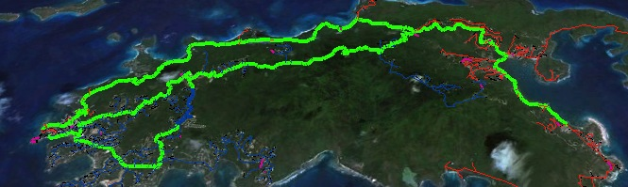
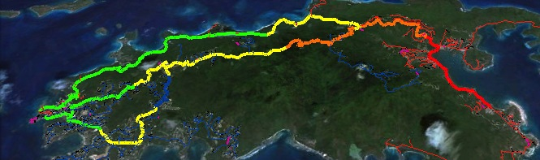
DER Optimization with Advanced Inverters
6AM: No PV impact
Noon: 20MW PV causes overvoltage
Noon: 20MW PV with advanced inverters set at 0.9 power factor stabilizes voltage
Notes:
Here’s an example from our grid modeling work for the Water and Power Authority of the US Virgin Islands that shows how advanced inverters paired with local solar or storage can manage voltage issues.
High levels of solar PV can cause overvoltage. In the top image, 20 MW of solar has no impact at 6am. In the second image, 20MW of PV causes overvoltage at noon. The third image shows that adding advanced inverters set at 0.9 power factor stabilizes voltage under the same conditions above.
It is worth noting that 20 MW PV means that the PV would essentially be powering the entire Island of St. John at noon on the modeled day. St. John has an average load of about 10 MW and achieving the 25% threshold requires about 12 MWdc of PV. It is also worth noting that the 20 MW of PV has been evenly spread across the three feeders.

Slide 16

C&I Customers: Great Match with Solar
C&I Match with Solar:
Most Generation
Larger rooftop spaces generate more energy
Lowest System Costs
Larger systems reduce overall costs
Best Grid Locations
Large loads served by robust feeder segments
Matching Load Profiles
Larger daytime loads match solar generation
Financially Motivating
Rooftop lease income is large enough to be compelling to property owners
Notes:
Commercial & Industrial customers offer the most cost-effective programs for utilities and communities due to their size, location, and matching load profiles, plus motivation to stabilize energy costs.
Via a robust and focused program, utilities and communities can take advantage of this customer category to accelerate and optimize DG/DERs.
Considerations:
Feeders are connected within each substation. This enables sharing energy across feeders and thus across customers and customer types.
Each urban/suburban substation or set of substations can find the most optimal mix between the three primary customer types: Commercial, Industrial, Residential.
Both weekday and weekend load profiles must be considered. In general, during weekday daytimes when residential load is low and C&I load is high, a good portion or all of the C&I daytime PV generation can be consumed “hyper-locally” by C&I customers, either directly or via sharing energy across those customers. During the weekends, C&I customers may use less daytime load which can then be shared more broadly with local residential customers who often use more load during weekend daytimes than weekday daytimes.
Multi-dwelling units can be bundled with C&I given the larger rooftops and loads; however, the load profiles will match residential, not C&I.

Slide 17
Solar Siting Survey for SCE
Objective: Conduct a Solar Siting Survey across Southern California Edison’s Preferred Resources Pilot (PRP) area for sites 500 kW or greater
The PRP area is approximately 120 square miles in Orange County, CA, bordered roughly by Santa Ana in the north and Laguna Niguel in the south.
Notes:
Completed in mid-April 2015

Slide 18


SCE PRP Solar Siting Survey summary
Summary: over 160 MW of new solar PV technical potential exists in the PRP on very large rooftops, parking lots, and parking garages (500kW+ project sizes)
PRP Solar Potential by PV size: totals per sites greater than 1 MW, sites greater then 500 kW but less than 1 MW, and sites less than 500 kW. The sites that are less than 500 kW are included as part of logical groupings such as office parks or shopping centers.
PRP Solar Potential by site type: totals for rooftops, parking garages (multi-story parking structures that would enable rooftop-style mounting), parking lots (e.g. ground mount), and brown fields

Slide 19
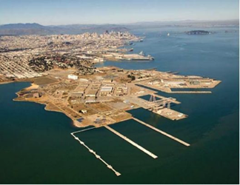
Hunters Point Community Microgrid Project
Overview
Innovative project in the Bayview-Hunters Point area of San Francisco, in collaboration with Pacific Gas & Electric
Model for achieving 25% of the total energy consumed in the area from local renewables, while maintaining or improving grid reliability and power quality using dynamic grid solutions
The Hunters Point substation serves ~20,000 customers (about 90% residential, 10% commercial/industrial)
Notes:
The Clean Coalition is currently working on the Hunters Point Project, a Community Microgrid Initiative project in collaboration with Pacific Gas & Electric. This project will serve 25% of total energy consumed at the substation with local renewables, balanced with dynamic grid solutions like advanced inverters, demand response, and energy storage.
The Hunters Point substation serves the Bayview-Hunters Point area of San Francisco, one of the most disadvantaged communities of the Bay Area. The area includes a former naval shipyard that was designated a federal superfund site. This gives us the opportunity to show how increasing local renewables and modernizing the grid can create major economic benefits for a disadvantaged community. At the same time, the Hunters Point shipyard area will be redeveloped, which will enable a comparison of retrofitting the built area with new construction in the redeveloped area. Note that most of the project (seven of nine feeders) is outside of the redevelopment zone, and we’re moving forward with the project right now, independent of the redevelopment timeline.
The Clean Coalition team has already delivered a site plan showing the amount of potential for distributed generation from the most cost-effective locations – i.e. commercial and multifamily rooftops and parking lots – along with the expected costs of local renewables by type of site. The team has also published an analysis of the economic, ratepayer and environmental benefits of the project, which is available on the Clean Coalition website.
Right now, the Clean Coalition team is deep in the powerflow modeling stage, working with data from our partner Pacific Gas & Electric to add DG and dynamic grid solutions to the validated baseline power flow model. We expect to complete this work in Q3. Later this year, the team will use cost optimization tools to develop optimal portfolios of local resources based on both powerflow and costs. We’ll deliver a full report of recommendations by the end of the year, completing Phase 1 of the project. Phase 2 of the project will involve working with PG&E, the City and County of San Francisco, California regulators, and local supporters to get the project deployed in 2015.

Slide 20
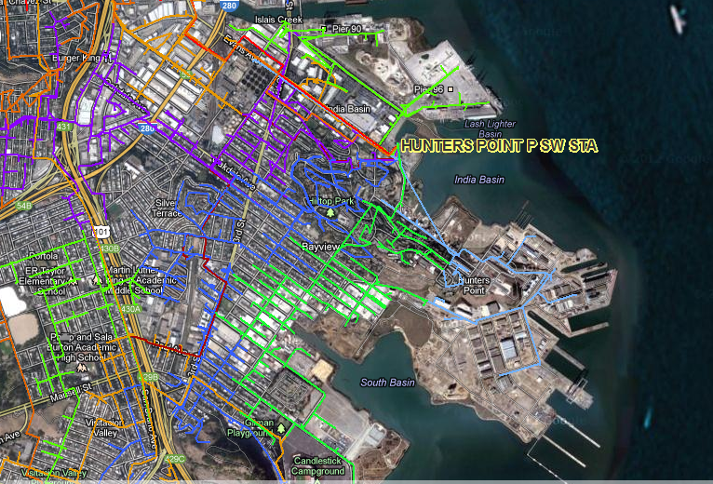
Hunters Point Project in San Francisco
Get 25% of electric energy consumed within Hunters Point substation (Bayview and Hunters Point neighborhoods) from local renewables while at least maintaining grid reliability and power quality
Notes:
01_sa, 14Nov2012

Slide 21



Hunters Point DG Benefits: 50 MW New PV = 25% Total Energy
50 MW Total = Existing Structures @ 30 MW + Redev Zone @ 20 MW
Example: 180 Napolean St.
PV Sq. Ft = 47,600
System size = 714 kW
Example: 1485 Bay Shore
PV Sq. Ft = 37,800
System size = 567 kW
Example: 50 avg. rooftops
Avg. PV Sq. Ft = 343
Avg. system size = 5 kW
Commercial: 18 MW
Parking Lots: 2 MW
Residential & MDU: 10 MW
Benefits from 50 MW New PV Over 20 Years
Energy
Cost Parity: Solar vs. NG, LCOE
$260M: Spent locally vs. remote
$80M: Avoided transmission costs
$30M: Avoided power interruptions
Economic
$200M: New regional impact
$100M: Added local wages
1,700 Job-Years: New near-term and ongoing employment
$10M: Site leasing income
Environmental
78M lbs.: Annual reductions in GHG emissions
15M Gallons: Annual water savings
375: Acres of land preserved
Notes:
ENERGY BENEFITS
Cost Parity via 20-year LCOE:
14.9¢/kWh solar vs. $15.3¢/kWh new combined cycle natural gas, LCOE. Modeling performed with NREL System Advisor Modeling (SAM) and PVWatts system design, using the mid-case scenario. For more details, see detailed LCOE slide later in deck.
Local Energy Spend
Based on 20 year average of $2,619,260 per year from avg output of 1484kWh/yr over that period
$52M over 20 years per 10MW
Avoided transmission access charges (TAC):
Calculated from CAISO 2013 TAC schedule and infrastructure projections. Note that the reductions in TAC are included in the LCOE comparison.
Avoided Costs from New Transmission Capacity:
Each 10 MW of added PV DG capacity will reduce the need for added transmission capacity investment by 0.05% relative to CAISO BAU projections and the related growth in TAC ratesResults in 0.0012¢/kWh reduction TAC rates applied to virtually all of the 254,000 GWh consumed within CAISO transmission system electricity by 2020
Avoided Line Losses
Based on PG&E Bay Area reported line loss rates, combined avoided line losses from transmission and distribution due to distributed generation average 5%, or 789 MWh per year for each 10 MW of PV DG installed. At an average current retail value of 15¢/kWh, the value of avoided losses is $118,350 per year, totaling $2,367,000 over 20 years.
Note that avoided lines losses are included in LCOE comparison.
Avoided Costs in Local Power System Interruptions:
Based on PG&E figures for Hunters Point outages, 10 MW of local DG would result in a 10% reduction in annual outages alone, or $304,000 per year, or $6M over a 20 year period. 50 MW would equal five times that, or $30M over 20 years. Source: PG&E 2012 Reliability Annual Report, DOE Interruption Cost Calculator - http://www.icecalculator.com/
ECONOMIC BENEFITS
Private Investment + Operations & Maintenance:
$200M investment over 20 years is comprised of near-term plus ongoing operations and maintenance as follows:
1. $165M represents the private investment amount for a 50MW PV system over 20 Years, as follows:
Installation & Construction: $137M ($27.5M per 10 MW)
Dynamic Grid Solutions @ 20% = $27,500
Total = $165K
O&M: $35M represents the O&M costs for a 50MW PV system over 20 years, as follows:
O&M adds $1.48M annually, or $29.7M over 20 years
plus 20% or $5.9M for Dynamic Grid Solutions
Total = $35.6M over 20 years.
Local Employment and Economic Impact:
Specific to MTA – Metropolitan Region.
Refers to PV installed in San Francisco at an average installed cost of $2.75/W(dc) (before taxes and incentives).
Local economic output is calculated as the value of expenditures on goods and services resulting from the project and captured within the study area, and excludes expenditures outside the region, such as to module manufacturers. During operating years local economic output is comprised of payments made by project owners, including the portion of project debt payments made to lenders located within the local analysis area. Payments including incentives, refunds, or revenues to project owners from the sale of energy produced by installed facilities are not included.
Economic activity in input-output models is assessed in three categories:
Salaries and wages for the project on-site labor and direct professional services
Local supply chain revenue related to materials acquisition, manufacture and services, including the local share of revenues from project financing and investment
Induced impacts in the local economy that result from workers salaries and wages
The model’s “output” is the sum of the above three categories for construction and for operations. State-specific multipliers and personal spending patterns are used to derive the results.
Near-term Job years of regional local employment from construction and installation. Ongoing job years in operation and maintenance over 25 years of operation.
Local wages in construction & installation.
The SF successor RDA estimates that 50% of the jobs and economic output will be captured within the boundaries of the city
Equipment and material sales will generate tax revenue as indicated.
NREL's JEDI models classify the first category of results—on-site labor and professional services results—as dollars spent on labor from companies engaged in development and on-site construction and operation of power generation and distribution. These results include labor only—no materials.
Econ impact
NREL JEDI model version PV 10.17.11
NREL JEDI Scenario model PVS 4.5.13
PV PPA pricing
NREL System Advisor Model (SAM) v. 2013.9.20
CEC Cost of Generation Model v.2
ENVIRONMENTAL BENEFITS
GHG Reductions:
Assuming PV replaces Combined Cycle Natural Gas (CCNG) generation in contributing to California’s Renewable Portfolio Standard (RPS), avoided emissions from displaced CCNG facilities equal:
CO₂: 16,630,000 lbs (7461 Metric tons)
NO_{X}: 30,700 lbs
Mercury (Hg): 0.016 lbs
Source: NREL Emissions Health Calculator, PG&E service territory
Water Use:
Thermal generation, including both fossil and nuclear facilities requires significant water use for cooling. NGCC facilities with cooling towers consume 0.7 cubic meters of water per MWh through evaporation.
A 10 MW PV facility would save:
11,050 cubic meters of water per year, or nearly 3 Million gallons, or 3,900 cubic feet.
This is equivalent to the average annual water use of 75 San Francisco residents.
Source: DOE 2009
Land saved, acres
DG avoids land impacts vs. conventional generation because it is typically deployed as a secondary use on existing structures, parking lots or otherwise already disturbed land. Each 10MW of DG preserves 75 acres of land. This does not include savings for adding transmission lines as well. Source: Civil Society Institute – “Hidden Costs of Electricity” (Sep 2012)

Slide 22

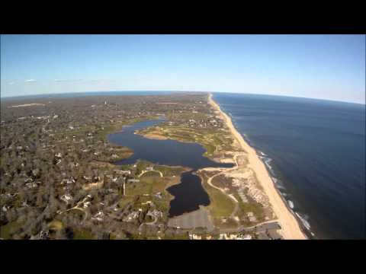

Long Island Community Microgrid Project
Overview
Collaboration with PSEG Long Island, Long Island Power Authority (LIPA), and NYSERDA covering a substation in East Hampton, NY that serves thousands of customers
15 MW of local solar (via Feed-In Tariff) combined with a 5 MW / 25 MWh battery system
50% of total annual energy from local renewables while minimizing use of existing fossil generators, including local diesel peakers and backup facilities
Indefinite and ongoing power backup to multiple critical facilities, including a fire station and two water pumping/filtration facilities
Sets the stage to preempt hundreds of millions of dollars in transmission and fossil generation investments

Slide 23
Configuration Options
Option 1: Dedicated Feeder
  Energy Storage: single large ES facility connected to substation via dedicated feeder
  PV: all connected via the dedicated feeder, regardless of whether from a single solar facility or distributed at critical load sites and/or other sites
  Critical loads: in backup mode, served by the dedicated feeder and its ES & PV facilities
Option 2: Distributed
  Energy Storage: large ES facility connected to substation via dedicated feeder, plus distributed ES facilities located at critical load sites
  PV: at critical load sites and/or other sites, connected via normal feeders
  Critical Loads: in backup mode, served locally by distributed solar + ES. Relevant solar facilities will be shunted to power critical loads and distributed ES facilities directly.
Option 3: Balanced
  Energy Storage: single large ES facility connected to substation via dedicated feeder
  PV: at critical load sites and/or other sites, connected via normal feeders
  Critical Loads: in backup mode, Bank 4 and its feeders island from the transmission grid and shed all non-critical loads. Shedding will be performed via utility-controlled DR, by switching off non-critical load customers.

Slide 24

Option 1: Dedicated Feeder
Critical Load B
Pumping Station
Critical Load A
Fire Station
9EU-4N7
Substation
(Bank 4)
9EU-4N8
ES
Critical Load C
Pumping Station

Slide 25
Option 2: Distributed
Critical Load B
Pumping Station
ES
Critical Load A
Fire Station
ES
9EU-4N7
Substation
(Bank 4)
ES
9EU-4N8
Critical Load C
Pumping Station
ES

Slide 26
Option 3: Balanced
Critical Load B
Pumping Station
Critical Load A
Fire Station
9EU-4N7
Substation
(Bank 4)
ES
9EU-4N8
Critical Load C
Pumping Station

Slide 27
Back-up Slides

Slide 28
LICMP Overview & Goals
The LICMP features 5 MW / 25 MWh energy storage and up to 15 MW of solar serving the two Bank 4 feeders of the East Hampton GT substation. Goals:
  Provide local power backup for the identified critical facilities: two SCWA filter/pumping stations, one Fire District facility
  Optimize the 5 MW / 25 MWh energy storage across cost and energy, utilizing both the local solar and import from transmission at night
  Maximize the interconnection and use of local solar generation, integrating up to 15 MW into Bank 4 of the substation
  Optimize other DER such as Demand Response and Energy Efficiency across cost and energy, in context of the local solar and load profiles
  Minimize the use of local diesel generators (e.g. during summer peaks)
  Prove both the economic and operational viability of the LICMP solution while setting the stage for deferring $100s of millions in Transmission costs
  Serve as a model for the State of NY and across the country (and everywhere else that distribution grids exist)
Notes:
Suffolk County Water Authority filter/pump stations at 127 Oak View Highway and 42 Montauk Highway
Springs Fire District facility at 179 Fort Pond Boulevard

Slide 29
LICMP Area Map

Slide 30
Hunters Point Substation Boundary
Hunters Point Substation Boundary

Slide 31

Hunters Point Reasonable DG Potential = 58 MW, Over 25% Total Energy
DG Potential: Over 25% of Total Load (320,000 MWh)
New PV in Bayview = 30 MW, or 46,000 MWh
New PV in HP Redev Zone = 20 MW, or 32,000 MWh
Existing DG = 8 MW (PV equivalent), or 13,000 MWh
Type | Capacity (Avg. MW) | Output (Annual MWh)
New PV: Commercial + MDUs | 14 | 21,000
New PV: Residential | 13.5 | 21,000
New PV: Parking Lots | 2.5 | 4,000
New PV: Redev Zone | 20 | 32,000
Total New PV | 50 MW | 78,000
Existing PV Equiv. * Includes 2MW biopower from wastewater plant @ 60% capacity | 8 | 13,000
Total DG Potential: | 58 MW | 91,000
Notes:
Existing DG = existing PV @ 1.8MW plus existing biopower @ 6.7MW solar equivalent (2MW @ 60% generating capacity).
Note on wind: Based on the HP Sustainability Plan, Hunters Point has been classified as a “Class 1” wind site. In terms of the economic feasibility of wind energy generation facilities, Class 1 sites are generally considered “very poor” or “poor”. Class 2 is considered “poor.” The Class 1 designation indicates that large scale wind power generation will not be feasible for the site. This is supported by a report commissioned by the California Energy Commission in 2004 that analyzed five locations around the City of San Francisco for wind generation viability. Hunters Point was one of the sites analyzed. The report indicated that out of the five sites, only Twin Peaks has a chance of being viable as a large-scale wind power generation site.

Slide 32


Hunters Point Economic Benefits from 50 MW New DG
$200M in Private Investment + Operations & Maintenance Over 20 Yrs. Equals:
Photo courtesy of GRID Alternatives
Economic Benefits
$200M: Added regional economic stimulation
$100M: Added local wages, near-term plus annual
1,270 Job-Years: New near-term regional employment
520 Job-Years: New ongoing regional employment
$10M: Site leasing income for property owners
$5.8M: Added construction-related state sales taxes
Source: NREL JEDI calculator. Based on average installed cost of $2.75/W(dc) before taxes & incentives using PG&E rates/region.
Notes:
Private Investment + Operations & Maintenance:
$200M investment over 20 years is comprised of near-term plus ongoing operations and maintenance as follows:
1. $165M represents the private investment amount for a 50MW PV system over 20 Years, as follows:
Installation & Construction: $137M ($27.5M per 10 MW)
Dynamic Grid Solutions @ 20% = $27,500
Total = $165K
O&M: $35M represents the O&M costs for a 50MW PV system over 20 years, as follows:
O&M adds $1.48M annually, or $29.7M over 20 years
plus 20% or $5.9M for Dynamic Grid Solutions
Total = $35.6M over 20 years.
Local Employment and Economic Impact:
Specific to MTA – Metropolitan Region.
Refers to PV installed in San Francisco at an average installed cost of $2.75/W(dc) (before taxes and incentives).
Local economic output is calculated as the value of expenditures on goods and services resulting from the project and captured within the study area, and excludes expenditures outside the region, such as to module manufacturers. During operating years local economic output is comprised of payments made by project owners, including the portion of project debt payments made to lenders located within the local analysis area. Payments including incentives, refunds, or revenues to project owners from the sale of energy produced by installed facilities are not included.
Economic activity in input-output models is assessed in three categories:
Salaries and wages for the project on-site labor and direct professional services
Local supply chain revenue related to materials acquisition, manufacture and services, including the local share of revenues from project financing and investment
Induced impacts in the local economy that result from workers salaries and wages
The model’s “output” is the sum of the above three categories for construction and for operations. State-specific multipliers and personal spending patterns are used to derive the results.
Near-term Job years of regional local employment from construction and installation. Ongoing job years in operation and maintenance over 25 years of operation.
Local wages in construction & installation.
The SF successor RDA estimates that 50% of the jobs and economic output will be captured within the boundaries of the city
Equipment and material sales will generate tax revenue as indicated.
NREL's JEDI models classify the first category of results—on-site labor and professional services results—as dollars spent on labor from companies engaged in development and on-site construction and operation of power generation and distribution. These results include labor only—no materials.
Econ impact
NREL JEDI model version PV 10.17.11
NREL JEDI Scenario model PVS 4.5.13
PV PPA pricing
NREL System Advisor Model (SAM) v. 2013.9.20
CEC Cost of Generation Model v.2

Slide 33
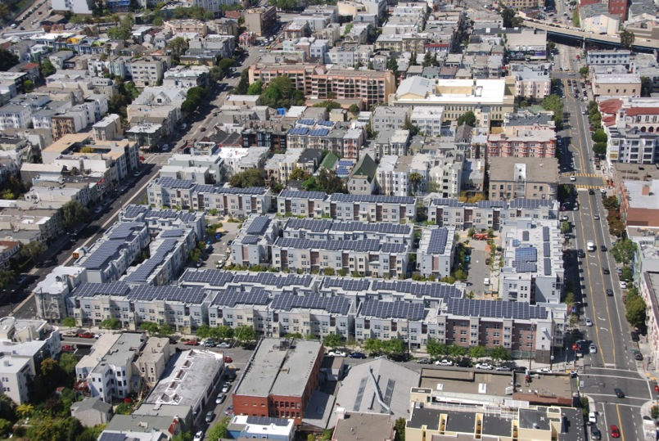
Peek at the Future of Bayview-Hunters Point
Ecoplexus project at the Valencia Gardens Apartments in SF. ~800 kW serving ~80% of the total annual load.
Notes:
33

Slide 34
Virgin Islands Example: Island of St John
6AM: No PV impact
Noon: 20MW PV causes overvoltage
Noon: Advanced inverters set at 0.9 power factor stabilizes voltage
Notes:
Here’s an example from our grid modeling work for the Water and Power Authority of the US Virgin Islands that shows how advanced inverters paired with local solar or storage can manage voltage issues.
High levels of solar PV can cause overvoltage. In the top image, 20 MW of solar has no impact at 6am. In the second image, 20MW of PV causes overvoltage at noon. The third image shows that adding advanced inverters set at 0.9 power factor stabilizes voltage under the same conditions above.
It is worth noting that 20 MW PV means that the PV would essentially be powering the entire Island of St. John at noon on the modeled day. St. John has an average load of about 10 MW and achieving the 25% threshold requires about 12 MWdc of PV. It is also worth noting that the 20 MW of PV has been evenly spread across the three feeders.

Slide 35
St. John Role for ES: Keep Fossil Generators OFF
Feeder | Avg Load | Solar Nameplate | ES Power | Estimated Cost (millions)
 | MW AC | MW DC | MW AC | 15 min | 30 min | 60 min
Feeder 7E | 3.5 | 4.9 | 2.0 | $2.4 | $3.6 | $5.58
Feeder 9E | 4.8 | 6.7 | 3.0 | $3.6 | $5.5 | $8.37
Water Plant | 2.1 | 2.9
Feeder 7E & 9E | 8.3 | 11.6 | 4.0 | $4.8 | $7.28 | $11.16
Feeders 7E, 9E & WP | 10.4 | 14.4 | 5.0 | $4.8 | $9.1 | $13.95

Slide 36
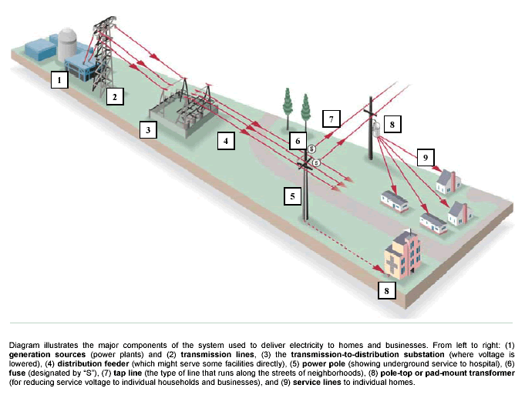
Community Microgrid Initiative: Proving the Feasibility of High DG while Enhancing Grid Quality
Work with five utilities across the US to deploy a Community Microgrid demonstration project at each by yearend-2016
Prove viability of Distributed Generation (DG) providing at least 25% of total electric energy consumed within a single substation grid area
Integrate Intelligent Grid (IG) solutions to ensure that grid reliability is maintained or improved from original level
  IG solutions include diversity and Energy Storage for sure, and potentially, advanced inverters, forecasting & curtailment, and/or Demand Response
Notes:
(cl, 18 Dec 2012)

Slide 37
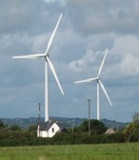

Clean Coalition Objectives
From 2020 onward, all new electricity generated in the U.S. will come from at least:
  80% renewable sources
  50% distributed sources
By 2020, established policies and programs will foster successful fulfillment of the above objectives
Notes:
37

Slide 38

Benefits of Modernizing the Grid
Power Quality, Reliability & Resilience benefits
  Increased customer satisfaction
  Improved equipment longevity
  Sustained vital services in otherwise complete blackout scenarios
  Avoided transmission & central generation vulnerabilities
Economic benefits
  Significant private-sector investment
  Substantial local job creation
  Fixed electricity prices for 20+ years
  Localized energy spending
  Avoided inefficiencies of central generation & transmission
Environmental benefits
  Avoiding dirty power generation, including nasty peaker plants that are often sited in underserved communities
  Utilizing built-environments and disturbed lands for generation projects
  Preserving pristine environments from transmission lines and other infrastructure

Slide 39
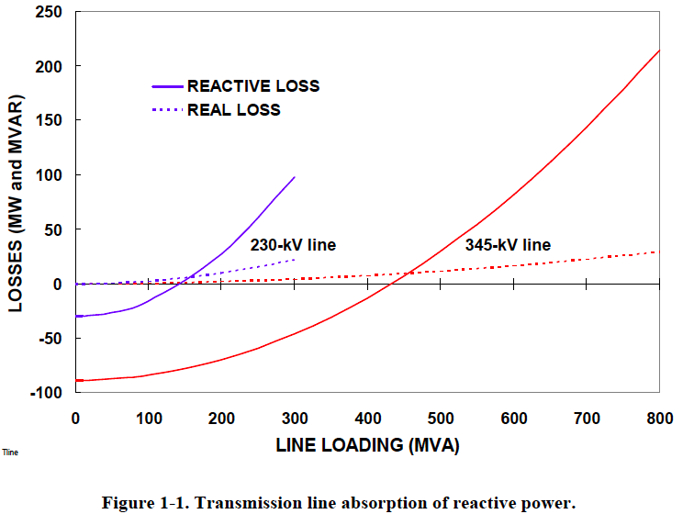
Distributed Voltage Regulation – Location Matters
“The old adage is that reactive power does not travel well.”
        Oak Ridge National Laboratory (2008)
T&D lines absorb 8-20x more reactive power than real power.
Prevent Blackouts:
When a transmission path is lost, remaining lines are heavily loaded and losses are higher.
Source: Oak Ridge National Laboratory (2008)
Notes:
Reactive power does not travel well.
This chart shows that reactive power has 8-20 times higher line losses than real power.
Also shows much higher transmission line vs. distribution line losses.
When a transmission path is lost, remaining lines are heavily loaded and losses are higher.
Expert audience notes:
The zero crossing of the reactive losses lines are the Surge Impedance Loading (SIL) points at which there is a balance between producing and absorbing reactive power.
When conducting power below its SIL, the line is primarily capacitive and supplies reactive power, tending to raise system voltages (same thing capacitor banks are used for). When the line carries more power than the SIL, it tends to absorb reactive power, lowering system voltages (same thing motor loads do).
The reactive impedances in a transmission systems are typically 8-20 times larger than real impedances, hence reactive losses are much higher, especially when lines carry higher power above the SIL.
Source: “Local Dynamic Reactive Power for Correction of System Voltage Problems,” Oak Ridge National Laboratory, September 2008

Slide 40
Potential Transmission Savings for California
Business as Usual 20 Year Levelized TAC = 2.7¢/kWh
Business As Usual TAC Growth
2.7
Current TAC
Rate (TAC₀) = 1.5¢/kWh
TAC₀ O&M Level
Business as Usual TAC Growth TAC₀ Depreciated Avoided TAC Opportunity from DG
Notes:
This chart shows the potential for ratepayer transmission savings by increasing reliance on Distributed Energy Resources.
NOTES:
This chart shows the potential to reduce Transmission Access Charges by increasing DER
All energy that uses the T-Grid requires payment of TACs.
Right now, CA ratepayers pay 1.5 cents per kWh
The 20 year levelized cost of TAC charges is 2.7 cents per kWh in current $
The lower slope is alternative. If from this point forward, if we only added generation on the distribution grid, the blue line shows how TACs would decrease as existing investments depreciate over the next 20 years. Eventually, we’d only pay basic operating and maintenance costs. We’d also avoid stranded costs (anything we put into the t-grid becomes stranded costs as we transition to DG.)
The green triangle represents the potential savings as the difference between business as usual and a DG future.
The High Voltage TAC currently is charged at $8.86/MWh and is consistent throughout the CAISO system. The Low Voltage TAC applies to the CAISO operated portion of systems within each individual utility service territory. For PG&E the use rate charged is currently $6.057/MWh, resulting in a total 2013 charge of $14.92/MWh (1.492¢/kWh). While the threshold definition of sub-transmission voltage and ISO operation varies between utilities, comparable cost allocation occurs either through ISO charges or internal utility accounting.

Slide 41
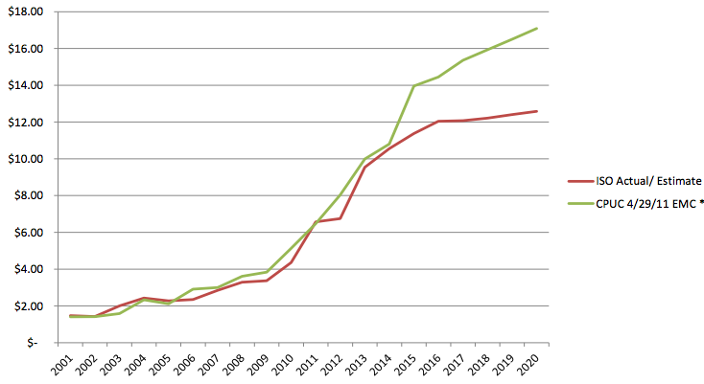
Opportunity: Shift Costs from Transmission to Distributed Energy Resources & Distribution Grid Hardening
Under a business as usual scenario, new incremental transmission investments will reach $80 billion over the next 20 years, imposed on California ratepayers
Levelized over 20 years, this approaches 3 cents/kWh – or roughly 25% of the wholesale cost of electricity, or 33% of the energy price of centralized solar
Avoiding half of these charges, for example, would free up roughly $40 billion for modernizing the distribution grid incl. local renewables, storage, etc.
Historical and Projected High Voltage Transmission Access Charges ($/MWh).
Does not include Low Voltage Transmission Access Charges.
Source: Palo Alto Utilities
Notes:
Today, levelized transmission costs associated with solar delivered over high voltage transmission adds 33% to the contract energy price, or 2.7¢/kWh. With transmission costs forecast to rise at >7% per year, in ten years the cost of transmission will exceed the cost of energy.
Driven by high cost of new transmission
TAC rates have increased at an annualized rate exceeding 15% since 2005 as new transmission dependent generation has been approved, and new transmission capacity is far more costly than maintaining existing capacity. CAISO mid value estimates for the rate of increase in TAC charges will be substantially less than the recent trend and prior CPUC estimates, as illustrated below. Utilizing CAISOs current projected average future estimate of 7% nominal escalation (5% real) over the next 20 years, the levelized current value of avoidable TAC charges applicable to a 20 year DG PPA is 2.4 ¢/kWh.
The original data on TAC growth was provided by the City of Palo Alto municipal utilities. We independently verified their results with ISO data, and our findings were confirmed by Navigant Consulting, who have performed related analysis for clients. These results have been presented in numerous forums and in formal comments in multiple proceedings over the past two years without contradiction. A recent update by the Palo Alto Utilities put this figure at 2.7¢/kWh, and this value is used by the utility in bid equalization and avoided cost basis for local procurement

Slide 42
Utility of the Future? “Distribution System Operator”
The Distribution System Operator (DSO) will:
In real time, reliably operate the local distribution system, optimizing all Distributed Energy Resources (DER): micro-grids, diverse small-scale generation, self-optimizing customers, energy storage, power flow control devices, demand response, etc.
Create a more stable and predictable interchange with the Transmission System Operator (TSO) that relies on more local balancing of resources
Source: 21st Century Electric Distribution System Operations, May 2014, by Lorenzo Kristov of CAISO and Paul Di Martini of the Caltech Resnick Institute
Notes:
The key quotes and diagram shown in this slide are taken from a paper published in May 2014 by Lorenzo Kristov of CAISO and Paul Di Martini of the Caltech Resnick Institute.

Slide 43
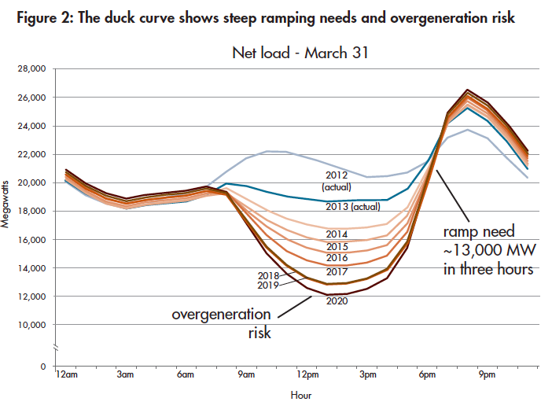
Is this Duck Real or a Decoy for Natural Gas?
Source: CAISO/NERC report (Nov 2013)

Slide 44
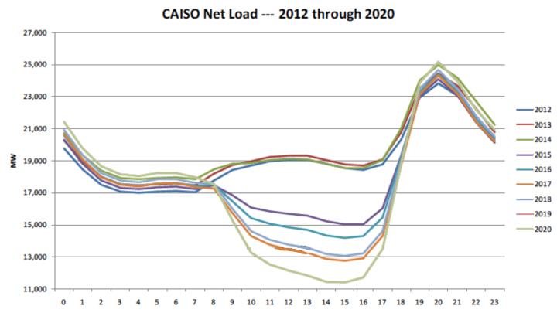
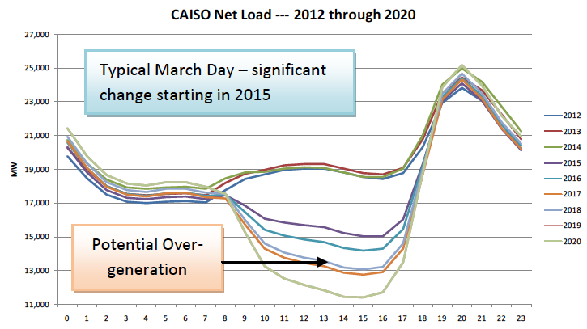
The California ISO Duck Chart (2012 – 2020)
13,100 MW 5-8pm
5,300 MW 8-11am
Potential
over-generation
Notes:
The California Independent System Operator (CAISO) created the “Duck Chart” to show how high levels of solar could result in system balancing issues starting in 2015 as California approaches the 33% RPS in 2020. CAISO has proposed procurement of “flexible capacity”, especially natural gas, to address the steep ramps and over-generation issues that may occur in the shoulder months as solar comes online in the mornings and tapers off in the evenings.
However, integrating renewables with natural gas is a step backwards from California’s clean energy and GHG goals. Further, the Loading Order requires California to procure low carbon resources before fossil resources.
NOTES:
The Duck Chart shows a typical March day, with each line representing a different year, from 2012 – 2020.
The bottom x-axis represents time of day, starting at midnight and ending at midnight.
The left y-axis shows net load in MW, meaning load minus wind and solar generation.
The chart shows that the shape of the net load curve begins to shift dramatically in 2015 due to increasing solar generation.
Potential over-generation shown starting in 2018 in the afternoon as net demand within CAISO territory would be lower than supply of inflexible, conventional base-load resources that are expensive to turn off – such as nuclear and less flexible natural gas. (March and April are more extreme cases because solar intensity is relatively high but the summer air conditioning needs haven’t kicked in.)
The annotations shows the periods during this March 2020 day with sharp changes in net demand.
1st – the quick 5,300 MW drop in net load from 8am-11am, as the sun rises and solar generation comes online
2nd – the steep rise of 13,100 MW in net load from 5pm-8pm, as the sun sets and solar output declines
44

Slide 45
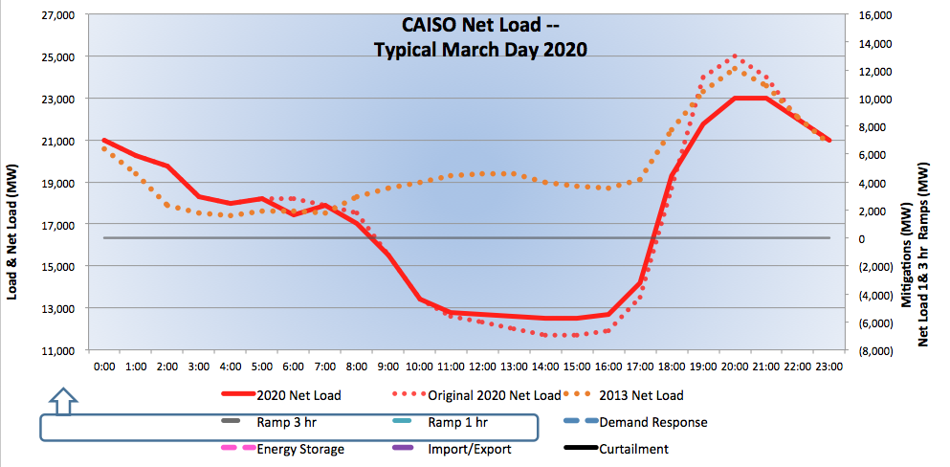
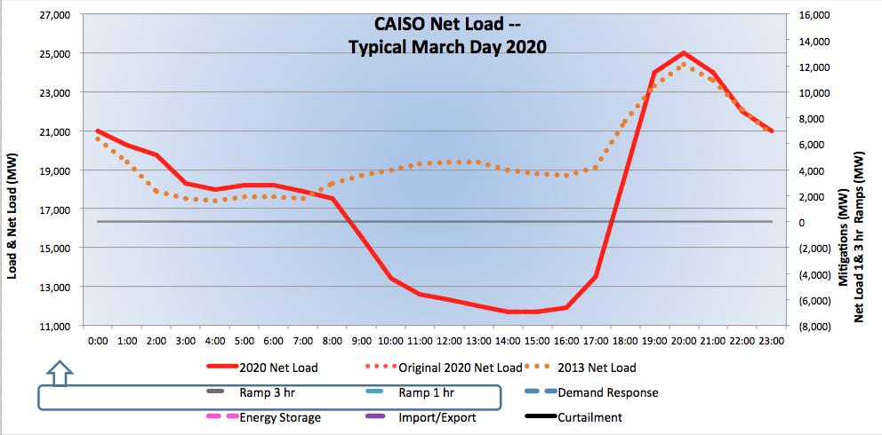
CAISO Duck Chart (2020 Issues)
13,100 MW 5-8pm
5,300 MW 8-11am
Potential
over-generation
Notes:
The Clean Coalition has developed a model to illustrate how California can integrate renewables in 2020 with dynamic grid solutions.
The red line shows the 2020 net load curve, while the orange dotted line shows the 2013 net load for comparison.
Please note that while the projections of net load on this chart are from the CAISO Duck Chart, the following slides show Clean Coalition’s projections of potential solutions. The assumptions are available in the back-up slides.
45

Slide 46
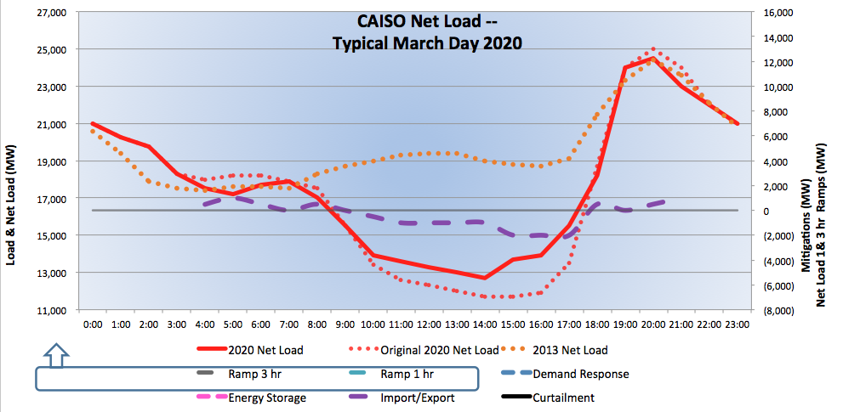
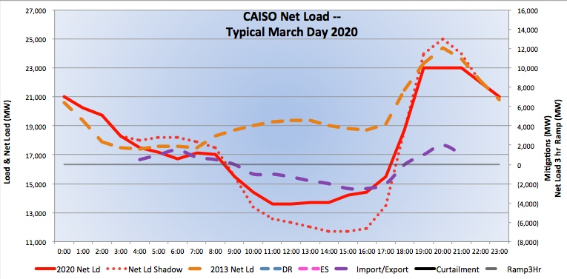
Flattening the Duck – Import/Export
Import/Export
Need to study how much California can export, expected pricing, and whether additional regional coordination is advisable
Notes:
First it’s important to remember that the original CAISO chart only includes net load for CAISO territory. Once you remove this limitation, the picture looks much less extreme.
The new Energy Imbalance Market will help to facilitate exports, but we still need a study to determine how much California can rely on exports for resource planning purposes.
NOTES:
From CAISO/NERC 2013 report: The potential to export excess generation to neighboring BAs during low system demand periods may be feasible but impractical, because other BAs may need to keep a portion of their dispatchable resources on-line to meet load changes and comply with mandatory control performance standards.
The purple dashed line shows imports/exports of renewables in MWs reflected on the scale to the right.
The dotted red line shows the old net load curve, while the new red line shows how Import/Export helps smooth the ramps in MWs reflected on the scale to the left.
46

Slide 47
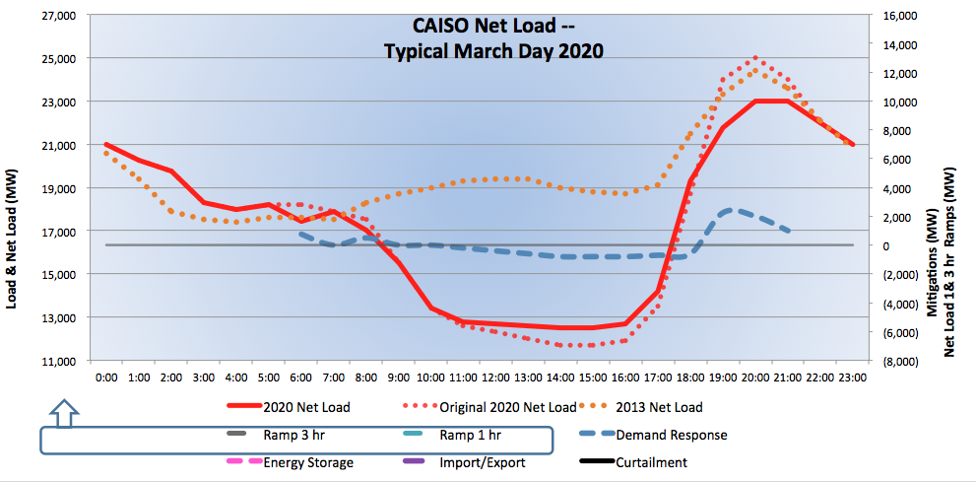
Flattening the Duck – Demand Response
Demand Response
California set a target of 1.5 million electric vehicles by 2025,
representing an additional load of 10,000 MW
Notes:
Demand response programs can incentivize customers to shift power consumption away from high net demand periods (flattening the head of the duck) and towards low net demand periods (lifting the belly of the duck). The blue dashed line shows demand response in MWs reflected on the scale to the right. The dotted red line shows the old net load curve, while the new red line shows how DR helps smooth the net load profile.
We recommend that policymakers prioritize identifying DR resources available to address these needs and the necessary pricing to incentivize customer participation. This is necessary since it’s not immediately obvious to policymakers or aggregators which commercial and industrial loads will be available to shift away from the early evenings and towards mid-day hours, and what price signals will be necessary.
For example, electric vehicles can act as a combination of distributed storage and demand response, responding to pricing signals to charge during hours of low net demand and dispatching energy to address high net demand. Since Governor Brown issued an Executive Order that established a target of 1.5 million zero-emission vehicles on the road in California by 2025, the CPUC has found that sending the right price signals to EV owners will be critical. The next step is for California agencies to determine how much demand response with EVs and other loads can modify the net load profile and what programs and pricing will be necessary to accomplish this task.
Source for poiint that EV target represents 10,000 MW of additional load – CPUC Vehicle-Grid Integration white paper (October 2013)
NOTES:
Negative DR = increase load
Positive DR = reduce load
Slide assumes a net load reduction of 1,600 MW from DR. More details in back-up slides
47

Slide 48
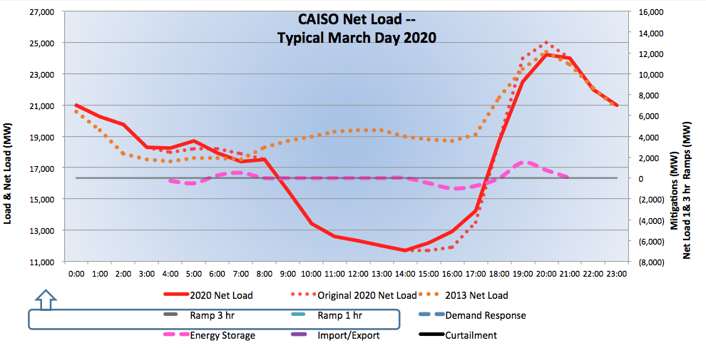
Flattening the Duck – Energy Storage
Energy Storage
California set a target of 1.325 GW of new cost-effective storage by 2020
Notes:
Energy storage can similarly charge during hours of low net demand and dispatch energy to the grid when desirable to address high demand, as illustrated by the dashed pink line. It is also an ideal resource for addressing minute-by-minute balancing needs
The dotted red line shows the old net load curve, while the new red line shows how ES helps smooth the net load profile.
Slide assumes a 1,500 MW maximum charge (below line) & 1,000 MW max dispatch (above the line) from ES.
48

Slide 49

Flattening the Duck – Curtail Solar
Curtailment
Can also curtail baseload by scheduling maintenance during shoulder months
Notes:
At times, it may be cost-effective to strategically curtail some solar generation to reduce the steep angle of the change in net demand.
First, curtail baseload, schedule maintenance during shoulder months.
Solar curtailment costs include increasing solar procurement to make up for curtailed energy to comply with an RPS.
Slide assumes a net reduction of 1,500MW solar generation. More details in back-up slides.
49

Slide 50
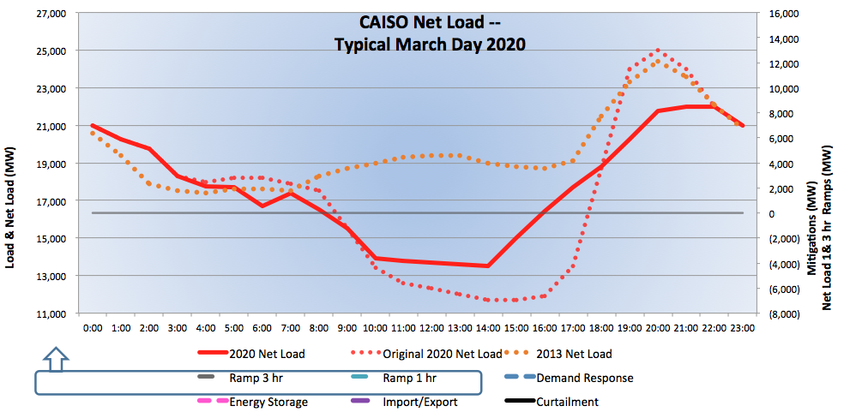
Flattening the Duck – Aggregated Solutions
The reflected aggregated solutions include imports/exports, demand response, energy storage, and solar curtailment
Notes:
With all solutions in place, the changes in net demand are very manageable.
The dotted red line is the original net load curve, and the solid red line is the new curve once all solutions are delivered. The orange dashed line is the 2013 net load for comparison.
50

Slide 51
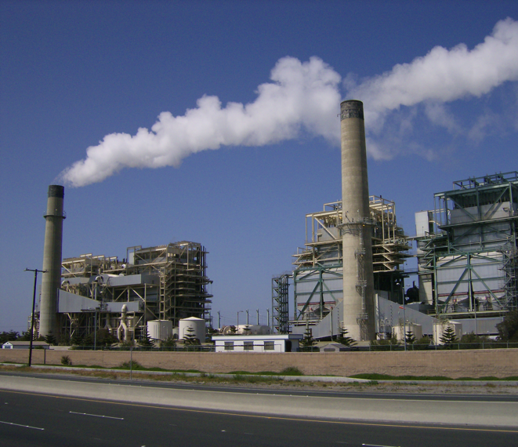
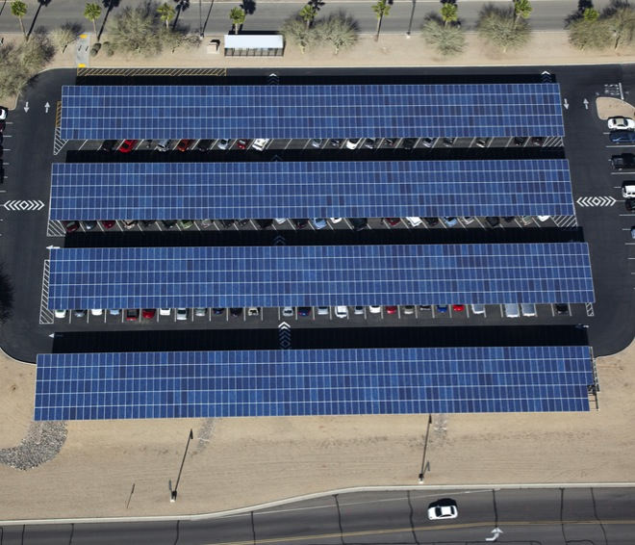
Replace SONGS – DG/Storage + Advanced Inverters
vs.
$80 million
2 Synchronous Condensers
San Luis Rey Substation
450 MVAr
(minus line losses = 400 MVAr)
800 MW of DG solar + storage with advanced inverters, oversized by 10% set at 0.9 Power Factor = 400 MVAr
CAISO proposed 320 MW DG solar + 580 MW storage = 900 MW (plus 1,400 MW of nat gas)
Notes:
SONGS provided a large amount of reactive power for voltage regulation in Southern California.
Local solar PV paired with advanced inverters can cost-effectively both reduce load on transmission lines and provide large amounts of reactive power 247/365 without reducing the amount of real power it provides while the sun shines.
For example, 570 MW capacity of PV with advanced inverters oversized by 10% at 0.9 power factor could provide the same amount of reactive power as the Huntington Beach synchronous condensers.

Slide 52
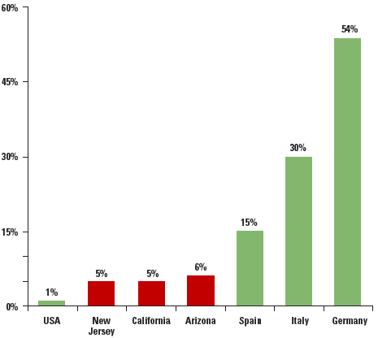
Renewables + Intelligent Grid Solutions = Reliable
The German power system, which incorporates enough rooftop solar to meet half the country's peak energy needs, set a global reliability record in 2011.
2012 Solar PV Capacity as % of Peak Demand
Source: Union of Concerned Scientists, SEIA 2013
Notes:
Although renewables are often said to cause reliability issues, global experience proves this untrue. The German power system, which incorporates enough rooftop solar to meet half the country's midday energy needs, set a global reliability record in 2011 with only 15.31 minutes of downtime. What's even more impressive is that Germany -- the world's fourth largest economy and home to a heavy industrial base -- demands enormous amounts of reliable power, and distributed renewables have delivered.
52

Slide 53
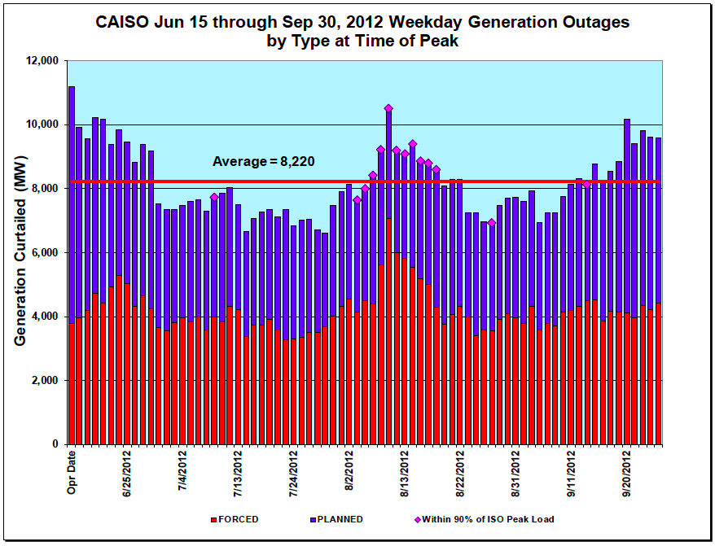
Natural Gas Has Integration Costs
Natural gas plants often shut down unexpectedly, forcing energy consumers to foot the bill for reserves and frequency response.
  Source: CAISO Summer Loads and Resources Assessment (2013)
More than half of the outages associated with conventional generation are unplanned
Notes:
NOTE: This chart does not include solar or wind generation. SONGS outages are shown as planned outages since “forced” outages are due to “unanticipated failure”.
53

Slide 54
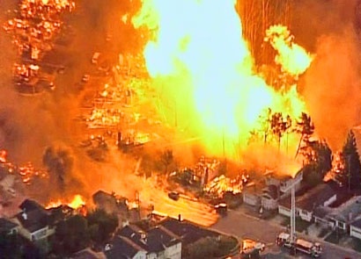
Natural Gas Is Not The Solution
Future generations will be asking what we were thinking (or smoking). You allowed massive quantities of toxic chemicals to be injected into the earth, and to contaminate ungodly volumes of water, in pursuit of a highly flammable gas that would be routed through your neighborhoods and into your homes?! WTF?
2010 San Bruno natural gas pipeline explosion
Notes:
Data from: (Investing in Grid Modernization, Perfect Power Institute, Feb 2013)

Slide 55
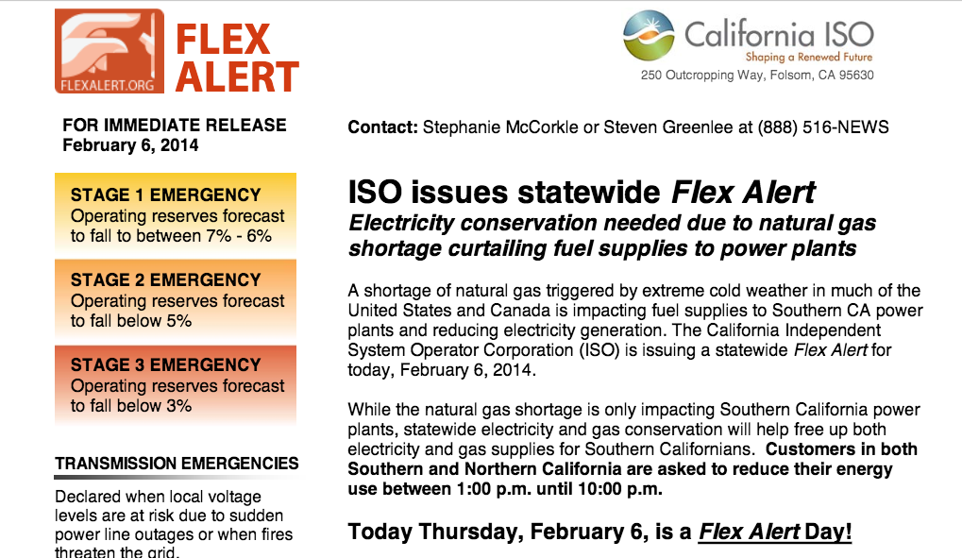
Natural Gas Is Not Reliable

Slide 56
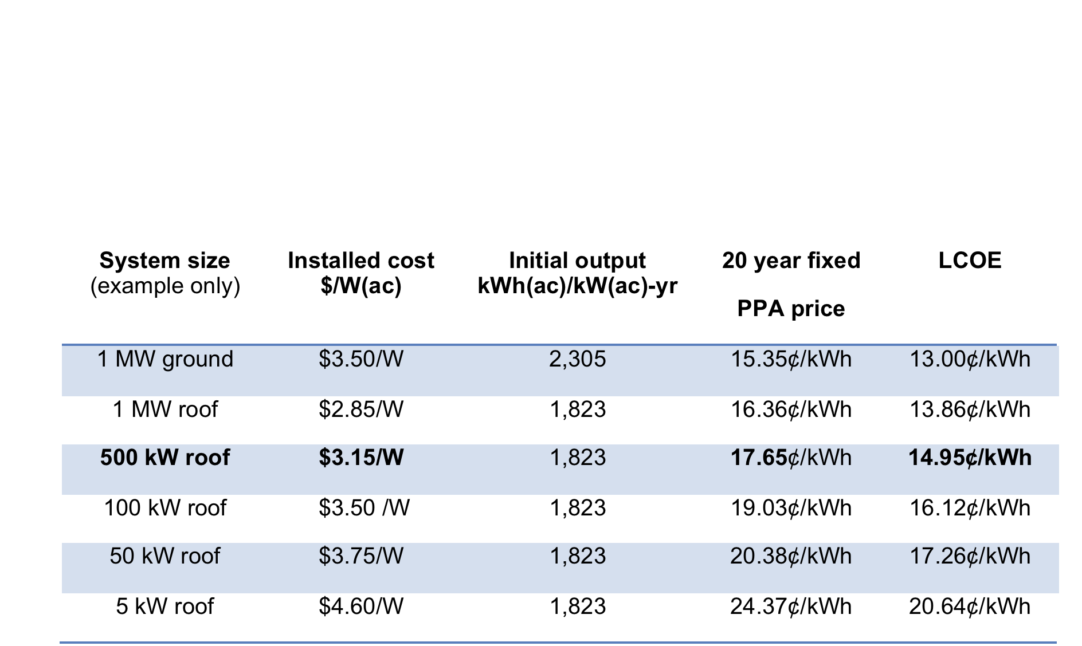
Hunters Point Scale: Cost Benefit
Hunters Point Solar LCOE is less than CCNG
500 kW Solar achieves lower LCOE than new natural gas generation – Hunters Point average expected commercial size = 650 kW
SOLAR
Busbar wholesale cost from plant
2015: $11.7 ¢/kWh
2024: $17.1 ¢/kWh
2034: $21.7 ¢/kWh
LCEO: $15.4 ¢/kWh
NATURAL GAS
Source: CEC, 2010
Notes:
PV 20 year LCOE is based on the estimated installed cost of the example system size
Modeling performed with NREL System Advisor Modeling and PVWatts standardized system design.
CCNG20 year LCOE is determined by the CEC Cost of Generation Model v.2 for new facilities COC 2015

Slide 57
Zero Net Energy is Key Driver for Smart Buildings

Slide 58
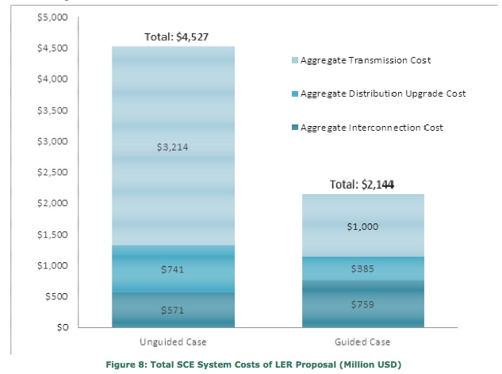
Guided Siting: Locational Value, Interconnection
SCE Share of 12,000 MW Goal
Locational Value methodology should include transmission costs.
Interconnection policies should favor high value locations, reduce cost uncertainty for developers.
Guided Siting Saves Ratepayers 50%
Source: SCE Report May 2012
Notes:
The CPUC has contracted a study 2 years ago on comparing locational value within the distribution system, but ignored comparing D-grid locations to transmission interconnection and the cost of delivering power to load. We commented on this a year ago at the last workshop (TACs and new transmission costs) but there has been zero public action since. ALL reliable peak shaving that occurs on the D-grid avoids the need for transmission capacity to meet that peak load, plain and simple. And EVERY DG kWh serving local load avoids TAC delivery charges for ratepayers. There's a reason TACs only apply to energy using the transmission system, as it's important to recognize that energy using transmission creates extra costs that are avoided by DG.
Interconnection Cost Averaging could be broadly applied. The weak IOU proposal only applied to low cost locations, but these are the more urban/close-to-load locations and it still gets the door open on the first US flat rate d-grid upgrade charges for WDG.
At least as important is our separate but related Cost Certainty proposal - where studies are required, offer a binding cap based on 125% of the estimated cost. This "not to exceed" study result would greatly reduce the risk and uncertainty around interconnection.
Notes on graphic:
A May 2012 study by Southern California Edison found that T&D upgrade costs for their share of the Governor’s goal of 12,000 MW of distributed generation could be reduced by over 50% from the trajectory scenario. The lower costs were associated with the “guided case” where 70 percent of projects would be located in urban areas, and the higher costs were associated with the “unguided case” where 70 percent of projects would be located in rural areas.
The Impact of Localized Energy Resources on Southern California Edison’s Transmission and Distribution System, SCE, May 2012
All interconnection and upgrade costs are ultimately included in energy prices and T&D charges reflected in rates
The goal of new cost arrangements in this proceeding should be to reduce rates through optimal use of grid capacity and cost-effective interconnection policies for lower net cost of delivered energy
Billions of dollars in avoided transmission may be saved if investments are cost-effectively redirected to enable generation close to loads within the local distribution system

Slide 59
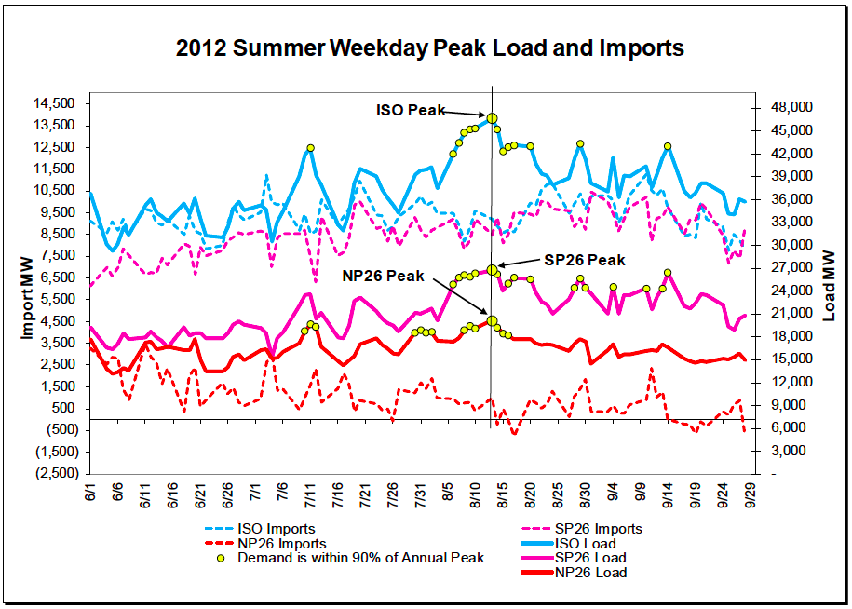
Import/Exports – Transmission Not the Issue
2012 Peak Daily ISO Imports = ~11,500 MW
Source: CAISO 2013 Summer Loads & Resources Assessment (May 6, 2013)
Notes:
2012 summer weekday peak imports by CAISO (~8,000 to 11,500 MW) show that transmission capacity is not the issue for imports/exports.
However, CA has not traditionally exported significant levels of energy. CA needs to study the potential for other balancing authorities to accept our exports, taking into account the needs of other BAs, and existing and potential policies to facilitate greater levels of exports.
59

Slide 60
Advanced Inverters – Reactive Power
Advanced Inverter at 0.9 Power Factor = 43.6% reactive power
REACTIVE (Q)
P: Real power (kW)
Q: Reactive power (kVAr)
S: Total power (kVA)
S
100%
Q
43.6%
REAL (P)
100 kW solar PV AC power
100 kVA inverter capacity
0.9 power factor
43.6 kVAr reactive power
90 kW real power
P
90%
Standard-sized inverter:
Diverts up to 10% solar capacity to provision reactive power
Notes:
The unity power circle shows that an advanced inverter at 0.9 power factor (as set in Germany) can provision 44% of its nameplate capacity reactive power while diverting only up to 10% of solar real power capacity.
Percentages refer to percent of rated AC power

Slide 61
Advanced Inverters – Reactive Power (Oversized)
REACTIVE (Q)
P: Real power (kW)
Q: Reactive power (kVAr)
S: Total power (kVA)
S
110%
100 kW solar PV AC power
110 kVA inverter capacity
0.9 power factor
45.8 kVAr reactive power
100 kW real power
Q
45.8%
REAL (P)
P
100%
Oversized inverter:
No reduction of PV real power
Draws up to 10 kW real power from the grid
Provides reactive power 24/7/365
Notes:
When the inverter is oversized, it allows all of the DG power to be put into delivering real power back to the grid, maximizing the system owner’s revenue.
When reactive power is needed, real power can be drawn back from the grid and redirected into reactive power to assist in voltage regulation. This can be done at any time, even when there is no power coming from the DG, e.g. at night on PV systems.
The unity power circle shows that an advanced inverter at 0.9 power factor (as set in Germany) can provision 46% of its nameplate capacity as reactive power while drawing up to 10% of its nameplate capacity of real power from the grid.
Percentages refer to percent of rated AC power

Slide 62
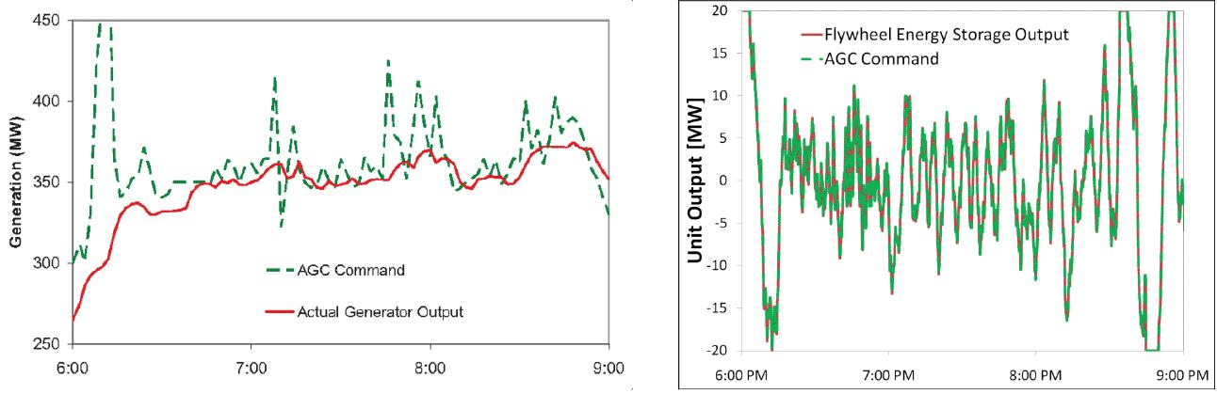
Regulation: Faster, More Accurate Solutions
Ideal flexible resources should look like storage, not natural gas –
faster, more accurate, cleaner, and full capacity to dispatch and absorb power.
Flywheel Storage
Conventional Spinning Generator
Storage provides both supply and demand
Faster and more accurate regulation = less MW required
Notes:
62

Slide 63
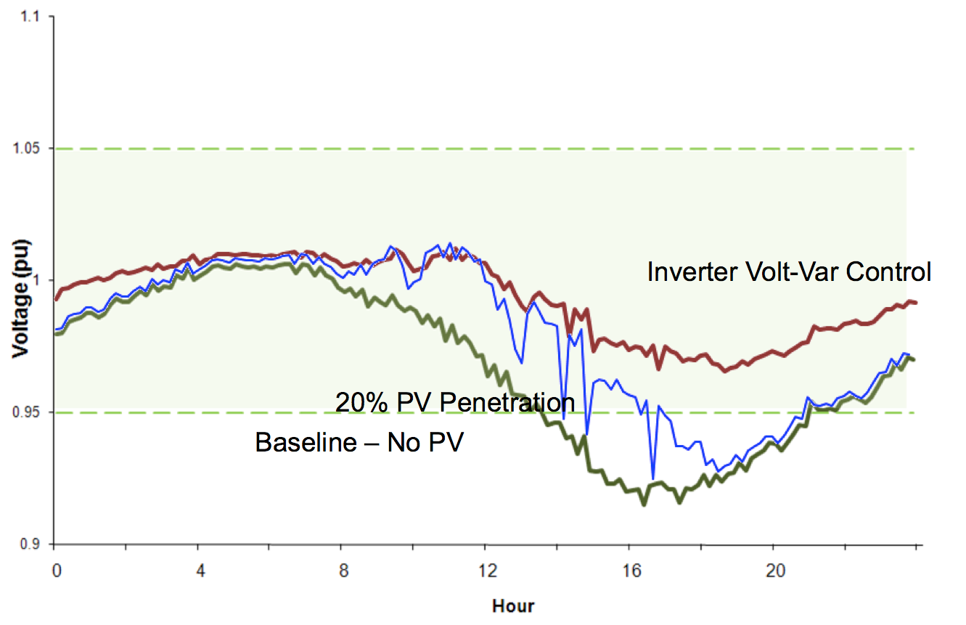
Advanced Inverters Keep Voltage in Balance
Advanced inverters have been programmed to deliver reactive power in Germany and Georgia Power’s territory.
Proposed changes to IEEE 1547a and UL standards will allow advanced inverters to provide reactive power for voltage regulation in California.
Source: EPRI (2011)
Notes:
The chart above shows how solar paired with advanced inverters keeps voltage within appropriate boundaries.
Green line shows baseline local voltage dipping below the bounds in a particular location
Blue line shows local voltage with 20% PV penetration (max solar output to peak). Voltage is still dipping below optimal bounds when less sunlight is available.
Red line shows local voltage regulated by solar with advanced inverters. When there’s less sun available to provide real power to keep voltage high enough, the advanced inverters draw real power from the grid and convert it to reactive power to keep voltage within the optimal range.
Advanced notes:
Source of graphic: Advanced Voltage Control Strategies for High Penetration of Distributed Generation, EPRI 1020155, Figure 4-28 Secondary Voltages at a Customer on the Feeder
Voltage levels fall later in the day during periods of peak demand. More demand → lower voltages.
For high-pen of local generation, over-voltages are a bigger concern. Use storage or AI reactive power to lower voltages.
Reactive power can both raise and lower voltage.

Slide 64
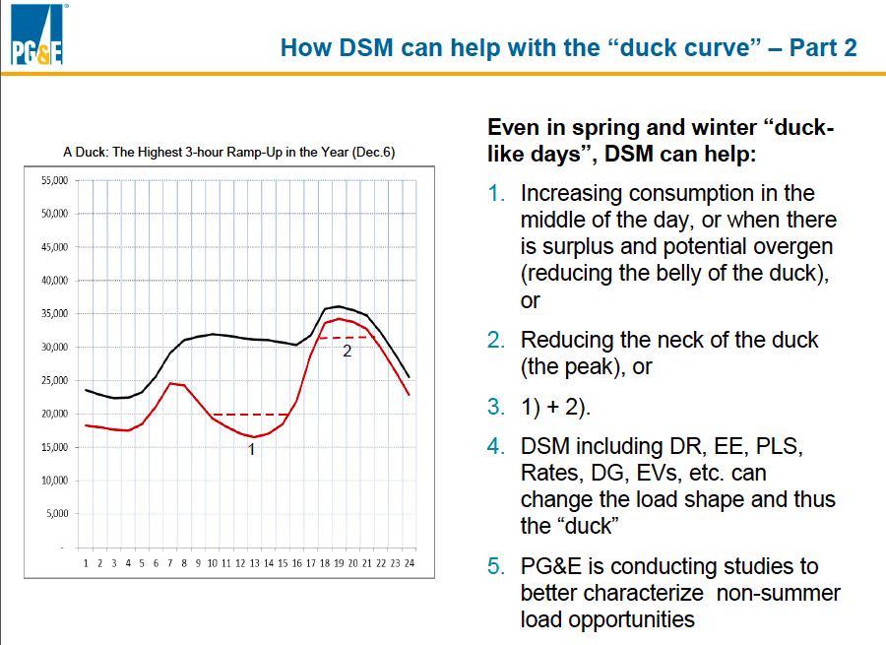
Flattening the Duck – Demand Response
  Source: PG&E and CPUC meeting 12/11/2013
Notes:
PG&E supports this approach as a very cost-effective way to address the Duck curve and is exploring non-summer load shifting opportunities.
64

Slide 65
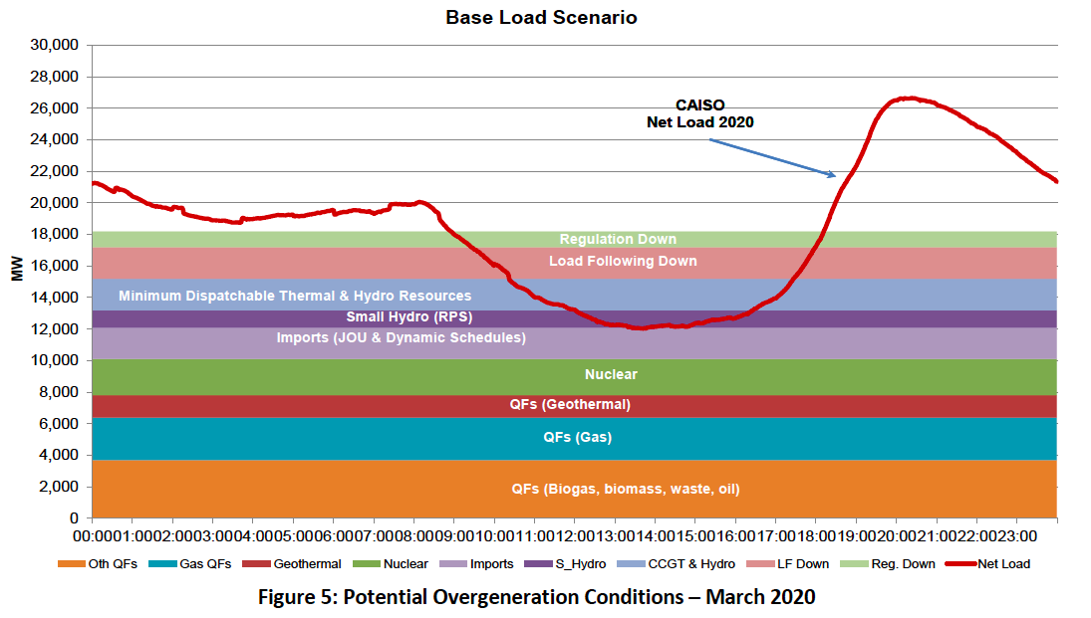
Flattening the Duck – Curtail Baseload
Source: CAISO/NERC variable resources integration report (Nov 2013)
Notes:
Notes:
QFs gas = CHP
CAISO plans on exploring ways to incentivize Qualifying Capacity (QFs) to curtail production during low net load demand periods in order to minimize the magnitude of potential over-generation. (From 2013 CAISO/NERC report.)
65

Slide 66
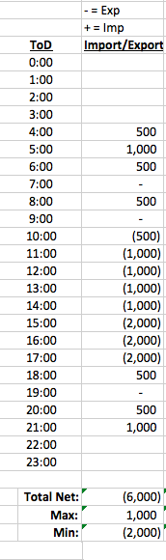
Import/Export Assumptions
Notes:
The original CAISO chart only includes energy available in CAISO territory. Once you remove this artificial limitation and account for imports and exports of energy in and out of CAISO territory, the picture looks much less extreme.
The dotted red line shows the old net load curve, while the new red line shows how Import/Export helps smooth the ramps.
Slide assumes a net export of 5,750MW. More details in back-up slides
66

Slide 67
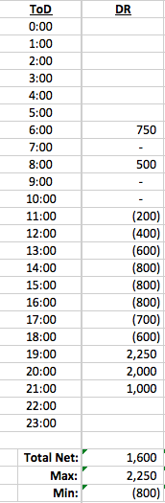
Demand Response Assumptions
Notes:
Demand response programs can incentivize customers to shift power consumption away from high net demand periods (head of the duck) and towards low net demand periods (belly of the duck), as shown by the blue dashed line shows demand response in MWs reflected on the scale to the right.
The dotted red line shows the old net load curve, while the new red line shows how DR helps smooth the net load profile.
Slide assumes a net load reduction of 1,600 MW from DR.
67

Slide 68
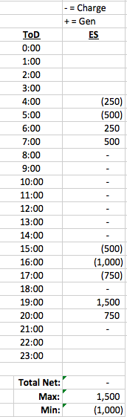
Energy Storage Assumptions
Notes:
Energy storage can similarly charge during hours of low net demand and dispatch energy to the grid when desirable to address high demand, as illustrated by the dashed pink line.
The dotted red line shows the old net load curve, while the new red line shows how ES helps smooth the net load profile.
Slide assumes a 1,500 MW maximum charge (below line) & 1,000 MW max dispatch (above the line) from ES.
68

Slide 69
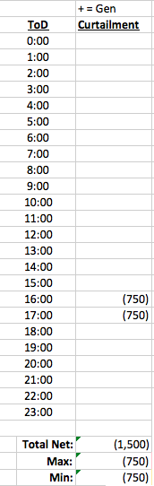
Curtailment Assumptions
Notes:
At times, it may be cost-effective to strategically curtail some solar generation to reduce the angle of the change in net demand.
(Note that this assumes that exports have been maximized and all cost-effective and available demand response and energy storage have been employed.)
Slide assumes a net reduction of 1,500MW solar generation.
69

Slide 70

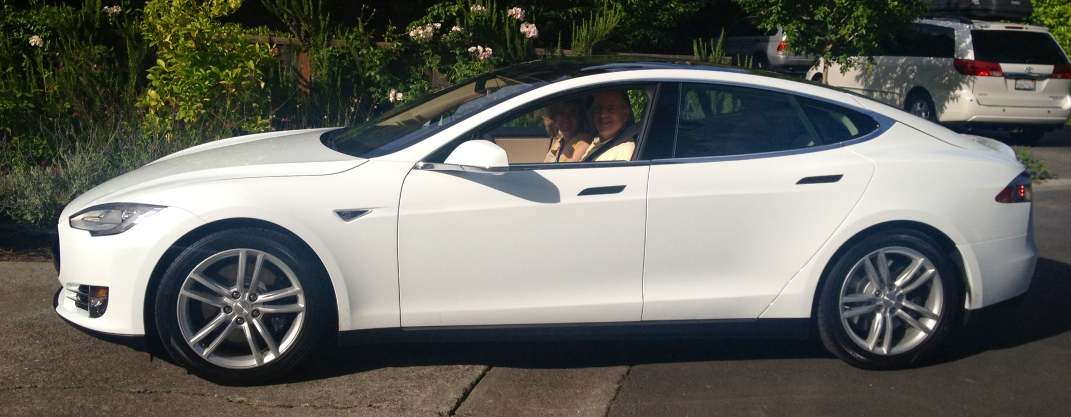
The Fossil Free Future is Arriving
Notes:
(sw 2, 19 Jan 2012)
70

