Slide 1
Distributed Generation + Intelligent Grid
Optimizing Value for Ratepayers
Craig Lewis
Executive Director
Clean Coalition
650-796-2353 mobile
craig@clean-coalition.org
22 August 2013
Notes:
(ac_1, 15Sept2011)

Slide 2
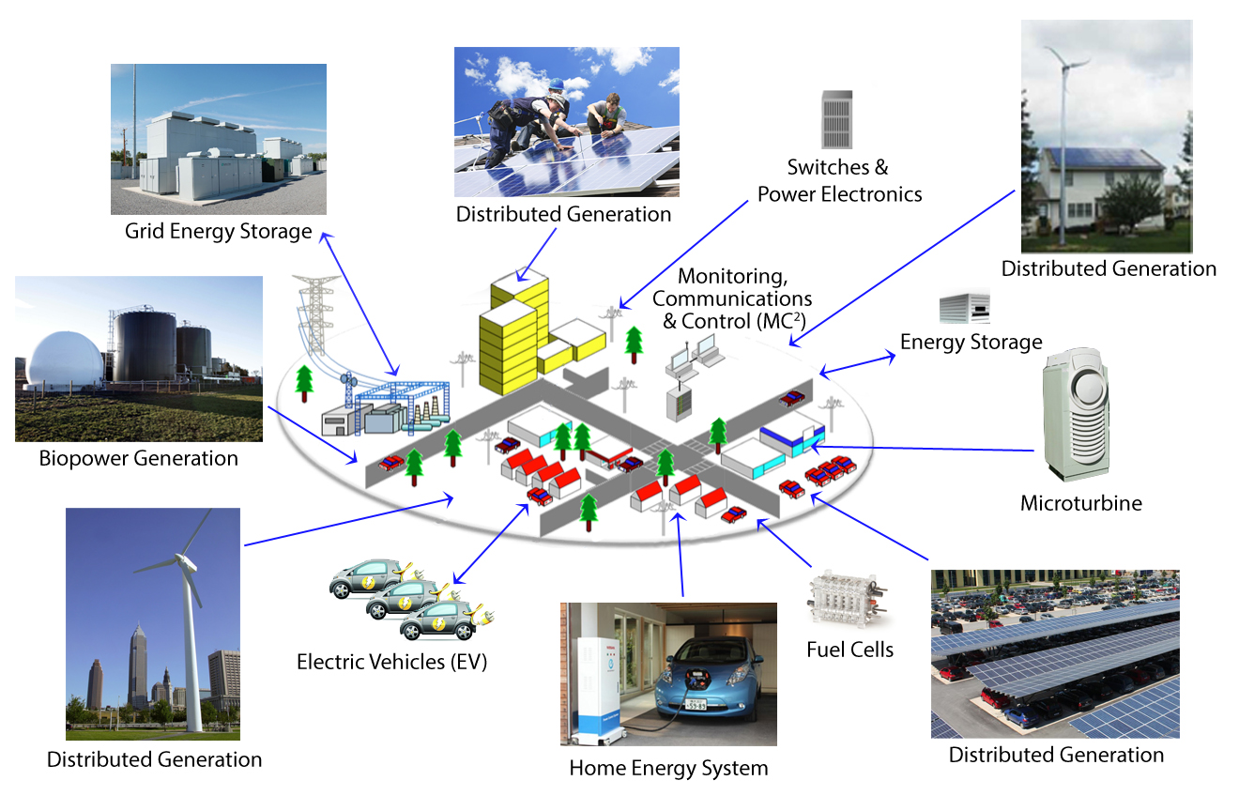
Clean Coalition Vision = Clean Local Energy
Notes:
(cl_04a, 12 Jan 2012)
To lay the groundwork, this slide represents the ultimate Clean Coalition vision.
This is what a smart energy future looks like.
The key components will be:
Distributed Generation + Demand Response + Energy Storage + Electrical Vehicle + overall Monitoring Communications and Controls or MC2 for short.
The Clean Coalition envisions a future where these components are no longer treated as independent silos. These components will work seamlessly together, using information technology to locally control, create and balance supply and demand of electricity.
What this slide also shows is the huge market opportunity for the transition. There is a $6 trillion dollar energy market AND it will transition to a smart energy future – and there are three key drivers behind that:
Economic sensibility
Energy security
Environmental sustainability
Regardless of your political affiliation, one of these drivers or a combination there of, will take us to this future.
The only question is how painful will this transition be, how fast will it happen, and who’s going to win all the economic benefits.
2

Slide 3
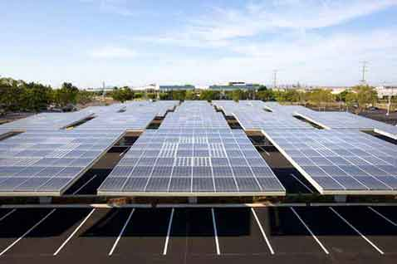
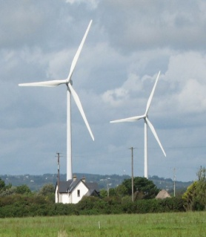
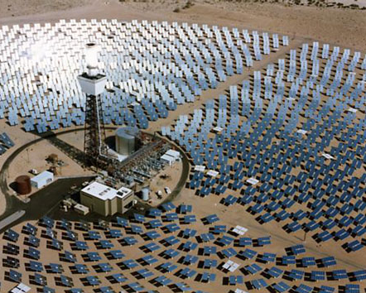
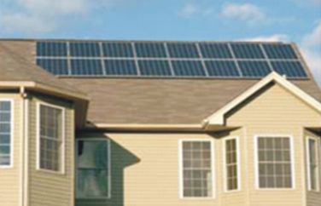
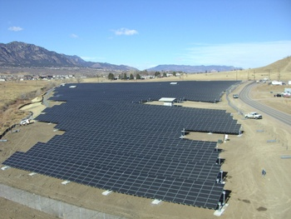
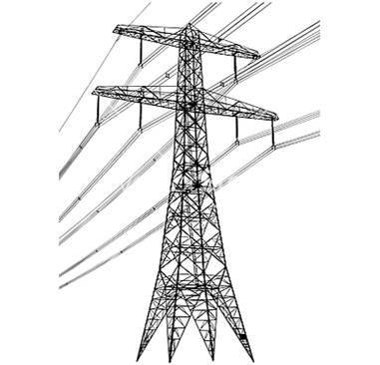
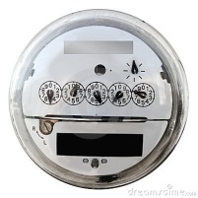
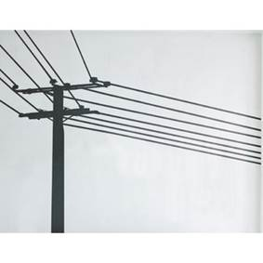
Wholesale DG is the Critical & Missing Segment
Project Size
Central Generation
Serves Remote Loads
Wholesale DG
Serves Local Loads
Retail DG
Serves Onsite Loads
Behind the
Meter
Distribution
Grid
Transmission
Grid
Notes:
(jf 01, 30 March 2012)

Slide 4
Wholesale DG has Superior Value
Total Ratepayer Cost of Solar
 | Distribution Grid |  |  |  |  | T-Grid
PV Project size and type | 100kW roof | 500kW roof | 1 MW roof | 1 MW ground | 5 MW ground | 50 MW ground
Required PPA Rate | 16¢ | 15¢ | 13¢ | 9-11¢ | 8-10¢ | 7-9¢
T&D costs | 0¢ | 0¢ | 0¢ | 0¢ | 0¢ | 2-4¢
Ratepayer cost per kWh | 16¢ | 15¢ | 13¢ | 9-11¢ | 8-10¢ | 9-13¢
Sources: CAISO, CEC, and Clean Coalition, Nov2012; see full original analysis from Jul2011 at www.clean-coalition.org/studies
The most cost-effective solar is large WDG, not central station due to significant hidden T&D costs
Notes:
4

Slide 5
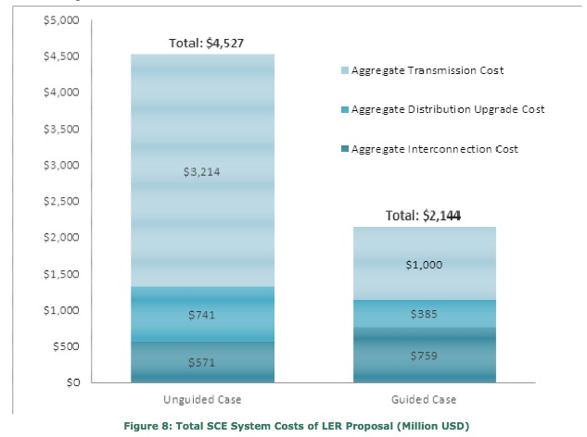
Guided Siting Saves Ratepayers 50%
SCE Share of 12,000 MW Goal
Note that interconnection costs are higher in the Guided Case. Siting costs may also be higher. Applicants will seek their lowest cost if they get no value from “preferred locations”.
Transmission costs would be born by ratepayers
Sources: SCE Report May 2012
Notes:
Overall costs to connect new LER (Local Energy Resources = DG) into the distribution system are highest in rural areas where the generation is further from local loads. However, over 70% of current
applications received for new LER are in rural systems. Continuation of this “unguided”
scenario would result in overall costs estimated to be approximately $4.5 billion for
SCE’s estimated share of the 12,000 MW.
  Costs to connect generation were less in local urban load centers where the generation
is smaller and more likely to be installed onsite. In the “guided” scenario, where 70%
of new LER were located in the urban area, the overall costs of reaching SCE’s
projected portion of the Governor’s goal are estimated to be $2.1 billion. Though this is
still a significant investment, it represents a 45% decrease from the “unguided” case.
All interconnection and upgrade costs are ultimately included in energy prices and T&D charges reflected in rates
The goal of new cost arrangements in this proceeding should be to reduce rates through optimal use of grid capacity and cost-effective interconnection policies for lower net cost of delivered energy
Billions of dollars in avoided transmission may be saved if investments are cost-effectively redirected to enable generation close to loads within the local distribution system

Slide 6
Avoided Transmission in CA = $80 Billion over 20 yrs
Business as Usual Year-20 TAC (TAC₂₀ ) = 2.7
2.7
Business As Usual TAC Growth
Current TAC
Rate (TAC₀) = 1.2
TAC₀ O&M Level
Business as Usual TAC Growth TAC₀ Depreciation + O&M Avoided TAC Opportunity from DG
Notes:
(cl_06 10 April 2012)
This chart shows the potential to reduce Transmission Access Charges by increasing DG
All energy that comes of the T-Grid requires payment of TACs.
Right now, CA ratepayers pay 1.1 cents per kWh
The yellow line shows the expected growth over the next 25 years BAU.
In 20 years, TACs will cost 2.5 cents per kWh
The blue line is alternative. If from this point forward, if we only added generation on the distribution grid, the blue line shows how TACs would decrease as existing investments depreciate over the next 20 years. Eventually, we’d only pay basic operating and maintenance costs. We’d also avoid stranded costs (anything we put into the t-grid becomes stranded costs as we transition to DG.)
The green triangle represents the potential savings as the difference between business as usual and a DG future.

Slide 7
Transmission Costs Exceed 3 cents/KWh in CA
“Palo Alto CLEAN will expand clean local energy production while only increasing the average utility bill by a penny per month” -- Yiaway Yeh, Mayor of Palo Alto
Notes:
CLEAN Programs work in the U.S.

Slide 8
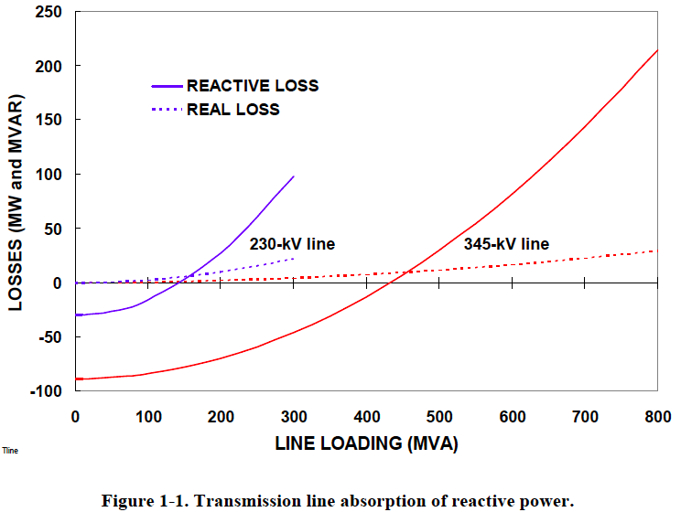
Distributed Voltage Regulation – Location Matters
“The old adage is that reactive power does not travel well.”
        Oak Ridge National Laboratory (2008)
T&D lines absorb 8-20x more reactive power than real power.
Prevent Blackouts:
When a transmission path is lost, remaining lines are heavily loaded and losses are higher.
Source: Oak Ridge National Laboratory (2008)
Notes:
Reactive power does not travel well.
This chart shows that reactive power has 8-20 times higher line losses than real power.
Also shows much higher transmission line vs. distribution line losses.
When a transmission path is lost, remaining lines are heavily loaded and losses are higher.
Expert audience notes:
The zero crossing of the reactive losses lines are the Surge Impedance Loading (SIL) points at which there is a balance between producing and absorbing reactive power.
When conducting power below its SIL, the line is primarily capacitive and supplies reactive power, tending to raise system voltages (same thing capacitor banks are used for). When the line carries more power than the SIL, it tends to absorb reactive power, lowering system voltages (same thing motor loads do).
The reactive impedances in a transmission systems are typically 8-20 times larger than real impedances, hence reactive losses are much higher, especially when lines carry higher power above the SIL.
Source: “Local Dynamic Reactive Power for Correction of System Voltage Problems,” Oak Ridge National Laboratory, September 2008

Slide 9
DG+IG Core Solutions for Voltage Regulation
Solutions | Benefits
Distributed Generation | Provisions reactive power where it’s needed most for regulation Avoids line losses Reduces congestion of transmission and distribution lines
Advanced Inverters (paired with solar, storage) | Provisions distributed reactive power Reacts automatically within fractions of a second (conventional resources can take minutes to react) Converts real power from the grid to reactive power 24/7/365 Oversized inverters can deliver reactive power without reducing DG real power output Ride-through voltage events, remain attached longer than conventional spinning generators without harm Modern inverters already have these advanced capabilities
Energy Storage (batteries, flywheel) | Provisions both real and reactive power Generally paired with advanced inverters
Notes:
Note: System operators traditionally have used centrally located resources to regulate voltage. Many of these conventional resources, such as capacitors, large generators, and load tap changers, can take minutes to react.
9

Slide 10
Advanced Inverters – Reactive Power (Oversized)
REACTIVE (Q)
P: Real power (performs work)
Q: Reactive power (voltage regulation)
S: Apparent power (total power)
S
110%
100 MW solar PV AC power
110 MW inverter
0.9 Power Factor
45.8 MVAr Reactive Power
100 MW Real Power
Q
45.8%
REAL (P)
P
100%
Oversized inverter:
No reduction of PV real power
Draws up to 10 MW real power from the grid
Provides reactive power 24/7/365
Notes:
For single phase inverter, can you provision reactive power by borrowing real power from the grid?
Bob’s EDITS
Show S going out 10%
Dotted circle to represent 10% extra
S is 100% of dotted circle
When the inverter is oversized, it allows all of the DG power to be put into delivering real power back to the grid, maximizing the system owner’s revenue.
When reactive power is needed, real power can be drawn back from the grid and redirected into reactive power to assist in voltage regulation. This can be done at any time, even when there is no power coming from the DG, e.g. at night on PV systems.
Percentages refer to percent of rated AC power

Slide 11

Advanced Inverters Gaining Broad Agreement
WEIL Pushing for Smart Inverters
  Western utility group called for policymakers to require smart inverters for all new solar facilities in August 2013 letter.
  Framed issue in terms of DG causing problems that can be inexpensively solved with advanced inverters.
  Pointed out that Germany required everyone to retrofit inverters.
Accordingly, the Clean Coalition is educating policymakers about how DG combined with advanced inverters cost-effectively improves grid reliability and efficiency compared with conventional solutions.
WEIL Group includes:
  SCE, SDG&E, PG&E, SMUD, LADWP
  Arizona Public Service
  Portland General Electric
  Salt River Project
  Several others

Slide 12
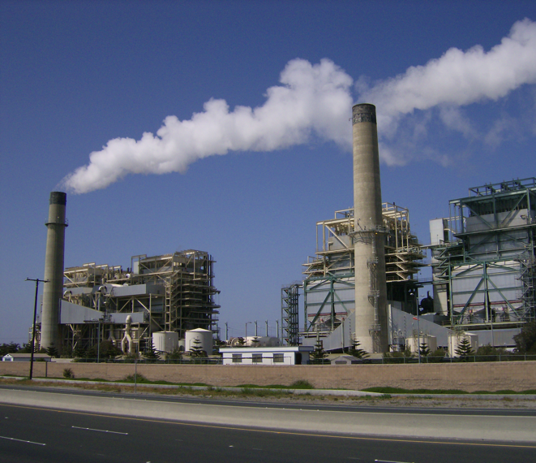
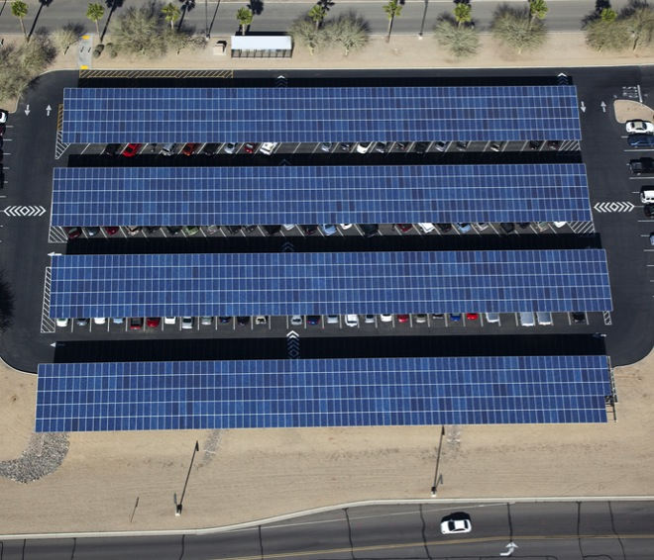
Replacing SONGS with PV + Advanced Inverters
vs
Huntington Beach
290 MVars
(minus line losses =
261 MVars)
570 MW of local solar with advanced inverters, oversized by 10% set at 0.9 Power Factor = 261 MVArs
Notes:
SONGS provided a large amount of reactive power for voltage regulation in Southern California.
CAISO produced a good duct tape solution for this summer – Huntington Beach (which provides 290 MVArs of reactive power), and 4 strategically located capacitors that provide 80 MVArs each.
Local solar PV paired with advanced inverters can cost-effectively both reduce load on transmission lines and provide large amounts of reactive power 247/365 without reducing the amount of real power it provides while the sun shines.
By oversizing the inverters by 10% at 0.9 power factor, the solar panels can produce 63% of the PV system’s nameplate capacity as reactive power without reducing real power output. At night, the inverters can act like capacitors, drawing real power from the grid and converting it to reactive power.
For example, 570 MW capacity of PV with advanced inverters oversized by 10% at 0.9 power factor could provide the same amount of reactive power as the Huntington Beach synchronous condensers.

Slide 13
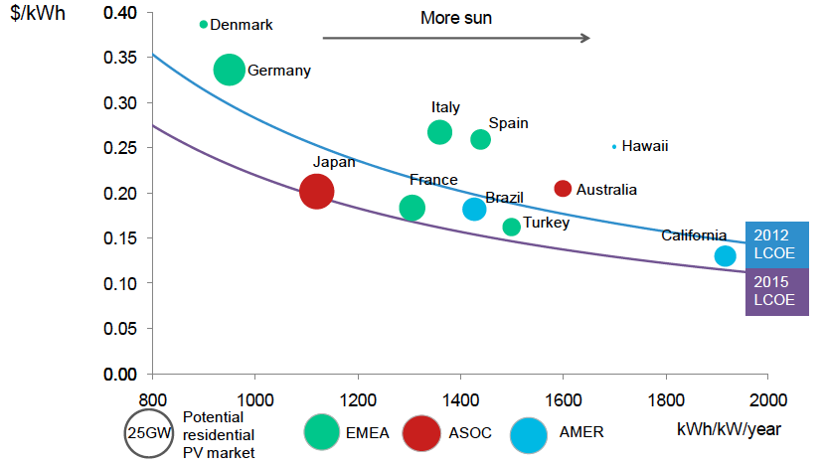
WDG Priority: High Capacity, Lower Cost
Huge Untapped Resource
76 GW of rooftop capacity in California
111 GW of ground capacity >1 MW in urban areas
20 GW near rural substations
  Many Studies: NREL, E3, KEMA, UCLA, LABC….
Lower Cost
Outdated Price Awareness
Cheaper than Peaker
Competitive with New CCNG
Notes:
NREL U.S. Renewable Energy Technical Potentials
Technical Report
NREL/TP-6A20-51946 July 2012
does not included parking lots, assumes 27% of residential and 60% of commercial roof area is usable.
California has 111GW of Urban ground mount >1MW, again excluding parking lots
Cost estimates are consistently overstated, based on outdated values that have fallen very substantially, and based on RDG CSI figures, which are rough 2X WDG figures. Cost of energy from WDG is competitive with delivered cost of CCNG, and far below levelized cost of energy from peaker plants.
The PV industry has seen unprecedented declines in prices since the second half of 2008. Yet, awareness of the current economics of solar power lags among many commentators, policy makers, energy users and even utilities.
The reasons are numerous and include:
the very rapid pace of PV price reductions,
the persistence of out-of-date data in information still being disseminated (occasionally by those with an interest in clouding the discussion),
ambiguity surrounding many of the metrics and concepts commonly used in the PV industry, and ambiguities regarding underlying PV costs due to the numerous policy support measures that have been put in place over the last decade
Chart:
Residential PV price parity (size of bubbles refers to market size) (BNEF, 2012a).
Note: LCOE based on 6% weighted average cost of capital, 0.7%/year module degradation, 1% capex as O&M annually, $3.01/W capex assumed for 2012, $2.00/W for 2015.
‘Re-considering the Economics of Photovoltaic Power ‘,
Morgan Baziliana, United Nations Industrial Development Organization, Vienna, Austria, et al.

Slide 14
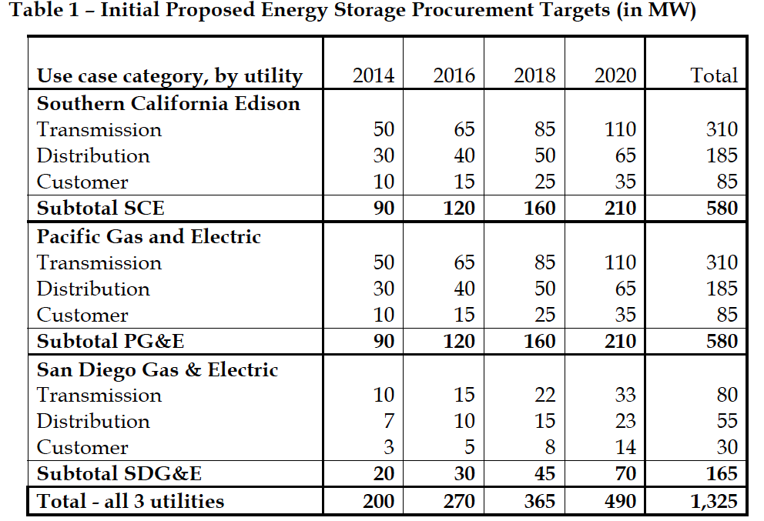
Replace SONGS – Energy Storage Potential
Targets proposed by CPUC include 745 MW storage in Southern California
Notes:
CPUC Commissioner Peterman has proposed targets of over 1.3 GW of new energy storage by 2020, including 745 MW in Southern California.
150 MW in Southern California by 2016.

Slide 15
DG+IG Solutions for Balancing Power & Frequency
Solutions | Benefits
Demand Response | Automated demand response can address power imbalances within fractions of a second Reduces or shift load away from peak hours to free up other resources to provide real power
Energy Storage (batteries, flywheel) | Supplies and absorbs power Can reduce or shift load Can react automatically within fractions of a second
Forecasting | Forecasting improvements will reduce unpredicted differences between scheduled supply and actual supply
Curtailment (proactive ramp control) | Reduce output from intermittent generators for proactive ramp control to smooth out short term impulse
Notes:
SAHM – curtail to for proactive ramp control
NEED NEW GRAPHIC / SLIDE
Puerto Rico example – no more than 10% nameplate can change in 1 minute time frame
15

Slide 16
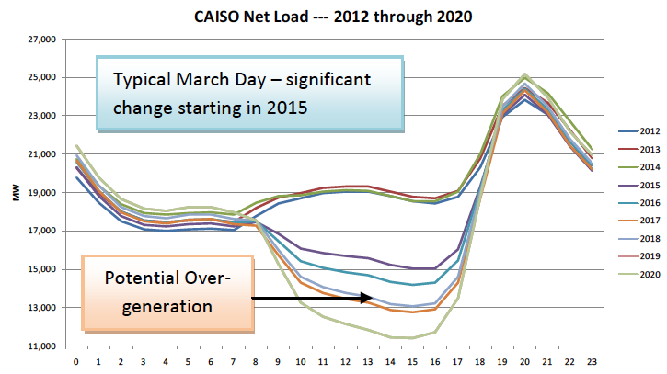
DG+IG Keeps Power in Balance
DR, ES shifts load
ES, Auto-DR, curtail for steep ramp
DR, ES shifts load
Notes:
This “Duck Chart” was created by CAISO to show that the shape of the net load curve begins to shift dramatically in 2015 due to increasing solar generation.
Chart shows a typical March day, with each line representing a different year, from 2012 – 2020.
The bottom x-axis represents time of day, starting at midnight and ending at midnight.
The left y-axis shows net load in MW, meaning load minus wind and solar generation.
The chart shows two major issues for California:
Supply may exceed demand in the afternoons of certain months beginning in 2018.
Increasing ramping each year through 2020.
DG+IG is ideal for keeping power in balance from a system wide perspective
DR and ES can shift demand away from the early evening hours, flattening the head of the duck, and increase demand during the afternoon hours, lifting the belly of the duck.
Generally, DR can reduce or shift load away from peak hours
Automated demand response and ES are extremely fast-acting resources that can keep power in balance during steep ramp periods of the day.
When supply is forecasted to be greater than demand, system operators can also curtail output of variable generators.

Slide 17
Renewables are Reliable
Country | Percent of electrical generation in 2007 from non-hydro renewables | 2007 SAIDI – outage duration (minutes) | 2007 SAIFI – outage frequency (number of outage events)
Denmark | 29.4% | 23 | 0.5
Germany | 12% | 24 | 0.5
United States | 2.8% | 240 | 1.5
Sources: Galvin Electricity Initiative, Electric Reliability: Problems, Progress and Policy Solutions, February 2011
U.S. Energy Information Administration, International Energy Statistics, 2011
Notes:
Relevant Content:
Germany and other European countries have already shown that modern power systems are both technically possible and economically viable. Investing in an intelligent grid that integrates significant amounts of clean local energy enhances system reliability -- minimizing economic losses from outages. The German power system, which incorporates enough rooftop solar to meet half the country's midday energy needs, set a global reliability record in 2011 with only 15.31 minutes of downtime. What's even more impressive is that Germany -- the world's fourth largest economy and home to a heavy industrial base -- demands enormous amounts of reliable power, and distributed renewables have delivered. Similarly, renewables provide more than 40 percent of Denmark's electrical generation, and their grid is markedly more reliable than in the United States. On average, the U.S. has three times as many outages as Denmark with each outage lasting fourteen times as long. In other words, the U.S. spends about 50 times as long in the dark even though Denmark gets 40 percent of its power from renewables.
Notes:
SAIDI = system average interruption duration index
SAIFI = system average interruption frequency index
Also, these 2007 numbers are from the CEER 4th annual benchmarking report published in 2010. The 5th annual report from 2011 (available at http://www.energy-regulators.eu/portal/page/portal/EER_HOME/EER_PUBLICATIONS/CEER_PAPERS/Electricity/Tab/CEER_Benchmarking_Report.pdf) has updated numbers that are slightly lower for Germany and Denmark; however no U.S. numbers are provided. Thus, I kept everything consistent using the 4th annual report.
Source:
Galvin Electricity Initiative, Electric Reliability: Problems, Progress and Policy Solutions. See
http://www.galvinpower.org/sites/default/files/Electricity_Reliability_031611.pdf.
U.S. Energy Information Administration, International Energy Statistics, 1980-2011
http://www.eia.gov/cfapps/ipdbproject/iedindex3.cfm?tid=2&pid=alltypes&aid=12&cid=DA,GM,US,&syid=1980&eyid=2007&unit=BKWH

Slide 18
Distribution Grid Upgrade Vision
Utility Distribution Investment Planning (UDIP) will be a transparent process in which the utilities are held accountable for investing in ways that meet coordinated State goals.
  Instead of reactive planning on a case-by-case basis, the utilities will step back and create a plan, then build deliberately for the future distribution grid.
  By anticipating advanced capabilities in future upgrades, new technology will be far faster and easier to incorporate and cost less for consumers, developers and the State.
Recent documents from the CEC and Southern California Edison reflect the growing acceptance of this vision of the grid.
  SCE’s report from May of 2012 notes that overall grid upgrade costs will be cut by more than half, and transmission investments will be reduced by more than two-thirds, if DG siting is based on a ‘guided’ planning process.
  The recent workshop on climate change adaptation at the energy commission highlighted the importance of a smart grid and locating energy generation very close to load in mitigating the impacts of extreme weather events.
Notes:
Key elements of a UDIP are:
Publicly available information
Rate-based upgrades
Integrated with interconnection
If it happens at Transmission level, it should be at Distribution level as well.
Distribution planning would pull together currently disparate policy silos – procurement, smart grid, GRC, LTPP, RA
75% of California IOU capital expenditures are on the distribution grid. This massive investment needs to be future-proofed to allow significant penetrations of clean local energy.
Currently, developers are responsible for 100% of D-grid upgrade costs without any opportunity for reimbursement
This is different than transmission upgrade costs that are ALWAYS borne by the ratepayer
For the 50% of the D-grid where Locational Benefits are above average, utilities should recover D-grid upgrades through the rate-base.
Ratepayers currently get massive free value from WDG in the form of uncompensated D-grid upgrade costs
18

Slide 19
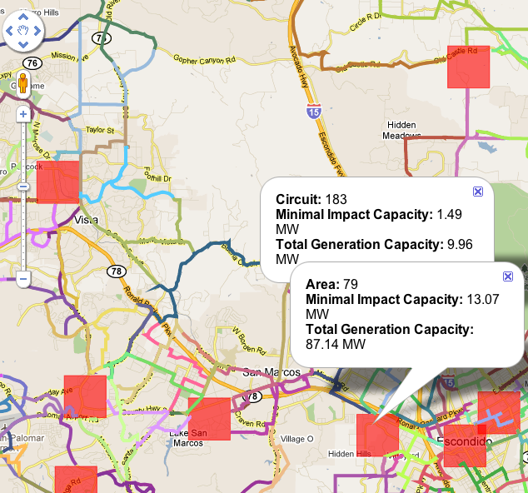
Data Availability is Improving
  More D-grid information is being made accessible through improved interconnection maps
  But, improved information does not necessarily translate into transparent upgrade assessments
  Data in maps must be relevant to how interconnection studies are performed
Notes:
Rule 21 Phase II is stalled at the CPUC. Settlement was filed in March 2012 outlining Phase II. Proposals for improved predictability were submitted by parties in November 2012, with revisions and additional IOU proposals in Feb 2013, and no action since.
Map data should be made available in searchable spreadsheets, in addition to the maps
Sortable rank ordering
Boolean search (and/or/not…)
New data components that should be included:
Line Section data (Screen M)
Minimum daytime load data (where available)
Applicable deadlines in queue data
For example, the ability to search & rank circuits by available capacity within a zip code or county
• Add a spreadsheet containing all of the interconnection map data, in
searchable form, at the same website as each utility’s interconnection map
• Add the locations of line sectioning devices to the interconnection maps
• Work with the utilities to determine how smart meter data can be used to
calculate or estimate minimum and peak circuit and line section data, and
publish this information in the interconnection maps and spreadsheets,
and/or make this information available to parties requesting a Pre-Application Report (PAR)

Slide 20
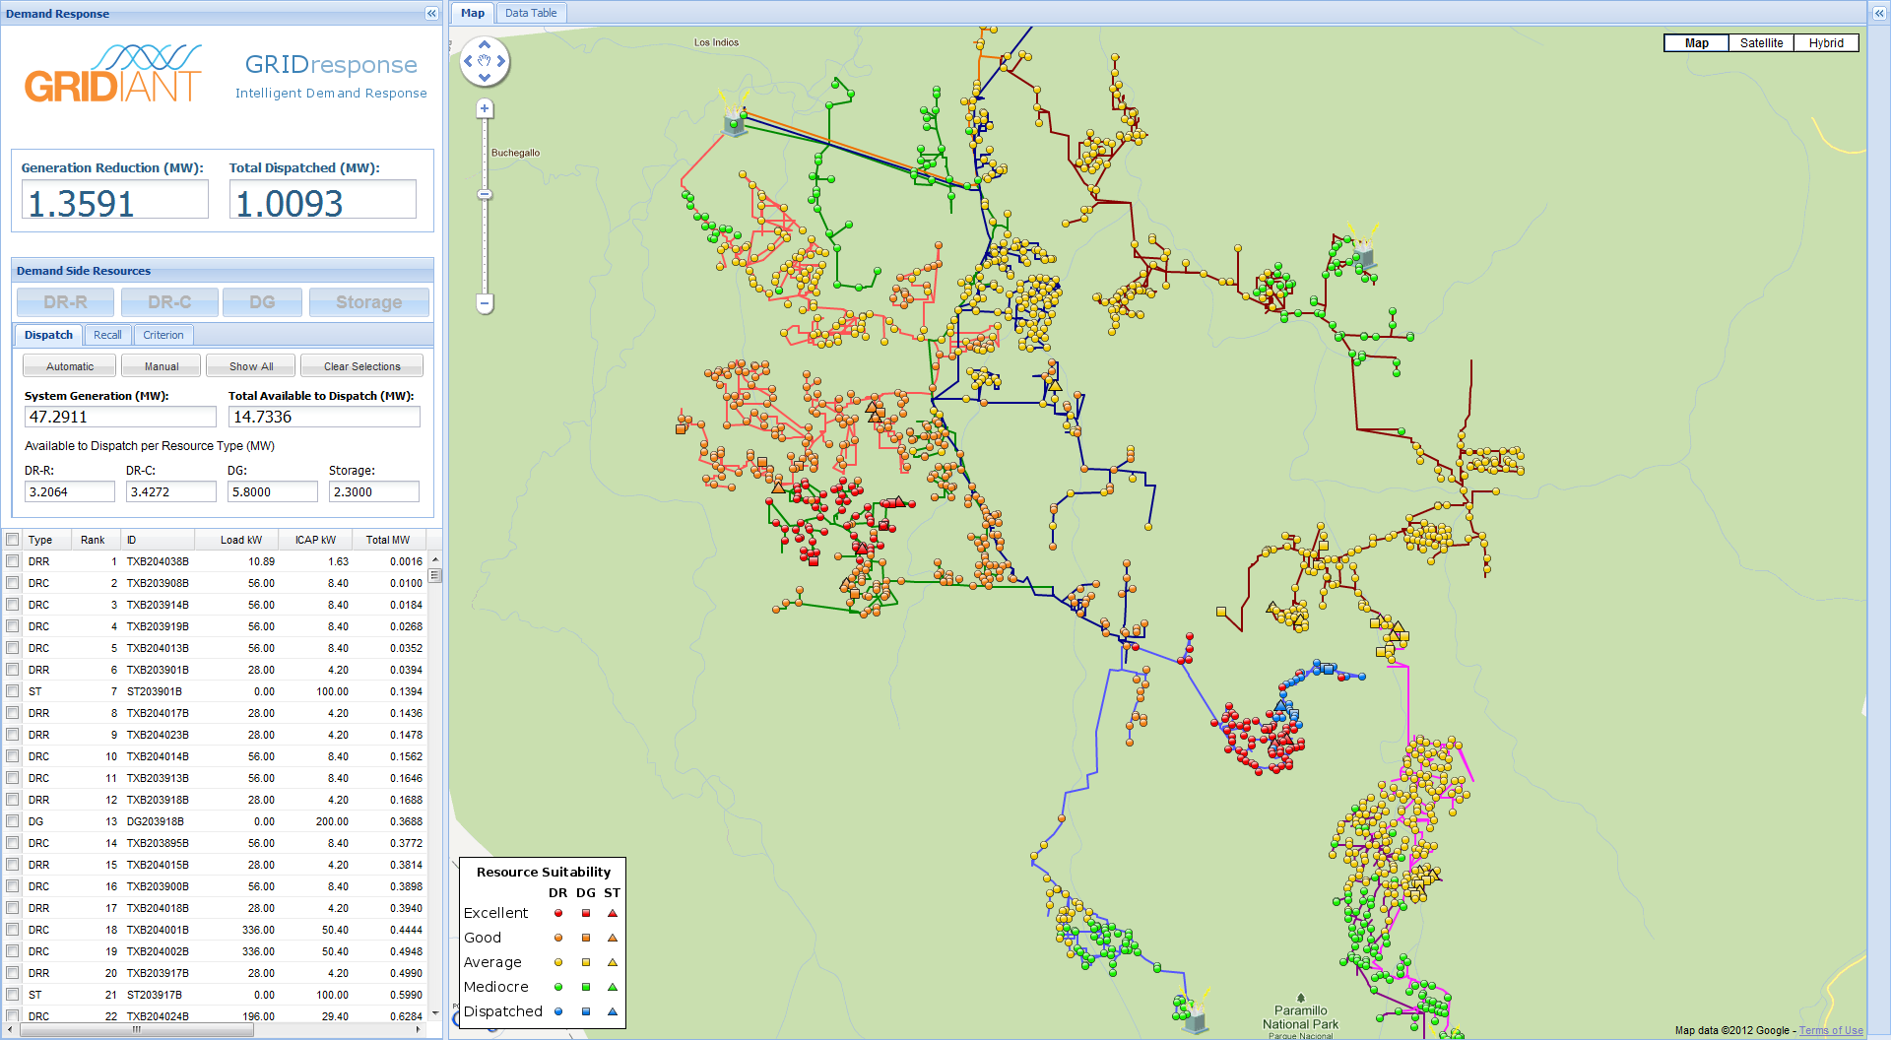
DG+IG Projects Begin with Grid Modeling & Simulation
Notes:
(cl, Aug2012)

Slide 21
DG+IG Policy Recommendations
Integrate Grid Planning
  Transparent and public T&D planning processes
  Proactively evaluate DG+IG alternatives to new transmission investments
  Necessary to meet goals re: renewables, EVs, costs, local job creation, resilience
Implement Full Cost & Value Accounting
  Investments should reflect the full spectrum of rate impacts, economic growth, health, safety, and environmental sustainability
  Prevent bias against DG+IG (e.g. hidden transmission costs)
Monetize DG+IG Grid Services
  Establishing markets that compensate at full value of grid services is fundamental to optimizing value for ratepayers
Prioritize DG+IG Development in High Value Locations
  Identify preferred locations on the grid based on transparent cost & value criteria
  Set “Local Portfolio Standard” targets
Update Technical Standards:
  Update national technical standards (IEEE/ UL) to allow DG+IG to provide grid services to the fullest potential
Notes:
21

