Slide 1
Flattening the Duck
Facilitating Renewables for the 21st Century Grid
Craig Lewis
Executive Director
Clean Coalition
650-796-2353 mobile
craig@clean-Coalition.org
11 February 2014
Notes:
This presentation will focus on integrating renewables with cost-effective intelligent grid solutions, including demand response, storage, and advanced inverters. The presentation will show how to address grid reliability challenges (steep ramps, over-generation, voltage control, and minute-to-minute fluctuations) with preferred resources, staying aligned with California goals.

Slide 2
Clean Coalition – Mission and Advisors
Mission
To accelerate the transition to local energy systems through innovative policies and programs that deliver cost-effective renewable energy, strengthen local economies, foster environmental sustainability, and provide energy resilience
Board of Advisors
Jeff Anderson
Co-founder and Former ED, Clean Economy Network
Josh Becker
General Partner and Co-founder, New Cycle Capital
Pat Burt
CEO, Palo Alto Tech Group;
Councilman & Former Mayor, City of Palo Alto
Jeff Brothers
CEO, Sol Orchard
Jeffrey Byron
Vice Chairman National Board of Directors, Cleantech Open; Former Commissioner, CEC
Rick DeGolia
Senior Business Advisor, InVisM, Inc.
John Geesman
Former Commissioner, CEC
Eric Gimon
Independent Energy Expert
Patricia Glaza
Principal, Arsenal Venture Partners
Mark Z. Jacobson
Director of the Atmosphere/Energy Program & Professor of Civil and Environmental Engineering, Stanford University
Dan Kammen
Director of the Renewable and Appropriate Energy Laboratory at UC Berkeley; Former Chief Technical Specialist for RE & EE, World Bank
Fred Keeley
Treasurer, Santa Cruz County, and Former Speaker pro Tempore of the California State Assembly
Felix Kramer
Founder, California Cars Initiative
Amory B. Lovins
Chairman and Chief Scientist, Rocky Mountain Institute
L. Hunter Lovins
President, Natural Capitalism Solutions
Ramamoorthy Ramesh
Founding Director, DOE SunShot Initiative
Governor Bill Ritter
Director, Colorado State University’s Center for the New Energy Economy, and Former Colorado Governor
Terry Tamminen
Former Secretary of the California EPA and Special Advisor to CA Governor Arnold Schwarzenegger
Jim Weldon
Technology Executive
R. James Woolsey
Chairman, Foundation for the Defense of Democracies; Former Director of Central Intelligence (1993-1995)
Kurt Yeager
Vice Chairman, Galvin Electricity Initiative; Former CEO, Electric Power Research Institute
Notes:
(Dec2012)
2

Slide 3
There are Three Vital Grid Services
Service | Key to Delivering Service
Power Balancing | Capacity of real power (W)
Voltage Balancing | Location of reactive power (VAr)
Frequency Balancing | Speed of ramping real power (W)
The Duck Chart only addresses Power Balancing but Distributed Energy Resources deliver unparalleled location and speed characteristics
Notes:
3

Slide 4
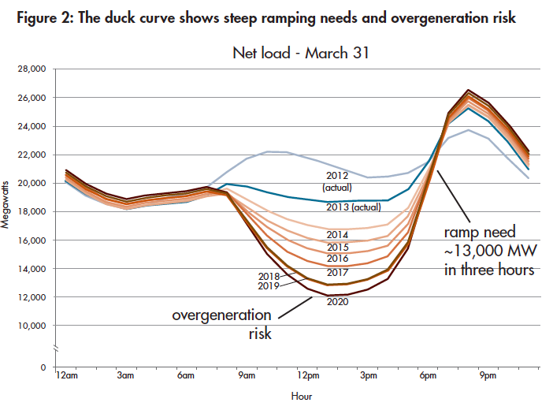
Is this Duck Real or a Decoy for Natural Gas?
Source: CAISO/NERC report (Nov 2013)

Slide 5
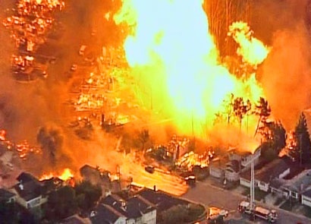
Natural Gas Is Not The Solution
Future generations will be asking what we were thinking (or smoking). You allowed massive quantities of toxic chemicals to be injected into the earth, and to contaminate ungodly volumes of water, in pursuit of a highly flammable gas that would be routed through your neighborhoods and into your homes?! What were you thinking?
2010 San Bruno pipeline explosion
Notes:
Data from: (Investing in Grid Modernization, Perfect Power Institute, Feb 2013)

Slide 6
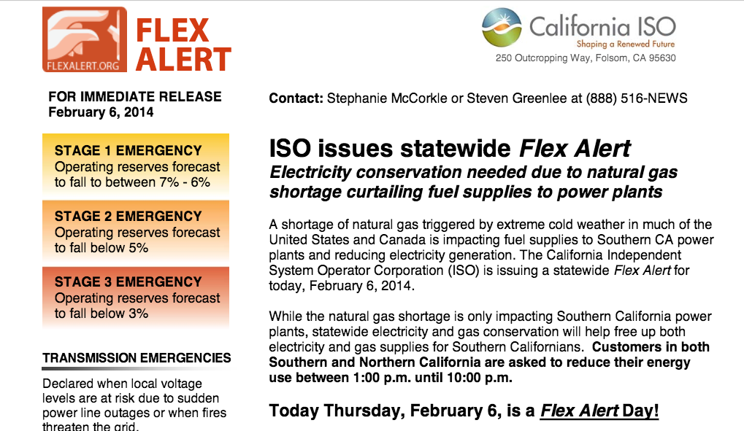
Natural Gas Is Not Reliable

Slide 7
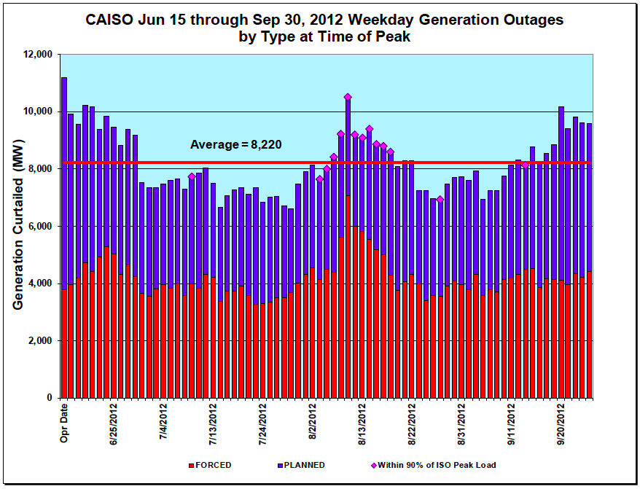
Natural Gas Has Integration Costs
Natural gas plants often shut down unexpectedly, forcing energy consumers to foot the bill for reserves and frequency response.
  Source: CAISO Summer Loads and Resources Assessment (2013)
More than half of the outages associated with conventional generation are unplanned
Notes:
NOTE: This chart does not include solar or wind generation. SONGS outages are shown as planned outages since “forced” outages are due to “unanticipated failure”.
7

Slide 8
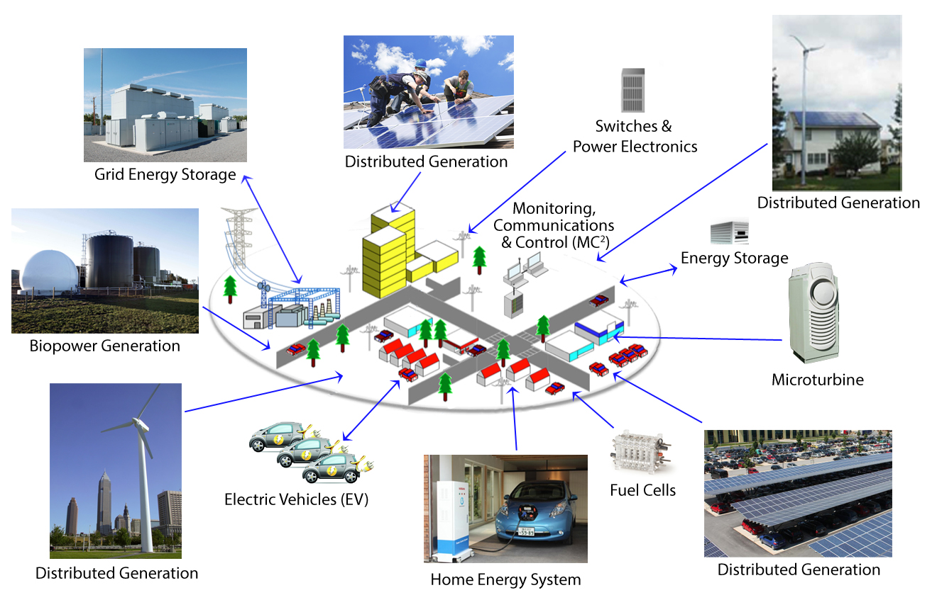
Integrating Renewables in a Forward Direction
Use cost-effective, renewables and intelligent grid solutions to modernize the grid.
Minimize natural gas, which would move backward from California’s goals.

Slide 9
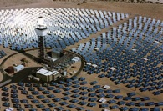
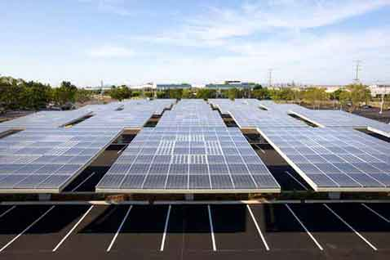



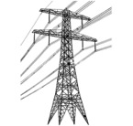

Wholesale DG is the Critical & Missing Segment
Project Size
Central Generation
Serves Remote Loads
50+ MW
Wholesale DG
Serves Local Loads
500 kW
Retail DG
Serves Onsite Loads
5 kW
Behind the Meter
Distribution Grid
Transmission Grid
Notes:
Wholesale Distributed Generation or WDG is the market segment that makes this transition possible. The retail DG – behind the meter – and central generation renewables – out in the desert, most of the time – are both part of the equation, but WDG has enough potential and uses economies to scale that will really change the game.
When we refer to DG, we mean a generating resource that is located on the distribution grid and the generated electricity does not feed back onto the transmission grid. WDG, therefore, is DG that sells all of its generation to the utility (or other purchaser). In future slides, I will refer to the distribution grid as the d-grid.
*National policies focus on removing barriers for large-scale renewable power facilities and infrastructure.
*State and local net-metering policies promote small-scale renewables:
---Net-metering is designed to reduce a utility customer’s electric bills
---Net-metering is not designed for owners of commercial and multi-tenant properties (where tenants pay the utility bills)
---Annual on-site energy use generally caps net-metering project size
---Investors and lenders find a utility customer’s energy savings from net-metering far less attractive than a revenue stream from a stable utility
(03_gp, 28 May 2013)

Slide 10
WDG Delivers Scale & Cost-Effectiveness Fast
Solar Markets: Germany vs California (RPS + CSI + other)
Cumulative MW
Sources: CPUC, CEC, SEIA and German equivalents.
Germany has deployed 12 times more solar than California in the last decade despite California’s 70% better solar resource!!!
Notes:
Germany is the best example we currently have to show the efficacy of CLEAN Programs and the WDG market. If there is any confusion, Germany is in green and California—known as the leading market it the U.S.–is in red. It is astonishing that Germany is adding 11 times more solar than California even though California has a 70% better resource.
Rooftop solar in Germany today is priced at the California-equivalent of 7-10 cents/kWh, which would be the most cost-effective resource deployed in California.
Ground-based solar projects typically generate about 25% more kWh/W than rooftop projects, because they use tracking, which allows the panels to follow the sun throughout the day. The net result is that ground-based projects are generally about 20% more cost-effective than rooftop projects. The difference between the 25% and the 20% is that the O&M costs for ground-based projects are a bit higher due to their moving parts.
(07_gp, 23 Sep 2013)

Slide 11
German Solar Capacity is Small WDG (Rooftops)
26%
23.25%
22.5%
19%
9.25%
Source: Paul Gipe, March 2011
Germany’s solar deployments are almost entirely sub-2 MW projects on built-environments and interconnected to the distribution grid (not behind-the-meter)
Notes:
(cl_04a, 12 Jan 2012)

Slide 12
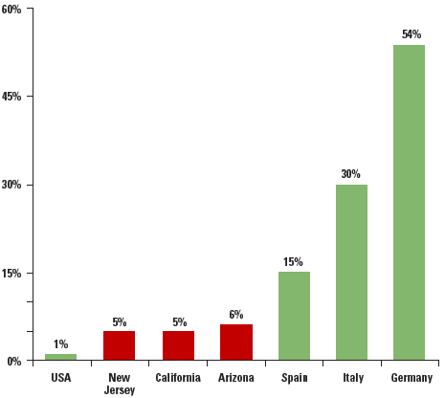
Renewables + Intelligent Grid Solutions = Reliable
The German power system, which incorporates enough rooftop solar to meet half the country's peak energy needs, set a global reliability record in 2011.
2012 Solar PV Capacity as % of Peak Demand
Source: Union of Concerned Scientists, SEIA 2013
Notes:
Although renewables are often said to cause reliability issues, global experience proves this untrue. The German power system, which incorporates enough rooftop solar to meet half the country's midday energy needs, set a global reliability record in 2011 with only 15.31 minutes of downtime. What's even more impressive is that Germany -- the world's fourth largest economy and home to a heavy industrial base -- demands enormous amounts of reliable power, and distributed renewables have delivered.
12

Slide 13
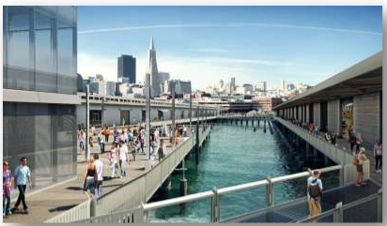
Align Renewables Integration with CA Goals
AB 32 (Reduce GHG emissions to 1990 levels by 2020)
Loading Order (Procure cost-effective preferred resources first)
Energy Storage Target (1.325 GW by 2020)
Electric Vehicles Target (1.5 million EVs by 2025)
Zero Net Energy (IOUs proposed “district” rather than building level ZNE)
  All new residential construction ZNE by 2020
  All new commercial construction and 50% existing commercial retrofit to ZNE by 2030
Notes:
Photo of ZNE building – Exploratorium, San Francisco
Source of ZNE Goals and photo: CPUC presentation 9/18/2013 available at http://annualmeeting.naseo.org/Data/Sites/2/presentations/Fogel-Getting-to-ZNE-CA-Experience.pdf
IOU comments to CEC IEPR ZNE workshop in July 2013:
Significant economic and operational benefits from looking at "district" level solutions for both efficiency and renewables measures.

Slide 14
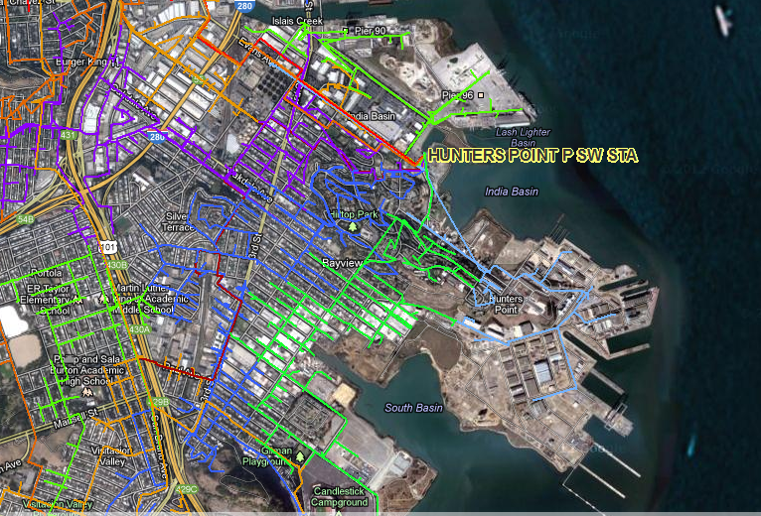
Hunters Point Project in San Francisco
Get 25% of electric energy consumed within Hunters Point substation (Bayview and Hunters Point neighborhoods) from local renewables while at least maintaining grid reliability and power quality
Notes:
01_sa, 14Nov2012

Slide 15


Hunters Point Economic Benefits from 50 MW New DG
$200M in Private Investment + Operations & Maintenance Over 20 Yrs. Equals:
Photo courtesy of GRID Alternatives
Economic Benefits
$200M: Added regional economic stimulation
$100M: Added local wages, near-term plus annual
1,270 Job-Years: New near-term regional employment
520 Job-Years: New ongoing regional employment
$10M: Site leasing income for property owners
$5.8M: Added construction-related state sales taxes
Source: NREL JEDI calculator. Based on average installed cost of $2.75/W(dc) before taxes & incentives using PG&E rates/region.
Notes:
Private Investment + Operations & Maintenance:
$200M investment over 20 years is comprised of near-term plus ongoing operations and maintenance as follows:
1. $165M represents the private investment amount for a 50MW PV system over 20 Years, as follows:
Installation & Construction: $137M ($27.5M per 10 MW)
Dynamic Grid Solutions @ 20% = $27,500
Total = $165K
O&M: $35M represents the O&M costs for a 50MW PV system over 20 years, as follows:
O&M adds $1.48M annually, or $29.7M over 20 years
plus 20% or $5.9M for Dynamic Grid Solutions
Total = $35.6M over 20 years.
Local Employment and Economic Impact:
Specific to MTA – Metropolitan Region.
Refers to PV installed in San Francisco at an average installed cost of $2.75/W(dc) (before taxes and incentives).
Local economic output is calculated as the value of expenditures on goods and services resulting from the project and captured within the study area, and excludes expenditures outside the region, such as to module manufacturers. During operating years local economic output is comprised of payments made by project owners, including the portion of project debt payments made to lenders located within the local analysis area. Payments including incentives, refunds, or revenues to project owners from the sale of energy produced by installed facilities are not included.
Economic activity in input-output models is assessed in three categories:
Salaries and wages for the project on-site labor and direct professional services
Local supply chain revenue related to materials acquisition, manufacture and services, including the local share of revenues from project financing and investment
Induced impacts in the local economy that result from workers salaries and wages
The model’s “output” is the sum of the above three categories for construction and for operations. State-specific multipliers and personal spending patterns are used to derive the results.
Near-term Job years of regional local employment from construction and installation. Ongoing job years in operation and maintenance over 25 years of operation.
Local wages in construction & installation.
The SF successor RDA estimates that 50% of the jobs and economic output will be captured within the boundaries of the city
Equipment and material sales will generate tax revenue as indicated.
NREL's JEDI models classify the first category of results—on-site labor and professional services results—as dollars spent on labor from companies engaged in development and on-site construction and operation of power generation and distribution. These results include labor only—no materials.
Econ impact
NREL JEDI model version PV 10.17.11
NREL JEDI Scenario model PVS 4.5.13
PV PPA pricing
NREL System Advisor Model (SAM) v. 2013.9.20
CEC Cost of Generation Model v.2

Slide 16
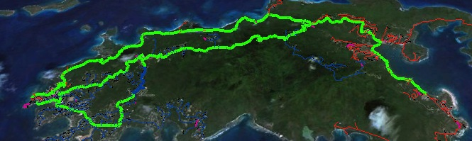
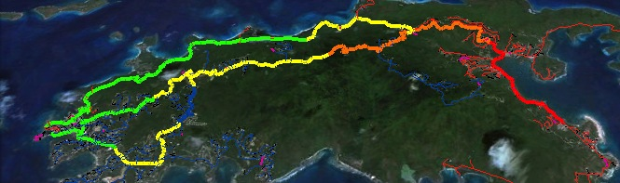
St. John Project in Virgin Islands: Local PV with Advanced Inverters to Maintain Grid Reliability
6AM: no PV impact
Noon: 20MW PV causes overvoltage
Noon: Dynamic grid solutions stabilize voltage impact from 20MW PV
Notes:
Significant amounts of PV can cause the grid to de-stabilize due to overvoltage in the system. In this example, 20MW of PV causes overvoltage at noon. However, using DG+IG solutions, including storage and advanced inverters to help regulate voltage, the grid is stabilized even though the 20MW of PV is producing at a high capacity level.

Slide 17
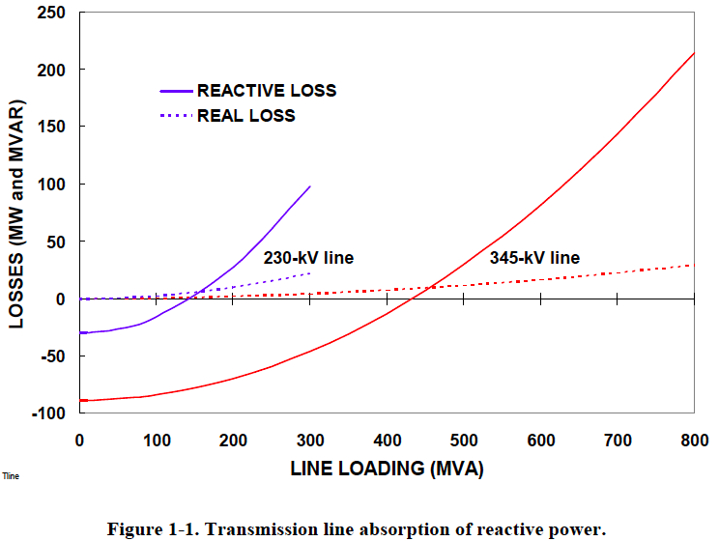
Distributed Voltage Regulation – Location Matters
“The old adage is that reactive power does not travel well.”
        Oak Ridge National Laboratory (2008)
T&D lines absorb 8-20x more reactive power than real power.
Prevent Blackouts:
When a transmission path is lost, remaining lines are heavily loaded and losses are higher.
Source: Oak Ridge National Laboratory (2008)
Notes:
Reactive power does not travel well.
This chart shows that reactive power has 8-20 times higher line losses than real power.
Also shows much higher transmission line vs. distribution line losses.
When a transmission path is lost, remaining lines are heavily loaded and losses are higher.
Expert audience notes:
The zero crossing of the reactive losses lines are the Surge Impedance Loading (SIL) points at which there is a balance between producing and absorbing reactive power.
When conducting power below its SIL, the line is primarily capacitive and supplies reactive power, tending to raise system voltages (same thing capacitor banks are used for). When the line carries more power than the SIL, it tends to absorb reactive power, lowering system voltages (same thing motor loads do).
The reactive impedances in a transmission systems are typically 8-20 times larger than real impedances, hence reactive losses are much higher, especially when lines carry higher power above the SIL.
Source: “Local Dynamic Reactive Power for Correction of System Voltage Problems,” Oak Ridge National Laboratory, September 2008

Slide 18
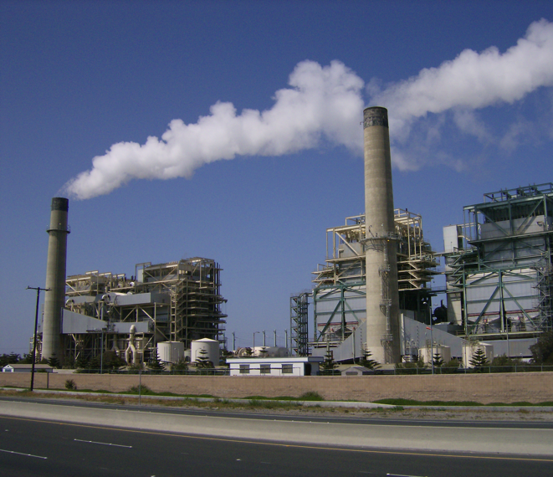
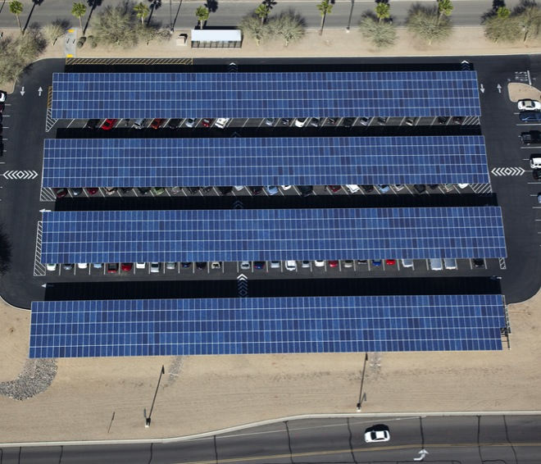
Replace SONGS – DG/Storage + Advanced Inverters
vs.
$80 million
2 Synchronous Condensers
San Luis Rey Substation
450 MVAr
(minus line losses = 400 MVAr)
800 MW of DG solar + storage with advanced inverters, oversized by 10% set at 0.9 Power Factor = 400 MVAr
CAISO proposed 320 MW DG solar + 580 MW storage = 900 MW (plus 1,400 MW of nat gas)
Notes:
SONGS provided a large amount of reactive power for voltage regulation in Southern California.
Local solar PV paired with advanced inverters can cost-effectively both reduce load on transmission lines and provide large amounts of reactive power 247/365 without reducing the amount of real power it provides while the sun shines.
For example, 570 MW capacity of PV with advanced inverters oversized by 10% at 0.9 power factor could provide the same amount of reactive power as the Huntington Beach synchronous condensers.

Slide 19
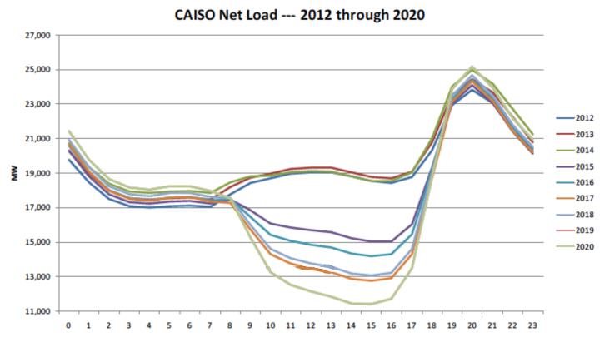
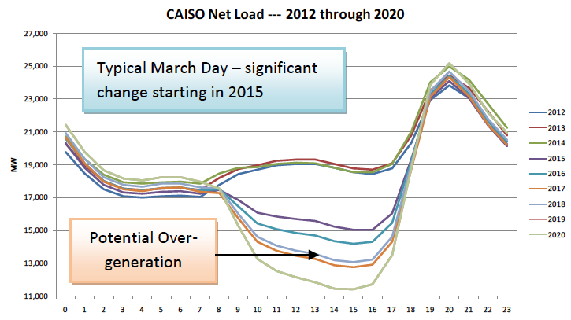
The California ISO Duck Chart (2012 – 2020)
13,100 MW 5-8pm
5,300 MW 8-11am
Potential
over-generation
Notes:
The California Independent System Operator (CAISO) created the “Duck Chart” to show how high levels of solar could result in system balancing issues starting in 2015 as California approaches the 33% RPS in 2020. CAISO has proposed procurement of “flexible capacity”, especially natural gas, to address the steep ramps and over-generation issues that may occur in the shoulder months as solar comes online in the mornings and tapers off in the evenings.
However, integrating renewables with natural gas is a step backwards from California’s clean energy and GHG goals. Further, the Loading Order requires California to procure low carbon resources before fossil resources.
NOTES:
The Duck Chart shows a typical March day, with each line representing a different year, from 2012 – 2020.
The bottom x-axis represents time of day, starting at midnight and ending at midnight.
The left y-axis shows net load in MW, meaning load minus wind and solar generation.
The chart shows that the shape of the net load curve begins to shift dramatically in 2015 due to increasing solar generation.
Potential over-generation shown starting in 2018 in the afternoon as net demand within CAISO territory would be lower than supply of inflexible, conventional base-load resources that are expensive to turn off – such as nuclear and less flexible natural gas. (March and April are more extreme cases because solar intensity is relatively high but the summer air conditioning needs haven’t kicked in.)
The annotations shows the periods during this March 2020 day with sharp changes in net demand.
1st – the quick 5,300 MW drop in net load from 8am-11am, as the sun rises and solar generation comes online
2nd – the steep rise of 13,100 MW in net load from 5pm-8pm, as the sun sets and solar output declines
19

Slide 20
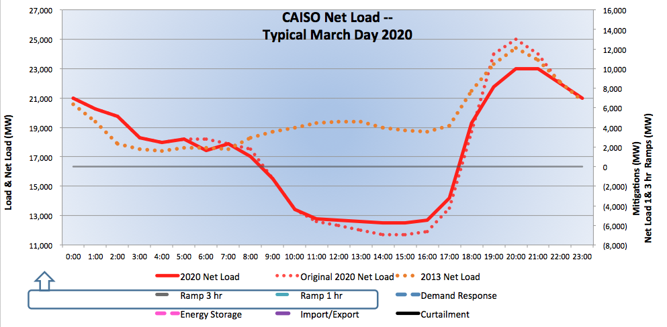
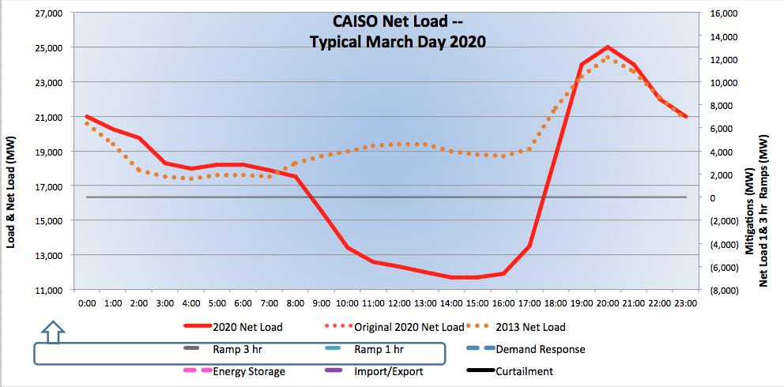
CAISO Duck Chart (2020 Issues)
13,100 MW 5-8pm
5,300 MW 8-11am
Potential
over-generation
Notes:
The Clean Coalition has developed a model to illustrate how California can integrate renewables in 2020 with dynamic grid solutions.
The red line shows the 2020 net load curve, while the orange dotted line shows the 2013 net load for comparison.
Please note that while the projections of net load on this chart are from the CAISO Duck Chart, the following slides show Clean Coalition’s projections of potential solutions. The assumptions are available in the back-up slides.
20

Slide 21
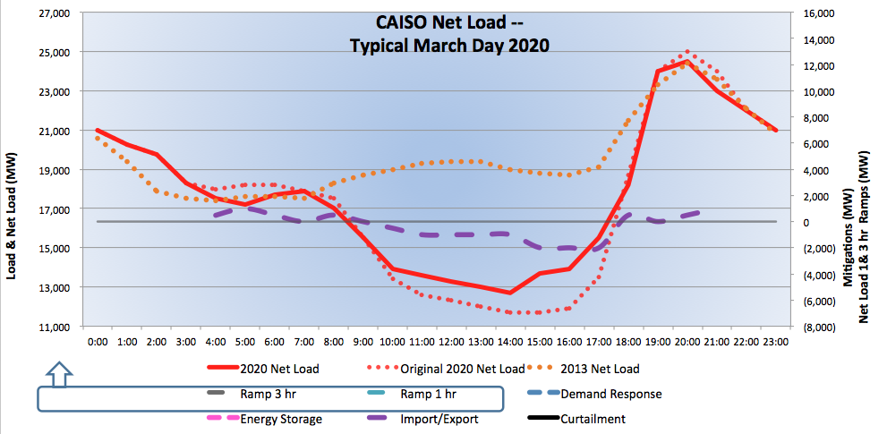
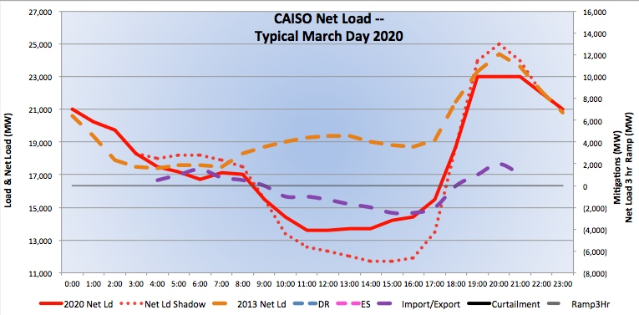
Flattening the Duck – Import/Export
Import/Export
Need to study how much California can export, expected pricing, and whether additional regional coordination is advisable
Notes:
First it’s important to remember that the original CAISO chart only includes net load for CAISO territory. Once you remove this limitation, the picture looks much less extreme.
The new Energy Imbalance Market will help to facilitate exports, but we still need a study to determine how much California can rely on exports for resource planning purposes.
NOTES:
From CAISO/NERC 2013 report: The potential to export excess generation to neighboring BAs during low system demand periods may be feasible but impractical, because other BAs may need to keep a portion of their dispatchable resources on-line to meet load changes and comply with mandatory control performance standards.
The purple dashed line shows imports/exports of renewables in MWs reflected on the scale to the right.
The dotted red line shows the old net load curve, while the new red line shows how Import/Export helps smooth the ramps in MWs reflected on the scale to the left.
21

Slide 22
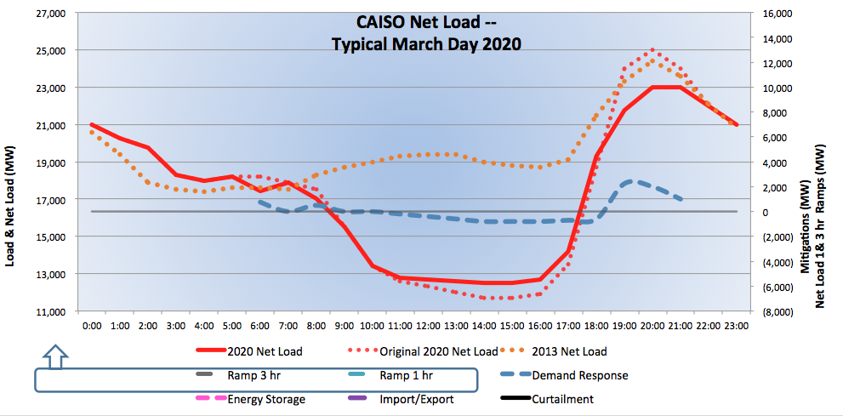
Flattening the Duck – Demand Response
Demand Response
California set a target of 1.5 million electric vehicles by 2025,
representing an additional load of 10,000 MW
Notes:
Demand response programs can incentivize customers to shift power consumption away from high net demand periods (flattening the head of the duck) and towards low net demand periods (lifting the belly of the duck). The blue dashed line shows demand response in MWs reflected on the scale to the right. The dotted red line shows the old net load curve, while the new red line shows how DR helps smooth the net load profile.
We recommend that policymakers prioritize identifying DR resources available to address these needs and the necessary pricing to incentivize customer participation. This is necessary since it’s not immediately obvious to policymakers or aggregators which commercial and industrial loads will be available to shift away from the early evenings and towards mid-day hours, and what price signals will be necessary.
For example, electric vehicles can act as a combination of distributed storage and demand response, responding to pricing signals to charge during hours of low net demand and dispatching energy to address high net demand. Since Governor Brown issued an Executive Order that established a target of 1.5 million zero-emission vehicles on the road in California by 2025, the CPUC has found that sending the right price signals to EV owners will be critical. The next step is for California agencies to determine how much demand response with EVs and other loads can modify the net load profile and what programs and pricing will be necessary to accomplish this task.
Source for poiint that EV target represents 10,000 MW of additional load – CPUC Vehicle-Grid Integration white paper (October 2013)
NOTES:
Negative DR = increase load
Positive DR = reduce load
Slide assumes a net load reduction of 1,600 MW from DR. More details in back-up slides
22

Slide 23
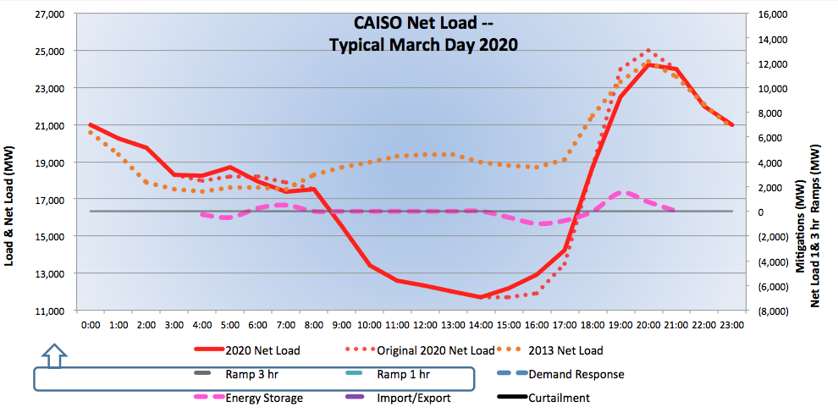
Flattening the Duck – Energy Storage
Energy Storage
California set a target of 1.325 GW of new cost-effective storage by 2020
Notes:
Energy storage can similarly charge during hours of low net demand and dispatch energy to the grid when desirable to address high demand, as illustrated by the dashed pink line. It is also an ideal resource for addressing minute-by-minute balancing needs
The dotted red line shows the old net load curve, while the new red line shows how ES helps smooth the net load profile.
Slide assumes a 1,500 MW maximum charge (below line) & 1,000 MW max dispatch (above the line) from ES.
23

Slide 24

Flattening the Duck – Curtail Solar
Curtailment
Can also curtail baseload by scheduling maintenance during shoulder months
Notes:
At times, it may be cost-effective to strategically curtail some solar generation to reduce the steep angle of the change in net demand.
First, curtail baseload, schedule maintenance during shoulder months.
Solar curtailment costs include increasing solar procurement to make up for curtailed energy to comply with an RPS.
Slide assumes a net reduction of 1,500MW solar generation. More details in back-up slides.
24

Slide 25
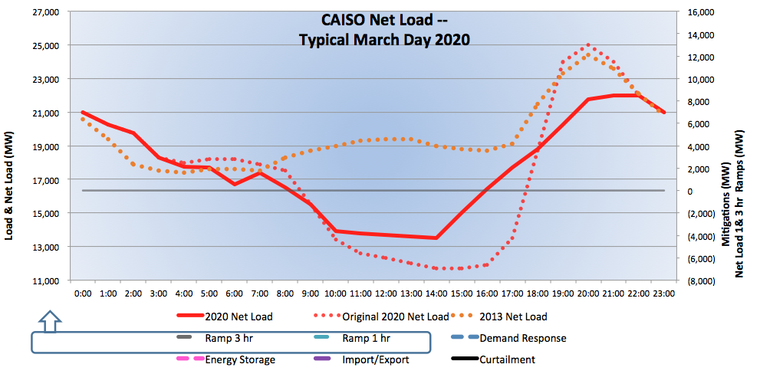
Flattening the Duck – Aggregated Solutions
The reflected aggregated solutions include imports/exports, demand response, energy storage and solar curtailment
Notes:
With all solutions in place, the changes in net demand are very manageable.
The dotted red line is the original net load curve, and the solid red line is the new curve once all solutions are delivered. The orange dashed line is the 2013 net load for comparison.
25

Slide 26
Back-up Slides

Slide 27
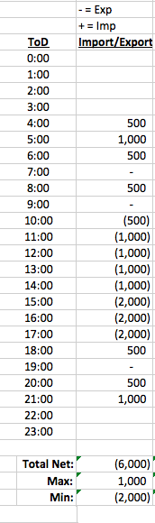
Import/Export Assumptions
Notes:
The original CAISO chart only includes energy available in CAISO territory. Once you remove this artificial limitation and account for imports and exports of energy in and out of CAISO territory, the picture looks much less extreme.
The dotted red line shows the old net load curve, while the new red line shows how Import/Export helps smooth the ramps.
Slide assumes a net export of 5,750MW. More details in back-up slides
27

Slide 28
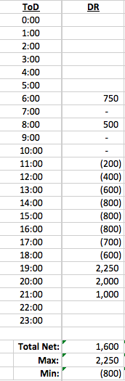
Demand Response Assumptions
Notes:
Demand response programs can incentivize customers to shift power consumption away from high net demand periods (head of the duck) and towards low net demand periods (belly of the duck), as shown by the blue dashed line shows demand response in MWs reflected on the scale to the right.
The dotted red line shows the old net load curve, while the new red line shows how DR helps smooth the net load profile.
Slide assumes a net load reduction of 1,600 MW from DR.
28

Slide 29
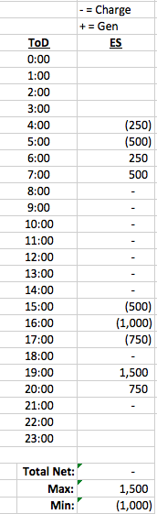
Energy Storage Assumptions
Notes:
Energy storage can similarly charge during hours of low net demand and dispatch energy to the grid when desirable to address high demand, as illustrated by the dashed pink line.
The dotted red line shows the old net load curve, while the new red line shows how ES helps smooth the net load profile.
Slide assumes a 1,500 MW maximum charge (below line) & 1,000 MW max dispatch (above the line) from ES.
29

Slide 30
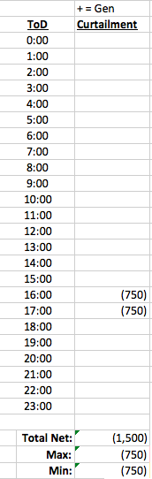
Curtailment Assumptions
Notes:
At times, it may be cost-effective to strategically curtail some solar generation to reduce the angle of the change in net demand.
(Note that this assumes that exports have been maximized and all cost-effective and available demand response and energy storage have been employed.)
Slide assumes a net reduction of 1,500MW solar generation.
30

Slide 31
Avoided Transmission in CA = $80 Billion over 20 yrs
Business as Usual Year-20 TAC (TAC₂₀ ) = 2.7
2.7
Business As Usual TAC Growth
Current TAC
Rate (TAC₀) = 1.2
TAC₀ O&M Level
Business as Usual TAC Growth TAC₀ Depreciation + O&M Avoided TAC Opportunity from DG
Notes:
(cl_06 10 April 2012)
This chart shows the potential to reduce Transmission Access Charges by increasing DG
All energy that comes of the T-Grid requires payment of TACs.
Right now, CA ratepayers pay 1.1 cents per kWh
The yellow line shows the expected growth over the next 25 years BAU.
In 20 years, TACs will cost 2.5 cents per kWh
The blue line is alternative. If from this point forward, if we only added generation on the distribution grid, the blue line shows how TACs would decrease as existing investments depreciate over the next 20 years. Eventually, we’d only pay basic operating and maintenance costs. We’d also avoid stranded costs (anything we put into the t-grid becomes stranded costs as we transition to DG.)
The green triangle represents the potential savings as the difference between business as usual and a DG future.

Slide 32
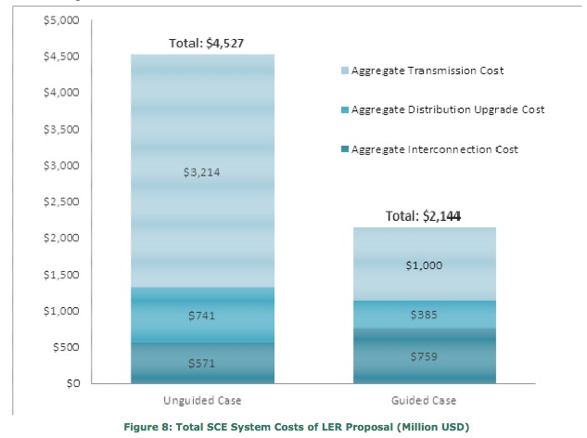
Guided Siting: Locational Value, Interconnection
SCE Share of 12,000 MW Goal
Locational Value methodology should include transmission costs.
Interconnection policies should favor high value locations, reduce cost uncertainty for developers.
Guided Siting Saves Ratepayers 50%
Source: SCE Report May 2012
Notes:
The CPUC has contracted a study 2 years ago on comparing locational value within the distribution system, but ignored comparing D-grid locations to transmission interconnection and the cost of delivering power to load. We commented on this a year ago at the last workshop (TACs and new transmission costs) but there has been zero public action since. ALL reliable peak shaving that occurs on the D-grid avoids the need for transmission capacity to meet that peak load, plain and simple. And EVERY DG kWh serving local load avoids TAC delivery charges for ratepayers. There's a reason TACs only apply to energy using the transmission system, as it's important to recognize that energy using transmission creates extra costs that are avoided by DG.
Interconnection Cost Averaging could be broadly applied. The weak IOU proposal only applied to low cost locations, but these are the more urban/close-to-load locations and it still gets the door open on the first US flat rate d-grid upgrade charges for WDG.
At least as important is our separate but related Cost Certainty proposal - where studies are required, offer a binding cap based on 125% of the estimated cost. This "not to exceed" study result would greatly reduce the risk and uncertainty around interconnection.
Notes on graphic:
A May 2012 study by Southern California Edison found that T&D upgrade costs for their share of the Governor’s goal of 12,000 MW of distributed generation could be reduced by over 50% from the trajectory scenario. The lower costs were associated with the “guided case” where 70 percent of projects would be located in urban areas, and the higher costs were associated with the “unguided case” where 70 percent of projects would be located in rural areas.
The Impact of Localized Energy Resources on Southern California Edison’s Transmission and Distribution System, SCE, May 2012
All interconnection and upgrade costs are ultimately included in energy prices and T&D charges reflected in rates
The goal of new cost arrangements in this proceeding should be to reduce rates through optimal use of grid capacity and cost-effective interconnection policies for lower net cost of delivered energy
Billions of dollars in avoided transmission may be saved if investments are cost-effectively redirected to enable generation close to loads within the local distribution system

Slide 33
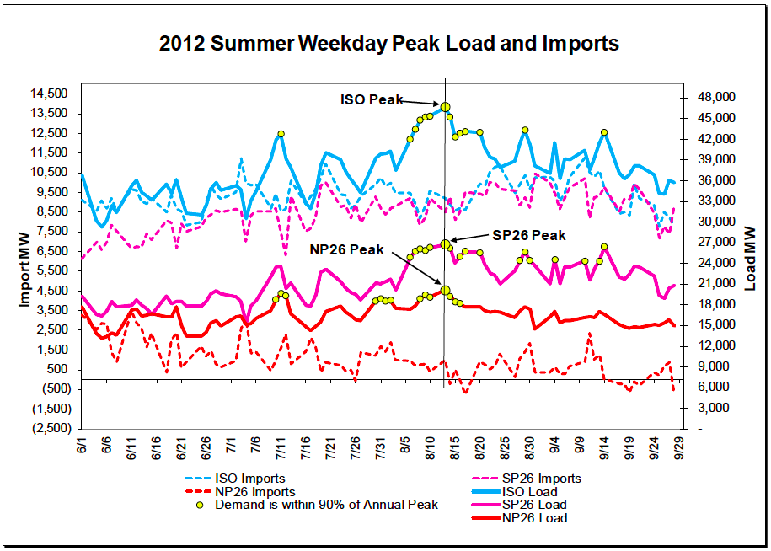
Import/Exports – Transmission Not the Issue
2012 Peak Daily ISO Imports = ~11,500 MW
Source: CAISO 2013 Summer Loads & Resources Assessment (May 6, 2013)
Notes:
2012 summer weekday peak imports by CAISO (~8,000 to 11,500 MW) show that transmission capacity is not the issue for imports/exports.
However, CA has not traditionally exported significant levels of energy. CA needs to study the potential for other balancing authorities to accept our exports, taking into account the needs of other BAs, and existing and potential policies to facilitate greater levels of exports.
33

Slide 34
Advanced Inverters – Reactive Power
Advanced Inverter at 0.9 Power Factor = 43.6% reactive power
REACTIVE (Q)
P: Real power (kW)
Q: Reactive power (kVAr)
S: Total power (kVA)
S
100%
Q
43.6%
REAL (P)
100 kW solar PV AC power
100 kVA inverter capacity
0.9 power factor
43.6 kVAr reactive power
90 kW real power
P
90%
Standard-sized inverter:
Diverts up to 10% solar capacity to provision reactive power
Notes:
The unity power circle shows that an advanced inverter at 0.9 power factor (as set in Germany) can provision 44% of its nameplate capacity reactive power while diverting only up to 10% of solar real power capacity.
Percentages refer to percent of rated AC power

Slide 35
Advanced Inverters – Reactive Power (Oversized)
REACTIVE (Q)
P: Real power (kW)
Q: Reactive power (kVAr)
S: Total power (kVA)
S
110%
100 kW solar PV AC power
110 kVA inverter capacity
0.9 power factor
45.8 kVAr reactive power
100 kW real power
Q
45.8%
REAL (P)
P
100%
Oversized inverter:
No reduction of PV real power
Draws up to 10 kW real power from the grid
Provides reactive power 24/7/365
Notes:
When the inverter is oversized, it allows all of the DG power to be put into delivering real power back to the grid, maximizing the system owner’s revenue.
When reactive power is needed, real power can be drawn back from the grid and redirected into reactive power to assist in voltage regulation. This can be done at any time, even when there is no power coming from the DG, e.g. at night on PV systems.
The unity power circle shows that an advanced inverter at 0.9 power factor (as set in Germany) can provision 46% of its nameplate capacity as reactive power while drawing up to 10% of its nameplate capacity of real power from the grid.
Percentages refer to percent of rated AC power

Slide 36
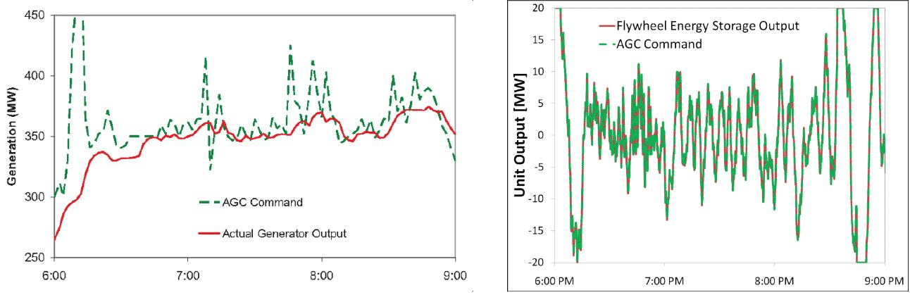
Regulation: Faster, More Accurate Solutions
Ideal flexible resources should look like storage, not natural gas –
faster, more accurate, cleaner, and full capacity to dispatch and absorb power.
Flywheel Storage
Conventional Spinning Generator
Storage provides both supply and demand
Faster and more accurate regulation = less MW required
Notes:
36

Slide 37
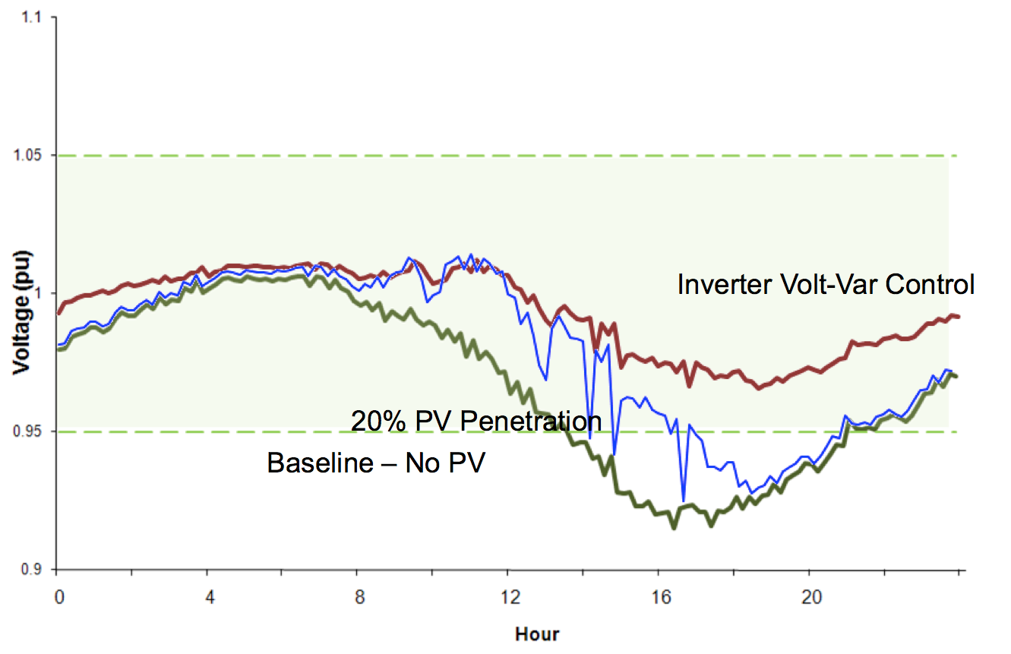
Advanced Inverters Keep Voltage in Balance
Advanced inverters have been programmed to deliver reactive power in Germany and Georgia Power’s territory.
Proposed changes to IEEE 1547a and UL standards will allow advanced inverters to provide reactive power for voltage regulation in California.
Source: EPRI (2011)
Notes:
The chart above shows how solar paired with advanced inverters keeps voltage within appropriate boundaries.
Green line shows baseline local voltage dipping below the bounds in a particular location
Blue line shows local voltage with 20% PV penetration (max solar output to peak). Voltage is still dipping below optimal bounds when less sunlight is available.
Red line shows local voltage regulated by solar with advanced inverters. When there’s less sun available to provide real power to keep voltage high enough, the advanced inverters draw real power from the grid and convert it to reactive power to keep voltage within the optimal range.
Advanced notes:
Source of graphic: Advanced Voltage Control Strategies for High Penetration of Distributed Generation, EPRI 1020155, Figure 4-28 Secondary Voltages at a Customer on the Feeder
Voltage levels fall later in the day during periods of peak demand. More demand → lower voltages.
For high-pen of local generation, over-voltages are a bigger concern. Use storage or AI reactive power to lower voltages.
Reactive power can both raise and lower voltage.

Slide 38
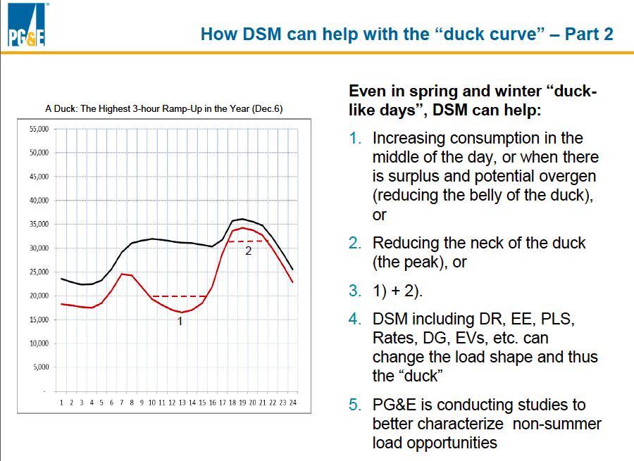
Flattening the Duck – Demand Response
  Source: PG&E and CPUC meeting 12/11/2013
Notes:
PG&E supports this approach as a very cost-effective way to address the Duck curve and is exploring non-summer load shifting opportunities.
38

Slide 39
German Solar Pricing Translates to 5 cents/kWh
Project Size | Euros/kWh | USD/kWh | California Effective Rate $/kWh
Under 10 kW | 0.145 | 0.1903 | 0.0762
10 kW to 40 kW | 0.138 | 0.1805 | 0.0722
40.1 kW to 1 MW | 0.123 | 0.161 | 0.0644
1.1 MW to 10 MW | 0.101 | 0.1317 | 0.0527
Source: http://www.wind-works.org/cms/index.php?id=92, 10 September 2013
Conversion rate for Euros to Dollars is €1:$1.309
California’s effective rate is reduced 40% due to tax incentives and then an additional 33% due to the superior solar resource
Replicating German scale and efficiencies would yield rooftop solar at only between 5 and 7 cents/kWh to California ratepayers
Notes:
Critics of Germany’s CLEAN Program tend to say that they are paying too much for renewable energy generation, but this chart shows that – using the appropriate conversion – they are paying less for solar than we pay for electricity almost anywhere in the U.S. This conversion uses the U.S. tax incentives and solar resource.

Slide 40
PV Potential of Top 25 Roofs in LA is Over 75 MW
100+ GW of Built-Environment Solar Potential in California vs 60 GW of Peak Load
Notes:
40

Slide 41
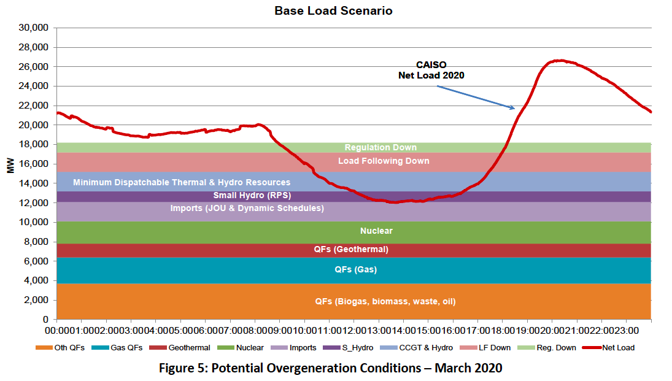
Flattening the Duck – Curtail Baseload
Source: CAISO/NERC variable resources integration report (Nov 2013)
Notes:
Notes:
QFs gas = CHP
CAISO plans on exploring ways to incentivize Qualifying Capacity (QFs) to curtail production during low net load demand periods in order to minimize the magnitude of potential over-generation. (From 2013 CAISO/NERC report.)
41

Slide 42

Benefits of Modernizing the Grid
Power Quality, Reliability & Resilience benefits
  Increased customer satisfaction
  Improved equipment longevity
  Sustained vital services in otherwise complete blackout scenarios
  Avoided transmission & central generation vulnerabilities
Economic benefits
  Significant private-sector investment
  Substantial local job creation
  Fixed electricity prices for 20+ years
  Localized energy spending
  Avoided inefficiencies of central generation & transmission
Environmental benefits
  Avoiding dirty power generation, including nasty peaker plants that are often sited in underserved communities
  Utilizing built-environments and disturbed lands for generation projects
  Preserving pristine environments from transmission lines and other infrastructure

Slide 43
Replace SONGS – Solar PV + Advanced Inverters
vs
Huntington Beach
290 MVars
(minus line losses =
261 MVars)
570 MW of local solar with advanced inverters, oversized by 10% set at 0.9 Power Factor = 261 MVArs
Notes:
SONGS provided a large amount of reactive power for voltage regulation in Southern California.
Local solar PV paired with advanced inverters can cost-effectively both reduce load on transmission lines and provide large amounts of reactive power 247/365 without reducing the amount of real power it provides while the sun shines.
For example, 570 MW capacity of PV with advanced inverters oversized by 10% at 0.9 power factor could provide the same amount of reactive power as the Huntington Beach synchronous condensers.

Slide 44

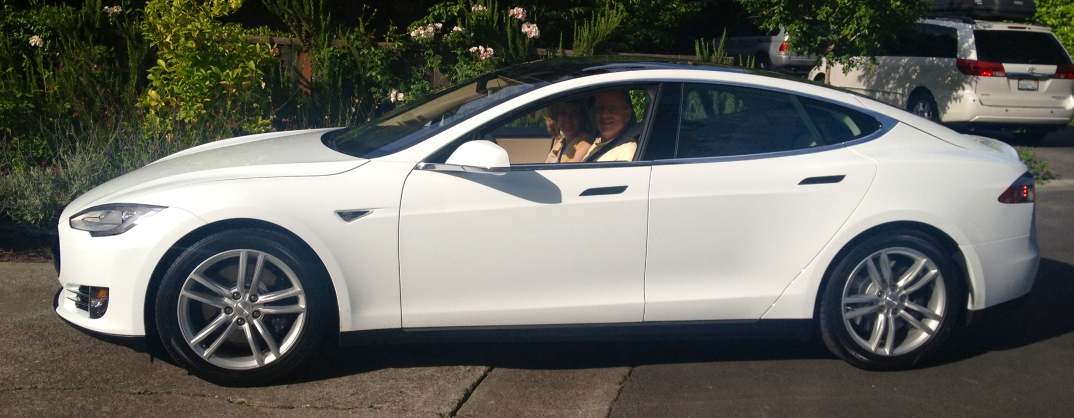
The Fossil Free Future is Arriving
Notes:
(sw 2, 19 Jan 2012)
44

