Slide 1
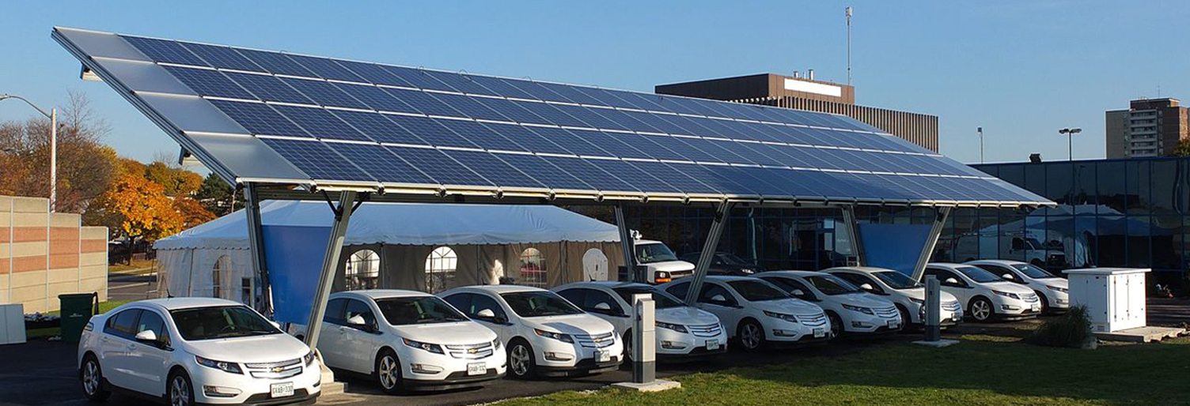
North Bay Community Resilience Initiative:
The Path to Resilience and Sustainability
Greg Thomson
Director, Community Microgrid Initiative
Clean Coalition
415-845-3872 mobile
greg@clean-coalition.org

Slide 2
Clean Coalition (nonprofit) mission
To accelerate the transition to renewable energy and a modern grid through
technical, policy, and project development expertise
Notes:
2

Slide 3
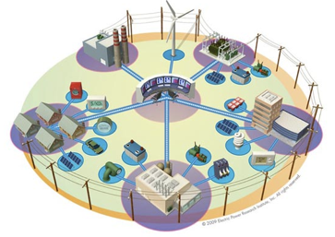
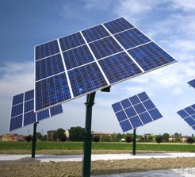

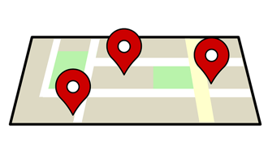
Expertise areas
Community Microgrid Projects
Program and Policy Design
Grid Modeling & Optimization
Analysis & Planning
Full cost and value accounting for DER; siting analysis
PG&E
PSEG
SCE
Powerflow modeling; DER optimization
PG&E
PSEG
SCE
Grid planning, procurement, and interconnection
LADWP, Fort Collins, PSEG
City of Palo Alto (FIT and solar canopy RFP)
RAM, ReMAT
Rule 21 & FERC
Design and implementation
San Francisco, CA
Long Island, NY
U.S. Virgin Islands
Notes:
3

Slide 4
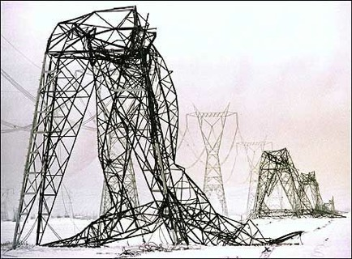
Energy is critical infrastructure
Our legacy, centralized energy architecture carries multiple critical risks.
This architecture is costly, aging, inefficient, and a highly vulnerable security risk
Extreme weather events are occurring more frequently, further demonstrating the vulnerability and high cost
Cyber attacks are a growing risk, and an attack on a centralized system can affect millions
To ensure both local and national security, we must move quickly to a new solution
  Community Microgrids:
  Cleaner, more reliable and resilient, more affordable

Slide 5
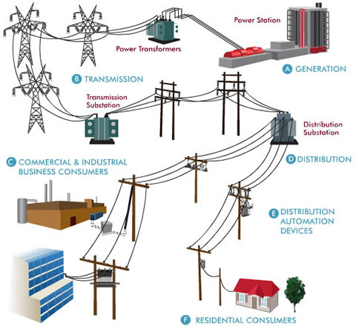
Traditional microgrids focus on single customers
Source: Oncor Electric Delivery Company
Notes:
5

Slide 6
Community Microgrids serve thousands of customers
Source: Oncor Electric Delivery Company
Notes:
6

Slide 7
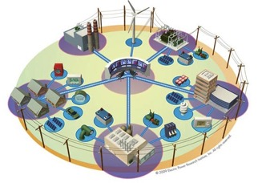
Community Microgrids: The grid of the future
Community Microgrids are a modern approach for designing and operating the electric grid, stacked with local renewables and staged for resilience.
Key features:
A targeted and coordinated local grid area served by one or more distribution substations
Optimal penetrations of clean local energy and other Distributed Energy Resources (DER) such as energy storage and demand response
Ongoing, renewables-driven backup power for critical and prioritized loads across the grid area
A solution that can be readily extended throughout a utility service territory – and replicated into any utility service territory around the world
Notes:
http://ewh.ieee.org/r6/san_francisco/ias/archive/pdf/archived_presentations/2009_11_IAS_Presentation.pdf

Slide 8
Community Microgrids: Why?
A Community Microgrid brings communities four benefits that are not provided by today’s mostly centralized energy system.
Lower costs and increased economic investment
  Reduces the cost of electricity by eliminating expensive peak periods and associated infrastructure costs
  Increases local economic investment
Improved overall performance
  Replaces fossil fuels, improves grid performance, and serves local transportation needs
  Provides better outcomes for all stakeholders
Resilience and security
  Provides ongoing power to critical and priority loads
  in communities
  Can withstand multiple disaster and/or cybersecurity scenarios
Replicable and scalable model
  Can cover an entire substation area
  Can be scaled and deployed in any community
Notes:
Additional Benefits:
(1) Scalable - design and control logic can be applied to individual building, large campus, up to entire local distribution area
(2) Microgrids at different sizes can be linked in a hierarchical network for simpler, more stable control architecture
(3) This nesting enhances cyber-security as well as resilience to major disruptions

Slide 9



Community Microgrids: Benefits analysis
Example target: 30 MW Solar PV
Benefits over 20 years
Energy
Cost parity: Solar vs. NG, LCOE
$150M: Spent locally vs. remotely
$50M: Avoided transmission costs
$20M: Avoided power interruptions
Economic
$120M: New regional impact
$60M: Added local wages
1,000 job-years: New near-term and ongoing employment
$6M: Site leasing income
Environmental
46M pounds: Annual reductions in GHG emissions
10M gallons: Annual water savings
225: Acres of land preserved
Example: Large rooftop
PV sq. ft = 47,600
System size = 714 kW
Example: Large parking lot
PV sq. ft = 37,800
System size = 567 kW
Example: 50 avg. rooftops
Avg. PV sq. ft = 343
Avg. system size = 5 kW
Commercial: 18 MW
Parking lots: 2 MW
Residential & MDU: 10 MW
Notes:
ENERGY BENEFITS
Cost Parity via 20-year LCOE:
14.9¢/kWh solar vs. $15.3¢/kWh new combined cycle natural gas, LCOE. Modeling performed with NREL System Advisor Modeling (SAM) and PVWatts system design, using the mid-case scenario. For more details, see detailed LCOE slide later in deck.
Local Energy Spend
Based on 20 year average of $2,619,260 per year from avg output of 1484kWh/yr over that period
$52M over 20 years per 10MW
Avoided transmission access charges (TAC):
Calculated from CAISO 2013 TAC schedule and infrastructure projections. Note that the reductions in TAC are included in the LCOE comparison.
Avoided Costs from New Transmission Capacity:
Each 10 MW of added PV DG capacity will reduce the need for added transmission capacity investment by 0.05% relative to CAISO BAU projections and the related growth in TAC ratesResults in 0.0012¢/kWh reduction TAC rates applied to virtually all of the 254,000 GWh consumed within CAISO transmission system electricity by 2020
Avoided Line Losses
Based on PG&E Bay Area reported line loss rates, combined avoided line losses from transmission and distribution due to distributed generation average 5%, or 789 MWh per year for each 10 MW of PV DG installed. At an average current retail value of 15¢/kWh, the value of avoided losses is $118,350 per year, totaling $2,367,000 over 20 years.
Note that avoided lines losses are included in LCOE comparison.
Avoided Costs in Local Power System Interruptions:
Based on PG&E figures for Hunters Point outages, 10 MW of local DG would result in a 10% reduction in annual outages alone, or $304,000 per year, or $6M over a 20 year period. 50 MW would equal five times that, or $30M over 20 years. Source: PG&E 2012 Reliability Annual Report, DOE Interruption Cost Calculator - http://www.icecalculator.com/
ECONOMIC BENEFITS
Private Investment + Operations & Maintenance:
$200M investment over 20 years is comprised of near-term plus ongoing operations and maintenance as follows:
1. $165M represents the private investment amount for a 50MW PV system over 20 Years, as follows:
Installation & Construction: $137M ($27.5M per 10 MW)
Dynamic Grid Solutions @ 20% = $27,500
Total = $165K
O&M: $35M represents the O&M costs for a 50MW PV system over 20 years, as follows:
O&M adds $1.48M annually, or $29.7M over 20 years
plus 20% or $5.9M for Dynamic Grid Solutions
Total = $35.6M over 20 years.
Local Employment and Economic Impact:
Specific to MTA – Metropolitan Region.
Refers to PV installed in San Francisco at an average installed cost of $2.75/W(dc) (before taxes and incentives).
Local economic output is calculated as the value of expenditures on goods and services resulting from the project and captured within the study area, and excludes expenditures outside the region, such as to module manufacturers. During operating years local economic output is comprised of payments made by project owners, including the portion of project debt payments made to lenders located within the local analysis area. Payments including incentives, refunds, or revenues to project owners from the sale of energy produced by installed facilities are not included.
Economic activity in input-output models is assessed in three categories:
Salaries and wages for the project on-site labor and direct professional services
Local supply chain revenue related to materials acquisition, manufacture and services, including the local share of revenues from project financing and investment
Induced impacts in the local economy that result from workers salaries and wages
The model’s “output” is the sum of the above three categories for construction and for operations. State-specific multipliers and personal spending patterns are used to derive the results.
Near-term Job years of regional local employment from construction and installation. Ongoing job years in operation and maintenance over 25 years of operation.
Local wages in construction & installation.
The SF successor RDA estimates that 50% of the jobs and economic output will be captured within the boundaries of the city
Equipment and material sales will generate tax revenue as indicated.
NREL's JEDI models classify the first category of results—on-site labor and professional services results—as dollars spent on labor from companies engaged in development and on-site construction and operation of power generation and distribution. These results include labor only—no materials.
Econ impact
NREL JEDI model version PV 10.17.11
NREL JEDI Scenario model PVS 4.5.13
PV PPA pricing
NREL System Advisor Model (SAM) v. 2013.9.20
CEC Cost of Generation Model v.2
ENVIRONMENTAL BENEFITS
GHG Reductions:
Assuming PV replaces Combined Cycle Natural Gas (CCNG) generation in contributing to California’s Renewable Portfolio Standard (RPS), avoided emissions from displaced CCNG facilities equal:
CO₂: 16,630,000 lbs (7461 Metric tons)
NO_{X}: 30,700 lbs
Mercury (Hg): 0.016 lbs
Source: NREL Emissions Health Calculator, PG&E service territory
Water Use:
Thermal generation, including both fossil and nuclear facilities requires significant water use for cooling. NGCC facilities with cooling towers consume 0.7 cubic meters of water per MWh through evaporation.
A 10 MW PV facility would save:
11,050 cubic meters of water per year, or nearly 3 Million gallons, or 3,900 cubic feet.
This is equivalent to the average annual water use of 75 San Francisco residents.
Source: DOE 2009
Land saved, acres
DG avoids land impacts vs. conventional generation because it is typically deployed as a secondary use on existing structures, parking lots or otherwise already disturbed land. Each 10MW of DG preserves 75 acres of land. This does not include savings for adding transmission lines as well. Source: Civil Society Institute – “Hidden Costs of Electricity” (Sep 2012)

Slide 10

North Bay Community Resilience Initiative
Objective: make energy abundant, affordable, resilient, and sustainable
Rebuild fire-destroyed areas with high levels of sustainability in homes, buildings, and the electric grid, enabling a modern, distributed, and carbon-free system that delivers substantial economic, environmental, and resilience benefits.
Establish a blueprint for rebuilding disaster-destroyed areas in a timely and cost-effective manner that also maximizes the economic and resilience value of energy as a critical resource to ratepayers, property owners, and municipalities.
Provide a model for operating a modern distribution grid that incorporates optimal distributed energy resources, cost-effective local balancing, full interaction with the transmission system, and local energy markets — with resulting benefits across both grid operations and economics.
Ensure that building codes are advanced to achieve more resilient, safer, and cleaner building stock and communities.
Lower ratepayer costs: DER will be utilized to defer or avoid substantial costs in centralized energy delivery, including peak energy procurement and transmission & distribution (T&D) infrastructure investments.
Notes:
10

Slide 11

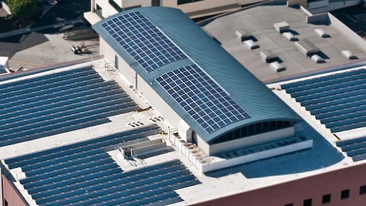
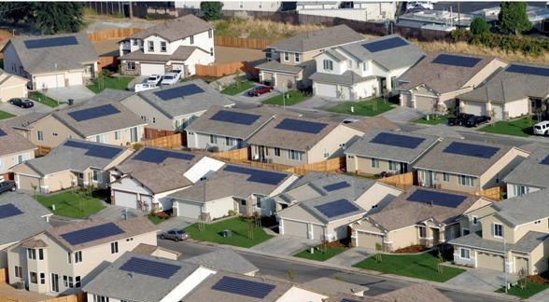
North Bay Community Resilience Initiative
Homes and buildings are grid partners
Well-designed and well-situated ZNE homes: A valuable part of the resource mix when combined with larger PV arrays on commercial and industrial structures
Notes:
11

Slide 12
Advanced Energy Rebuild for Homes
  Support for rebuild
  Sonoma Clean Power (SCP), Pacific Gas and Electric Company (PG&E), and Bay Area Air Quality Management District have joined efforts to help homeowners affected by the October 2017 firestorms rebuild energy-efficient, sustainable homes.
  The program will be an enhancement to PG&E’s long-standing California Advanced Homes Program, and offers two incentive packages tailored to Sonoma and Mendocino Counties.
  Each package has a flexible performance pathway or a simple prescriptive menu.
  For questions about the program, please e-mail programs@sonomacleanpower.org.
  Advanced Energy Rebuild for Homes
  Program scheduled to launch in early May
  Check back in early April for details on incentives and criteria.
  https://sonomacleanpower.org/advancedenergyrebuild/
Notes:
12

Slide 13
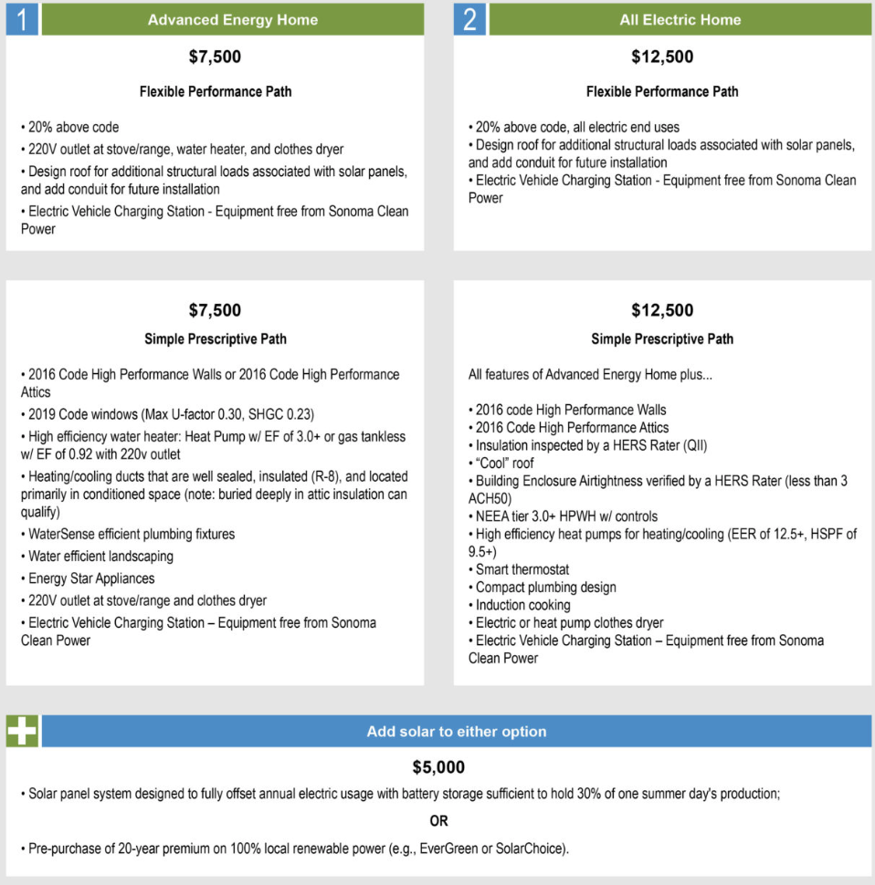
Advanced Energy Rebuild for Homes
Notes:
13

Slide 14

North Bay Community Resilience Initiative
  Team
  Clean Coalition
  Sonoma Clean Power
  PG&E
  Rebuild North Bay
  Center for Climate Protection
  County of Sonoma, Energy & Sustainability Division
  Regional Climate Protection Authority
  Bay Area Air Quality Management District
  Design AVEnues, LLC — EE/ZNE expert Ann Edminster
  Stone Edge Farm Microgrid
Stone Edge Farm Microgrid
Notes:
14

