Slide 1
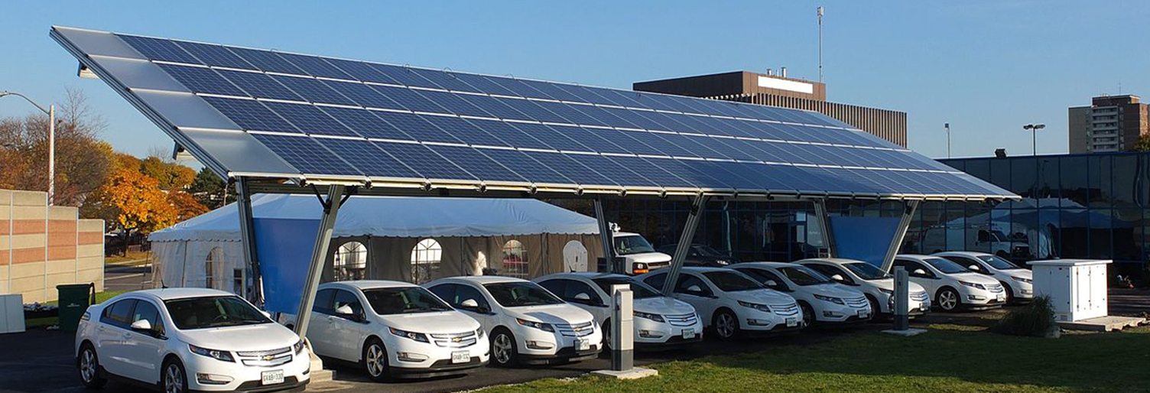
The Sonoma Community Microgrid Initiative:
The Path to Resilience and Sustainability
Greg Thomson
Director, Community Microgrid Initiative
Clean Coalition
415-845-3872 mobile
greg@clean-coalition.org

Slide 2


GoToWebinar FAQ
Webinar recording and slides will be sent to registered attendees within two business days
All webinars are archived on www.clean-coalition.org and the Clean Coalition’s YouTube channel
Submit questions in the Questions window at any time (window view varies by operating system and browser)
Questions will be answered during the Q&A portion of the webinar
Contact Josh for webinar questions: josh@clean-coalition.org

Slide 3
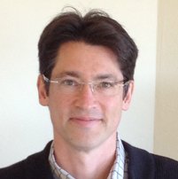
Today’s presenter
Greg Thomson
Director, Community Microgrid Initiative
greg@clean-coalition.org
Notes:
Who is the CC: The Clean Coalition is a nonprofit working to accelerate America’s transition away from an outdated energy system built around large, centralized, fossil-fueled power plants and miles of inefficient transmission lines; and toward a modern energy system where smaller-scale, efficient, renewable energy projects deliver affordable and reliable power to communities.
Transitioning to clean local energy generation drives innovation and economic development. And it empowers communities to turn underused space — such as rooftops and abandoned industrial sites — into cost-effective renewable energy resources.

Slide 4
Clean Coalition (nonprofit) mission
To accelerate the transition to renewable energy and a modern grid through
technical, policy, and project development expertise
Notes:
4

Slide 5
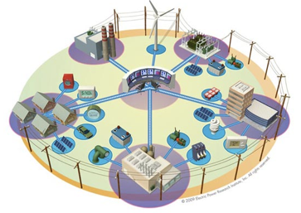


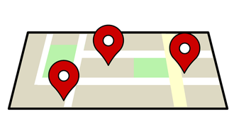
Expertise areas
Community Microgrid Projects
Program and Policy Design
Grid Modeling & Optimization
Analysis & Planning
Full cost and value accounting for DER; siting analysis
PG&E
PSEG
SCE
Powerflow modeling; DER optimization
PG&E
PSEG
SCE
Grid planning, procurement, and interconnection
LADWP, Fort Collins, PSEG
City of Palo Alto (FIT and solar canopy RFP)
RAM, ReMAT
Rule 21 & FERC
Design and implementation
San Francisco, CA
Long Island, NY
U.S. Virgin Islands
Notes:
5

Slide 6
The Sonoma Community Microgrid Initiative Part Part 1: Overview of Community Microgrids

Slide 7
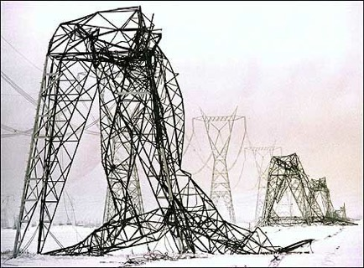
Energy is critical infrastructure
Our legacy, centralized energy architecture carries multiple critical risks.
This architecture is costly, aging, inefficient, and a highly vulnerable security risk
Extreme weather events are occurring more frequently, further demonstrating the vulnerability and high cost
Cyber attacks are a growing risk, and an attack on a centralized system can affect millions
To ensure both local and national security, we must move quickly to a new solution
  Community Microgrids:
  Cleaner, more reliable and resilient, more affordable

Slide 8
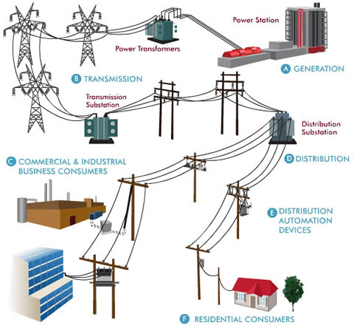
Traditional microgrids focus on single customers
Source: Oncor Electric Delivery Company
Notes:
8

Slide 9
Community Microgrids serve thousands of customers
Source: Oncor Electric Delivery Company
Notes:
9

Slide 10
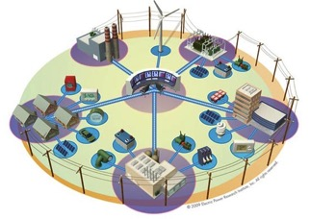
Community Microgrids: The grid of the future
Community Microgrids are a modern approach for designing and operating the electric grid, stacked with local renewables and staged for resilience.
Key features:
A targeted and coordinated local grid area served by one or more distribution substations
Optimal penetrations of clean local energy and other Distributed Energy Resources (DER) such as energy storage and demand response
Ongoing, renewables-driven backup power for critical and prioritized loads across the grid area
A solution that can be readily extended throughout a utility service territory – and replicated into any utility service territory around the world
Notes:
http://ewh.ieee.org/r6/san_francisco/ias/archive/pdf/archived_presentations/2009_11_IAS_Presentation.pdf

Slide 11
Community Microgrids: Why?
A Community Microgrid brings communities four benefits that are not provided by today’s mostly centralized energy system.
Lower costs and increased economic investment
  Reduces the cost of electricity by eliminating expensive peak periods and associated infrastructure costs
  Increases local economic investment
Improved overall performance
  Replaces fossil fuels, improves grid performance, and serves local transportation needs
  Provides better outcomes for all stakeholders
Resilience and security
  Provides ongoing power to critical and priority loads
  in communities
  Can withstand multiple disaster and/or cybersecurity scenarios
Replicable and scalable model
  Can cover an entire substation area
  Can be scaled and deployed in any community
Notes:
Additional Benefits:
(1) Scalable - design and control logic can be applied to individual building, large campus, up to entire local distribution area
(2) Microgrids at different sizes can be linked in a hierarchical network for simpler, more stable control architecture
(3) This nesting enhances cyber-security as well as resilience to major disruptions

Slide 12
Community Microgrids feature “local balancing”
Local balancing is a more efficient way to operate the grid
Flattens and lowers load shapes across entire community areas, reducing system-wide peaks and thus the most costly energy and grid infrastructure
Manages variability/volatility locally, rather than exporting volatility as an aggregated issue up to the centralized system
Provides energy resiliency and security to cities and communities via power generated, delivered, and consumed locally
The distribution and transmission grids become equal partners in grid operations and efficiencies.

Slide 13
Local balancing offers multiple economic benefits
The six economic benefits of local balancing via Community Microgrids
  Cost reductions due to peak management
    Protection against the high cost of peak energy
  Cost reductions due to demand charges
    Protection against additional fees charged by utilities for peaks
  Cost reductions due to rate management:
    Protection against future rate changes, e.g., evening ramp
  Cost reductions due to investment deferrals
    Deferral of substantial costs for centralized infrastructure
  Cost certainty
    Keeping rates and costs constant for consumers as well as grid operators.
  Increased economic investment in communities
The current cost issues are a product of our mostly centralized system

Slide 14

Example: Local balancing optimizations
Opportunity:
Vastly untapped commercial and industrial energy assets
The formula for low-carbon cities:
Example: Solar on 25% of commercial and industrial rooftops
= 25%+ local annual energy use
    Largest financial opportunity — largest DER systems
    Largest rooftops and parking lots — most generation
    Largest daytime loads — matching solar
    Largest utility bills, including demand charges — motivated
    Best solution for grid — system peak reduction, strong feeders
    Most carbon emissions within cities

Slide 15
The Sonoma Community Microgrid Initiative Part Part 2: Community Microgrid examples

Slide 16
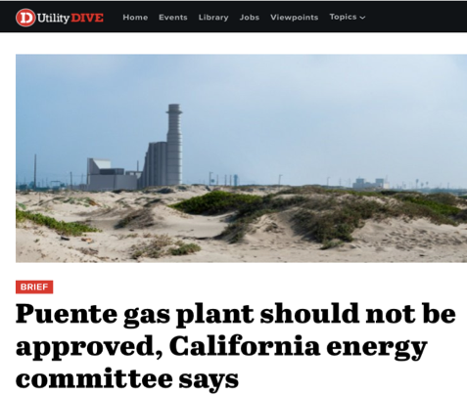
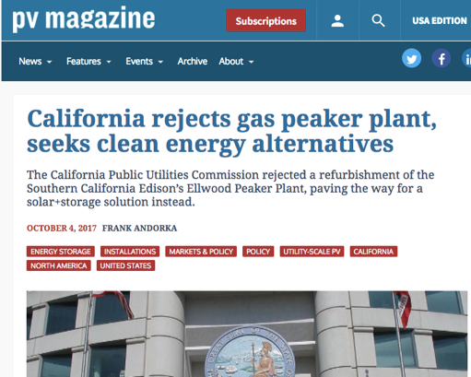
Example: California
Setting a precedent: Community Microgrids eliminate gas peakers
Influenced by Clean Coalition cost analysis, the California regulators are rejecting new peaker plants, such as Puente in Oxnard, CA, in favor of solar+storage
In Jan 2018, the California Public Utilities Commission also announced that PG&E will be required to use renewables and storage instead of gas-fired plants run by Calpine
This appears to be “the first time a utility will procure energy storage to replace existing gas plants for local capacity needs.”
Leveraging this important analysis can prevent future new gas plants across the country
Source: https://www.greentechmedia.com/articles/read/pge-must-solicit-energy-storage-ders-to-replace-three-existing-gas-plants
Notes:
On October 5, at the urging of Clean Coalition, the California Energy Commission halted the Puente Power Project $299 million, 262 MW gas-fired beachfront power plant in Oxnard, CA, which is a Disadvantaged Community as defined by CalEPA’s CalEnviroScreen 3.0.
This follows on the heels of another nearby gas-fired project rejected by the California Public Utilities Commission after Clean Coalition analysis and advocacy.
Our analysis found that this project could be replaced entirely with solar+storage at a lower cost to ratepayers and a significantly reduced local environmental impact.
Our study and model of the alternative to the Puente Power Project using solar+storage can be downloaded here: http://www.clean-coalition.org/press-releases/solarstorage-is-more-cost-effective-than-proposed-gas-plants-in-southern-california/
Press Coverage:
Utility Dive: http://www.utilitydive.com/news/california-energy-interests-set-to-square-off-over-puente-natural-gas-plant/504472/
Greentech Media: https://www.greentechmedia.com/articles/read/caiso-suggests-new-rfo-to-settle-question-of-storage-vs-puente-gas-plant
PV Magazine: https://pv-magazine-usa.com/2017/10/04/california-group-applauds-gas-peaker-plant-rejection-seeks-clean-energy-alternatives/
Clean Coalition filings:
Ellwood Peaker - http://www.clean-coalition.org/regulatory-filings/cpuc-rejecting-ellwood-peaker-plant-refurbishment-solarstorage-analysis/
Puente alternatives - http://www.clean-coalition.org/regulatory-filings/cpuc-proposing-a-cost-effective-solarstorage-alternative-to-puente-gas-plant-with-supplemental-testimony/

Slide 17
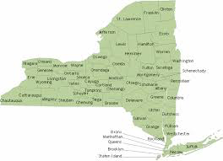
Example: New York
New York State uses peak power only 100 hours each year – costing ratepayers $1.7 billion to serve less than 1% of the system’s needs.
On Jan 2, 2018 Gov. Andrew Cuomo announced a state initiative to deploy 1,500 MW of energy storage by 2025.
Includes utility procurements, changes in utility rates and wholesale energy markets, and storage for large-scale renewable procurements
The Marcus Garvey affordable housing complex in Brooklyn, NY uses a new solar+storage microgrid system to cut costs, improve grid reliability, and provide resilient backup power
NY Green Bank to commit at least $200 million for storage-related investments
Notes:
Source: Renewable Energy World.com, June 2015
http://www.renewableenergyworld.com/articles/2015/06/how-new-york-is-using-local-power-microgrids-to-transform-the-state.html

Slide 18

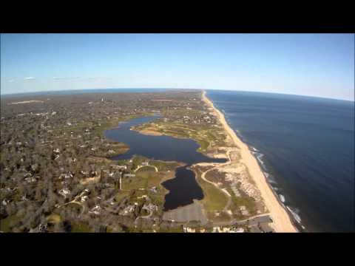

New York: Long Island Community Microgrid
  Long Island Community Microgrid (LICMP) design
  LICMP would avoid $29-38 million of new transmission capacity resulting in a net cost benefit for all ratepayers.
  The combined solar+storage system would reduce NYISO capacity charges by $6 million through 2022, and over $1 million annually thereafter.
  LICMP would shift wholesale power purchases from peak to off-peak periods, realizing net energy savings of $2.5 million by 2022 and more than $500,000 annually thereafter.
  Resilience savings from avoided outages would exceed $330,000 per outage day.
  Savings = lower electric rates for all PSEG-LI utility customers.

Slide 19
Long Island Community Microgrid design

Slide 20
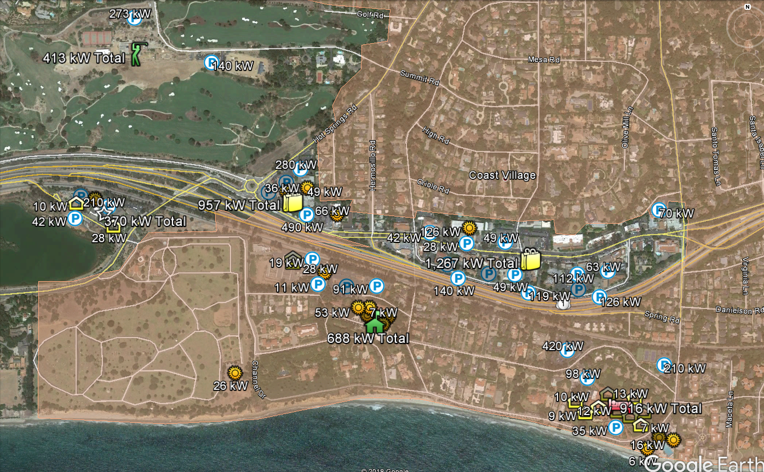
California: Montecito Community Microgrid map view

Slide 21
Montecito Community Microgrid block diagram
Montecito Country Club
Vons cluster
Other Tier 1 Loads
CVS
North of 101
Santa Barbara Substation
Hot Springs feeder loop 16 kV
Tier 2 & 3 Loads
Transmission
Tier 2 & 3 Loads
Tier 2 & 3 Loads
South of 101
Athletic Club
Event Center
Cemetery
Sanitary District
Music Academy
Four Seasons
Coral Casino
Diagram Elements
Autonomously Controllable Microgrid
Relay/Switch (open, closed)

Slide 22
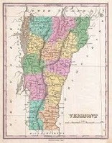
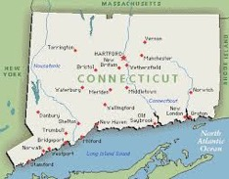

Examples: many other states
Many other states are taking big steps towards Community Microgrids – recognizing the full value including cost savings, resilience, and sustainability. These community programs cover distributed solar, storage, and now even “microgrid clusters.” (See backup slides for more…)
Vermont
Massachusetts
Connecticut
Minnesota
Illinois

Slide 23
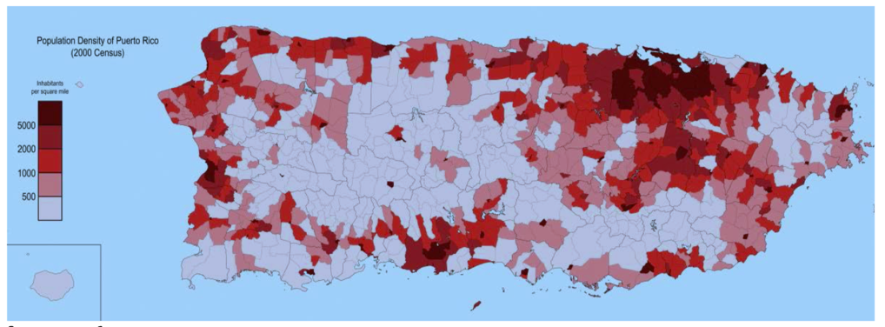
Moving forward: Puerto Rico
  Puerto Rico rebuild highlights: the “Build Back Better” plan
  A unique opportunity to rebuild and update the power system to 21st-century technologies and best practices, rethinking how power is generated and distributed.
  Hurricanes Maria and Irma decimated T&D lines across the island and caused widespread wind and flooding damage to substations, generation, and distribution facilities.
  Damage from the hurricanes resulted in the longest power outage in US history.
Notes:
23

Slide 24
Moving forward: Puerto Rico
  Puerto Rico rebuild highlights: the “Build Back Better” plan
  Team: Features many grid and energy experts including NY Power Authority, Con Ed, Edison International, EPRI, PSE&G Long Island, DOE, SEPA, Puerto Rico Electric Power Authority, Navigant Consulting, NREL, PNNL, Grid Modernization Lab Consortium
  Goal: Implement resilience and hardening measures designed to increase the capability of Puerto Rico’s electric power grid to withstand future storms
  Recommendation: Use modern grid technologies and control systems, renewable energy resources, and new technologies such as energy storage and microgrids to make energy abundant, affordable, resilient, and sustainable. Lowers the dependence on large central generating stations.
  This modern power system design will provide a model for the industry while promoting private investments in the use of clean energy for a low-carbon future.
Notes:
Also: Incorporate lessons learned from the successful rebuild efforts in other regions, post natural disasters, e.g. Hurricane Sandy in New York.
24

Slide 25
The Sonoma Community Microgrid Initiative Part Part 3: Rebuilding resiliently in Sonoma

Slide 26

Sonoma Community Microgrid Initiative
Objective: make energy abundant, affordable, resilient, and sustainable
Rebuild fire-destroyed areas with high levels of resilience and sustainability in homes, buildings, and grid, enabling a modern, distributed, and carbon-free system that delivers substantial economic, environmental, and resilience benefits.
Establish a blueprint for rebuilding disaster-destroyed areas in a timely and cost-effective manner that also maximizes the economic and resilience value of energy as a critical resource to ratepayers, property owners, and municipalities.
Provide a model for operating a modern distribution grid that incorporates optimal distributed energy resources, cost-effective local balancing, full interaction with the transmission system, and local energy markets — with resulting benefits across both grid operations and economics.
Ensure that building codes are advanced to achieve more resilient, safer, and cleaner building stock and communities.
Notes:
26

Slide 27



Sonoma Community Microgrid Initiative:
Benefits Analysis
Sonoma Initiative example target: 30 MW Solar PV
Benefits over 20 years
Energy
Cost parity: Solar vs. NG, LCOE
$150M: Spent locally vs. remotely
$50M: Avoided transmission costs
$20M: Avoided power interruptions
Economic
$120M: New regional impact
$60M: Added local wages
1,000 job-years: New near-term and ongoing employment
$6M: Site leasing income
Environmental
46M pounds: Annual reductions in GHG emissions
10M gallons: Annual water savings
225: Acres of land preserved
Example: Large rooftop
PV sq. ft = 47,600
System size = 714 kW
Example: Large parking lot
PV sq. ft = 37,800
System size = 567 kW
Example: 50 avg. rooftops
Avg. PV sq. ft = 343
Avg. system size = 5 kW
Commercial: 18 MW
Parking lots: 2 MW
Residential & MDU: 10 MW
Notes:
ENERGY BENEFITS
Cost Parity via 20-year LCOE:
14.9¢/kWh solar vs. $15.3¢/kWh new combined cycle natural gas, LCOE. Modeling performed with NREL System Advisor Modeling (SAM) and PVWatts system design, using the mid-case scenario. For more details, see detailed LCOE slide later in deck.
Local Energy Spend
Based on 20 year average of $2,619,260 per year from avg output of 1484kWh/yr over that period
$52M over 20 years per 10MW
Avoided transmission access charges (TAC):
Calculated from CAISO 2013 TAC schedule and infrastructure projections. Note that the reductions in TAC are included in the LCOE comparison.
Avoided Costs from New Transmission Capacity:
Each 10 MW of added PV DG capacity will reduce the need for added transmission capacity investment by 0.05% relative to CAISO BAU projections and the related growth in TAC ratesResults in 0.0012¢/kWh reduction TAC rates applied to virtually all of the 254,000 GWh consumed within CAISO transmission system electricity by 2020
Avoided Line Losses
Based on PG&E Bay Area reported line loss rates, combined avoided line losses from transmission and distribution due to distributed generation average 5%, or 789 MWh per year for each 10 MW of PV DG installed. At an average current retail value of 15¢/kWh, the value of avoided losses is $118,350 per year, totaling $2,367,000 over 20 years.
Note that avoided lines losses are included in LCOE comparison.
Avoided Costs in Local Power System Interruptions:
Based on PG&E figures for Hunters Point outages, 10 MW of local DG would result in a 10% reduction in annual outages alone, or $304,000 per year, or $6M over a 20 year period. 50 MW would equal five times that, or $30M over 20 years. Source: PG&E 2012 Reliability Annual Report, DOE Interruption Cost Calculator - http://www.icecalculator.com/
ECONOMIC BENEFITS
Private Investment + Operations & Maintenance:
$200M investment over 20 years is comprised of near-term plus ongoing operations and maintenance as follows:
1. $165M represents the private investment amount for a 50MW PV system over 20 Years, as follows:
Installation & Construction: $137M ($27.5M per 10 MW)
Dynamic Grid Solutions @ 20% = $27,500
Total = $165K
O&M: $35M represents the O&M costs for a 50MW PV system over 20 years, as follows:
O&M adds $1.48M annually, or $29.7M over 20 years
plus 20% or $5.9M for Dynamic Grid Solutions
Total = $35.6M over 20 years.
Local Employment and Economic Impact:
Specific to MTA – Metropolitan Region.
Refers to PV installed in San Francisco at an average installed cost of $2.75/W(dc) (before taxes and incentives).
Local economic output is calculated as the value of expenditures on goods and services resulting from the project and captured within the study area, and excludes expenditures outside the region, such as to module manufacturers. During operating years local economic output is comprised of payments made by project owners, including the portion of project debt payments made to lenders located within the local analysis area. Payments including incentives, refunds, or revenues to project owners from the sale of energy produced by installed facilities are not included.
Economic activity in input-output models is assessed in three categories:
Salaries and wages for the project on-site labor and direct professional services
Local supply chain revenue related to materials acquisition, manufacture and services, including the local share of revenues from project financing and investment
Induced impacts in the local economy that result from workers salaries and wages
The model’s “output” is the sum of the above three categories for construction and for operations. State-specific multipliers and personal spending patterns are used to derive the results.
Near-term Job years of regional local employment from construction and installation. Ongoing job years in operation and maintenance over 25 years of operation.
Local wages in construction & installation.
The SF successor RDA estimates that 50% of the jobs and economic output will be captured within the boundaries of the city
Equipment and material sales will generate tax revenue as indicated.
NREL's JEDI models classify the first category of results—on-site labor and professional services results—as dollars spent on labor from companies engaged in development and on-site construction and operation of power generation and distribution. These results include labor only—no materials.
Econ impact
NREL JEDI model version PV 10.17.11
NREL JEDI Scenario model PVS 4.5.13
PV PPA pricing
NREL System Advisor Model (SAM) v. 2013.9.20
CEC Cost of Generation Model v.2
ENVIRONMENTAL BENEFITS
GHG Reductions:
Assuming PV replaces Combined Cycle Natural Gas (CCNG) generation in contributing to California’s Renewable Portfolio Standard (RPS), avoided emissions from displaced CCNG facilities equal:
CO₂: 16,630,000 lbs (7461 Metric tons)
NO_{X}: 30,700 lbs
Mercury (Hg): 0.016 lbs
Source: NREL Emissions Health Calculator, PG&E service territory
Water Use:
Thermal generation, including both fossil and nuclear facilities requires significant water use for cooling. NGCC facilities with cooling towers consume 0.7 cubic meters of water per MWh through evaporation.
A 10 MW PV facility would save:
11,050 cubic meters of water per year, or nearly 3 Million gallons, or 3,900 cubic feet.
This is equivalent to the average annual water use of 75 San Francisco residents.
Source: DOE 2009
Land saved, acres
DG avoids land impacts vs. conventional generation because it is typically deployed as a secondary use on existing structures, parking lots or otherwise already disturbed land. Each 10MW of DG preserves 75 acres of land. This does not include savings for adding transmission lines as well. Source: Civil Society Institute – “Hidden Costs of Electricity” (Sep 2012)

Slide 28
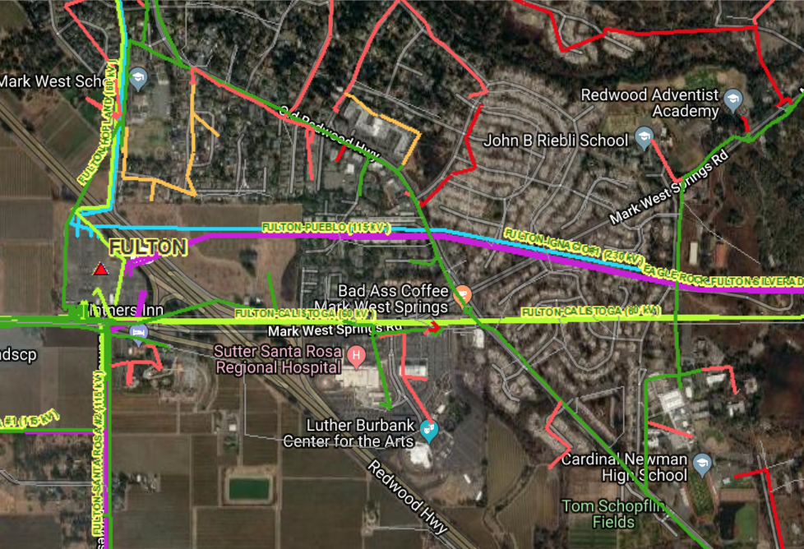
Sonoma Community Microgrid Initiative:
Example Location 1
  Larkfield and the Old Redwood Highway Corridor – ideal for Community Microgrid
  Served by single substation, Fulton.
Fire-damaged area
Notes:
28

Slide 29
Sonoma Community Microgrid Initiative
  Example key sites:
  critical, priority, large roofs & parking, etc.
  Larkfield and the Old Redwood Highway Corridor
  Sutter Santa Rosa Regional Hospital
  Luther Burbank Center for the Arts
  Cardinal Newman High School
  Mark West School and area
  Larkfield Shopping Center
  Molsberry Markets
  John B Riebli School
  St. Rose School
Notes:
29

Slide 30

Example: Larkfield and Old Redwood Highway Area
Community Microgrid block diagram
Larkfield Shopping Center
Tier 2 & 3 Loads
CVS
Tier 2 & 3 Loads
Tier 2 & 3 Loads
FULTON 1107
Fulton Substation
North of Mark West Springs Rd
Transmission
South of Mark West Springs Rd
Sutter
Santa Rosa Hospital
Medical Offices
Luther Burbank Ctr for Arts
Cardinal Newman High School
Tier 2 & 3 Loads
Diagram Elements
Autonomously Controllable Microgrid
Relay/Switch (open, closed)

Slide 31
Example Community Microgrid Elements
Cluster | Elements | PV kW AC
Sutter Regional Hospital | Hospital | 959
 | Medical Offices | 1144
 | Luther Burbank Ctr | 1722
Larkfield Shopping Center | Shopping Center & Fire Station | 920
Cardinal Newman HS | School | 789

Slide 32
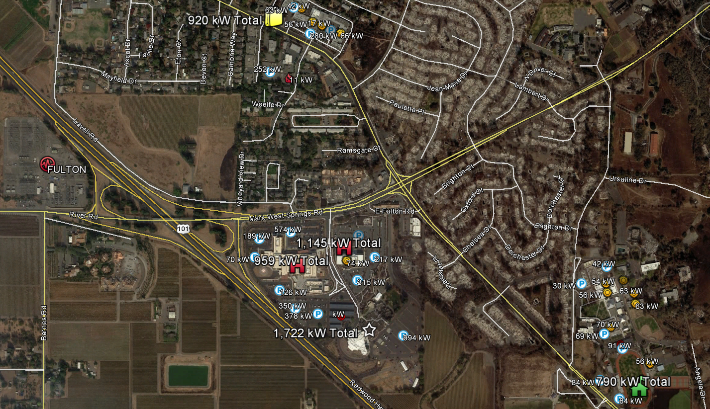
Example Sonoma Community Microgrid Elements:
Fulton substation area

Slide 33
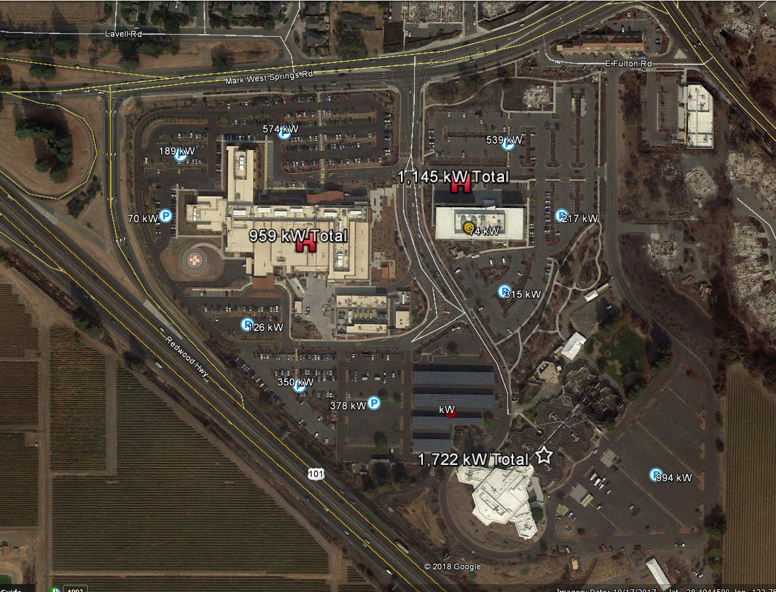
Hospital Cluster

Slide 34
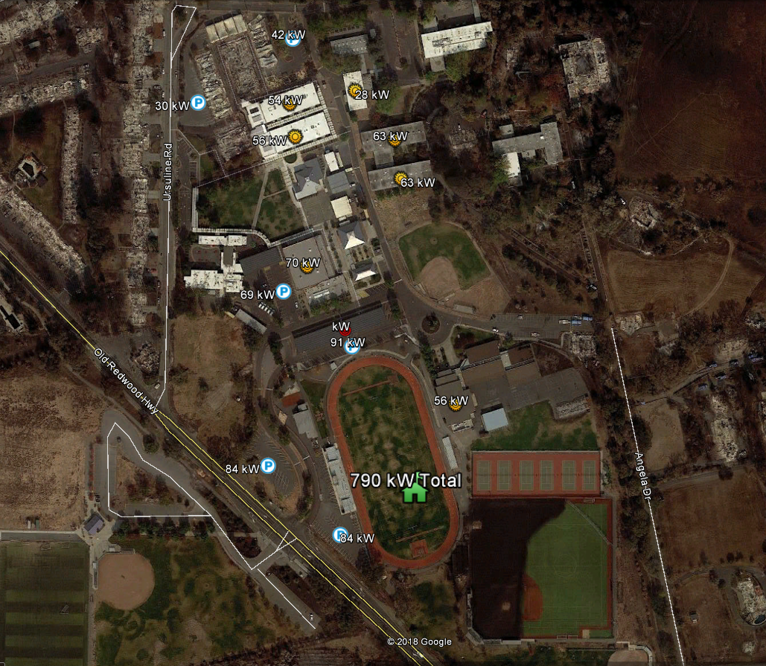
Cardinal Newman High School Cluster

Slide 35
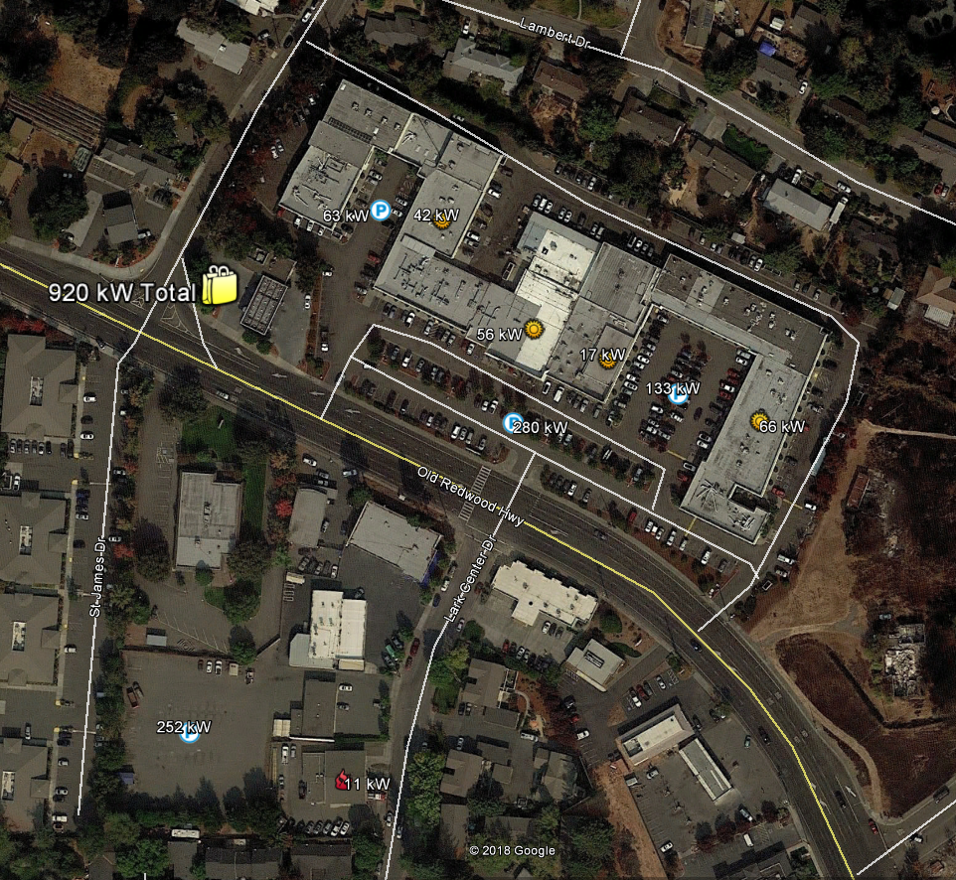
Larkfield Shopping Center Cluster
Fire Station

Slide 36
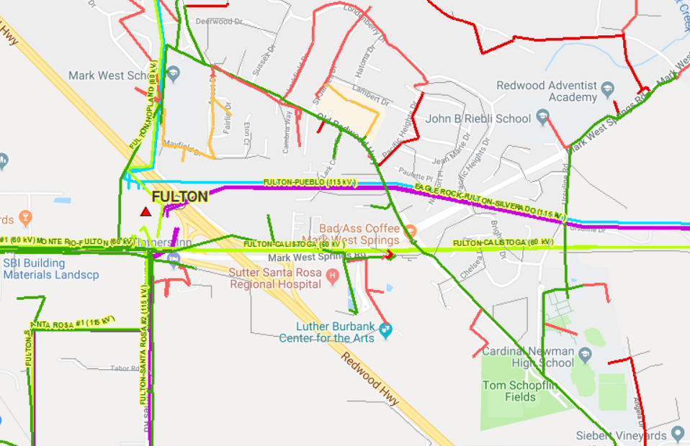
ICA Feeder Map with clusters circled

Slide 37
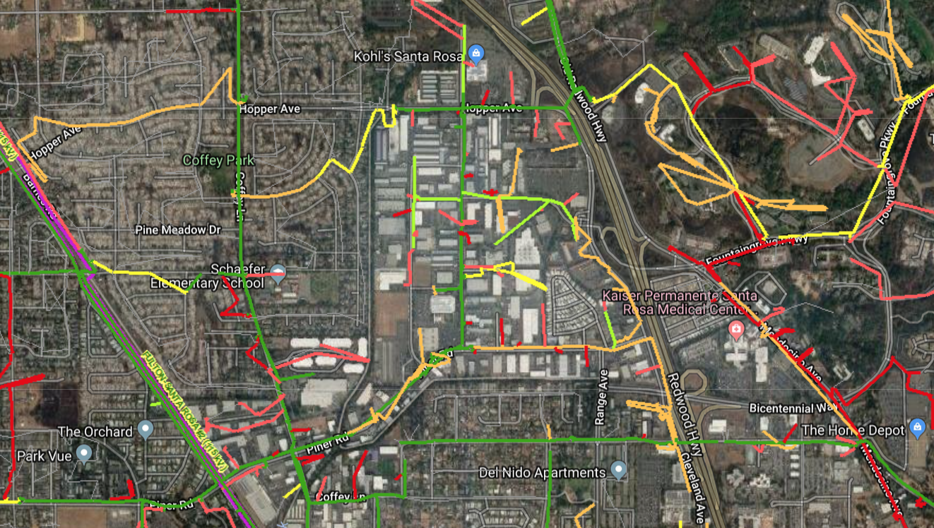
Sonoma Community Microgrid Initiative:
Example Location 2
  Coffey Park and the Bicentennial Corridor — ideal for Community Microgrid.
  Served by single substation, Monroe.
Fire-damaged area
Notes:
37

Slide 38
Sonoma Community Microgrid Initiative:
Locations
  Example key sites:
  critical, priority, large roofs and parking, etc.
  Coffey Park and the Bicentennial Corridor
  Kaiser Permanente Santa Rosa Medical Center & Foundation Hospital
  Kaiser Permanente Santa Rosa Hearing Center
  Sonoma County Sheriff’s Office
  Superior Court of California
  Sonoma County Clerk Recorder
  Sutter Urgent Care
  Security Public Storage
  Schaefer Elementary School
  Solstice Senior Living Center
  And dozens of Commercial & Industrial roof and parking lot locations including K-Mart, Vertex Climbing Center, Trader Joe’s, Epicenter, Walgreens, Pepsi Bottling Group, etc.
Notes:
38

Slide 39
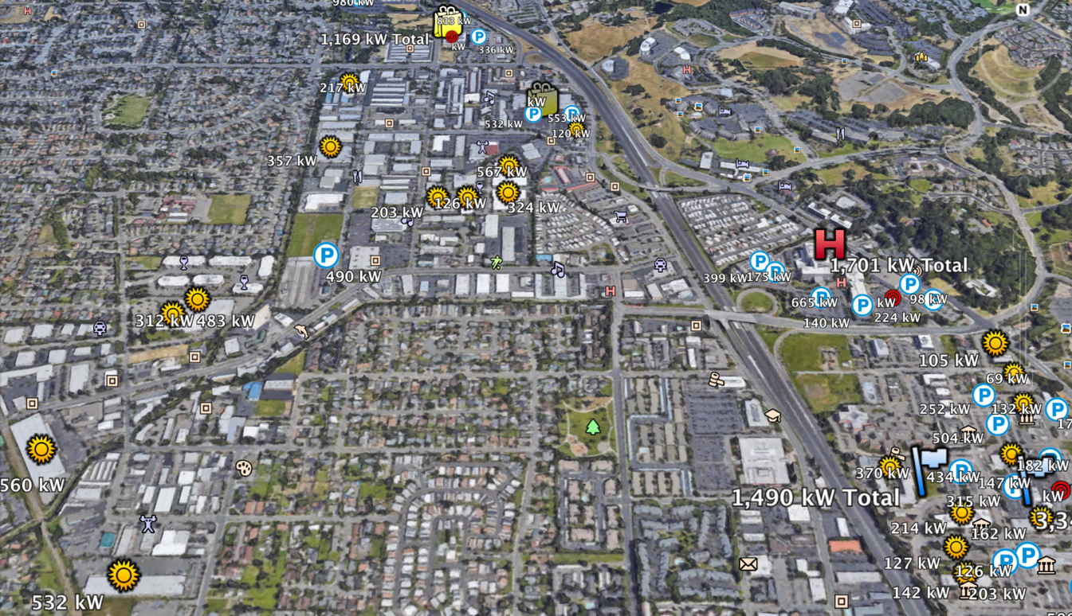
Example Sonoma Community Microgrid elements:
Monroe substation area
Notes:
39

Slide 40
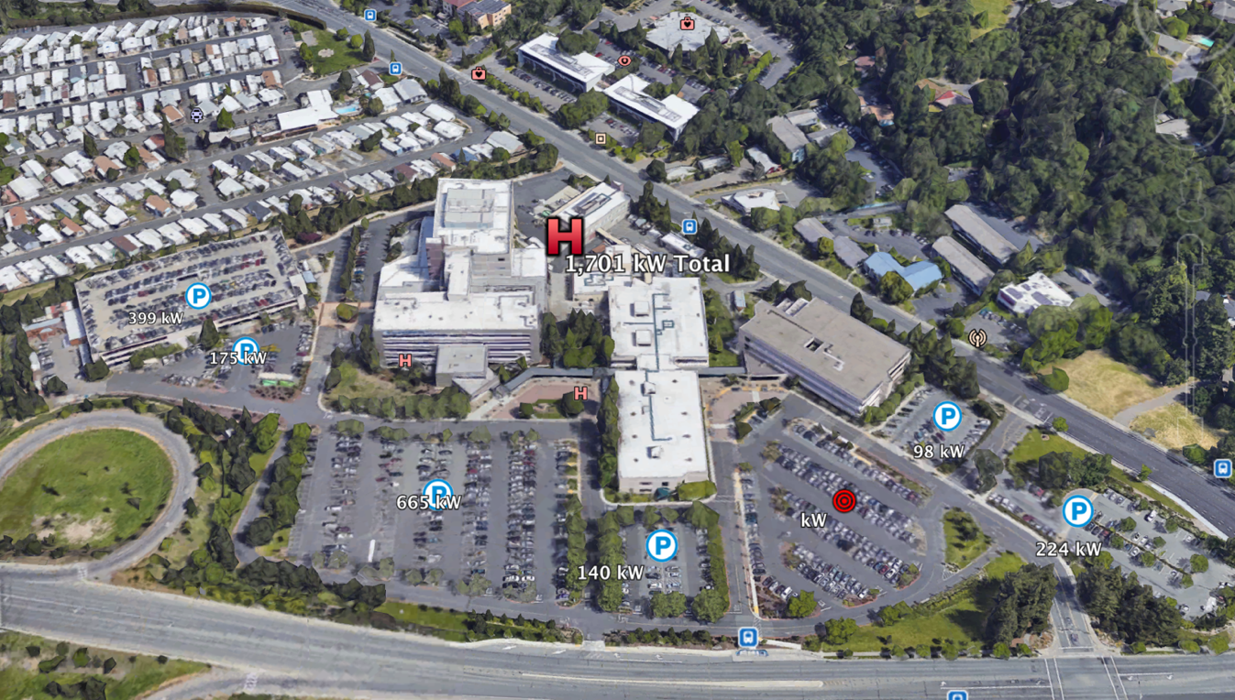
Kaiser Medical Center and Foundation Hospital
Notes:
40

Slide 41
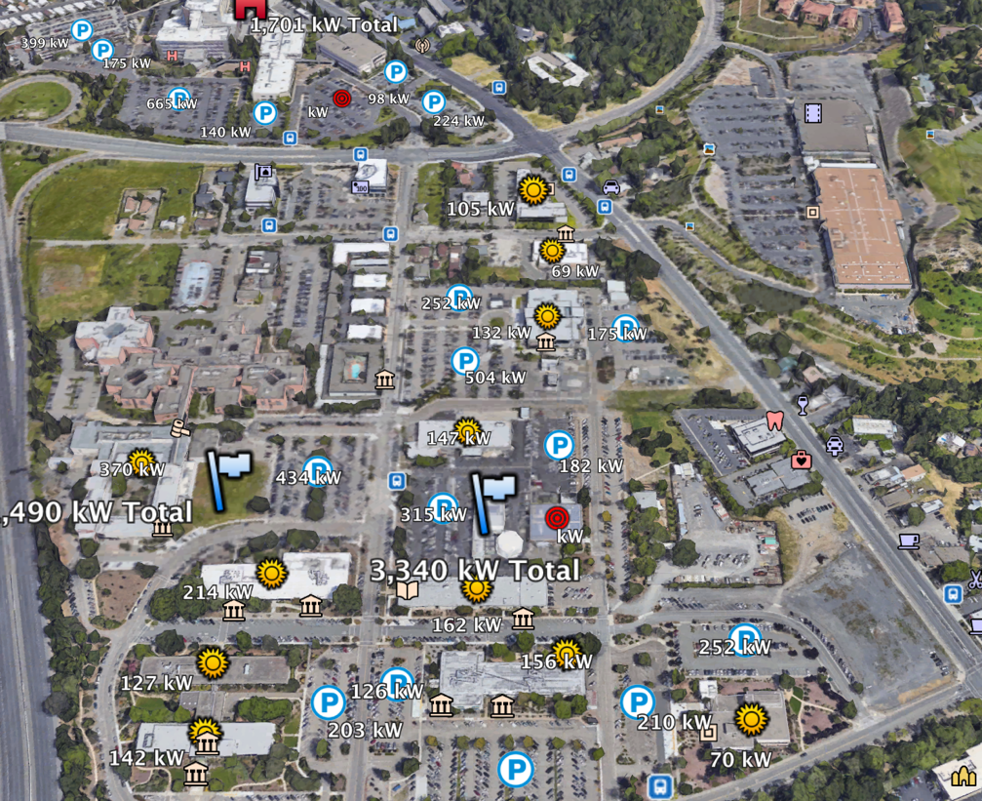
Sonoma County Government Buildings Cluster
Notes:
41

Slide 42
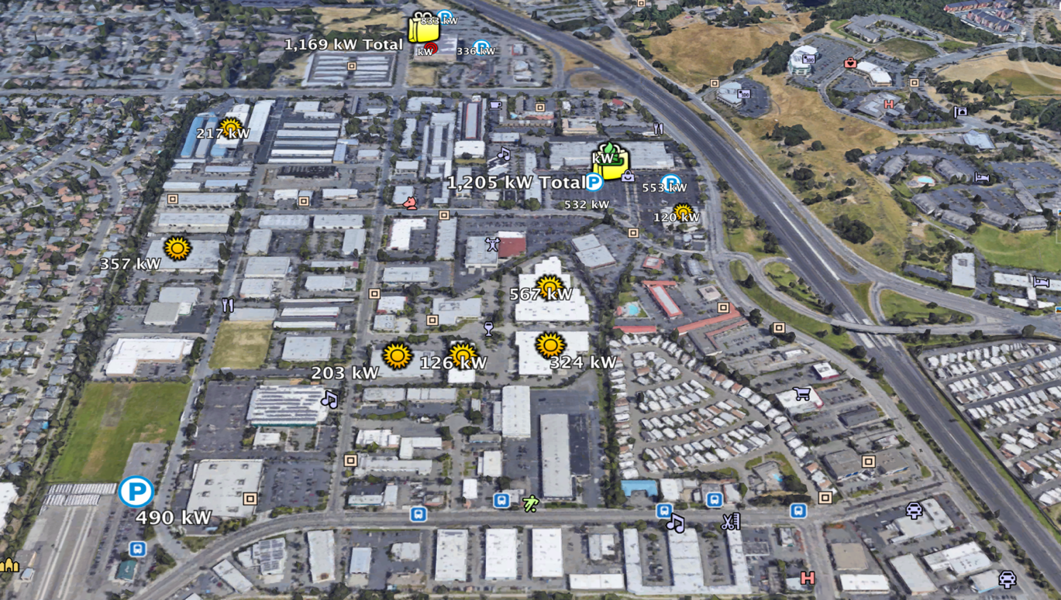
Commercial and Industrial Cluster
Notes:
42

Slide 43
Sonoma Community Microgrid Initiative: Utility Support
  Ongoing PG&E support & commitment
  PG&E is in full support of the Sonoma initiative, including the re-build program for homes (upcoming slide).
  PG&E is also committed to the Community Microgrid and grid modernization effort, in sync with the re-build.
  PG&E has made significant progress on their analysis of grid opportunities for the fire rebuild areas. This analysis includes:
    Customer/ feeder load profiles
    Estimated duration of power required by building type and criticality type
    Circuit configuration, telemetry and control requirements
    Rough costs for deploying microgrids at various target locations
Notes:
43

Slide 44
Sonoma Community Microgrid Initiative: Utility Support
  Ongoing PG&E support & commitment
  Key analysis criteria
    High risk areas due to wind, fire, etc.
    Grid topology – including the capability to sectionalize the grid to provide required isolation during emergencies
    Community layout including opportunity for local generation, resilience for critical services, etc.
  PG&E’s analysis and recommendation for target areas to be completed in approximately 2 weeks.
  The completed analysis plus input from the community will be considered to determine the best location opportunities.
  Recommendations will include developing “Microgrid-Ready” areas, including Community Resilience Zones. This will help ensure homes and buildings are prepared for Community Microgrids in terms of design, electronics, wiring, etc.
Notes:
44

Slide 45

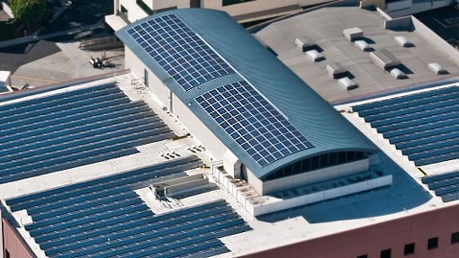
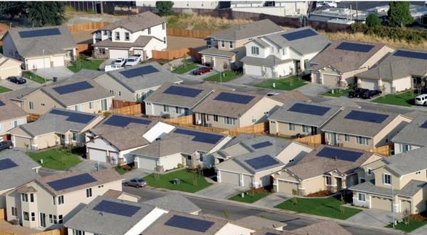
Sonoma Community Microgrid Initiative:
Homes and buildings as grid partners
Well-designed and well-situated ZNE homes
  A valuable part of the resource mix when combined with larger PV arrays on commercial and industrial structures
Notes:
45

Slide 46
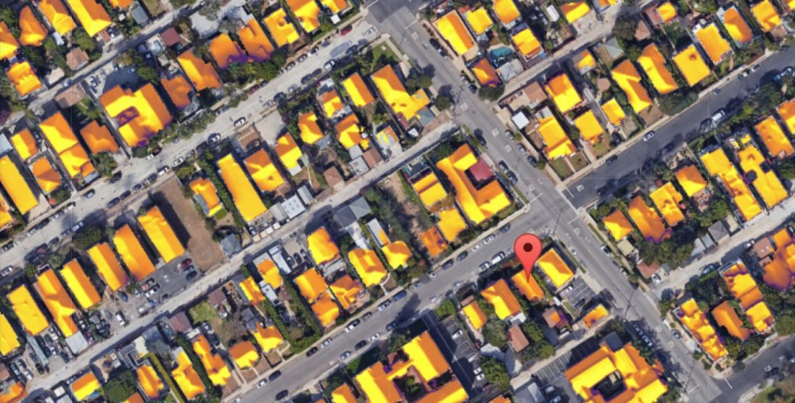
Sonoma Community Microgrid Initiative:
Homes and buildings as grid partners
Residential PV arrays as part of a community microgrid
  Can be sized for optimum contribution and fair compensation to owners regardless of their site-specific demand via total procurement
Notes:
46

Slide 47
Sonoma Advanced Energy Rebuild for Homes
  Advanced Energy Rebuild for Homes
  Program scheduled to launch in early May
  Check back in early April for details on incentives and criteria.
  https://sonomacleanpower.org/advancedenergyrebuild/
  Ongoing PG&E support & commitment
  Sonoma Clean Power (SCP), Pacific Gas and Electric Company (PG&E), and Bay Area Air Quality Management District have joined efforts to help homeowners affected by the October 2017 firestorms rebuild energy-efficient, sustainable homes.
  The program will be an enhancement to PG&E’s long-standing California Advanced Homes Program, and offers two incentive packages tailored to Sonoma and Mendocino Counties.
  Each package has a flexible performance pathway or a simple prescriptive menu.
  If you have any questions about the program, please e-mail programs@sonomacleanpower.org.
Notes:
47

Slide 48
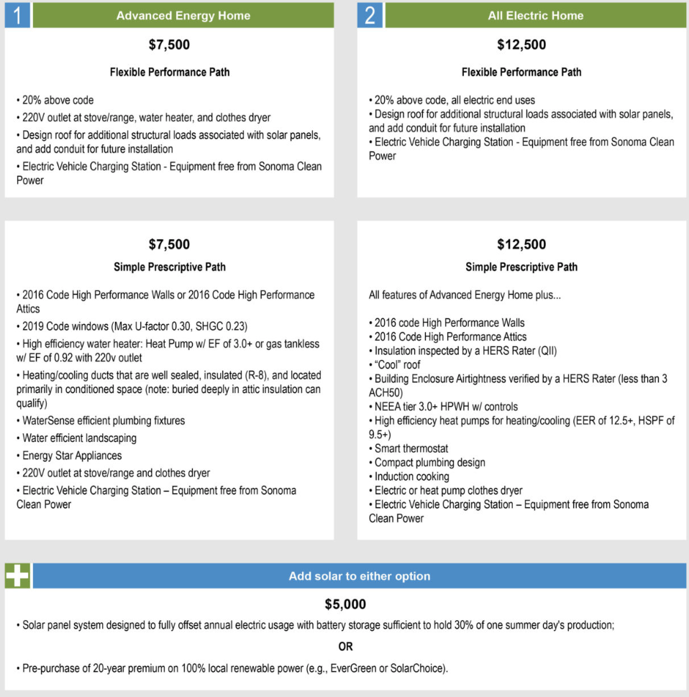
Sonoma Advanced Energy Rebuild for Homes
  Advanced Energy Rebuild for Homes
  Program scheduled to launch in early May
  Check back in early April for details on incentives and criteria.
  https://sonomacleanpower.org/advancedenergyrebuild/
Notes:
48

Slide 49
Sonoma Community Microgrid Initiative
  Sonoma Team
  Clean Coalition
  Sonoma Clean Power
  PG&E
  Rebuild North Bay
  Center for Climate Protection
  County of Sonoma, Energy & Sustainability Division
  Regional Climate Protection Authority
  Bay Area Air Quality Management District
  Design AVEnues, LLC — EE/ZNE expert Ann Edminster
  Stone Edge Farm Microgrid
  Other city and county leadership
Stone Edge Farm Microgrid
Notes:
49

Slide 50
Thank you. Any questions?
For questions and assistance, contact:
  Greg Thomson
  Director, Community Microgrid Initiative
  greg@clean-coalition.org
  ‭415-845-3872 (mobile)
Notes:
50

Slide 51
Thank you. Any questions?
Backup
Notes:
51

Slide 52
Example: Vermont
Vermont utility Green Mountain Power now pays customers over $30 per month to use their battery systems as a load-offsetting capacity resource.
Makes investments in battery-based backup systems more attractive for customers.
For Green Mountain Power, access to the batteries helps address the steep transmission access charge assessed by ISO New England. That charge more than doubled from $3 per kilowatt per month in 2016 to over $7 in 2017, and is expected to increase to over $9 in 2018.
As more solar is installed on the distribution grid, access to that local solar at times when electricity from transmission is the most expensive is a grid benefit that can save a utility money.
Source: http://www.qatargreenleaders.com/news/sustainability-news/1668-unlocking-the-distributed-grid-with-flexibility-management-software

Slide 53
Example: Massachusetts
Massachusetts announced a new model for community-scale energy systems: SMART (Solar Massachusetts Renewable Target)
Fully compensates solar PV for the total output of a system — rather than relying on net metering, which only accounts for net bill savings.
A large warehouse roof or shopping center parking lot can be fully compensated for all the solar generated on that site, regardless of the amount of electricity used onsite.
Commercial and industrial sector example: 250kW – 1,000kW solar systems would receive incentives of $0.16 - $0.18/kWh over a term of 20 years.
This model is commonly referred to as a Feed-In-Tariff — or CLEAN program — and has been used successfully in other locations such as Germany to deploy more clean local energy.
Source: http://www.qatargreenleaders.com/news/sustainability-news/1668-unlocking-the-distributed-grid-with-flexibility-management-software

Slide 54
Example: Connecticut
A new group of microgrids has been proposed to help support Connecticut’s critical facilities in the event of emergencies.
Funding opportunities under the state’s Department of Energy and Environmental Protection (DEEP) microgrid program
New focus on the growing movement to provide resilient power to essential buildings during emergency situations
Includes a proposal for Westbrook, CT middle school and high schools, which have recently been designated as emergency/evacuation shelter and support areas
Another proposal for Coventry, CT would island a circuit loop for nine critical facilities, including schools, a communication tower, and a senior care center
Source: http://www.renewableenergyworld.com/articles/2018/01/this-is-what-microgrids-for-resilience-in-emergencies-look-like.html

Slide 55
Example: Illinois
Illinois now supports shared utility + customer microgrids.
Extends distributed clean energy, islanding, and controls across utility infrastructure and to multiple customers — not limited to individual behind-the-meter implementations.
Expands competitive bids for distributed energy resources to serve generation needs while relying on solar, energy storage, and other alternatives to diesel-fueled generators.
Joe Svachula, vice president of engineering and smart grid technology at ComEd “It’s an important step forward in our effort to develop a more secure, resilient and reliable distribution system in the future.”
“Microgrid Clusters”: bottoms-up Community Microgrids
source: https://www.greentechmedia.com/articles/read/xcel-energy-community-solar-program-turns-three#gs.rPWCafg
Notes:
55

Slide 56
Example: Minnesota
Largest Community Solar program in the country — helping double the solar generation across the state.
More than doubled the community solar capacity in 2017, to 211 megawatts in operation today, demonstrating awareness and accelerating success.
Any customer can participate. Provides monthly bill credits to those who subscribe.
Beginning to offer predictability and transparency due to a mature process. The most effective program strides have been made in access to interconnection information.
One pilot project will pair energy-efficiency improvements with community solar, and there is now a push for this model to be expanded across Xcel’s service territory
Is Community Storage next? Yes — Community Microgrids
source: https://www.greentechmedia.com/articles/read/xcel-energy-community-solar-program-turns-three#gs.rPWCafg
Notes:
56

Slide 57
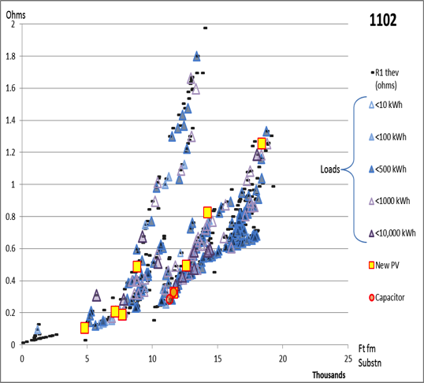
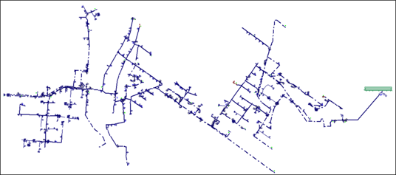
Example: Local Balancing optimizations
Optimal locations for PV, to help reduce daytime peaks across the system:
Matching load types: e.g. higher loads during daytime means better match for PV
Robust feeder locations: less resistance (lower Ohms) means more capacity for local generation
Avoided costs: service transformers, etc.
PV locations & sizes
Resistance in Ohms
Feeder map based on resistance (Ohms)
Existing load sizes
Source: The Clean Coalition’s Hunters Point Community Microgrid Project

Slide 58
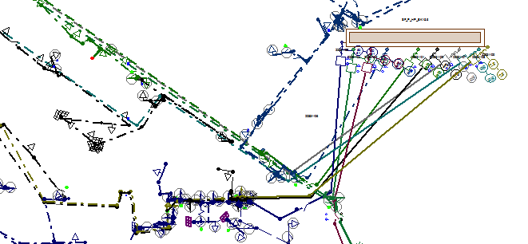
Example: Local Balancing optimizations
Connected feeders enables substation-wide optimizations and balancing across a substation, such as:
“Crossfeeding,” e.g. over-generation on certain feeders consumed by load on other feeders within the substation area
Optimizing DER such as storage and demand response across the substation feeders
Optimizing settings, e.g. load tap changers, across the substation feeders
Notes:
Commercial & Industrial customers offer the most cost-effective programs for utilities and communities due to their size, location, and matching load profiles, plus motivation to stabilize energy costs.
Via a robust and focused program, utilities and communities can take advantage of this customer category to accelerate and optimize DG/DERs.
Considerations:
Feeders are connected within each substation. This enables sharing energy across feeders and thus across customers and customer types.
Each urban/suburban substation or set of substations can find the most optimal mix between the three primary customer types: Commercial, Industrial, Residential.
Both weekday and weekend load profiles must be considered. In general, during weekday daytimes when residential load is low and C&I load is high, a good portion or all of the C&I daytime PV generation can be consumed “hyper-locally” by C&I customers, either directly or via sharing energy across those customers. During the weekends, C&I customers may use less daytime load which can then be shared more broadly with local residential customers who often use more load during weekend daytimes than weekday daytimes.
Multi-dwelling units can be bundled with C&I given the larger rooftops and loads; however, the load profiles will match residential, not C&I.

Slide 59
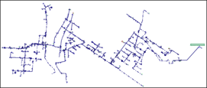
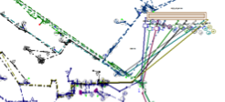
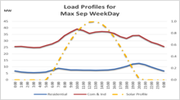
Example: Local Balancing optimizations
Step 4: DER Optimization
The DER Wheel of Fortune! Unlocking optimal and most cost-effective DER portfolios.
Derived In combination with the other optimizations
Optimal feeder locations
Local load shapes and forecasts
Local avoided grid upgrades
Local Market Value – e.g. Rates
Optimal DER Portfolio
Locally connected feeders
More reliable, cost-predictable, cleaner
Helps achieve local balance
Also extends to system-wide avoided costs
Unlocks optimal customers and DER

