Slide 1
Goleta Load Pocket and Montecito
Community Microgrid Initiatives
Craig Lewis
Executive Director
650-796-2353 mobile
craig@clean-coalition.org
Alistair Berven
Program Engineer
415-596-5727 mobile
alistair@clean-coalition.org
Gregory Young
Program Associate
805-350-2931 mobile
gregory@clean-coalition.org
30 October 2018

Slide 2
Clean Coalition (non-profit) Mission
To accelerate the transition to renewable energy and a modern grid through
technical, policy, and project development expertise
Notes:
2

Slide 3
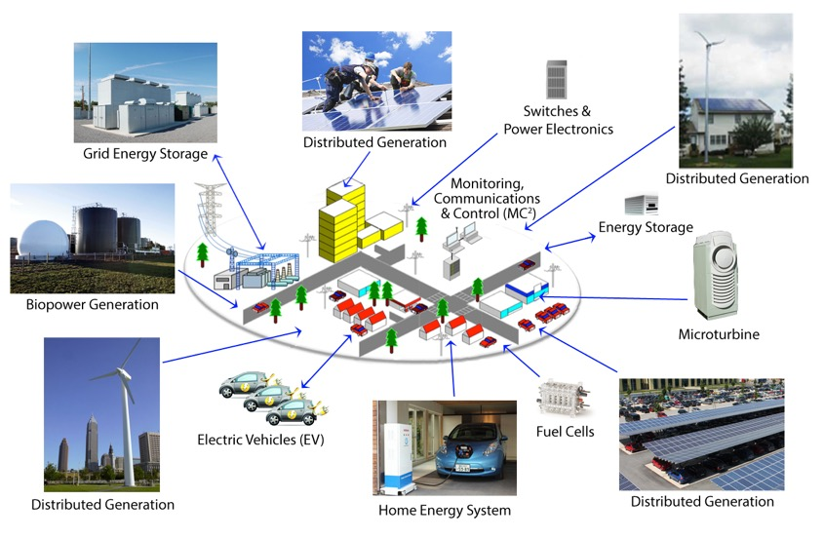
Community Microgrid Vision

Slide 4
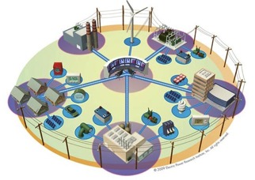
Community Microgrids (CM): The grid of the future
A Community Microgrid is a new approach for designing and operating the electric grid, stacked with local renewables and staged for resilience.
Key features:
A targeted and coordinated local grid area served by one or more distribution substations
High penetrations of local renewables and other Distributed Energy Resources (DER) such as energy storage and demand response
Staged capability for ongoing renewables-driven power backup for critical and prioritized loads across the grid area
A solution that can be readily extended throughout a utility service territory – and replicated into any utility service territory around the world

Slide 5
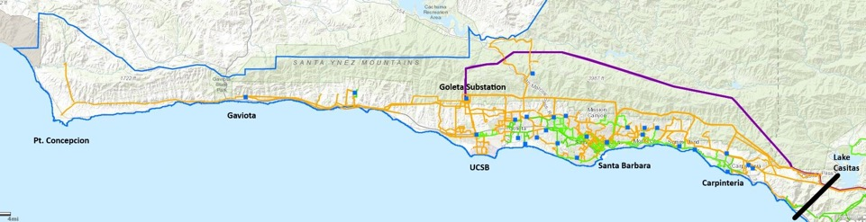
Goleta Load Pocket (GLP)
The GLP is the perfect opportunity for a comprehensive Community Microgrid
The GLP stretches from northwest of Gaviota to southeast of Carpinteria

Slide 6






GLPCM collaborators

Slide 7
GLP Community Microgrid “APE”
Aim:
  Realize a comprehensive Community Microgrid for the entire Goleta Substation grid area.
  Ensure that the GLP resilience objective is delivered via local renewables and other DER, and preempt any new gas peaker infrastructure.
  Deliver the trifecta of Community Microgrid benefits to the region in the form of economic, environmental, and resilience benefits.
Plan:
  Assess the level of resilience that can cost-effectively be provided by the GLP Community Microgrid (GLPCM).
  Create a multi-dimensional narrative of gas peakers as neither clean, safe, nor resilient.
  Showcase the Community Microgrid approach via Montecito Community Microgrids.
  Facilitate policies and programs that can realize a cost-effective GLPCM.
    Feed-In Tariff (FIT), streamlined interconnection, residential solar+storage programs, etc.
  Gain community support for the GLPCM approach from electeds to the public.
  Prepare to win the CPUC battle that will be fought starting in early-2019.
Execution:
  Assign responsible parties for each planned task.
  Identify a GLPCM Initiative manager.
  Secure funding for a successful initiative.

Slide 8
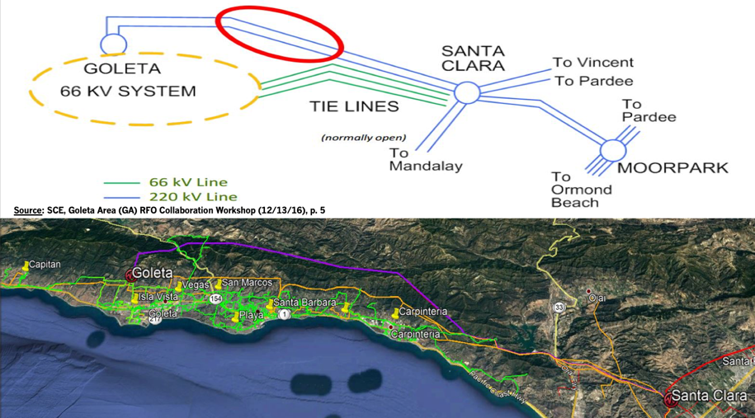
GLP is vulnerable to transmission system disruption

Slide 9
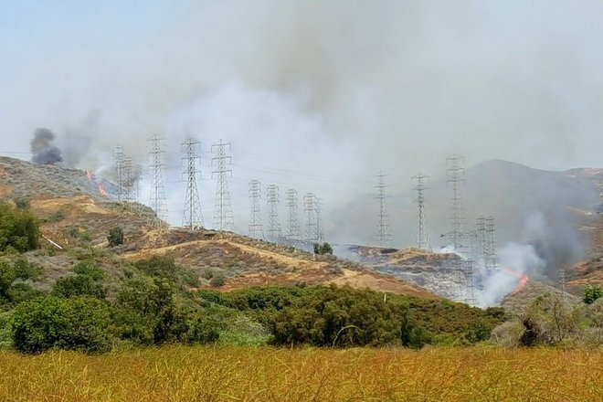
May 2016 Edison Fire
(NW of Santa Clara station- multiple lines threatened)

Slide 10
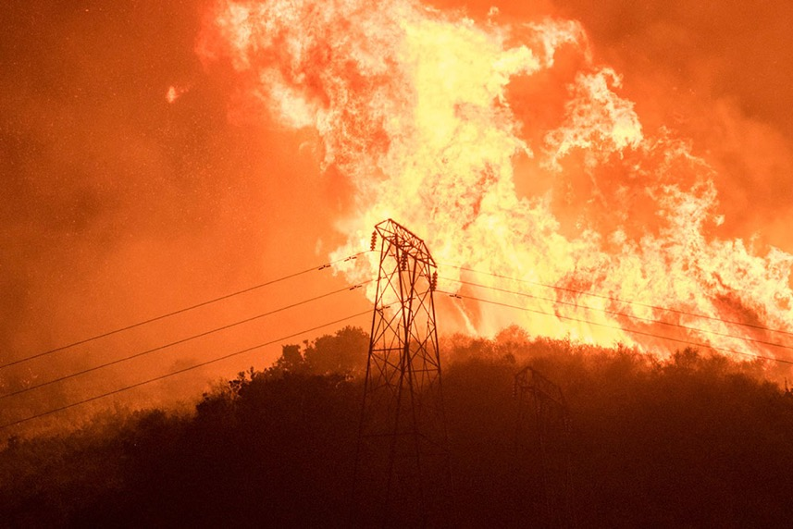
December 2017-Thomas Fire
(Multiple Outages)

Slide 11
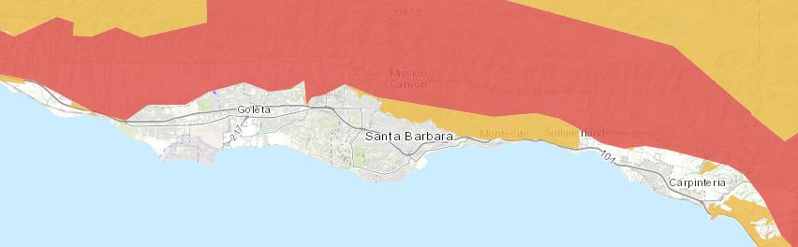
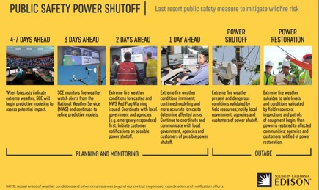
Transmission lines subject to preemptive shutdown
Source: CPUC FireMap
Given the recent passage of wildfire legislation and potential liability for wildfires started from utility wires and equipment, SCE has instituted preemptive measures, outlined on the right, that may result in more frequent de-energizing of transmission lines in advance of oncoming wildfires.
The CPUC FireMap above shows that the Goleta Load Pocket is surrounded by extreme (Tier 3) fire threats.

Slide 12
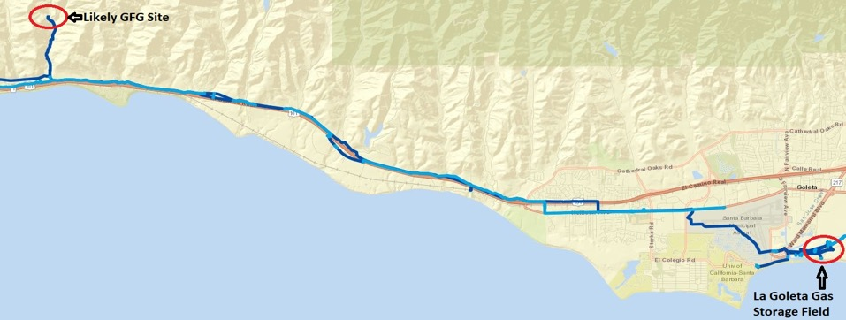
SCE is positioning to propose a gas plant in GLP
SCE Statement: “Most project offers that can address resiliency are natural-gas based.”
Likely Remote Location: Adjacent to the Capitan Substation, which is ~15 miles northwest of the La Goleta gas storage field.

Slide 13
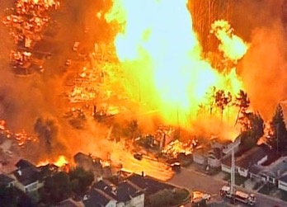
Natural gas infrastructure is not resilient
Assertion: SCE will frame gas-fired generation (GFG) as resilient.
Reality: Gas infrastructure is not resilient and requires 30 times longer to restore service than electricity.
Threats: Gas infrastructure is vulnerable to earthquakes, fires, and mudslides, as well as terrorism.
2010 San Bruno Pipeline Explosion
Source: The City and County of San Francisco Lifelines Study

Slide 14
Recent gas pipeline explosions
October 9, 2018: British Columbia.
September 13, 2018: Merrimack Valley, Massachusetts. Over 80 individual fires, one person killed and 30,000 forced to evacuate.
February 17, 2017: A natural gas pipeline operated by Kinder Morgan in Refugio Texas exploded creating a massive fire. The explosion shook homes 60 miles away.
February 10, 2017: A natural gas pipeline operated by Phillips 66 Pipeline in St. Charles Parish, LA exploded, injuring 3 workers.
February 1, 2017: A DCP pipeline in Panola County TX exploded and created a crater in an airport runway, shutting down the airport for a month.
January 17, 2017: A natural gas pipeline operated by DCP Midstream exploded in Spearman, TX, which led to multiple fire crews being called to the scene.
From 2010 to 2016 -- Gas companies reported 35 explosions and 32 ignitions at their transmission pipelines, according to federal records. The explosion killed 17 people and injured 86.
September 9, 2010: San Bruno, California, killed eight and injured 51 people.

Slide 15
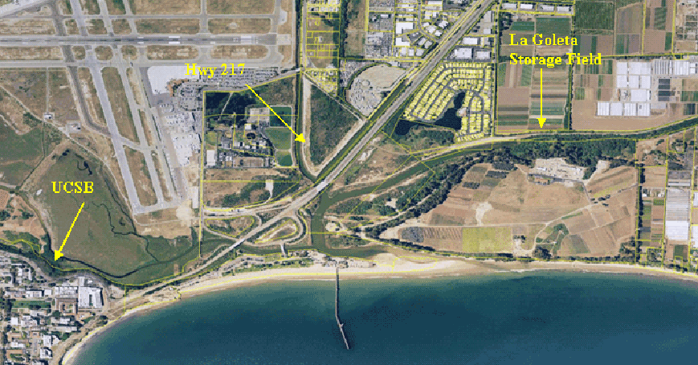
La Goleta Gas Storage Field
Converted into a gas storage reservoir in 1941, it is the oldest storage facility of four maintained by SoCalGas and is the third largest, with a maximum capacity of 21.5 billion cubic feet.
The gas field is within an anticlinal structure cut and bounded on the north by the More Ranch Fault.

Slide 16
The GLPCM requires multi-faceted action
Amend Santa Barbara County Land Use and Development Code (LUDC) to remove de facto ban on installing In-Front-of-Meter (IFOM) solar.
Santa Barbara, Goleta, and Carpinteria cities to take leadership role in securing sufficient solar siting potential.
Local government review of Laws, Ordinances, Regulations, and Standards (LORS) in conflict with GFG plant.
Amend and/or enact local LORS to impose local regulations/ban on natural gas power facilities.
Persuade SCE to procure local renewables and other DER through a market-efficient FIT and to allow distribution grid to provide Community Microgrid functionality during transmission grid outages.

Slide 17
Community Microgrid key stakeholders
Property Owners
Municipalities
Residents
Community Microgrid
Utilities
Philanthropic
Funders
Solution Providers
Financiers

Slide 18
Montecito offers opportunity for initial demonstration
Map of areas at high and extreme risk from mud and debris flow in the event of a major storm.
Source: Santa Barbara County OEM

Slide 19
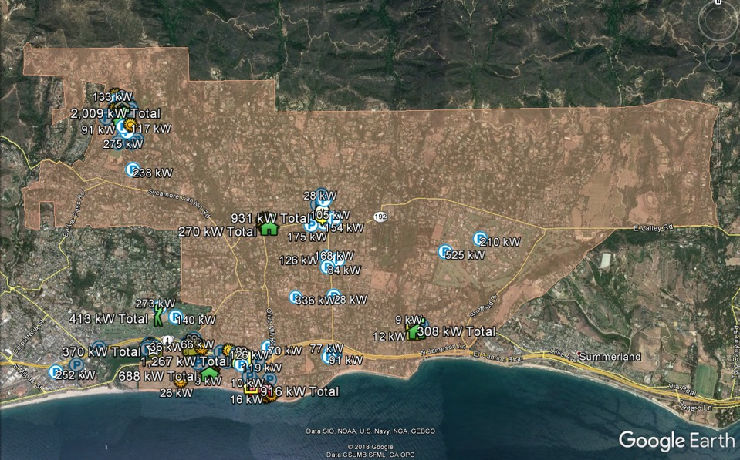
Solar Siting Survey (SSS) for Montecito

Slide 20
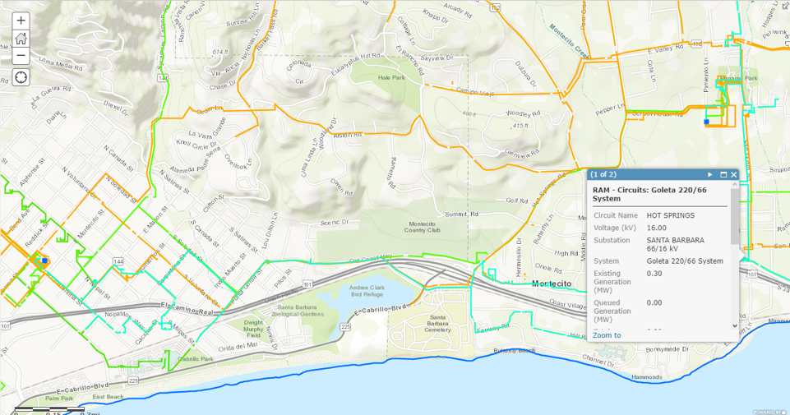
Hot Springs Feeder via Santa Barbara Substation
Santa Barbara Substation

Slide 21




Upper Village Community Microgrid block diagram
Diagram Elements
Autonomously controllable microgrid
relay/switch (open, closed)
Emergency response cluster
Tier 2 & 3 Loads
Commercial cluster
Commercial cluster
Tier 2 & 3 Loads
Emergency sheltering
cluster
Emergency sheltering
cluster
Southern Portion
Southern Portion
Santa Barbara Substation
Transmission
Coast Village
Community Microgrid
Hot Springs Feeder (16 kV)

Slide 22
Upper Village critical facilities include five along
Hot Springs Feeder

Slide 23
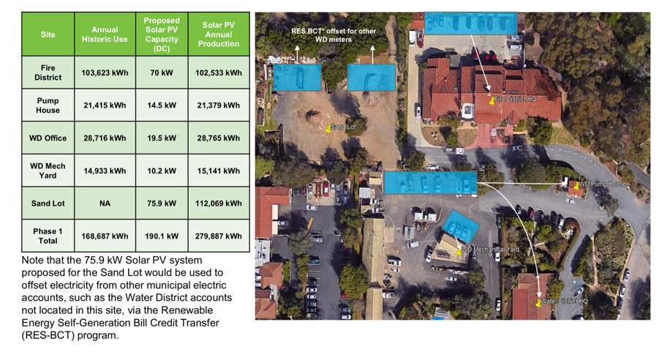
Upper Village emergency response facilities

Slide 24
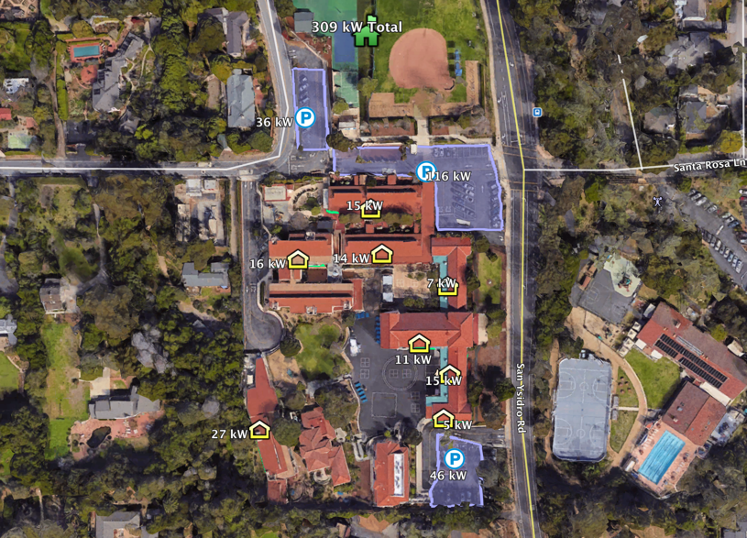
Montecito Union School District

Slide 25
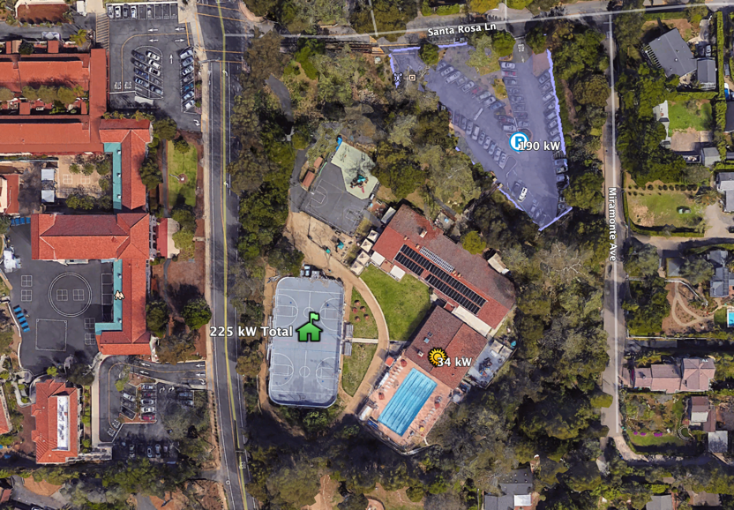
Montecito YMCA

Slide 26
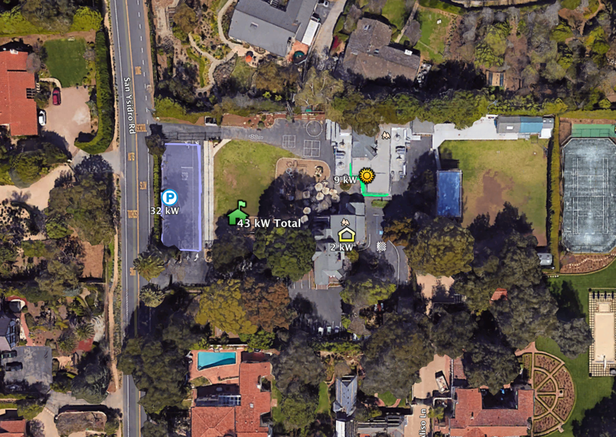
Laguna Blanca School

Slide 27
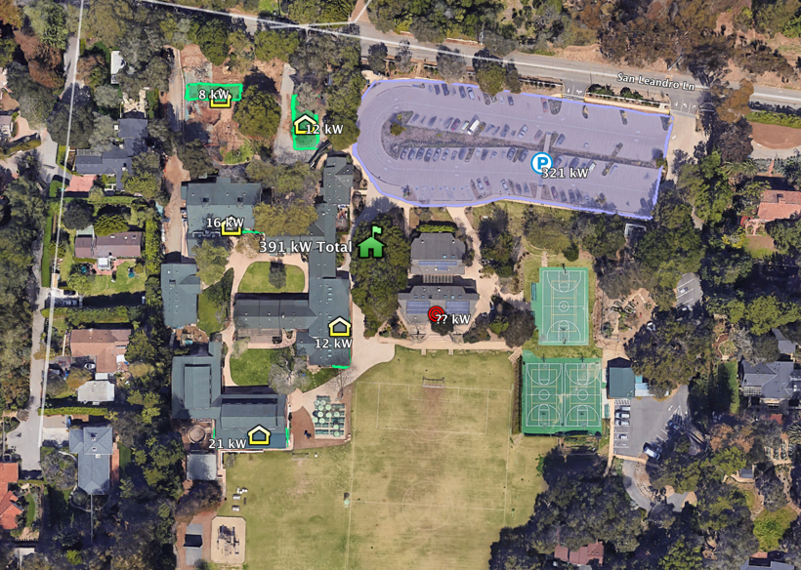
Crane Country Day School

Slide 28
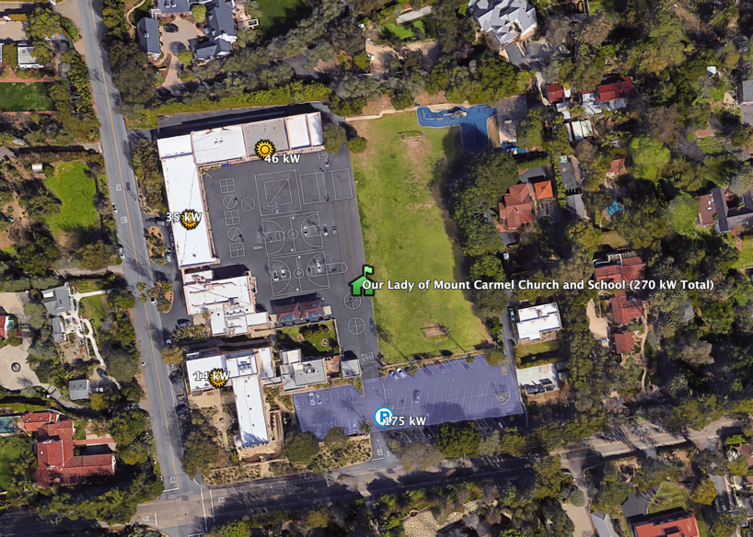
Our Lady of Mount Carmel Church and School

Slide 29
Back Up Slides

Slide 30
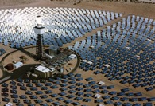
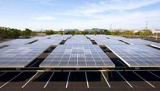



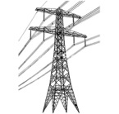

Feed in Tariffs (FITs) address the Wholesale DG market segment
Project Size
Central Generation
Serves Remote Loads
50+ MW
Wholesale DG
Serves Local Loads
500 kW
Retail DG
Serves Onsite Loads
5 kW
Behind the Meter
Distribution Grid
Transmission Grid

Slide 31
Wholesale DG drove huge solar use in Germany
Solar Markets: Germany vs. California (2002-2012)
Cumulative MW
Sources: CPUC, CEC, SEIA and German equivalents.
Germany deployed over 10 times more solar than California in the decade from 2002 — despite California having 70% better solar resource.

Slide 32
The majority of German solar is local solar
26%
23.25%
22.5%
19%
9.25%
Source: Paul Gipe, March 2012
Germany’s solar deployments are almost entirely sub-2 MW projects on built-environments and interconnected to the distribution grid (not behind-the-meter).

Slide 33
German rooftop solar is 4 to 6 cents/kWh today
Project Size | Euros/kWh | USD/kWh | California Effective Rate $/kWh
Under 10 kW | 0.1270 | 0.1359 | 0.0628
10 kW to 40 kW | 0.1236 | 0.1323 | 0.0611
40.1 kW to 750 kW | 0.1109 | 0.1187 | 0.0548
Other projects up to 750 kW* | 0.0891 | 0.0953 | 0.0440
Conversion rate for Euros to Dollars is €1:$1.07.
California’s effective rate is reduced 40% due to tax incentives and then an additional 33% due to the superior solar resource.
Replicating German scale and efficiencies would yield rooftop solar today at only between 4 and 6 cents/kWh to California ratepayers.
* For projects that are not sited on residential structures or sound barriers.
Notes:
Critics of Germany’s CLEAN Program tend to say that they are paying too much for renewable energy generation, but this chart shows that – using the appropriate conversion – they are paying less for solar than we pay for electricity almost anywhere in the U.S. This conversion uses the U.S. tax incentives and solar resource.
The higher rates apply to residential and roadway noise barrier installations, the lower “other” rate to all other installations

Slide 34
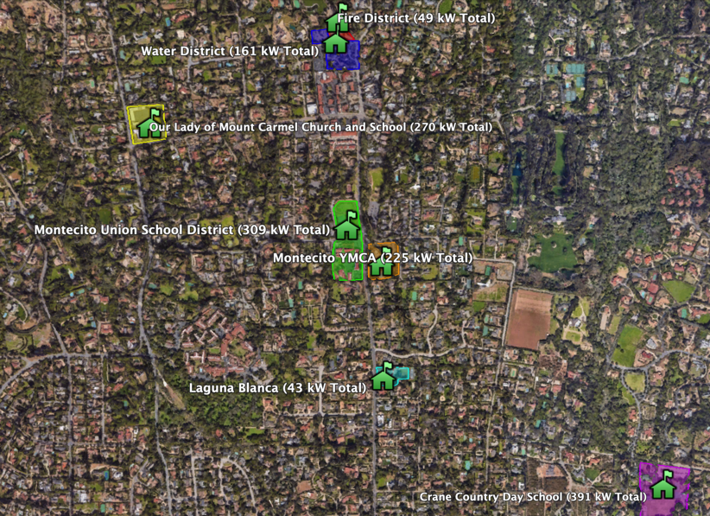
Upper Village critical facilities

Slide 35
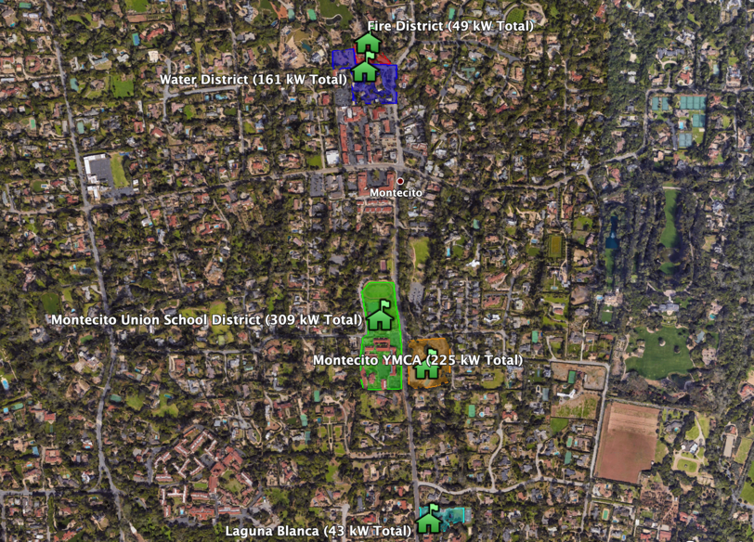
Sites along Hot Springs Feeder

Slide 36
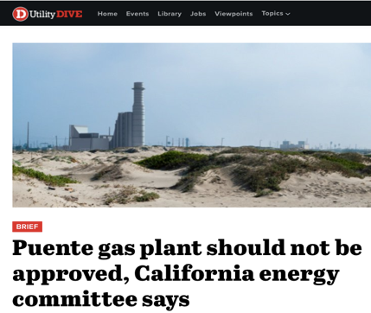
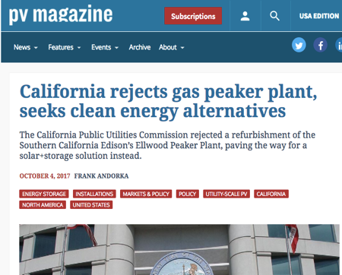
Community Microgrids obviate gas peakers
Thanks in part to our analysis, California regulators have rejected Ellwood and signaled their intent to reject Puente as well
“Let’s take this opportunity to move the Oxnard community into the clean energy future — which is here already.” Carmen Ramirez, Mayor of Oxnard
Significant opportunity to leverage this work to prevent future new gas plant proposals across the country

Slide 37
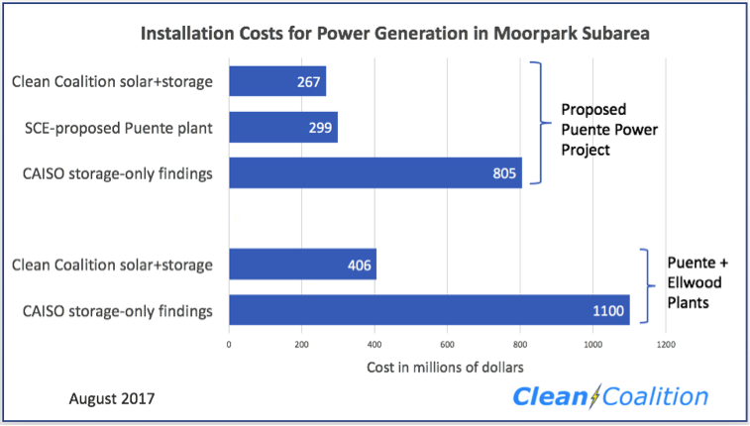
Community Microgrids cheaper than gas peakers
Leveraging our technical and economic expertise, the Clean Coalition conducted an analysis to determine the viability of solar+storage as a better alternative

