Slide 1
Clean Coalition
Making Clean Local Energy Accessible Now
Craig Lewis
Executive Director
Clean Coalition
650-204-9768
craig@clean-coalition.org
8-9 December 2011
Notes:
(ac_1, 15Sept2011)

Slide 2
Clean Coalition Vision = DG+DR+ES+EV+MC2
Notes:
..

Slide 3
Clean Coalition – Mission and Advisors
Mission To implement policies and programs that transition the world to cost-effective clean energy now while delivering unparalleled economic benefits
Clean Coalition – Mission and Advisors
Board of Advisors
Jeff Anderson ED, Clean Economy Network
Josh Becker General Partner, New Cycle Capital
Jeff Brothers CEO, Sol Orchard
Jeffrey Byron Former Commissioner, California Energy Commission
Rick DeGolia Executive Chairman, InVisM, Inc.
Mark Fulton Managing Director, Global Head of Climate Change Investment Research, DB Climate Change Advisors, a member of the Deutsche Bank Group
Felix Kramer Founder, California Cars Initiative
Governor Bill Ritter Director, Colorado State University’s Center for the New Energy Economy, and Former Colorado Governor
Terry Tamminen Former Secretary of the California EPA and Special Advisor to CA Governor Arnold Schwarzenegger
Jim Weldon CEO, Solar Junction
R. James Woolsey Chairman, Woolsey Partners, and Former Director of the CIA
Kurt Yeager ED, Galvin Electricity Initiative
John Geesman Former Commissioner, California Energy Commission
Patricia Glaza Principal, Arsenal Venture Partners
L. Hunter Lovins President, Natural Capitalism Solutions
Dan Kammen Chief Technical Specialist for Renewable Energy and Energy Efficiency, World Bank
Fred Keeley Treasurer, Santa Cruz County, and Former Speaker pro Tempore of the California State Assembly
Notes:
(ac_3, 27Oct2011)

Slide 4
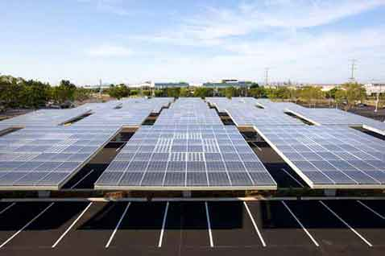
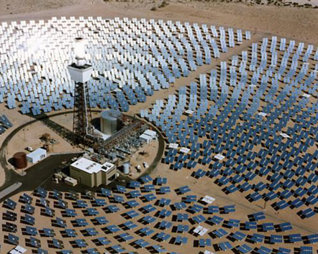
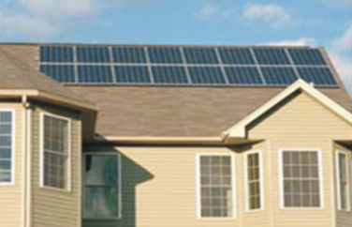
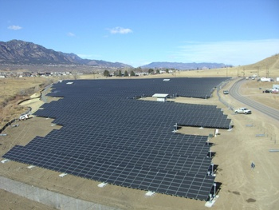
Wholesale DG is the Critical & Missing Segment
Project Size
Central Station, Transmission-Interconnected
~20 MW-and-larger
Wholesale DG, Distribution-Interconnected
<20 MW
Retail DG
<1 MW
Distribution grid
Transmission grid

Slide 5
Superior Value of Wholesale DG Solar
Solar Markets: Germany vs California (RPS + CSI + other)
Sources: CPUC, CEC, SEIA and German equivalents.
Germany added 28 times more solar than California in 2010.
Even though California’s solar resource is 70% better!!!
Notes:
(jf_1, 15Sept2011)

Slide 6
German Solar Capacity is Small WDG (Rooftops)
26%
23.25%
22.5%
19%
9.25%
Source: Paul Gipe, March 2011
Germany’s solar deployments are almost entirely <2 MW rooftop projects interconnected to the distribution grid (not behind-the-meter)

Slide 7
WDG is about Maximizing Economics for California
Wholesale DG = 3x job creation
+ $50 billion added
private investment
UC Berkeley study
(Dan Kammen)
Notes:
(ac_1, 15Sept2011)

Slide 8
Wholesale DG has Superior Value
Total Ratepayer Cost of Solar
 | Distribution Grid |  |  |  |  | T-Grid
PV Project size and type | 100kW roof | 500kW roof | 1 MW roof | 1 MW ground | 5 MW ground | 50 MW ground
Required PPA Rate | 15¢ | 14¢ | 13¢ | 12¢ | 11¢ | 10¢
T&D costs | 0¢ | 0-1¢ | 1¢ | 1¢ | 1-2¢ | 2-4¢
Ratepayer cost per kWh | 15¢ | 14-15¢ | 14¢ | 13¢ | 12-13¢ | 12-14¢
Sources: CAISO, CEC, and Clean Coalition, July 2011
The most cost-effective solar is ground-based WDG, not central station as commonly thought; due to immense transmission costs

Slide 9
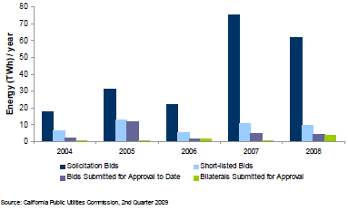
Policies Need to Reduce Costs and Risks
Current California Policies Result in ~97% Failure Rates
Current solicitation/auction and interconnection processes result in massive failure rates: roughly 97% of the bid capacity fails to reach contract.

Slide 10
Potential TAC Savings From DG are Massive
Business as Usual Year-20 TAC (TAC₂₀ ) = 2.5
2.5
Business As Usual TAC Growth
Potential Future Transmission Investment (and potential future stranded costs)
Current TAC
Rate (TAC₀) = 1.1
TAC₀ O&M Level

Slide 11
Connecting-the-Dots to Reform
75% of California IOU capital expenditures are made on the distribution grid (D-grid) and California ratepayers deserve maximized returns on their MASSIVE investments (2007 IEPR)
Investment needs to be future-proofed to allow significant penetrations of clean local energy
Confidentiality rules need to change to allow proper regulatory oversight of these massive ratepayer investments
Germany and Spain are excellent proxies for assuring that California’s existing D-grid can accommodate significant penetrations of clean local energy (May 2011 CEC/KEMA report)
MPR is determined at point-of-interconnect and Wholesale Distributed Generation (WDG) and a Locational Benefits (LBs) adder is needed to compensate for extra value of WDG
Average extra LBs value of DG is in the neighborhood of 25% (Transmission Access Charges of 1.5 cents/kWh plus 10% for transmission line/congestion losses)
The LBs adder should be handled just like the Time-of-Delivery (TOD) adder
Ratepayers currently get massive free value from WDG in the form of uncompensated LBs
Notes:
(ac_1, 15Sept2011)

Slide 12
Connecting-the-Dots to Reform (continued)
Currently, developers are responsible for 100% of D-grid upgrade costs without any opportunity for reimbursement, EVER
This is different than transmission upgrade costs that are ALWAYS borne by the ratepayer
Recommendation for the 50% of the D-grid where LBs value is above average, utilities pay for D-grid upgrades and recover through the rate-base.
Ratepayers currently get massive free value from WDG in the form of uncompensated D-grid upgrade costs
Wholesale Distributed Generation (WDG) interconnections need to be far more timely and transparent
WDG interconnection processes in IOU D-grids are expected to require an average of 2 years
WDG interconnection processes in the SMUD D-grid requires 6 months
Interconnection studies for 100 MW of WDG projects in its Feed-In Tariff program were completed in 2 months (performed by 2 guys)
100 MW of WDG in SMUD territory is equivalent to 2,500 MW of WDG statewide
TWO GUYS for TWO MONTHS should be an achievable benchmark for all utilities
Notes:
(ac_1, 15Sept2011)

