Slide 1
Community Microgrid Initiative
Overview for LPA
Greg Thomson
Director of Programs
Clean Coalition
415-845-3872 mobile
greg@clean-coalition.org
June 12, 2014

Slide 2
Clean Coalition Mission and Advisors
Mission
To accelerate the transition to renewable energy and a modern grid through technical, policy, and project development expertise.
Board of Advisors
Jeff Anderson
Co-founder and Former ED, Clean Economy Network
Josh Becker
General Partner and Co-founder, New Cycle Capital
Pat Burt
CEO, Palo Alto Tech Group;
Councilman & Former Mayor, City of Palo Alto
Jeff Brothers
CEO, Sol Orchard
Jeffrey Byron
Vice Chairman National Board of Directors, Cleantech Open; Former Commissioner, CEC
Rick DeGolia
Senior Business Advisor, InVisM, Inc.
John Geesman
Former Commissioner, CEC
Eric Gimon
Independent Energy Expert
Patricia Glaza
Principal, Arsenal Venture Partners
Mark Z. Jacobson
Director of the Atmosphere/Energy Program & Professor of Civil and Environmental Engineering, Stanford University
Dan Kammen
Director of the Renewable and Appropriate Energy Laboratory at UC Berkeley; Former Chief Technical Specialist for RE & EE, World Bank
Fred Keeley
Treasurer, Santa Cruz County, and Former Speaker pro Tempore of the California State Assembly
Felix Kramer
Founder, California Cars Initiative
Amory B. Lovins
Chairman and Chief Scientist, Rocky Mountain Institute
L. Hunter Lovins
President, Natural Capitalism Solutions
Ramamoorthy Ramesh
Founding Director, DOE SunShot Initiative
Governor Bill Ritter
Director, Colorado State University’s Center for the New Energy Economy, and Former Colorado Governor
Terry Tamminen
Former Secretary of the California EPA and Special Advisor to CA Governor Arnold Schwarzenegger
Jim Weldon
Technology Executive
R. James Woolsey
Chairman, Foundation for the Defense of Democracies; Former Director of Central Intelligence (1993-1995)
Kurt Yeager
Vice Chairman, Galvin Electricity Initiative; Former CEO, Electric Power Research Institute
Notes:
(Dec2012)
2

Slide 3
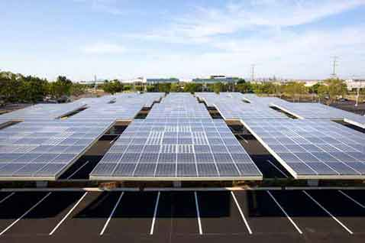
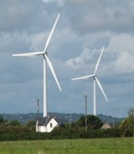

Clean Coalition Objectives
From 2020 onward, all new electricity generated in the U.S. will come from at least:
  80% renewable sources
  50% distributed sources
By 2020, established policies and programs will foster successful fulfillment of the above objectives
Notes:
(04_cl, 20 Dec 2012)
3

Slide 4
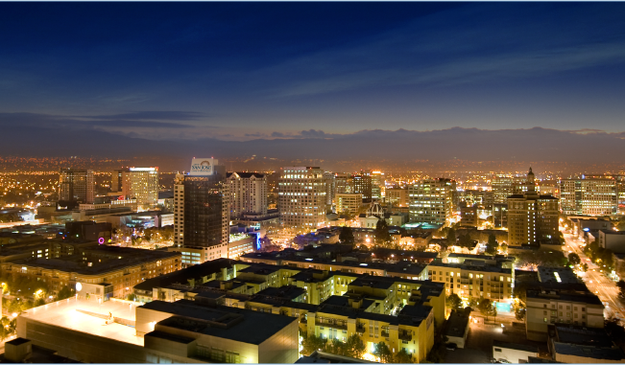
The Clean Coalition’s Impact to Date
We have helped bring more than 1 gigawatt of clean local energy online – enough to provide peak power to San Jose.
Notes:
The Clean Coalition works with leaders from communities, utilities, businesses, and governments to advance local, renewable energy. We are active on the local, state, and national levels.
Already, the Clean Coalition has provided policy support to utilities across the country, and so far we have helped bring more than 1 gigawatt of clean local energy online — enough to provide peak power to about 1 million homes.
We work with utilities to evaluate, design, and implement CLEAN Programs, which are the world’s most effective policy to bring renewable energy online.
CLEAN Programs make it easier to build clean local energy projects, connect them to the grid, and establish long-term contracts to sell the power produced to utilities. With CLEAN Programs in place, financing clean local energy projects becomes much easier, and the whole community benefits.
San Jose has an estimated 998,000k is 2013: http://en.wikipedia.org/wiki/List_of_United_States_cities_by_population
4

Slide 5
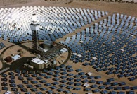



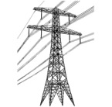

Wholesale DG is the Critical & Missing Segment
Project Size
Central Generation
Serves Remote Loads
50+ MW
Wholesale DG
Serves Local Loads
500 kW
Retail DG
Serves Onsite Loads
5 kW
Behind the Meter
Distribution Grid
Transmission Grid
Notes:
Wholesale Distributed Generation or WDG is the market segment that makes this transition possible. The retail DG – behind the meter – and central generation renewables – out in the desert, most of the time – are both part of the equation, but WDG has enough potential and uses economies to scale that will really change the game.
When we refer to DG, we mean a generating resource that is located on the distribution grid and the generated electricity does not feed back onto the transmission grid. WDG, therefore, is DG that sells all of its generation to the utility (or other purchaser). In future slides, I will refer to the distribution grid as the d-grid.
*National policies focus on removing barriers for large-scale renewable power facilities and infrastructure.
*State and local net-metering policies promote small-scale renewables:
---Net-metering is designed to reduce a utility customer’s electric bills
---Net-metering is not designed for owners of commercial and multi-tenant properties (where tenants pay the utility bills)
---Annual on-site energy use generally caps net-metering project size
---Investors and lenders find a utility customer’s energy savings from net-metering far less attractive than a revenue stream from a stable utility
(03_gp, 28 May 2013)

Slide 6

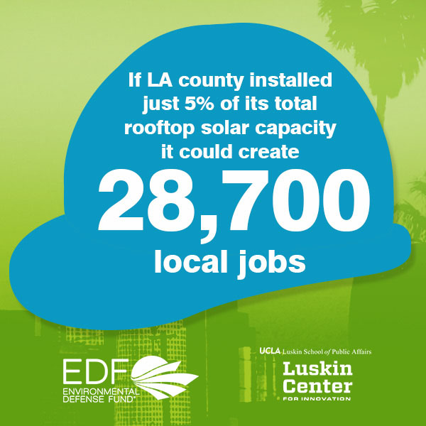
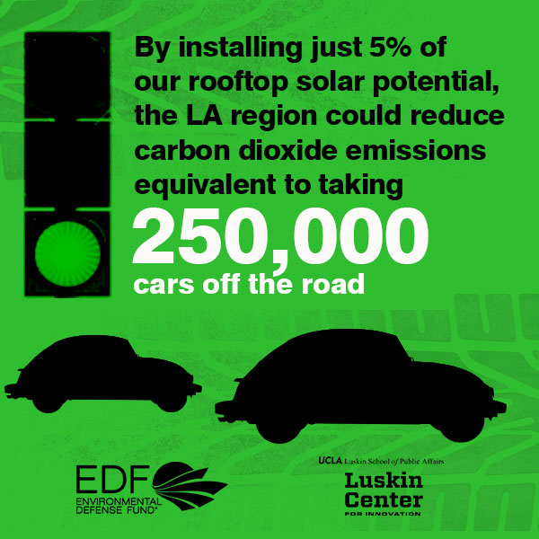
Distributed Renewable Potential: Examples
Los Angeles
San Francisco
“An enormous opportunity exists for solar energy to expand on California’s rooftops, rather than in its deserts, due to vast areas of undeveloped rooftop space and suitable conditions in California cities.”
UCLA Luskin Center for Innovation, Nov 2013
“Significant solar potential exists today in San Francisco – for example, as much as 50 MW of new, local clean energy in the Bayview-Hunters Point area alone – offering substantial economic and environmental benefits.”
Clean Coalition, Dec 2013
50 MW New Solar in Hunters Point Equals:
$200M: Added regional economic stimulation
$100M: Added local wages
1,270 Job-Years: New regional employment
$5.8M: Added state sales taxes
Notes:
(Los Angeles, CA – November 13, 2013) Today, the UCLA Luskin Center for Innovation and the Environmental Defense Fund released a set of maps titled “Los Angeles Solar and Efficiency Report (LASER): Atlas of Investment Potential for LA County,” which shows that nearly 29,000 local job years could be created if merely 5 percent of the rooftop solar energy generating potential in LA County was realized.
Capturing this 5 percent of solar capacity would reduce carbon dioxide emissions by 1.25 million tons, equivalent to avoiding the emissions of more than 250,000 cars annually.
LASER maps also indicate that nearly 1.5 million buildings in LA County were built before energy efficiency codes went into effect. This means that 80% of all buildings in LA County have elevated potential for cost-saving, energy efficiency investments.
The LASER Atlas contains profiles of 9 sub-regions across LA County, mapping the areas in each sub-region where there is elevated potential for solar generation and energy efficiency improvements for local buildings. The LASER Atlas also identifies where these investments are needed the most. There is significant overlap between areas of strong physical potential as defined by infrastructure, and disadvantaged areas as identified by environmental health and socioeconomic data.
EDF commissioned and the Luskin Center produced the LASER Atlas to provide a tool to help local decision-makers and community members think strategically about investing new state funding. In particular, cap-and-trade proceeds stemming from AB 32, the California Global Warming Solutions Act, and Proposition 39, the California Clean Energy Jobs Act, will results in billions of dollars to mitigate climate change pollution, expand renewable energy generation, and create jobs in California.

Slide 7
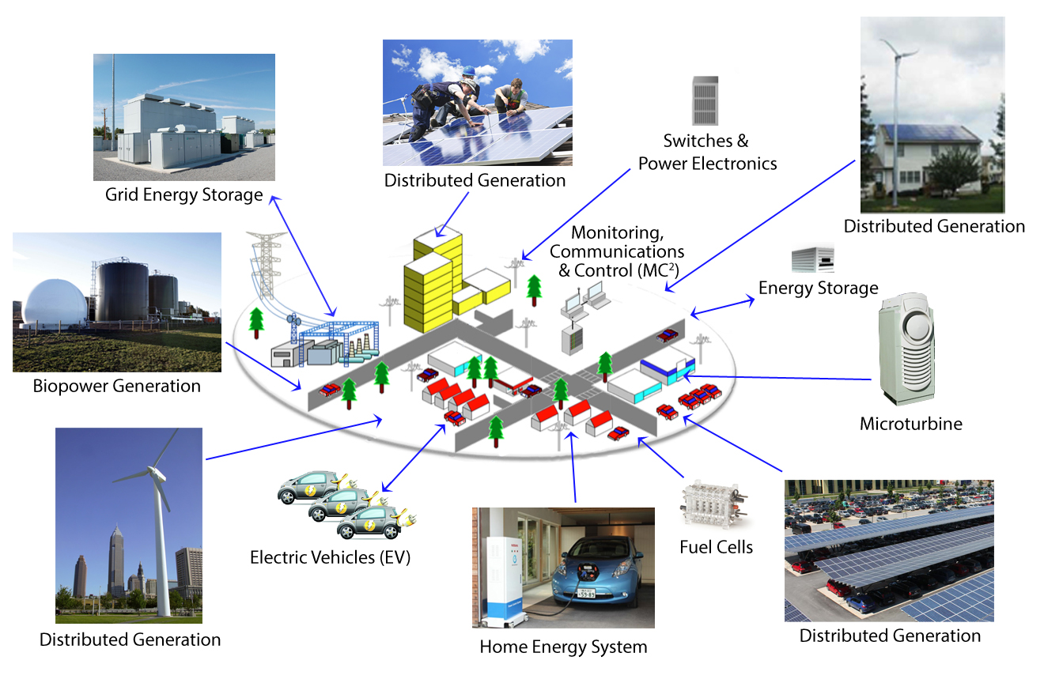
A Modern Power System
Notes:
(cl_04a, 12 Jan 2012)
To lay the groundwork, this slide represents the ultimate Clean Coalition vision.
This is what a smart energy future looks like.
The key components will be:
Distributed Generation + Demand Response + Energy Storage + Electrical Vehicle + overall Monitoring Communications and Controls or MC2 for short.
The Clean Coalition envisions a future where these components are no longer treated as independent silos. These components will work seamlessly together, using information technology to locally control, create and balance supply and demand of electricity.
What this slide also shows is the huge market opportunity for the transition. There is a $6 trillion dollar energy market AND it will transition to a smart energy future – and there are three key drivers behind that:
Economic sensibility
Energy security
Environmental sustainability
Regardless of your political affiliation, one of these drivers or a combination there of, will take us to this future.
The only question is how painful will this transition be, how fast will it happen, and who’s going to win all the economic benefits.
7

Slide 8
Clean Coalition’s Community Microgrid Initiative
1
Accelerate clean energy & sustainability
Achieve 25% or more of the total energy consumed in a community from local renewables
Improve grid reliability & resilience
Leverage dynamic grid solutions: advanced inverters, demand response, energy storage, and local reserves (e.g. CHP)
Optimize for cost-effectiveness
Across DG, dynamic grid solutions, and physical locations, leading to financially viable deployments
Capture local economic benefits
Secure predictable energy prices, reduce transmission-related costs & inefficiencies, and increase local investment & jobs
Modern Distribution Grid
More clean energy now
Improved grid performance
Stronger long-term economics
2
3
4
Notes:
To make this simple, just look at the arrow on the right. The goal of the Community Microgrid Initiative is in the arrow: to modernize the distribution grid with more clean energy, improved grid performance, and stronger long-term economics. We do this by focusing on the four objectives on the left, which are…

Slide 9
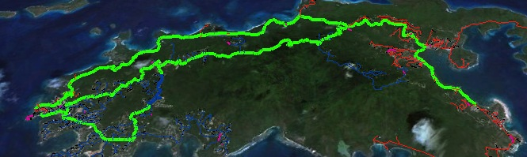
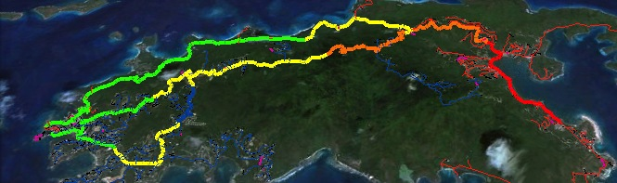
Example: A Dynamic Distribution Grid
6AM: No PV impact
Noon: 20MW PV causes overvoltage
Noon: Advanced inverters set at 0.9 power factor stabilizes voltage
Notes:
Here’s an example from our grid modeling work for the Water and Power Authority of the US Virgin Islands that shows how advanced inverters paired with local solar or storage can manage voltage issues.
High levels of solar PV can cause overvoltage. In the top image, 20 MW of solar has no impact at 6am. In the second image, 20MW of PV causes overvoltage at noon. The third image shows that adding advanced inverters set at 0.9 power factor stabilizes voltage under the same conditions above.
It is worth noting that 20 MW PV means that the PV would essentially be powering the entire Island of St. John at noon on the modeled day. St. John has an average load of about 10 MW and achieving the 25% threshold requires about 12 MWdc of PV. It is also worth noting that the 20 MW of PV has been evenly spread across the three feeders.

Slide 10
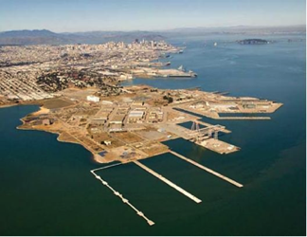
Community Microgrid: Hunters Point Project
Overview
Innovative project in the Bayview-Hunters Point area of San Francisco, in collaboration with Pacific Gas & Electric
Model for achieving 25% of the total energy consumed in the area from local renewables, while maintaining or improving grid reliability and power quality using dynamic grid solutions
The Hunters Point substation serves ~20,000 customers (about 90% residential, 10% commercial/industrial)
Notes:
The Clean Coalition is currently working on the Hunters Point Project, a Community Microgrid Initiative project in collaboration with Pacific Gas & Electric. This project will serve 25% of total energy consumed at the substation with local renewables, balanced with dynamic grid solutions like advanced inverters, demand response, and energy storage.
The Hunters Point substation serves the Bayview-Hunters Point area of San Francisco, one of the most disadvantaged communities of the Bay Area. The area includes a former naval shipyard that was designated a federal superfund site. This gives us the opportunity to show how increasing local renewables and modernizing the grid can create major economic benefits for a disadvantaged community. At the same time, the Hunters Point shipyard area will be redeveloped, which will enable a comparison of retrofitting the built area with new construction in the redeveloped area. Note that most of the project (seven of nine feeders) is outside of the redevelopment zone, and we’re moving forward with the project right now, independent of the redevelopment timeline.
The Clean Coalition team has already delivered a site plan showing the amount of potential for distributed generation from the most cost-effective locations – i.e. commercial and multifamily rooftops and parking lots – along with the expected costs of local renewables by type of site. The team has also published an analysis of the economic, ratepayer and environmental benefits of the project, which is available on the Clean Coalition website.
Right now, the Clean Coalition team is deep in the powerflow modeling stage, working with data from our partner Pacific Gas & Electric to add DG and dynamic grid solutions to the validated baseline power flow model. We expect to complete this work in Q3. Later this year, the team will use cost optimization tools to develop optimal portfolios of local resources based on both powerflow and costs. We’ll deliver a full report of recommendations by the end of the year, completing Phase 1 of the project. Phase 2 of the project will involve working with PG&E, the City and County of San Francisco, California regulators, and local supporters to get the project deployed in 2015.

Slide 11
Hunters Point Substation Boundary
Hunters Point Substation Boundary
Notes:
The yellow outline is the boundary of the Hunters Point Substation, serving both the Bayview area, on the left, and the Hunters Point area, on the right. Within the yellow boundary, to the right of the red outline is the planned Hunters Point redevelopment zone. The Bayview area represents the near-term opportunity to deploy a Community Microgrid in a built environment, on existing rooftops and parking lots. The redevelopment zone is adding shops, restaurants and housing over a number of years and will showcase how the Community Microgrid model can be integrated into the development plan.

Slide 12
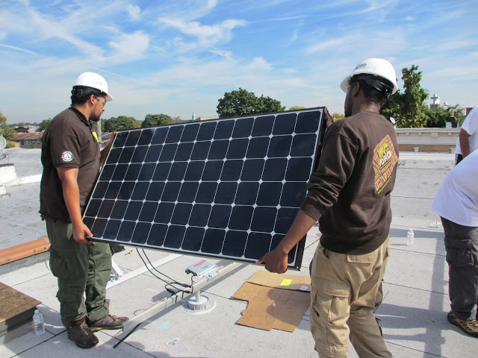
Hunters Point Reasonable DG Potential = 58 MW, Over 25% Total Energy
DG Potential: Over 25% of Total Load (320,000 MWh)
New PV in Bayview = 30 MW, or 46,000 MWh
New PV in HP Redev Zone = 20 MW, or 32,000 MWh
Existing DG = 8 MW (PV equivalent), or 13,000 MWh
Type | Capacity (Avg. MW) | Output (Annual MWh)
New PV: Commercial + MDUs | 14 | 21,000
New PV: Residential | 13.5 | 21,000
New PV: Parking Lots | 2.5 | 4,000
New PV: Redev Zone | 20 | 32,000
Total New PV | 50 MW | 78,000
Existing PV Equiv. * Includes 2MW biopower from wastewater plant @ 60% capacity | 8 | 13,000
Total DG Potential: | 58 MW | 91,000
Notes:
Existing DG = existing PV @ 1.8MW plus existing biopower @ 6.7MW solar equivalent (2MW @ 60% generating capacity).
Note on wind: Based on the HP Sustainability Plan, Hunters Point has been classified as a “Class 1” wind site. In terms of the economic feasibility of wind energy generation facilities, Class 1 sites are generally considered “very poor” or “poor”. Class 2 is considered “poor.” The Class 1 designation indicates that large scale wind power generation will not be feasible for the site. This is supported by a report commissioned by the California Energy Commission in 2004 that analyzed five locations around the City of San Francisco for wind generation viability. Hunters Point was one of the sites analyzed. The report indicated that out of the five sites, only Twin Peaks has a chance of being viable as a large-scale wind power generation site.

Slide 13
Hunters Point Reasonable DG Potential: Commercial + MDUs
Potential PV: Commercial Rooftops + MDUs
Highlights:
Number of visually-sited highest value “A” sites = 74
Total PV-potential rooftop square feet = 1.6M
Total participating sq. ft. @ 50% = 891K
Total average generation, participating rooftops = 14 MW
Hunters Point Rooftops - Commercial + MDUs
Assumptions
Watts/sq. ft. | 15
PV hrs./yr. | 1570
Participation Factor | 50%
Results
Total Sq. Ft. | 1,627,605
Total Sq. Ft. Participating | 891,605
Total Watts Participating | 13,374,068
Total PV in MW | 14
Total PV in Annual MWhr | 21,333
Average kW per site | 357
Example: 180 Napolean St.
PV Sq. Ft = 47,600
System size = 714 kW

Slide 14
Hunters Point Reasonable DG Potential: Parking Lots
Potential PV: Parking Lots
Highlights:
Number of visually-sited highest value “A” sites = 13
Total PV-potential parking lot square feet = 348K
Total participating sq. ft. @ 50% = 174K
Total average generation, participating parking lots = 2.5 MW
Hunters Point Parking Lots
Assumptions
Watts/sq. ft. | 15
PV hrs./yr. | 1,570
Participation Factor | 50%
Results
Total Sq. Ft. | 348,400
Total Sq. Ft Participating | 174,200
Total Watts Participating | 2,613,000
Total PV in MW | 2.5
Total PV in Annaul MWh | 4,102
Average kW per site | 402
Example: 1485 Bay Shore Blvd
PV Sq. Ft = 37,800
System size = 567 kW

Slide 15
Hunters Point Reasonable DG Potential: Residential
Potential PV: Residential Rooftops
Highlights:
Total residential sites = 14,000
Average PV-viable square feet per residence (from 50 sites) = 343
Total PV-potential residential square feet = 3.6M
Total participating sq. ft. @ 25% = 900K
Total average generation, participating rooftops = 13.5 MW
Hunters Point Rooftops - Residential
Assumptions
Watts/sq. ft. | 15
PV hrs./yr. | 1570
Participation Factor | 25%
Results
Total HH | 14,000
Average PV-viable sq. ft. per HH | 257
Total PV-viable Sq. Ft. | 3,601,920
Total PV-viable Sq. Ft. Participating | 900,480
Total PV in Watts | 13,507,200
Total PV in MW | 13.5
Total PV in Annual MWh | 21,206
Average PV system size per HH, kW | 4
Example: 50 average rooftops
Average PV Sq. Ft = 343
Average system size = 5 kW

Slide 16

HPP Benefits Analysis: 50 MW New DG
$200M in Private Investment + Operations & Maintenance Over 20 Yrs. Equals:
Photo courtesy of GRID Alternatives
Economic Benefits
$200M: Added regional economic stimulation
$100M: Added local wages, near-term plus annual
1,270 Job-Years: New near-term regional employment
520 Job-Years: New ongoing regional employment
$10M: Site leasing income for property owners
$5.8M: Added construction-related state sales taxes
Source: NREL JEDI calculator. Based on average installed cost of $2.75/W(dc) before taxes & incentives using PG&E rates/region.
Notes:
Private Investment + Operations & Maintenance:
$200M investment over 20 years is comprised of near-term plus ongoing operations and maintenance as follows:
1. $165M represents the private investment amount for a 50MW PV system over 20 Years, as follows:
Installation & Construction: $137M ($27.5M per 10 MW)
Dynamic Grid Solutions @ 20% = $27,500
Total = $165K
O&M: $35M represents the O&M costs for a 50MW PV system over 20 years, as follows:
O&M adds $1.48M annually, or $29.7M over 20 years
plus 20% or $5.9M for Dynamic Grid Solutions
Total = $35.6M over 20 years.
Local Employment and Economic Impact:
Specific to MTA – Metropolitan Region.
Refers to PV installed in San Francisco at an average installed cost of $2.75/W(dc) (before taxes and incentives).
Local economic output is calculated as the value of expenditures on goods and services resulting from the project and captured within the study area, and excludes expenditures outside the region, such as to module manufacturers. During operating years local economic output is comprised of payments made by project owners, including the portion of project debt payments made to lenders located within the local analysis area. Payments including incentives, refunds, or revenues to project owners from the sale of energy produced by installed facilities are not included.
Economic activity in input-output models is assessed in three categories:
Salaries and wages for the project on-site labor and direct professional services
Local supply chain revenue related to materials acquisition, manufacture and services, including the local share of revenues from project financing and investment
Induced impacts in the local economy that result from workers salaries and wages
The model’s “output” is the sum of the above three categories for construction and for operations. State-specific multipliers and personal spending patterns are used to derive the results.
Near-term Job years of regional local employment from construction and installation. Ongoing job years in operation and maintenance over 25 years of operation.
Local wages in construction & installation.
The SF successor RDA estimates that 50% of the jobs and economic output will be captured within the boundaries of the city
Equipment and material sales will generate tax revenue as indicated.
NREL's JEDI models classify the first category of results—on-site labor and professional services results—as dollars spent on labor from companies engaged in development and on-site construction and operation of power generation and distribution. These results include labor only—no materials.
Econ impact
NREL JEDI model version PV 10.17.11
NREL JEDI Scenario model PVS 4.5.13
PV PPA pricing
NREL System Advisor Model (SAM) v. 2013.9.20
CEC Cost of Generation Model v.2

Slide 17

HPP Benefits Analysis: 50 MW New DG
$200M in Private Investment + Operations & Maintenance Over 20 Yrs. Equals:
Photo courtesy of GRID Alternatives
Energy Benefits
Cost Parity: Solar vs. combined cycle natural gas, LCOE
$260M: Energy dollars spent on local vs. remote generation
$38M: Avoided transmission access charges
$30M: Avoided costs for new transmission capacity
$12M: Avoided costs from transmission line losses
$30M: Avoided costs from reducing power interruptions
Source: NREL JEDI calculator. Based on average installed cost of $2.75/W(dc) before taxes & incentives using PG&E rates/region.
Notes:
Private Investment + Operations & Maintenance:
1. $165M represents the private investment amount for a 50MW PV system over 20 Years, as follows:
Installation & Construction: $137M (27.5M per 10 MW)
Dynamic Grid Solutions @ 20% = $27,500
Total = $165K
O&M: $35M represents the O&M costs for a 50MW PV system over 20 years, as follows:
O&M adds $1.48M annually, or $29.7M over 20 years
plus 20% or $5.9M for Dynamic Grid Solutions
Total = $35.6M over 20 years.
Cost Parity via 20-year LCOE:
14.9¢/kWh solar vs. $15.3¢/kWh new combined cycle natural gas, LCOE. Modeling performed with NREL System Advisor Modeling (SAM) and PVWatts system design, using the mid-case scenario. For more details, see detailed LCOE slide later in deck.
Local Energy Spend
Based on 20 year average of $2,619,260 per year from avg output of 1484kWh/yr over that period
$52M over 20 years per 10MW
Avoided transmission access charges (TAC):
Calculated from CAISO 2013 TAC schedule and infrastructure projections. Note that the reductions in TAC are included in the LCOE comparison.
Avoided Costs from New Transmission Capacity:
Each 10 MW of added PV DG capacity will reduce the need for added transmission capacity investment by 0.05% relative to CAISO BAU projections and the related growth in TAC ratesResults in 0.0012¢/kWh reduction TAC rates applied to virtually all of the 254,000 GWh consumed within CAISO transmission system electricity by 2020
Avoided Line Losses
Based on PG&E Bay Area reported line loss rates, combined avoided line losses from transmission and distribution due to distributed generation average 5%, or 789 MWh per year for each 10 MW of PV DG installed. At an average current retail value of 15¢/kWh, the value of avoided losses is $118,350 per year, totaling $2,367,000 over 20 years.
Note that avoided lines losses are included in LCOE comparison.
Avoided Costs in Local Power System Interruptions:
Based on PG&E figures for Hunters Point outages, 10 MW of local DG would result in a 10% reduction in annual outages alone, or $304,000 per year, or $6M over a 20 year period. 50 MW would equal five times that, or $30M over 20 years. Source: PG&E 2012 Reliability Annual Report, DOE Interruption Cost Calculator - http://www.icecalculator.com/

Slide 18

HPP Benefits Analysis: 50 MW New DG
$200M in Private Investment + Operations & Maintenance Over 20 Yrs. Equals:
Photo courtesy of GRID Alternatives
Environmental Benefits
78M lbs.: Annual reductions in GHG emissions
6,660: Equivalent in cars removed
8,720: Equivalent emissions offset, # of homes
15M Gallons: Annual water savings
375: Acres of land preserved
Source: NREL JEDI calculator. Based on average installed cost of $2.75/W(dc) before taxes & incentives using PG&E rates/region.
Notes:
Private Investment + Operations & Maintenance:
1. $165M represents the private investment amount for a 50MW PV system over 20 Years, as follows:
Installation & Construction: $137M (27.5M per 10 MW)
Dynamic Grid Solutions @ 20% = $27,500
Total = $165K
O&M: $35M represents the O&M costs for a 50MW PV system over 20 years, as follows:
O&M adds $1.48M annually, or $29.7M over 20 years
plus 20% or $5.9M for Dynamic Grid Solutions
Total = $35.6M over 20 years.
GHG Reductions:
Assuming PV replaces Combined Cycle Natural Gas (CCNG) generation in contributing to California’s Renewable Portfolio Standard (RPS), avoided emissions from displaced CCNG facilities equal:
CO₂: 16,630,000 lbs (7461 Metric tons)
NO_{X}: 30,700 lbs
Mercury (Hg): 0.016 lbs
Water Use:
Thermal generation, including both fossil and nuclear facilities requires significant water use for cooling. NGCC facilities with cooling towers consume 0.7 cubic meters of water per MWh through evaporation.
A 10 MW PV facility would save:
11,050 cubic meters of water per year, or nearly 3 Million gallons, or 3,900 cubic feet.
This is equivalent to the average annual water use of 75 San Francisco residents.
Land saved, acres
DG avoids land impacts vs. conventional generation because it is typically deployed as a secondary use on existing structures, parking lots or otherwise already disturbed land. Each 10MW of DG preserves 75 acres of land. This does not include savings for adding transmission lines as well.

Slide 19
Hunters Point Project Deliverables
✔
DG Survey
Identified 50 MW of new PV potential: commercial, residential, parking lots
Existing DG includes 2 MW wastewater biopower (6.5 MW PV equiv.)
✔
Benefits Analysis
DG Economic: $200M in local stimulus, $100M going to local wages
DG Environmental: 78M lbs. of GHG eliminated per year, 15M gallons of water saved per year, 375 acres of land preserved
Baseline Model
Required data sets and circuit model from PG&E
Model of existing powerflow, validated by PG&E
2Q 2014
Optimized
Scenarios
Optimal mix of DG, dynamic grid solutions, and physical locations
Cost-optimized scenarios
3Q 2014
Standardized reports, modeling, and methodologies, setting the stage for implementation (Phase 2) and industry-wide scalability
Streamlined & scalable procurement & interconnection
4Q 2014
Results

Slide 20

“Plug-n-Play” Deployment Opportunity
Planning for local capacity in the distribution grid, then upgrading the grid as appropriate, enables “Plug-n-Play” distributed energy – creating scale and simplicity.
DG connects in bulk quantities based on defined substation targets and locations. For example:
  3. More Cost
  E.g. 75MW, or >40% of total energy
DG Penetration
  2. Low Cost
  E.g. 50 MW, or 25% of total energy
  No Cost
  E.g. 25 MW, or 10% of total energy
  Requires major grid upgrades, and/or:
  Achieves target performance goals to alleviate grid outages and enable islanding
  Requires minimal upgrades
  Utilizes demand response and cost-effective storage
  Requires no upgrades
  Uses advanced inverters
Notes:
Data sets include utility circuit data and loads, equipment lists w/pricing, insolation, weather forecasting, etc.

Slide 21
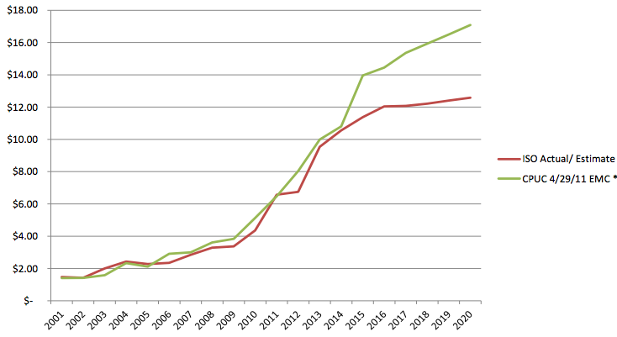
Opportunity: Shift Costs from Transmission to Distribution
Under a business as usual scenario, new incremental transmission investments will reach $80 billion over the next 20 years, imposed on California ratepayers
Levelized over 20 years, this approaches 3 cents/kWh – or roughly 25% of the wholesale cost of electricity, or 33% of the energy price of centralized solar
Avoiding half of these charges, for example, would free up roughly $40 billion for modernizing the distribution grid incl. local renewables, storage, etc.
Historical and Projected High Voltage Transmission Access Charges ($/MWh).
Does not include Low Voltage Transmission Access Charges.
Source: Palo Alto Utilities
Notes:
Today, levelized transmission costs associated with solar delivered over high voltage transmission adds 33% to the contract energy price, or 2.7¢/kWh. With transmission costs forecast to rise at >7% per year, in ten years the cost of transmission will exceed the cost of energy.
Driven by high cost of new transmission
TAC rates have increased at an annualized rate exceeding 15% since 2005 as new transmission dependent generation has been approved, and new transmission capacity is far more costly than maintaining existing capacity. CAISO mid value estimates for the rate of increase in TAC charges will be substantially less than the recent trend and prior CPUC estimates, as illustrated below. Utilizing CAISOs current projected average future estimate of 7% nominal escalation (5% real) over the next 20 years, the levelized current value of avoidable TAC charges applicable to a 20 year DG PPA is 2.4 ¢/kWh.
The original data on TAC growth was provided by the City of Palo Alto municipal utilities. We independently verified their results with ISO data, and our findings were confirmed by Navigant Consulting, who have performed related analysis for clients. These results have been presented in numerous forums and in formal comments in multiple proceedings over the past two years without contradiction. A recent update by the Palo Alto Utilities put this figure at 2.7¢/kWh, and this value is used by the utility in bid equalization and avoided cost basis for local procurement

Slide 22
Utility of the Future: “Distribution System Operator”
The Distribution System Operator (DSO) will:
In real time, reliably operate the local distribution system, optimizing all Distributed Energy Resources (DER): micro-grids, diverse small-scale generation, self-optimizing customers, energy storage, power flow control devices, demand response, etc.
Create a more stable and predictable interchange with the Transmission System Operator (TSO) that relies on more local balancing of resources
Source: 21st Century Electric Distribution System Operations, May 2014
Notes:
The key quotes and diagram shown in this slide are taken from a paper published in May 2014 by Lorenzo Kristov of CAISO and Paul Di Martini of the Caltech Resnick Institute.

Slide 23
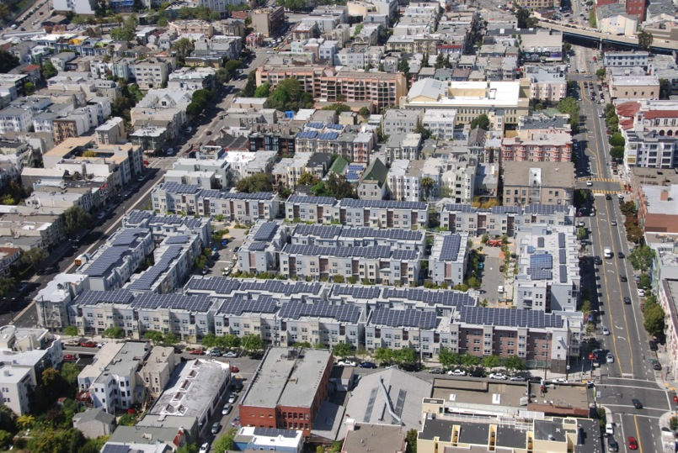
Peek at the Future of Bayview-Hunters Point
Ecoplexus project at the Valencia Gardens Apartments in SF. ~800 kW serving ~80% of the total annual load.
Notes:
23

