Slide 1
Long Island Community Microgrid Project
New approach for grid design and operations
Craig Lewis
Executive Director
Clean Coalition
650-796-2353 mobile
craig@clean-coalition.org
10 June 2016

Slide 2
Clean Coalition Mission
To accelerate the transition to renewable energy and a modern grid through
technical, policy, and project development expertise
Notes:
2

Slide 3
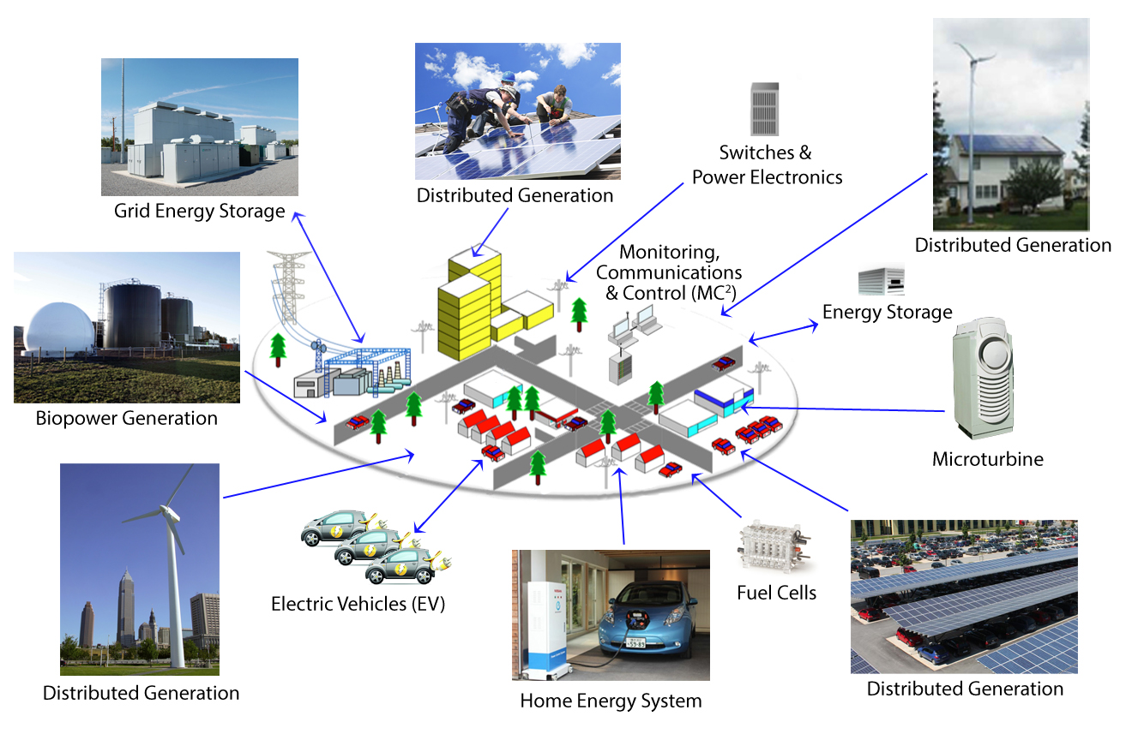
Clean Coalition Vision: Clean Local Energy
Notes:
Our goal: A cleaner, more reliable and more affordable power system.
3

Slide 4
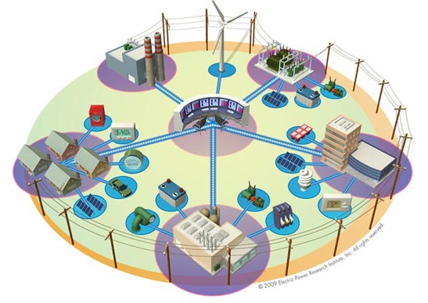


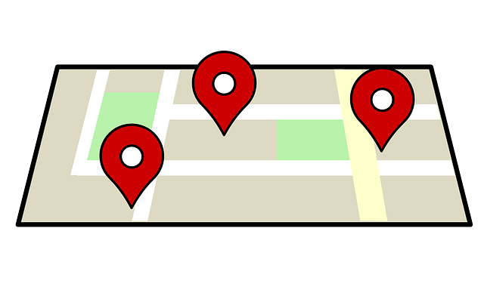
Clean Coalition technical & project expertise
Community Microgrid Projects
Program Design
Grid Modeling & Optimization
Analysis & Planning
Renewable energy siting surveys
Full cost and value assessment
Powerflow modeling
Distributed energy resources optimization
Procurement and interconnection policies and procedures
Community-scale distributed energy resources planning and design
Notes:
These steps build on one another and are interrelated. We have done work with electric utilities, regulatory agencies, legislators, and cities.
Distribution level modeling and optimization
DER siting
Also bring substantial policy & communications expertise
4

Slide 5
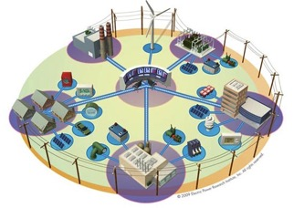
What is a Community Microgrid?
A Community Microgrid is a new approach for designing and operating the electric grid, stacked with local renewables.
Key features:
A targeted and coordinated local grid area served by one or more distribution substations
High penetrations of local renewables and other Distributed Energy Resources (DER) such as energy storage and demand response
Ongoing renewables-driven power backup for critical and prioritized loads across the grid area
A solution that can be readily extended throughout a utility service territory – and replicated across utilities

Slide 6

Community Microgrid benefits
Community Microgrids offer a more scalable, cost-effective, and modern solution for our electricity grid. Key benefits include:
1
Scale, Sustainability: local renewables reaching 25% - 50% of total annual energy – 10 times more than today
Cost-effectiveness: lower long-term costs via technology vs commodity advantage, plus peak & transmission reductions
Local investment: substantial energy dollars spent on local / regional jobs instead of remote / offshore
Resilience & Security: improved grid reliability, resilience, and security via a replicable model that extends across any area
2
3
4
RESUILT: A smarter more cost-effective distribution grid featuring cleaner energy, improved grid performance, and unparalleled local economic stimulation
Notes:
Highlights:
Scalable & replicable using the substation area as the foundation
Cost-effective due to scale and local optimizations
Leverages existing utility distribution grid assets and operations
Load-centric design reduces costly peaks
Islands only critical loads (can add more over time)

Slide 7
Community Microgrids in Six Steps
1. Goals
Desired goals & performance metrics of the target grid area based on local resources and known or anticipated grid issues.
Includes renewables penetration goals, grid reliability & power quality performance targets, and power backup requirements.
2. Baseline Analysis
Inventory of the existing grid assets including load profiles, voltage regulation, feeder and transformer capacities, and existing generation.
Includes identifying prioritized services that require backup power during outages.
3. Siting Survey
Comprehensive survey of the renewable energy potential in the target grid area specific to local resources & site characteristics
Informs other requirements such as energy storage capacity needs and control system functionality.
4. DER Optimization
Design of optimal DER portfolios combining renewables, energy storage, and demand response.
Incorporates Baseline Grid Analysis and Renewables Survey to achieve optimal outcomes based on local resources and grid assets.
5. Benefits Analysis
Full analysis of cost- benefits and net value including reductions in T&D investments, ratepayer impacts, and local job creation.
Includes bulk procurement & interconnection that achieve a “plug-and-play” model, further reducing costs.
6.Deployment Plan
Final system design, financial model and operational plan for the Community Microgrid.
Includes vendor analysis (e.g. RFIs, RFPs) appropriate to the final design criteria, financial model, and operational requirements.

Slide 8

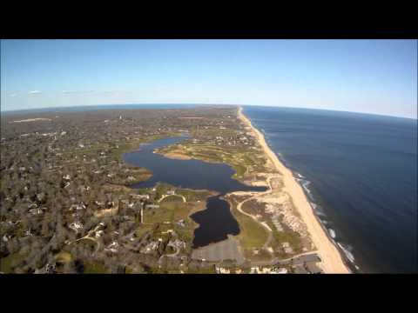

Deployment Planning - Long Island example
NY Prize Community Microgrids Competition grant award. Collaboration with PSEG Long Island, Long Island Power Authority (LIPA), and NYSERDA covering a substation in the East End of Long Island that serves over 3,300 customers (10% C&I).
Combines 15 MW of local solar (via Feed-In Tariff) with a 5 MW / 25 MWh battery system, multiple smaller batteries, and targeted load management
Achieves almost 50% of total annual energy consumption from local solar. Minimizes the use of existing fossil generators including local diesel peakers and diesel backup generators.
Provides ongoing power backup to multiple critical facilities as well as other priority loads across the area
Sets the stage to preempt hundreds of millions of dollars in transmission and fossil generation investments – pays for itself from day 1

Slide 9
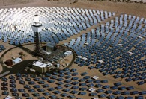
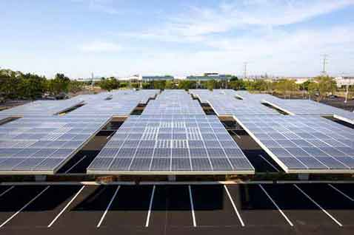



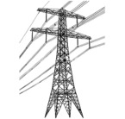

Wholesale DG is the Critical & Missing Segment
Project Size
Central Generation
Serves Remote Loads
50+ MW
Wholesale DG
Serves Local Loads
500 kW
Retail DG
Serves Onsite Loads
5 kW
Behind the Meter
Distribution Grid
Transmission Grid
Notes:
Wholesale Distributed Generation or WDG is the market segment that makes this transition possible. The retail DG – behind the meter – and central generation renewables – out in the desert, most of the time – are both part of the equation, but WDG has enough potential and uses economies to scale that will really change the game.
When we refer to DG, we mean a generating resource that is located on the distribution grid and the generated electricity does not feed back onto the transmission grid. WDG, therefore, is DG that sells all of its generation to the utility (or other purchaser). In future slides, I will refer to the distribution grid as the d-grid.
*National policies focus on removing barriers for large-scale renewable power facilities and infrastructure.
*State and local net-metering policies promote small-scale renewables:
---Net-metering is designed to reduce a utility customer’s electric bills
---Net-metering is not designed for owners of commercial and multi-tenant properties (where tenants pay the utility bills)
---Annual on-site energy use generally caps net-metering project size
---Investors and lenders find a utility customer’s energy savings from net-metering far less attractive than a revenue stream from a stable utility
(03_gp, 28 May 2013)

Slide 10
Scaling local renewables achieves cost-effectiveness
Solar Markets: Germany vs California (RPS + CSI + other)
Cumulative MW
Sources: CPUC, CEC, SEIA and German equivalents.
Germany has deployed over 10 times more solar than California in the last decade despite California’s 70% better solar resource!!!
Notes:
Germany is the best example we currently have to show the efficacy of CLEAN Programs and the WDG market. If there is any confusion, Germany is in green and California—known as the leading market it the U.S.–is in red. It is astonishing that Germany is adding 11 times more solar than California even though California has a 70% better resource.
Rooftop solar in Germany today is priced at the California-equivalent of 7-10 cents/kWh, which would be the most cost-effective resource deployed in California.
Ground-based solar projects typically generate about 25% more kWh/W than rooftop projects, because they use tracking, which allows the panels to follow the sun throughout the day. The net result is that ground-based projects are generally about 20% more cost-effective than rooftop projects. The difference between the 25% and the 20% is that the O&M costs for ground-based projects are a bit higher due to their moving parts.
(07_gp, 23 Sep 2013)

Slide 11
German solar is mostly local (on rooftops)
26%
23.25%
22.5%
19%
9.25%
Source: Paul Gipe, March 2011
Germany’s solar deployments are almost entirely sub-2 MW projects on built-environments and interconnected to the distribution grid (not behind-the-meter)
Notes:
(cl_04a, 12 Jan 2012)

Slide 12
German rooftop solar is 5 to 7 cents/kWh today
Project Size | Euros/kWh | USD/kWh | California Effective Rate $/kWh
Under 10 kW | 0.145 | 0.1903 | 0.0762
10 kW to 40 kW | 0.138 | 0.1805 | 0.0722
40.1 kW to 1 MW | 0.123 | 0.161 | 0.0644
1.1 MW to 10 MW | 0.101 | 0.1317 | 0.0527
Source: http://www.wind-works.org/cms/index.php?id=92, 10 September 2013
Conversion rate for Euros to Dollars is €1:$1.309
California’s effective rate is reduced 40% due to tax incentives and then an additional 33% due to the superior solar resource
Replicating German scale and efficiencies would yield rooftop solar today at only between 5 and 7 cents/kWh to California ratepayers
Notes:
Critics of Germany’s CLEAN Program tend to say that they are paying too much for renewable energy generation, but this chart shows that – using the appropriate conversion – they are paying less for solar than we pay for electricity almost anywhere in the U.S. This conversion uses the U.S. tax incentives and solar resource.

Slide 13
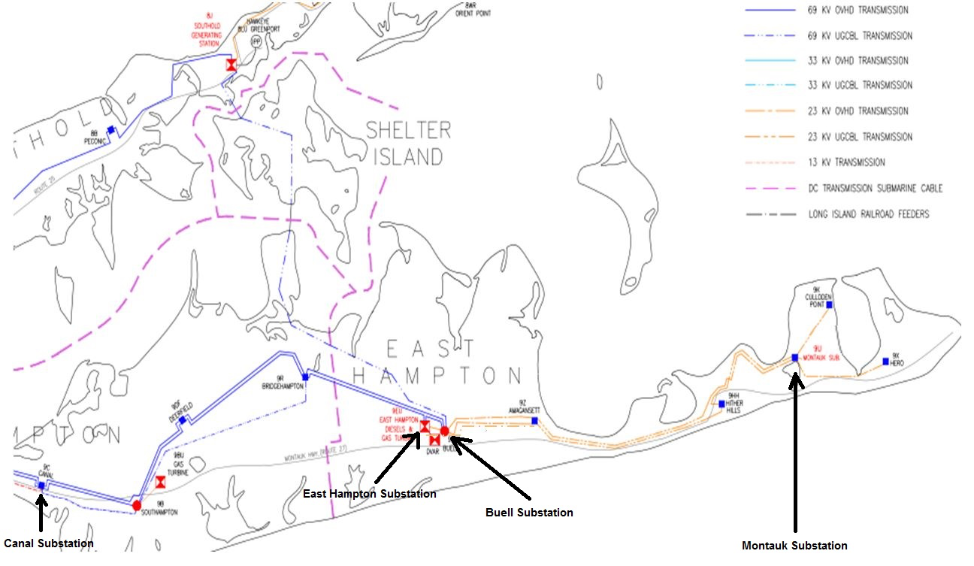
South Fork Transmission System
LONG
ISLAND

Slide 14
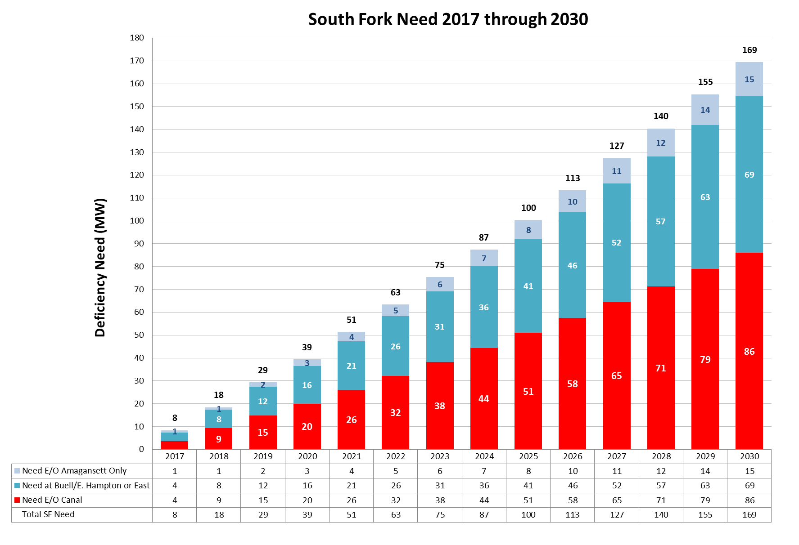
South Fork – Forecasted Deficiency
Request for Proposals (RFP) for South Fork are seeking 63 MW of capacity
LONG
ISLAND

Slide 15
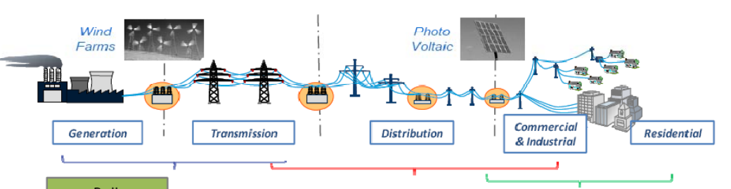

Why is energy storage important to PSEG Long Island?
Benefits across the electricity value chain: Generation to T&D to End Users
Primary drivers:
  Develop a robust and resilient electricity delivery system
  Enable & Enhance renewable energy integration
  Mitigate Infrastructure investment
Bulk Storage
Utility Scale
Community Scale
LONG
ISLAND

Slide 16
Community Microgrids start with Goals
Typical Community Microgrid Goals
  Achieve high penetrations of local renewables (generally at least 25% of total electric energy consumed within the grid area served by the Community Microgrid)
  Defer substantial investments in traditional Transmission & Distribtution (T&D) infrastructure through load shifting and peak shaving etc
  Save ratepayers money
  Provide an efficient pathway to Distribution Services Operator (DSO) grid operations and the Distributed Energy Resources (DER) future
  Enhance grid performance (grid power quality, reliability, and resilience), including by combining local renewables and Energy Storage for indefinitely ongoing power backup to prioritized loads (critical loads and premium services)

Slide 17
Long Island Deployment Plan overview

Slide 18
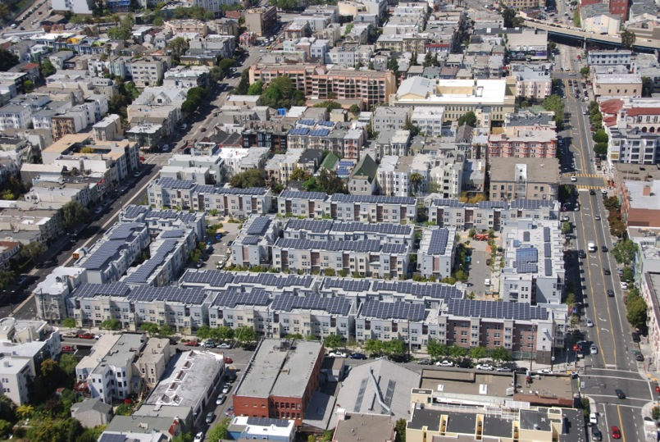
Peek at the Future of Community Microgrid areas
Ecoplexus project at the Valencia Gardens Apartments in SF. ~800 kW meeting ~80% of the total annual load.
Notes:
18

Slide 19
Backup
Backup

Slide 20
Community Microgrids start with Goals
Typical Community Microgrid Goals
  Achieve high penetrations of local renewables.
  Enhance grid reliability and power quality.
  Provide energy resilience to the community.
  Defer investments in traditional Transmission & Distribtution (T&D).
  Save ratepayers money.
  Stage an efficient pathway to Distribution Services Operator (DSO) grid operations and the Distributed Energy Resources (DER) future.
  Meet community expectations etc.

Slide 21
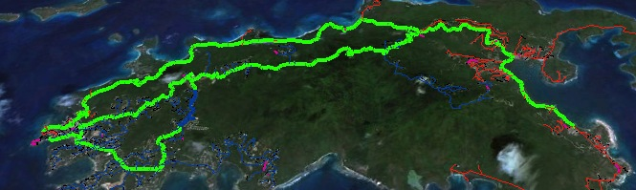
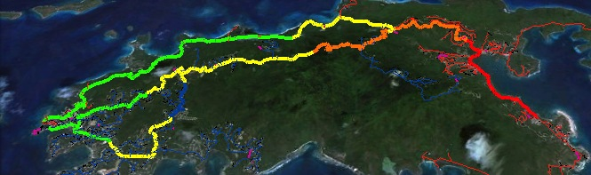
Baseline vs DER Optimization with Advanced Inverters
6AM: No PV impact
Noon: 20MW PV causes overvoltage
Noon: 20MW PV with advanced inverters set at 0.9 power factor stabilizes voltage
Notes:
Here’s an example from our grid modeling work for the Water and Power Authority of the US Virgin Islands that shows how advanced inverters paired with local solar or storage can manage voltage issues.
High levels of solar PV can cause overvoltage. In the top image, 20 MW of solar has no impact at 6am. In the second image, 20MW of PV causes overvoltage at noon. The third image shows that adding advanced inverters set at 0.9 power factor stabilizes voltage under the same conditions above.
It is worth noting that 20 MW PV means that the PV would essentially be powering the entire Island of St. John at noon on the modeled day. St. John has an average load of about 10 MW and achieving the 25% threshold requires about 12 MWdc of PV. It is also worth noting that the 20 MW of PV has been evenly spread across the three feeders.

Slide 22

Siting Considerations are Critical
C&I Match with Solar:
Most Generation
Larger rooftop spaces generate more energy
Lowest System Costs
Larger systems reduce overall costs
Best Grid Locations
Large loads served by robust feeder segments
Matching Load Profiles
Larger daytime loads match solar generation
Financially Motivating
Rooftop lease income is large enough to be compelling to property owners
Notes:
Commercial & Industrial customers offer the most cost-effective programs for utilities and communities due to their size, location, and matching load profiles, plus motivation to stabilize energy costs.
Via a robust and focused program, utilities and communities can take advantage of this customer category to accelerate and optimize DG/DERs.
Considerations:
Feeders are connected within each substation. This enables sharing energy across feeders and thus across customers and customer types.
Each urban/suburban substation or set of substations can find the most optimal mix between the three primary customer types: Commercial, Industrial, Residential.
Both weekday and weekend load profiles must be considered. In general, during weekday daytimes when residential load is low and C&I load is high, a good portion or all of the C&I daytime PV generation can be consumed “hyper-locally” by C&I customers, either directly or via sharing energy across those customers. During the weekends, C&I customers may use less daytime load which can then be shared more broadly with local residential customers who often use more load during weekend daytimes than weekday daytimes.
Multi-dwelling units can be bundled with C&I given the larger rooftops and loads; however, the load profiles will match residential, not C&I.

Slide 23
Solar Siting Survey for SCE Preferred Resources Pilot
Objective: Conduct a Solar Siting Survey across Southern California Edison’s Preferred Resources Pilot (PRP) area for sites 500 kW or greater
The PRP area is approximately 120 square miles in Orange County, CA, bordered roughly by Santa Ana in the north and Laguna Niguel in the south.
Notes:
Completed in mid-April 2015

Slide 24


SCE PRP Solar Siting Survey summary
Summary: over 160 MW of new solar PV technical potential exists in the PRP on very large rooftops, parking lots, and parking garages (500kW+ project sizes)
PRP Solar Potential by PV size: totals per sites greater than 1 MW, sites greater then 500 kW but less than 1 MW, and sites less than 500 kW. The sites that are less than 500 kW are included as part of logical groupings such as office parks or shopping centers.
PRP Solar Potential by site type: totals for rooftops, parking garages (multi-story parking structures that would enable rooftop-style mounting), parking lots (e.g. ground mount), and brown fields

Slide 25
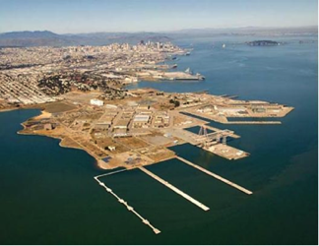
Benefits Matter - Hunters Point example
Overview
Innovative project in the Bayview-Hunters Point area of San Francisco, in collaboration with Pacific Gas & Electric
Model for achieving 25% of the total energy consumed in the area from local renewables, while maintaining or improving grid reliability and power quality using dynamic grid solutions
The Hunters Point substation serves ~20,000 customers (about 90% residential, 10% commercial/industrial)
Notes:
The Clean Coalition is currently working on the Hunters Point Project, a Community Microgrid Initiative project in collaboration with Pacific Gas & Electric. This project will serve 25% of total energy consumed at the substation with local renewables, balanced with dynamic grid solutions like advanced inverters, demand response, and energy storage.
The Hunters Point substation serves the Bayview-Hunters Point area of San Francisco, one of the most disadvantaged communities of the Bay Area. The area includes a former naval shipyard that was designated a federal superfund site. This gives us the opportunity to show how increasing local renewables and modernizing the grid can create major economic benefits for a disadvantaged community. At the same time, the Hunters Point shipyard area will be redeveloped, which will enable a comparison of retrofitting the built area with new construction in the redeveloped area. Note that most of the project (seven of nine feeders) is outside of the redevelopment zone, and we’re moving forward with the project right now, independent of the redevelopment timeline.
The Clean Coalition team has already delivered a site plan showing the amount of potential for distributed generation from the most cost-effective locations – i.e. commercial and multifamily rooftops and parking lots – along with the expected costs of local renewables by type of site. The team has also published an analysis of the economic, ratepayer and environmental benefits of the project, which is available on the Clean Coalition website.
Right now, the Clean Coalition team is deep in the powerflow modeling stage, working with data from our partner Pacific Gas & Electric to add DG and dynamic grid solutions to the validated baseline power flow model. We expect to complete this work in Q3. Later this year, the team will use cost optimization tools to develop optimal portfolios of local resources based on both powerflow and costs. We’ll deliver a full report of recommendations by the end of the year, completing Phase 1 of the project. Phase 2 of the project will involve working with PG&E, the City and County of San Francisco, California regulators, and local supporters to get the project deployed in 2015.

Slide 26



Hunters Point CMP Benefits from 50 MW New PV
50 MW Total = Existing Structures @ 30 MW + Redev Zone @ 20 MW
Example: 180 Napolean St.
PV Sq. Ft = 47,600
System size = 714 kW
Example: 1485 Bay Shore
PV Sq. Ft = 37,800
System size = 567 kW
Example: 50 avg. rooftops
Avg. PV Sq. Ft = 343
Avg. system size = 5 kW
Commercial: 18 MW
Parking Lots: 2 MW
Residential & MDU: 10 MW
Benefits from 50 MW New PV Over 20 Years
Energy
Cost Parity: Solar vs. NG, LCOE
$260M: Spent locally vs. remote
$80M: Avoided transmission costs
$30M: Avoided power interruptions
Economic
$200M: New regional impact
$100M: Added local wages
1,700 Job-Years: New near-term and ongoing employment
$10M: Site leasing income
Environmental
78M lbs.: Annual reductions in GHG emissions
15M Gallons: Annual water savings
375: Acres of land preserved
Notes:
ENERGY BENEFITS
Cost Parity via 20-year LCOE:
14.9¢/kWh solar vs. $15.3¢/kWh new combined cycle natural gas, LCOE. Modeling performed with NREL System Advisor Modeling (SAM) and PVWatts system design, using the mid-case scenario. For more details, see detailed LCOE slide later in deck.
Local Energy Spend
Based on 20 year average of $2,619,260 per year from avg output of 1484kWh/yr over that period
$52M over 20 years per 10MW
Avoided transmission access charges (TAC):
Calculated from CAISO 2013 TAC schedule and infrastructure projections. Note that the reductions in TAC are included in the LCOE comparison.
Avoided Costs from New Transmission Capacity:
Each 10 MW of added PV DG capacity will reduce the need for added transmission capacity investment by 0.05% relative to CAISO BAU projections and the related growth in TAC ratesResults in 0.0012¢/kWh reduction TAC rates applied to virtually all of the 254,000 GWh consumed within CAISO transmission system electricity by 2020
Avoided Line Losses
Based on PG&E Bay Area reported line loss rates, combined avoided line losses from transmission and distribution due to distributed generation average 5%, or 789 MWh per year for each 10 MW of PV DG installed. At an average current retail value of 15¢/kWh, the value of avoided losses is $118,350 per year, totaling $2,367,000 over 20 years.
Note that avoided lines losses are included in LCOE comparison.
Avoided Costs in Local Power System Interruptions:
Based on PG&E figures for Hunters Point outages, 10 MW of local DG would result in a 10% reduction in annual outages alone, or $304,000 per year, or $6M over a 20 year period. 50 MW would equal five times that, or $30M over 20 years. Source: PG&E 2012 Reliability Annual Report, DOE Interruption Cost Calculator - http://www.icecalculator.com/
ECONOMIC BENEFITS
Private Investment + Operations & Maintenance:
$200M investment over 20 years is comprised of near-term plus ongoing operations and maintenance as follows:
1. $165M represents the private investment amount for a 50MW PV system over 20 Years, as follows:
Installation & Construction: $137M ($27.5M per 10 MW)
Dynamic Grid Solutions @ 20% = $27,500
Total = $165K
O&M: $35M represents the O&M costs for a 50MW PV system over 20 years, as follows:
O&M adds $1.48M annually, or $29.7M over 20 years
plus 20% or $5.9M for Dynamic Grid Solutions
Total = $35.6M over 20 years.
Local Employment and Economic Impact:
Specific to MTA – Metropolitan Region.
Refers to PV installed in San Francisco at an average installed cost of $2.75/W(dc) (before taxes and incentives).
Local economic output is calculated as the value of expenditures on goods and services resulting from the project and captured within the study area, and excludes expenditures outside the region, such as to module manufacturers. During operating years local economic output is comprised of payments made by project owners, including the portion of project debt payments made to lenders located within the local analysis area. Payments including incentives, refunds, or revenues to project owners from the sale of energy produced by installed facilities are not included.
Economic activity in input-output models is assessed in three categories:
Salaries and wages for the project on-site labor and direct professional services
Local supply chain revenue related to materials acquisition, manufacture and services, including the local share of revenues from project financing and investment
Induced impacts in the local economy that result from workers salaries and wages
The model’s “output” is the sum of the above three categories for construction and for operations. State-specific multipliers and personal spending patterns are used to derive the results.
Near-term Job years of regional local employment from construction and installation. Ongoing job years in operation and maintenance over 25 years of operation.
Local wages in construction & installation.
The SF successor RDA estimates that 50% of the jobs and economic output will be captured within the boundaries of the city
Equipment and material sales will generate tax revenue as indicated.
NREL's JEDI models classify the first category of results—on-site labor and professional services results—as dollars spent on labor from companies engaged in development and on-site construction and operation of power generation and distribution. These results include labor only—no materials.
Econ impact
NREL JEDI model version PV 10.17.11
NREL JEDI Scenario model PVS 4.5.13
PV PPA pricing
NREL System Advisor Model (SAM) v. 2013.9.20
CEC Cost of Generation Model v.2
ENVIRONMENTAL BENEFITS
GHG Reductions:
Assuming PV replaces Combined Cycle Natural Gas (CCNG) generation in contributing to California’s Renewable Portfolio Standard (RPS), avoided emissions from displaced CCNG facilities equal:
CO₂: 16,630,000 lbs (7461 Metric tons)
NO_{X}: 30,700 lbs
Mercury (Hg): 0.016 lbs
Source: NREL Emissions Health Calculator, PG&E service territory
Water Use:
Thermal generation, including both fossil and nuclear facilities requires significant water use for cooling. NGCC facilities with cooling towers consume 0.7 cubic meters of water per MWh through evaporation.
A 10 MW PV facility would save:
11,050 cubic meters of water per year, or nearly 3 Million gallons, or 3,900 cubic feet.
This is equivalent to the average annual water use of 75 San Francisco residents.
Source: DOE 2009
Land saved, acres
DG avoids land impacts vs. conventional generation because it is typically deployed as a secondary use on existing structures, parking lots or otherwise already disturbed land. Each 10MW of DG preserves 75 acres of land. This does not include savings for adding transmission lines as well. Source: Civil Society Institute – “Hidden Costs of Electricity” (Sep 2012)

Slide 27
Cubberley Solar Emergency Microgrid
Leverage the existing 125 kW solar facility and allow it to continue operating under the existing Net Energy Metering (NEM) agreement and interconnection with the Palo Alto Utilities.
Implement an electrical configuration that allows the Cubberly Solar Emergency Microgrid (SEM) to autonomously isolate (aka “island”) from the Palo Alto Utilities grid without power interruption to the identified critical facilities, including the Offices of Emergency Services (OES) communication facilities and administrative offices; and all facilities associated with Palo Alto’s only emergency shelter.
Implement energy storage to complement the solar and provide indefinite backup power to the critical facilities, which are estimated to require average power of 10kW and peak power of 50kW.

Slide 28
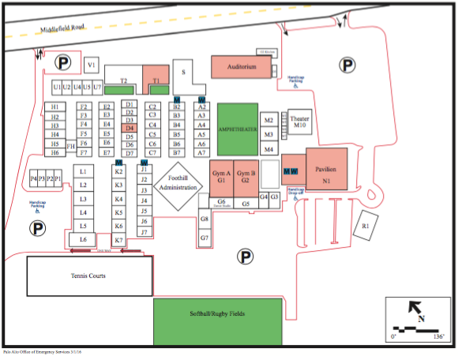
Solar Emergency Microgrid (SEM) - Cubberley

Slide 29
Peninsula Advance Energy Community (PAEC)
Funding: 20-month, $1.3 million California Energy Commission (CEC) planning & design grant to stage policy and project implementations that facilitate and showcase Advanced Energy Communities (AECs).
Policy: Identify best-practice AEC policies associated and stage to proliferate them policies throughout the PAEC region and beyond.
Projects: Identify showcase AEC projects and cross-fertilize them to projects throughout the PAEC region and beyond.

Slide 30
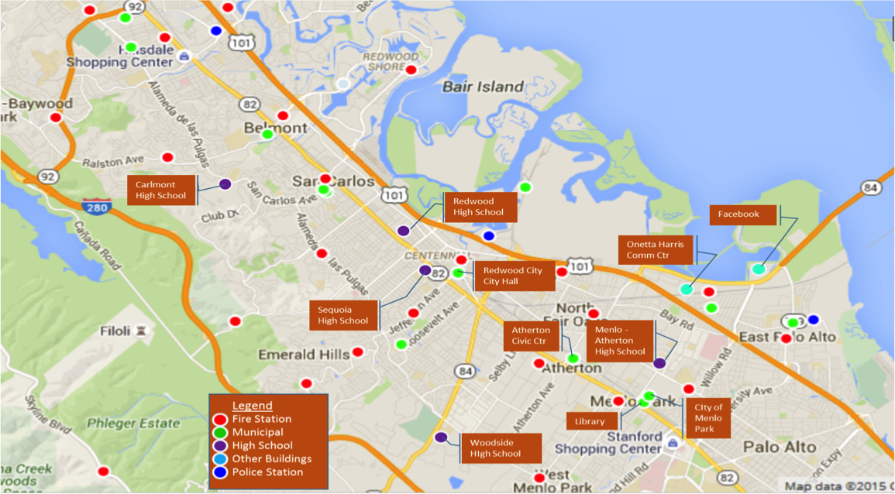
PAEC Geography
Core region: Southern San Mateo County within the boundaries of Redwood City, Atherton, Menlo Park, and East Palo; including embedded unincorporated areas.
Broader region: San Mateo County in its entirety plus City of Palo Alto.
California & beyond: PAEC region is representative of suburban California, largely built-out a facing development pressure; ensuring wide PAEC replication with relative ease.

Slide 31
PAEC Core Tasks
Streamlining of Permits, Codes, and Ordinances that facilitate AECs
Streamlining interconnection of AEC projects to the grid
Financial and Business Models that facilitate AECs
Solar Emergency Microgrids (SEM)
Electric Vehicle Charging Infrastructure (EVCI) Master Plan
Atherton Civic Center Net Zero Energy (NZE) & Fuel Switching (FS) Showcase
Solar Siting Survey (SSS)
PAEC Case Study & Master Community Design

Slide 32
Atherton Civic Center Showcase
Design Development of Civic Center’s Sustainability Features
  ZNE, EE, RE, Fuel Switching, water saving and storage
  No natural gas service (no natural gas plumbing whatsoever)
  Scorecard of potential green building initiatives
  Benefit-Cost Analysis
Project timed to begin build-out in 2018, perfect for PAEC Phase II

Slide 33




















PAEC Collaborators – So Far

