Slide 1
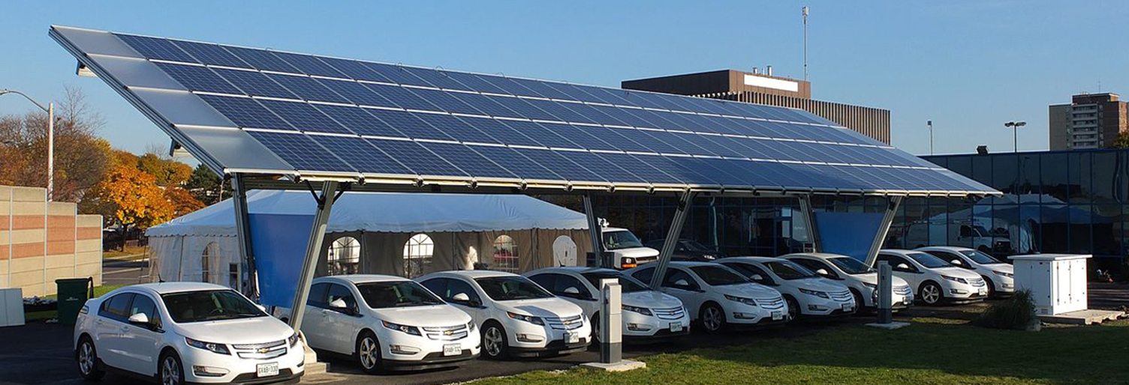
Peninsula Advanced Energy Community (PAEC)
Solar Siting Survey
Bob O’Hagan
Programs Engineer
Clean Coalition
408-394-9067 mobile
bob@clean-coalition.org
27 Feb 2018

Slide 2
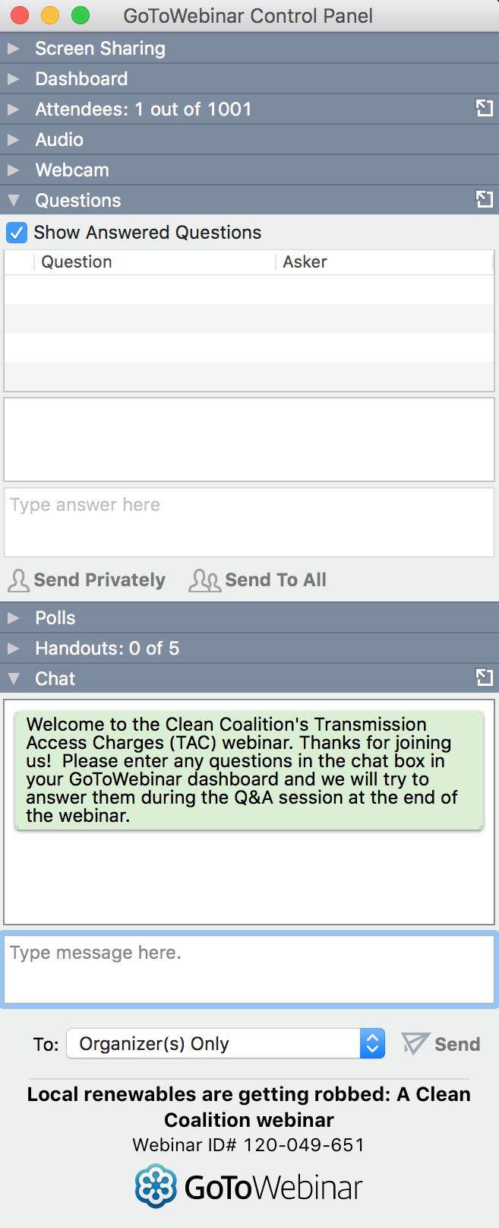

GoToWebinar FAQ
Webinar recording and slides will be sent to registered attendees within two business days
All webinars are archived on www.clean-coalition.org and the Clean Coalition’s YouTube channel
Submit questions in the Questions window at any time (window view varies by operating system and browser)
Questions will be answered during the Q&A portion of the webinar
Contact Josh for webinar questions: josh@clean-coalition.org

Slide 3

Today’s presenter
Bob O’Hagan
Program Engineer
bob@clean-coalition.org
Notes:
Who is the CC: The Clean Coalition is a nonprofit working to accelerate America’s transition away from an outdated energy system built around large, centralized, fossil-fueled power plants and miles of inefficient transmission lines; and toward a modern energy system where smaller-scale, efficient, renewable energy projects deliver affordable and reliable power to communities.
Transitioning to clean local energy generation drives innovation and economic development. And it empowers communities to turn underused space — such as rooftops and abandoned industrial sites — into cost-effective renewable energy resources.

Slide 4
Solar Siting Survey: Purpose
Who is the Clean Coalition
  Why do a Solar Siting Survey?
What does a Solar Siting Survey consist of?
  How is it done?
What did we find?
What does the report/map look like?
What is the Integration Capacity Analysis?
Notes:
Who is the CC: The Clean Coalition is a nonprofit working to accelerate America’s transition away from an outdated energy system built around large, centralized, fossil-fueled power plants and miles of inefficient transmission lines; and toward a modern energy system where smaller-scale, efficient, renewable energy projects deliver affordable and reliable power to communities.
Transitioning to clean local energy generation drives innovation and economic development. And it empowers communities to turn underused space — such as rooftops and abandoned industrial sites — into cost-effective renewable energy resources.

Slide 5
Clean Coalition mission
To accelerate the transition to renewable energy and a modern grid through
technical, policy, and project development expertise
Notes:
5

Slide 6
Clean Coalition overarching objectives
From 2025 onward, at least 80% of all electricity from newly added generation capacity in the United States will be from renewable energy sources.
From 2025 onward, at least 25% of all electricity from newly added generation capacity in the United States will be from local renewable energy sources.
  Locally generated electricity does not travel over the transmission grid to get from the location it is generated to where it is consumed.
By 2025, policies and programs are well established for ensuring successful fulfillment of the 80% & 25% objectives.
  Policies reflect the full value of local renewable energy.
  Programs prove the superiority of local energy systems in terms of economics, environment, and resilience; and in terms of timeliness.
Notes:
6

Slide 7
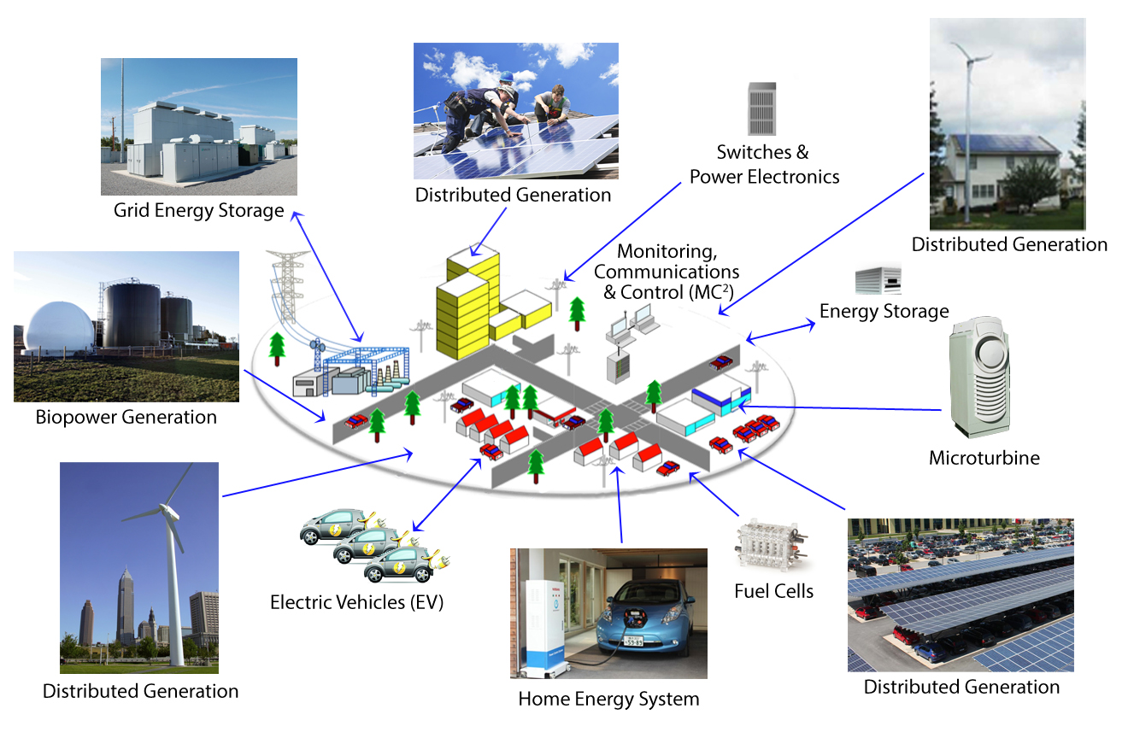
Clean Coalition vision = Community Microgrid future
Notes:
Bringing DER onto the grid is the pathway to a cleaner, more resilient system.
Elaborate just a bit more on what this slide means.
7

Slide 8
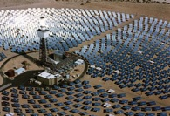




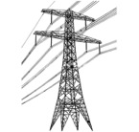

FITs address the wholesale DG market segment
Project Size
Central Generation
Serves Remote Loads
50+ MW
Wholesale DG
Serves Local Loads
500 kW
Retail DG
Serves Onsite Loads
5 kW
Behind the Meter
Distribution Grid
Transmission Grid
Notes:
Wholesale Distributed Generation or WDG is the market segment is unleashed by successful FITs. The retail DG – behind the meter – and central generation renewables – out in the desert, most of the time – are both part of the equation, but WDG has enough potential and uses economies to scale that will really change the game.
When we refer to DG, we mean a generating resource that is interconnected to the distribution grid, sells its energy to a utility (wholesale), and serves local loads (WDG does not backfeed to the transmission grid).

Slide 9
WDG unleashed solar in Germany
Solar Markets: Germany vs California (RPS + CSI + other)
Cumulative MW
Sources: CPUC, CEC, SEIA and German equivalents.
Germany deployed over 10 times more solar capacity than California, almost entirely on built-environments, in the decade starting 2002, despite California having 70% better solar resource
Notes:
Germany is the best example we currently have to show the efficacy of CLEAN Programs and the WDG market. As you can see from the chart, Germany is in green; and, California—known as the leading market it the U.S.–is in red. It is astonishing that Germany is adding 11 times more solar than California even though California has a 70% better resource.
Rooftop solar in Germany today is priced at the California-equivalent of 7-10 cents/kWh, which would be the most cost-effective resource deployed in California.
Ground-based solar projects typically generate about 25% more kWh/W than rooftop projects, because they use tracking, which allows the panels to follow the sun throughout the day. The net result is that ground-based projects are generally about 20% more cost-effective than rooftop projects. The difference between the 25% and the 20% is that the O&M costs for ground-based projects are a bit higher due to their moving parts.
(07_gp, 23 Sep 2013)

Slide 10
German solar is mostly local (on rooftops)
26%
23.25%
22.5%
19%
9.25%
Source: Paul Gipe, March 2011
Germany’s solar deployments are almost entirely sub-2 MW projects on built-environments and interconnected to the distribution grid (not behind-the-meter)
Notes:
(cl_04a, 12 Jan 2012)

Slide 11
Solar Siting Survey: Components
What is it?
  Survey of potential PV siting opportunities performed over a well-defined area
  Includes primarily large rooftops and aggregations of closely related smaller rooftops
  Also includes parking lots and parking garages
  Has a lower limit generation size of 100 KW AC
Tools used to site the potential opportunities
  Survey and coordinates: Google Earth
  Database and KML generation: Excel
  Addresses and site names: Google Maps, Bing Maps, Mapquest
  Alternate display app: Google Maps

Slide 12
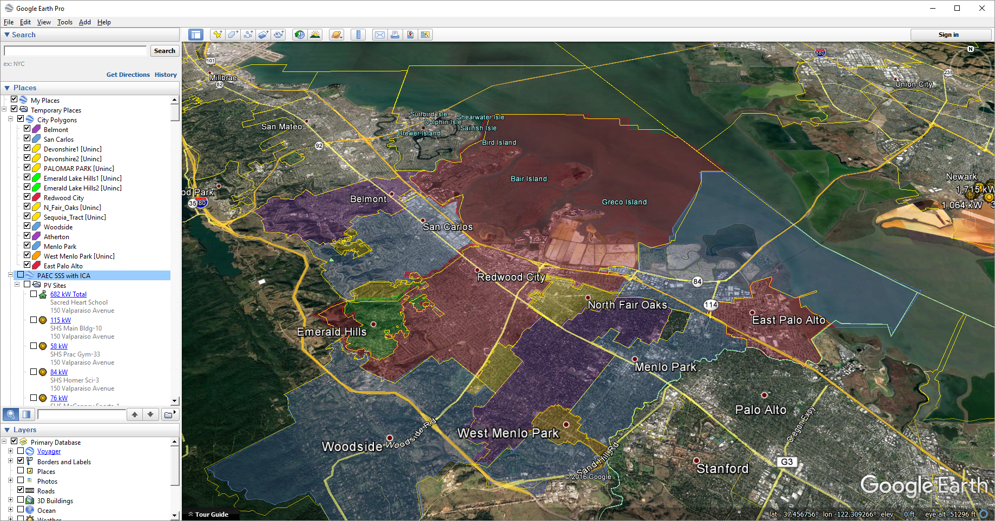
PAEC survey area in Google Earth
Notes:
This is an overview of the areas covered.
The focus has been on the corridor from Redwood City down through Menlo Park – East Palo Alto.
Stanford is also participating since they have property in RWC.

Slide 13
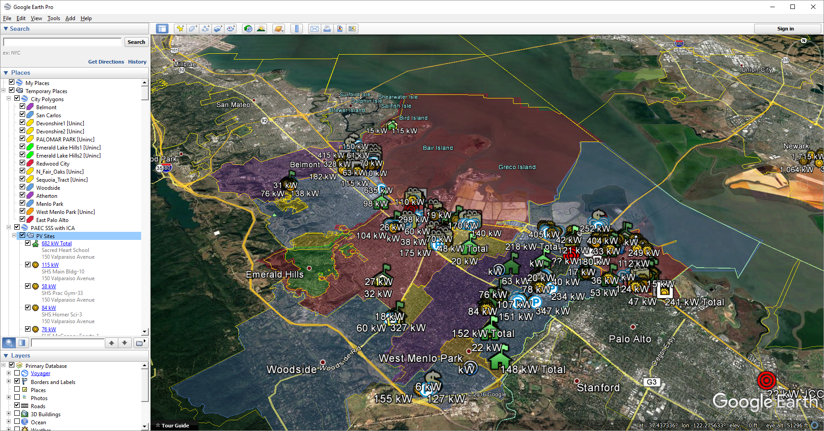
PAEC survey overview
Notes:
This is how the survey looks with the PV site icons enabled.
Add a bit more commentary on exactly what this slide is showing; the estimated PV within the various site locations.

Slide 14
Solar Siting Survey summary
Key findings
  Over 65 MW of PV potential can be easily found at the 100 kW minimum level
Key takeaways
  Parking lots and garages are very underutilized, comprising over 40% of the total
Tie-in to overall objectives
  The capacity to site PV on commercial, industrial, and civic rooftops is waiting to be utilized

Slide 15
Deliverables
Spreadsheet database
Summary report
Google Earth map derived from the database
  Includes ICA data
Google Maps readable version of Google Earth file

Slide 16
PAEC Solar Siting Survey summary by PV size
Notes:
The large majority of the sites are under 250 kW.
This is typical of older areas without a lot of room to expand for bigger projects. The older buildings tend to be smaller.

Slide 17
Summary of aggregations by type
Notes:
Shopping centers, business/industrial parks, and schools normally comprise most of the aggregations.
What is new in this survey is the smaller project size allows personal storage facilities to be significant contributors.

Slide 18
Survey data excerpt
Notes:
This is an excerpt of the main data table, showing how the information is structured.
The Google Earth KML files are built directly from this data table.

Slide 19
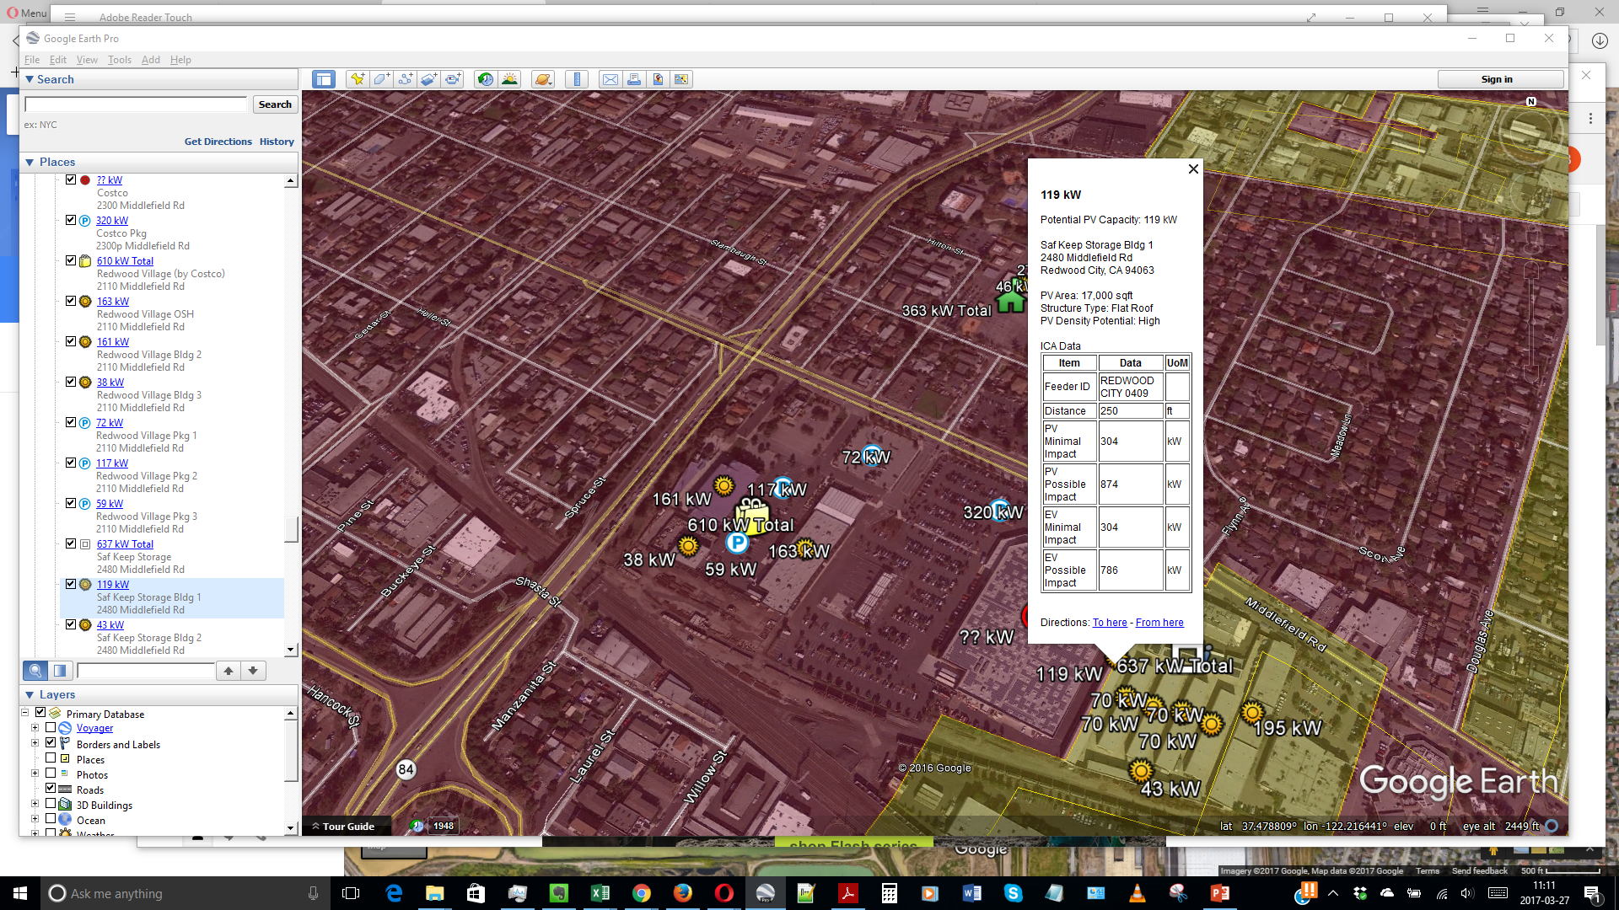
PAEC Solar Siting Survey example of information
Notes:
At each selected site or structure, an information window pops up with details from the Data table.
ICA (Integration Capacity Analysis) data from PG&E is also included for an estimate in interconnection difficulty.

Slide 20
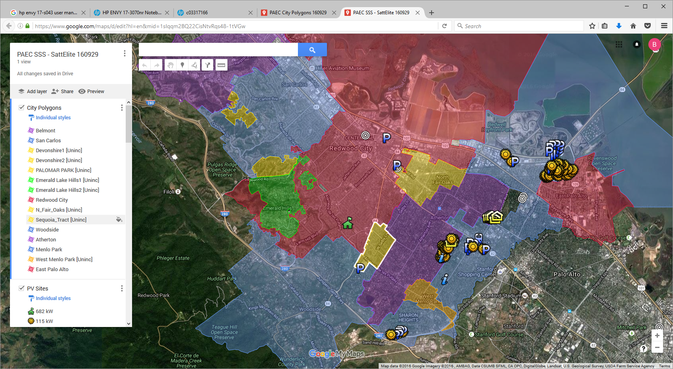
Survey map viewed in Google Maps
Notes:
The Google Earth information can also be displayed in Google Maps so that those that don’t have Google Earth can view it.
There is some loss of display features when using Google Maps, but the information content is identical.
Features lost: sizing and coloring of icons and icon labels.

Slide 21
Integration Capacity Analysis (ICA)
Brief look at components
  Feeder map
  Analysis criteria
  Sample of the types of generation and load profiles that are used in the analysis

Slide 22
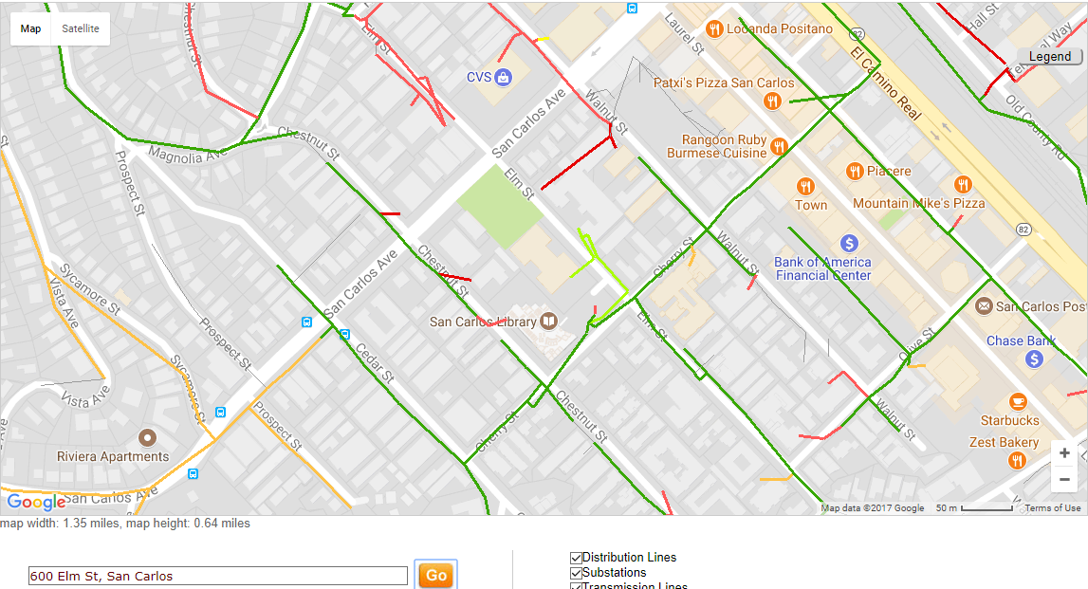
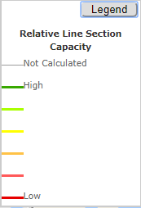
ICA map for 600 Elm St, San Carlos (50 m, closest)
ICA Data for City Hall
Notes:
The feeders show up on the map between altitudes of 50 and 500 m.
Red, amber, green legend has been added to clarify interpretation.
Caveat: only the 3 phase portions are modeled.

Slide 23
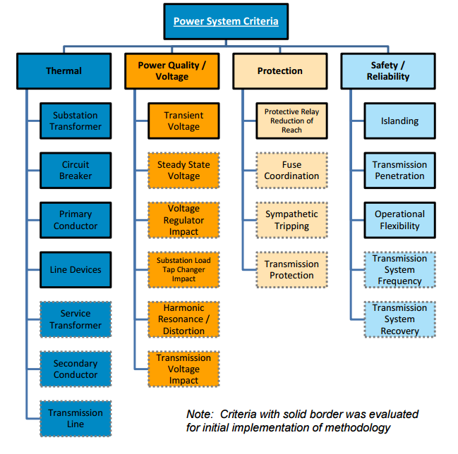
Distribution Resources Planning (DRP):
Integration Capacity Analysis criteria
Source: https://www.navigantresearch.com/blog/distribution-resource-plans-integrated-capacity-analysis
Notes:
The Distribution Resources Planning proceedings were modified to include the ICA.
Focus of ICA is on 4 main issues on top row.
Dotted outline boxes will be added in the future. The methods for the solid box calculations are still in development among the IOUs.

Slide 24
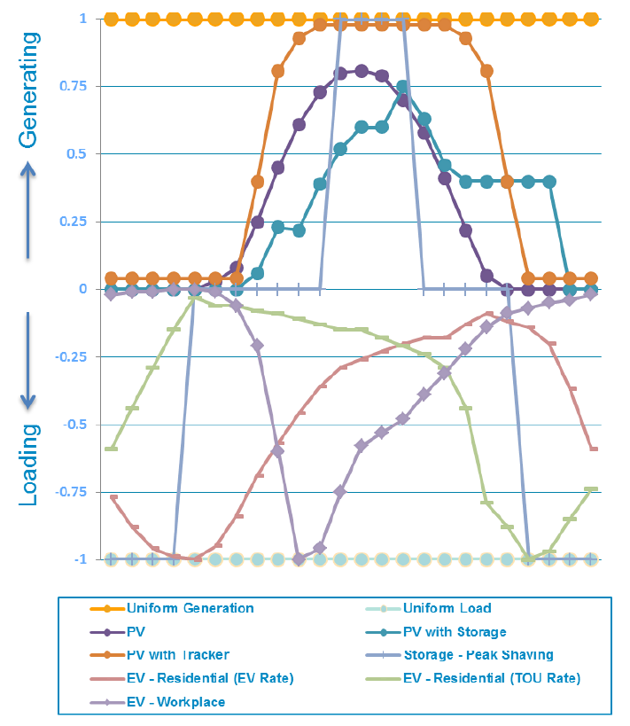
ICA: DER generation and load profiles
Source: https://www.navigantresearch.com/blog/distribution-resource-plans-integrated-capacity-analysis
Notes:
Load and generation profiles used in calculation the amount of DER that a line segment can handle.
[Discuss profiles if there is interest]

Slide 25
Summary of Solar Siting Survey
Purpose
Elements
How it helps a FIT program
Notes:
Kickoff for a marketing campaign that is part of a FIT program.
Provides site ID and rough estimate of technical potential, along with ICA data (if available).
Is a key enabler for making a FIT program viable. Need to know which property owners to target.

Slide 26
Thank you. Any questions?
For questions and assistance, contact:
  Bob O’Hagan
  Programs Engineer
  bob@clean-coalition.org
  (m) 408-394-9067
Notes:
26

Slide 27
Backup slides

Slide 28
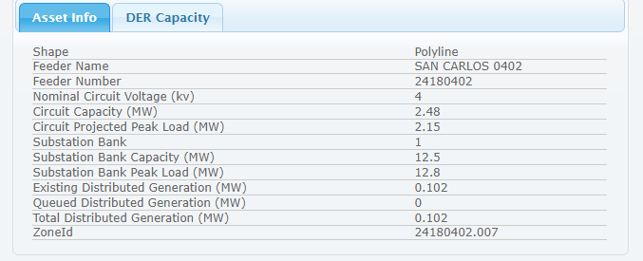
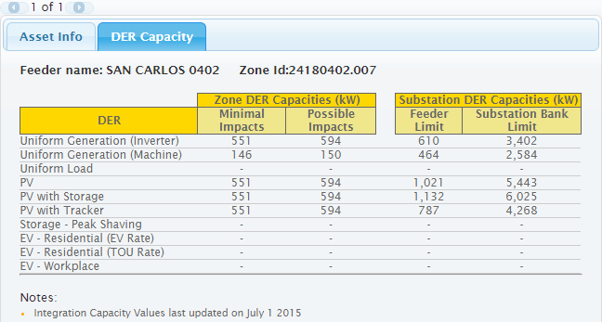
ICA data at feeder into San Carlos City Hall
500 kW PV should be straightforward interconnection
Notes:
Information available when a feeder section is selected.
Note that it covers the topics in the DRP and Gen/Load Profiles slides.
Projects under Minimal Impacts have high probability of Fast Track approval and minimal grid upgrade costs.

Slide 29
Quote from PG&E’s ICA help page
Integration Capacity Data
The RAM map is now designed to display integration capacity values for DER. These values are intended to help users by indicating DER capacities that are expected to require Detailed Interconnection Studies. It is encouraged that customers apply using DER capacities that are less than the reported Integration Capacity value to have better chances of passing the interconnection Fast Track.
The distribution lines are colored based on a Red Amber Green coloring scale where green represents locations on each feeder that have higher integration capacity values then other locations on the feeder. Red is intended to display locations with lower capacity values, but does not necessarily mean a DER is not allowed to interconnect. The lower capacity values intended to show high chances of requiring detailed interconnection study. The coloring scheme is currently based on the PV Integration Capacity values.

Slide 30
PG&E ICA URLs
PG&E (login account needed)
  ICA Map URL
    https://www.pge.com/b2b/energysupply/wholesaleelectricsuppliersolicitation/PVRFO/PVRAMMap/index.shtm
  ICA Map Help URL
    https://www.pge.com/b2b/energysupply/wholesaleelectricsuppliersolicitation/PVRFO/PVRAMMap/help/
SCE (no login needed)
  https://www.arcgis.com/home/webmap/viewer.html?webmap=e62dfa24128b4329bfc8b27c4526f6b7
  No login needed
SDG&E (login account needed)
  https://www.sdge.com/generation-interconnections/renewable-auction-mechanism-ram-map
  Logins
  https://sempra.maps.arcgis.com/home/signin.html?returnUrl=https%3A//sempra.maps.arcgis.com/apps/webappviewer/index.html%3Fid%3D8b11127abc7a47169de07eb77c2657c9

Slide 31
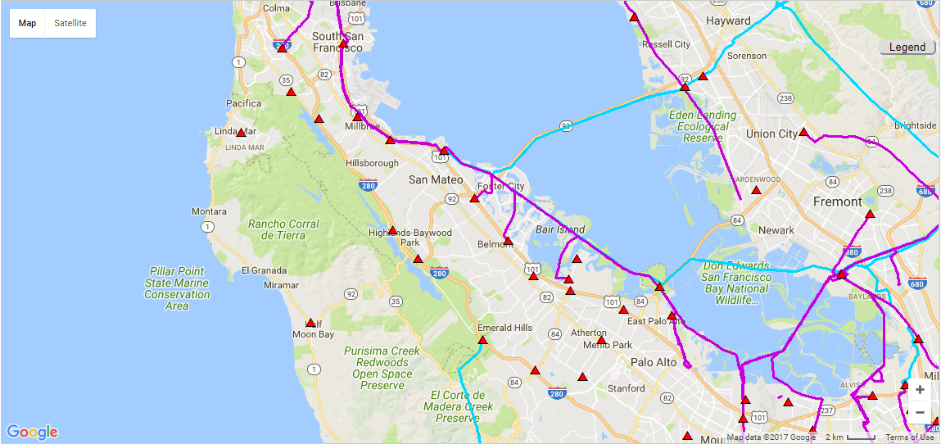
ICA map of San Mateo County
At high altitude, only transmission lines and substations are shown
Notes:
ICA map at high altitude does not show the feeders, only the transmission lines.

Slide 32
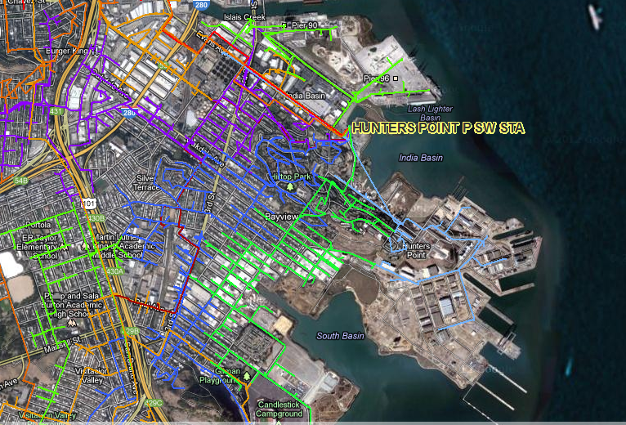
Distribution Resources Planning history:
Hunters Point Substation feeders
Notes:
Clean Coalition did a study of Hunters Point Substation loading with high penetrations of PV in 2014 and 2015.
Done with full cooperation and assistance of PG&E.

Slide 33
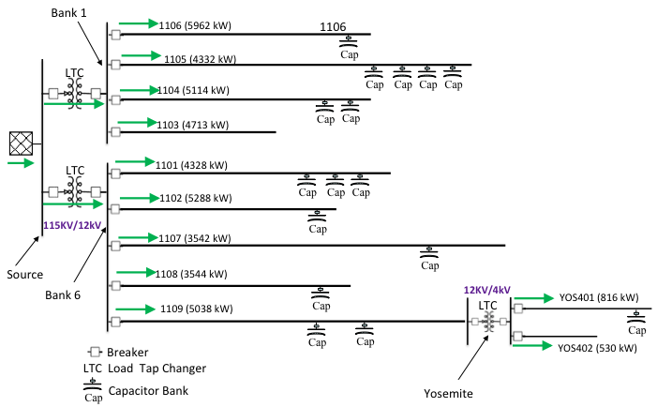
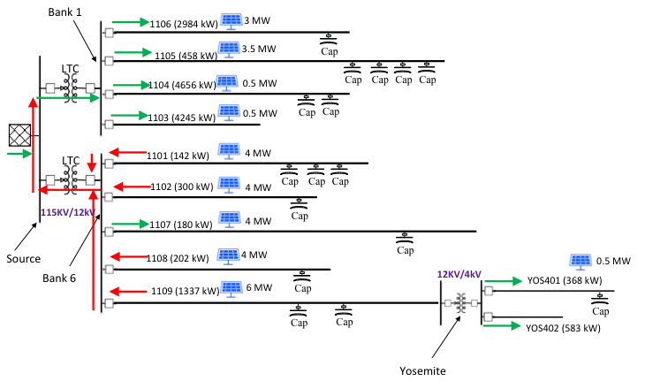
Substation operation: Normal vs high-penetration PV
High-penetration PV:
Power on some feeders flows back through substation
Normal:
All power flows from transmission grid down to loads
Notes:
Normal: all power flows through hub and spoke system from transmission grid to loads (green arrows)
PV: On some feeders, power flows back upstream through substation (red arrows) but finds loads on adjacent feeders.
Result: no excess high voltages with 25% of all Energy coming from PV. Mixed use urban environment provides large C&I loads to accept PV power.
The LACK OF PROBLEMS was the big finding. The system is well designed, and the nearby C&I loads solve a lot of problems with high PV generation.

