Slide 1

Scaling Deployments & Improving Conversion Efficiency
Surest Pathways to Reducing Solar Pricing
Craig Lewis
Executive Director
Clean Coalition
650-204-9768
Craig@Clean-Coalition.org
19 April 2012
Notes:
(ac_1, 15Sept2011)

Slide 2
Clean Coalition – Mission and Advisors
Mission
To implement policies and programs that transition the world to cost-effective clean energy while delivering unparalleled economic benefits
Clean Coalition – Mission and Advisors
Board of Advisors
Jeff Anderson
Co-founder and Former ED, Clean Economy Network
Josh Becker
General Partner and Co-founder, New Cycle Capital
Jeff Brothers
CEO, Sol Orchard
Jeffrey Byron
Vice President Integrated Solutions, NRG Energy; Former Commissioner, California Energy Commission
Rick DeGolia
Senior Business Advisor, InVisM, Inc.
Mark Fulton
Managing Director, Global Head of Climate Change Investment Research, DB Climate Change Advisors, a member of the Deutsche Bank Group
John Geesman
Former Commissioner, California Energy Commission
Felix Kramer
Founder, California Cars Initiative
Governor Bill Ritter
Director, Colorado State University’s Center for the New Energy Economy, and Former Colorado Governor
Terry Tamminen
Former Secretary of the California EPA and Special Advisor to CA Governor Arnold Schwarzenegger
Jim Weldon
CEO, Solar Junction
R. James Woolsey
Chairman, Woolsey Partners, and Venture Partner, Lux Capital;
Former Director of Central Intelligence
Kurt Yeager
Vice Chairman, Galvin Electricity Initiative; Former CEO, Electric Power Research Institute
Patricia Glaza
Principal, Arsenal Venture Partners; Former Executive Director, Clean Technology and Sustainable Industries Organization
Amory B. Lovins
Chairman and Chief Scientist, Rocky Mountain Institute
L. Hunter Lovins
President, Natural Capitalism Solutions
Dan Kammen
Director of the Renewable and Appropriate Energy Laboratory at UC Berkeley; Former Chief Technical Specialist for Renewable Energy and Energy Efficiency, World Bank
Fred Keeley
Treasurer, Santa Cruz County, and Former Speaker pro Tempore of the California State Assembly
Notes:
(cl_04a, 12 Jan 2012)
2

Slide 3
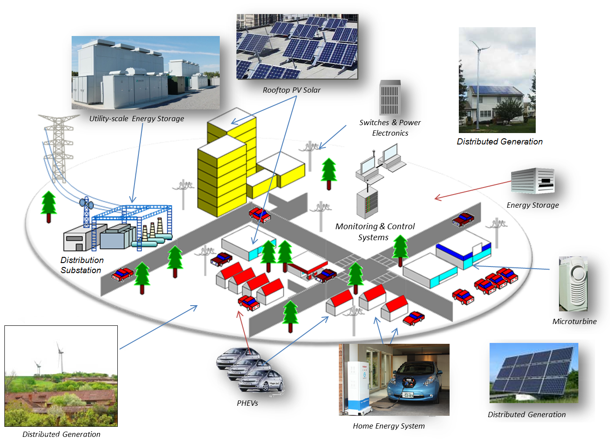
Clean Coalition Vision = DG+DR+ES+EV+MC2
Notes:
(cl_04a, 12 Jan 2012)
To lay the groundwork, this slide represents the ultimate Clean Coalition vision.
This is what a smart energy future looks like.
The key components will be:
Distributed Generation + Demand Response + Energy Storage + Electrical Vehicle + overall Monitoring Communications and Controls or MC2 for short.
The Clean Coalition envisions a future where these components are no longer treated as independent silos. These components will work seamlessly together, using information technology to locally control, create and balance supply and demand of electricity.
What this slide also shows is the huge market opportunity for the transition. There is a $6 trillion dollar energy market AND it will transition to a smart energy future – and there are three key drivers behind that:
Economic sensibility
Energy security
Environmental sustainability
Regardless of your political affiliation, one of these drivers or a combination there of, will take us to this future.
The only question is how painful will this transition be, how fast will it happen, and who’s going to win all the economic benefits.
3

Slide 4
Solar Value Chain Driven by Deployments
Developers
Technology
Systems
Generation Projects
Utilities
Investors
Debt
Equity
The health of the entire solar market is critically dependent on deployments

Slide 5
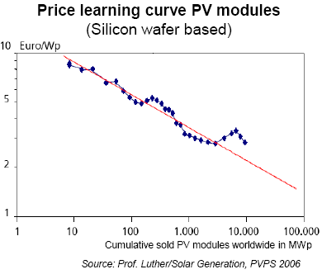
Deployment Volume Drives Learning Curves
Solar pricing is reduced by 20% for every doubling of deployed volume
Si learning curve
New technology learning curve
Efficiency innovation

Slide 6
Fundamentals of Scaling Deployments NOW
Focus on the Most Promising Market Segment
  Wholesale Distributed Generation: Cost-effective near-term results with excellent economic and environmenal benefits
  Leverage policymakers: DOE, DOD Senator Wyden, FERC, Administration, State PUCs and ISOs, and local utilities
Remove Barriers and Minimize Risk
  Procurement: Standard and guaranteed contract between the utility and a renewable energy facility owner
  Interconnection: Predictable and streamlined distribution grid access
  Financing: Predefined and financeable fixed rates for long durations
Notes:
(cl_4, 13 April 2012)
6

Slide 7
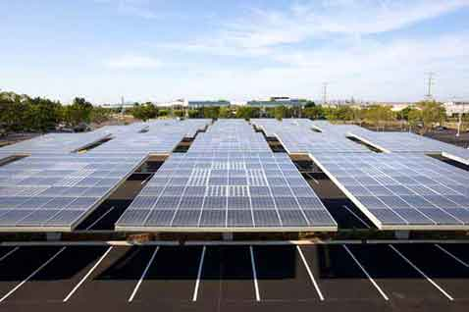
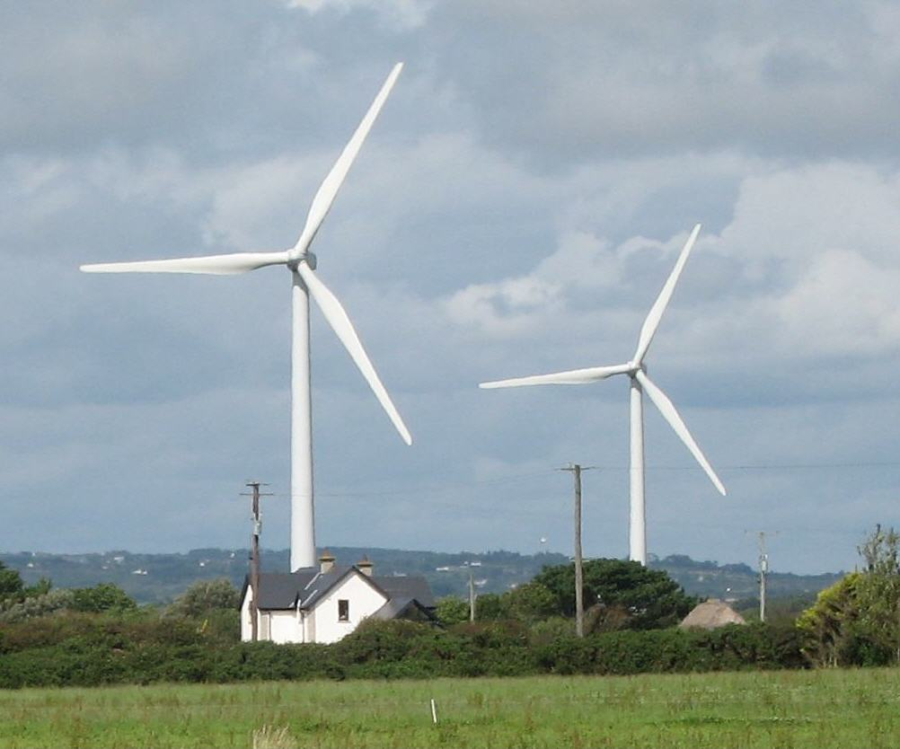
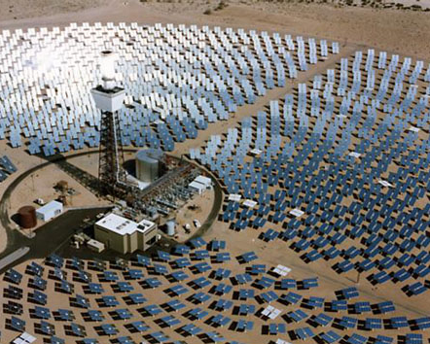
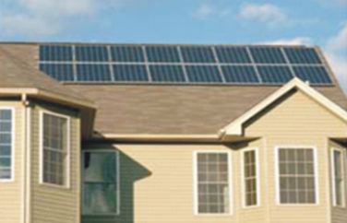
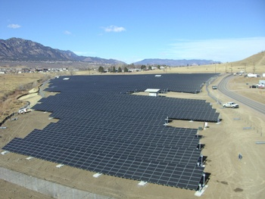
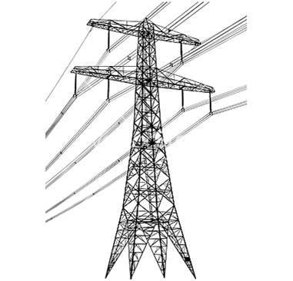
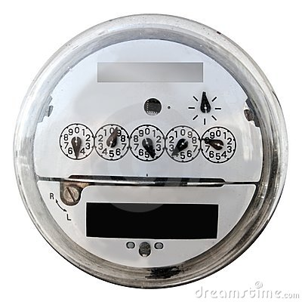
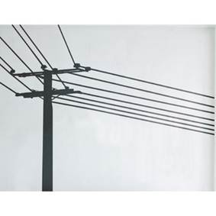
Wholesale DG is the Critical & Missing Segment
Project Size
Central Generation
~20 MW-and-larger
Wholesale DG,
<20 MW
Retail DG
<1 MW
Behind the
Meter
Distribution
Grid
Transmission
Grid
Notes:
(jf 01, 30 March 2012)

Slide 8
Wholesale DG Delivers Superior Ratepayer Value
Total Ratepayer Cost of Solar
 | Distribution Grid |  |  |  |  | T-Grid
PV Project size and type | 100kW roof | 500kW roof | 1 MW roof | 1 MW ground | 5 MW ground | 50 MW ground
Required PPA Rate | 15¢ | 14¢ | 13¢ | 12¢ | 11¢ | 10¢
T&D costs | 0¢ | 0-1¢ | 1¢ | 1¢ | 1-2¢ | 2-4¢
Ratepayer cost per kWh | 15¢ | 14-15¢ | 14¢ | 13¢ | 12-13¢ | 12-14¢
Sources: CAISO, CEC, and Clean Coalition, July 2011; see full analysis at www.clean-coalition.org/studies
The most cost-effective solar is MW-scale WDG, not central station as commonly thought, due to massive transmission costs
Notes:
8

Slide 9
Avoided Transmission in CA = $80 Billion over 20 yrs
Business as Usual Year-20 TAC (TAC₂₀ ) = 2.7
2.7
Business As Usual TAC Growth
Current TAC
Rate (TAC₀) = 1.2
TAC₀ O&M Level
Business as Usual TAC Growth TAC₀ Depreciation + O&M Avoided TAC Opportunity from DG

Slide 10
CLEAN Programs Defined
CLEAN = Clean Local Energy Accessible Now
CLEAN Features:
  Procurement: Standard and guaranteed contract between the utility and a renewable energy facility owner
  Interconnection: Predictable and streamlined distribution grid access
  Financing: Predefined and financeable fixed rates for long durations
CLEAN Benefits:
  Removes the top three barriers to renewable energy
  The vast majority of renewable energy deployed in the world has been driven by CLEAN Programs
  Allows any party to become a clean energy entrepreneur
  Attracts private capital, including vital new sources of equity
  Drives local employment and generates tax revenue at no cost to government
Notes:
(cl_4, 13 April 2012)
10

Slide 11
CLEAN Programs Deliver Cost-Effective Scale
Solar Markets: Germany vs California (RPS + CSI + other)
Cumulative MW
Sources: CPUC, CEC, SEIA and German equivalents.
Germany added nearly 15 times more solar than California in 2011,
even though California’s solar resource is 70% better!!!
Notes:
(jf_05, 7 Mar 2011)
Beyond the obvious details on this slide, see the notes below.
CLEAN = Clean Local Energy Acceccible Now and CLEAN Programs are the new name for feed-in tariffs in the United States.
Rooftop solar in Germany today is priced at the California-equivalent of 12 cents/kWh, which would be the most cost-effective solar that has ever been deployed in California -- even more cost-effective than ground-based solar projects deployed in California to date. Ground-based solar projects typically generate about 25% more kWh/W than rooftop projects, because they use tracking, which allows the panels to follow the sun throughout the day. The net result is that ground-based projects are generally about 20% more cost-effective than rooftop projects. The difference between the 25% and the 20% is that the O&M costs for ground-based projects are a bit higher due to their moving parts.

Slide 12
German Solar Capacity is Small WDG (Rooftops)
26%
23.25%
22.5%
19%
9.25%
Source: Paul Gipe, March 2011
Germany’s solar deployments are almost entirely <2 MW rooftop projects interconnected to the distribution grid (not behind-the-meter)
Notes:
(cl_04a, 12 Jan 2012)

Slide 13
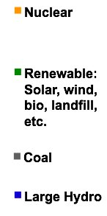
CLEAN Delivers Ontario’s Goals
On track to replace 100% of coal power by 2014
Created tens of thousands of jobs, and on track to create 50,000 jobs
Attracted over $20 billion in private-sector investment to Ontario
More than 30 companies are currently operating or plan to build, solar and wind manufacturing facilities in Ontario
6 GW
Coal
Power
Notes:
(ssw_1, 12 April 2012)
The Canadian Province of Ontario had 31 GW of peak electric capacity in 2009.
The source of the economic data is the Ontario Economic Ministry’s Feed-in Tariff Two Year Review Report (March 2012)

Slide 14
CLEAN-Gainesville Starts a US Solar Revolution
Notes:
(SW_13, 9 April 2012)
Prior to the launch of the CLEAN-Gainesville program in October 2008, GRU had 328 kW of installed solar capacity. In the first 3.5 years of the program, GRU experienced 3,500% solar growth reaching 11.5 MW by April 2012 and growing fast. More than 90% of GRU’s solar capacity has been driven by the CLEAN program. The rest is due to its net metering program.

Slide 15
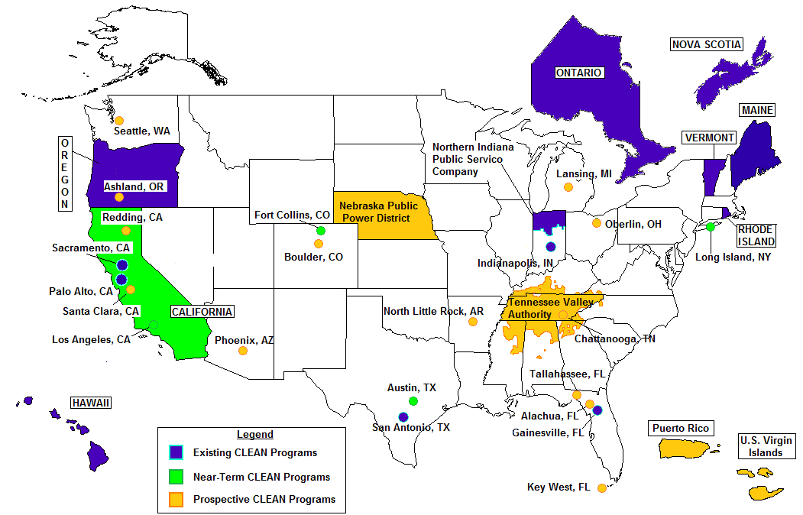
Map of CLEAN Programs in North America

Slide 16

CLEAN Streamlines Procurement for Utilities
"Several aspects of the CLEAN Program have proven to simplify and streamline the process.
First, there is a standard set of "bright line" rules for a project to qualify, demanding no staff analysis or interpretations.
Second, there is a clear method for assigning capacity to qualifying projects… There is no staff time wasted with evaluating RFPs…
Third, each project… signs a short, standard offer contract and interconnection agreement.
There is no valuable staff time wasted in negotiations and legal disputes.”
- John Crider, GRU Strategic Planning
Notes:
(cl_2, 13 April 2012)

Slide 17
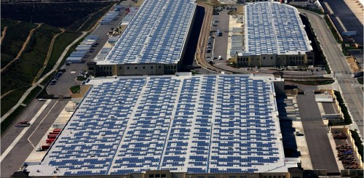

Project Amp = Outstanding DOE WDG Initiative
Over 750 MW of WDG solar rooftop projects deployed by 2015

Slide 18
CLEAN Interconnection (Sacramento, CA)
Timely and transparent distribution grid interconnection:
Interconnection of wholesale distributed generation projects to California investor owned utility distribution grids takes an average of 2 years.
In contrast, interconnection to Sacramento Municipal Utility District’s (SMUD) distribution grid takes an
average of 6 months.
Two SMUD staff members completed
interconnection studies for 100 MW
CLEAN Program projects in
two months.
SMUD maximized transparency by
publishing this interconnection map
on its website.
Notes:
(sw 2, 19 Jan 2012)
18

Slide 19
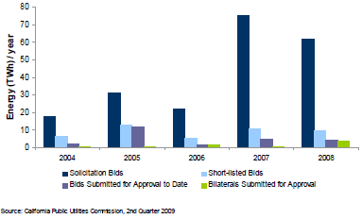
Policies Need to Reduce Costs and Risks
Failure Rate of California Auctions/Solicitations is ~97%
Auctions have massive failure rates. Policymakers need to CLEAN that up.

Slide 20
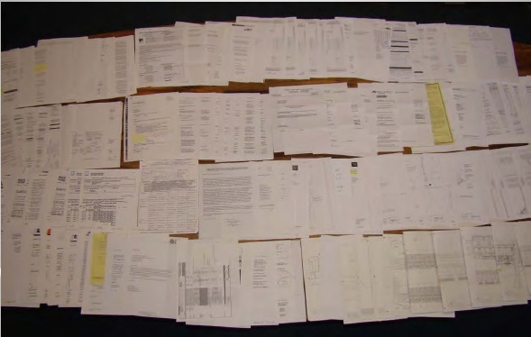
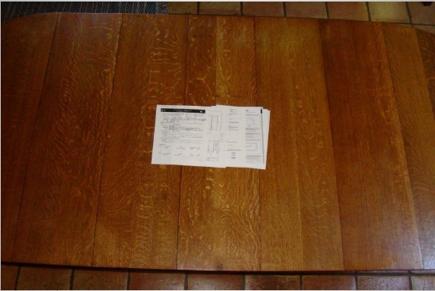
CLEAN Programs are Simple and Transparent
CLEAN Programs remove barriers and reduce costs
Typical California paperwork for one project
Typical Germany paperwork for one project
Could be a 1 kW-sized project, but maximum 1 MW (via CSI program). Even more paperwork for California projects larger than 1MW (via RPS program).
Could be a 1 kW or 10 MW-sized project.
Source: Gary Gerber, President of CalSEIA and Sun Light & Power, Jun09
CLEAN can easily reduce costs by 20% by preempting bureaucracy alone

Slide 21
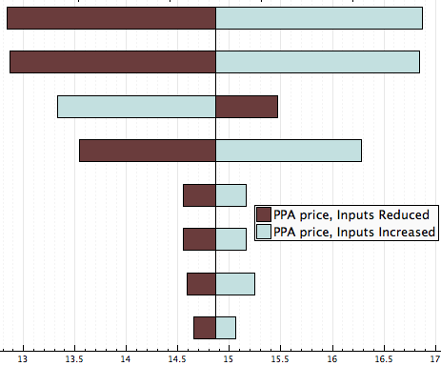
PPA Comparative Price Sensitivity
Financing and property tax costs and contract duration have impacts in the same range as module costs
Module Cost +/- 30%
Property Tax 0 - 2%
Loan Term 25 vs 15 years
Loan Rate 5 - 9%
IRR 6 - 10%
Sales Tax 6.5 - 10.5%
Grid Interconnection +/- 30%
Permit Cost +/- 30%
PPA Rate (¢/kWh)

Slide 22













Need to Expand the Financing Universe
Banks Finance/Insurance Corporates
Notes:
22

Slide 23
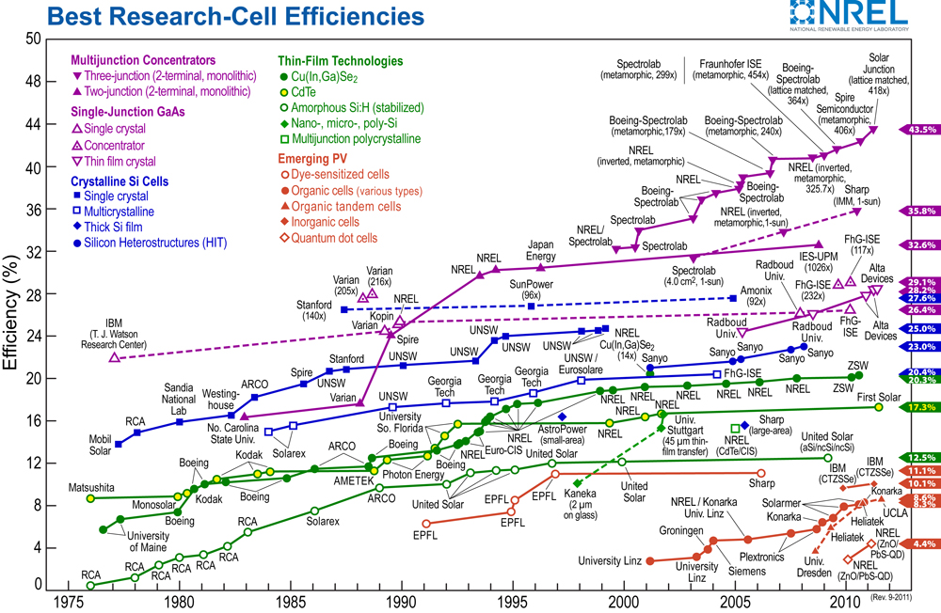
Long-Term Price Reduction Drive by Efficiency
Notes:
23

Slide 24
Solar Cell Efficiency Leverages the BOS
1% increase in CPV solar cell efficiency delivers 2-3% reduction in installed system cost
Notes:
24

Slide 25
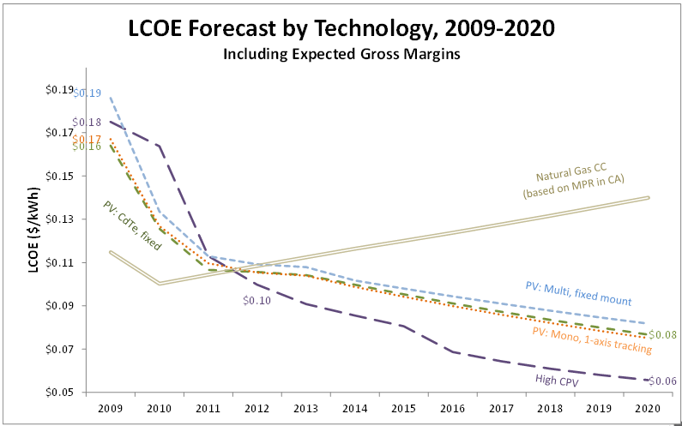

Efficiency Wins in the End
HCPV
Notes:
25

Slide 26

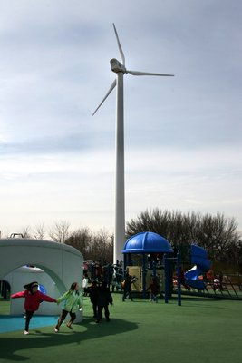
CLEAN Maximizes Economic Benefits
Local Job Creation
  CLEAN projects are local and “shovel-ready”
  Renewable energy creates far more jobs than
  fossil fuels or nuclear power (UC Berkeley)
Local Capital Investment
  CLEAN Programs level the playing field,
  giving local residents and businesses the
  opportunity to reinvest capital in the community
  Local ownership of renewable energy
  increases the economic benefits to the
  community by 200% to 300% (US GAO)
Local Tax Revenues
  Local job creation and capital investment in the community creates new sources of state and local tax revenues
  Does not rely on government subsidies
Notes:
(sw 2, 19 Jan 2012)

Slide 27
Clean Coalition Vision = DG+DR+ES+EV+MC2
Notes:
(cl_04a, 12 Jan 2012)
To lay the groundwork, this slide represents the ultimate Clean Coalition vision.
This is what a smart energy future looks like.
The key components will be:
Distributed Generation + Demand Response + Energy Storage + Electrical Vehicle + overall Monitoring Communications and Controls or MC2 for short.
The Clean Coalition envisions a future where these components are no longer treated as independent silos. These components will work seamlessly together, using information technology to locally control, create and balance supply and demand of electricity.
What this slide also shows is the huge market opportunity for the transition. There is a $6 trillion dollar energy market AND it will transition to a smart energy future – and there are three key drivers behind that:
Economic sensibility
Energy security
Environmental sustainability
Regardless of your political affiliation, one of these drivers or a combination there of, will take us to this future.
The only question is how painful will this transition be, how fast will it happen, and who’s going to win all the economic benefits.
27

Slide 28
Back-Up Slides
Back-Up Slides
Notes:
(sw 2, 19 Jan 2012)
28

Slide 29
Download the Local CLEAN Program Guide
Free download: http://www.Clean-Coalition.org/local-action
Contact us: LocalGuide@Clean-Coalition.org
Structure of the Guide:
Module 1: Overview & Key Considerations
Module 2: Establishing CLEAN Contract Prices
Module 3: Evaluating Avoided Costs
Module 4: Determining Program Size & Cost Impact
Module 5: Estimating CLEAN Economic Benefits
Module 6: Designing CLEAN Policies & Procedures
Module 7: Gaining Support for a CLEAN Program
Notes:
(ssw_4, 22March2012)

Slide 30
CLEAN Avoids Hidden Transmission Costs
“Palo Alto CLEAN will expand clean local energy production while only increasing the average utility bill by a penny per month” -- Yiaway Yeh, Mayor of Palo Alto
Source: Palo Alto Utilities
Notes:
(ssw_6, 10 April 2012)
7.04 cents - Base Energy
3.35 cents - RPS Value
0.60 cents - Local Capacity
1.94 cents - Transmission
0.62 cents - T&D Losses
0.45 cents - Premium

Slide 31
CLEAN Programs Stabilize Electricity Rates
May result in a small rate increase during initial years
(e.g. Gainesville, Florida, achieved a 2,000% increase in deployed solar capacity with a rate increase of less than 1% during first 2.5 years of program)
Protects communities from rising fossil fuel costs over time
For this single 10 kW solar rooftop project in Colorado,
avoided costs will rise above the CLEAN contract price within a few years
Source: Clean Coalition, 2012
Notes:
(ksw_1, 15Sept2011)

Slide 32
Volumetric Price Adjustment (California SB 32)
Volumetric Price Adjustment (VPA) automatically adjusts the fixed CLEAN Contracts price as the market responds to the program.
To implement a VPA, program designers determine:
  Buckets of capacity for assessing market response
  Magnitude of price adjustments (up and down)
  Length of the waiting periods to gauge market response before the price is adjusted
For example:
  Start with first 20 MW of capacity to contract at 16 cents/kWh.
  If the first 20 MW bucket is filled within 6 months, then the next 20 MW bucket will contract at 15.5 cents/kWh
  However, if the first 20 MW of capacity is not filled within 9 months, then the contract price for that bucket will automatically rise to 16.5 cents/per kWh.
Notes:
(sw 2, 19 Jan 2012)
32

Slide 33
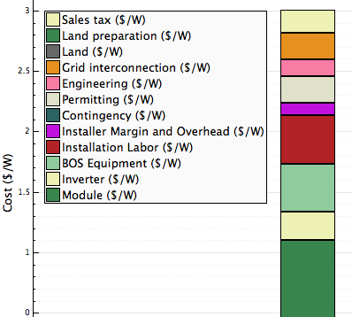
PPA Comparative Price Sensitivity
Project analysis assumptions:
1,000 MW rooftop system
$3.00/W total installed cost $3,000,000
Module $1.10/W $1,100,000
Inverters $0.23/W $235,000
BOS $0.40/W $400,000
Installation labor $0.40/W $400,000
Margin & overhead $0.10/W $100,000
Engineering 6% $134,000
Grid interconnection 10% $223,000
Transactional costs 10% $223,000
Sales tax 8.5% $190,000
ITC & 5 year MACRS
Financed loan (50% debt fraction) $1,500,000
Nominal Discount Rate 7.1%

Slide 34
Avoided Fossil Backup = Funds for Superior Solutions
Frequency Regulation
  Stabilizes grid at 60 Hz.
  Commonly provided by natural gas powered generators, but all fossil sources are slow ramping.
  Energy Storage and Demand Response are nearly instantaneous while providing a multitude of additional benefits.
60
50
40
30
20
10
0
GW
Too Much Demand
Too Much Supply
12a 6a 12p 6p 12a
Time of day
Notes:
Over the course of the day the average demand for power is fairly smooth. However, if we zoom in on a section of the curve, we can see that the actual demand fluctuates wildly. This poses a problem for big power plants, which cannot ramp up and down quickly enough to compensate for these fluctuations. Too much demand causes the frequency to slow down, while too much supply causes the frequency to speed up, both of which are undesirable. A specialized service called frequency regulation works to balance these fluctuations. Frequency regulation is what stabilizes the grid on a second-to-second and minute-to-minute basis.

