Slide 1
Wholesale DG and CLEAN Programs
The World’s Most Successful Approach to
Solar in Local Communities
Ted Ko
Associate Executive Director
Clean Coalition
ted@clean-coalition.org
23 May 2012
Notes:
(ac_1, 15Sept2011)

Slide 2
Clean Coalition – Mission and Advisors
Mission To implement policies and programs that transition the world to cost-effective clean energy now while delivering unparalleled economic benefits
Clean Coalition – Mission and Advisors
Board of Advisors
Jeff Anderson Co-founder and Former ED, Clean Economy Network
Josh Becker General Partner and Co-founder, New Cycle Capital
Jeff Brothers CEO, Sol Orchard
Jeffrey Byron Vice President Integrated Solutions, NRG Energy; Former Commissioner, California Energy Commission
Rick DeGolia Senior Business Advisor, InVisM, Inc.
Mark Fulton Managing Director, Global Head of Climate Change Investment Research, DB Climate Change Advisors, a member of the Deutsche Bank Group
John Geesman Former Commissioner, California Energy Commission
Felix Kramer Founder, California Cars Initiative
Governor Bill Ritter Director, Colorado State University’s Center for the New Energy Economy, and Former Colorado Governor
Terry Tamminen Former Secretary of the California EPA and Special Advisor to CA Governor Arnold Schwarzenegger
Jim Weldon CEO, Solar Junction
R. James Woolsey Chairman, Woolsey Partners, and Venture Partner, Lux Capital; Former Director of Central Intelligence
Kurt Yeager Vice Chairman, Galvin Electricity Initiative; Former CEO, Electric Power Research Institute
Patricia Glaza Principal, Arsenal Venture Partners; Former Executive Director, Clean Technology and Sustainable Industries Organization
Amory B. Lovins Chairman and Chief Scientist, Rocky Mountain Institute
L. Hunter Lovins President, Natural Capitalism Solutions
Dan Kammen Director of the Renewable and Appropriate Energy Laboratory at UC Berkeley; Former Chief Technical Specialist for Renewable Energy and Energy Efficiency, World Bank
Fred Keeley Treasurer, Santa Cruz County, and Former Speaker pro Tempore of the California State Assembly
Notes:
(cl_04a, 12 Jan 2012)
2

Slide 3
CLEAN Programs Deliver Cost-Effective Scale
Solar Markets: Germany vs California (RPS + CSI + other)
Cumulative MW
Sources: CPUC, CEC, SEIA and German equivalents.
Germany added nearly 15 times more solar than California in 2011,
even though California’s solar resource is 70% better!!!
Notes:
(jf_06, 29 Mar 2011)
Beyond the obvious details on this slide, see the notes below.
CLEAN = Clean Local Energy Acceccible Now and CLEAN Programs are the new name for feed-in tariffs in the United States.
Rooftop solar in Germany today is priced at the California-equivalent of 12 cents/kWh, which would be the most cost-effective solar that has ever been deployed in California -- even more cost-effective than ground-based solar projects deployed in California to date. Ground-based solar projects typically generate about 25% more kWh/W than rooftop projects, because they use tracking, which allows the panels to follow the sun throughout the day. The net result is that ground-based projects are generally about 20% more cost-effective than rooftop projects. The difference between the 25% and the 20% is that the O&M costs for ground-based projects are a bit higher due to their moving parts.

Slide 4
German Solar Capacity is Small WDG (Rooftops)
26%
23.25%
22.5%
19%
9.25%
Source: Paul Gipe, March 2011
Germany’s solar deployments are almost entirely <2 MW rooftop projects
Notes:
(cl_04a, 12 Jan 2012)

Slide 5
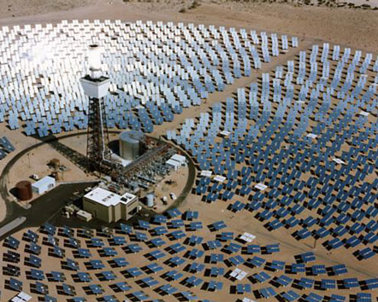
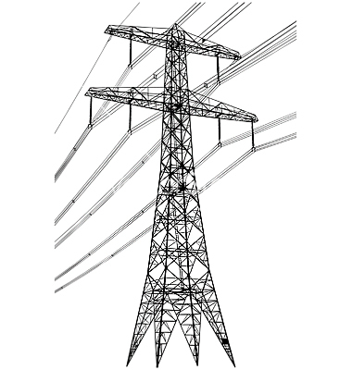
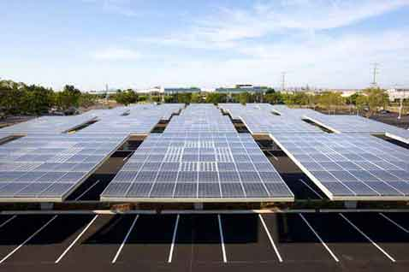
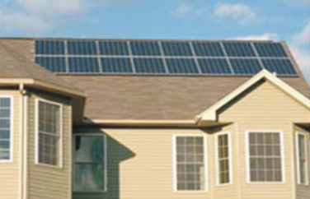
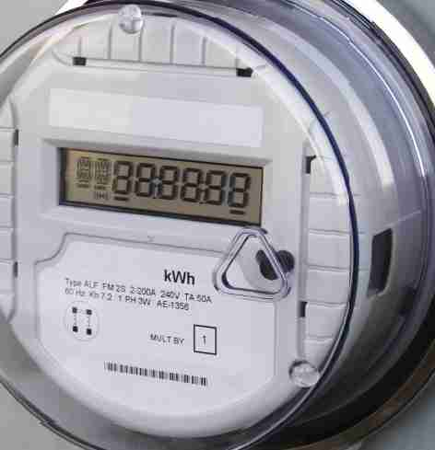
Energy Generation Market Segments
Transmission Grid
Central Station
Distribution Grid
Wholesale DG
Retail DG
Energy is sold to the
local utility
Energy is mostly used on-site

Slide 6
Community Solar?
Installed in Your Local Community
Community “Owns” the Solar Panels
What Policies are Relevant to Community Solar?
Net Metering = subset of Retail DG
Virtual Net Metering (VNM) = Modified Retail DG
Solar Gardens = Hybrid VNM and Wholesale DG
CLEAN Programs = Wholesale DG
Notes:
(ac_1, 15Sept2011)

Slide 7
CLEAN Programs Defined
CLEAN = Clean Local Energy Accessible Now
CLEAN Features:
Procurement: Standard and guaranteed contract between the utility and a renewable energy facility owner
Interconnection: Predictable and streamlined distribution grid access
Financing: Predefined and financeable fixed rates for long durations
CLEAN Benefits:
Removes the top three barriers to renewable energy
The vast majority of renewable energy deployed in the world has been driven by CLEAN Programs
Allows any party to become a clean energy entrepreneur
Attracts private capital, including vital new sources of equity
Drives local employment and generates tax revenue at no cost to government
Notes:
(cl_4, 13 April 2012)
7

Slide 8
CLEAN in California
Statewide Policy:
AB 1969 – Old CLEAN program started in 2008 (500 MW)
SB 32 – Improved CLEAN passed in 2009 (+ 250 MW)
AB 1990 – “Solar for All” in Legislature now ( + 375 MW)
SB 1332 – POUs to launch SB 32 programs in Legislature now
Local Initiatives:
SMUD – Launched CLEAN 2010 (100 MW)
Marin Energy Authority (CCA) – Small experiment in 2011
Palo Alto CLEAN – Launched April 2012 (4 MW)
LA CLEAN – Launching next month (10 MW, 75MW)
Total is still less than 1.5 GW statewide
Opportunities:
Clean Power SF? Sonoma CCA?
Any publicly-owned utility
SB 32 expansion
Notes:
(cl_4, 13 April 2012)
8

Slide 9
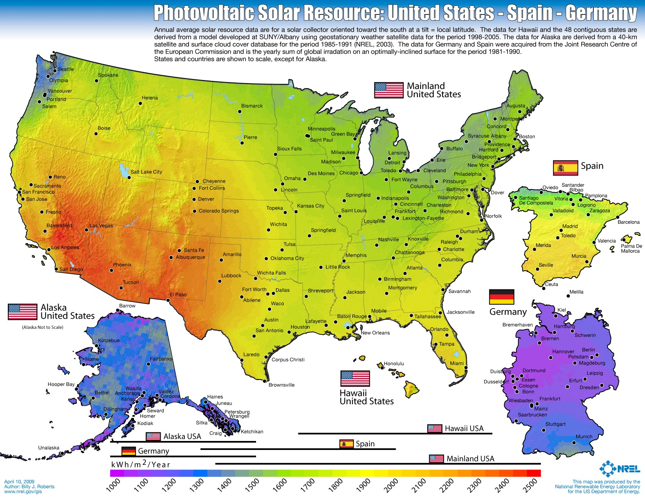
US Has Far Better Solar Resource than Germany
Source: NREL
Notes:
(ac_1, 15Sept2011)

Slide 10
BACKUP SLIDES
Notes:
(cl_4, 13 April 2012)
10

Slide 11
Clean Coalition Vision = DG+DR+ES+EV+MC2
Notes:
11

Slide 12
CLEAN Delivers Renewable Energy Goals
CLEAN Programs (also known as feed-in tariffs) are the most effective policy solution for spurring renewable energy installations around the world
CLEAN Programs are responsible for 45% of all wind energy and 75% of all solar PV capacity installed in the world before 2008 (National Renewable Energy Laboratory)
CLEAN Programs are responsible for 86% of the solar capacity deployed in the world in 2009
(Meister Consultants Group)
Notes:
(sw 2, 19 Jan 2012)
12

Slide 13
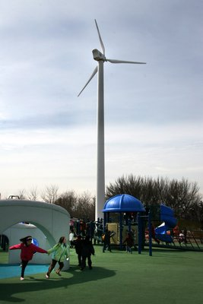
CLEAN Maximizes Local Economic Benefits
Local Job Creation
CLEAN projects are local and “shovel-ready”
Renewable energy creates far more jobs than fossil fuels or nuclear power (UC Berkeley)
Local Capital Investment
CLEAN Programs level the playing field, giving local residents and businesses the opportunity to reinvest capital in the community
Local ownership of renewable energy increases the economic benefits to the community by 200% to 300% (US GAO)
Local Tax Revenues
Local job creation and capital investment in the community creates new sources of state and local tax revenues
Does not rely on government subsidies
Notes:
(sw 2, 19 Jan 2012)

Slide 14
CLEAN Avoids Hidden Transmission Costs
“Palo Alto CLEAN will expand clean local energy production while only increasing the average utility bill by a penny per month” -- Yiaway Yeh, Mayor of Palo Alto
Source: Palo Alto Utilities
Notes:
(ssw_5, 29March2012)
7.04 cents - Base Energy 3.35 cents - RPS Value 0.60 cents - Local Capacity 1.94 cents - Transmission 0.62 cents - T&D Losses 0.45 cents - Premium

Slide 15
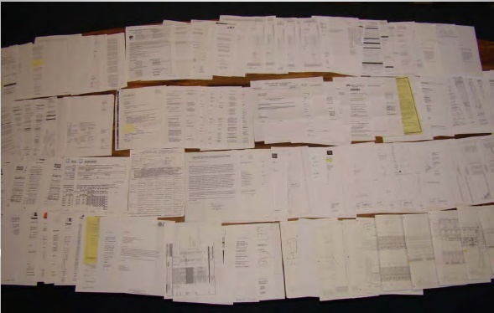
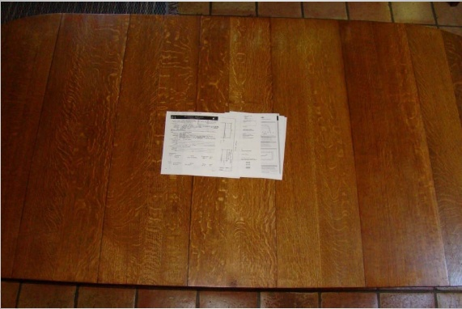
CLEAN Programs are Simple and Transparent
CLEAN Programs remove barriers and reduce costs
Typical California paperwork for one project
Typical Germany paperwork for one project
Could be a 1kW-sized project, but maximum 1MW (via CSI program). Even more paperwork for California projects larger than 1MW (via RPS program).
Could be a 1kW or 20MW-sized project, or bigger.
Source: Gary Gerber, President of CalSEIA and Sun Light & Power, Jun09
CLEAN can easily reduce costs by 20% by preempting bureaucracy alone
Notes:
(ac_1, 15Sept2011)

