Slide 1
Implications of TAC Assessment on Distributed Generation
Damon Franz, Director of Policy
September 1, 2016

Slide 2
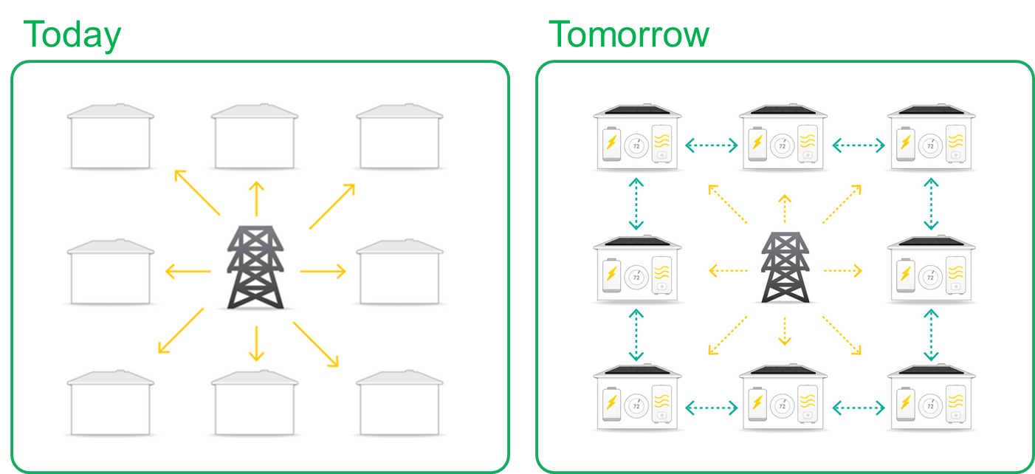
Designing a 21st Century Grid
SolarCity envisions a grid built on interconnected smart energy homes, where power is produced, consumed and exchanged on the distribution grid

Slide 3
Advantages of a Distributed Grid
Better resiliency through decentralized generation
Reduction of land use, wildlife disturbance, fresh water use and marine impacts
Improved system utilization through replacement of large “lumpy” investments with modular ones
Potential ratepayer savings through elimination of large “failure-prone” infrastructure investments
Avoidance of climate pollution and emissions

Slide 4
Value of Avoided Transmission
Avoiding transmission investment is a major way that distributed resources convey benefits to ratepayers
California Energy Commission: “DER can potentially provide ratepayer benefits in comparison to traditional system infrastructure investments. In the San Joaquin Valley region, the primary benefit is transmission infrastructure deferrals with an estimated long-term ratepayer benefit over $300 million.”
Greentech Media: “Californians just saved $192 million from Energy Efficiency and Rooftop Solar”
“The canceled projects include line improvements, transformer replacements and bus upgrades.”

Slide 5
LSEs Should Share the Benefits of Avoided Transmission
Perverse Incentives: Utilities benefit via return on assets when they build new transmission, but they do not benefit when their customer programs avoid the need to make those investments
FERC Order 1000 requires ISOs to consider “non-transmission alternatives” (NTAs) in lieu of new transmission lines, but it does not provide a way for utilities to earn a return of and on investments in NTAs
Because TAC charges are socialized across LSEs and assessed at the EUML, utilities are further dis-incented from using local resources to avoid transmission

Slide 6
Impact of TAC Assessment on DG policy
If utilities could reduce customer TAC charges through generating power at the distribution level, they might factor those savings into investment decisions
This could be particular relevant in an expanded ISO, where not all utilities are subject to the same state policy requirements
Assessing the TAC at the TED would provide an easily-quantifiable way to account for avoided transmission in cost-effectiveness analysis
Assessing the TAC at the TED could improve the scoring of distribution-site renewables in RPS solicitations

