Slide 1
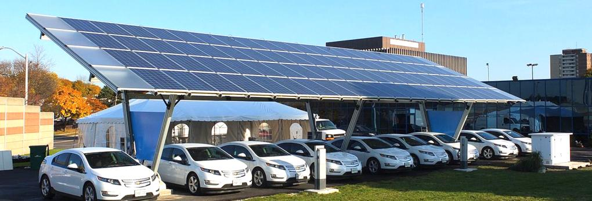
North Bay Community Resilience Initiative:
The path to energy resilience and sustainability
John Sarter Malini Kannan
Program Manager, NBCRI Program Engineer
Clean Coalition Clean Coalition
415-342-7199 mobile 650-533-8039 mobile
johns@clean-coalition.org malini@clean-coalition.org

Slide 2
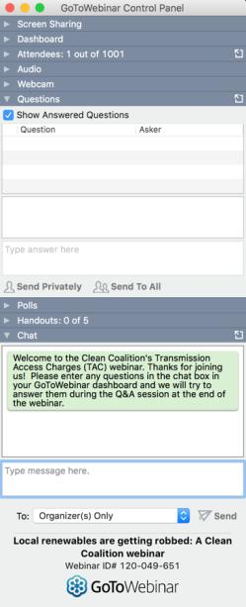

GoToWebinar FAQ
Webinar recording and slides will be sent to registered attendees within two business days
All webinars are archived on clean-coalition.org and the Clean Coalition’s YouTube channel
Submit questions in the Questions window at any time (window view varies by operating system and browser)
Questions will be answered during the Q&A portion of the webinar
Contact Josh for webinar questions: josh@clean-coalition.org

Slide 3
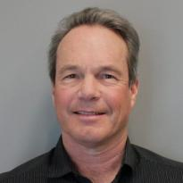

Today’s presenters
John Sarter, Program Manager
John is a sustainable designer/developer, innovator in systems integration, and expert in real estate, renewable energy, and transportation. He has owned and operated his firms, Sarter Construction & Design, Off The Grid Design, and Sol Lux Alpha, since 1986. A recognized leader in the solar+storage space since 2008, John founded the Microgrid Development Group in San Francisco in 2014 to unite a consortium of technology, energy, engineering, and other professionals committed to creating a resilient and sustainable, 100% renewable energy future.
Malini Kannan, Program Engineer
Malini leads the technical activities of Clean Coalition’s Community Microgrid Initiative. She has helped communities across California, the New York metropolitan area, and Puerto Rico design and develop Community Microgrids through scoping, planning, and engineering design and analysis work. Previously, as a Research Engineer at the Schatz Energy Research Center, Malini tested and analyzed performance data from small-scale solar, battery, and LED consumer electronics as a consultant to the World Bank.

Slide 4
Clean Coalition (nonprofit) mission
To accelerate the transition to renewable energy and a modern grid through
technical, policy, and project development expertise
Notes:
4

Slide 5
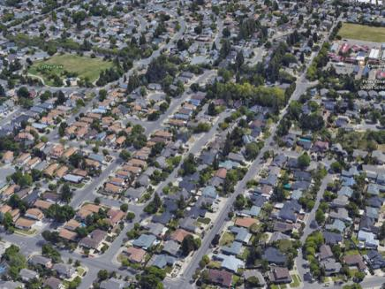
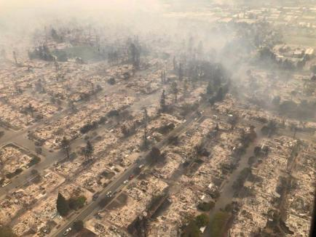
Motivation and need for the
North Bay Community Resilience Initiative (NBCRI)
  Coffey Park neighborhood of Santa Rosa, before and after.
  NBCRI primary objectives:
  Help impacted communities rebuild with greater efficiency, decarbonize, and enhance resilience
  Encourage all new development to do the same
  Create healthy, safe communities

Slide 6
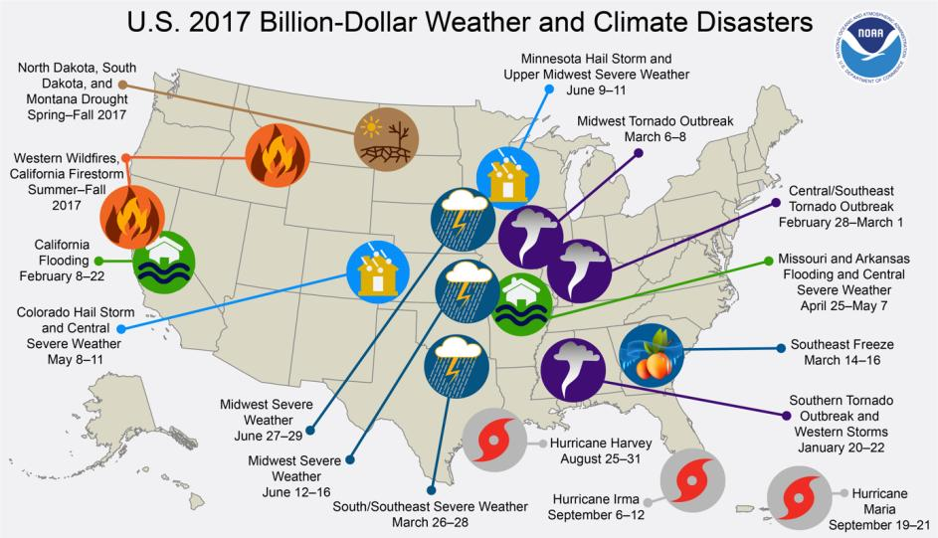
$1B+ weather events in U.S. Jan – Sept 2017
Source: National Oceanic and Atmospheric Administration
Notes:
6

Slide 7
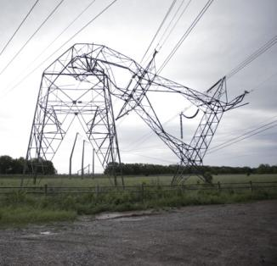
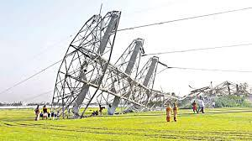
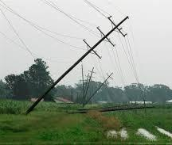
Why do we need a resilient power system?
Our centralized energy infrastructure is costly, aging, inefficient, and a security risk — highly vulnerable to extreme weather and cyber attacks
Extreme weather events are occurring more frequently:
From January through September 2017, the U.S. experienced 16 weather- and climate-related events that cost $1B or more, for a record-breaking total of $300B (National Oceanic and Atmospheric Administration)
Notes:
7

Slide 8
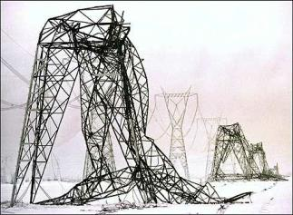
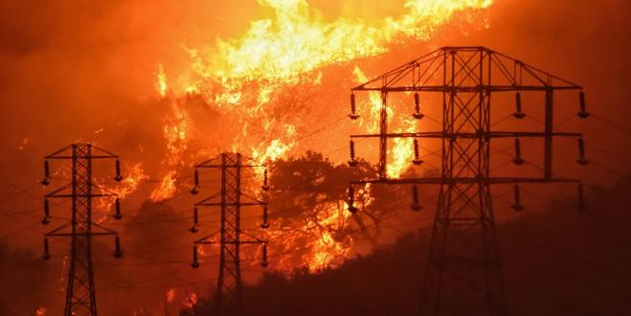
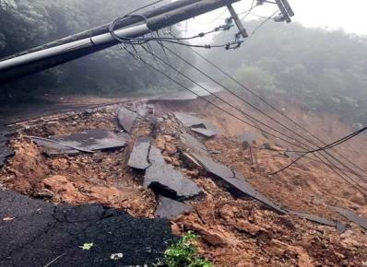
What is power system resilience?
Resilience = The ability to keep critical loads online indefinitely
in the face of extreme or damaging conditions
Goes beyond reliability — which is measured after only 5 minutes of grid outage
Driven by renewables with energy storage and demand response
Focused on reducing outage duration, cost, and impact on critical services

Slide 9
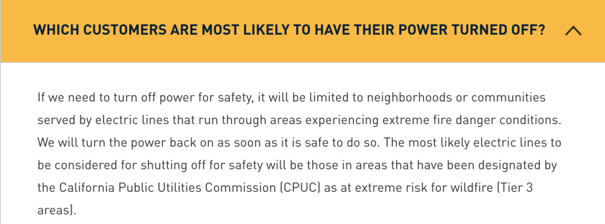
Public Safety Power Shutoffs (PSPS) outages
Multiple PSPS events were planned in 2018.
PG&E has brought in mobile fossil-fuel generators to connect at the substation in the past, but PG&E will not provide this service long-term.
Negative impact: Critical facilities, businesses, and residents lose power during planned shutdowns and cannot provide services.

Slide 10
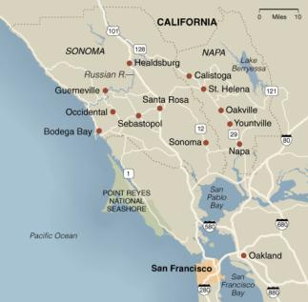

North Bay Community Resilience Initiative goals
Goal 1: Track, promote, and publicize cutting-edge resilience-related energy efficiency and electrification incentives and policy advancements by government agencies.
Goal 2: Procure and develop a database of model structures with “Community Microgrid–ready” designs: new and retrofit residential, commercial, and municipal.
Goal 3: Develop Community Microgrid roadmap and stage pilot projects beginning with critical-facility microgrids such as fire stations, hospitals, and emergency shelters.
Position these pilots in areas that are conducive to expansion into Community Microgrids, ideally at preinstalled interconnection hub (PIH) locations identified by PG&E.
Notes:
10

Slide 11










North Bay Community Resilience Initiative Team
Stone Edge Farm Microgrid
Notes:
11

Slide 12

Goal 1: Support Advanced Energy Rebuild (AER) for Homes
  Support for rebuilding with resilience, efficiency, and electrification
  Sonoma Clean Power (SCP), Pacific Gas and Electric Company (PG&E), and Bay Area Air Quality Management District have joined efforts to help homeowners affected by the firestorms to rebuild energy-efficient, sustainable homes.
  The program is an enhancement to PG&E’s long-standing California Advanced Homes Program, and offers two incentive packages tailored to Sonoma and Mendocino Counties.
  Each package has a flexible performance pathway or a simple prescriptive menu.
  MCE has a similar program for the Napa rebuilding efforts.
  The Clean Coalition is helping to reduce barriers to adoption of these programs
Notes:
12

Slide 13
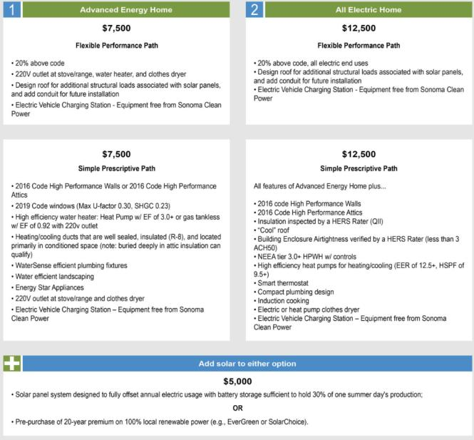
SCP Advanced Energy Rebuild for Homes
Notes:
13

Slide 14

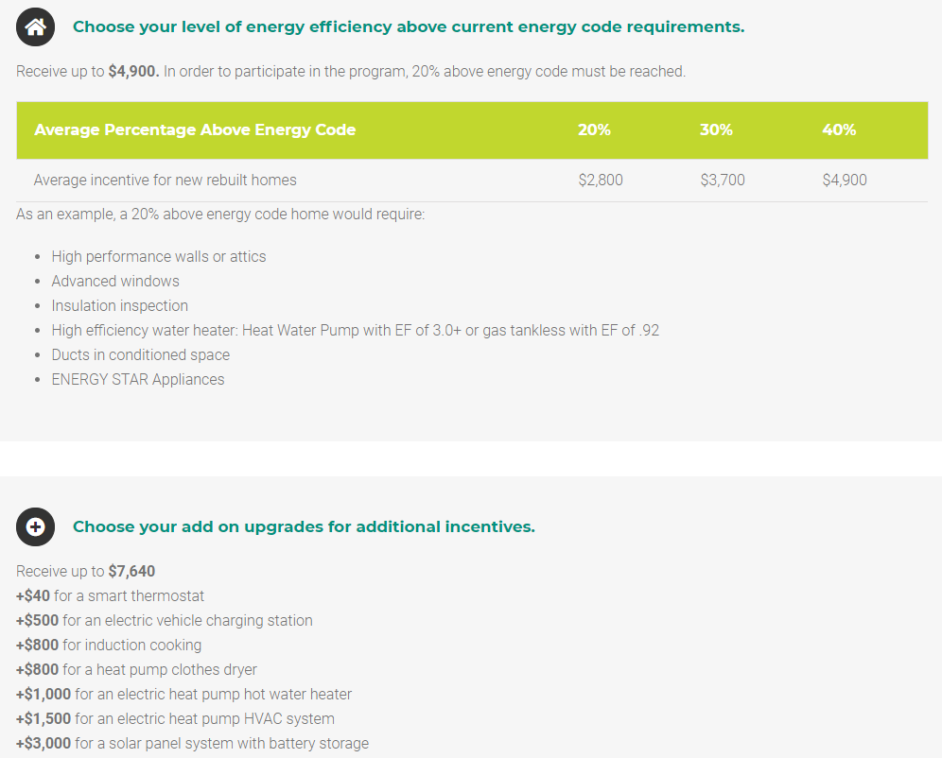
MCE Advanced Energy Rebuild Napa (AERN)
Contact MCE at energysavings@mcecleanenergy.org or (415) 464-6033 for additional program details and funding availability prior to submitting applications.
The funding for this program will expire December 31, 2019 or once funding is depleted. Application is valid for 36 months from date of utility acceptance.

Slide 15
Goal 2: Community Microgrid–ready model structures
Grid-optimal: Light on the grid by virtue of very high energy efficiency and solar+storage
Islandable building and campus microgrids, adding layers of resilience
Grid-integrated electric infrastructure; appliances, electric vehicle chargers, and soon bi-directional chargers
Designed to interconnect into Community Microgrids as “prosumers,” a customer who both produces and consumes energy
Model structure will incorporate elements in the Electrification & Community Microgrid–ready guideline document that the Clean Coalition developed

Slide 16







Model structures: Design Challenge
Design Challenge for model structures for new and retrofit residential, commercial, and municipal buildings
Collaborate with highest building performance organizations:
  US DOE Zero Energy Ready Home Program
  US DOE Solar Decathlon Program
  Rocky Mountain Institute
  USGBC / New Buildings Institute “Grid-Optimal”
  Passive House Institute US - “Source Zero”
  Modular Building Institute

Slide 17
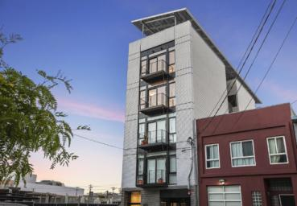


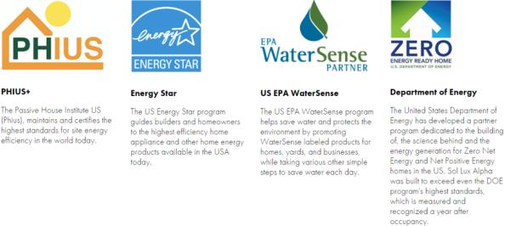
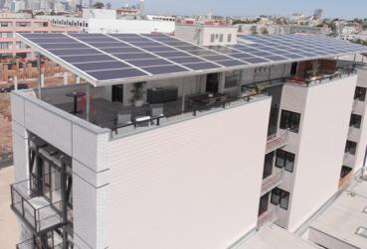
Model structures:
Carbon-neutral living + transportation
SOL LUX ALPHA
First Passive House certified multi-unit “Nanogrid” in U.S. market
Passive House = 80% savings on heating/cooling
Carbon-neutral living + transportation system
4-unit, 6-story using only PV within the building site
All-electric: Fossil-fuel-free
2018 US DOE Housing Innovation Award winner
2018 PHIUS “Best Overall Project” - North America

Slide 18
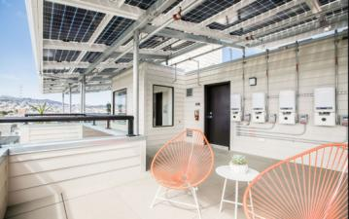
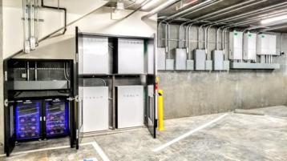
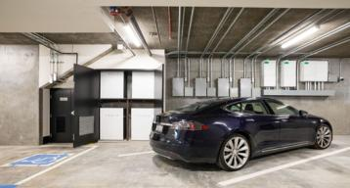
Model structures:
Sol-Lux Alpha nanogrid system
Sunpreme GxB 380w Bifacial panels (up to 25% boost) = 475w ea. (21 panels per unit = 8 kW array per unit)
Tesla Energy Powerwall x3 (triple redundancy, 2-3 days energy) and Tesla Backup Gateways (battery management system (BMS) and automatic transfer switching)
Blue Planet Energy Blue Ion (for 3 phase - common area loads)
3 Schneider Conext inverters (building management system and automatic transfer switch)
V2B architecture–enabled (allows mobile energy for community resilience)

Slide 19
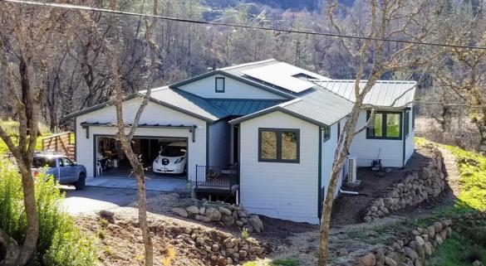
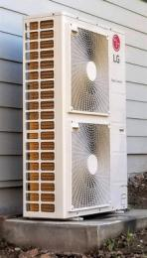
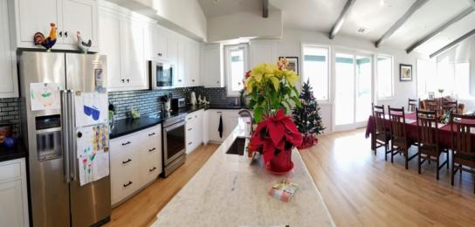
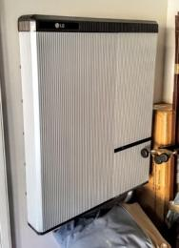
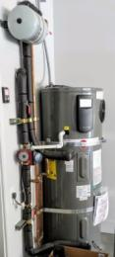
Model structures:
Advanced Energy Rebuild case studies
Hirsch residence: First SCP Advanced Energy Rebuild
Heat pump HVAC Hirsch residence all-electric kitchen with induction range LG Chem energy storage Rheem HPWH

Slide 20
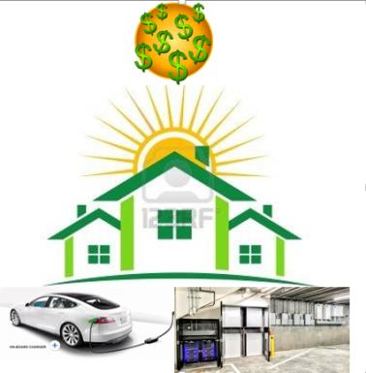

Model structures:
Consumer benefits
Financial impact @ building scale
Lower operation costs (near-zero energy bills)
Revenue from excess energy export (HOA dividends?)
Electric vehicles powered by renewables
Better occupant health (reduced medical costs)
Home becomes a community asset
= Higher appraised property values

Slide 21
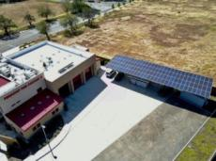
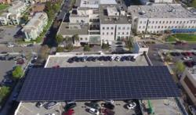

Goal 3: Critical-facility microgrids
Stage pilot projects beginning with critical-facility microgrids
City / County Centers
  Offices of Emergency Services
Fire Departments
  Rincon Valley Fire Protection District
  Sonoma County Fire and Emergency Services
Hospitals
  Kaiser Permanente Santa Rosa
  Sutter Hospital Larkfield Campus
Emergency shelters
  County Veterans Buildings
  Luther Burbank Center
  Community Centers
Fremont Fire Station mIcrogrid
Kaiser Permanente Richmond microgrid
Seattle Community Center microgrid

Slide 22
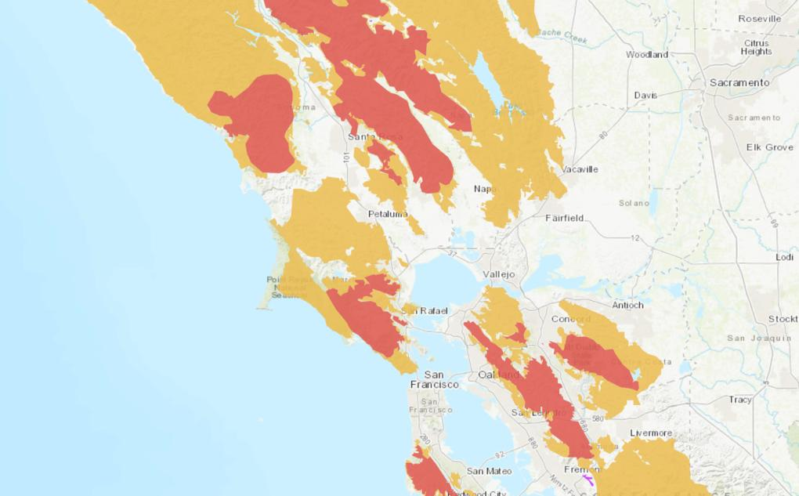
Why do we need microgrids?
CPUC fire threat map
Source: https://ia.cpuc.ca.gov/firemap/

Slide 23
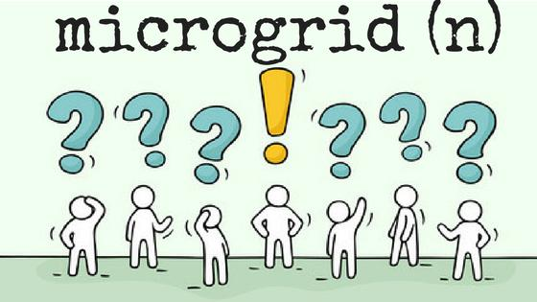
What is a microgrid?

Slide 24
What is a microgrid?
A microgrid is a group of interconnected loads and distributed energy resources (DER) within clearly defined electrical boundaries that acts as a single controllable load with respect to the grid. A microgrid can connect and disconnect from the grid to enable it to operate in both grid-connected or island mode.
Microgrid is an umbrella term that incorporates a variety of scopes, scales, and use-cases.
A microgrid can provide cost savings, but it can also be more expensive than energy from PG&E. The economics are project-specific.

Slide 25
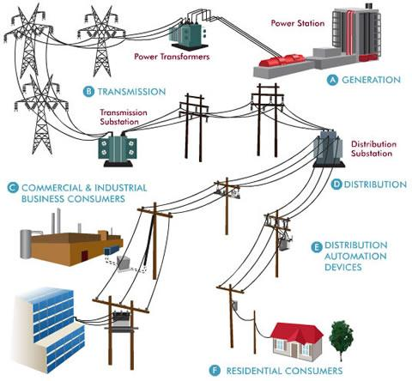
Facility microgrids focus on single customers
Source: Oncor Electric Delivery Company
Notes:
25

Slide 26

Community Microgrids can serve up to thousands of customers
“PROSUMERS”
CRITICAL FACILITY MICROGRIDS
“PROSUMERS”
Source: Oncor Electric Delivery Company
Notes:
26

Slide 27
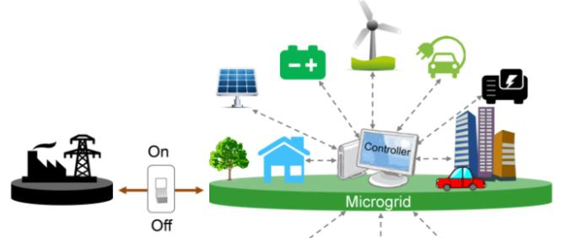
Community Microgrid defined
A modern approach for designing and operating the electric grid, stacked with local renewables and staged for resilience.
“Islanding” from the grid: A coordinated local grid area that can separate from the main grid and operate independently.
Components: Solar PV and other renewable energy, energy storage, demand response, and monitoring, communications, & control.
Clean local energy: Community Microgrids facilitate optimal deployment of distributed energy resources (DER).
Resilient: Ongoing, renewables-driven backup power for critical and prioritized loads, and eventually all community energy needs.
Replicable: A solution that can be readily extended
and replicated throughout any utility service territory.

Slide 28
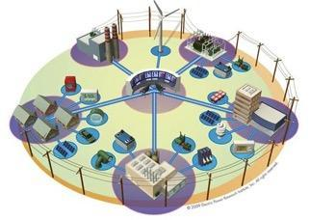
Benefits of Community Microgrids
Community Microgrids bring communities four benefits
not provided by today’s centralized energy system
Lower costs and increased
economic investment
Improved overall performance
Resilience and security
Replicable, scalable model
Indefinite renewables-driven
backup power provides an unparalleled trifecta of economic, environmental, and resilience benefits

Slide 29
Benefits of Community Microgrids
Reliability and power continuity
Resilience and safety
Local, renewable energy
  Greenhouse gas reductions
  Local control of energy
  For electric vehicles and charging infrastructure
  Reduced transmission losses
Local jobs in engineering,
construction, and maintenance
More participation enables by a
network of “prosumers” who share the use, generation, and revenue of and from energy
Energy security and national security

Slide 30
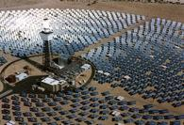
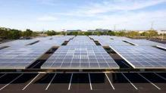



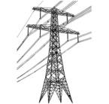

WDG unleashes renewables for California’s
100% renewable energy future
Project Size
Central Generation
Serves Remote Loads
50+ MW
Wholesale DG
Serves Local Loads
500 kW
Retail DG
Serves Onsite Loads
5 kW
Behind the Meter
Distribution Grid
Transmission Grid

Slide 31
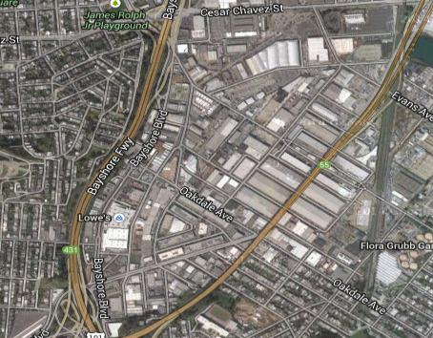
Commercial and industrial (C&I) parking lots and rooftops have untapped solar potential
    Large rooftops, parking lots, and parking garages provide local solar generation potential.
    Electric load profiles of C&I facilities often match peak solar production hours.
    Large utility bills with demand charges motivate customers to install solar and energy storage.
    Local solar can reduce system peaks, and often industrial areas have excess feeder capacity to install large amounts of solar and energy storage without grid upgrades.
    Reduce carbon emissions from the heaviest polluters.

Slide 32
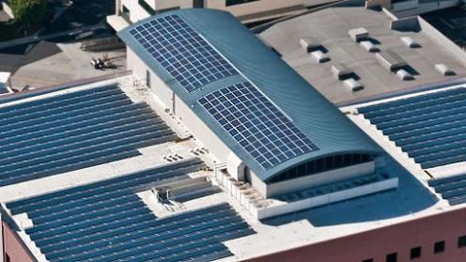
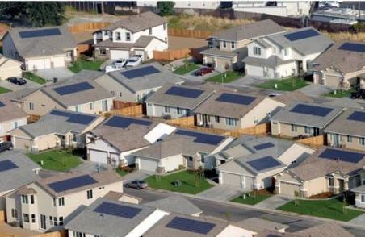
Homes and buildings can be grid partners
Well-designed and well-situated zero-net energy and net positive energy buildings become a valuable grid participant when combined with larger PV arrays on commercial and industrial structures.
Individual building microgrids can be incorporated into a larger Community Microgrid with the appropriate hardware and software. It's critical to design behind-the meter systems now to be compatible with future advances in energy infrastructure.
Notes:
32

Slide 33
Advancements from PG&E
Pre-Installed Interconnection Hub (PIH)
PG&E is developing a new technology called a pre-installed interconnection hub. The PIH enables a mobile generation source to be interconnected during a grid outage event. This technology is still in the pilot phase.
This would provide power to an islandable section of the grid, and develop a Resilience Zone.
  This is essentially a basic microgrid, with variable but limited scope.
We are collaborating with PG&E to identify locations on the distribution grid where a PIH could be installed.
We are working with municipalities and PG&E to enable Community Microgrids in Resilience Zones.

Slide 34
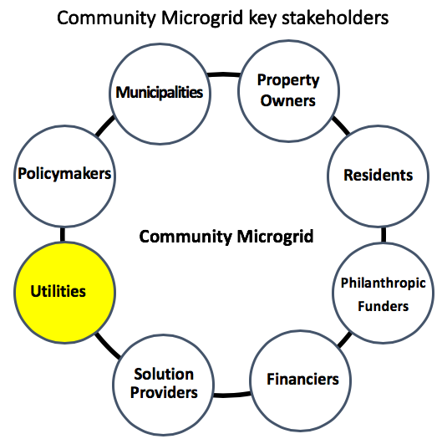
Community Microgrid key stakeholders

Slide 35
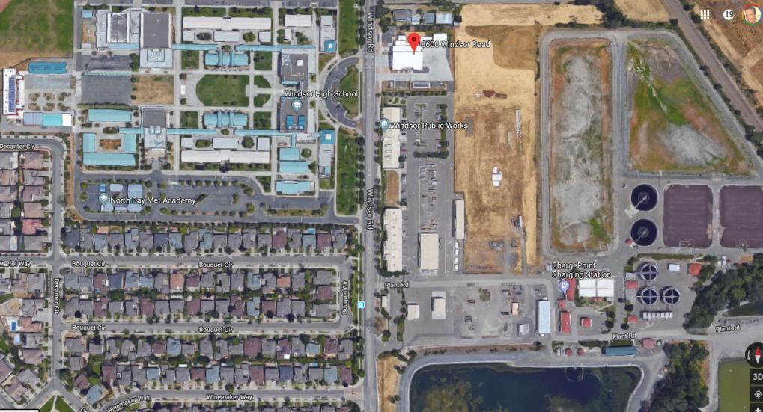
Example: Community Microgrid site
Fire dept
High school campus
Public works department
Wastewater treatment plant
Residential solar+storage microgrids
Floating solar array

Slide 36
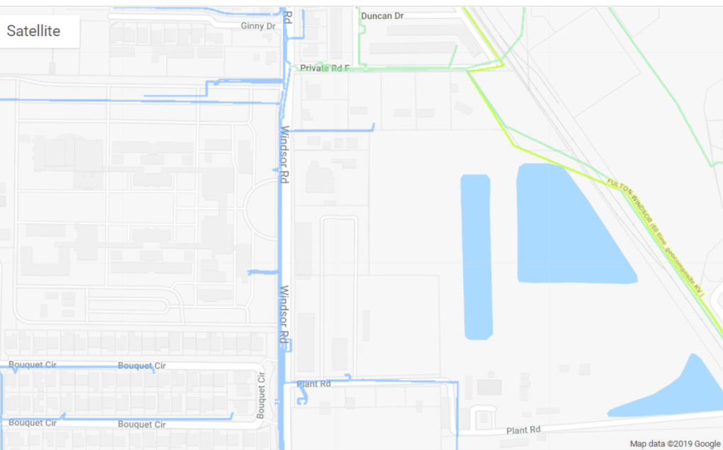
Example: Community Microgrid site grid feeders: Substation level
All locations on single blue feeder line = ability to share energy

Slide 37
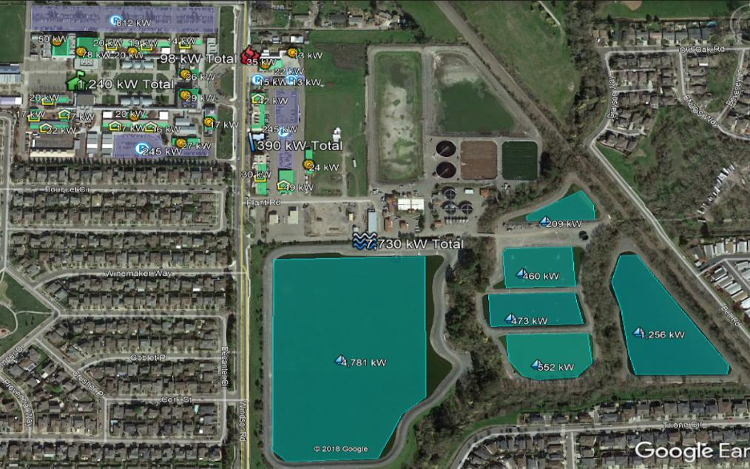
Example: Community Microgrid site
Solar Siting Survey

Slide 38
Example: Community Microgrid site
Total solar assets available
Cluster | Elements | Solar siting potential
Water Treatment Facility | Floating solar arrays | 7.7 MW
Public Utility Department | Roof and parking lot arrays | 390 kW
Fire Department | Roof and parking lot arrays | 98 kW
High school TOTAL_________________ Residential Solar | Roof and parking lot arrays ______________________ 5 – 10 kW per home | 1.2 MW 9.388 MW 300 homes = 3000 kW (3MW)
1 MW powers 750 to 1000 homes, 12 MW powers up to 12,000 homes

Slide 39
Example: Community Microgrid site
Priority sites: Critical infrastructure first
Critical infrastructure: Essential for life and safety
  Fire departments
  Public works departments
  Water treatment and pumping
  High schools (emergency shelters)
Target sites have solar siting potential on large rooftops, parking lots, areas that can accommodate floating solar
Secondary sites: homes and non-critical businesses
  ZNE microgrid-ready homes
  EV charging infrastructure

Slide 40
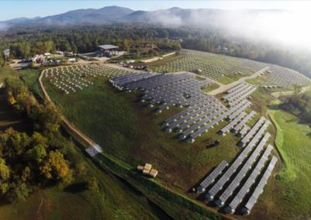
Team successes
Developed “Electrification & Community Microgrid–ready” document (ECMR)
Developed draft document “Resolution for resilient communities”
Developing a Community Microgrid plan for the City of Calistoga
In discussion with West and North County communities for resilient microgrid plans

Slide 41
Resolution for Resilient Communities document
Designed for adoption by cities and municipalities, to state intentions toward developing resilient communities.
No binding measures; the document states intentions for staff to keep in mind while designing programs, codes, standards, etc.
Please suggest connections to decision makers within your communities, or recommendations.
Link to the document: Resolution for Resilient Communities

Slide 42
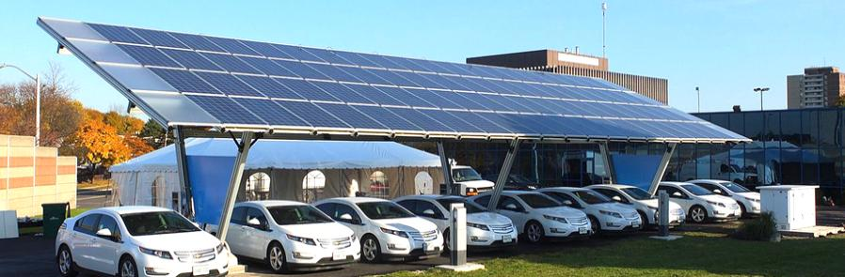
How to get involved
Subscribe to Clean Coalition newsletter
Subscribe to team partners’ newsletters
Share information on potential model structure case studies
Suggest city or municipal staff to connect with
Suggest publications to reach out to
Suggest individuals/organizations to connect with
Suggest experts in related fields to connect with and invite to join our team to fulfill the goals of the NBCRI

Slide 43
Questions?
Thank you for attending!
Questions?
Contact information:
John Sarter, Program Manager, NBCRI, johns@clean-coalition.org
Malini Kannan, Program Engineer, Clean Coalition, malini@clean-coalition.org
Webinar series with deep dives into the 3 main NBCRI goals coming in early May. Check the Clean Coalition website for details:
https://clean-coalition.org/news/category/events/upcoming-events/

