Slide 1
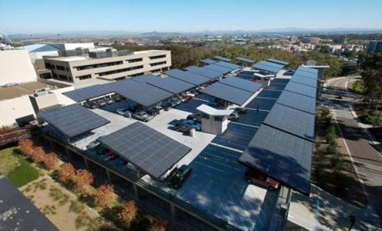
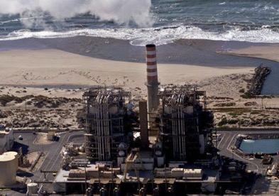
Community Microgrids are superior to
gas peakers
Craig Lewis
Executive Director
650-796-2353 mobile
craig@clean-coalition.org
13 May 2019

Slide 2
Community Microgrids superior to gas peakers on all dimensions
Technical performance
  Dispatchable Energy Capacity Services (DECS) is the key market mechanism solution to unleash unparalleled Community Microgrid performance.
Economics (full benefits & costs comparison)
  Capital expenditures (capex).
  Operational expenditures (opex).
  Local economic stimulation.
Environmental (this is a given)
Safety
Resilience

Slide 3
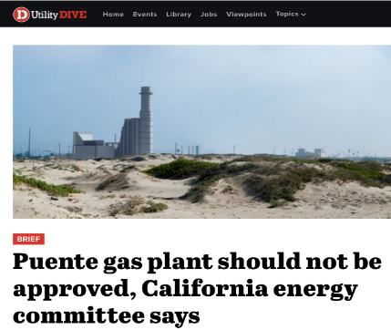
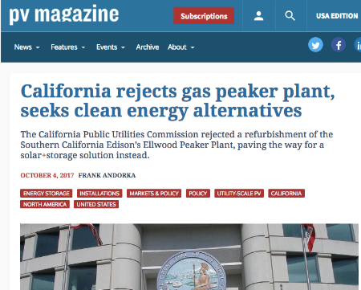
Community Microgrids obviate gas peakers
Thanks in part to our analysis, California regulators have rejected Ellwood and signaled their intent to reject Puente as well
“Let’s take this opportunity to move the Oxnard community into the clean energy future — which is here already.” Carmen Ramirez, Mayor of Oxnard
Significant opportunity to leverage this work to prevent future new gas plant proposals across the country

Slide 4
There are three vital grid services
Service | Key to delivering service
Power balancing | Capacity of real power (W)
Voltage balancing | Location of reactive power (VAr)
Frequency balancing | Speed of ramping real power (W)
The Duck Chart only addresses power balancing, but distributed energy resources (DER) deliver unparalleled location and speed characteristics
Notes:
4

Slide 5
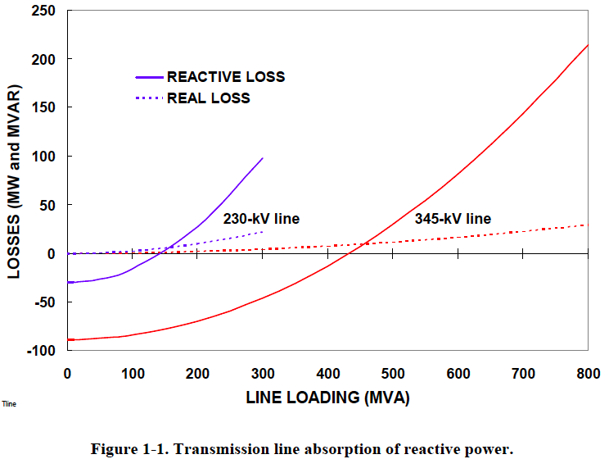
Voltage regulation – location matters
“The old adage is that reactive power does not travel well.”
        Oak Ridge National Laboratory (2008)
T&D lines absorb 8-20x more reactive power than real power.
Prevent blackouts:
When a transmission path is lost, remaining lines are heavily loaded and losses are higher.
Source: Oak Ridge National Laboratory (2008)
Notes:
Reactive power does not travel well.
This chart shows that reactive power has 8-20 times higher line losses than real power.
Also shows much higher transmission line vs. distribution line losses.
When a transmission path is lost, remaining lines are heavily loaded and losses are higher.
Expert audience notes:
The zero crossing of the reactive losses lines are the Surge Impedance Loading (SIL) points at which there is a balance between producing and absorbing reactive power.
When conducting power below its SIL, the line is primarily capacitive and supplies reactive power, tending to raise system voltages (same thing capacitor banks are used for). When the line carries more power than the SIL, it tends to absorb reactive power, lowering system voltages (same thing motor loads do).
The reactive impedances in a transmission systems are typically 8-20 times larger than real impedances, hence reactive losses are much higher, especially when lines carry higher power above the SIL.
Source: “Local Dynamic Reactive Power for Correction of System Voltage Problems,” Oak Ridge National Laboratory, September 2008

Slide 6
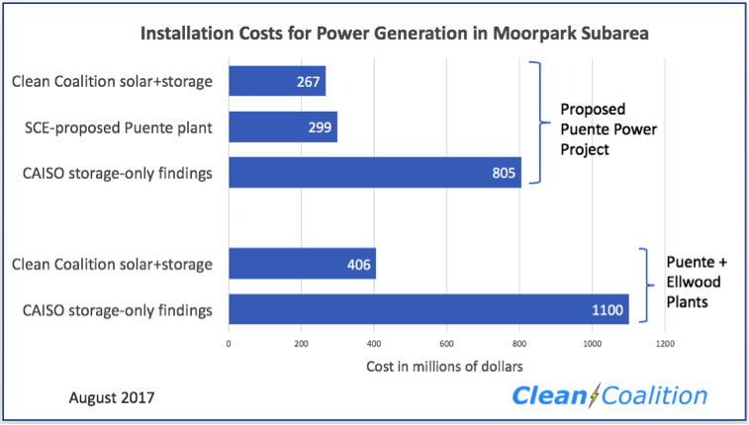
Community Microgrids cheaper than gas peakers
Leveraging our technical and economic expertise, the Clean Coalition conducted an analysis to determine the viability of solar+storage as a better alternative

Slide 7
Wholesale distributed generation (WDG) has
superior value
Total ratepayer cost of solar
 | Distribution Grid |  |  |  |  | T-Grid
PV Project size and type | 100 kW roof | 500 kW roof | 1 MW roof | 1 MW ground | 5 MW ground | 50 MW ground
Required PPA Rate | 12-15¢ | 9-12¢ | 8-10¢ | 6-8¢ | 4-7¢ | 3-6¢
T&D costs | 0¢ | 0¢ | 0¢ | 0¢ | 0¢ | 2-4¢
Ratepayer cost per kWh | 12-15¢ | 9-12¢ | 8-10¢ | 6-8¢ | 4-7¢ | 5-10¢
Sources: CAISO, CEC, CPUC and Clean Coalition
The most cost-effective solar is large WDG, not central station due to significant hidden T&D costs
Notes:
7

Slide 8
PPA pricing

Slide 9
Benefits-costs analysis (BCA) pricing
Range of local economic &
resilience value
True rooftop pricing

Slide 10
FITs proliferated WDG solar in Germany
Solar markets: Germany vs California (2002-2012)
Cumulative MW
Sources: CPUC, CEC, SEIA and German equivalents.
Germany deployed over 10 times more solar than California in the decade from 2002 — despite California having 70% better solar resource.

Slide 11
The majority of German solar is local solar
26%
23.25%
22.5%
19%
9.25%
Source: Paul Gipe, March 2012
Germany’s solar deployments are almost entirely sub-2 MW projects on built-environments and interconnected to the distribution grid (not behind-the-meter).

Slide 12
German rooftop solar is 4 to 6 cents/kWh today
Project Size | Euros/kWh | USD/kWh | California Effective Rate $/kWh
Under 10 kW | 0.1270 | 0.1359 | 0.0628
10 kW to 40 kW | 0.1236 | 0.1323 | 0.0611
40.1 kW to 750 kW | 0.1109 | 0.1187 | 0.0548
Other projects up to 750 kW* | 0.0891 | 0.0953 | 0.0440
Conversion rate for euros to dollars is €1:$1.07.
California’s effective rate is reduced 40% due to tax incentives and then an additional 33% due to the superior solar resource.
Replicating German scale and efficiencies would yield rooftop solar today at only between 4 and 6 cents/kWh to California ratepayers.
* For projects that are not sited on residential structures or sound barriers.
Notes:
Critics of Germany’s CLEAN Program tend to say that they are paying too much for renewable energy generation, but this chart shows that – using the appropriate conversion – they are paying less for solar than we pay for electricity almost anywhere in the U.S. This conversion uses the U.S. tax incentives and solar resource.
The higher rates apply to residential and roadway noise barrier installations, the lower “other” rate to all other installations

Slide 13


Hunters Point economic benefits from 50 MW DER
$200M in private investment + operations & maintenance over 20 years yields:
Photo courtesy of GRID Alternatives
Economic benefits
$200M: Added regional economic stimulation
$100M: Added local wages, near-term plus annual
1,270 Job-years: New near-term regional employment
520 Job-years: New ongoing regional employment
$10M: Site leasing income for property owners
$5.8M: Added construction-related state sales taxes
Source: NREL JEDI calculator. Based on average installed cost of $2.75/W(dc) before taxes & incentives using PG&E rates/region.
Notes:
Private Investment + Operations & Maintenance:
$200M investment over 20 years is comprised of near-term plus ongoing operations and maintenance as follows:
1. $165M represents the private investment amount for a 50MW PV system over 20 Years, as follows:
Installation & Construction: $137M ($27.5M per 10 MW)
Dynamic Grid Solutions @ 20% = $27,500
Total = $165K
O&M: $35M represents the O&M costs for a 50MW PV system over 20 years, as follows:
O&M adds $1.48M annually, or $29.7M over 20 years
plus 20% or $5.9M for Dynamic Grid Solutions
Total = $35.6M over 20 years.
Local Employment and Economic Impact:
Specific to MTA – Metropolitan Region.
Refers to PV installed in San Francisco at an average installed cost of $2.75/W(dc) (before taxes and incentives).
Local economic output is calculated as the value of expenditures on goods and services resulting from the project and captured within the study area, and excludes expenditures outside the region, such as to module manufacturers. During operating years local economic output is comprised of payments made by project owners, including the portion of project debt payments made to lenders located within the local analysis area. Payments including incentives, refunds, or revenues to project owners from the sale of energy produced by installed facilities are not included.
Economic activity in input-output models is assessed in three categories:
Salaries and wages for the project on-site labor and direct professional services
Local supply chain revenue related to materials acquisition, manufacture and services, including the local share of revenues from project financing and investment
Induced impacts in the local economy that result from workers salaries and wages
The model’s “output” is the sum of the above three categories for construction and for operations. State-specific multipliers and personal spending patterns are used to derive the results.
Near-term Job years of regional local employment from construction and installation. Ongoing job years in operation and maintenance over 25 years of operation.
Local wages in construction & installation.
The SF successor RDA estimates that 50% of the jobs and economic output will be captured within the boundaries of the city
Equipment and material sales will generate tax revenue as indicated.
NREL's JEDI models classify the first category of results—on-site labor and professional services results—as dollars spent on labor from companies engaged in development and on-site construction and operation of power generation and distribution. These results include labor only—no materials.
Econ impact
NREL JEDI model version PV 10.17.11
NREL JEDI Scenario model PVS 4.5.13
PV PPA pricing
NREL System Advisor Model (SAM) v. 2013.9.20
CEC Cost of Generation Model v.2

Slide 14

Hunters Point
Environmental benefits from 50 MW of DER:
Photo courtesy of GRID Alternatives
Environmental benefits
78M pounds: Annual reductions in greenhouse gas (GHG) emissions (equivalent to removing 6,660 cars from the road)
15M gallons: Annual water savings
375 acres: Land preserved through secondary use of roof and parking lot areas
Sources: NREL Emissions Health Calculator, PG&E service territory; DOE 2009; Civil Society Institute: “Hidden Costs of Electricity” (Sep 2012)
Notes:
Private Investment + Operations & Maintenance:
$200M investment over 20 years is comprised of near-term plus ongoing operations and maintenance as follows:
1. $165M represents the private investment amount for a 50MW PV system over 20 Years, as follows:
Installation & Construction: $137M ($27.5M per 10 MW)
Dynamic Grid Solutions @ 20% = $27,500
Total = $165K
O&M: $35M represents the O&M costs for a 50MW PV system over 20 years, as follows:
O&M adds $1.48M annually, or $29.7M over 20 years
plus 20% or $5.9M for Dynamic Grid Solutions
Total = $35.6M over 20 years.
Local Employment and Economic Impact:
Specific to MTA – Metropolitan Region.
Refers to PV installed in San Francisco at an average installed cost of $2.75/W(dc) (before taxes and incentives).
Local economic output is calculated as the value of expenditures on goods and services resulting from the project and captured within the study area, and excludes expenditures outside the region, such as to module manufacturers. During operating years local economic output is comprised of payments made by project owners, including the portion of project debt payments made to lenders located within the local analysis area. Payments including incentives, refunds, or revenues to project owners from the sale of energy produced by installed facilities are not included.
Economic activity in input-output models is assessed in three categories:
Salaries and wages for the project on-site labor and direct professional services
Local supply chain revenue related to materials acquisition, manufacture and services, including the local share of revenues from project financing and investment
Induced impacts in the local economy that result from workers salaries and wages
The model’s “output” is the sum of the above three categories for construction and for operations. State-specific multipliers and personal spending patterns are used to derive the results.
Near-term Job years of regional local employment from construction and installation. Ongoing job years in operation and maintenance over 25 years of operation.
Local wages in construction & installation.
The SF successor RDA estimates that 50% of the jobs and economic output will be captured within the boundaries of the city
Equipment and material sales will generate tax revenue as indicated.
NREL's JEDI models classify the first category of results—on-site labor and professional services results—as dollars spent on labor from companies engaged in development and on-site construction and operation of power generation and distribution. These results include labor only—no materials.
Econ impact
NREL JEDI model version PV 10.17.11
NREL JEDI Scenario model PVS 4.5.13
PV PPA pricing
NREL System Advisor Model (SAM) v. 2013.9.20
CEC Cost of Generation Model v.2

Slide 15
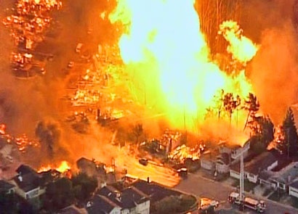
Natural gas is not safe
Future generations will be asking what we were thinking (or smoking). You allowed massive quantities of toxic chemicals to be injected into the earth, and to contaminate ungodly volumes of water, in pursuit of a highly flammable gas that would be routed through your neighborhoods and into your homes?! What were you thinking?
2010 San Bruno pipeline explosion
Notes:
Data from: (Investing in Grid Modernization, Perfect Power Institute, Feb 2013)

Slide 16
Recent gas pipeline explosions
October 9, 2018: British Columbia.
September 13, 2018: Merrimack Valley, Massachusetts. Over 80 individual fires, one person killed and 30,000 forced to evacuate.
February 17, 2017: A natural gas pipeline operated by Kinder Morgan in Refugio Texas exploded creating a massive fire. The explosion shook homes 60 miles away.
February 10, 2017: A natural gas pipeline operated by Phillips 66 Pipeline in St. Charles Parish, LA exploded, injuring 3 workers.
February 1, 2017: A DCP pipeline in Panola County TX exploded and created a crater in an airport runway, shutting down the airport for a month.
January 17, 2017: A natural gas pipeline operated by DCP Midstream exploded in Spearman, TX, which led to multiple fire crews being called to the scene.
From 2010 to 2016: Gas companies reported 35 explosions and 32 ignitions at their transmission pipelines, according to federal records. The explosion killed 17 people and injured 86.
September 9, 2010: San Bruno, California, killed eight and injured 51 people.

Slide 17

Natural gas is not resilient
Reality: Gas infrastructure is not resilient and requires 30 times longer to restore service than electricity.
Threats: Gas infrastructure is vulnerable to earthquakes, fires, and mudslides, as well as terrorism.
2010 San Bruno Pipeline Explosion
Source: The City and County of San Francisco Lifelines Study

Slide 18
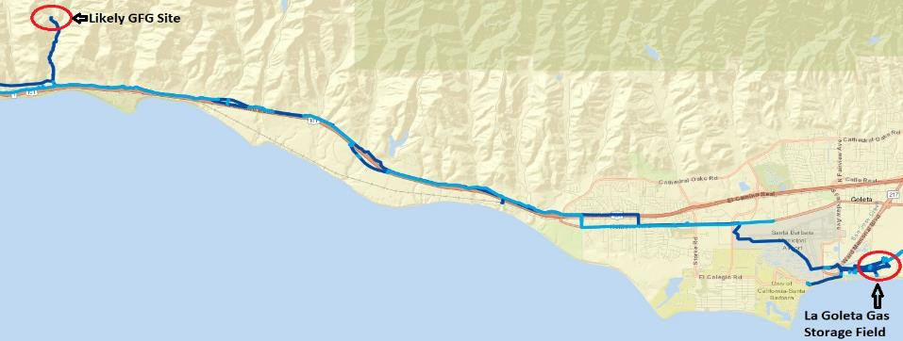
SCE is positioning to propose a gas plant in GLP
SCE statement: “Most project offers that can address resiliency are natural-gas based.”
Likely remote location: Adjacent to the Capitan Substation, which is ~15 miles northwest of the La Goleta gas storage field.

Slide 19
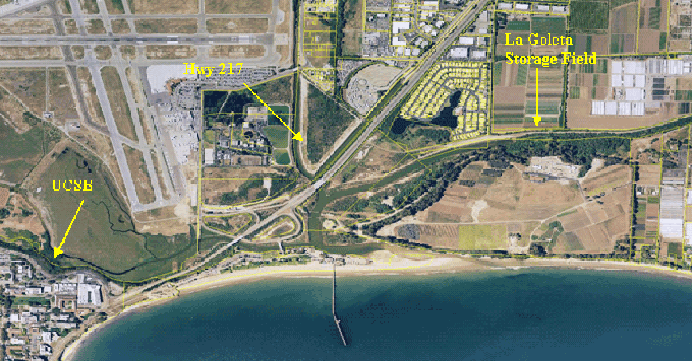
La Goleta Gas Storage Field
Converted into a gas storage reservoir in 1941, it is the oldest storage facility of four maintained by SoCalGas and is the third largest, with a maximum capacity of 21.5 billion cubic feet.
The gas field is within an anticlinal structure cut and bounded on the north by the More Ranch Fault.

