Slide 1

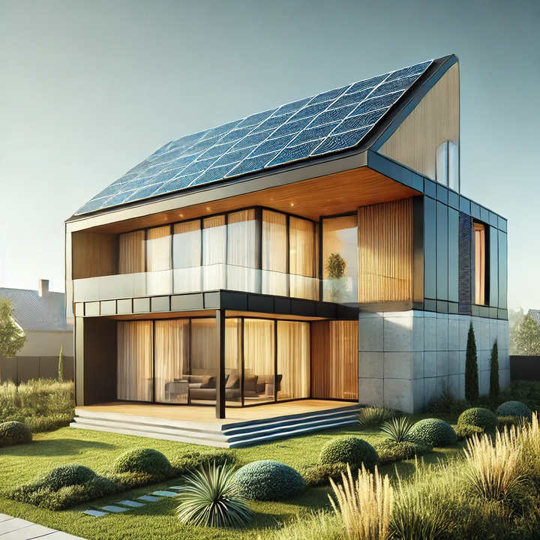
Green Rebuild Initiative
Super Green building & retrofits for an unparalleled trifecta of economic, environmental, and resilience benefits
Craig Lewis
Executive Director
Clean Coalition
650-796-2353 mobile
craig@clean-coalition.org
Santa Barbara
17 September 2026

Slide 2
Clean Coalition (nonprofit)
Mission
To accelerate the transition to renewable energy and a modern grid through
technical, policy, and project development expertise.
Renewable Energy End-Game
100% renewable energy; 25% local, interconnected within the distribution grid and ensuring resilience without dependence on the transmission grid; and 75% remote, fully dependent on the transmission grid for serving loads.
Notes:
2

Slide 3
Green Rebuild Initiative (GRI)
GRI overiview
The Green Rebuild Initiative (GRI) aims to help ensure that the homes that get rebuilt in Pacific Palisades and Altadena (and beyond) will be done in a Super Green fashion. The target audiences are property owners, architects & designers, and builders. Super Green homes are 100% electric and feature enough solar to achieve Net Zero Energy (NZE) -- and are configured with energy storage to benefit from the unparalleled resilience delivered by Solar Microgrids.
GRI website
https://clean-coalition.org/programs/green-rebuild-initiative/
Notes:
3

Slide 4
Green Rebuild Initiative
Mission:
The Green Rebuild Initiative (GRI) aims to facilitate sustainable and resilient rebuilds through “Super Green” home designs that are all-electric, Net Zero Energy (NZE), and supported by Solar Microgrids for unparalleled resilience. The GRI also encourages homes to be designed for high energy efficiency and low embedded carbon, while being engineered to withstand extreme weather events and built with non-toxic materials.
Actions:
              Educate property owners, architects, builders, policymakers, lenders, insurers, and everyone else about the superiority of Super Green homes.
              Illuminate the economic benefits of Super Green designs, including the associated tax benefits and other incentives.
              Provide easy access to specifications associated with Super Green designs.
              Share showcase Super Green home designs.
              Connect parties for Super Green outcomes, including property owners, architects, builders, and associated experts.
Notes:
4

Slide 5
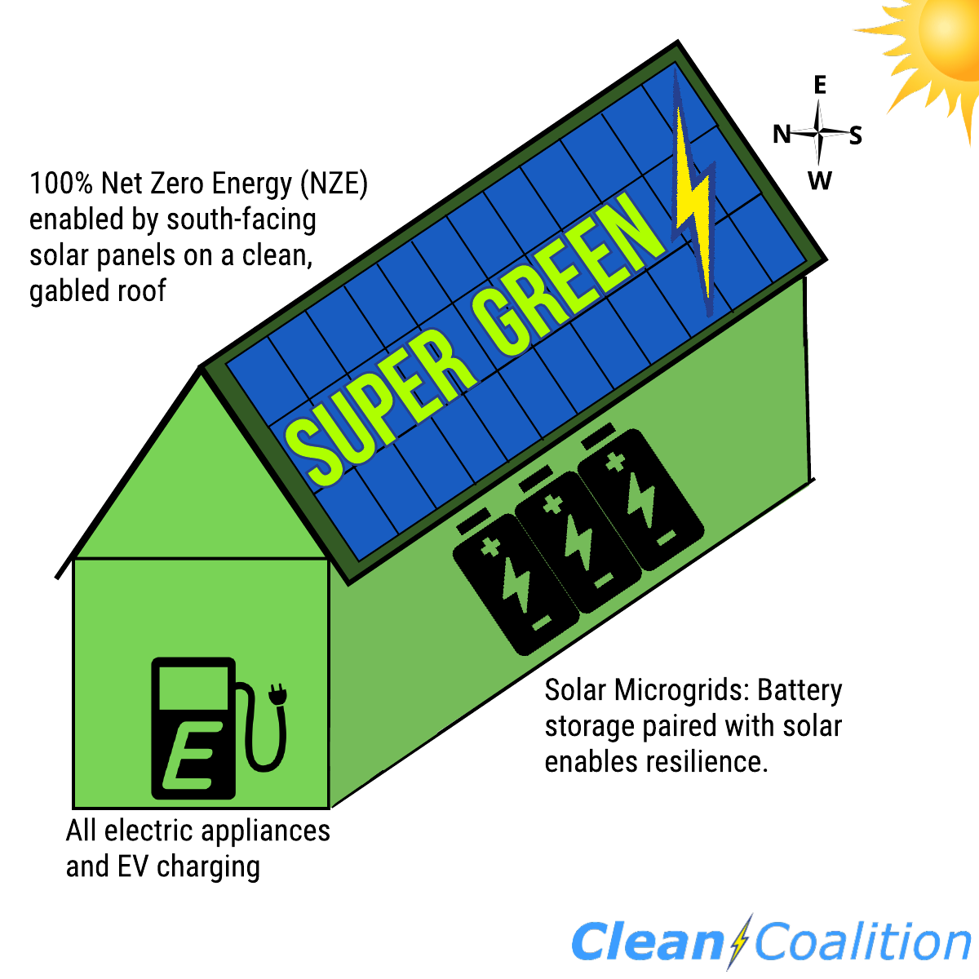
What is Super Green?
100% Electric: No gas service to the home and ideally an all-EV household.
Net Zero Energy (NZE): Onsite solar energy production at least equals the annual energy consumption across the premise, including to cover home EV charging.
Solar Microgrid: Combines a battery to the solar for economic optimization and achieving unparalleled energy resilience.

Slide 6
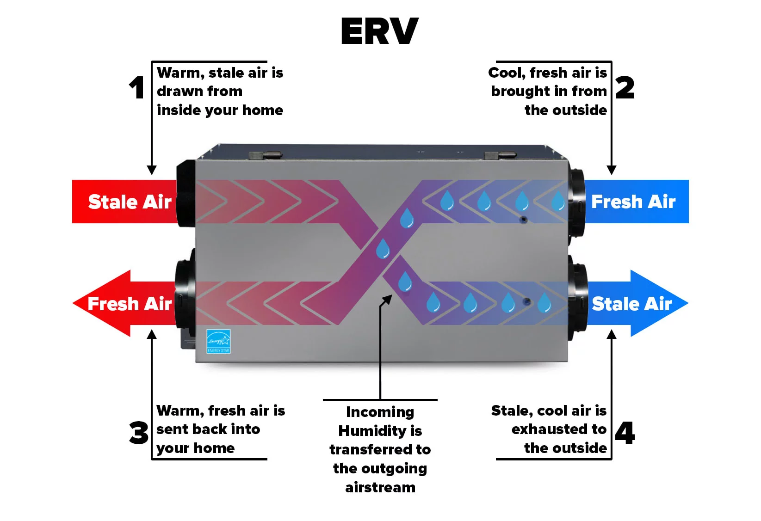
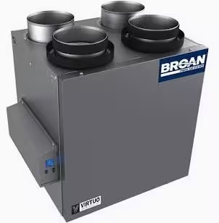
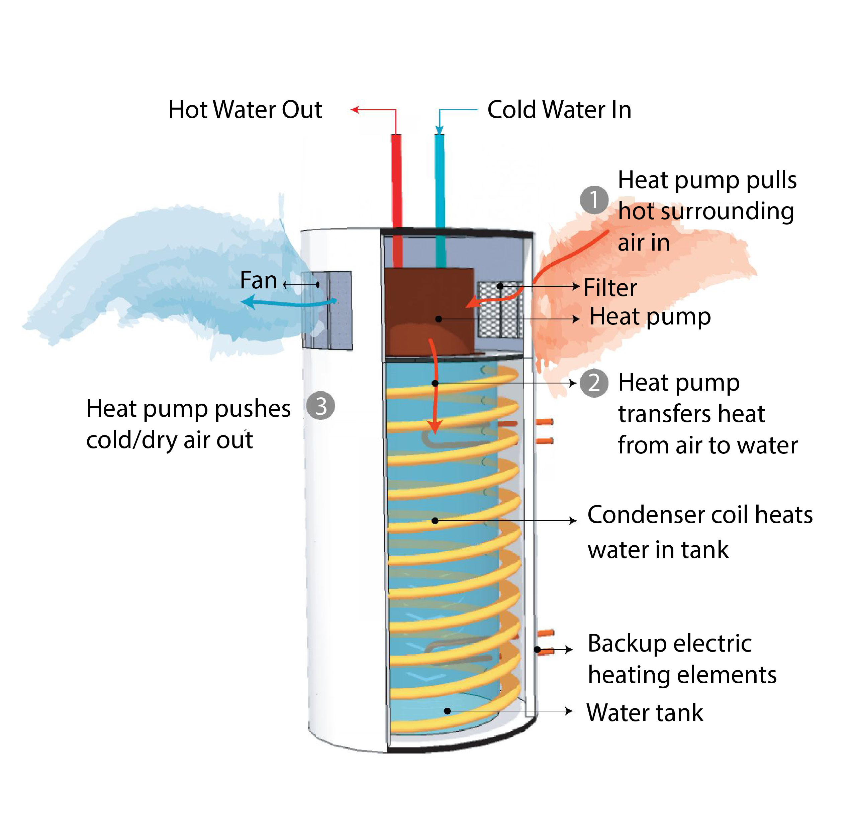
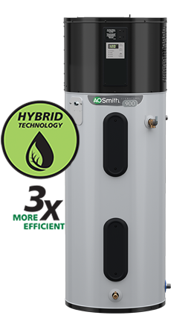
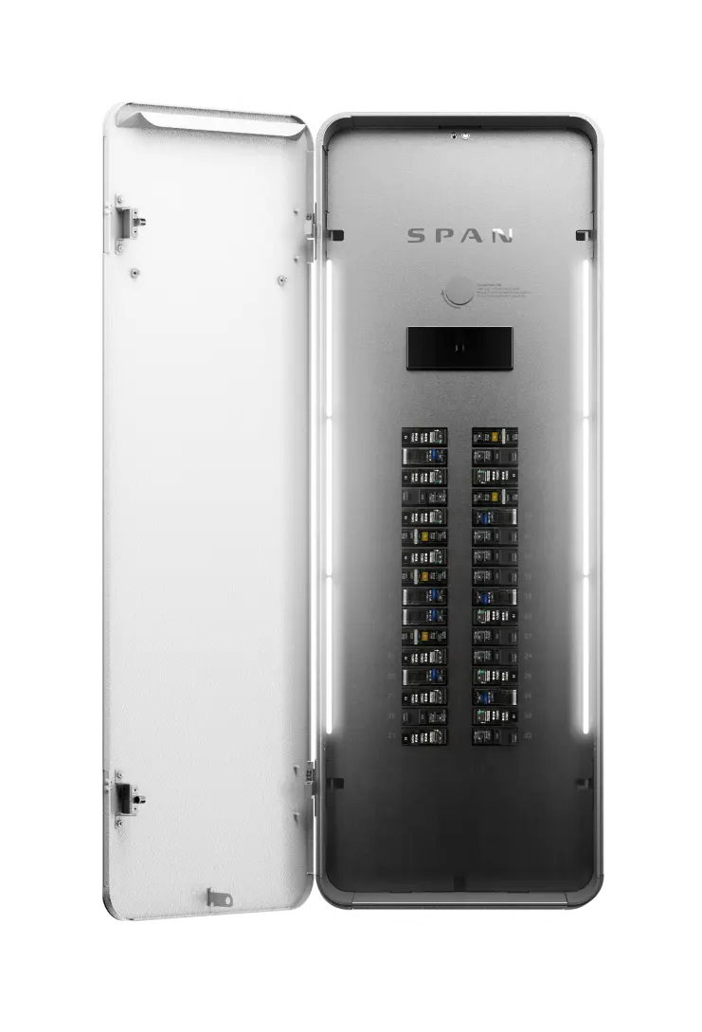
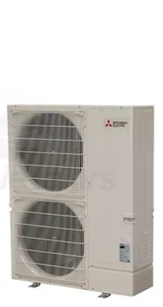

Super Green: 100% Electric
Specifications
Mechanical and Plumbing
  Heat Pump HVAC
  Heat Pump Water Heater
  ERV: Energy Recovery Ventilator
  E-Fireplace: Napoleon Alluravision 60” [Optional]
  Heat Pump Pool Water Heater [Optional]
Electrical
  LED Light Bulbs
  Occupancy/Vacancy Sensors
  Dimming Switches
  Span Panel [Optional]
Notes:
Sealed Ducting, No Flex Duct (G90 Zinc) w/ R6 Insulation
Wall and Ceiling Registers - Titus

Slide 7
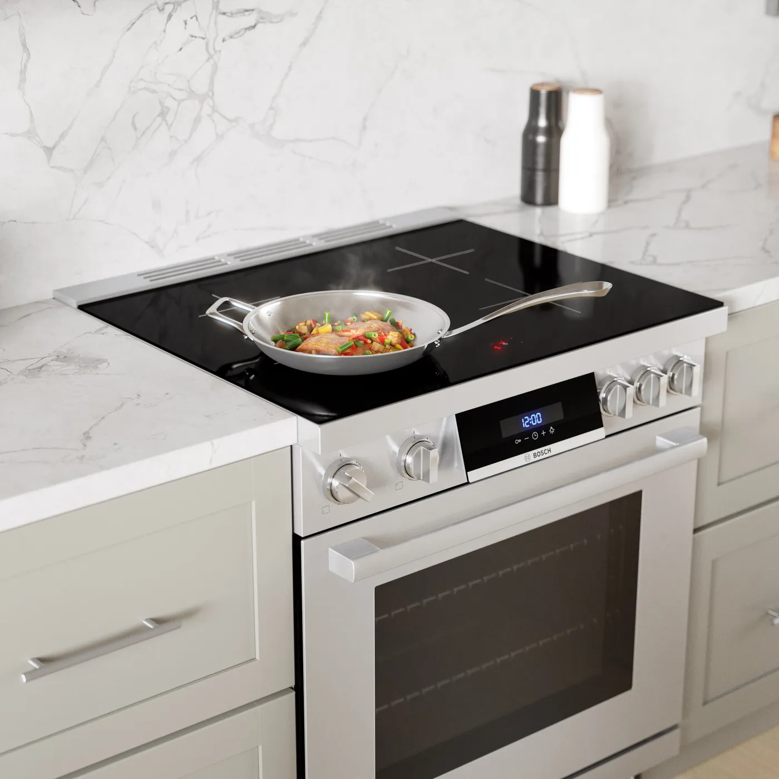


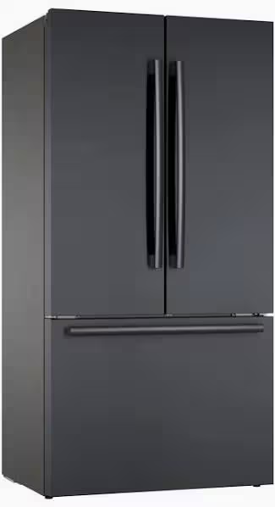
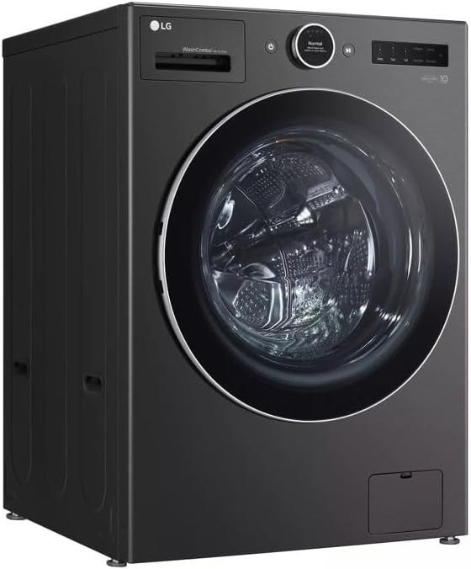
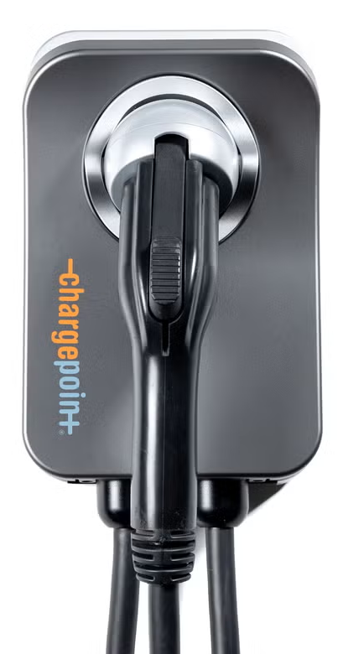
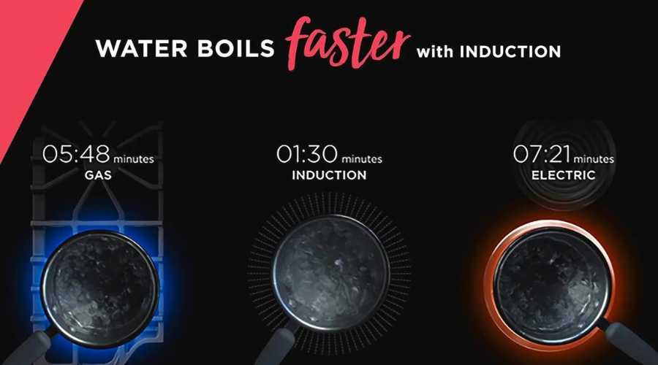
Super Green: 100% Electric
Appliances
  Induction Cooktop
  EnergyStar Refrigerator
  EnergyStar Dishwasher
  EnergyStar Washing Machine
  Energy Efficient Microwave
  Heat Pump Dryer
  EV Charging Outlet and/or Charger
  (Level 2 capable)
Energy Efficient
100% Electric
Induction Cooktops

Slide 8
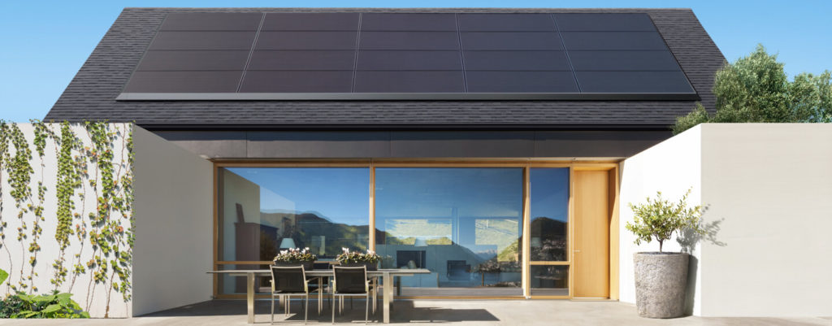
Super Green: Net Zero Energy (NZE)
NZE requires the solar to produce at least as much energy as the home consumes over the course of a year. Solar needed to achieve NZE for homes with Title 24 levels of energy efficiency and two EVs (22,000 miles of home EV charging per year):
1,500sf home requires 9.8kW of solar
(24 solar panels).
2,500sf home requires 14.8kW of solar
(36 solar panels).
California Energy Code Title 24 (Part 6) falls far short of NZE:
1,500sf home only requires 2kW
(5 solar panels)
2,500sf home only requires 3kW of solar
(7 solar panels).
Notes:
CalGreen Title 24 Building Code Compliance

Slide 9
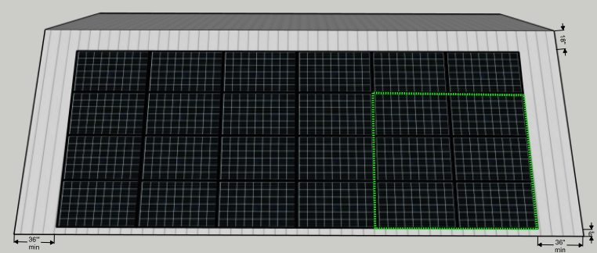
Super Green: Solar to achieve 1,500sf NZE home
Total single roof area required to achieve NZE for a 1,500 sf house is 700 sf, to accommodate 507 sf of solar (9.8 kW) plus setbacks
South-facing rooftop at a 30° pitch is ideal
6 solar panels needed to NZE one EV, assuming 12,000 miles of home charging per year
14,600 kWh per year is the estimated energy consumption for a typical 4-person household in a 1,500sf home.
A 9.8kW solar array (assuming 1,512kWh/kW-yr) is required to achieve Net Zero Energy (NZE), which includes charging two EVs
Note: an EV driving 12,000 miles per year will require 3,600kWh of energy per year to charge, which can be offset by 6 solar panels. This model also assumes there is a second EV using 10,000kWh per year.
Assumes QCELL 410W solar panels, each with dimensions of 6.2 ft x 3.4 ft (21.1 sf per panel).
24 solar panels required to achieve NZE, requiring 507 sf for the solar layout, and producing 14,808 kWh per year.
Total roof area required is 700 sf, including setbacks of 3 feet on side edges, 1.5 feet from the ridge, and 0.5 feet from the bottom edge (the bottom setback is needed to ensure proper rain drainage into a gutter).

Slide 10
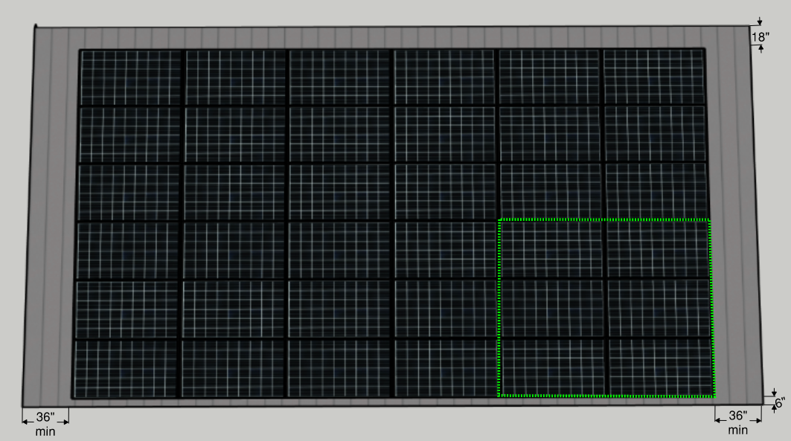
Super Green: Solar to achieve 2,500sf NZE home
Total single roof area required to achieve NZE for a 2,500 sf house is 1,000 sf, to accommodate 760 sf of solar (14.8 kW) plus setbacks
South-facing rooftop at a 30° pitch is ideal
6 solar panels needed to NZE one EV, assuming 12,000 miles of home charging per year
21,221 kWh per year is the estimated energy consumption for a typical 2,500sf 4-person household
A 14.8kW solar array (assuming 1,512kWh/kW-yr) is required to achieve Net Zero Energy (NZE), which includes charging two EVs
Note: an EV driving 12,000 miles per year will require 3,600kWh of energy per year to charge, which can be offset by 6 solar panels. This model also assumes there is a second EV using 10,000kWh per year.
Assumes QCELL 410W solar panels, each with dimensions of 6.2 ft x 3.4 ft = 21.1 square feet
36 solar panel required to achieve NZE, requiring 760 sf for the solar layout, and producing 22,223 kWh per year.
Total roof area required is 1,000 sf, including setbacks of 3 feet on side edges, 1.5 feet from the ridge, and 0.5 feet from the bottom edge (the bottom setback is needed to ensure proper rain drainage into a gutter).

Slide 11
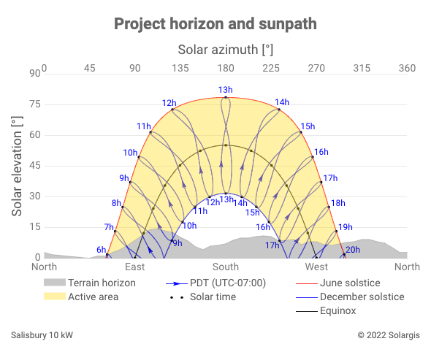
Solar should be as close to south-facing as possible

Slide 12
Value-of-Resilience (VOR) details
VOR123
VOR123 is the value-of-resilience (VOR) from Solar Microgrids methodology that the Clean Coalition has developed to normalize VOR across all types of facilities & geographies. The VOR normalization is founded in tiering loads into three categories: Tier 1 (critical), Tier 2 (priority), and Tier 3 (discretionary). Since each Tier has its own resilience requirement and VOR, this methodology is called VOR123.
VOR123 webinar
https://clean-coalition.org/news/webinar-valuing-resilience-solar-microgrids-thursday-5-nov-2020/
Notes:
12

Slide 13
Percentage of time online for Tier 1, 2, and 3 loads for a Solar Microgrid designed for the University of California Santa Barbara (UCSB) with enough solar to achieve net zero and 200 kWh of energy storage per 100 kW solar.
Typical load tier resilience from Solar Microgrids
Percentage of total load
Tier 3 = Discretionary load, ~75% of total load
Tier 2 = Priority load, ~15% of total load
Tier 1 = Critical, life-sustaining load, ~10% of total load
Percentage of time

Slide 14
A typical diesel generator is configured to maintain 25% of the normal load for two days. If diesel fuel cannot be resupplied within two days, goodbye. This is hardly a solution for increasingly necessary long-term resilience. In California, Solar Microgrids provide a vastly superior trifecta of economic, environmental, and resilience benefits.
Diesel generators are designed for limited resilience
Percentage of total load
Tier 3 = Discretionary load, ~75% of total load
Tier 2 = Priority load, ~15% of total load
Tier 1 = Critical, life-sustaining load, ~10% of total load
Percentage of time

Slide 15
Load Management is key to Solar Microgrids
SPAN Panels are king of residential Load Management
Control circuits from anywhere
Real-time on/off control over every circuit in the home from the SPAN Home App + scheduling with Amazon Alexa.
Learn from deep energy insights
360-degree view of your home’s energy from a smartphone or tablet helps you save more.
Save on energy bills
Quantify the impact of appliances on your energy bill, and make smarter decisions to save.
Set a powerful foundation
Future-proof your home for upgrades such as EV, solar, battery storage, heat pumps, induction cooktops, and more.
https://www.span.io/

Slide 16
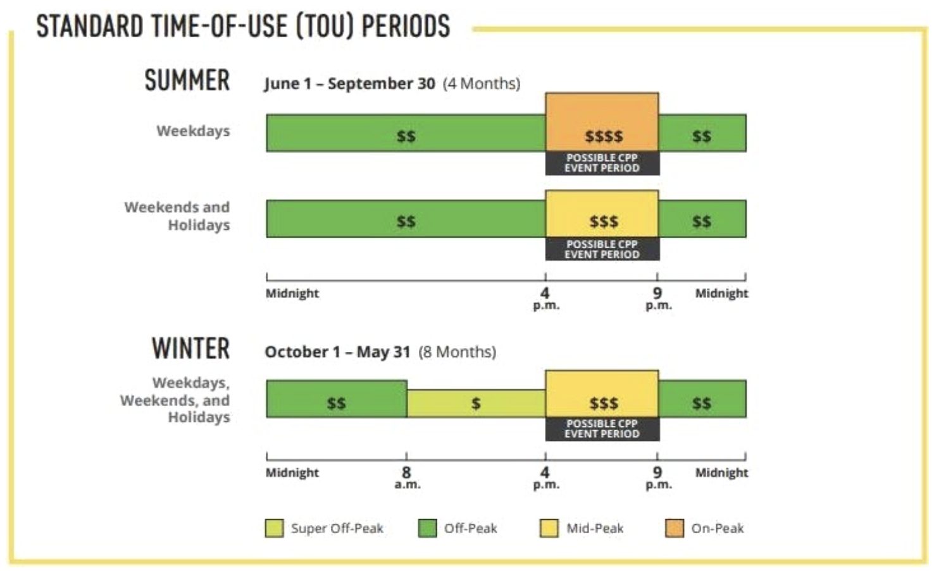
Solar Microgrids optimize daily economics
Time-shift solar for economic optimization to use during the super peak, which is increasingly in the mid-afternoon to late-night, as illuminated in this current time-of-use (TOU) rate chart from SCE:
Notes:
16

Slide 17
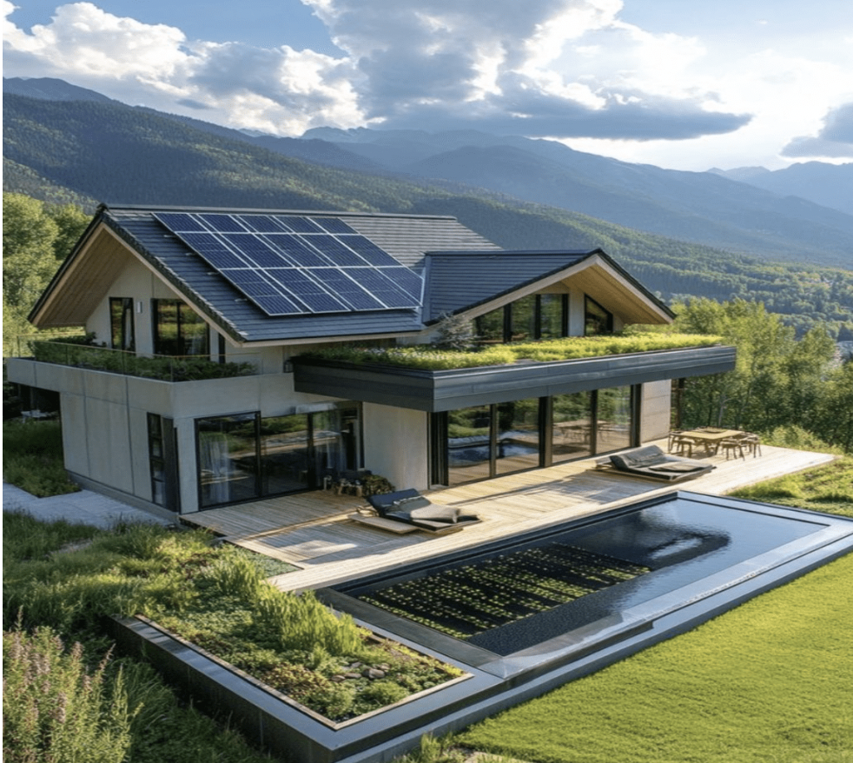
Super Green is a lucrative personal investment
Achieving Super Green for a new 2,500 sq ft home adds approximately $50,000 to construction costs, compared to standard California requirements known as Title 24.
Even without any tax benefits or other incentives, the investment in SCE territory yields a 10% annual, tax-free, risk-free return through reduced energy bills.
This return is comparable to a long-term certificate of deposit (CD) offering a 15% annual percentage rate (APR), which is taxable. Hence, lucrative for mortgage rates up to 15%.
Notes:
17

Slide 18
Super Green showcase for new construction & retrofit
Super Green showcase for new construction and retrofit of 1920-vintage house at
1221 Laguna St in Santa Barbara

Slide 19
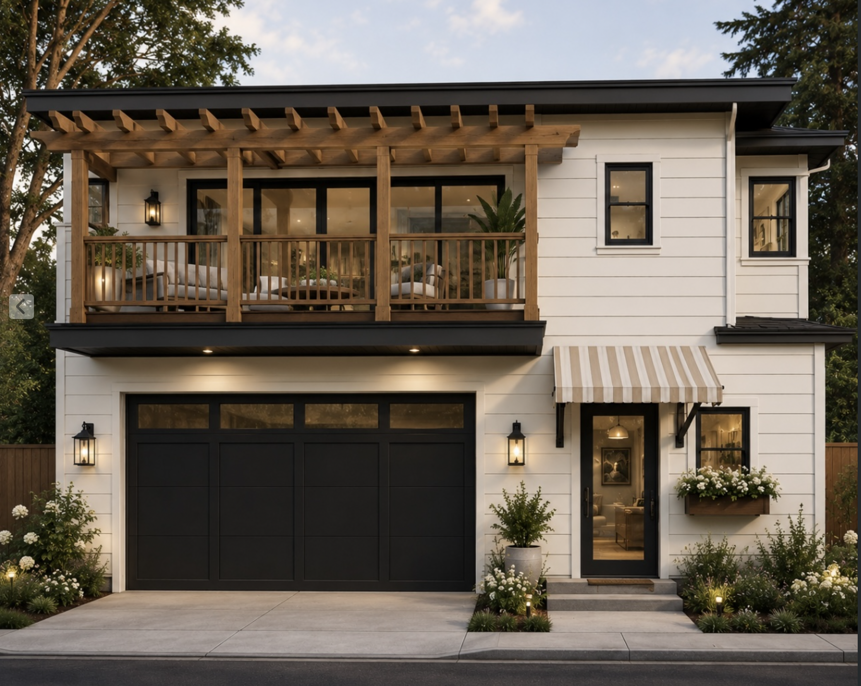
New construction: ADU-over-garage

Slide 20
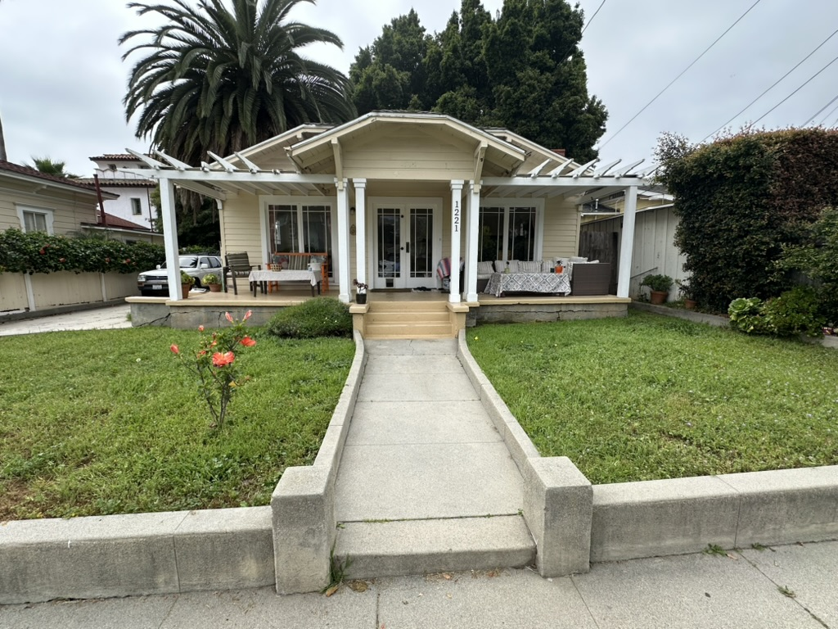
Retrofit: 1920s-vintage house

Slide 21
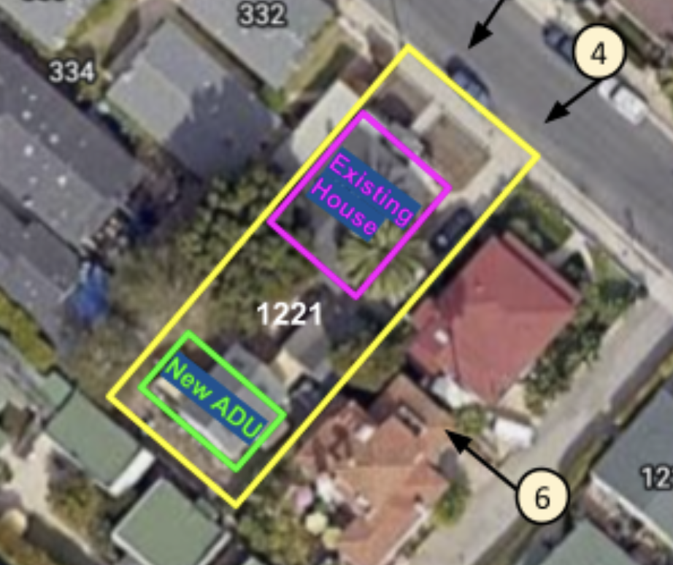
Planned site layout of 1221 Laguna St

Slide 22
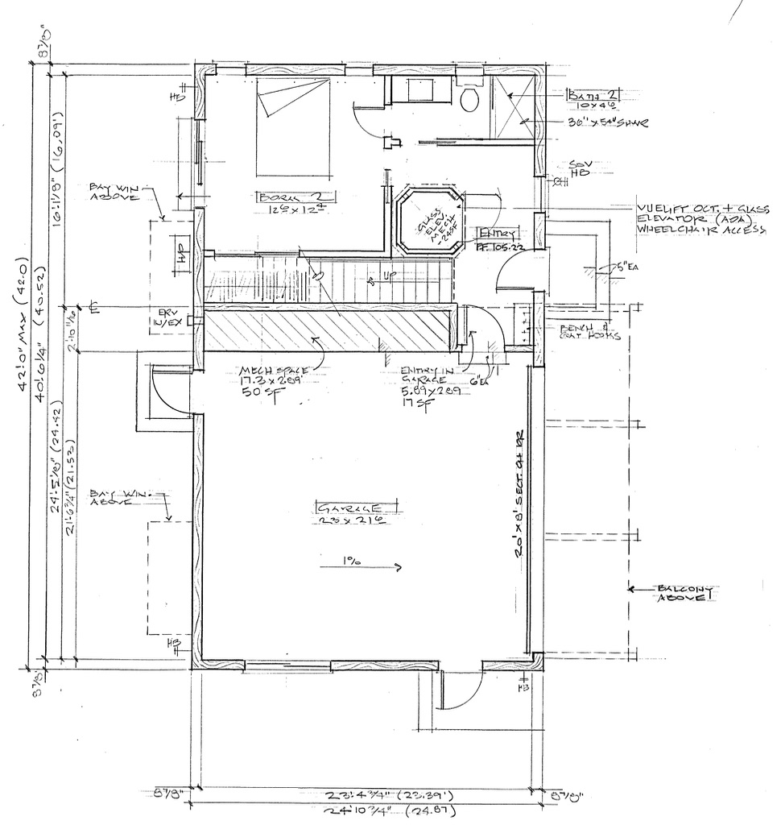
1st floor Schematic Design of ADU-over-garage

Slide 23
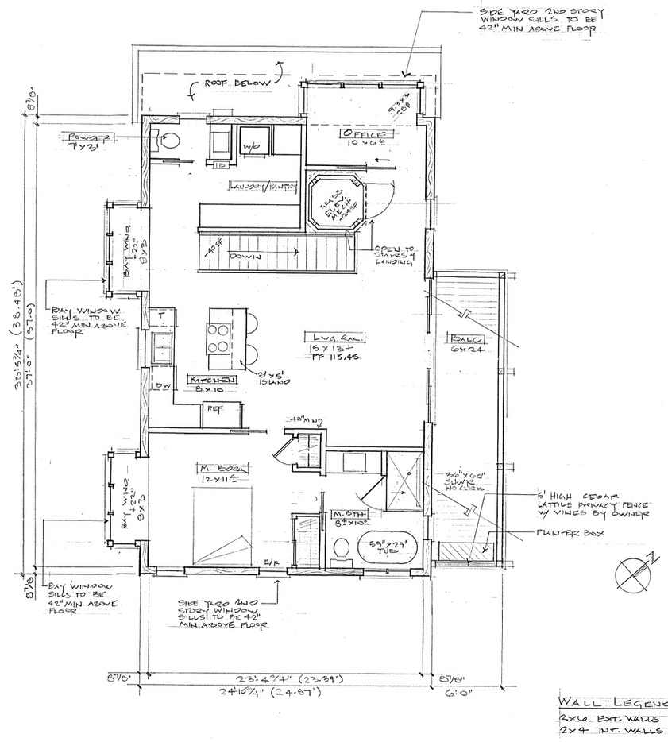
2nd floor Schematic Design of ADU-over-garage

Slide 24
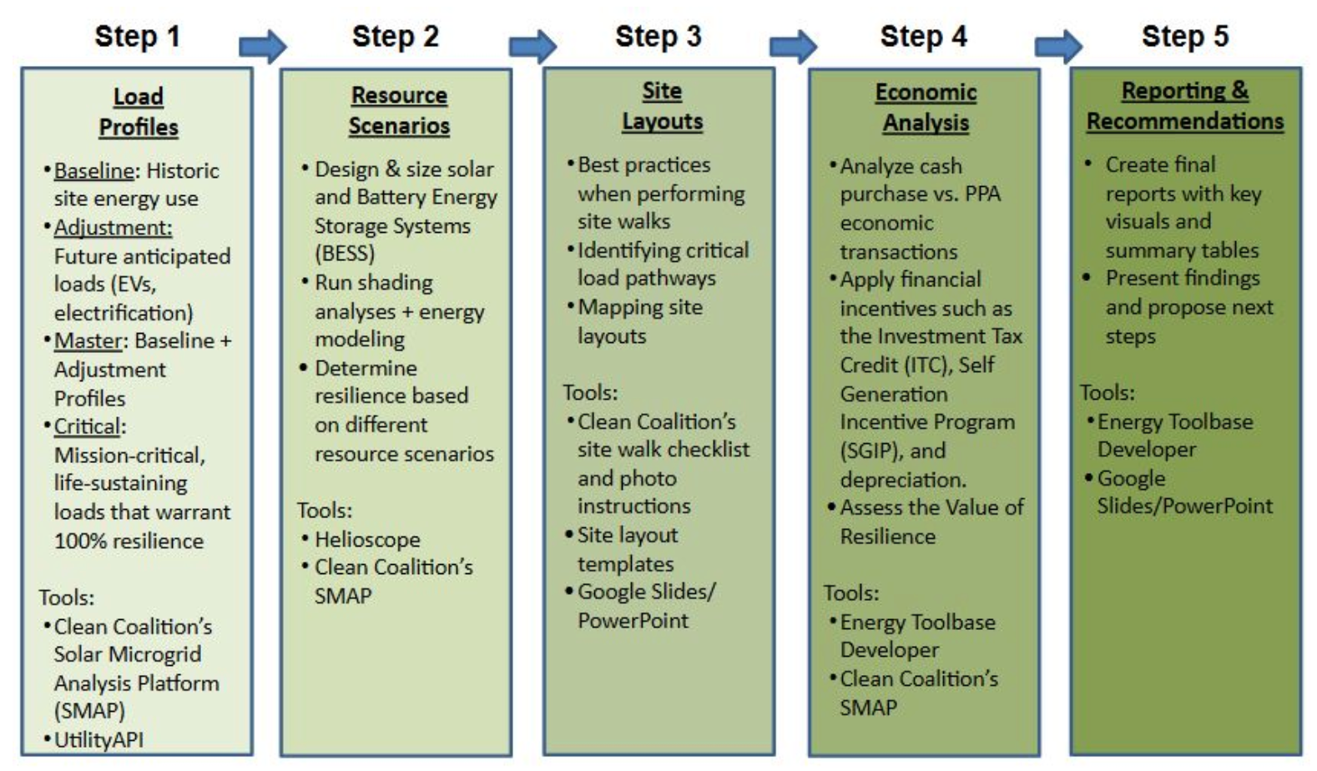
Solar Microgrid Methodology (SMM)

Slide 25
Load profile types
Load Type | Definition
Baseline load profile | The historical annual usage of electrical loads per site that forms the basis for creating the master load profile.
Adjustments load profile | Adjustments for anticipated EV Charging Infrastructure (EVCI), electrification, energy efficiency, and new facilities.
Master load profile | The forecasted annual load profile used for this study’s analysis, created from the baseline load profile plus adjustments for anticipated EV Charging Infrastructure (EVCI), electrification, energy efficiency, and new facilities.
Critical load profile | Annual load profile of the critical loads.
Critical loads | Electrical loads that are necessary to be provided with 100% energy resilience during grid outages

Slide 26
Load profiles used in this study
Baseline Load Profile (BLP): The utility data available for 1221 Laguna Street was obtained from the previous owners and spans from 2/11/2025 to 3/15/2026 in 1-hour intervals. For cleanliness, the data used for these profiles was chosen to start in March 2025 and go through the end of February 2026. This data was formatted to fit a typical calendar year, so all analyses and visuals will start in January but keep in mind the first two month’s data is from 2026. Only the electricity usage is included in the BLP.
Adjustments Load Profile (ALP): The gas usage data was also obtained from the previous owners and makes up the ALP for this study. SoCal Gas provides usage in US therms, which was converted to kWh using 29.3 kWh/US therm. Finally, this usage was divided by 3 to account for improved efficiency of new electric appliances compared to their gas counterparts.
Master Load Profile (MLP): The load profile used to analyze the economics and resilience of a Solar Microgrid at this site. This load profile is the combination of the BLP and ALP at every 1-hour interval.
Critical Load Profile (CLP): The CLP is assumed to be 10% of the Master Load Profile.

Slide 27
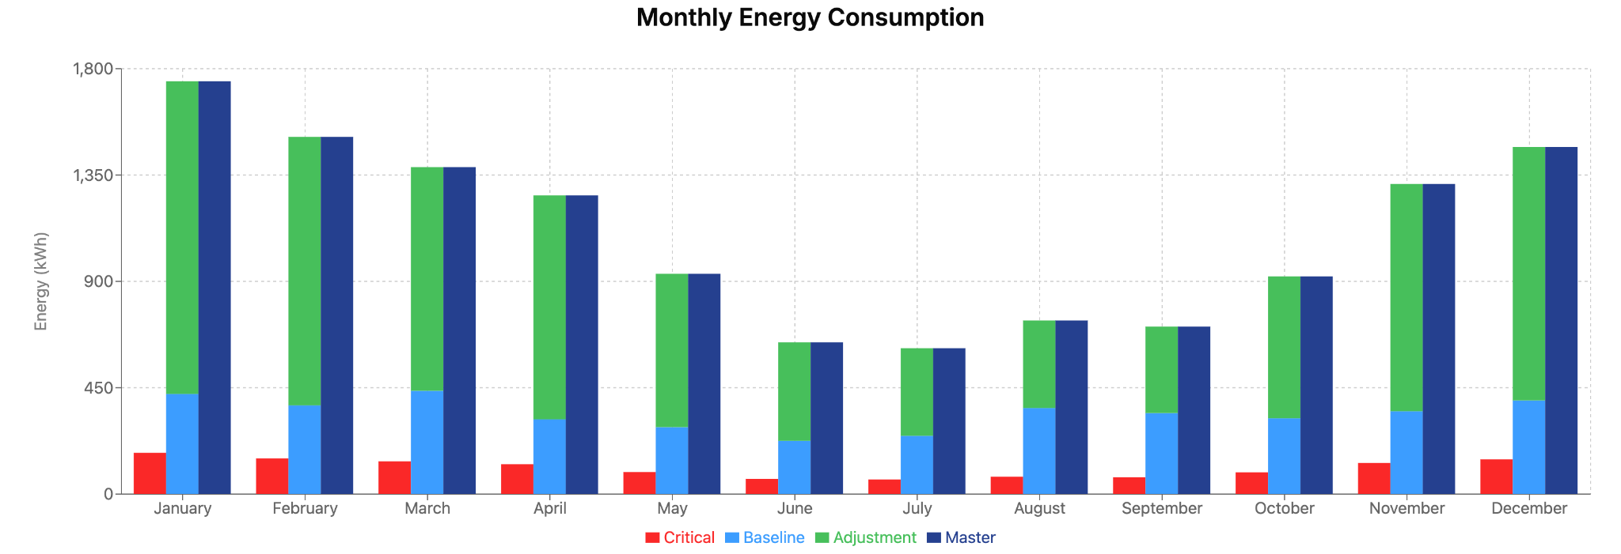
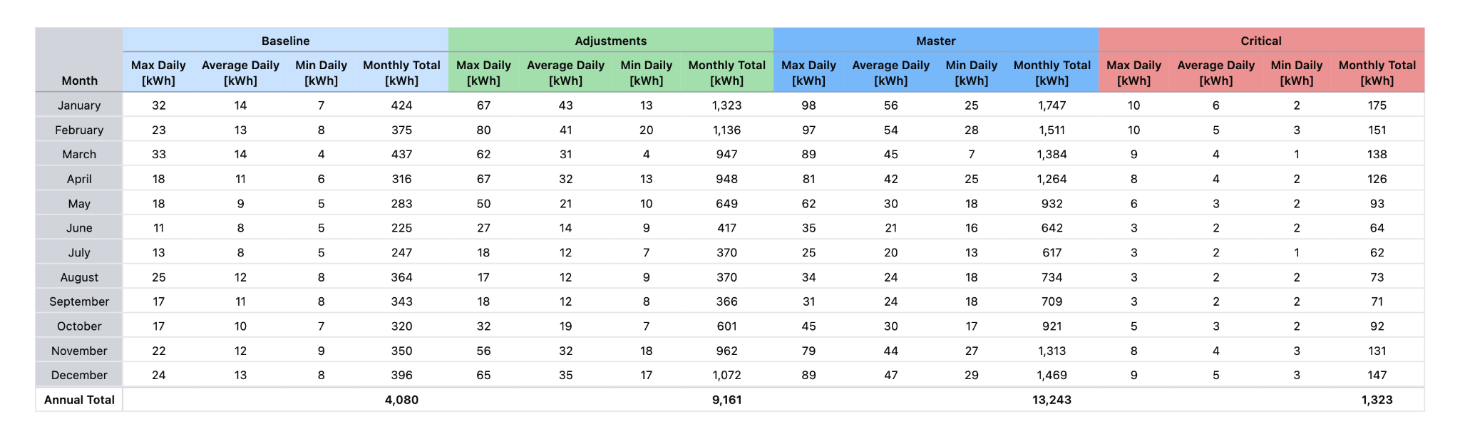
Load profile energy summary
Daily Max, Average, Min and Monthly Total Electricity Usage by Profile Type

Slide 28
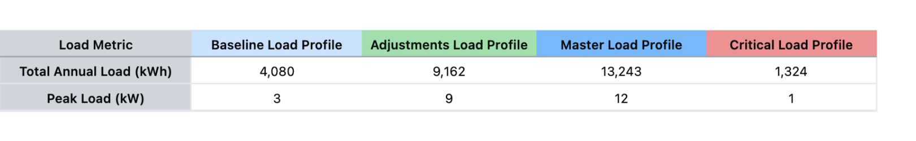
Load profile demand summary

Slide 29
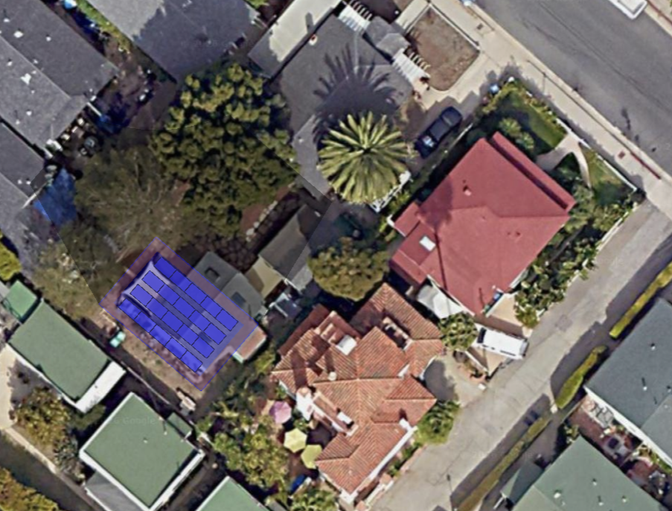
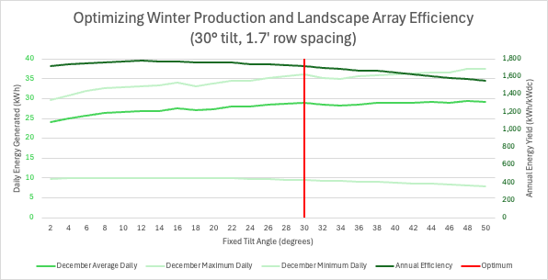
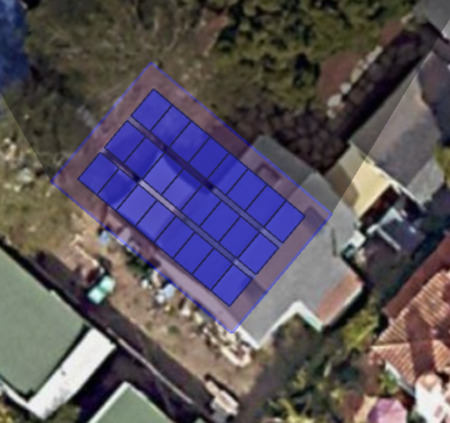
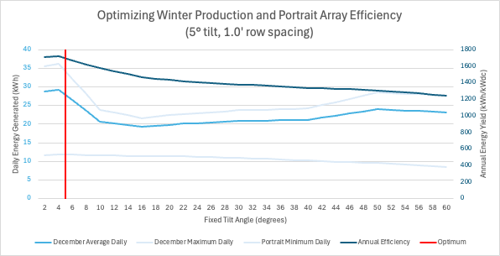
Varying the angle of tilt to optimize winter solar production for landscape and portrait in a given area

Slide 30
Modeling 5 solar microgrid scenarios
The dimensions of the rooftop for siting solar resources is 38 feet by 25 feet. It is assumed that 3 foot setbacks will be required on all sides, making the usable space 32’x19’. Within this space, both residential and commercial solar module options were considered. However for a full array of commercial modules, 32.5’ of usable width is required, so ideally the setback on one side can be reduced by 6”. Scenarios #3, #4, and #5 are included in backup.
Scenario #1: Residential panels used are REC Solar, REC470AA Pure-RX (470W) in 3 rows of 5 panels each in landscape orientation.
Scenario #2: Residential panels used are REC Solar, REC470AA Pure-RX (470W) in 2 rows of 10 panels each, stacked in landscape orientation.
Scenario #3: In back-up- Commercial panels used are Q Cells, Q.PEAK DUO XL-G11S.3 / BFG 590 (590W) in 3 rows of 4 panels each in landscape orientation.
Scenario #4: In back-up- Commercial panels used are Q Cells, Q.PEAK DUO XL-G11S.3 / BFG 590 (590W) in 2 rows of 8 panels each in landscape orientation.
Scenario #5: In back-up- Residential panels used are REC Solar, REC470AA Pure-RX (470W) in 4 rows of 5 panels each in landscape orientation, first row is an overhang.

Slide 31
BESS sizing and resilience
BESS Sizing
Scenario | MLP Peak Load (kW) | Solar System Size (kWdc) | Year 1 Standard Option BESS Power Charge/Discharge Capacity (kW) | Year 1 Standard Option BESS Energy Capacity (kWh) | Year 15 Standard Option BESS Energy Capacity (kWh)
#6: Tight rows landscape | 12 | 9.4 | 23 | 27 | 17.6
#7: Tight rows portrait | 12 | 11.3 | 23 | 27 | 17.6
#8: South panels portrait | 12 | 9.9 | 23 | 27 | 17.6
#9: North panels portrait | 12 | 9.9 | 23 | 27 | 17.6
Worst-case Solar Microgrid resilience results at year-15 (after 15 years of 0.5% solar & 3% BESS degradation)
Scenario #6: Tight rows landscape
  MLP worst case resilience duration: 4.25 hours
  MLP percentage of indefinite resilience: 13%
Scenario #7: Tight rows portrait
  MLP worst case resilience duration: 4.25 hours
  MLP percentage of indefinite resilience: 15%
Scenario #8: South panels portrait
  MLP worst case resilience duration: 4.25 hours
  MLP percentage of indefinite resilience: 14%
Scenario #6: North panels portrait
  MLP worst case resilience duration: 4.25 hours
  MLP percentage of indefinite resilience: 14%

Slide 32
Project resources
Scenario #6 tight rows landscape project resources (Year 1)
Solar PV: 9.4 kWdc via 20x REC Solar, REC470AA Pure-RX (470W) modules
  Racking: fixed tilt
  Orientation: landscape
  Tilt: 30 degrees
  Azimuth: 220.7 degrees
Inverters: 23 kW via 2x Tesla Powerwall 3s
Battery Energy Storage System: 23 kW / 27 kWh via 2x Tesla Powerwall 3s
Scenario #7 tight rows portrait project resources (Year 1)
Solar PV: 11.3 kWdc via 24x REC Solar, REC470AA Pure-RX (470W) modules
  Racking: fixed tilt
  Orientation: portrait
  Tilt: 5 degrees
  Azimuth: 220.7 degrees
Inverters: 23 kW via 2x Tesla Powerwall 3s
Battery Energy Storage System: 23 kW / 27 kWh via 2x Tesla Powerwall 3s
Scenario #8&9 south panels portrait and north panels portrait project resources (Year 1)
Solar PV: 9.9 kWdc via 21x REC Solar, REC470AA Pure-RX (470W) modules
  Racking: fixed tilt
  Orientation: portrait
  Tilt: 5 degrees
  Azimuth: 220.7 degrees
Inverters: 23 kW via 2x Tesla Powerwall 3s
Battery Energy Storage System: 23 kW / 27 kWh via 2x Tesla Powerwall 3s

Slide 33

Scenario #6 tight rows landscape: 9.4 kWdc (122% NZE)
1221 Laguna St, Santa Barbara, CA 93101
Total annual load:
BLP: 4,080 kWh
ALP: 9,161 kWh
MLP: 13,243 kWh
CLP: 1,323 kWh (10% of MLP)
Peak Load (Meter# 6685926):
BLP: 3 kW
ALP: 9 kW
MLP: 12 kW
CLP: 1 kW (10% of MLP)
Solar system details (9.4kWdc)
Area: 38’ wide by 25’ deep
Setback: 3’
Module: REC Solar, REC470AA Pure-RX (470W)
Row spacing: 1.7’
Azimuth: 220.7°
Tilt: 30°
Back edge height: 2.1’
Solar annual generation (9.4 kWdc)
Year 1 total: 16,121 kWh
Average daily production in worst month (Dec Y1): 29 kWh
Inverters and Battery Storage Sizing:
Year 1: 23 kW / 27 kWh (via 2x Tesla Powerwall 3s)
Potential BESS location
New BTM solar

Slide 34
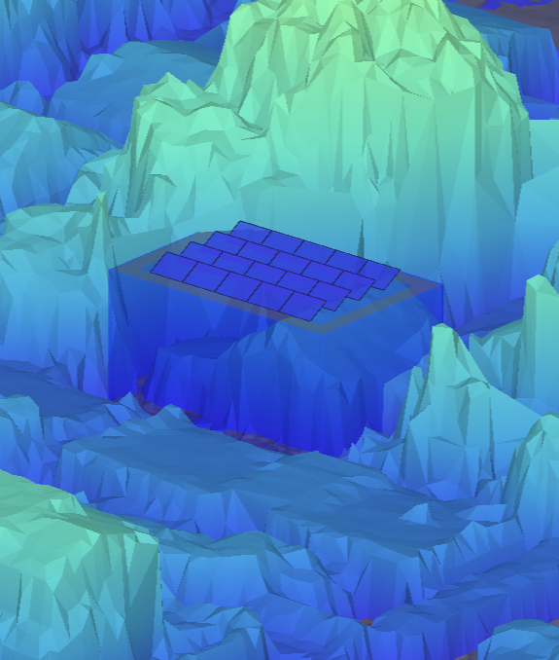

Scenario #6 tight rows landscape: 9.4 kWdc (122% NZE)
2.1’
30°
3.0’ setback from all roof edges
1.7’
repeated row spacing
25’
Side view from Southeast
Lidar view from South

Slide 35
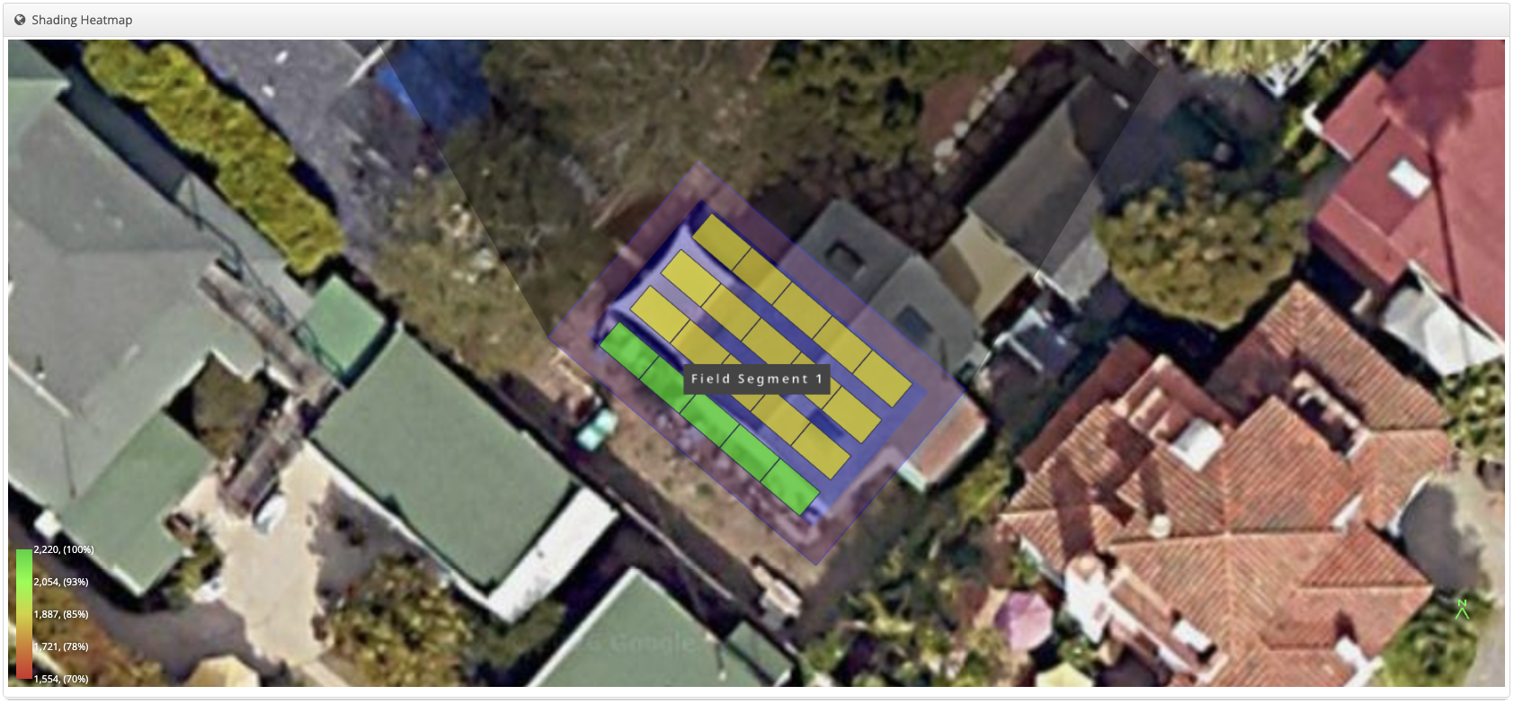
Scenario #6 tight rows landscape: 9.4 kWdc (122% NZE)

Slide 36
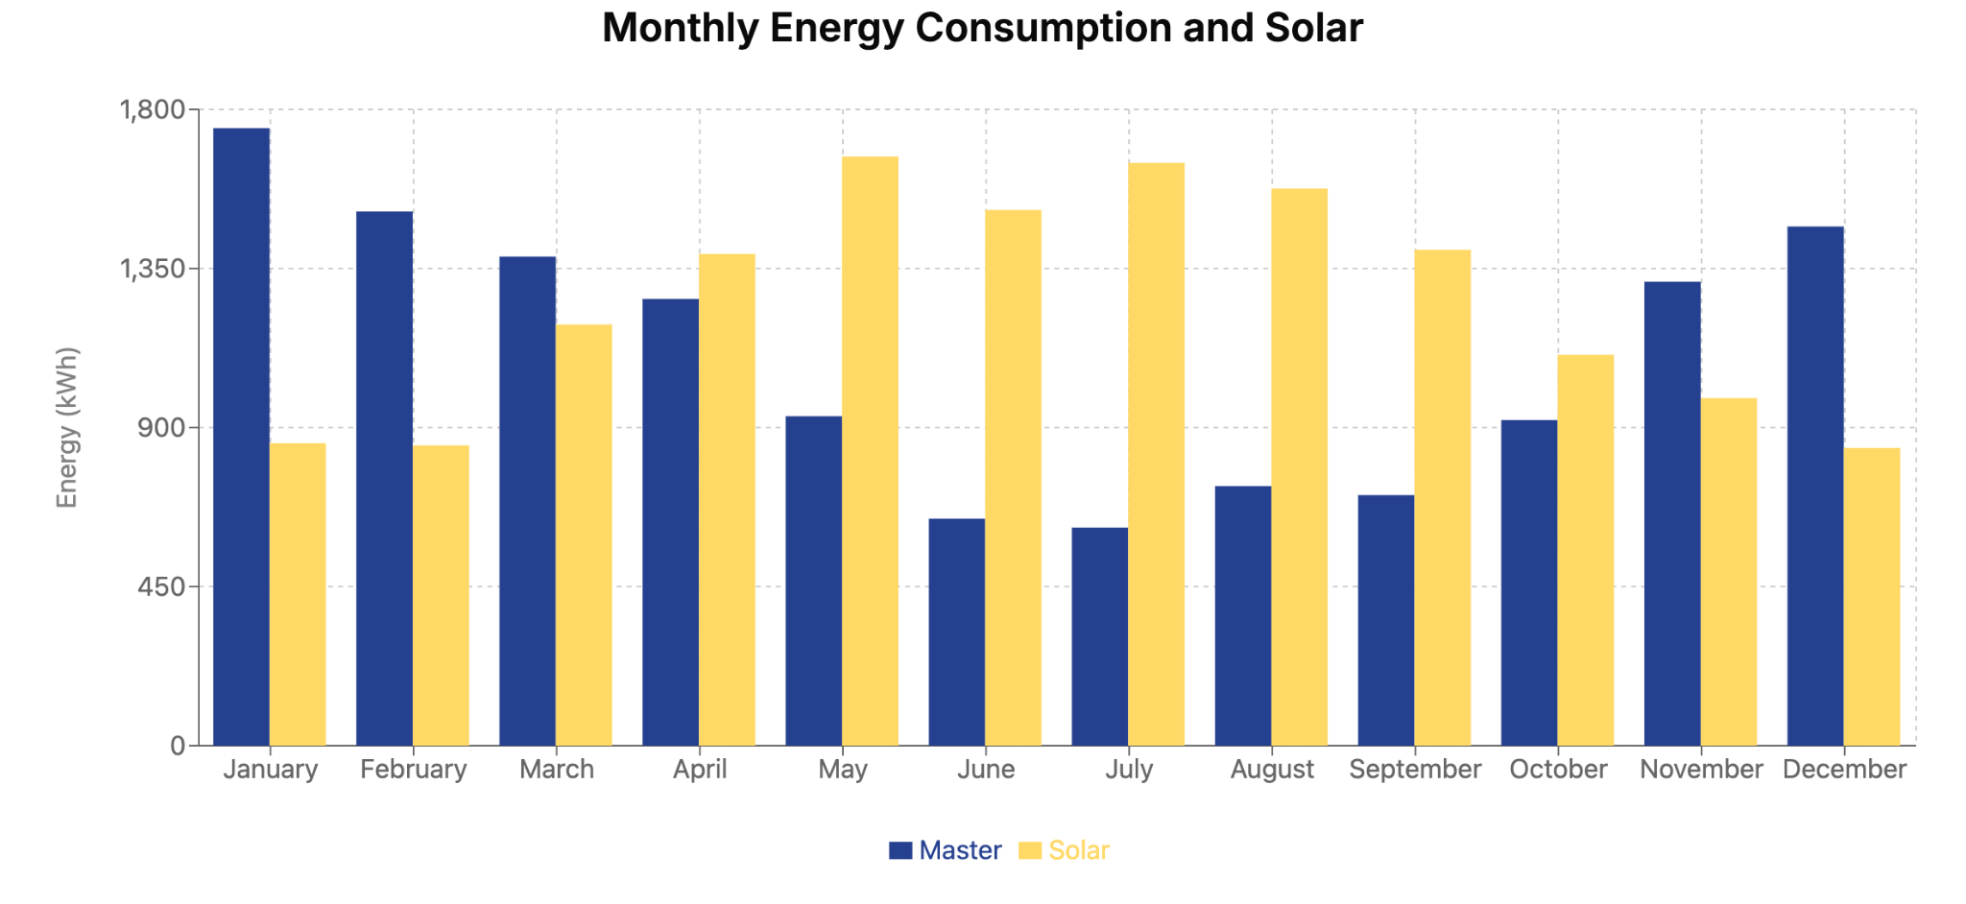
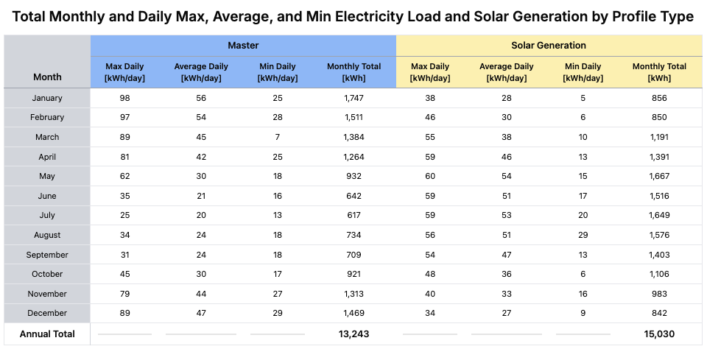
MLP and Scenario #6 tight rows landscape (year 15) - 9.4 kWdc

Slide 37
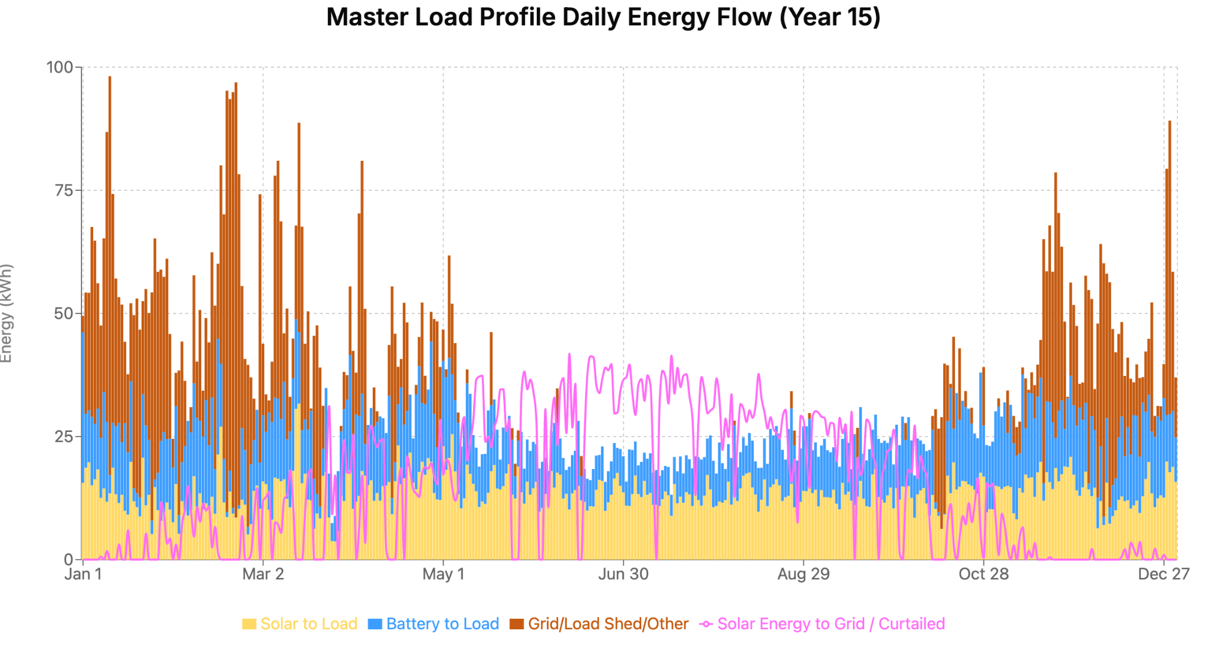
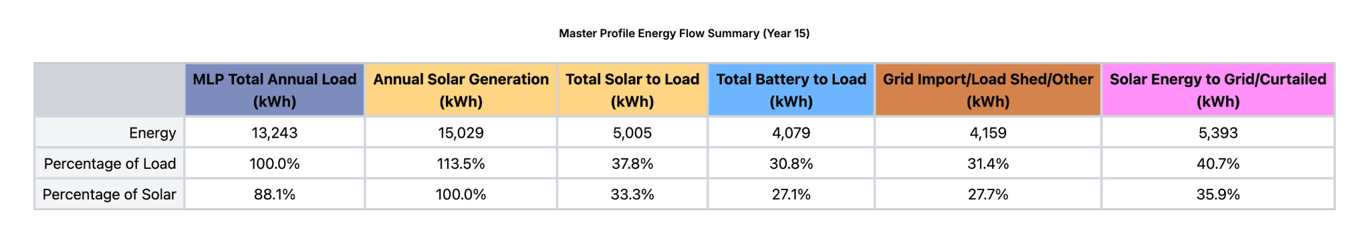
Energy Flow Diagram: Scenario #6 tight rows landscape (year 15)

Slide 38
Building Information Modeling (BIM) expert needed

