Slide 1
Grid saturation lessons from Australia and Hawaii
Steve Thrall
Director of Development (NA)
Planet Ark Power
780-499-1264 mobile
steve@planetarkpower.com
Ben Schwartz
Policy Associate
Clean Coalition
626-232-7573 mobile
ben@clean-coalition.org
12 May 2020

Slide 2
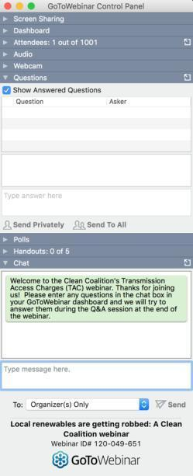
GoToWebinar FAQ
Webinar recording and slides will be sent to registered attendees within two business days.
All webinars are archived on clean-coalition.org and the Clean Coalition’s YouTube channel.
Submit questions in the Questions window at any time (window view varies by operating system and browser).
Questions will be answered during the Q&A portion of the webinar.
Contact Josh for webinar questions: josh@clean-coalition.org.

Slide 3
Presenters
Steve Thrall
Director of Development – North America
Planet Ark Power
After first working with Planet Ark Power in their Australia office, Steve has returned to his home country of Canada to lead Planet Ark Power’s global expansion into the North America clean energy market using their game-changing technology, eleXsys™, an AI and IoT-based solution that transforms the electricity grid into a true two-way grid. Steve has been involved in the energy sector for several years, first beginning with investment banking and the execution of oil and gas acquisitions before applying his knowledge and skillset to the renewable energy industry. He seeks to become an expert in his field and to help Planet Ark Power succeed in decarbonizing the electricity sector to create a clean energy world.

Slide 4
Presenters
Ben Schwartz
Policy Associate
Clean Coalition
Ben focuses primarily on representing the Clean Coalition in proceedings at the California Public Utilities Commission on microgrids and net energy metering. Ben is a fourth-year student at UCSB and uses his background in Environmental Studies and History of Public Policy to inform the diverse local, state, and national policy work he does at the Clean Coalition. In addition to working with the Clean Coalition, he is passionate about helping humanity solve the three greatest crises that exist today: climate change, water scarcity, and the lack of clean energy. Ben also works with the nonprofit the World Business Academy as producer for the New Business Paradigms podcast and joined the writing staff for the Academy’s Solutions News Radio Show as an assistant producer when the radio show began in January 2019.

Slide 5
Webinar agenda
Clean Coalition’s mission and the Goleta Load Pocket Community Microgrid (GLPCM)
Overview of Planet Ark Power and eleXsys®
Australia: Lessons from the leader in rooftop solar
Hawaii: Policy evolution required to accommodate high saturations of rooftop solar+storage
California: What can be learned from Australia & Hawaii

Slide 6
Clean Coalition (nonprofit)
Mission
The Clean Coalition is a nonprofit organization whose mission is to accelerate the transition to renewable energy and a modern grid through
technical, policy, and project development expertise.
Renewable energy end-game
100% renewable energy; 25% local, interconnected within the distribution grid and ensuring resilience without dependence on the transmission grid; 75% remote, fully dependent on the transmission grid for serving loads.
Notes:
6

Slide 7
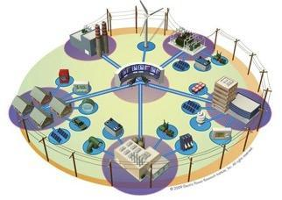
Community Microgrids are the grid of the future
A Community Microgrid is a new approach for designing and operating the electric grid, stacked with local renewables and staged for resilience.
Key features:
A targeted and coordinated distribution grid area served by one or more substations – ultimately including a transmission-distribution substation that sets the stage for Distribution System Operator (DSO) performance.
Ability to utilize existing distribution grid infrastructure to serve the Community Microgrid during broader grid outages.
High penetrations of local renewables and other distributed energy resources (DER) such as energy storage and demand response.
Staged capability for indefinite renewables-driven backup power for critical community facilities across the grid area – achieved by 25% local renewables mix.
A solution that can be readily extended throughout a utility service territory – and replicated into any utility service territory around the world.
Solar Microgrids at individual facilities are the building blocks for Community Microgrids.

Slide 8
Goleta Load Pocket (GLP) Community Microgrid
The GLP is the perfect opportunity for a comprehensive Community Microgrid
GLP spans 70 miles of California coastline, from Point Conception to Lake Casitas, encompassing the cities of Goleta, Santa Barbara (including Montecito), and Carpinteria.
GLP is highly transmission-vulnerable and disaster-prone (fire, landslide, earthquake).
200 megawatts (MW) of solar and 400 megawatt-hours (MWh) of energy storage will provide 100% protection to GLP against a complete transmission outage (“N-2 event”).
200 MW of solar is equivalent to only about 5 times the amount of solar currently deployed in the GLP and represents about 25% of the energy mix.
Multi-GW of solar siting opportunity exists on commercial-scale built environments like parking lots, parking structures, and rooftops; 200 MW represents only about 7% of the technical siting potential.
Other resources like energy efficiency, demand response, and offshore wind can significantly reduce solar+storage requirements.

Slide 9
Planet Ark Power
Planet Ark Power is an Australia-based technology and engineering company that is accelerating global decarbonization with AI-based software coupled with an IoT device (SiC).
Planet Ark Power has developed eleXsys®, an advanced power electronics device with a suite of artificial intelligence (AI) applications enabling next-generation
two-way smart grids.
Notes:
9

Slide 10
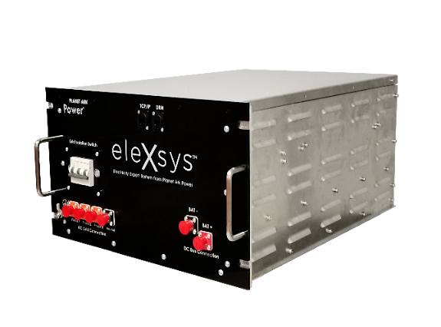
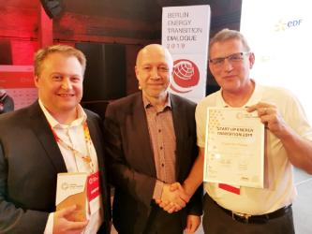
eleXsys®
This award-winning technology platform manages stability and resilience of distributed generation and unlocks the full potential of electricity networks to integrated distributed solar+storage
Recognized as a global energy transition pioneer by the World Energy Council & German Energy Agency
Notes:
10

Slide 11
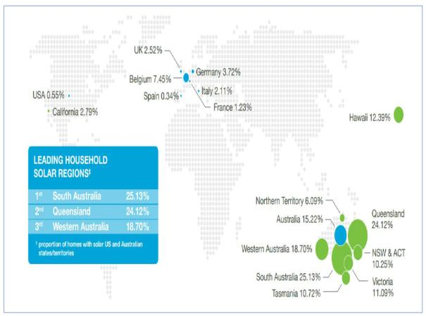
Australia — the global leader in rooftop solar
Australia was the first place in the world to experience the problems caused by high saturations of rooftop solar
Australia is global #1 for residential rooftop solar penetration per capita
2x more than Hawaii
8x more than Germany
10x more than California
Notes:
11

Slide 12
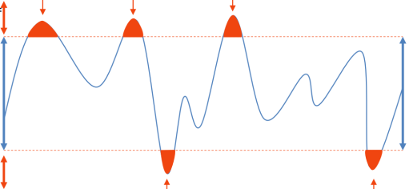
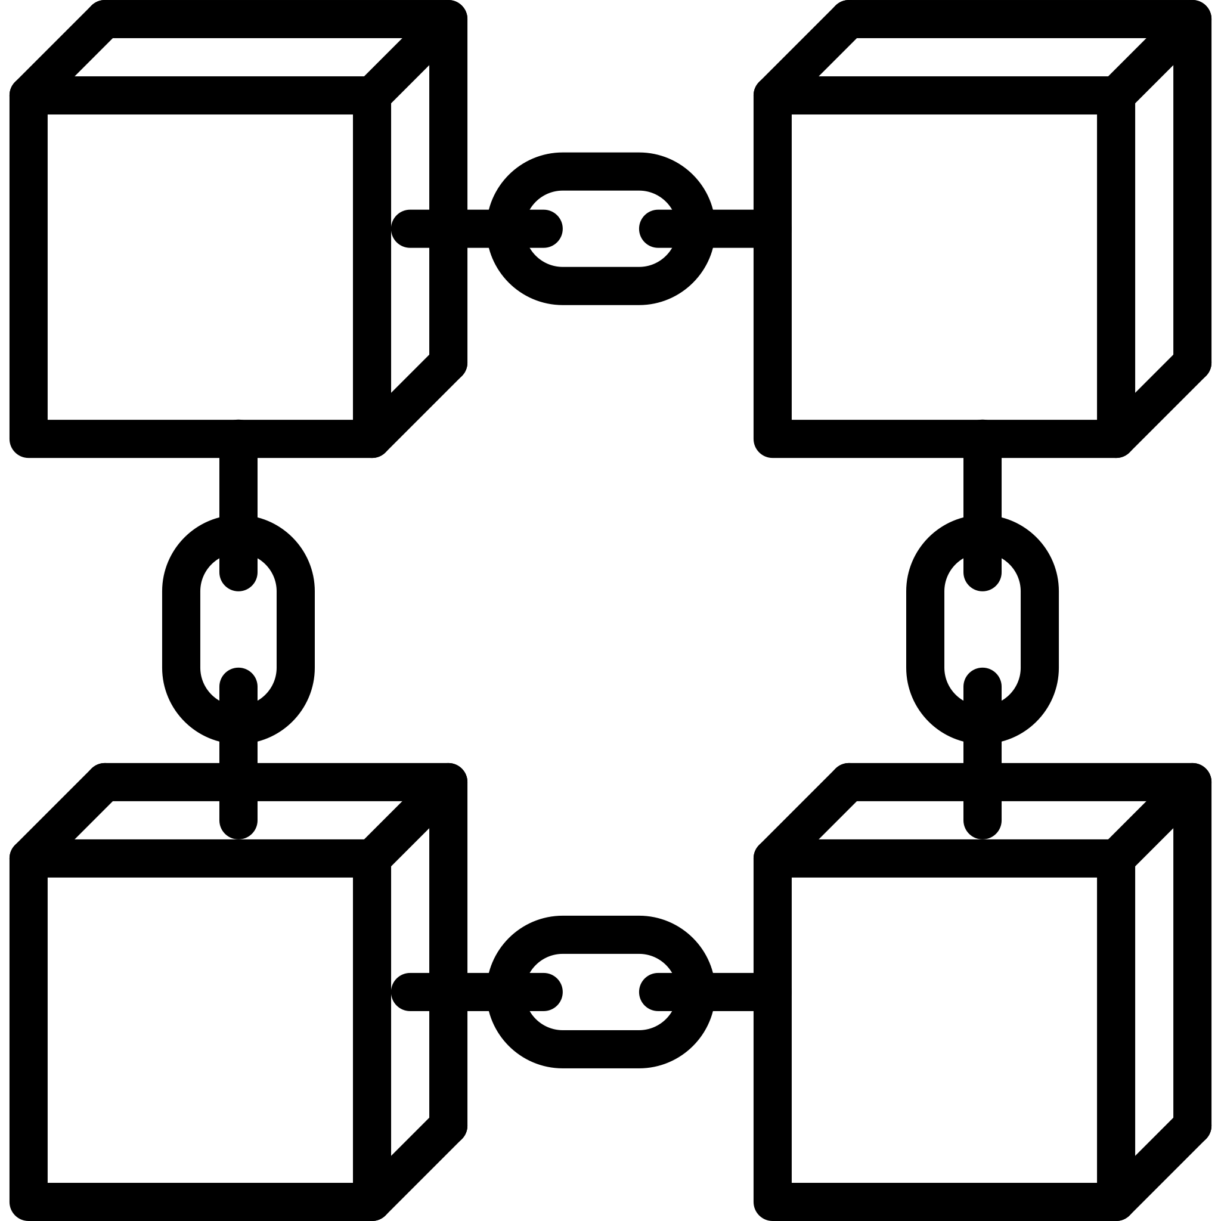
The problem: Voltage instability from excess solar fed into the distribution grid
Voltage peaks due to feed-in of excess solar
Excess voltage
= grid instability
Excess solar fed into the distribution grid causes voltage instability, so the grid imposes solar curtailment restrictions or expensive distribution grid upgrades
Acceptable
voltage range
Low voltage
= power shortage
Voltage drops due to excess demand
Significant capital spending by the grid is required to upgrade distributed network
Reduces ROI of rooftop solar and batteries
Destroys Virtual Power Plant effectiveness
Makes commercial-scale rooftop solar, VPP, and microgrids non-bankable
Prevents P2P trading and Blockchain
Causes social injustice
Notes:
12

Slide 13
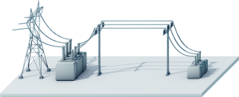
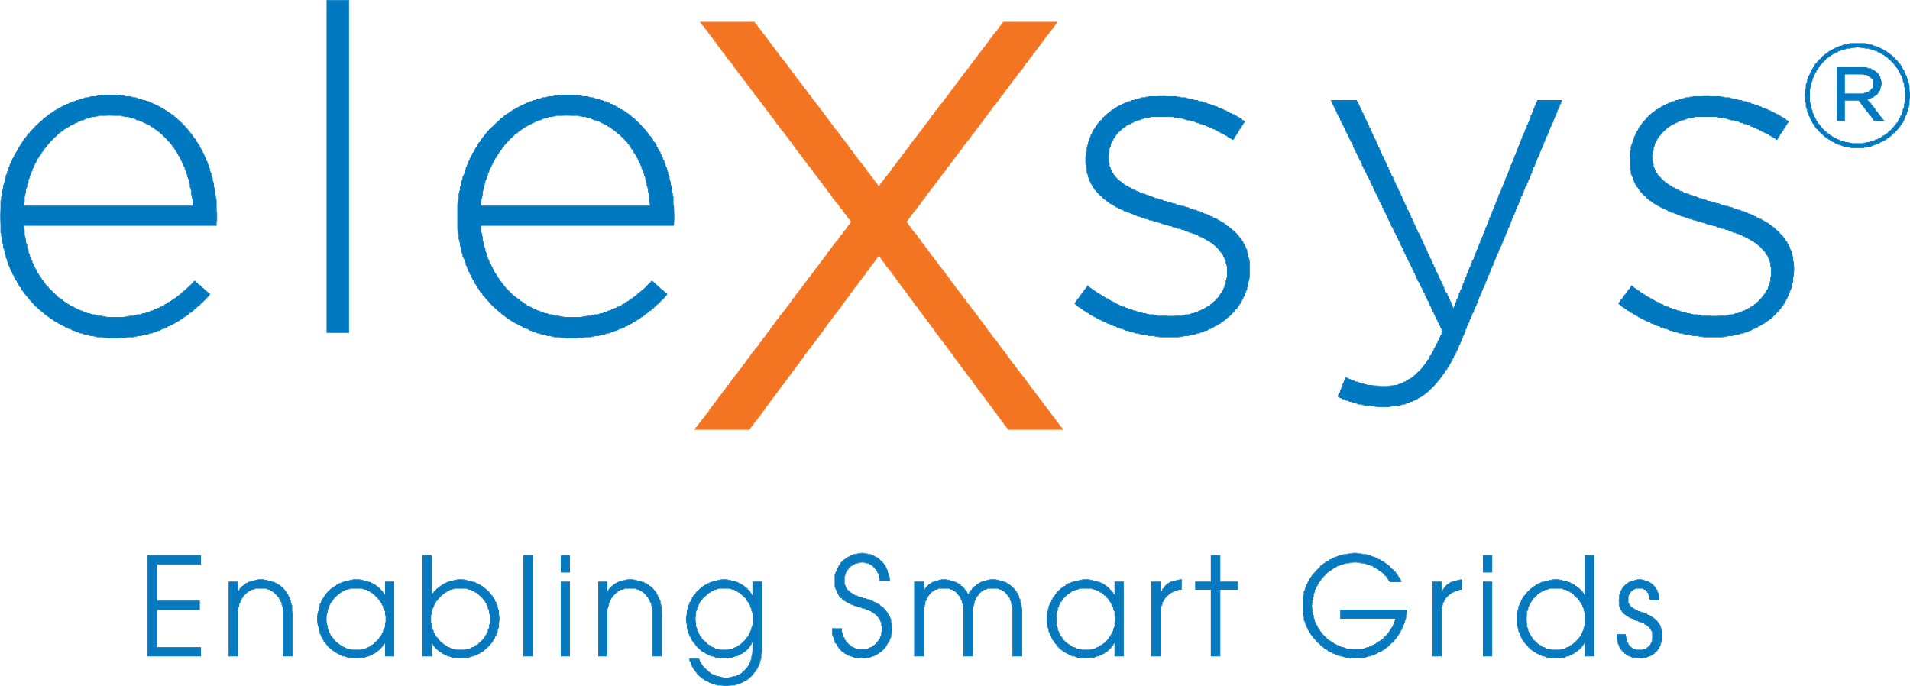
The Solution: eleXsys®
13x more DER
Runs VPPs and microgrids
NO grid investment
2-way energy flow
Distribution network
C&I consumer
Makes DER a new bankable asset class that pension funds can invest into
DER = Distributed Energy Resources
Notes:
13

Slide 14
Understanding rooftop solar energy policy: Australia
Australia
Feed-In Tariff: Excess generation can be exported, receiving compensation from the energy retailer
Solar curtailment
Once grid hosting capacity limits are reached, solar curtailment restrictions are imposed
Curtailment reduces project returns and destroys bankability (no 3rd-party financing)
Results in smaller solar+storage installations
Curtailment does not fix the voltage problem
Notes:
14

Slide 15
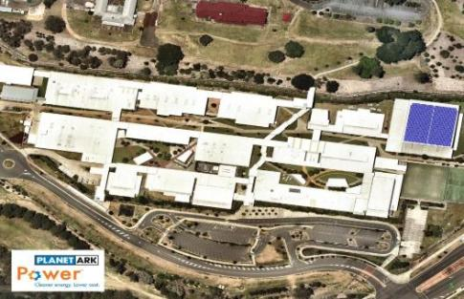
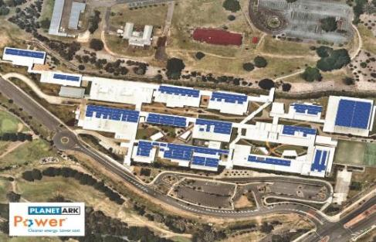
Australia example
eleXsys® = up to 13x increase in DER the grid can host
Rooftop solar with
100% two-way grid
Traditional one-way grid:
sized for self-consumption only
Fig 1 One-way grid, restrictions and curtailment
Fig 2 Two-way grid,
with eleXsys®
Notes:
15

Slide 16
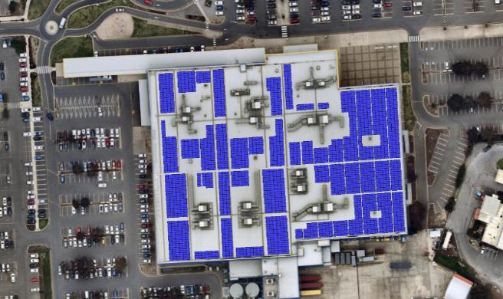
Planet Ark Power’s flagship project
Largest C&I single-site Virtual Power Plant in Australia
Major project under way with a leading global furniture retailer
3.2 MW rooftop solar + 3.4 MWh VPP batteries Grid-interactive microgrid
Owned by pension fund, earning 20- year return
Customer buys cheaper clean energy from pension fund
Landlord gets rent for rooftop by pension fund
eleXsys® creates a new billion $ asset class
Pension fund finance $ billions of similar projects
Stage 1 is 1.2 MW solar + Stage 2 is 2 MW solar car park
Notes:
16

Slide 17
Planet Ark Power’s flagship project
Project not viable without eleXsys®
Grid congestion and voltage issues make big rooftop solar and battery projects non-institutional-grade investments
eleXsys® harmonizes the grid to deliver predicable income streams so investors can invest $Bs into DER & decarbonization
Stage 1 is 1.2 MW solar + Stage 2 is 2 MW solar car park
Notes:
17

Slide 18
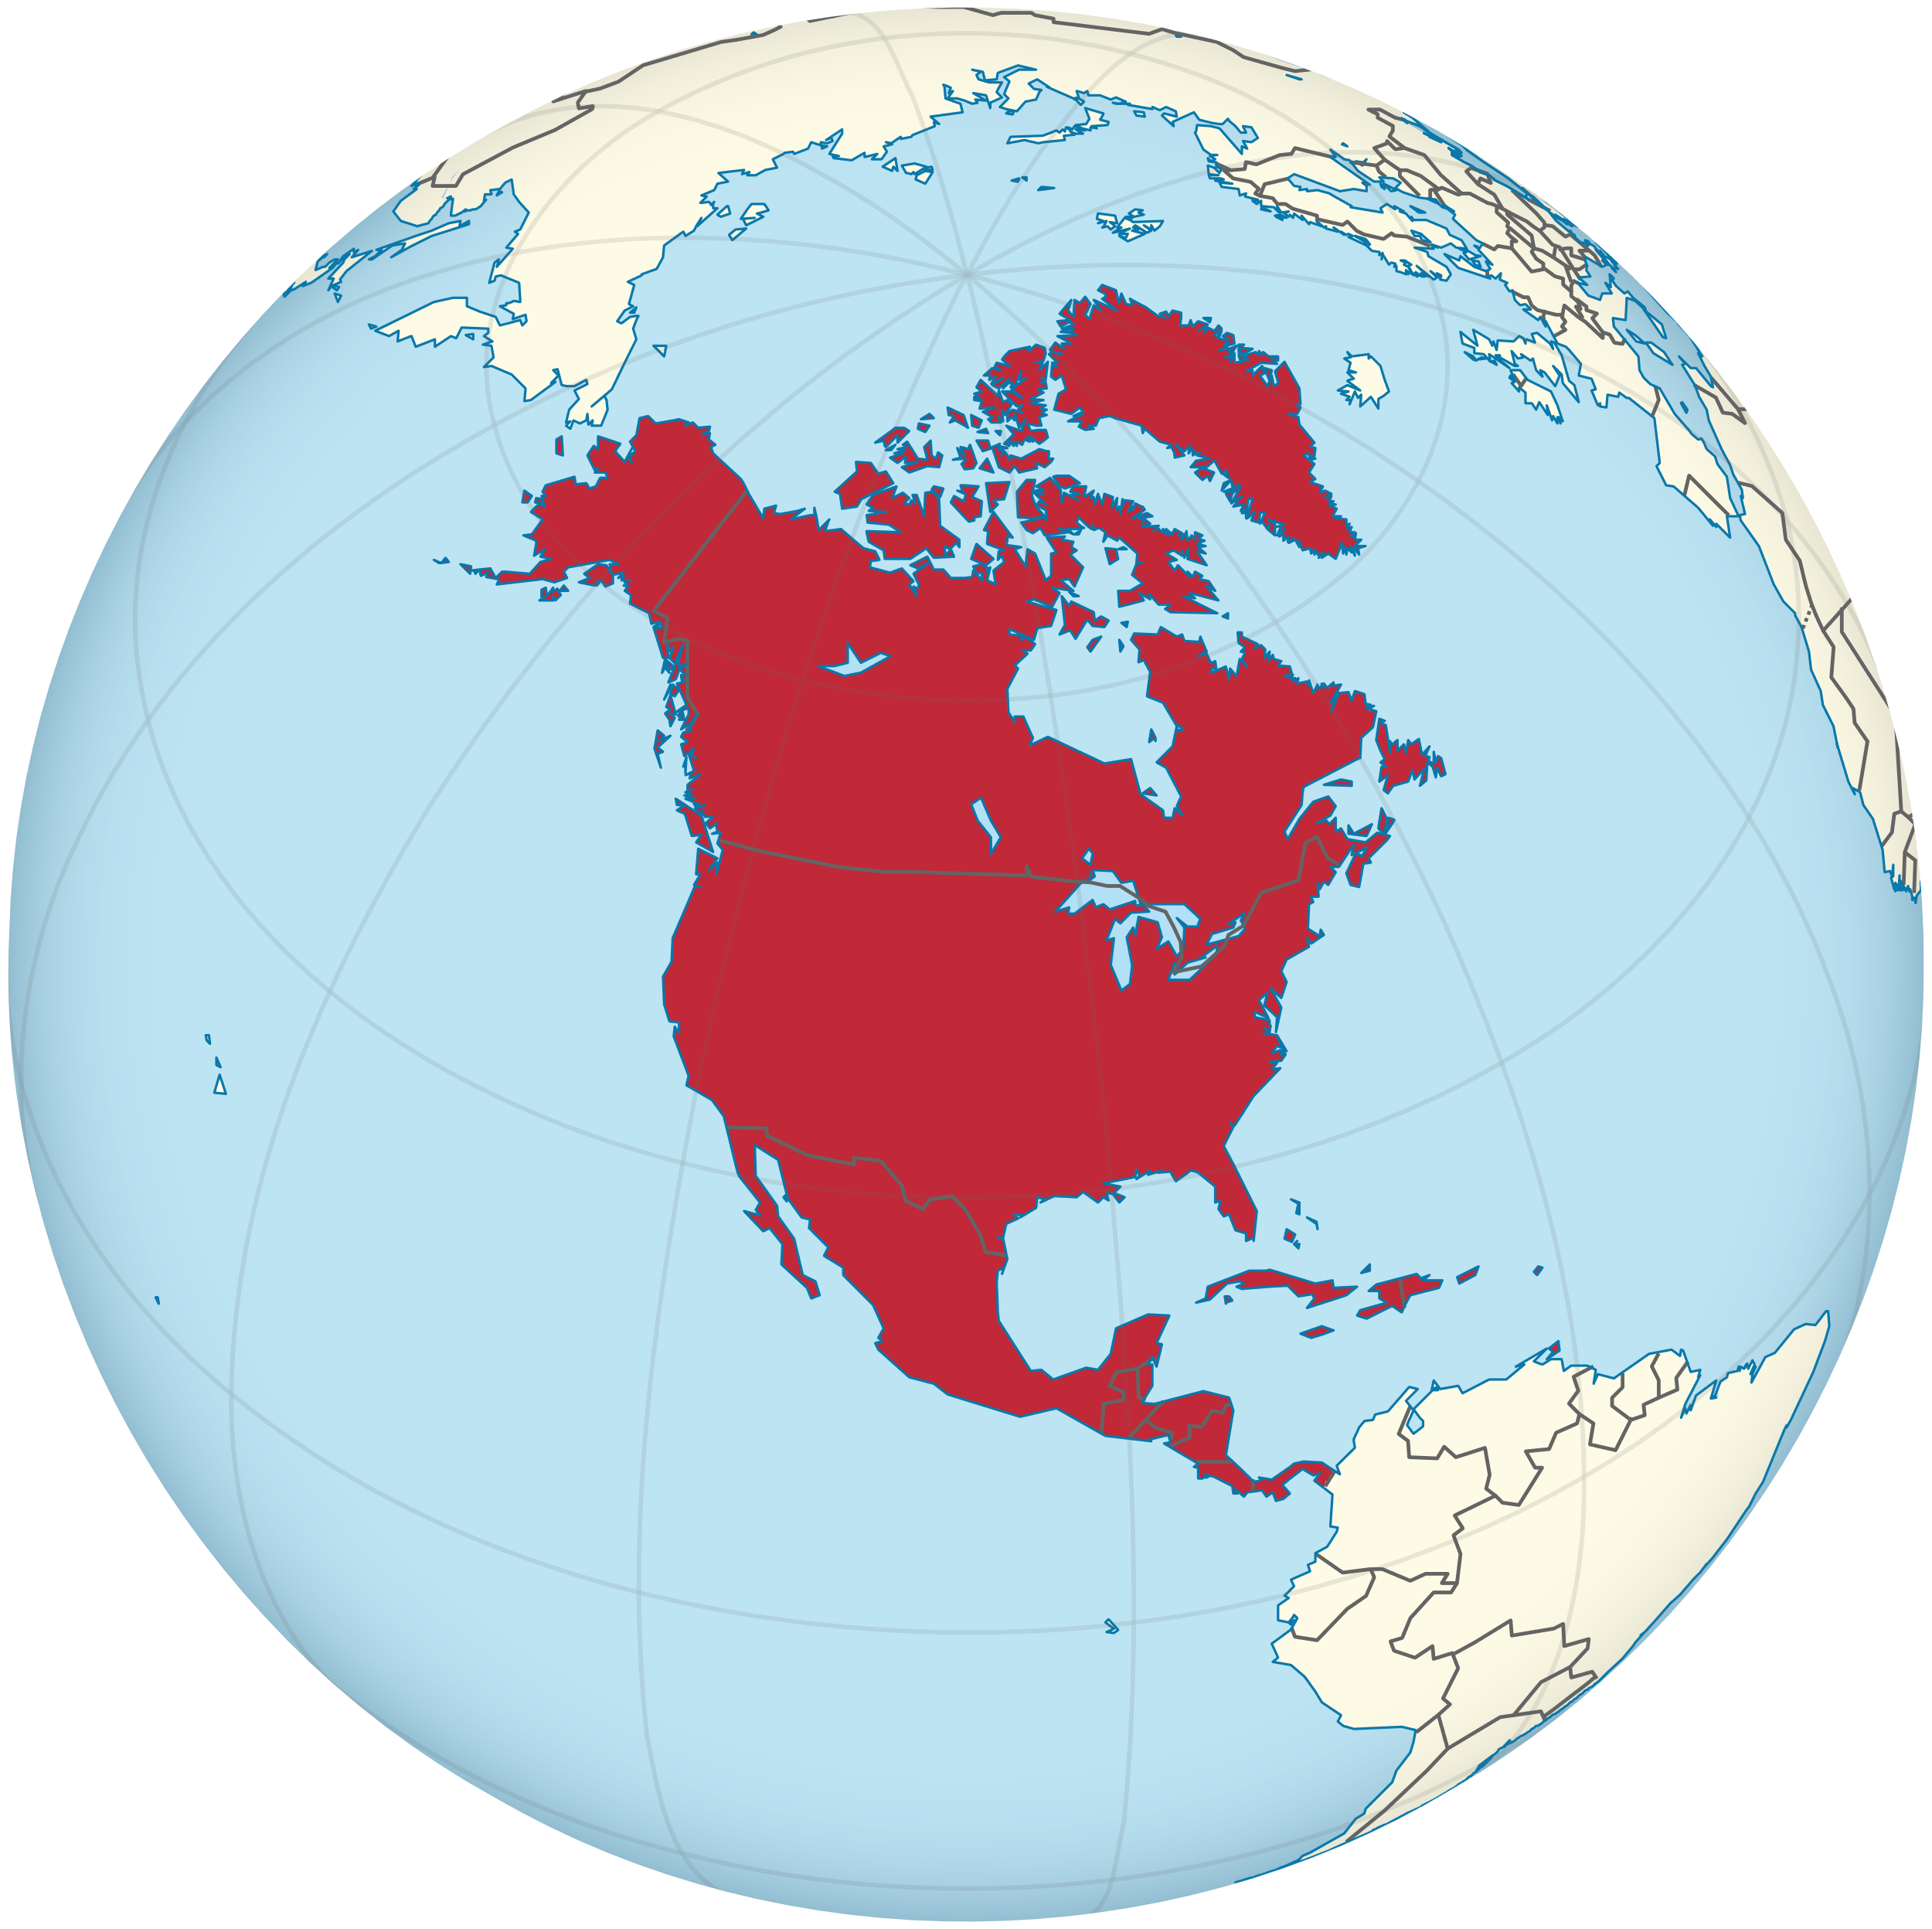
Understanding Rooftop Solar Energy Policy: North America
North America
Net energy metering (NEM): Solar incentive allowing customers to store excess energy in the electricity grid for later use
Distribution grid upgrades
Export of excess solar energy must be guaranteed under NEM
Once grid hosting capacity limits are reached, distribution grid upgrades are completed by utility
Upgrades increase project costs and electricity rates
Upgrades do not fix the voltage problem
Notes:
18

Slide 19
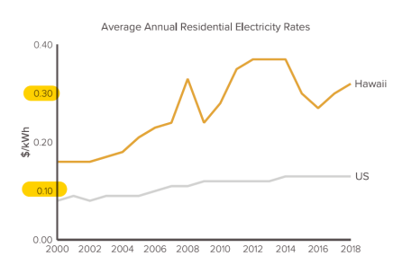
Hawaii: Highest solar saturation levels in the US
Hawaii has the highest retail electricity rates in the US due to a dependence on imported petroleum for electricity generation
Source: RMI Powering Paradise Report
Distributed solar is the number-one source of clean electricity in the state of Hawaii
1 in 5 residential customers have rooftop solar, with some islands as high as 1 in 3 —compared to the national average of 1 in 50
In 2015, Hawaii became the first US state to commit to 100% renewables
Notes:
19

Slide 20
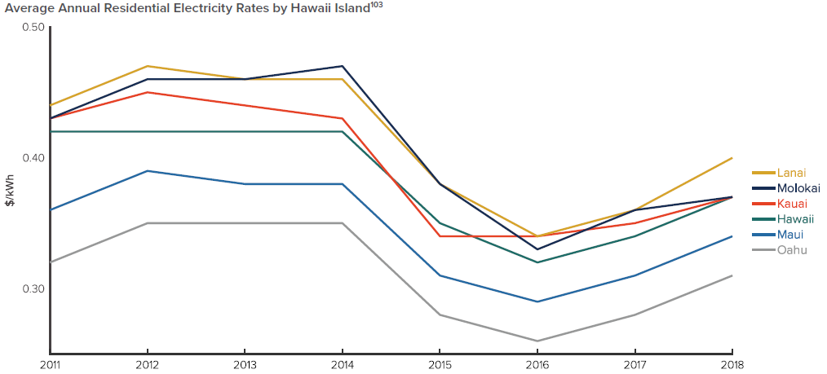
Hawaii’s transition away from net energy metering
The transition to rooftop solar initially reduced electricity costs, but not for long…
The PUC identified utility capital and operation expenditures as driving retail rates up
Source: RMI Powering Paradise Report
In 2015, the Hawaii Public Utilities Commission (HPUC) decided that it was time to transition away from the unsustainable growth of solar under NEM
“It is difficult to ascertain whether HECO Companies’ increasing capital investments are strategic investments or simply a series of unrelated capital projects to expand utility rate base and increase profits appearing to provide little or limited long-term customer value.”
Commission’s Inclinations on the Future of Hawaii’s Electric Utilities: Aligning the Utility Business Model with Customer Interests and Public Policy Goals
Notes:
20

Slide 21
Replacing NEM: CSS & CGS
To rectify market signals and help align solar output with grid needs, the PUC approved two new programs to replace NEM:
Customer Self-Supply (CSS): Self-generated electricity must either be consumed as it is produced or stored for later use by the customer
Customer Grid-Supply (CGS): Customers can export excess generation to the grid but are compensated at a rate akin to avoided cost rather than at the retail rate as under NEM
Customer Self-Supply = Curtailment
Customer Grid-Supply = Feed-in Tariff
These market mechanisms are similar to those used in Australia to manage high saturations of local DER
Notes:
21

Slide 22
Hawaii: Leading by example
Progressing toward Hawaii’s 100% renewable energy goal
Stakeholder alignment is key, starting from the grassroots levels with community support, all the way up to political and regulatory leadership
“If you wait for that perfect moment, you might now know what it will be until it has already passed.”
Source: RMI Powering Paradise Report
Notes:
22

Slide 23
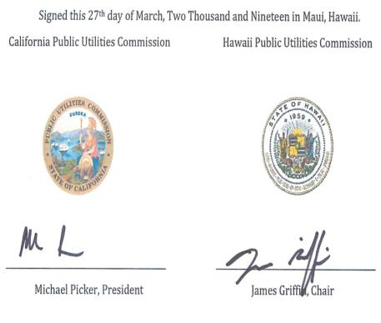
..
Hawaii and California clean energy goals
In 2015, California passed SB 350, which mimicked Hawaii in its call for 100% clean energy by 2045
On 27 March 2019, the Hawaii PUC and the California PUC signed an MOU “supporting the individual efforts” furthering each state toward achieving the ambitious goal of becoming carbon-free
The two PUCs declared that they would cooperate through sharing best practices and pursuing joint opportunities.
Topics include: Demand response, cybersecurity, energy efficiency, resilience, reliability, forward-thinking policy developments, the social cost of carbon
Hawaii is on track to meet its 2020 RPS goals and believes it will achieve 40% renewable energy by 2040.
Notes:
23

Slide 24
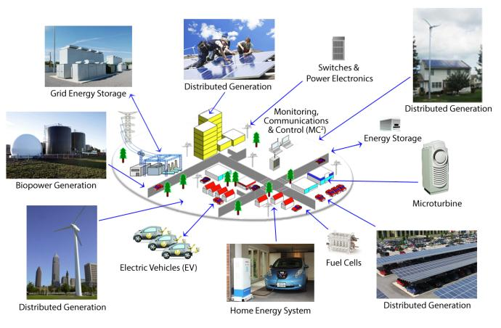
New microgrid tariff in Hawaii
In February 2019, the HPUC started a new proceeding (Docket No. 2018-0163) to properly compensate microgrid owners and streamline the interconnection process for new microgrids
In December 2019, the proceeding revealed a draft tariff
On 30 March 2020, the Hawaiian Electric Company officially filed the draft tariff with the HPUC

Slide 25
Developing microgrid tariffs in California
Key features of the Proposed Decision in California’s Microgrid Proceeding (R. 19-09-009) include:
Expedited interconnection for critical facility microgrids and for projects that use pre-approved single-line diagrams.
Increased information sharing between the utilities and local governments, CCAs, and tribal governments.
A removal of existing size limits for energy storage; energy storage will also be allowed to charge from the grid in pre-PSPS windows.
PG&E’s Community Microgrid Enablement Program is accepted, as long as it considers any area that has gone through an outage as a viable site.

Slide 26
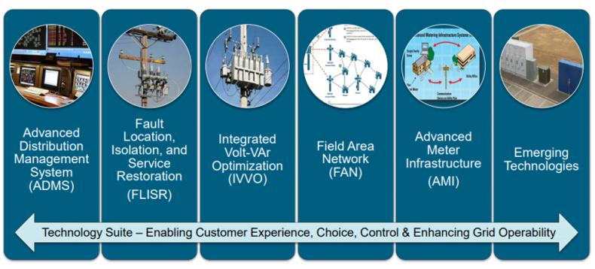
Promoting resilience
In August 2019, the HPUC passed a decision criticizing the Hawaiian Electric Company (HECO) for the lack of non-wires alternatives in its proposed Integrated Grid Plan
They lambasted a statement made by HECO: ”A traditional solution is necessary without the opportunity for market providers to offer an alternate solution."
The HPUC concluded that the question of resilience is too important to be overlooked.

Slide 27
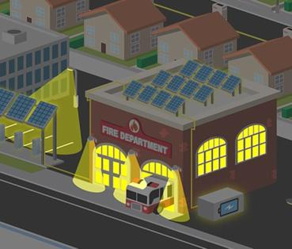
Value of Resilience (VOR) depends on tier of load
Everyone understands there is significant value to resilience provided by indefinite renewables-driven backup power
But no one has yet quantified the value of this unparalleled resilience.
Hence, there is an economic gap for innovative Community Microgrid projects while learning is still is the early stages.
The Clean Coalition aims to establish a standardized Value of Resilience (VOR) for critical, priority, and discretionary loads that will help everyone understand that premiums are appropriate for indefinite renewables-driven backup power for critical loads and almost constant backup power for priority loads, which yields a configuration that delivers backup power to all loads a lot of the time
The Clean Coalition’s VOR approach will establish standardized values for resilience of three tiers of loads:
Tier 1 loads, usually about 10% of the total load, are mission-critical and life-sustaining loads, crucial to keep operational at all times, including during grid outages.
Tier 2 loads, usually about 15% of the total load, are priority loads that should be maintained as long as long as doing so does not threaten the ability to maintain Tier 1 loads.
Tier 3 loads, usually about 75% of the total load, are the remaining, discretionary loads and are maintained when doing so does not threaten the ability to maintain Tier 1 & 2 loads.
Notes:
- Hawaii has close to 80,000 solar systems installed on residential development, but few of those have the energy storage that would make them resilient.

Slide 28
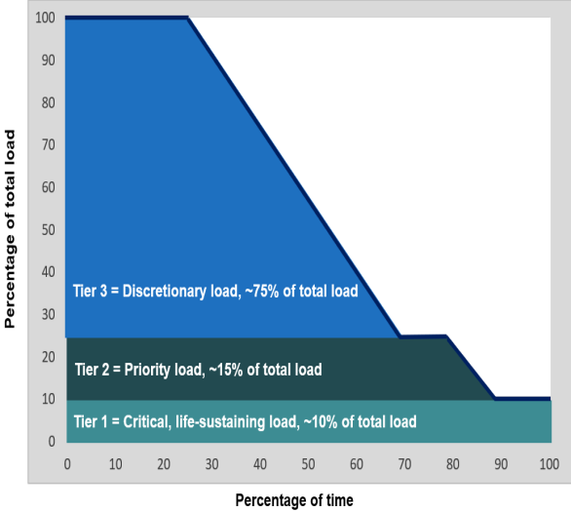
Calculating a standard Value of Resilience (VOR)
Value of Resilience (VOR) is different for each of three load tiers, resulting in a blended VOR123 price adder that typically calculates to a 25% adder on top of the price of non-resilient electricity (i.e., the typical VOR123 adder equates to 25% of the normal price paid for electricity):
Tier 1: 100% resilience is worth approximately 3 to 5 times the normal price paid for electricity. Given that the typical facility has a Tier 1 load that is about 10% of the total load, applying the low side of the Tier 1 VOR multiplier typically yields a 20% adder to the pre-resilience electricity rate.
Tier 2: 80% resilience is worth approximately 1.5 to 3 times the normal price paid for electricity. Given that the typical facility has a Tier 2 load that is about 15% of the total, applying the low side of the Tier 2 VOR multiplier yields a 7.5% adder on top of the pre-resilience electricity rate.
Tier 3: Although a standard-size Solar Microgrid can provide backup power to Tier 3 loads a substantial percentage of the time, Tier 3 loads are by definition discretionary, and therefore, a Tier 3 VOR multiplier is negligible and assumed to be zero.

Slide 29
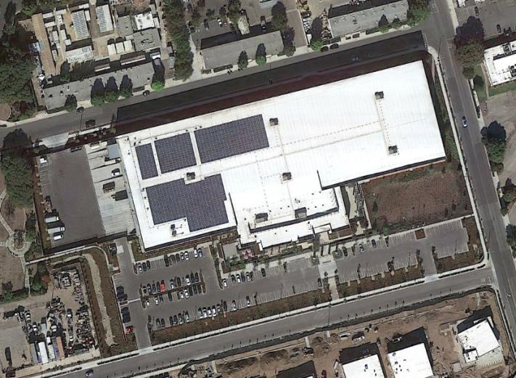
Direct Relief (Microgrid should expand greatly)
Location: Santa Barbara, CA.
Owner: Direct Relief (one of the largest disaster recover/supply non-profits in the world).
Brand new 155,000-square-foot pharmaceutical warehouse.
Ships direct to disasters zones, internationally. Cold storage cannot be without power.
Needed a microgrid for indefinite renewables-driven backup power.
Notes:
This slide contains information from the original SCE RFP
The top left shows the peak day usage at the Goleta substation; peak load is 201 MW
The top right shows the load profile included in the SCE RFP for the peak day (subset of total substation load)
The need identified is approximately 95 MW
The bottom left shows the Wildan load profile that was adapted for this analysis

Slide 30
Direct Relief Microgrid – onsite Resilience only
Resiliency is #1 concern:
320 kW PV
676 kWh Storage
600 kW generator
4000 gal. of fuel
PV annual generation designed to cover annual consumption.
Storage designed to time-shift the generation to more valuable times, and provide Resiliency.
Genset provides “back-up to the back-up”.
Direct Relief’s mission is to stay operational in the event of a local disaster that causes interruption of electricity.
676 kWh Li
320 kW PV
600 kW genset; 4000 gal. fuel

Slide 31
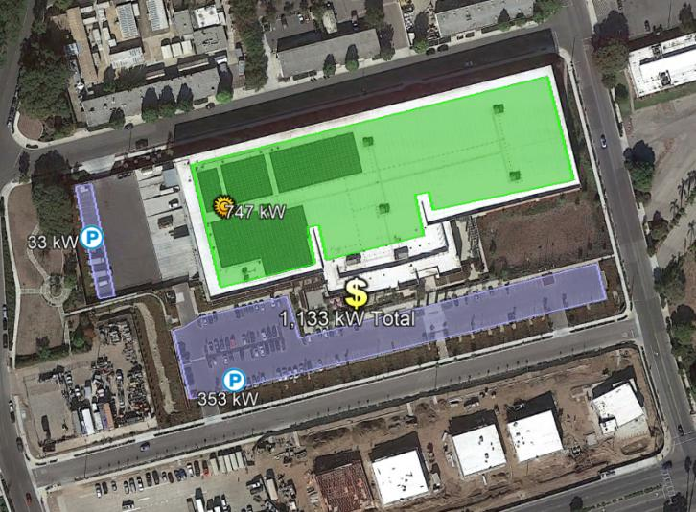
Obsolete Regulation = Stranded Opportunity
Microgrid only serves Direct Relief needs:
70% of roof and 100% of massive parking area solar potential is unused.
Additional storage not able to be considered due to policy prohibitions around exporting energy from a battery to the grid – even though the energy is 100% stored solar.
Ready to do way more:
1,133 kW in total solar siting potential, 427 kW more rooftop and 386 kW in parking lots.
Existing switch gear is already sized for the expansion and is just awaiting the policy innovation!

Slide 32
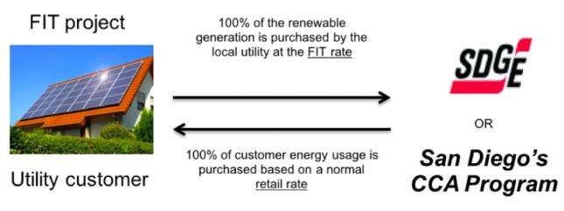
Feed-in Tariffs (FITs) with Dispatchable Energy Capacity Services (DECS)
The Clean Coalition designs market-based, cost-effective FITs with streamlined interconnection
A FIT is a standardized, long-term, guaranteed contract that allows smaller local renewable energy projects to sell power to the local utility or other load-serving entity
FITs work better than net energy metering (NEM) or auctions to unleash WDG
Our FITs use Market Responsive Pricing, which allows prices to adjust based on market response — ensuring that energy contracts are always set at the best market price
A Dispatchability Adder, a fixed ¢/kilowatt-hour (kWh) bonus on top of the FIT rate, offers a value for the DECS provided by solar+storage
Notes:
- In 2015, the Hawaii legislature passed a bill which created Renewable Portfolio Standards which set a 100% renewable electric energy goal by 2045. HB 623

Slide 33
Dispatchable Energy Capacity Services (DECS)
Load-serving entity (LSE)
Storage asset owner
LSE contracts for dispatchable daily cycling of energy capacity (kWh), at a fixed $/kWh fee, used or not.
LSE optimizes fully flexible energy capacity, dispatching for any purpose, which could be based on time of day, day of week, season, event, and/or other optimizations over the DECS-contract period.
Initial DECS contracts are priced at cost of service (COS) while subsequent DECS contract pricing is adjusted for market response.
Owner reserve
Owner retains discretion over any capacity not under DECS contract.
Owner earns guaranteed $/kWh payments for the DECS-contracted energy capacity.
Owner retains discretion over any capacity not under DECS contract.
DECS- contracted
energy
capacity (kWh)
kWh
$
Owner reserve
DECS offers a single bankable revenue stream for energy storage owners and a fully flexible and dispatchable energy source for LSEs available daily.
Three COS components:
Net cost of energy (NCOE).
Capital expenditure (capex).
Operating expenditure (opex).

Slide 34
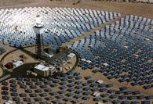
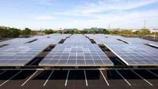
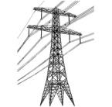
Wholesale Distributed Generation (WDG) defined
Project Size
Central Generation
Serves Remote Loads
50+ MW
Wholesale DG
Serves Local Loads
500 kW
Retail DG
Serves Onsite Loads
5 kW
Behind the Meter
Distribution Grid
Transmission Grid
Notes:
Wholesale Distributed Generation and DER is a key market segment. The behind the meter – and remote utility scale – resources are both part of the equation, but Wholesale DER combines economies to scale with proximity to load – maximizing use of local capacity while avoiding the losses, transmission costs, and land impacts.
_______
*National policies focus on removing barriers for large-scale renewable power facilities and infrastructure.
*State and local net-metering policies promote small-scale renewables:
---Net-metering is designed to reduce a utility customer’s electric bills
---Net-metering is not designed for owners of commercial and multi-tenant properties (where tenants pay the utility bills)
---Annual on-site energy use generally caps net-metering project size

Slide 35
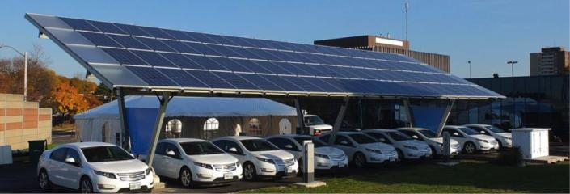
WDG interconnection
Wholesale distributed generation (WDG): projects on the utility side of the meter rather than behind the customer’s meter — often commercial-scale solar
The interconnection process for WDG is broken in California
It can take years to interconnect these projects to the grid
The process can be arduous and expensive
The Clean Coalition has designed a WDG Interconnection Pilot with these aims:
Make the WDG interconnection processes efficient and cost-effective while maintaining a safe and reliable electric grid
Give WDG the same advantageous streamlined treatment as net energy metered (NEM) projects, making it equally fast and predictable. Currently, WDG interconnections are significantly more risky, costly, time-consuming, and expensive.

Slide 36
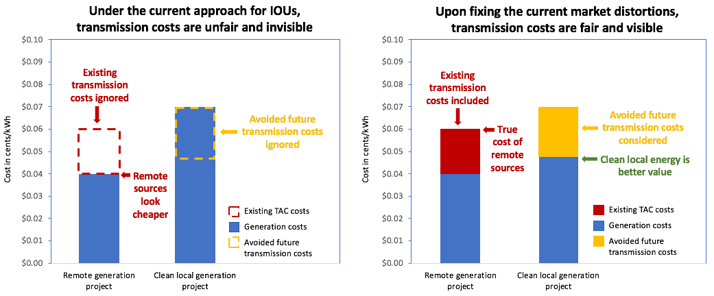
The real cost of clean local energy
Existing transmission costs, assessed as TAC and currently averaging 2¢/kWh, should be added to the cost of remote generation that requires use of the transmission grid to get energy from where it is generated to where it is used, which is almost always on the distribution grid where people live and work. Future transmission investments, currently averaging 2.5¢/kWh in the evenings, can be avoided via dispatchable local generation, and that value should reduce the evaluated cost of local generation. When correctly considering ratepayer impacts of transmission costs, dispatchable local generation provides an average of 4.5¢/kWh of better value to ratepayers than is currently assumed in the majority of instances.
Notes:
For PTOs, current TAC assessment unfairly increases the cost of local generation (DG) even though it generally does not use the transmission system
Fixing the TAC market distortion makes local generation more competitive
Over time, more local generation will be built, making transmission upgrades less necessary and decreasing overall system costs - for ratepayers
The TAC “usage pays” fix aligns CAISO with FERC Order 1000, and provides consistent treatment across California - non-PTOs already meter TAC on TED

Slide 37
Performance-based regulations
HPUC Commissioner Potter: “The current regulatory model encourages companies to make large capital investments to earn a return. Our efforts will break that link, so that utilities can earn a return on providing services and programs instead of just capital investments. We must think of a broader set of regulatory mechanisms that allow the utility to move with flexibility and accelerate our path to renewable energy. Regulation is where the rubber hits the road.”
Goals Include: Enhance the customer experience, improve utility performance;, and advance societal goals. “This will lead to increased efforts at reducing greenhouse gases, using distributed energy resources and investing in an efficient grid.”
Notes:
Energy Performance Contracts allow a one-stop contract where the installer will guarantee savings or pay the shortfall for installing the energy conservation measure (ECM.
- Hawaii has ranked number one in this type of investment for seven consecutive years (energy services coalition race to the top award).

Slide 38
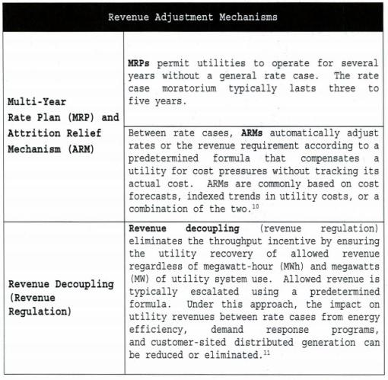
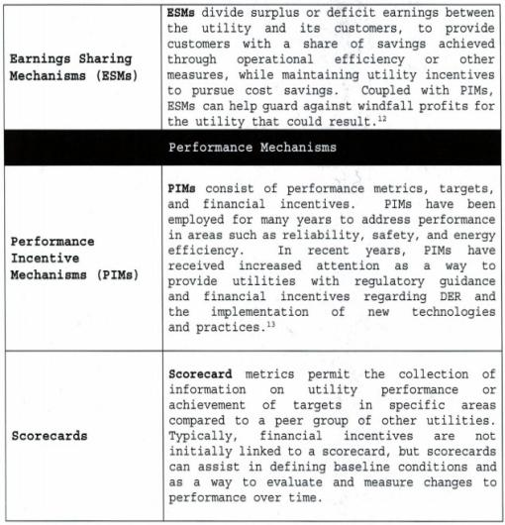
Requirements for performance-based metrics (according to the HPUC)
A multi-year rate plan with pre-determined formulas for revenue adjustments.
Performance mechanisms that increase or reduce revenue-based on metrics.

Slide 39
Questions?

Slide 40
Backup Slides

Slide 41
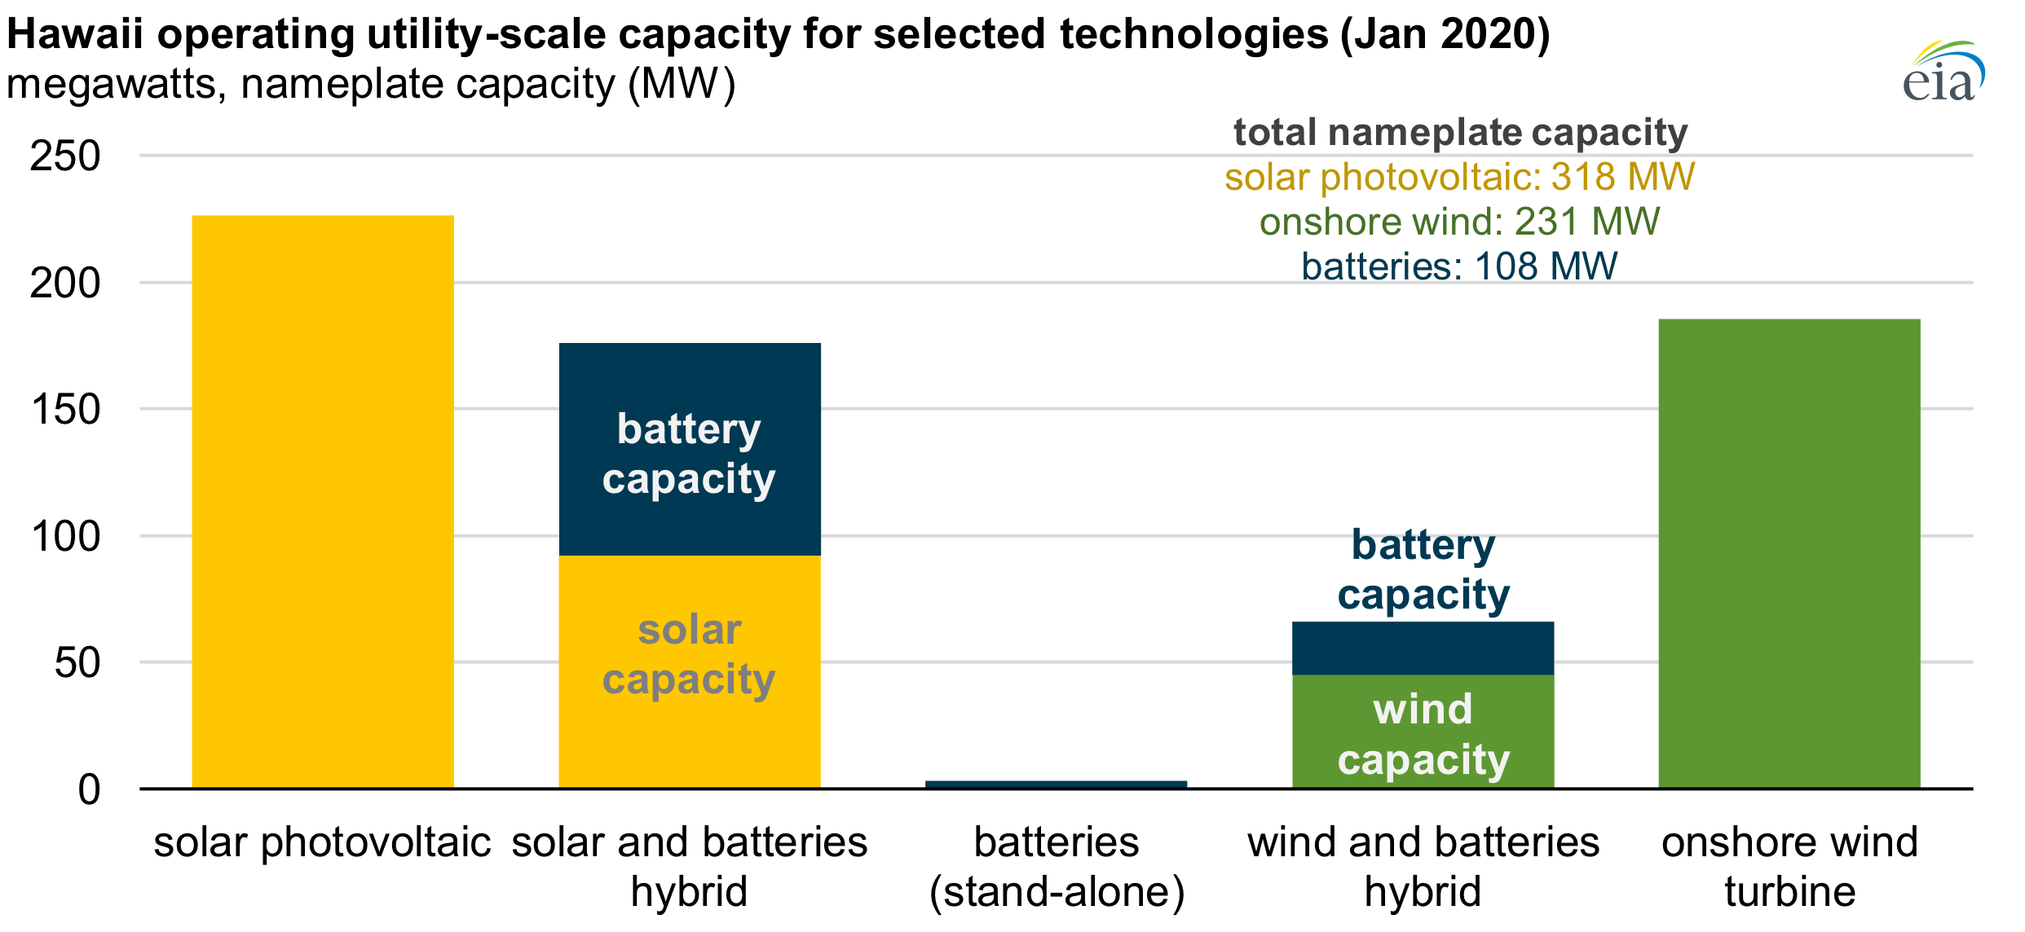
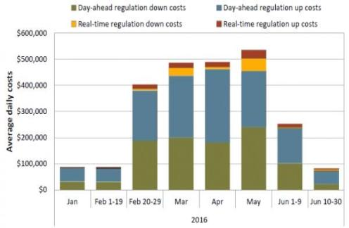
Energy Storage in Hawaii
HECO issued an RFP in August, 2019, calling for 900 MW of distributed generation paired with energy storage, including:
Energy storage capable of discharging 9 MW for 4 hours - or -
Contingency storage that qualifies for frequency response if the battery is capable of discharging 5 MW for half an hour.
Hawaii will need increasing amounts of frequency regulation in the future, given high saturations of residential PV and the multiple coal-fired plants that are being retired in the next few years.
Greater amounts of energy storage would magnify this effect.
California is going to need a huge increase in total energy storage capacity in the near future, for resilience, frequency balancing, and reliability of renewable resources.

Slide 42
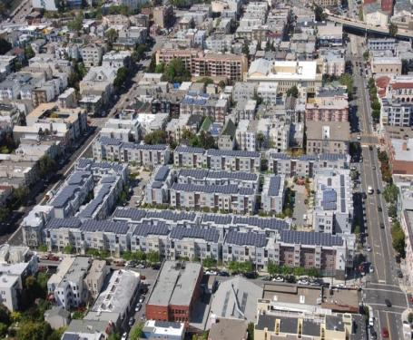
Valencia Gardens Energy Storage (VGES) project and merchant energy storage In California
California officials expect that the state needs 1 gigawatt of new long-duration storage by 2026.
Sited at the Valencia Gardens Apartments (VGA), a 300,000-square-foot low-income and senior housing facility with 260 units in San Francisco’s Mission District.
Will pair front-of-meter (FOM) energy storage with the existing 580 kW of existing FOM solar at the VGA — one of the largest solar installations in San Francisco — on a circuit with a peak load of 570 kW.
Designed to enhance the interconnection hosting capacity of the existing feeder by at least 25% and ensure that far more solar can be sited on that feeder.
VGES goals:
Deploy an energy storage configuration that provides a replicable and cost-effective model for advancing grid operations across the state of California.
Provide support for higher penetrations of distributed solar PV across multiple sites along a feeder.
Reduce system-wide peaks and the need for costly peak generation
Provide ancillary services to distribution and transmission including capacity and quick-response frequency regulation.

Slide 43
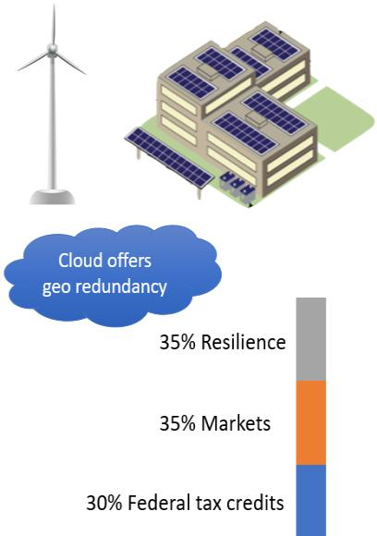
Other plays for local renewables + energy storage
Diversify renewables
Wind and solar generation profiles are highly complementary
One 3 MW wind turbine averages 24 MWh/day
Diversify geography
Demand response (DR) combined with renewables + energy storage = big UPS
Fail-over strategies can allow significant reduction in energy usage
Monetize energy storage in markets like DR and frequency regulation
Markets typically cover 35% of energy storage costs while tax credits cover another 30%

