Slide 1
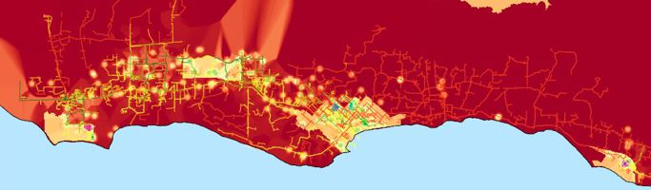
Identifying optimal locations for Community Microgrids
Gregory Young
Program Associate
805-350-2931 mobile
gregory@clean-coalition.org
18 March 2020

Slide 2


GoToWebinar FAQ
Webinar recording and slides will be sent to registered attendees within two business days.
All webinars are archived on clean-coalition.org and the Clean Coalition’s YouTube channel.
Submit questions in the Questions window at any time (window view varies by operating system and browser).
Questions will be answered during the Q&A portion of the webinar.
Contact Josh for webinar questions: josh@clean-coalition.org.

Slide 3

Presenter
Gregory Young
Program Associate
Gregory Young has worked with several nonprofits and community-based organizations in developing planning processes to help build resilience for disadvantaged populations. Universalizing local renewable energy resources has been an ongoing passion for Gregory, especially as more of the world’s population transitions to urban environments. Gregory received a BA in Psychology at the University of Colorado Boulder and is currently pursuing an MA in Urban Sustainability at Antioch University in Los Angeles, with a focus on the world’s dual challenges of climate change and inequality.

Slide 4
Webinar agenda
Clean Coalition’s mission and the Goleta Load Pocket Community Microgrid (GLPCM)
Graduate studies in Urban Sustainability and Geographic Information Systems
Community Microgrid Suitability Model
The model’s replicability
Data and ICA interactive maps

Slide 5
Clean Coalition (nonprofit)
Mission
To accelerate the transition to renewable energy and a modern grid through
technical, policy, and project development expertise.
Renewable energy end-game
100% renewable energy; 25% local, interconnected within the distribution grid and ensuring resilience without dependence on the transmission grid; 75% remote, fully dependent on the transmission grid for serving loads.
Notes:
5

Slide 6
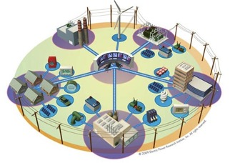
Community Microgrids are the grid of the future
A Community Microgrid is a new approach for designing and operating the electric grid, stacked with local renewables and staged for resilience.
Key features:
A targeted and coordinated distribution grid area served by one or more substations – ultimately including a transmission-distribution substation that sets the stage for Distribution System Operator (DSO) performance.
Ability to utilize existing distribution grid infrastructure to serve the Community Microgrid during broader grid outages
High penetrations of local renewables and other distributed energy resources (DER) such as energy storage and demand response.
Staged capability for indefinite renewables-driven backup power for critical community facilities across the grid area – achieved by 25% local renewables mix.
A solution that can be readily extended throughout a utility service territory – and replicated into any utility service territory around the world.

Slide 7
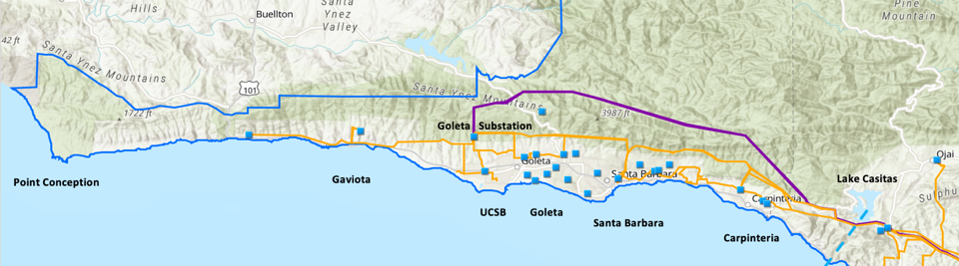
Goleta Load Pocket (GLP)
The GLP is the perfect opportunity for a comprehensive Community Microgrid
GLP spans 70 miles of California coastline, from Point Conception to Lake Casitas, encompassing the cities of Goleta, Santa Barbara (including Montecito), and Carpinteria.
GLP is highly transmission-vulnerable and disaster-prone (fire, landslide, earthquake).
200 megawatts (MW) of solar and 400 megawatt-hours (MWh) of energy storage will provide 100% protection to GLP against a complete transmission outage (“N-2 event”).
  200 MW of solar is equivalent to only about 5 times the amount of solar currently deployed in the GLP and represents about 25% of the energy mix.
  Multi-GW of solar siting opportunity exists on commercial-scale built environments like parking lots, parking structures, and rooftops; 200 MW represents only about 7% of the technical siting potential.
  Other resources like energy efficiency, demand response, and offshore wind can significantly reduce solar+storage requirements.

Slide 8
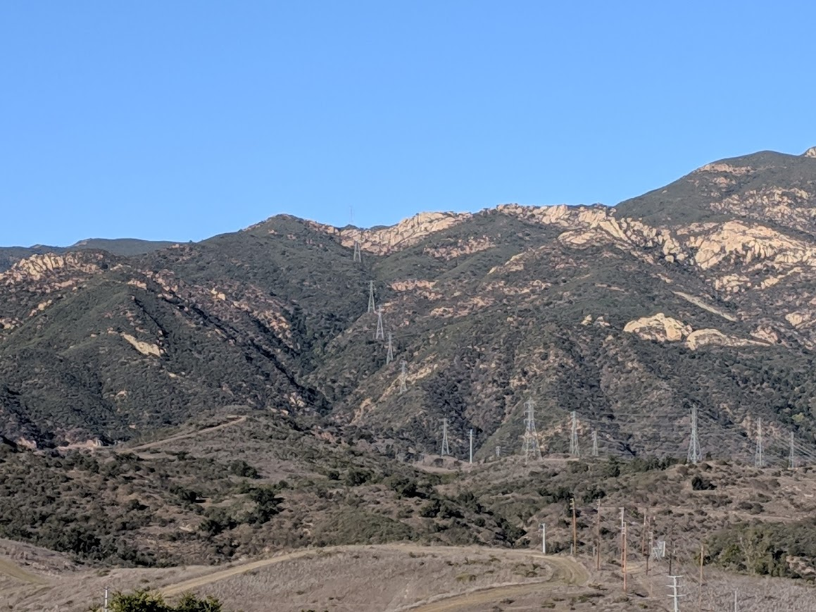
Advanced GIS final project
Locating suitable Community Microgrid regions
Gregory Young
Antioch University Los Angeles
Masters Candidate in Urban Sustainability
ES-6100
Final Project

Slide 9
Southern California Edison (SCE) statement
“Due to the rugged mountainous terrain, any required repair and replacement of transmission lines and transmission towers could take up to several weeks if a natural disaster, such as a landslide or earthquake, occurs.”
— A. Hernandez, 2019

Slide 10
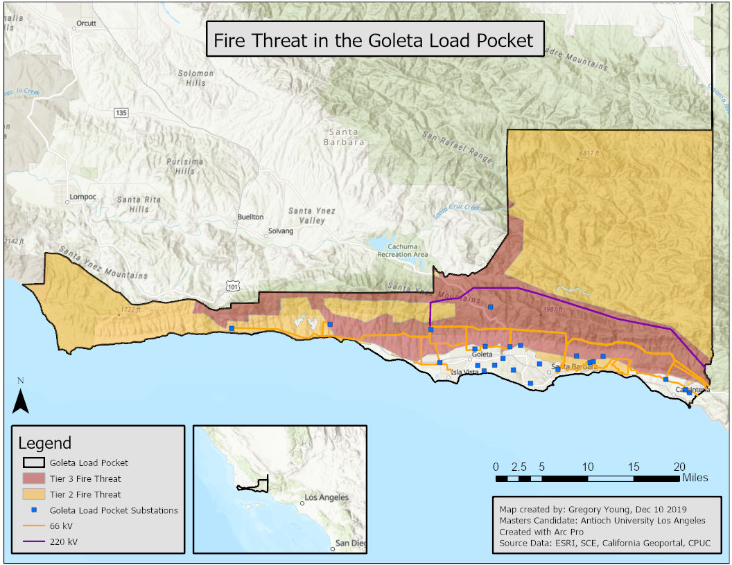
GLP fire threat map
Notes:
184 miles of the 220 kV transmission lines and 66kV distribution that traverse through tier 3 and tier 2 high fire risk.

Slide 11

GIS, ArcGIS Pro, and Suitability Modeling
GIS is the framework.
ArcGIS Pro is the software.
ModelBuilder is the visual programming language.
Suitability Modeling is the technique/toolset.
Notes:
A Geographic Information System (GIS) is a framework for gathering, managing, and analyzing data. GIS is rooted in the science of geography and integrates many types of data. It analyzes spatial location and organizes layers of information into visualizations using maps and 3D scenes. Allows for deeper insight into data, such as patterns, relationships, and situations – helping users make smarter decisions.
ArcGIS Pro is an application for building maps in 2D and 3D, analyzing data, and authoring geographic knowledge. Gives the user the power to examine relationships, test predictions, and ultimately make better decisions.
ArcGIS’ ModelBuilder, a visual programming language for building geoprocessing workflows, was used to create the Suitability Model. Within ModelBuilder, a model is represented as a diagram that chains together sequences of processes and geoprocessing tools, using the output of one process as the input to another process.
Suitability modeling is the most common application for ArcGIS Spatial Analyst extension and can solve a variety of problems:
Where to site a new housing development
Where to locate a new ski area
Where to deploy troops in a military operation
Where to locate firefighting crews to best fight fires in the dry season
For this case study, which sites are best for bobcat habitat

Slide 12
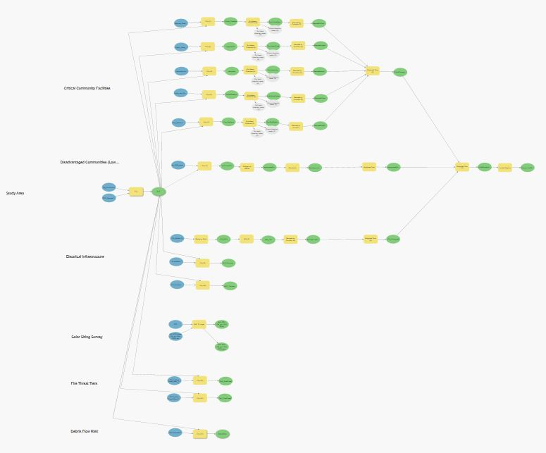
Final Community Microgrid Suitability Model
Notes:
Blue ovals are data inputs
Yellow squares are geoprocessing tools
Green ovals are data outputs

Slide 13
Datasets used
Dataset | Acquisition date | Application
Fire stations | 11/10/19 | Deriving suitability raster layer
Hospitals | 11/10/19 | Deriving suitability raster layer
Urgent care centers | 11/10/19 | Deriving suitability raster layer
Police stations | 11/10/19 | Deriving suitability raster layer
Critical sheltering sites | 11/10/19 | Deriving suitability raster layer
Priority population areas | 11/10/19 | Deriving low-income communities for suitability raster layer
SCE service layers (SCE Boundary, ICA segments, transmission and distribution lines, substations) | 11/10/19 | Defining study boundaries, important map elements, and suitability raster layer
Southern California Association of Governments - Counties | 11/10/19 | Defining study boundaries
CPUC Fire Threat areas | 11/10/19 | Defining study area
Solar Siting Survey points | 11/10/19 | Adding value to results

Slide 14
Critical community facilities
Data derived from Homeland Infrastructure Foundation-Level Data (HIFLD)
  Fire stations: Any location where firefighters are stationed or based out of, or where equipment that such personnel use in carrying out their jobs is stored for ready use. Fire departments not having a permanent location are included, in which case their location has been depicted at the city/town hall or at the center of their service area if a city/town hall does not exist.
  Hospitals: Hospital facilities included based only on data acquired from various state departments or federal sources.
  Urgent care centers: Any location that is capable of providing emergency medical care and must provide emergency medical treatment beyond what can normally be provided by an EMS unit, must be able to perform surgery, or must be able to provide recuperative care beyond what is normally provided by a doctor's office.
  Police stations: Sheriff departments, police departments, patrol stations, highway patrol stations, and jails.
  Critical sheltering sites: Facilities designated a shelter by either the Federal Emergency Management Agency (FEMA) or the American Red Cross (ARC).

Slide 15
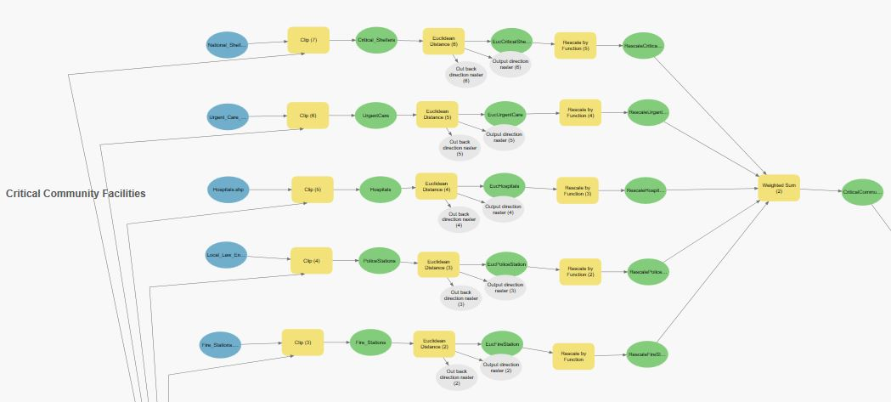
Critical community facilities and disadvantaged communities (low-income) sub-model

Slide 16
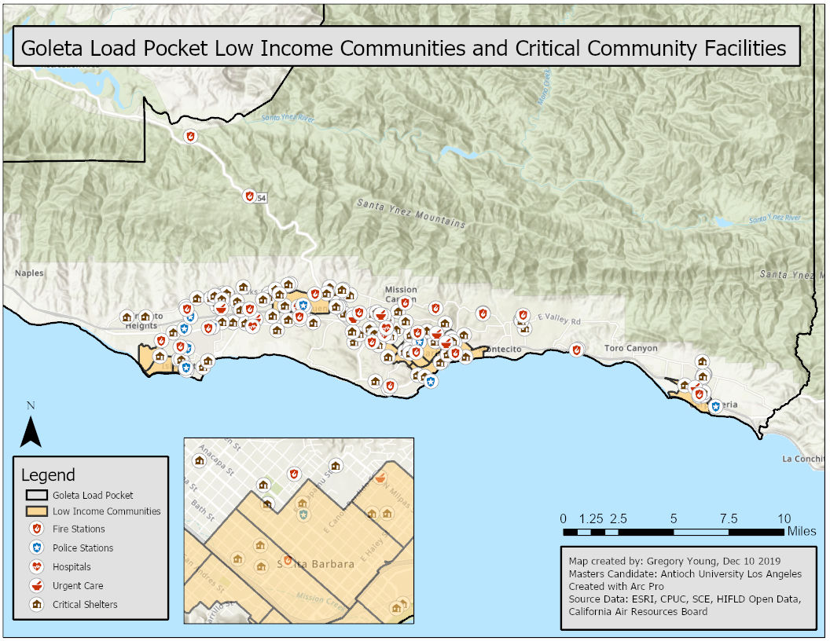
Critical community facilities and low-income communities within the GLP

Slide 17
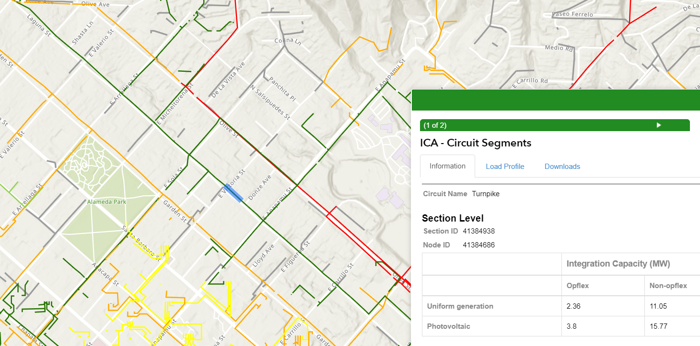
Southern California Edison integration capacity analysis (ICA) maps
The ICA maps offer four values for generation interconnection:
Uniform generation operational flexibility
Uniform generation non-operational flexibility
Photovoltaic operational flexibility
Photovoltaic non-operational flexibility
Uniform generation: Covers storage, PV, and other resources so that Community Microgrids can continue to operate at night.
Operational flexibility: A constraint that lowers the value of PV integration to take into account the possibility that an integration may need to be reviewed by a utility engineer.
Notes:
At the end of 2018, California’s largest utilities published updated Interconnection Capacity Analysis (ICA) maps, known as ICA 2.0, to better assist renewables developers in identifying ideal locations for new projects.
The maps are a product of the Distribution Resources Plan (DRP) proceeding at the California Public Utilities Commission (CPUC), and identify points on the grid where new distributed energy resource (DER) capacity can be added without significant grid upgrades.
These maps will analyze the most common interconnection capacity factors at the node level on every line section of all primary distribution circuits
These new maps "take a huge amount of risk and uncertainty out of DER project development, which will result in more of these projects being built at lower cost," Sahm White,

Slide 18
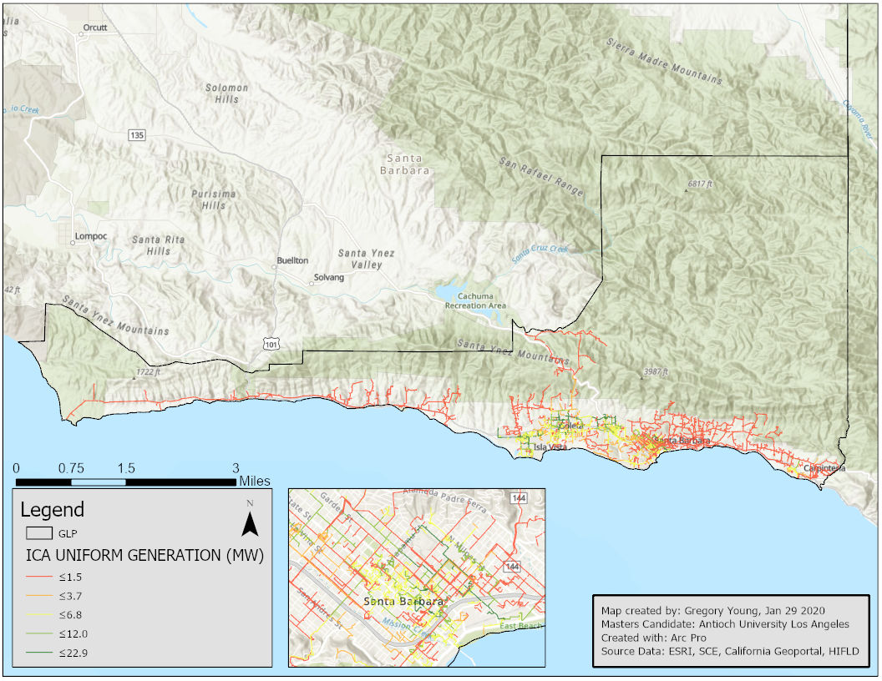
Distribution Resources External Portal integration capacity analysis (ICA) maps

Slide 19
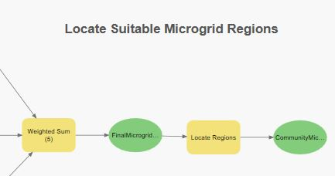
Creating the final suitability layer and locating regions
Weighted sum tool:
Gave all criteria the same weighted values, but these values could be changed based on what criteria a community deems to be more desirable (e.g., critical community facilities more important than low-income communities).
Locate regions tool:
Identifies the best regions that meet specified size requirements and spatial constraints.
Chose to locate five regions across the GLP

Slide 20
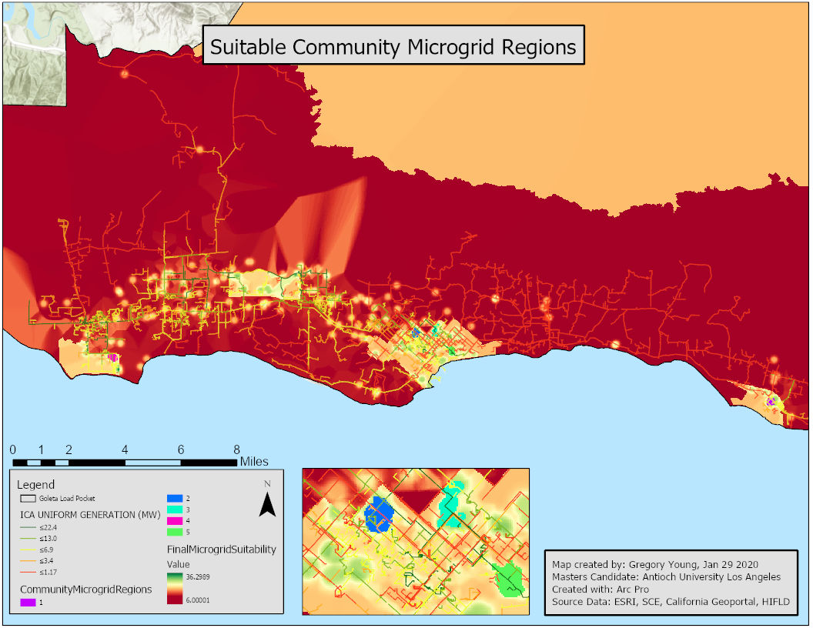
Optimal locations for Community Microgrids

Slide 21
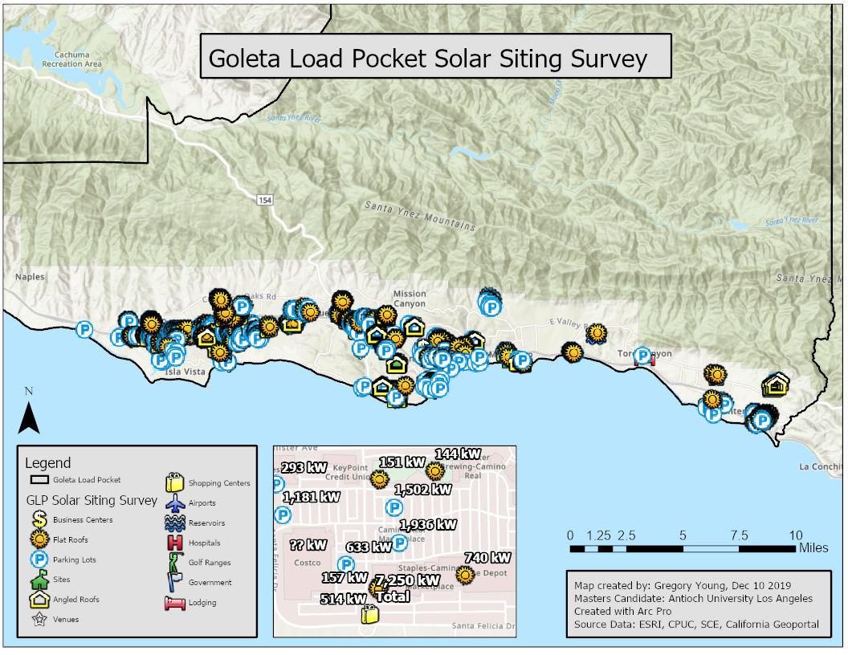
Solar Siting Survey across the GLP

Slide 22
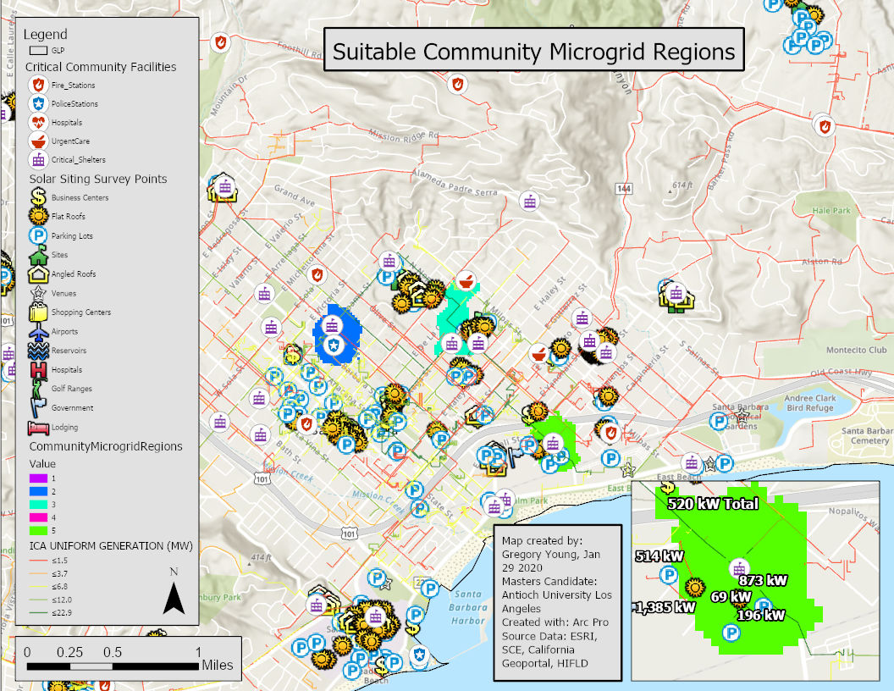
Community Microgrid regions with Solar Siting Survey

Slide 23
Final Community Microgrid Suitability Model

Slide 24

Replicability
This model was designed so that very few pieces need to be changed when conducting the analysis on a different study area:
  Swap out study area boundaries.
  Adjust disadvantaged/low-income community layers as needed.
  Swap out ICA data depending on which investor-owned utility (IOU) serves the study area.
  Consider if other critical community facilities should be included.
  If a Solar Siting Survey is desirable, then the Clean Coalition can provide this service.
  Consider if the criteria in the model should receive different weighted values

Slide 25
Community Microgrids are the grid of the future
A Community Microgrid is a new approach for designing and operating the electric grid, stacked with local renewables and staged for resilience.
Key features:
A targeted and coordinated distribution grid area served by one or more substations – ultimately including a transmission-distribution substation that sets the stage for Distribution System Operator (DSO) performance.
Ability to utilize existing distribution grid infrastructure to serve the Community Microgrid during broader grid outages
High penetrations of local renewables and other distributed energy resources (DER) such as energy storage and demand response.
Staged capability for indefinite renewables-driven backup power for critical community facilities across the grid area – achieved by 25% local renewables mix.
A solution that can be readily extended throughout a utility service territory – and replicated into any utility service territory around the world.
Notes:
By locating regions using the criteria previously discussed we are successfully locating a targeted and coordinated distribution grid area.
By using the ICA feeder data we are utilizing existing grid infrastructure with the highest capacity for interconnection.
By including a Clean Coalition Solar Siting Survey in this model we are ensuring that high penetrations of local renewables are included in this part of the planning processes.
By including critical community facilities as a criteria, we are ensuring that the indefinite renewables-driven backup power that Community Microgrids provide are being
Along with a Community Microgrid being a solution that can be readily extended throughout a utility service territory – and replicated into any utility service territory around the world, this Community Microgrid Suitability model has the ability to be replicated throughout a utility service territory as well. As more load serving entities (LSE) release their ICA data then the more territory this model can cover.

Slide 26
Data and information sources
Critical community facilities data (Homeland Infrastructure Foundation-Level Data)
Disadvantaged and low-income data (Priority Populations) maps and data
SCE ICA maps
  No registration required.
  Has limited viewing capabilities. Can’t toggle off opflex but shows values for non-opflex when you click on a feeder segment.
  Spatial data can be found using the ArcGIS webmap or in the ArcGIS Pro software Geospatial Portal.
PG&E ICA maps
  Must create a login for access.
  Poor user interface.
  Map toggles itself between Feeder level (RAM) and Line level (ICA) based on the visibility range.
  Spatial data can be downloaded straight from the interactive map’s front page (top right corner) but not directly available via the ArcGIS webmap.
SDG&E ICA maps:
  Must register with SDG&E; once registered, SDG&E will send an email that contains a web link, username, password, and instructions to access and use the map.
  Spatial data not directly available via the ArcGIS webmap but can be downloaded once SDG&E has provided you access to their interactive ICA map.
Clean Coalition Solar Siting Surveys

Slide 27
Questions?
Gregory Young
Program Associate
Email Gregory with questions at gregory@clean-coalition.org
clean-coalition.org

Slide 28
Backup slides
Backup slides

Slide 29
Percentage of time online for Tier 1, 2, and 3 loads for net zero solar + 2 hours storage microgrid at UCSB
Percentage of total load
Tier 3 = Discretionary load, ~75% of total load
Tier 2 = Priority load, ~15% of total load
Tier 1 = Critical, life-sustaining load, ~10% of total load
Percentage of time

Slide 30
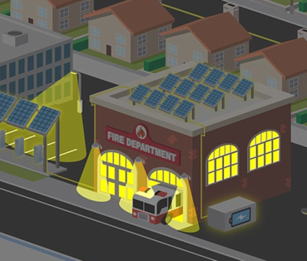
Value of Resilience (VOR) depends on tier of load
Everyone understands there is significant value to resilience provided by indefinite renewables-driven backup power
  But no one has yet quantified the value of this unparalleled resilience.
  Hence, there is an economic gap for innovative Community Microgrid projects while learning is still is the early stages.
The Clean Coalition aims to establish a standardized Value of Resilience (VOR) for critical, priority, and discretionary loads that will help everyone understand that premiums are appropriate for indefinite renewables-driven backup power for critical loads and almost constant backup power for priority loads, which yields a configuration that delivers backup power to all loads a lot of the time
The Clean Coalition’s VOR approach will establish standardized values for resilience of three tiers of loads:
  Tier 1 loads, usually about 10% of the total load, are mission-critical and life-sustaining loads, crucial to keep operational at all times, including during grid outages.
  Tier 2 loads, usually about 15% of the total load, are priority loads that should be maintained as long as long as doing so does not threaten the ability to maintain Tier 1 loads.
  Tier 3 loads, usually about 75% of the total load, are the remaining, discretionary loads and are maintained when doing so does not threaten the ability to maintain Tier 1 & 2 loads.

