Slide 1
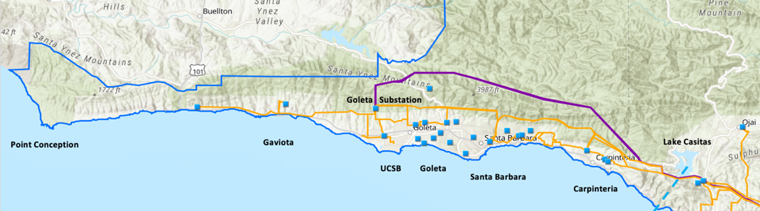
Unleashing Local Dispatchable Solar
San Diego Energy District 2020 Virtual Symposium
Craig Lewis
Executive Director
650-796-2353 mobile
craig@clean-coalition.org
5 June 2020

Slide 2
Local solar constraints & assumptions
Solar siting opportunities in any urban & suburban areas will predominantly be on built-environments like rooftops, parking lots, and parking structures
  Planning will be greatly informed by surveying associated solar siting potential.
  Hence, the Clean Coalition conducted a Solar Siting Survey (SSS) for the City of San Diego.
Achieving 25% local renewables will require unleashing Wholesale Distributed Generation (WDG)
  Only proven approach is a Feed-In Tariff (FIT).
  Hence, the Clean Coalition designed a FIT for the City of San Diego.
Achieving renewables-driven resilience will require high penetrations of local renewables that are dispatchable
  Hence, the FIT includes a mechanism for ensuring that energy storage is deployed in a manner that makes renewable energy available whenever needed, not just when the sun is shining or wind is blowing etc.
Notes:
2

Slide 3
WDG provides the gradient path to success
Wholesale Distributed Generation (WDG) is the market segment that is primed to truly unleash local solar.

Slide 4
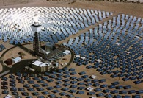
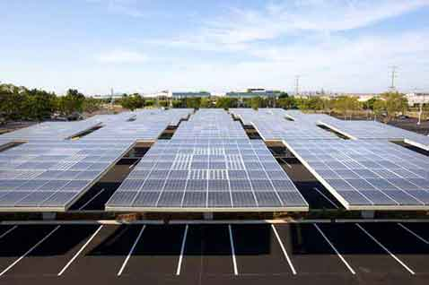



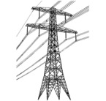

FITs address the WDG market segment
Project Size
Central Generation
Serves Remote Loads
50+ MW
Wholesale DG
Serves Local Loads
500 kW
Retail DG
Serves Onsite Loads
5 kW
Behind the Meter
Distribution Grid
Transmission Grid

Slide 5
FITs proliferated WDG solar in Germany
Solar Markets: Germany vs California (2002-2012)
Cumulative MW
Sources: CPUC, CEC, SEIA and German equivalents.
Germany deployed over 10 times more solar than California in the decade from 2002 — despite California having 70% better solar resource.

Slide 6
Solar Siting Surveys (SSS)
Solar Siting Survey (SSS)
for
City of San Diego

Slide 7
SSS methodology
SSS is performed manually through a multi-step process:
Set a minimum project size for the SSS.
Scan the target region via Google Earth Pro for prospective solar sites on built-environments (rooftops, parking lots, and parking structures) that meet the minimum project size.
Measure the usable surface area and eliminate obvious portions that are not viable due to setbacks, obstructions, and/or shading.
Assess the probable solar generation density against the minimum project size threshold (1 MWac for this SSS).
Where sensible, aggregate campus-type structures that are likely to have common ownership into a single site (examples being parking lots and rooftops in a shopping center, industrial park, or school campus).
Capture the details, including the interconnection hosting capacity.
Map the results.

Slide 8
Summary of SD SSS findings (all figures in AC)
Over 490 MW of technical solar siting potential was found on built environments that can support projects sized at least 1 MW.
75% of the potential is in parking lots and parking structures.
Extrapolations to lower minimum project sizes:
  Total potential doubles to 1 GW if project limit set at 500 kW.
  Total potential doubles again to 2 GW if project limit set at 100 kW.

Slide 9
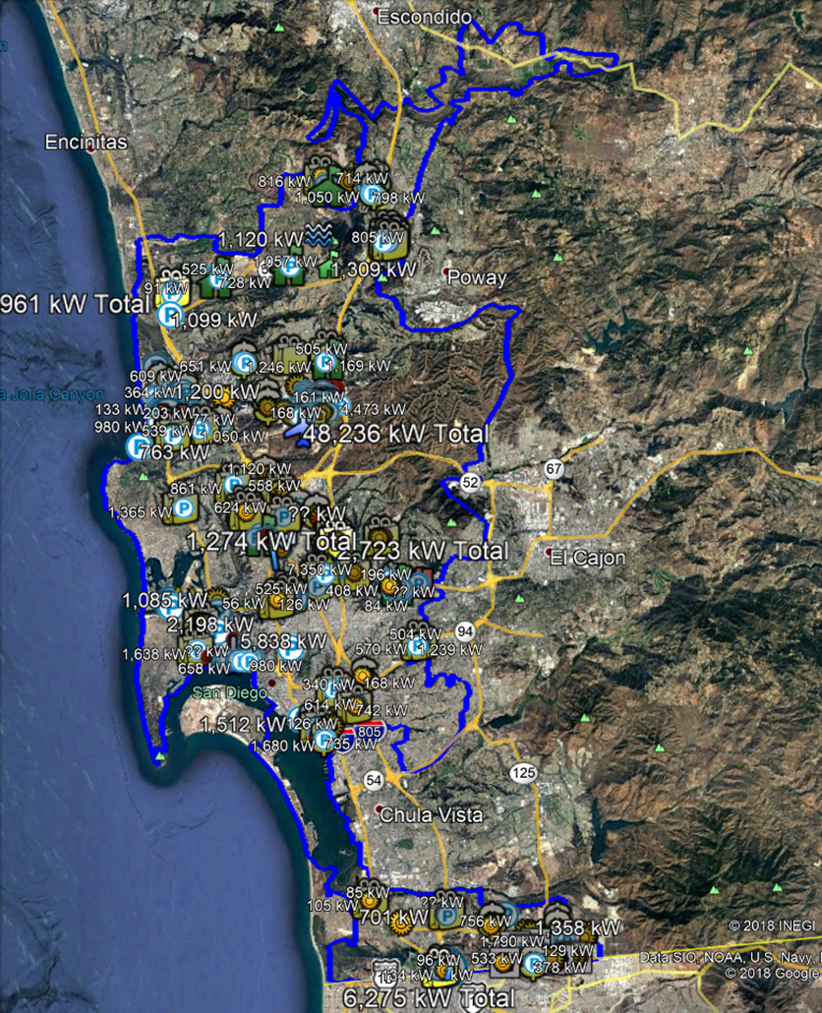
Overview of SD SSS sites
Over 490 MW of
Solar Siting Potential identified
Sites >1 MW
On built-environments

Slide 10
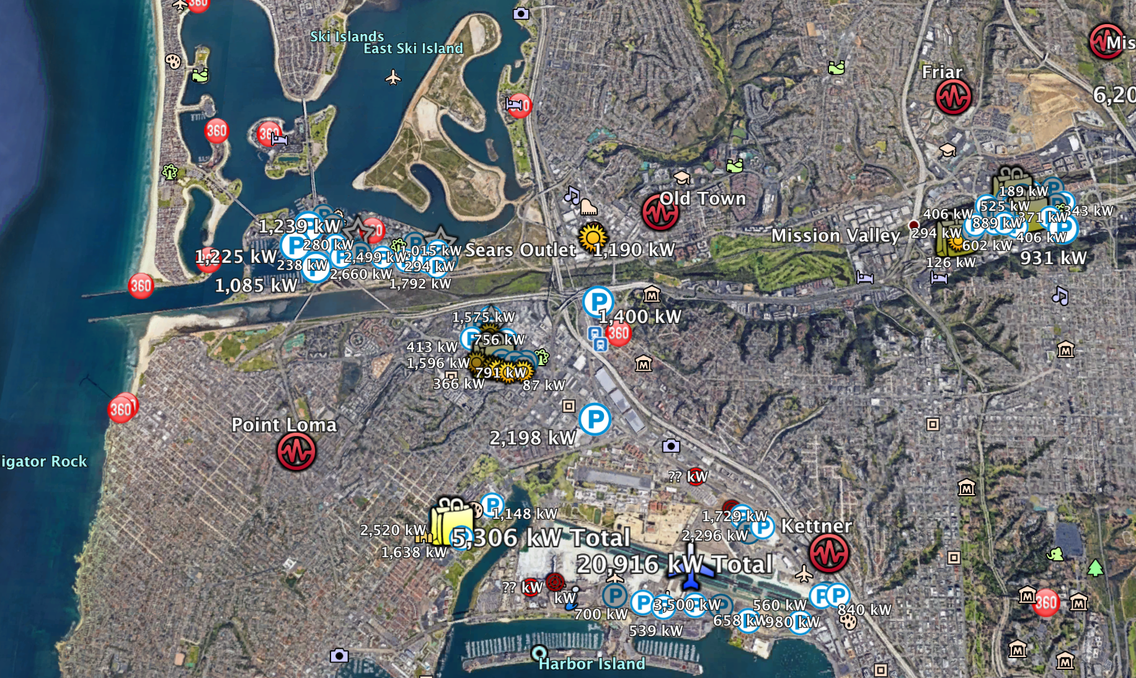
Sears Outlet

Slide 11
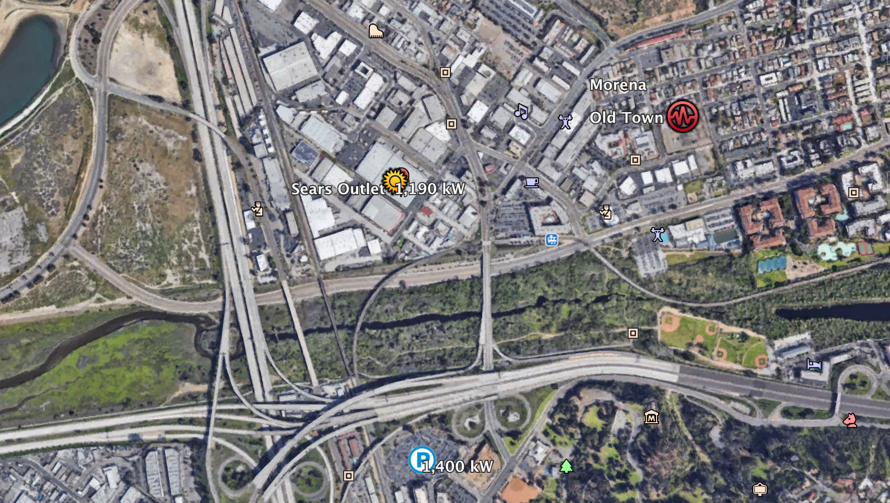
Sears Outlet

Slide 12
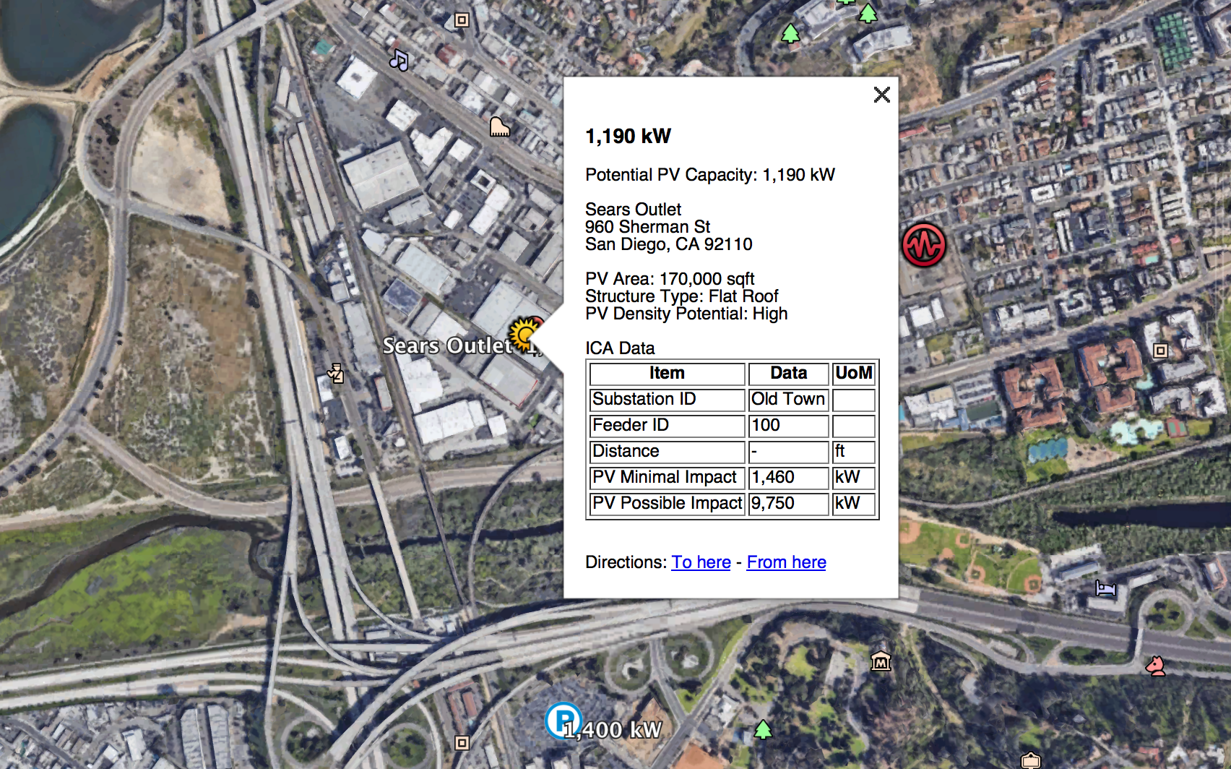
Sears Outlet

Slide 13
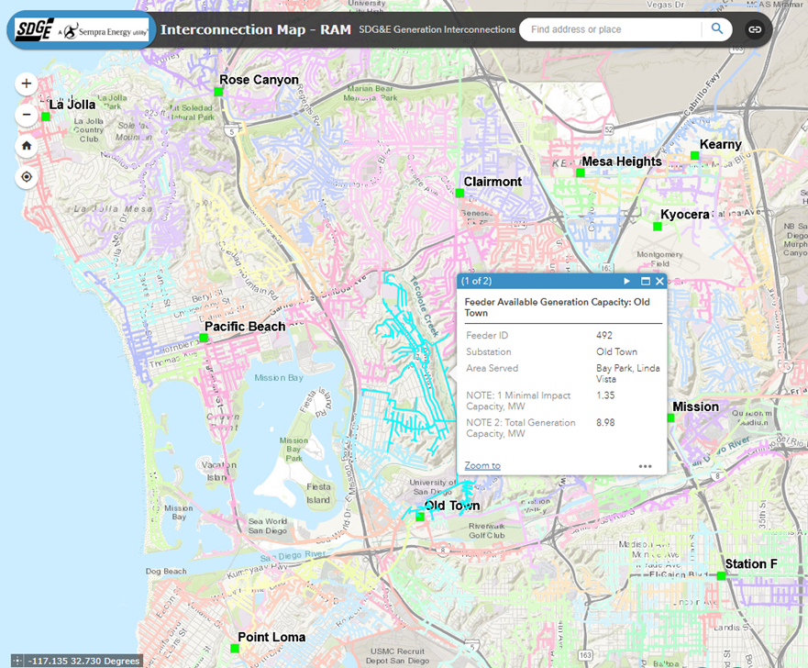
SD feeder map

Slide 14
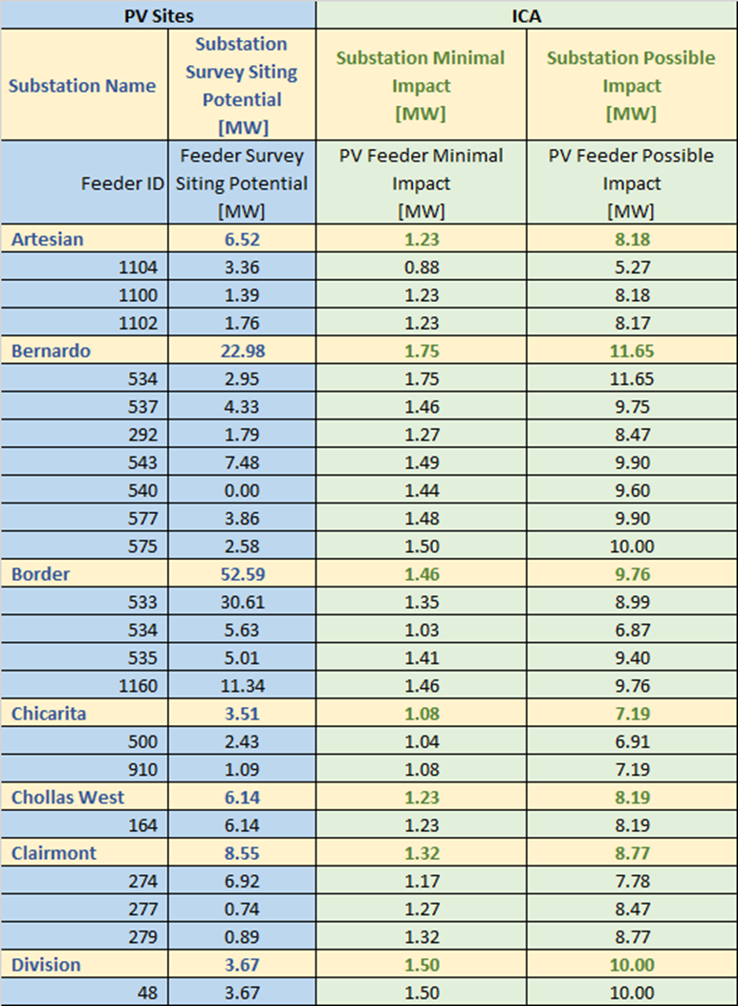
SD substation & feeder hosting capacities

Slide 15
Clean Coalition FIT design for The City of San Diego
Feed-In Tariff
for
City of San Diego

Slide 16
Why FITs are the world-class solution
FITs are unparalleled in unleashing
cost-effective, commercial-scale renewables

Slide 17

FITs keep things simple
Standardized and guaranteed contract between the solar or solar+storage facility and the Load Serving Entity (LSE) with a long-term, predefined rate paid for energy produced
FIT project
100% of the renewable energy generation is purchased by SDGE at FIT rate
100% of customer energy usage is purchased based on a normal retail rate
Utility customer
Notes:
17

Slide 18
FITs efficiently open the WDG market segment
FITs offer clear guidance to the market through predefined terms and prices, thereby allowing project developers to qualify their planned projects before undertaking significant investment in siting, interconnection, etc.
A clear, predictable purchase offer — and a simple, standardized contract for use between a LSE and energy generators — streamline the development of clean local energy. Not only does this approach nearly eliminate speculative projects, but it also drives down renewable energy development costs.
FITs secure projects that will be built immediately and proven to deliver power within 12 to 18 months.
Avoid limitations associated with Net Energy Metering (NEM).
Avoid issues associated with solicitation processes.
Notes:
18

Slide 19
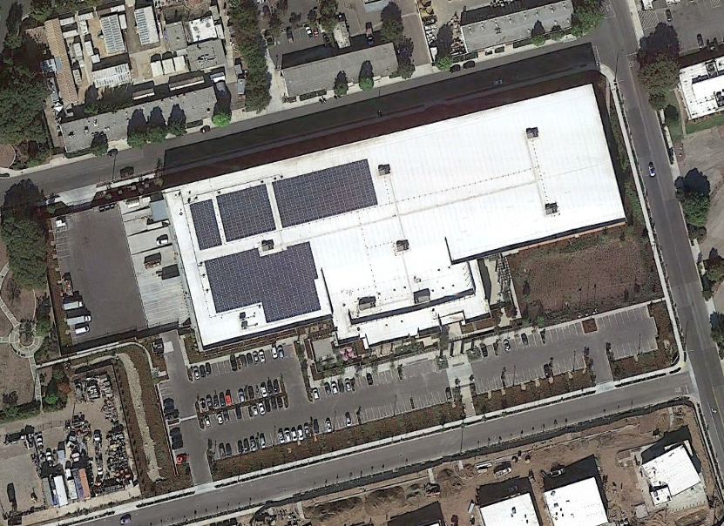
Direct Relief is a Solar Microgrid showcase
Resilience is required:
  320 kW PV
  676 kWh Storage
  600 kW diesel generator
  4000 gallons of diesel fuel
PV annual generation designed to cover annual consumption.
Storage designed to time-shift the generation to more valuable times, and provide Resilience.
Genset provides “back-up to the back-up”.
Direct Relief Microgrid requirement is that the critical loads are operational indefinitely, even through local disasters that causes long-term interruptions to normal electricity service.
676 kWh Li
320 kW PV
600 kW diesel generator with 4,000 gallon tank

Slide 20
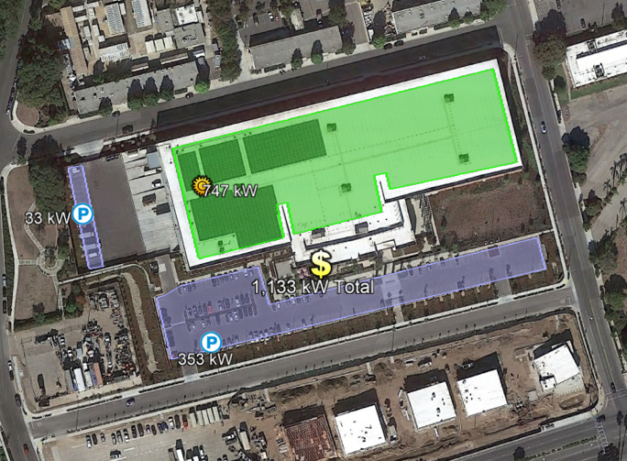
NEM limitations create a Stranded Opportunity
Microgrid only serves Direct Relief needs:
70% of roof and 100% of massive parking area solar potential is unused.
Additional storage not able to be considered due to policy prohibitions around exporting energy from a battery to the grid – even though the energy is 100% stored solar.
Ready to do way more:
1,133 kW in total solar siting potential, 427 kW more rooftop and 386 kW in parking lots.
Existing switch gear is already sized for the expansion and is just awaiting the policy innovation!

Slide 21
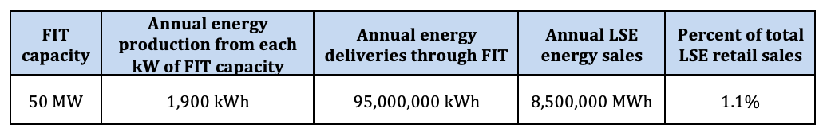
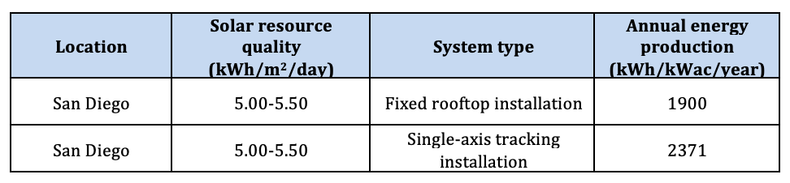
City of San Diego FIT program size
A 50 MW FIT will provide roughly 1.1% of the City of San Diego’s annual electric load
Annual production of 1,900 kWh/kWac of FIT capacity is based on solar resource analysis for the City of San Diego, as we expect PV to be the dominant FIT technology

Slide 22
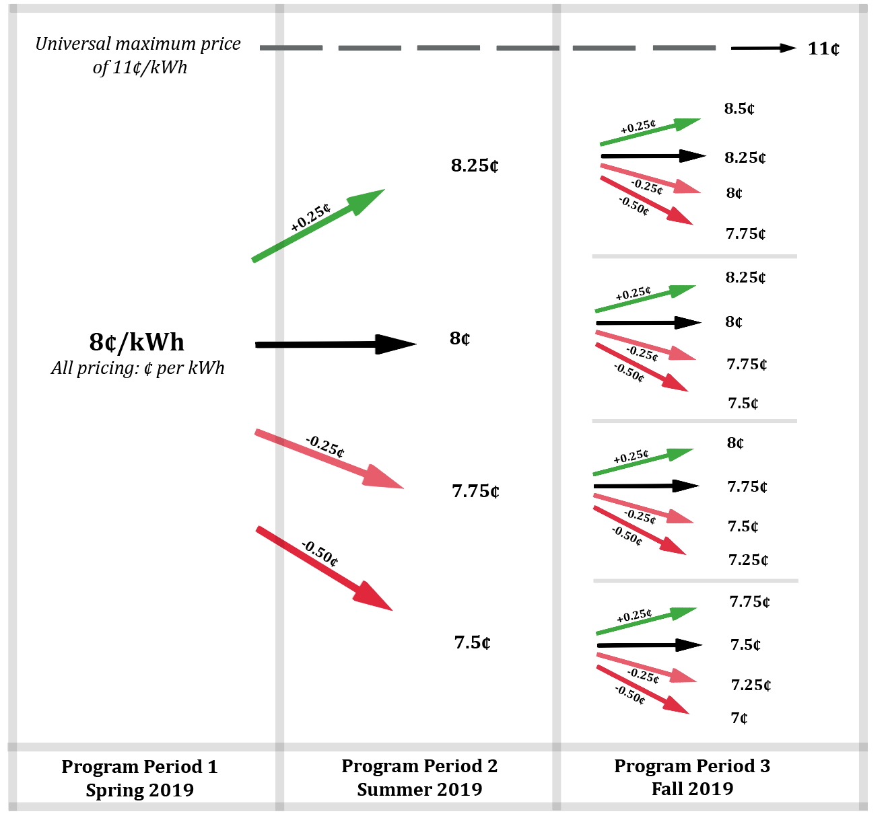
SD FIT Market Responsive Pricing (MRP)
Once baseline pricing is set for the initial FIT tranche, MRP governs baseline pricing, which can never exceed a universal maximum of 11¢/kWh.

Slide 23
City of San Diego FIT pricing adders
The concept of pricing adders is simple
  A Load Serving Entity (LSE) identifies the characteristics it would like to see in its FIT projects and then creates adders to its baseline FIT price to incentivize projects with these characteristics.
The Clean Coalition recommends the LSE implement four pricing adders:
  Built-environment adder at 20%
    Rooftops, parking lots, parking structures, etc.
  Small project adder at either 10% or 20%
    10% for projects larger than 100 kW and less than or equal to 350 kW.
    20% for projects less than or equal to 100 kW.
  Community benefit adder at 5%
    Tax-exempt and/or within Communities of Concern.
  Dispatchability adder at 15¢/kWh
    Eligible for guaranteed daily dispatchable renewable energy at 2-4 hours of nameplate renewable energy FIT project.

Slide 24
Dispatchable Energy Capacity Services (DECS)
Load Serving Entity (LSE)
Storage Asset Owner
LSE contracts for dispatchable daily cycling of energy capacity (kWh), at a fixed $/kWh fee, used or not.
LSE optimizes fully flexible energy capacity, dispatching for any purpose, which could be based on time of day, day of week, season, event, and/or other optimizations over the DECS contract period.
Initial DECS contracts are priced at Cost of Service (COS) while subsequent DECS contract pricing is adjusted for market response.
Owner Reserve
Owner retains discretion over any capacity not under DECS contract.
Owner earns guaranteed $/kWh payments for the DECS-contracted energy capacity.
Owner retains discretion over any capacity not under DECS contract.
DECS contracted
energy
capacity (kWh)
kWh
$
Owner Reserve
DECS offers a single bankable revenue stream for energy storage owners and a fully flexible & dispatchable energy source for LSEs available daily.
Three COS components:
Net Cost of Energy (NCOE).
Capital expenditure ("capex").
Operating expenditure ("opex").

Slide 25
Percentage of time online for Tier 1, 2, and 3 loads for net zero solar + 2 hours of storage microgrid at UCSB
Percentage of total load
Tier 3 = Discretionary load, ~75% of total load
Tier 2 = Priority load, ~15% of total load
Tier 1 = Critical, life-sustaining load, ~10% of total load
Percentage of time

Slide 26
BESS energy capacity allocations
Top owner reserve is often in place to absorb BESS degradation over time, while still delivering the contracted daily cycling energy capacity.
Owner reserve
SOCr = the minimum state-of-charge (SOC) that is reserved for provisioning resilience. The SOCr can be dynamic and/or resized to between 0% and 100% of the contracted BESS energy capacity. A lower SOCr facilitates BESS operations that optimize daily economic performance while a larger SOCr facilitates the provisioning of higher resilience.
Contracted BESS energy capacity (kWh) that must be available for daily cycling over the contract duration for achieving specified economic & resilience performance.
SOCr
Bottom owner reserve is often required to meet BESS warranty requirements that are imposed by BESS vendors.
Owner reserve

