Slide 1
Percentage of time online for Tier 1, 2, and 3 loads for a Solar Microgrid designed at University of California Santa Barbara (UCSB) with enough solar to achieve net zero and energy storage capacity hold to 2 hours of the nameplate solar (2 MWh energy storage per 1 MW solar)
Load tiering & valuing resilience (“VOR123”)
Percentage of total load
Tier 3 = Discretionary load, ~75% of total load
Tier 2 = Priority load, ~15% of total load
Tier 1 = Critical, life-sustaining load, ~10% of total load
Percentage of time

Slide 2
Batteries optimized for economics & resilience
Top owner reserve is often in place to absorb BESS degradation over time, while still delivering the contracted daily cycling energy capacity.
Owner reserve
SOCr = the minimum state-of-charge (SOC) that is reserved for provisioning resilience. The SOCr can be dynamic and/or resized to between 0% and 100% of the contracted BESS energy capacity. A lower SOCr facilitates BESS operations that optimize daily economic performance while a larger SOCr facilitates the provisioning of higher resilience.
Contracted BESS energy capacity (kWh) that must be available for daily cycling over the contract duration for achieving specified economic & resilience performance.
SOCr
Bottom owner reserve is often required to meet BESS warranty requirements that are imposed by BESS vendors.
Owner reserve

Slide 3
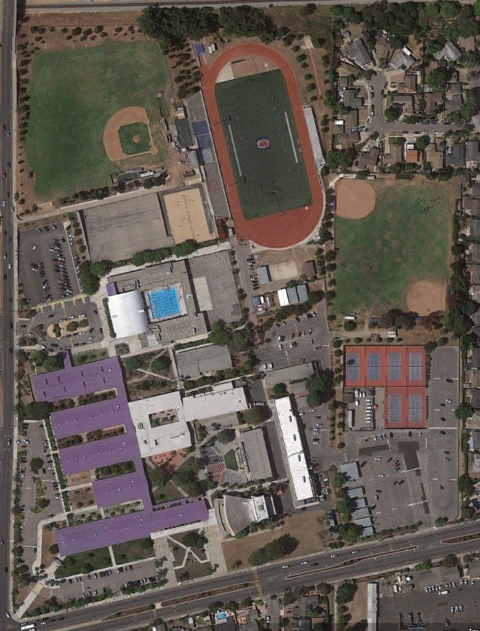
San Marcos High School (SMHS)
SMHS is a large public high school serving just over 2,000 grade 9-12 students.
Red Cross designated facility.
School features include:
Array of classroom buildings
Large Pool
Gymnasium
Football stadium
Multiple baseball fields
Cafeteria
Outdoor Greek theater
Auditorium
Numerous tennis & basketball courts
Craig Lewis in the Class of 1981.

Slide 4
SMHS Solar Microgrid overview
The SMHS Solar Microgrid is intended to enable the school to operate independently during grid outages of any duration with indefinite resilience for the most critical loads and resilience for all loads for significant percentages of time.
Solar
725 kWp
Solar is entirely in the form of solar parking canopies
Net Zero Energy (NZE) is exceeded at 101%
Battery Energy Storage System (BESS)
700 kWh energy capacity
350 kW power capacity
Critical (Tier 1) loads
Food service refrigerators & freezers, maintained indefinitely
4.36 kW of average load
3.44% of total average load
Priority (Tier 2) loads
Gym lights and Main Distribution Frame, maintained at least 80% of the time
4.32 kW of average load
3.41% of total average load

Slide 5
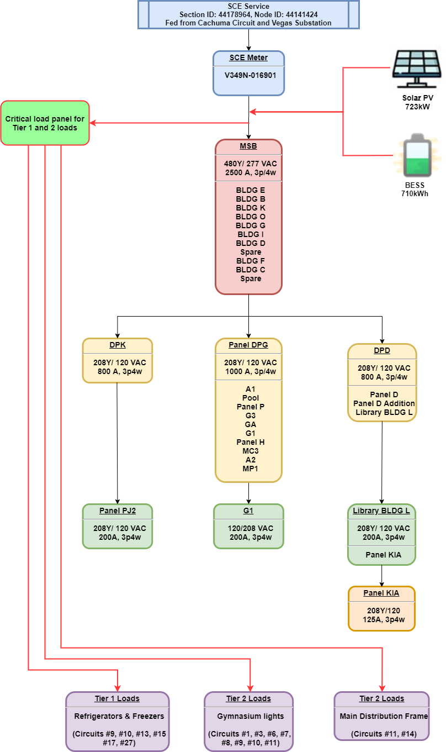
Load Management is fundamental to VOR123
Although there are multiple potential Load Management configurations, the minimal functionality anticipated to be cost-effectively implemented is referred to as the Critical Load Panel (CLP) approach.
The CLP name reflects the requirement for a smart critical load panel that maintains Tier 1 loads indefinitely and toggles Tier 2 loads. In the CLP approach, Tier 3 loads will be toggled as a group by toggling power to the Main Service Board (MSB). Figure 9 illustrates the CLP approach for SMHS, with Tier 1 and Tier 2 loads being served by new dedicated wire runs that connect to a new smart critical load panel.

