Slide 1
Solar Microgrids
Unparalleled trifecta of economic, environmental,
and resilience benefits
Craig Lewis
Executive Director
Clean Coalition
650-796-2353 mobile
craig@clean-coalition.org
29 September 2020

Slide 2
Clean Coalition (nonprofit)
Mission
To accelerate the transition to renewable energy and a modern grid through
technical, policy, and project development expertise.
100% renewable energy end-game
  25% local, interconnected within the distribution grid and facilitating resilience without dependence on the transmission grid.
  75% remote, dependent on the transmission grid for serving loads.
Notes:
2

Slide 3
Solar Microgrid key concepts
Solar Microgrid key concepts

Slide 4
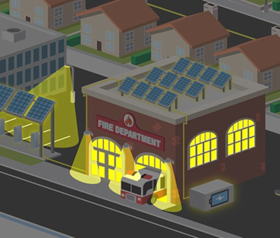
Value-of-resilience (VOR) depends on tier of load
Everyone understands there is significant value to resilience provided by indefinite renewables-driven backup power, especially for the most critical loads
  But, nobody has quantified this value of unparalleled resilience.
  Hence, there is a substantial economic gap for renewables-driven microgrids.
The Clean Coalition aims to establish a standardized value-of-resilience (VOR) for critical, priority, and discretionary loads that will help everyone understand that premiums are appropriate for indefinite renewables-driven backup power to critical loads and almost constant backup power to priority loads, which yields a configuration that delivers backup power to all loads a lot of the time
The Clean Coalition’s VOR approach (“VOR123”) standardizes resilience values for three tiers of loads:
  Tier 1 are mission-critical & life-sustaining loads and warrant 100% resilience. Tier 1 loads usually represent about 10% of the total load.
  Tier 2 are priority loads that should be maintained as long as long as doing so does not threaten the ability to maintain Tier 1 loads. Tier 2 loads usually represent about 15% of the total load.
  Tier 3 are discretionary loads make up the remaining loads, usually about 75% of the total load. Maintained when doing so does not threaten Tier 1 & 2 resilience.

Slide 5
Percentage of time online for Tier 1, 2, and 3 loads for a Solar Microgrid designed for the University of California Santa Barbara (UCSB) with enough solar to achieve net zero and enough energy storage capacity to hold 2 hours of the nameplate solar (200 kWh energy storage per 100 kW solar).
Typical load tier resilience from a Solar Microgrid
Percentage of total load
Tier 3 = Discretionary load, ~75% of total load
Tier 2 = Priority load, ~15% of total load
Tier 1 = Critical, life-sustaining load, ~10% of total load
Percentage of time

Slide 6
A typical diesel generator is configured to maintain 25% of the normal load for two days. f diesel fuel cannot be resupplied within two days, goodbye. This is hardly a solution for increasingly necessary long-term resilience. In California, Solar Microgrids provide a vastly superior trifecta of economic, environmental, and resilience benefits.
Diesel generators are designed for limited resilience
Percentage of total load
Tier 3 = Discretionary load, ~75% of total load
Tier 2 = Priority load, ~15% of total load
Tier 1 = Critical, life-sustaining load, ~10% of total load
Percentage of time

Slide 7
VOR123 methodology yields a 25% typical adder
There are different VOR multipliers for each of the three load tiers. The following valuation ranges are typical for most sites:
Tier 1: 100% resilience is worth 3 times the average price paid for electricity. In other words, indefinite energy resilience for critical loads is worth 3 times the average price paid for electricity. Given that the typical facility has a Tier 1 load that is about 10% of the total load, applying the 3x VOR Tier 1 multiplier warrants a 20% adder to the electricity bill.
Tier 2: 80% resilience is worth 1.5 times the normal price paid for electricity. In other words, energy resilience that is provisioned at least 80% of the time for priority loads is worth 1.5 times the average price paid for electricity. Given that the typical facility has a Tier 2 load that is about 15% of the total load, applying the 1.5x VOR Tier 2 multiplier warrants a 7.5% adder to the electricity bill.
Tier 3: Although a standard-size Solar Microgrid can provide backup power to Tier 3 loads a substantial percentage of the time, Tier 3 loads are by definition discretionary, and therefore, a Tier 3 VOR multiplier is negligible and assumed to be zero.
Taken together, the Tier 1 and Tier 2 premiums for a standard load tiering situation yields an effective VOR of between 25% and 30%. Hence, the Clean Coalition uses 25% as the typical VOR123 adder that a site should be willing to pay, including for indefinite renewables-driven backup power to critical loads — along with renewables-driven backup for the rest of the loads for significant percentages of time.

Slide 8
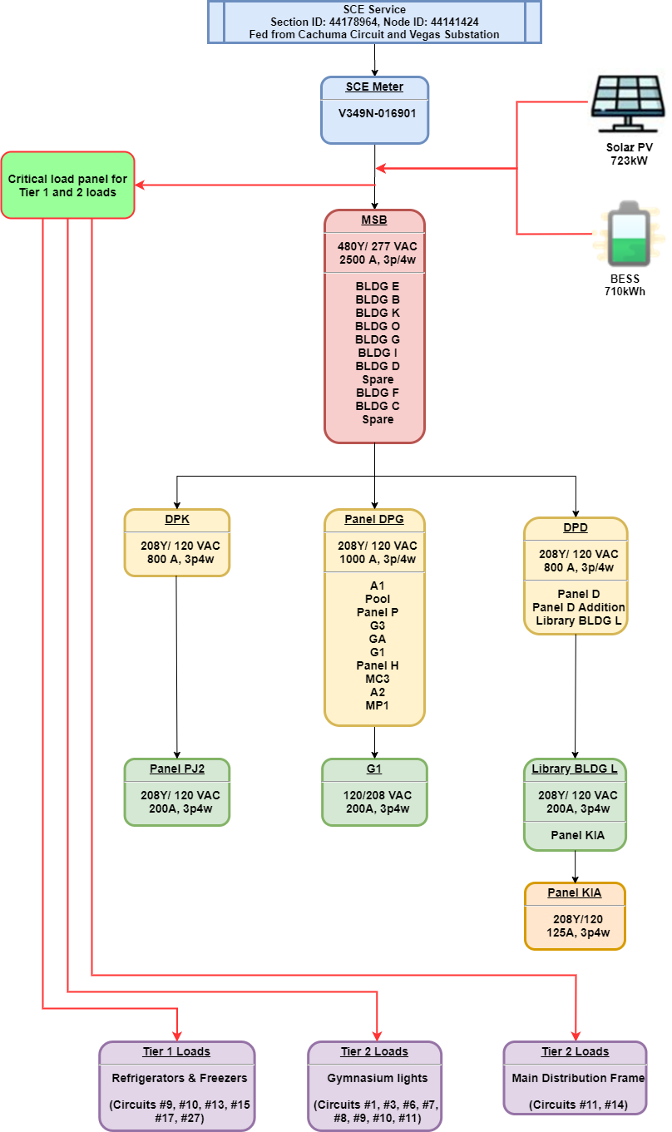
Load Management is fundamental to VOR123
Although there are multiple potential Load Management configurations, the minimal functionality anticipated to be cost-effectively implemented is referred to as the Critical Load Panel (CLP) approach.
The CLP name reflects the requirement for a smart critical load panel that maintains Tier 1 loads indefinitely and toggles Tier 2 loads. In the CLP approach, Tier 3 loads will be toggled as a group by toggling power to the Main Service Board (MSB). Figure 9 illustrates the CLP approach for SMHS, with Tier 1 and Tier 2 loads being served by new dedicated wire runs that connect to a new smart critical load panel.

Slide 9
Batteries optimized for economics & resilience
Top owner reserve is often in place to absorb battery energy storage system (BESS) degradation over time, while still delivering the contracted daily cycling energy capacity.
Owner reserve
SOCr = the minimum state-of-charge (SOC) that is reserved for provisioning resilience. The SOCr can be dynamic and/or resized to between 0% and 100% of the contracted BESS energy capacity. A lower SOCr facilitates BESS operations that optimize daily economic performance, while a higher SOCr facilitates the provisioning of greater resilience.
Contracted BESS energy capacity (kWh) that must be available for daily cycling over the contract duration for achieving specified economic & resilience performance.
SOCr
Bottom owner reserve is often required to meet BESS warranty requirements that are imposed by BESS vendors.
Owner reserve

Slide 10
SBUSD Solar Microgrids case study
Santa Barbara Unified School District (SBUSD)
Solar Microgrids case study

Slide 11
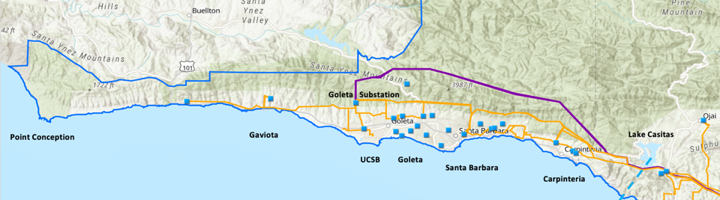
SMHS is vulnerable to long transmission outages
SMHS is located in the middle of one of the most grid-vulnerable regions in California: the Goleta Load Pocket (GLP).
The GLP spans 70 miles of California coastline, from Point Conception to Lake Casitas, encompassing the cities of Goleta, Santa Barbara (including Montecito), and Carpinteria.
The GLP is served by a single 40-mile transmission line routed through mountainous and disaster-prone terrain.
Southern California Edison (SCE) has identified the GLP’s transmission path as being vulnerable to catastrophic failure from fire, earthquake, and/or landslides that could cause a crippling, extended blackouts of weeks or even months in duration.

Slide 12
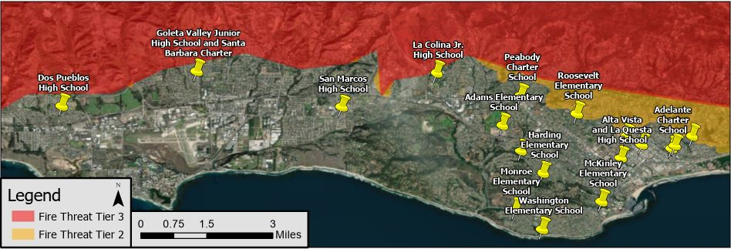
Santa Barbara Unified School District (SBUSD)
The entire Santa Barbara region is surrounded by extreme fire risk (earthquake & landslide risk too) and is extremely vulnerable to electricity grid outages.
The SBUSD is a major school district that increasingly recognizes the value-of-resilience (VOR) and has embraced the Clean Coalition’s vision to implement Solar Microgrids at a number of its key schools and other critical facilities.
SMHS is in the middle of the extensive SBUSD service area.

Slide 13
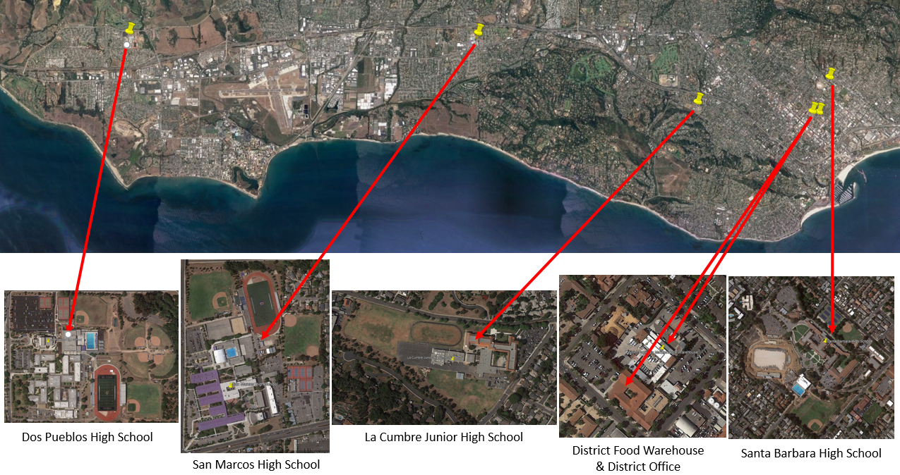
Six SBUSD Solar Microgrid sites

Slide 14
SBUSD unanimously approves Solar Microgrids
After a comprehensive feasibility study and a state-of-the-art Request for Proposal (RFP) process, on 22 September 2020, the SBUSD Board approved moving forward with the Solar Microgrids:
100% for Tier 1 loads (critical loads), 80% resilience for Tier 2 loads (priority loads), and about 25% resilience for Tier 3 loads (all remaining loads, which are totally discretionary).
Millions of dollars in economic benefits via a 28-year Power Purchase Agreement (PPA) and millions more in value-of-resilience (VOR), for free.
In addition to the six Solar Microgrids, eight additional schools will be getting solar parking canopies, enough to approximately net zero in all cases.

Slide 15
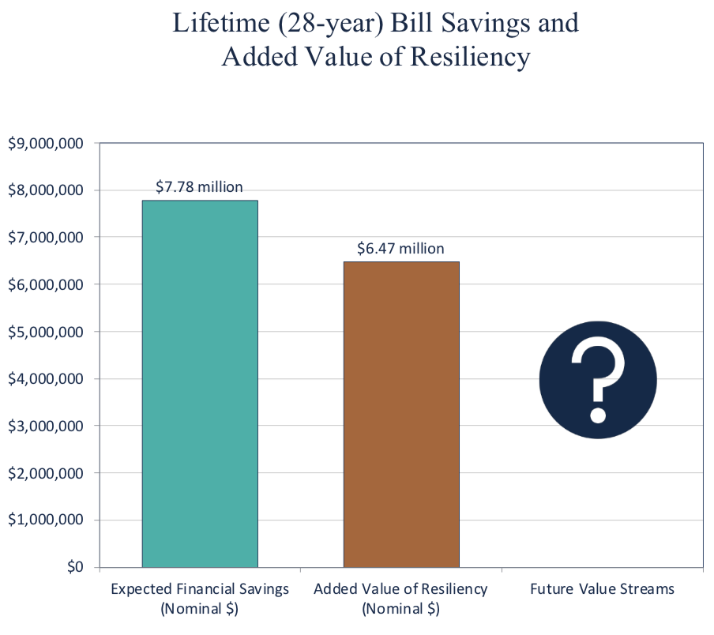
Guaranteed SBUSD bill savings and free VOR

Slide 16
City of Camarillo feasibility study
City of Camarillo feasibility study

Slide 17
Camarillo feasibility study sites & constraints
Determine the critical electrical needs for each site during a power outage, including business continuity for the following sites:
    City Hall
    Corp Yard
    Library
    Police Station
    WWTP
Provide recommendations for a standby power system that meets the City's environmental, economic, and resilience goals.
Analyze system power rating for 150% of the average daily use and meet peak demand.
Analyze a system capable of serving the building loads through 120-hours (5 days) of outage.
Recommend an optimal microgrid standby system that strengthens resiliency and is financially feasible.
Notes:
The high level project goals for this feasibility study are to:
Assess existing electrical infrastructure at all 5 sites to determine their critical loads and operational needs
Provide a recommendation for a backup power system to meet the City’s goals
Specific objectives
Provide a backup system with power rating of at least 150% of average daily use that is able to serve the buildings for a 120 hour outage
Provide a recommended optimal backup system that strengthens resiliency and is financially feasible

Slide 18
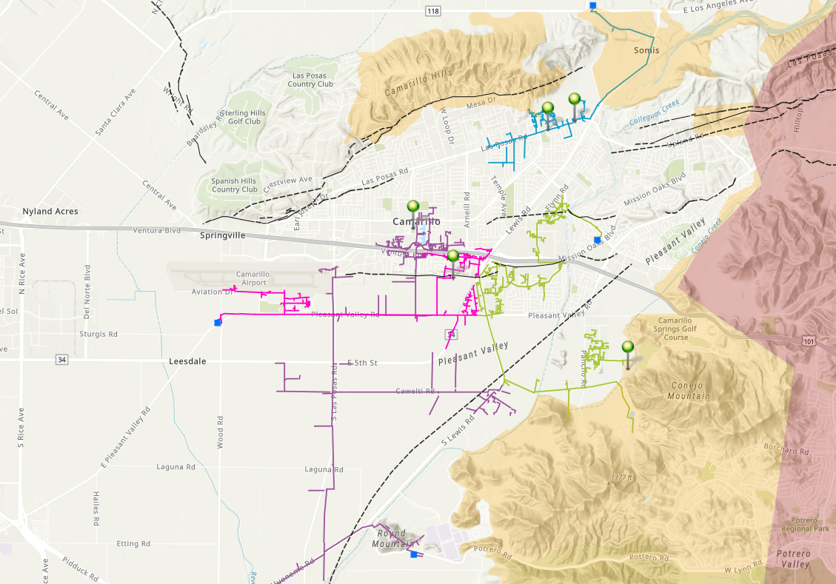
Fire & earthquake risk to Camarillo critical community facilities (CCFs)
Library
Police Station
Clemson feeder in Tier 2 Fire Threat
City Hall
Corp Yard
N
Quaternary Earthquake Faults
Fire Threat T2
Fire Threat T3
Clemson 16 kV Feeder
Flynn 16kV Feeder
Arneill 16 kV Feeder
Redstone 16 kV Feeder
WWTP
(In Tier 2 Fire Threat)

Slide 19
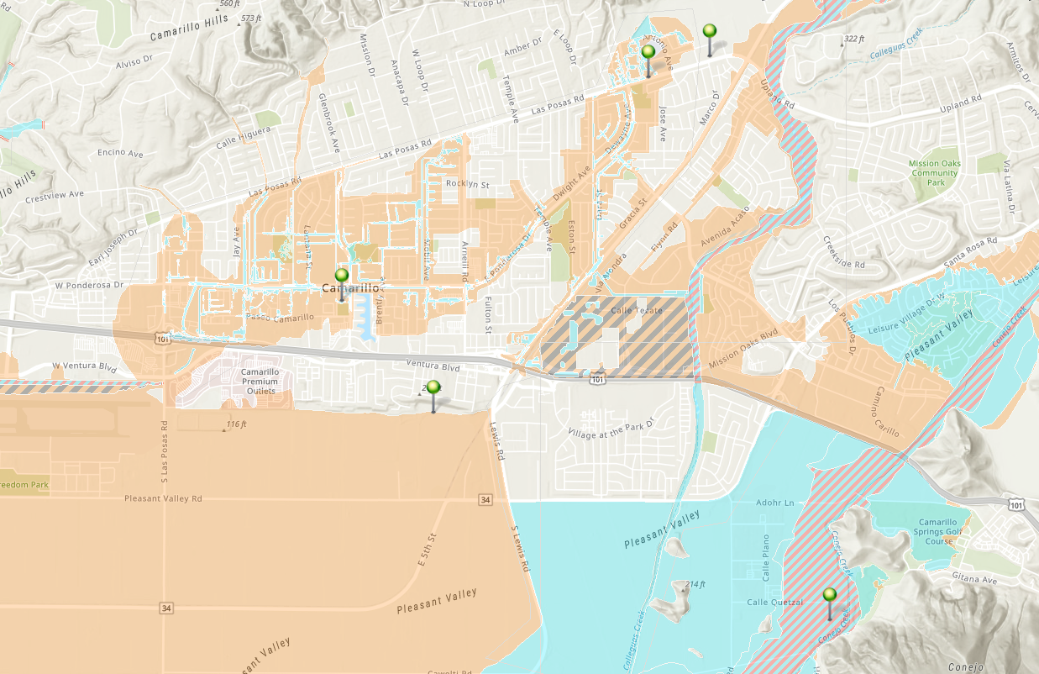
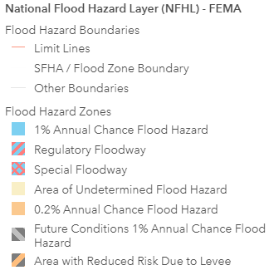
Flood risk to Camarillo CCFs
Police Station
In a 1% and 0.2% Annual Chance Flood Hazard area
City Hall
Within a 1% and 0.2% Annual Chance Flood Hazard area
Library
N
WWTP
Within a Regulatory Floodway
Corp Yard

Slide 20
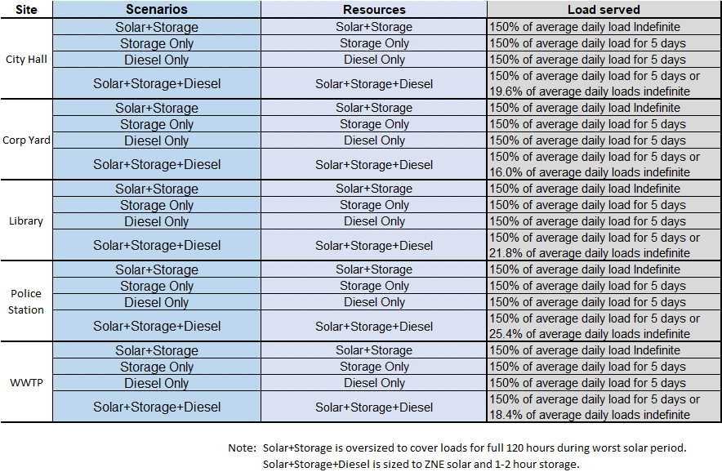
Description of scenarios, resources, and load served
Notes:
This table provides a high level summary of the 5 scenarios we analyzed and evaluated n this study.
The Solar+Storage+Diesel, storage only, and diesel generator only scenarios were all sized to meet 150% of average daily load and 120 hour outage backup design criteria outlined in the scope of this project
Additionally, all 3 scenarios were designed to serve 100% of the building loads during an outage event
The Solar+Storage+Diesel scenarios (hybrid A serves only critical loads & hybrid B serves 150% of average daily load. These are unique due to the solar being sized to annually generate the same amount of energy as the building consumes in 1 year (this is what we refer to as zero-net-energy, or ZNE)
Hybrid Critical (which serves only critical loads such as FL&S, computer resources, critical HVAC and so on) is sized for a 4-hour backup battery storage system rather than 100% of the loads
Hybrid 150% serves 150% of average daily load and can serve the peak power needs and 100% of the normal load.
Hybrid All Loads, as defined by the City
¹ Zero-Net-Energy (ZNE): A building with zero net energy consumption
(annual total energy used is equal to the amount of renewable energy generated on site).
² Critical loads are the must-serve building loads during and outage, referred to as Tier 1 Load.
These loads were identified during the analyses and confirmed with the City Stakeholders.

Slide 21
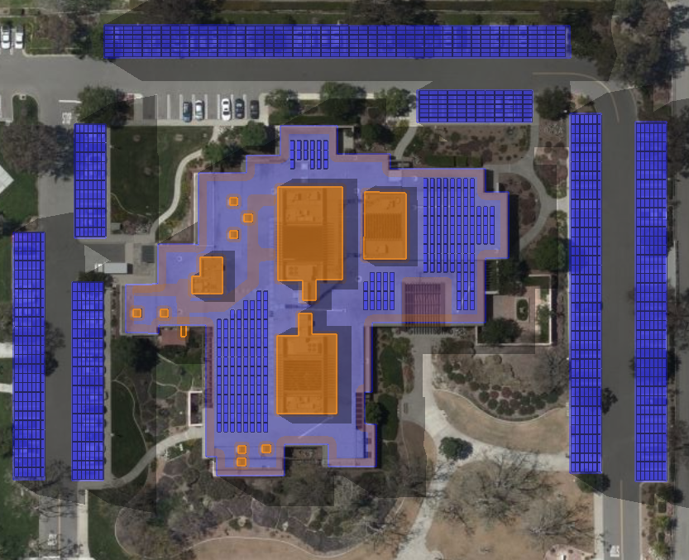
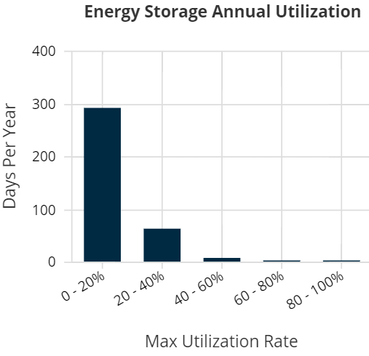
City Hall Load 150% indefinite
Resource: Solar+Storage
Solar: 646 kW
Storage: 3 MWh
CapEx: $5.17M
Carport Solar
Carport Solar
Rooftop Solar
Carport Solar
Battery
Storage
N
Notes:
After each Site’s 3 slides - we will pause for any questions the audience may have before moving to the next slide

Slide 22
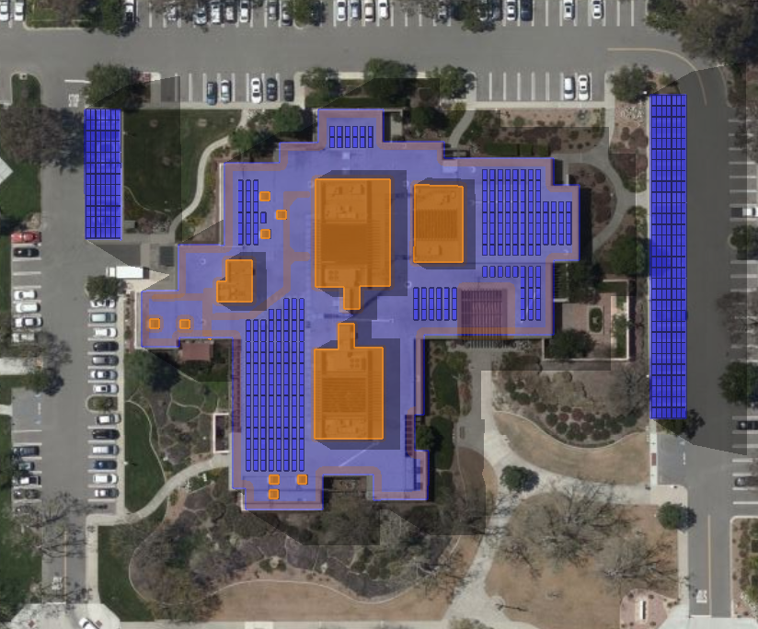
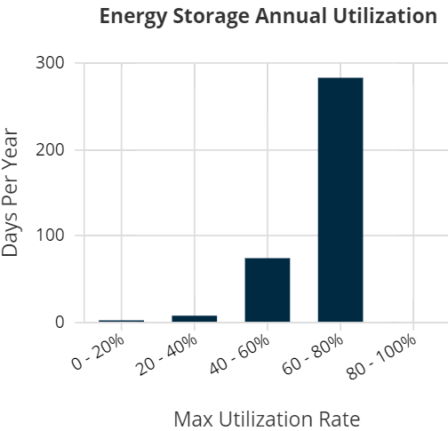
City Hall Load 150% for 5 days or 19.6% indefinite. Resource: Solar+Storage+Diesel
Solar: 224.4 kW
Storage: 420 kWh
Diesel: 139 kW
CapEx: $1.38M
Carport Solar
Carport Solar
Rooftop Solar
Battery
Storage
N

Slide 23
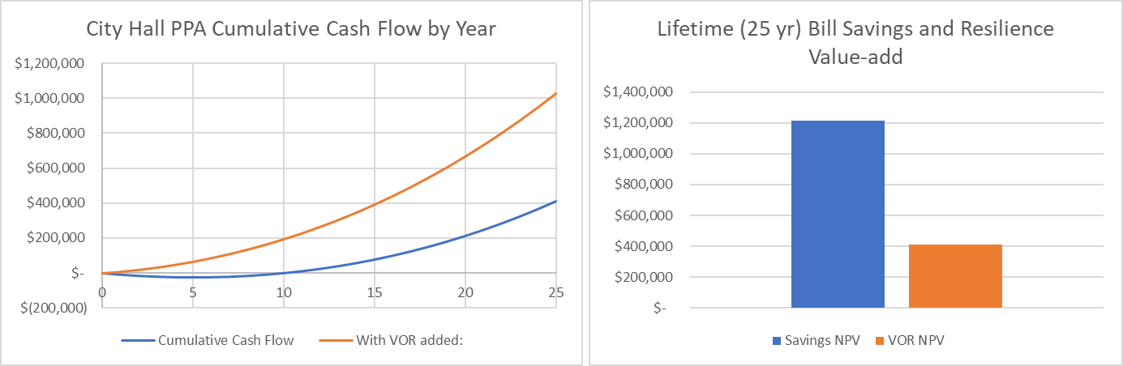
City Hall bill savings and VOR
Economic assumptions:
  discount rate of 3%
  annual utility rate escalation of 3%

