Slide 1
Community Microgrids
Unparalleled trifecta of benefits
Craig Lewis
Executive Director
Clean Coalition
650-796-2353 mobile
craig@clean-coalition.org
29 October 2020

Slide 2
Clean Coalition (nonprofit)
Mission
To accelerate the transition to renewable energy and a modern grid through
technical, policy, and project development expertise.
100% renewable energy end-game
  25% local, interconnected within the distribution grid and facilitating resilience without dependence on the transmission grid.
  75% remote, dependent on the transmission grid for serving loads.
Notes:
2

Slide 3
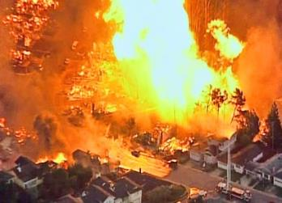
Natural gas infrastructure is not resilient
Assertion: Gas-driven generation is often claimed to be resilient.
Reality: Gas infrastructure is not resilient and takes much longer to restore than electricity infrastructure.
Threats: Gas infrastructure can be flat-out dangerous and is highly vulnerable to earthquakes, fires, landslides, and terrorism.
2010 San Bruno Pipeline Explosion
Source: The City and County of San Francisco Lifelines Study

Slide 4
Percentage of time online for Tier 1, 2, and 3 loads for a Solar Microgrid designed for the University of California Santa Barbara (UCSB) with enough solar to achieve net zero and enough energy storage capacity to hold 2 hours of the nameplate solar (200 kWh energy storage per 100 kW solar).
Typical load tier resilience from a Solar Microgrid
Percentage of total load
Tier 3 = Discretionary load, ~75% of total load
Tier 2 = Priority load, ~15% of total load
Tier 1 = Critical, life-sustaining load, ~10% of total load
Percentage of time

Slide 5
A typical diesel generator is configured to maintain 25% of the normal load for two days. f diesel fuel cannot be resupplied within two days, goodbye. This is hardly a solution for increasingly necessary long-term resilience. In California, Solar Microgrids provide a vastly superior trifecta of economic, environmental, and resilience benefits.
Diesel generators are designed for limited resilience
Percentage of total load
Tier 3 = Discretionary load, ~75% of total load
Tier 2 = Priority load, ~15% of total load
Tier 1 = Critical, life-sustaining load, ~10% of total load
Percentage of time

Slide 6
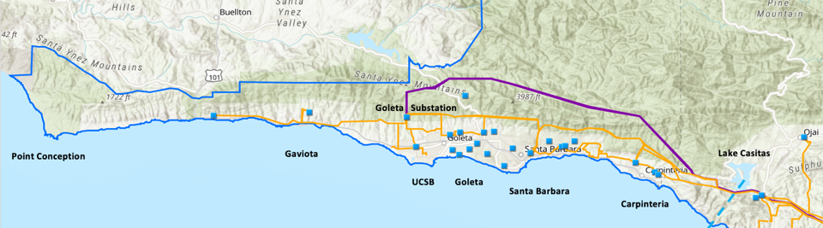
Goleta Load Pocket (GLP) Community Microgrid
The GLP is the perfect opportunity for a comprehensive Community Microgrid
GLP spans 70 miles of California coastline, from Point Conception to Lake Casitas, encompassing the cities of Goleta, Santa Barbara (including Montecito), and Carpinteria.
GLP is highly transmission-vulnerable and disaster-prone (fire, landslide, earthquake).
200 megawatts (MW) of solar and 400 megawatt-hours (MWh) of energy storage will provide 100% protection to GLP against a complete transmission outage (“N-2 event”).
  200 MW of solar is equivalent to about 5 times the amount of solar currently deployed in the GLP and represents about 25% of the energy mix.
  Multi-GWs of solar siting opportunity exists on commercial-scale built environments like parking lots, parking structures, and rooftops; and 200 MW represents about 7% of the technical siting potential.
  Other resources like energy efficiency, demand response, and offshore wind can significantly reduce solar+storage requirements.

Slide 7
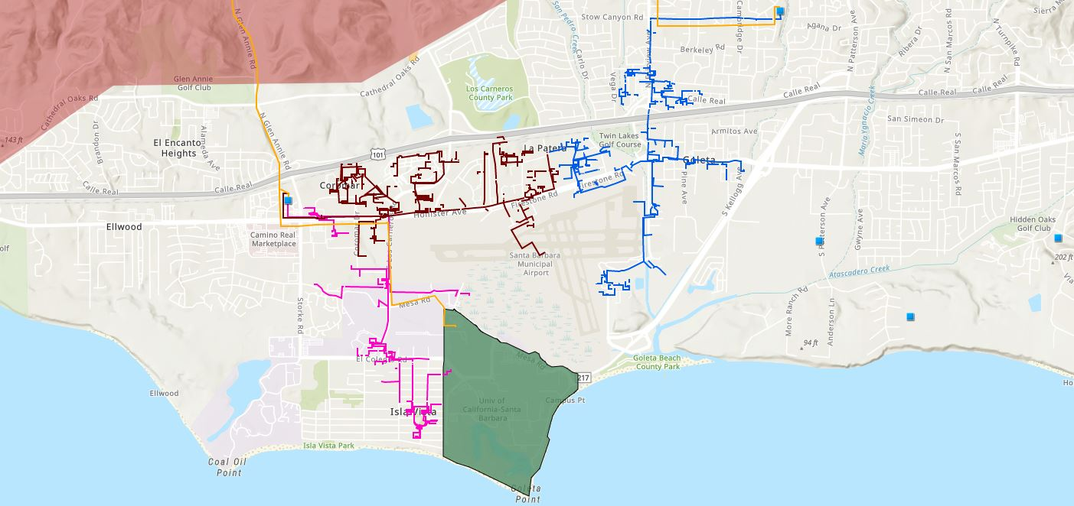







Need to properly value local energy
Proposed 160-240 MWh Battery
Vegas Substation
Direct Relief
Isla Vista Substation
SB Airport
Fire Station # 8
Fire Station # 17
UCSB
Goleta Sanitary District
Legend
16kV Gladiola Feeder
Tier 3 Fire Threat
Goleta Valley Cottage Hospital
220 kV Transmission
16kV Gaucho Feeder
University of California Santa Barbara
Direct Relief
66 kV Feeder #4311
16kV Professor Feeder
Fire Stations
Deckers
Substations
Santa Barbara Airport
Sanitary or Water Districts
Proposed 160-240 MWh Battery

Slide 8

Need to streamline Interconnection
Goleta Substation (220-to-66kV)
66kV distribution feeder #4311 with multiple branches
Vegas Substation (66-to-16kV)
Goleta Substation has eight feeders, all 66kV, that serve the entire GLP
Tier 2 & 3 facilities
66kV underground interconnection
Fire Station #8
Direct Relief
+ Solar Microgrid
Tier 2 & 3 facilities
Isla Vista Substation (66-to-16kV)
160+ MWh battery
Deckers
+ Solar Microgrid
SBA (runway lights & ATC)
Tier 2 & 3 facilities
Diagram Elements
66 kV Distribution Feeder #4311
16 kV Gladiola Feeder
16 kV Gaucho Feeder
16 kV Professor Feeder
Planned 160-240 MWh Battery
Grid isolation switch (open, closed)
Smart meter switch (open, closed)
Fire Station #17
SBA (Main Terminal)
Tier 2 & 3 facilities
Goleta Sanitary District
UCSB
+ Solar

Slide 9
Need to implement Feed-In Tariffs (FITs)
Direct Relief Solar Microgrid needs a FIT to maximize solar

