Slide 1


CAISO: New leadership and the path forward
9 December 2020

Slide 2

GoToWebinar FAQ
Webinar recording and slides will be sent to registered attendees within two business days.
All webinars are archived on clean-coalition.org, under Events.
Submit questions in the Questions pane at any time during the webinar.
        View varies by operating system and browser.
Questions will be answered during the Q&A portion of the webinar.
For other questions, contact Rosana Francescato: rosana@clean-coalition.org

Slide 3
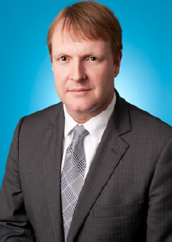
Presenters
Elliot Mainzer, CAISO President and CEO
Elliot Mainzer is committed to using leading-edge policies and new technologies to accelerate California’s drive toward the reliable decarbonization of its electric power grid. He started in his new role at the ISO on September 30, 2020 following a successful 18-year career at the Bonneville Power Administration (BPA) where he was at the forefront of transformational changes in the western electricity market. He has co-chaired the Western Electric Industry Leaders Group and has served as the Chair of the U.S. Entity for the Columbia River Treaty with Canada and on the boards of the Electric Power Research Institute, and the Utility Wind Integration Group.
A native of San Francisco, Mr. Mainzer has an undergraduate degree in geography from U.C. Berkeley and a master’s degrees in Business Administration and Environmental Studies from Yale University

Slide 4
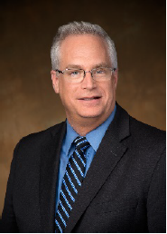


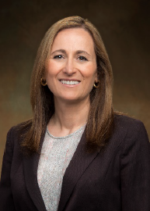
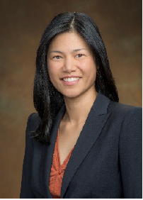
Presenters
Mark Rothleder
CAISO Chief Operating
Officer
Neil Millar
VP of Infrastructure and
Operations Planning
Stacey Crowley
VP of External and
Customer Affairs
Anna McKenna
Interim Head of Market
Policy and Performance
Delphine Hou
Director of California
Regulatory Affairs

Slide 5
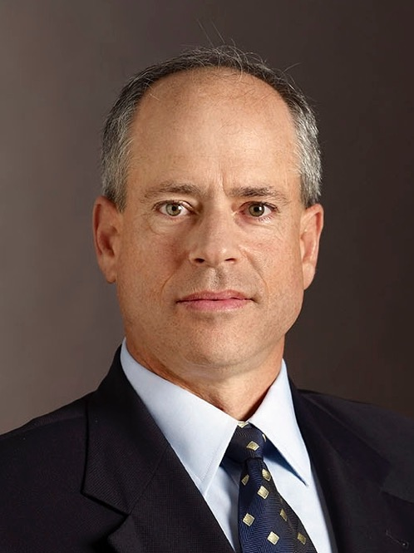
Presenters
Craig Lewis
Craig is Executive Director of the Clean Coalition. He has over 30 years of experience in the renewables, wireless, semiconductor, and banking industries. Previously VP of Government Relations at GreenVolts, he was the first to successfully navigate a solar project through California’s Renewable Portfolio Standard solicitation process. Craig was energy policy lead on Steve Westly’s 2006 California gubernatorial campaign. His resume includes senior government relations, corporate development, and marketing positions at leading wireless, semiconductor, and banking companies such as Qualcomm, Ericsson, and Barclays Bank. Craig received an MBA and MSEE from the University of Southern California and a BSEE from the University of California, Berkeley.

Slide 6
Clean Coalition (nonprofit)
Mission
To accelerate the transition to renewable energy and a modern grid through
technical, policy, and project development expertise.
100% renewable energy end-game
  25% local, interconnected within the distribution grid and facilitating resilience without dependence on the transmission grid.
  75% remote, dependent on the transmission grid for serving loads.
Notes:
6

Slide 7
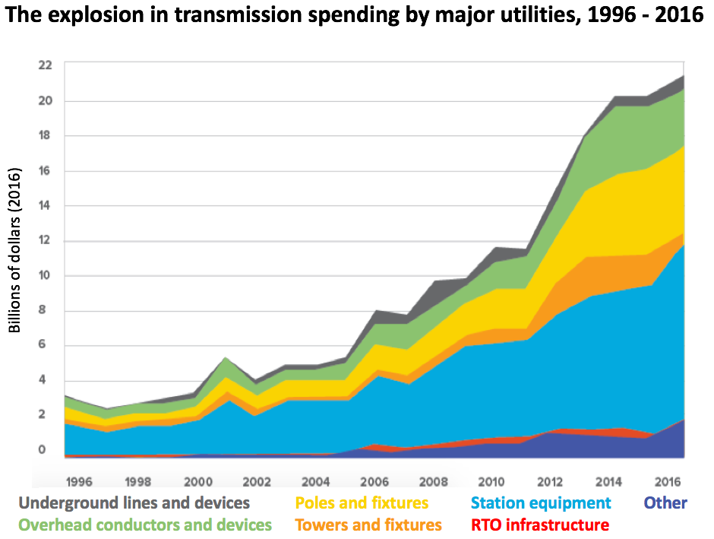
Transmission costs are fastest growing component of electricity costs
Unbelievably high guaranteed 12% return-on-equity for transmission investments leads to predictable conflicts-of-interest and perverse market outcomes.
Market distortions like the erroneous metering & assessment of Transmission Access Charges (TAC) for California IOUs creates massive market distortions that steal value from local generation, hurt ratepayers, and preempt energy resilience.
Notes:
Our transmission divestment article: https://www.utilitydive.com/news/how-to-protect-california-ratepayers-expand-clean-local-energy-and-avoid-b/554564/
Our article on TAC and ACC: https://www.tdworld.com/distributed-energy-resources/article/21132853/how-two-simple-fixes-can-fairly-compensate-the-true-value-of-ders-in-california

Slide 8
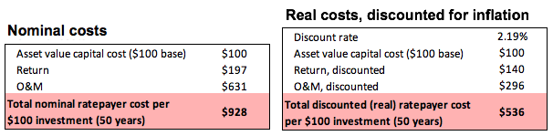
Transmission costs are bigger than they seem due to O&M driving ~10x increase to upfront costs
Transmission costs are the fastest-growing component of electricity bill and are already about the same cost as the energy itself.
The capital costs of transmission infrastructure represent a fraction of total transmission costs. Operations and maintenance (O&M) and returns on investments drive up transmission costs significantly over the life of these assets, with those excessive costs borne by ratepayers.
In nominal dollars, total lifetime ratepayer cost is nearly 10x the initial capital cost; O&M accounts for 68% of this because it increases much faster than inflation. In real dollars (constant value dollars, accounting for inflation), the total lifetime cost is 5x the initial capital cost, and O&M accounts for 55% of this.
Notes:
Our transmission divestment article: https://www.utilitydive.com/news/how-to-protect-california-ratepayers-expand-clean-local-energy-and-avoid-b/554564/

Slide 9
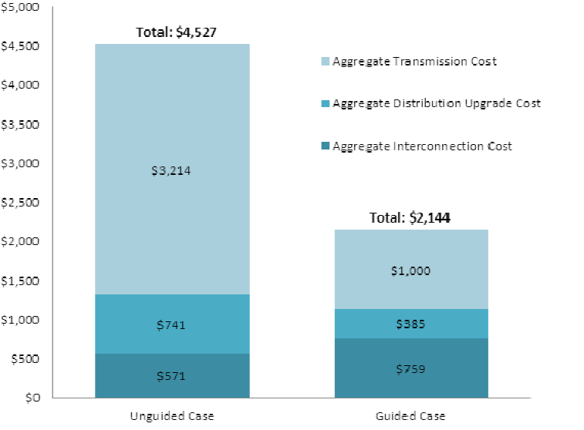
Optimizing the grid for ratepayer savings requires lots of local renewables & energy storage
SCE found that intelligently siting 4 GW of local solar would preempt over $2.2 billion in new transmission infrastructure investments, which represents approximately $20 billion in ratepayer savings over the lifetime of such transmission investments when considering O&M.
Transmission costs are always borne by ratepayers, while distribution & interconnection costs are always borne by solar project developers.
Notes:
Our transmission divestment article: https://www.utilitydive.com/news/how-to-protect-california-ratepayers-expand-clean-local-energy-and-avoid-b/554564/

Slide 10
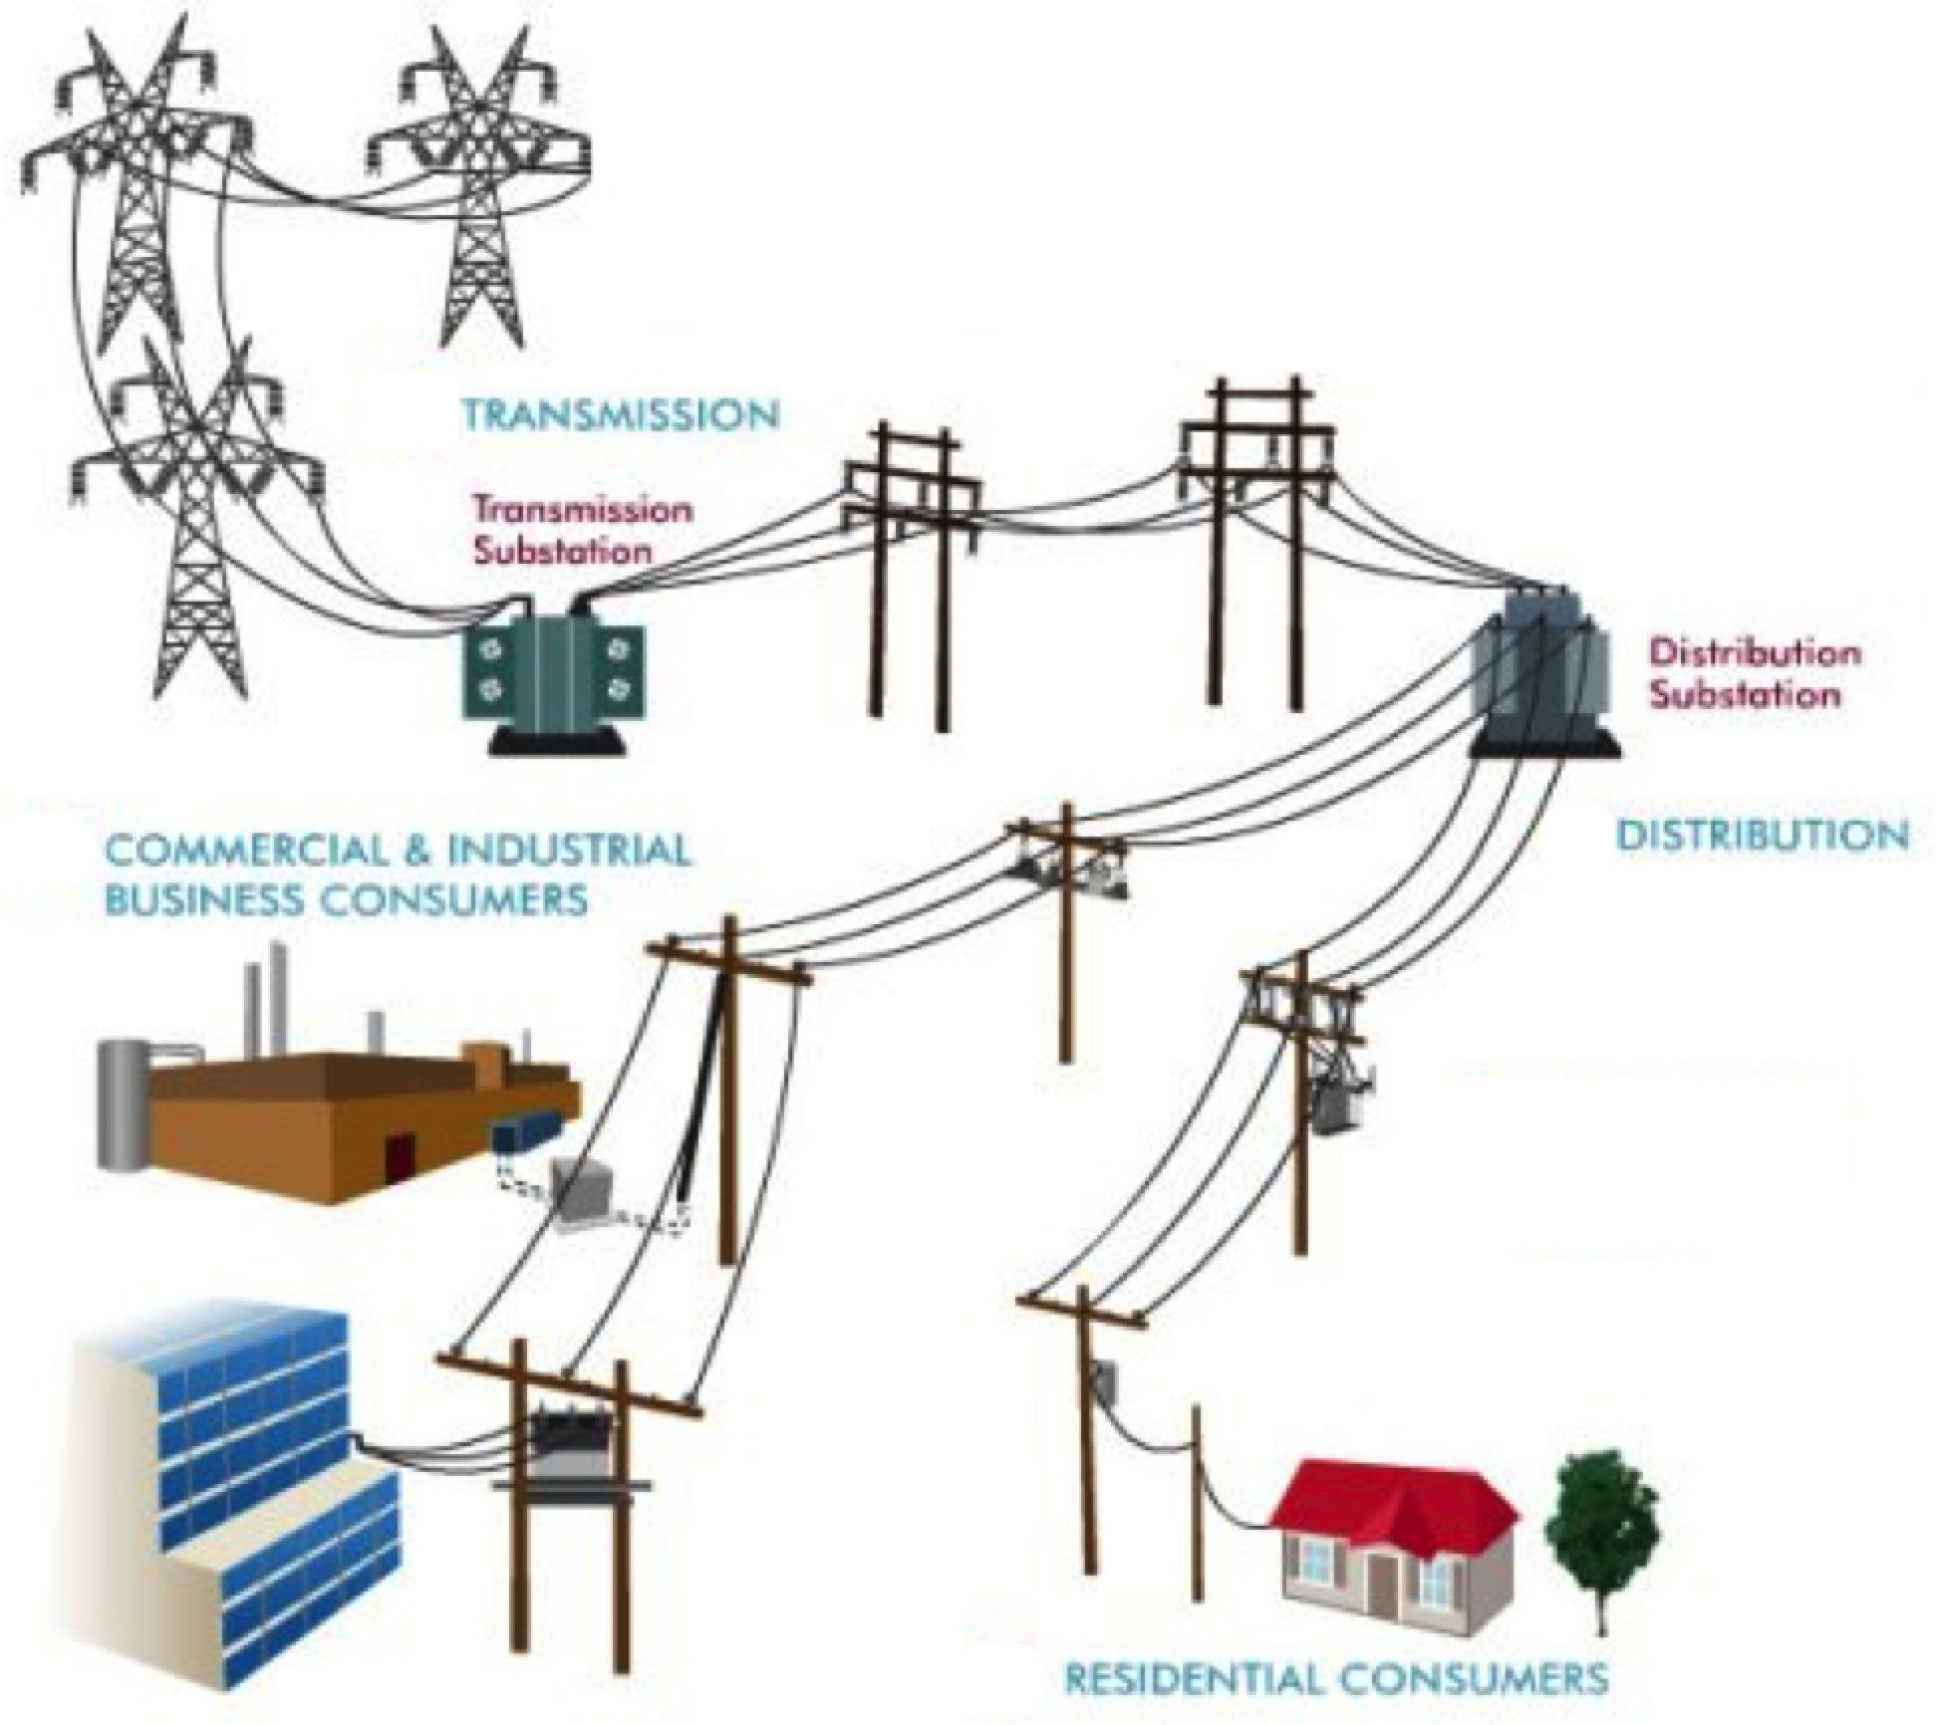
TAC market distortion visual
Proper interface for metering & assessing all High-Voltage TAC (done properly for municipal utilities, but not for IOUs
Proper interface for metering all
Low-Voltage TAC (done properly for municipal utilities, but not for P)
Current interface for metering TAC in IOU service territories
(at customer meters with no distinction of energy from next door vs 1,000 miles away)
Notes:
NOTE: Non-PTO utilities (metered sub-systems) currently operate under the system we are proposing. The Clean Coalition TAC fix would bring consistent TAC treatment to DG resources in all utility service territories.
TAC are currently treated properly at non-PTOs, which meter TAC at substations so that only transmission usage, as measured by Transmission Energy Downflow, pays for transmission.
However, TAC create a massive market distortion for PTOs, because TAC is being metered at the customer meter. This metering system imposes TAC on whole class of generation that does not use the transmission grid: local generation, or DG.
PTOs pay TAC on every kWh delivered at the customer level, even if that energy was not delivered through the transmission system.
The Clean Coalition seeks to correct CAISO’s tariff language so that all utilities meter TAC on their Transmission Energy Downflow, so that only energy that uses the transmission system pays for the transmission system. This “usage pays” fix will ensure proper valuation of local renewable generation, including the avoided use of transmission.
The TAC “usage pays” fix aligns CAISO with FERC Order 1000, and provides consistent treatment across state of CA, since non-PTOs already meter TAC on Transmission Energy Downflow.
Three of FERC Order 1000’s six principles for transmission cost allocation are about aligning costs with benefits.
Around the country, most ISOs assess transmission usage fees based on TED, so this fix also aligns CAISO with other ISOs.
Resolving the TAC metering issue should be a relatively simple accounting fix, once an investment of about $20 million is made to add Settlement Quality Meters to all substations in California; this cost is <1% of the projected savings that would result
This accounting fix requires a CAISO tariff change that FERC would have to approve.
It is worth noting that under proper substation TAC metering, any local generation that backfeeds to the transmission grid would be metered for TAC when it becomes Transmission Energy Downflow at a neighboring substation on its way to serving a load.

Slide 11
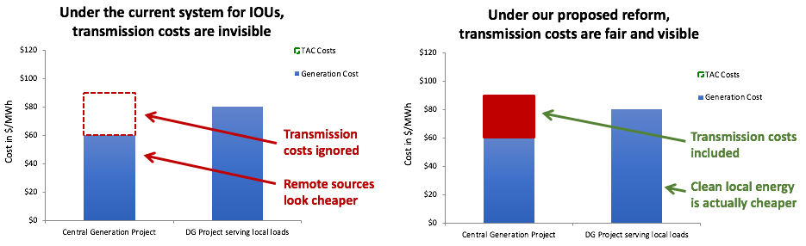
TAC Campaign = easy fix to massive distortion
Transmission Access Charges (TAC) in California are assessed inconsistently and unfairly, creating a massive market distortion
  In Participating Transmission Owner (PTO) utility service territories, like IOUs, California ratepayers erroneously pay the same volumetric transmission usage fee (aka TAC) whether or not the energy they use travels across the transmission grid.
The TAC market distortion is massive:
  3 cents per kWh is being stolen from local renewables, making them look more expensive at an estimated $60 billion cost to California ratepayers over 20 years.
  Stealing funds from DER-driven Community Microgrids that deliver community resilience.
The easy fix is to consistently meter and assess TAC based on actual volumetric use of the transmission grid as is already the case for non-PTO utilities.

Slide 12
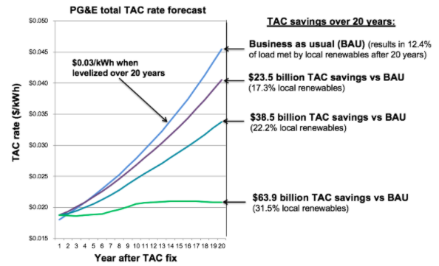
Not fixing TAC would cost Californians $60 billion over the next two decades
Generating energy closer to where we use it means we need less transmission infrastructure, which lowers costs for ratepayers by avoiding expensive transmission lines.
Continuing with business as usual will cost Californians ~ $60 billion in avoidable transmission costs over the next 20 years.

Slide 13
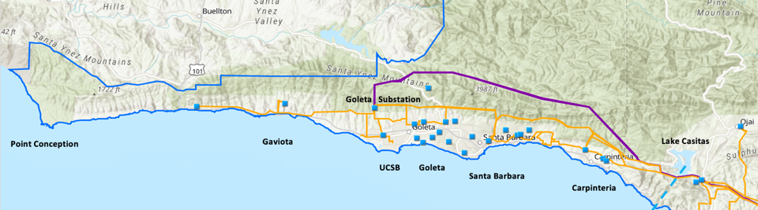
Optimizing the grid for energy resilience requires lots of local renewables & energy storage
Goleta Load Pocket (GLP) is the perfect opportunity for a Community Microgrid
GLP spans 70 miles of California coastline, from Point Conception to Lake Casitas, encompassing the cities of Goleta, Santa Barbara (including Montecito), and Carpinteria.
GLP is highly transmission-vulnerable and disaster-prone (fire, landslide, earthquake).
200 megawatts (MW) of solar and 400 megawatt-hours (MWh) of energy storage will provide 100% protection to GLP against a complete transmission outage (“N-2 event”).
  200 MW of solar is equivalent to about 5 times the amount of solar currently deployed in the GLP and represents about 25% of the energy mix.
  Multi-GWs of solar siting opportunity exists on commercial-scale built environments like parking lots, parking structures, and rooftops; and 200 MW represents about 7% of the technical siting potential.
  Other resources like energy efficiency, demand response, and offshore wind can significantly reduce solar+storage requirements.

Slide 14
Full value of local renewables must be compensated
Direct Relief case study: Can do five times more local solar (and lots more energy storage too), but there are no market mechanisms available for commercial-scale DER. What is clear, though, is that the TAC market distortion steals 3 cents/kWh from Feed-In Tariff (FIT) programs and Net Energy Metering (NEM) export — and this massive market distortion needs to be fixed.
Direct Relief Solar Microgrid could be 5 times bigger and serve the broader GLP Community Microgrid

