Slide 1
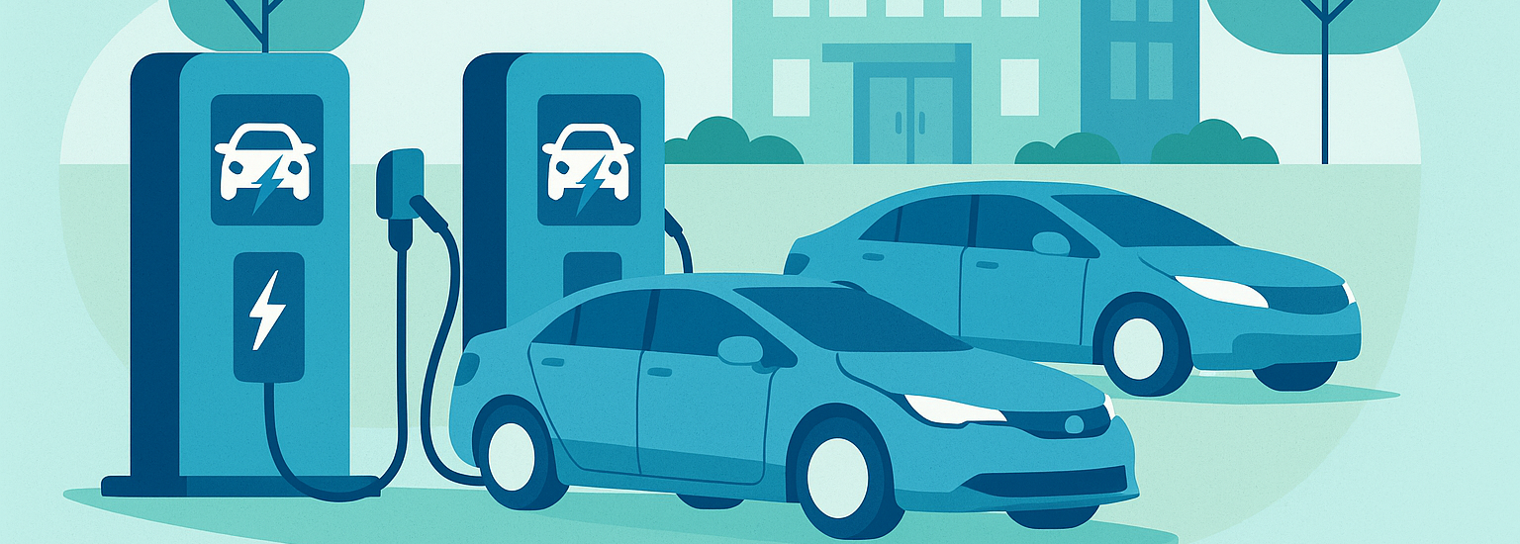
Powering Workplace EV Adoption: Charge@Work in Review & What’s Ahead
Brandon Oldham
Senior Project Manager
CALSTART
Haley Weinstein
Communications Lead
Clean Coalition
26 June 2025

Slide 2
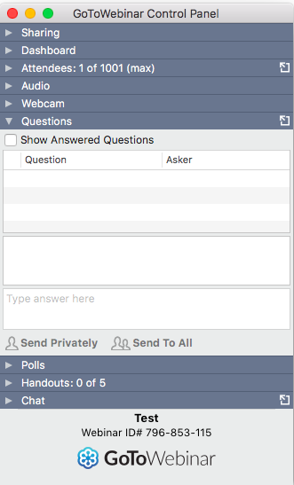
GoToWebinar FAQ
Webinar recording and slides will be sent to registered attendees within two business days.
All webinars are archived on clean-coalition.org, under Events.
Submit questions in the Questions pane at any time during the webinar.
View varies by operating system and browser.
Questions will be answered during the Q&A portion of the webinar.
For other questions, contact Haley: haley@clean-coalition.org

Slide 3
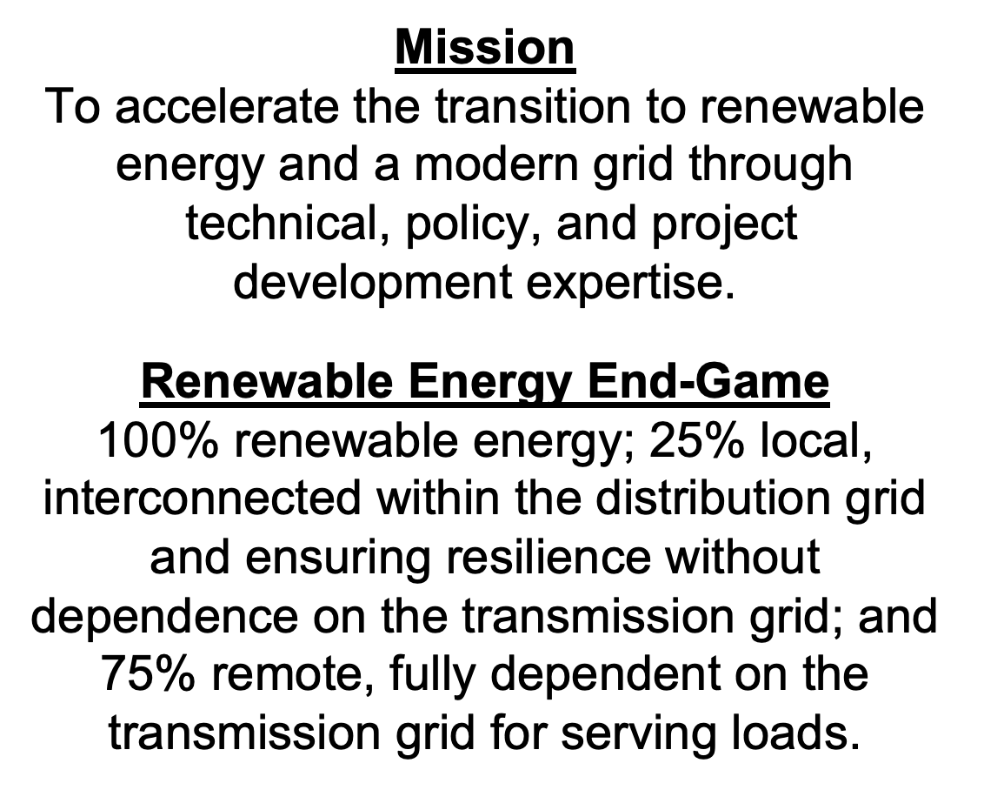
Clean Coalition (nonprofit)

Slide 4
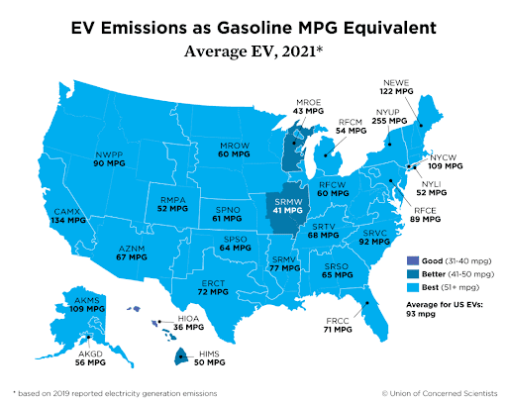
Electric Vehicles (EVs) -
On average, EVs emit as little as a 93 MPG gasoline car.
The time of day people charge is extremely important.
Being thoughtful about when we charge helps maximize the climate benefits of EVs by utilizing clean energy and reduces ratepayer costs.
https://clean-coalition.org/news/the-importance-of-robust-daytime-ev-charging/

Slide 5
Flattening the Duck - The importance of midday EV charging
California’s grid is cleanest from 10am to 2pm, when solar generation peaks and renewables are abundant.
As solar generation drops in the late afternoon, natural gas plants ramp up to meet rising demand. These plants emit greenhouse gases that drive climate change and release air pollutants that harm human health — especially in disadvantaged communities where many of these plants are located.
While Local Solar plus storage can flatten the duck curve, the grid still relies heavily on natural gas. (read the Clean Coalition’s article on Flattening California’s Duck Curve with Local Solar).
Learn more:
(The importance of robust daytime EV charging) (Flattening California’s Duck Curve with Local Solar)

Slide 6
Flattening the Duck - The importance of midday EV charging
Charging EVs in the evening adds to peak demand, increasing grid stress and fossil fuel use. This drives up electricity costs and contributes to expensive transmission upgrades — costs ultimately paid by ratepayers.
Charging EVs midday, when the sun is shining and solar energy is abundant, uses cleaner energy, eases grid stress, and reduces the need for costly transmission upgrades.
Most drivers aren’t home between 10am and 2pm, when renewable energy is plentiful. Workplace chargers are key to shifting charging behavior toward these cleaner, midday hours.
Learn more:
(The importance of robust daytime EV charging) (Flattening California’s Duck Curve with Local Solar)

Slide 7
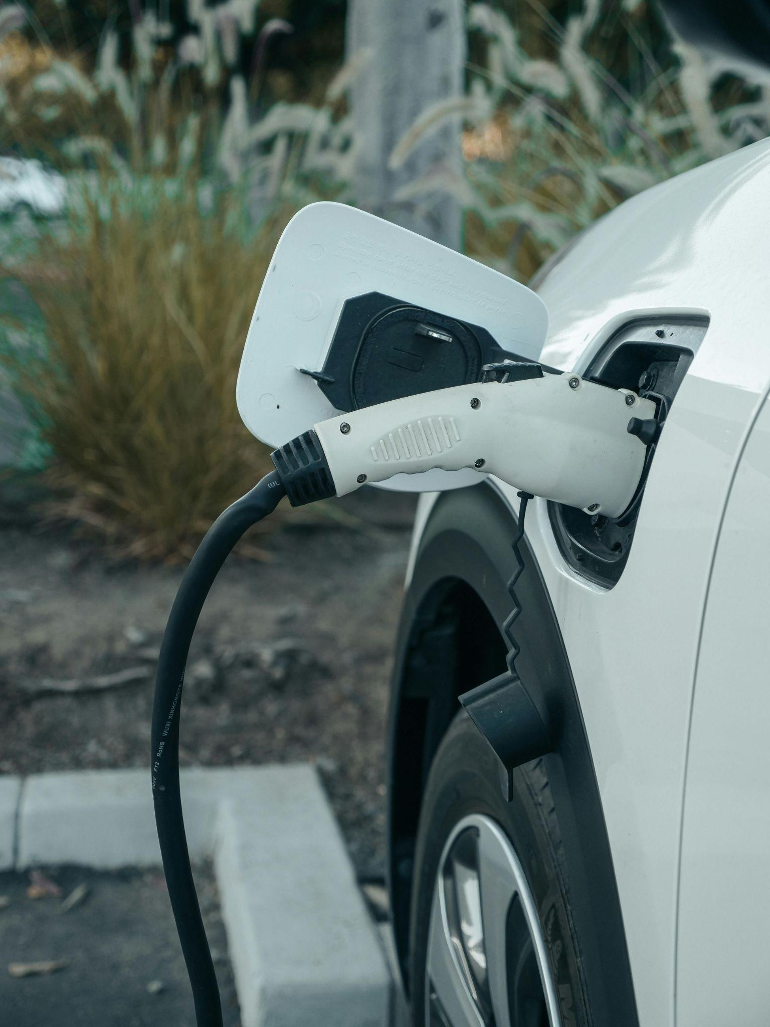
Charge@Work
For the past three years, the Charge@Work program — funded by the U.S. Department of Energy and led by CALSTART — has supported thousands of employers across the country in planning and deploying EV charging infrastructure at their workplaces. From small businesses to major national brands, the program has helped streamline the process, lower costs through incentives, and build momentum for clean transportation in real communities.
Today’s webinar will explore what we’ve learned through that work, the tools and funding pathways available to support your projects, and what comes next for the growing Charge@Work network.
Notes:
‹#›

Slide 8
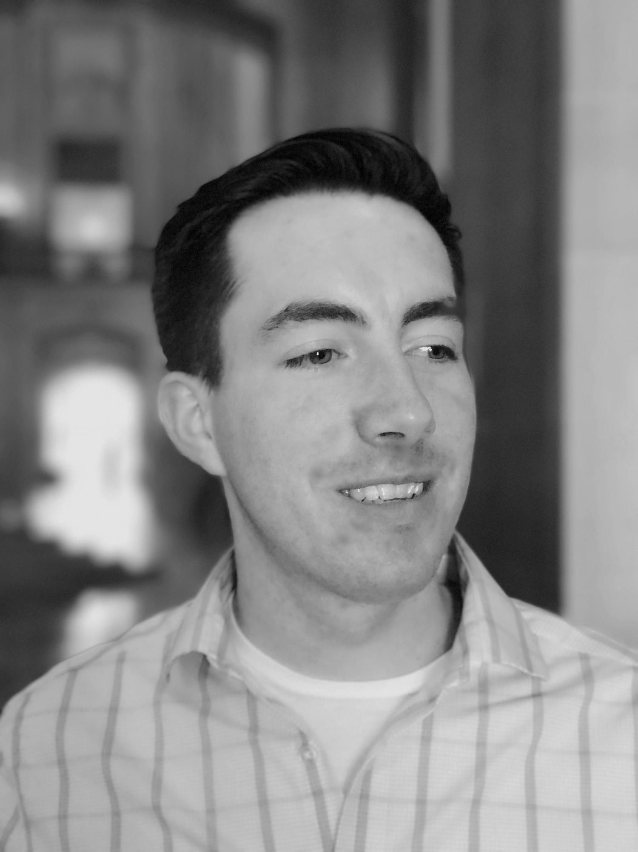
Presenter: Brandon Oldham
Brandon Oldham is a Senior Project Manager at CALSTART, leading the Charge@Work initiative to expand workplace EV charging across the U.S. With over seven years in e-mobility, he brings expertise in charging infrastructure, utility planning, and resilient energy solutions. Previously, Brandon supported national deployment projects with Electrify America at Shell Recharge Solutions. He holds a Bachelor’s in Environmental Science from the University of San Francisco and a Master’s in Energy Regulation and Law from Vermont Law School.
Notes:
‹#›

Slide 9
Powering Workplace EV Adoption: Charge@Work in Review & What’s Ahead
Brandon Oldham
Senior Project Manager
CALSTART
Haley Weinstein
Communications Lead
Clean Coalition
26 June 2025

