Slide 1
POWERING WORKPLACE EV ADOPTION: CHARGE@WORK IN REVIEW & WHAT’S AHEAD
Workplace charging is now a necessity, not just an amenity. Workplace’s role in accelerating EV adoption.
June 27, 2025
Brandon Oldham, Program Manager, CALSTART

Slide 2
Overview
Why Workplace Charging?
What is Charge@Work?
How can we work together on this?
Demonstration and Discussion

Slide 3
Why Workplace Charging?
74%
of current EV owners express strong interest in workplace charging.
60%
of EV drivers need chargers at work, either because of long commutes or no access to at-home charging.

Slide 4
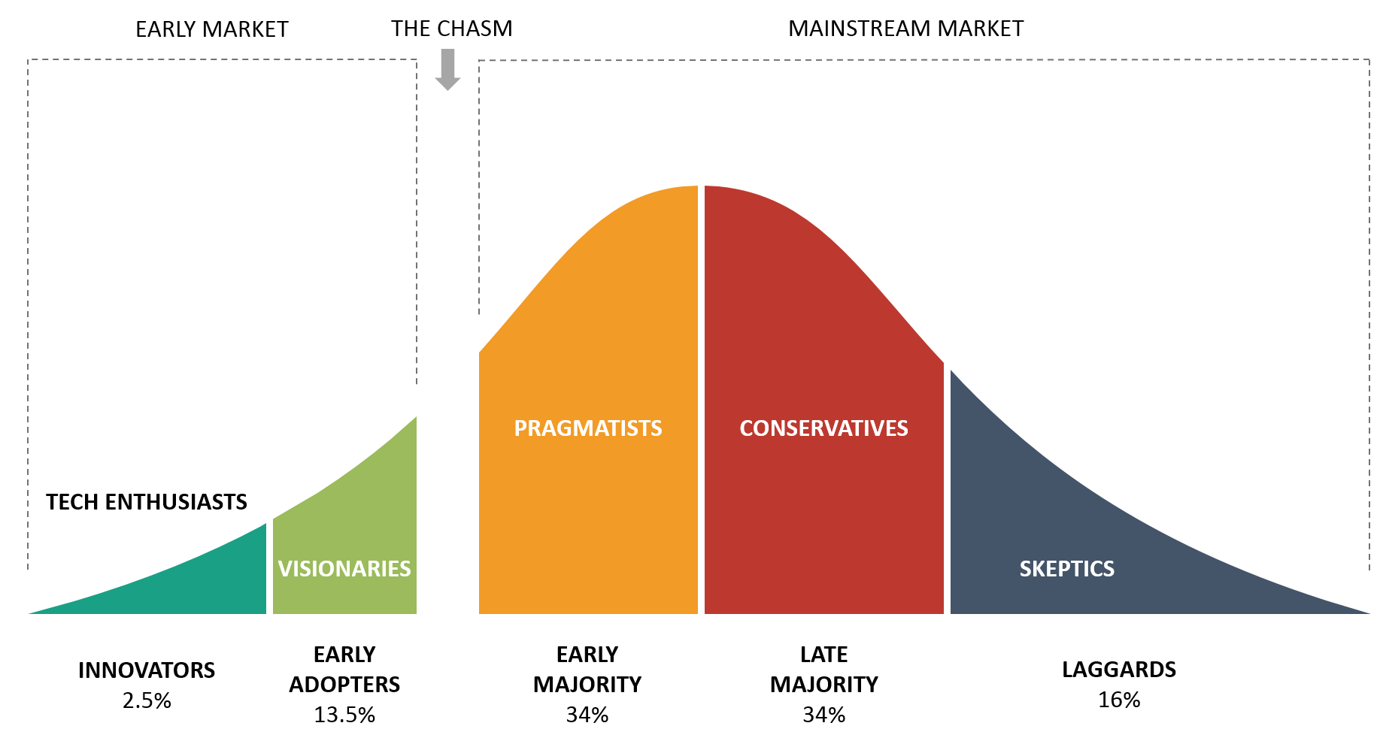
We Need Workplace Charging to Cross “the Chasm”

Slide 5
The Three-legged Stool Paradigm for EV Charging
EV Charging must exist where EV drivers Live, Work, and Play, otherwise Pragmatists (the Early Majority) will not consider EVs viable.
Live
Play
Work

Slide 6
Where do people work?
How do we make electric vehicle ownership viable for nurses, teachers, cashiers, operations managers, and customer service representatives?
Industry | Example of Common Building Type | % of workforce
Professional & business services | Office Buildings | 13.2
Health care & social assistance | Hospitals | 12.9
State & local government | Schools | 12.4
Retail Trade | Shopping Centers | 9.7
Leisure & hospitality | Hotels | 8.7
Source: Bureau of Labor Statistics (BLS)
( = 56.9% of the workforce)

Slide 7
Distinguishing between charging for customers, employees, and fleet operations
Focus on intended use – Who is this charging solution designed to serve? The customers? The employees? Or, the fleet?
For our purposes, workplace charging solutions are those that are designed for use by employees during typical working hours.
Workplace charging solutions are generally Level 1 and 2 chargers, not DC fast chargers.

Slide 8
Workplace Charging is Good for the Environment
A recent study by Stanford researchers suggests that shifting current EV charging from home to work and night to day could
cut costs,
improve grid efficiency, and
reduce greenhouse gas emissions significantly.
Enables wider buildout of and reliance on renewable generation.
Mid-day solar would be curtailed if not for vehicles being able to absorb it.

Slide 9
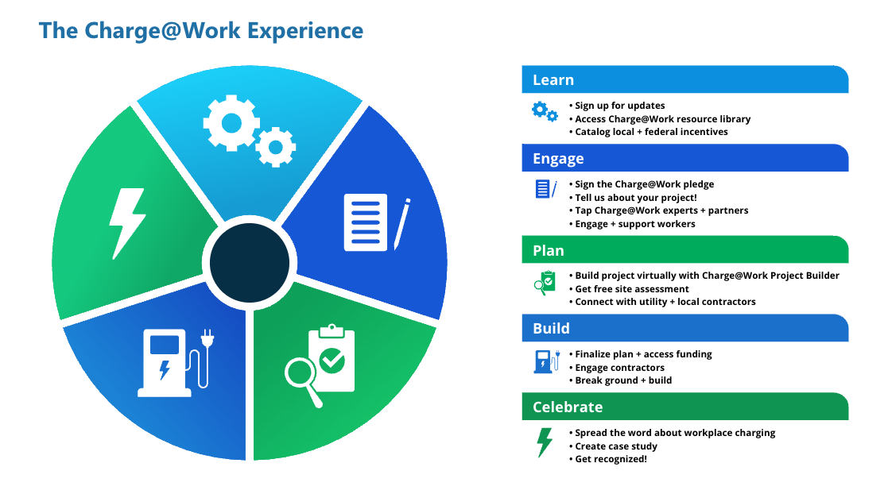
What is Charge@Work?
Technical Assistance
Free site assessments ($1,000 value)
Project Builder tool
Support from EV charging experts
Education and Outreach
Resources, guides, and case studies
Webinars, ribbon-cuttings, and ride-and-drive events
Press releases and articles
Employee engagement
Deploy Infrastructure

Slide 10
The Charge@Work Team

Slide 11
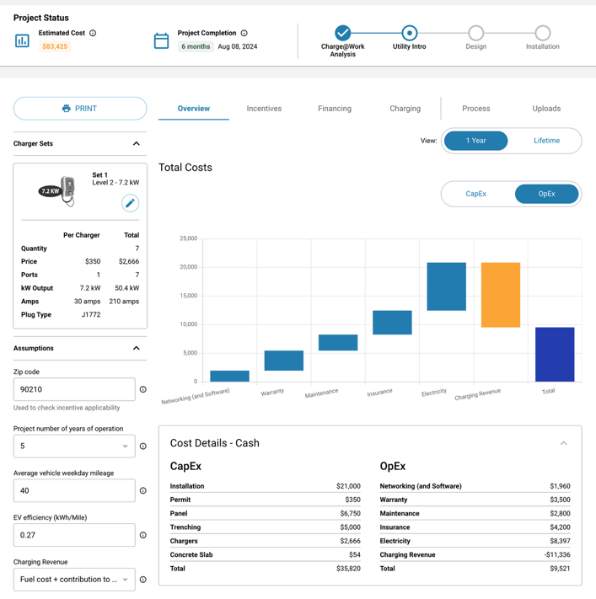
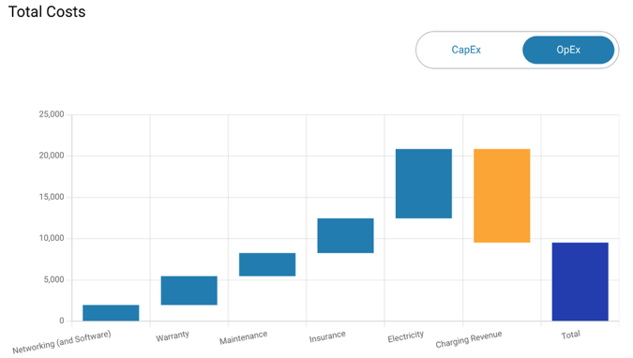
Charge@Work Project Builder
Free virtual workspace to build your project
Users can access:
Cost estimates for equipment and installation
Free site assessments
Incentives database
Charger catalog
Project planner

Slide 12
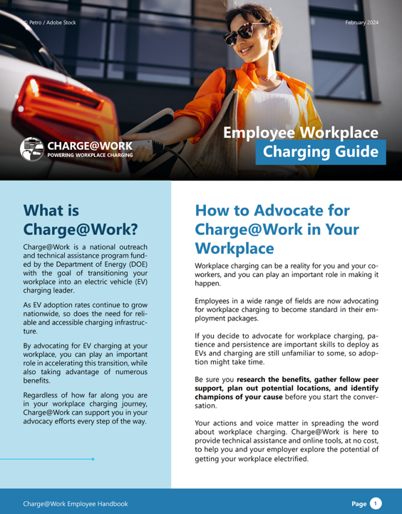
Charge@Work Employer & Employee Guides

Slide 13
Get Started with Charge@Work
Examples of Current Pledges
Join our program
Create a Project Builder account
Show your support for workplace charging

Slide 14
Connect with us.
Jason Zimbler
Senior Director, Light Duty Initiative
CALSTART
jzimbler@calstart.org
Brandon Oldham
Program Manager
CALSTART
boldham@calstart.org

