Slide 1
DER Deferral Evaluation Criteria and Performance Metrics
Ben Schwartz
Policy Manager
Clean Coalition
626-232-7573 mobile
ben@clean-coalition.org
clean-coalition.org
4 May 2021

Slide 2
Clean Coalition (non-profit)
Mission
To accelerate the transition to renewable energy and a modern grid through
technical, policy, and project development expertise.
Renewable Energy End-Game
100% renewable energy; 25% local, interconnected within the distribution grid and ensuring resilience without dependence on the transmission grid; and 75% remote, fully dependent on the transmission grid for serving loads.
Notes:
2

Slide 3
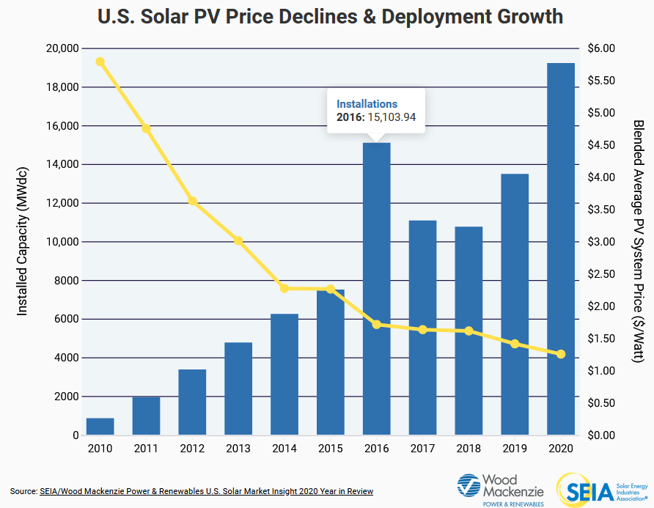
Achieving long-term success with DER Deferral
DER Deferral is relatively new, and the pilots should be continued so long as there is any avenue to success.
Changing market conditions and the new pilots means that it will take time before a reasonable picture of the true value of the pilots are realized.
While some modifications are reasonable, ramping either (or both) of the pilots down or ending them prematurely would be a mistake.
Any analysis should consider necessary technologies or structural changes that might lead to a more effective process.
Optimizing DER: Currently the two pilots are separated by resources on either side of the meter. Would one pilot that allows aggregations of resources on either side of the meter lead to ideal DER solutions?
Distributed Energy Management Systems (DERMS): Currently DERMS is not required for either pilot. How would the economics and procurement change with DERMS?

Slide 4
Evaluation Criteria – understanding the whole picture
The future of DER Deferral should factor in cost-effectiveness but should not hinge entirely on it.
Category | Reasoning
Cost-effectiveness (utility costs) | The two pilots should be measured for cost-effectiveness, but because of the prevalence of private capital, cost-effectiveness should only be measured with utility expenditures.
Avoided Costs Moving the cost cap | Using the Avoided Cost Calculator, the value of DER installed for the purpose of DER Deferral should be considered, including benefits on the broader grid (e.g., avoided transmission) Depending on the success of the program, it is reasonable to consider the potential for dual value that the program has. If the cost cap is shifted to 90% or 95%, it is still more cost effective than a traditional solution. Can the cost cap be increased to increase the penetration of DER in disadvantaged communities?
Notes:
Part of the problem is that there is currently no existing regulatory avenue to address the flaws in the FOM interconnection process. The solution is twofold; first, the best way to effectively fix the interconnection process is partnering with a utility — in this case, PG&E — to create agreed-upon solutions to clear problems. Collaborating with a utility will grease the wheels of a regulatory process that can at times be slow, particularly if there is significant stakeholder pushback.
Then the main issue becomes the best way to implement solutions throughout the state. While the Rule 21 Interconnection Rulemaking, R. 17-07-007 exists at the CPUC for BTM projects, it does not apply to FOM projects. So, second, the CPUC should either create a new OIR to tackle the issues with FOM interconnection or expand the existing interconnection rulemaking to include FOM interconnection as well. I would recommend the former rather than the latter since R. the Rule 21 Interconnection Proceeding is running behind schedule.

Slide 5
Performance metrics
Category | Reasoning
Greenhouse Gas Reductions | This can be considered an aspect of avoided costs, but it is worth mentioning here as well. DER add value through GHG reduction, which is necessary to achieve state goals. The resources types should also be cataloged.
Aggregator Survey Information about Aggregators | 1. How easy is it to navigate the interconnection process and ICA maps? What changes, if any, need to be made to maximize an aggregator’s experience? 2. How can the interconnection application for an aggregation be further streamlined? 3. How competitive are the payments made to resources compared to project costs? 4.Are any other market mechanisms needed to increase aggregator participation or to encourage the deployment of any type of resource? Information about the interest from aggregators is an important metric to consider. Data should be collected about the number of aggregators that bid on a project and the number that pass a pre-screening process in each IOU service territory.
Notes:
Part of the problem is that there is currently no existing regulatory avenue to address the flaws in the FOM interconnection process. The solution is twofold; first, the best way to effectively fix the interconnection process is partnering with a utility — in this case, PG&E — to create agreed-upon solutions to clear problems. Collaborating with a utility will grease the wheels of a regulatory process that can at times be slow, particularly if there is significant stakeholder pushback.
Then the main issue becomes the best way to implement solutions throughout the state. While the Rule 21 Interconnection Rulemaking, R. 17-07-007 exists at the CPUC for BTM projects, it does not apply to FOM projects. So, second, the CPUC should either create a new OIR to tackle the issues with FOM interconnection or expand the existing interconnection rulemaking to include FOM interconnection as well. I would recommend the former rather than the latter since R. the Rule 21 Interconnection Proceeding is running behind schedule.

Slide 6
Questions
Questions?

