Slide 1

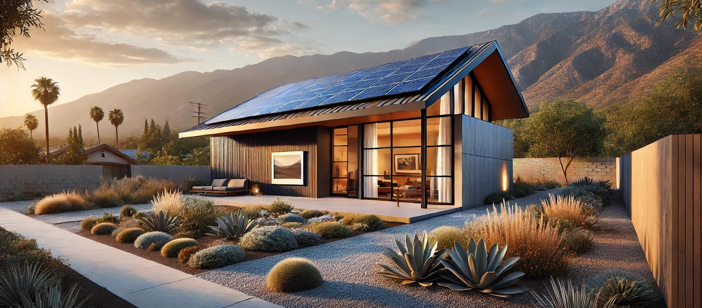
Incredible Economics of Super Green Rebuilds
Green Rebuild Initiative
Craig Lewis
Executive Director
Clean Coalition
Haley Weinstein
Communications Lead
Clean Coalition
John Bello
President
Bello Global Consulting
Patrice Hicks
Program Manager
RISE Homes
30 May 2025

Slide 2
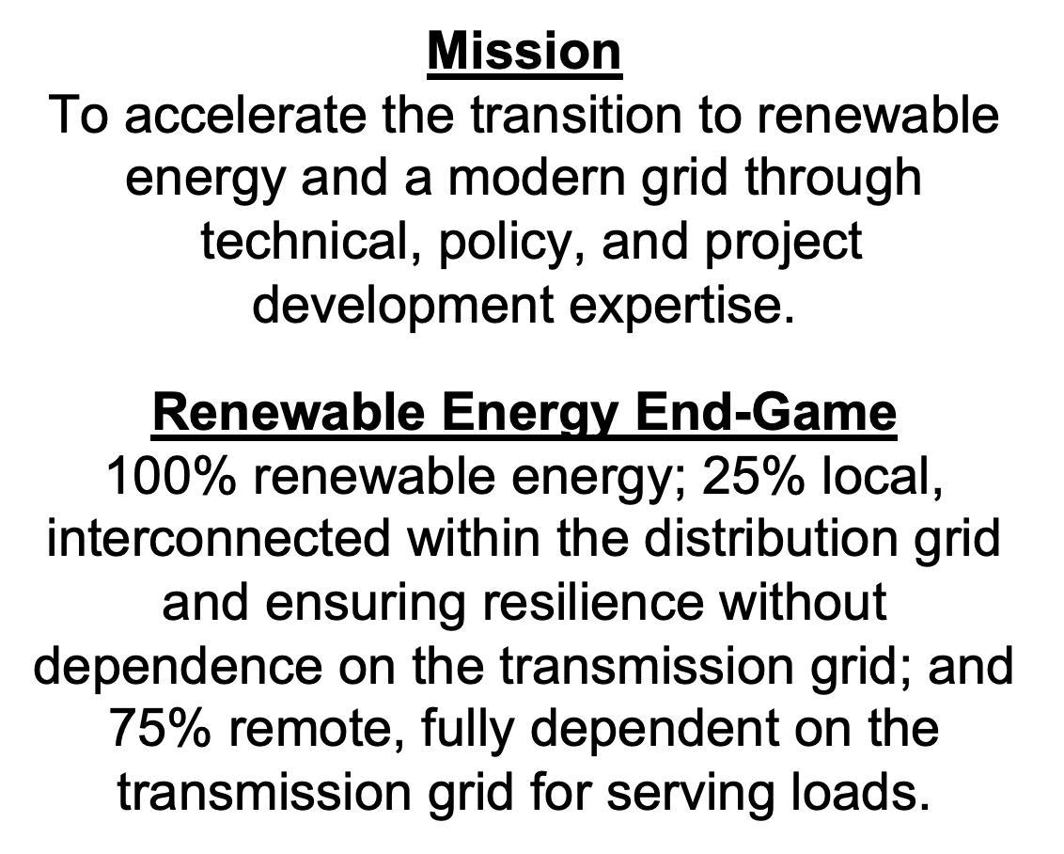
Clean Coalition (nonprofit)

Slide 3
Green Rebuild Initiative
Mission:
The Green Rebuild Initiative (GRI) aims to facilitate sustainable and resilient rebuilds through “Super Green” home designs that are all-electric, Net Zero Energy (NZE), and supported by Solar Microgrids for unparalleled resilience. The GRI also encourages homes to be designed for high energy efficiency and low embedded carbon, while being engineered to withstand extreme weather events and built with non-toxic materials.
Actions:
              Educate property owners, architects, builders, policymakers, lenders, insurers, and everyone else about the superiority of Super Green homes.
              Illuminate the economic benefits of Super Green designs, including the associated tax benefits and other incentives.
              Provide easy access to specifications associated with Super Green designs.
              Share showcase Super Green home designs.
              Connect parties for Super Green outcomes, including property owners, architects, builders, and associated experts.
Notes:
3

Slide 4
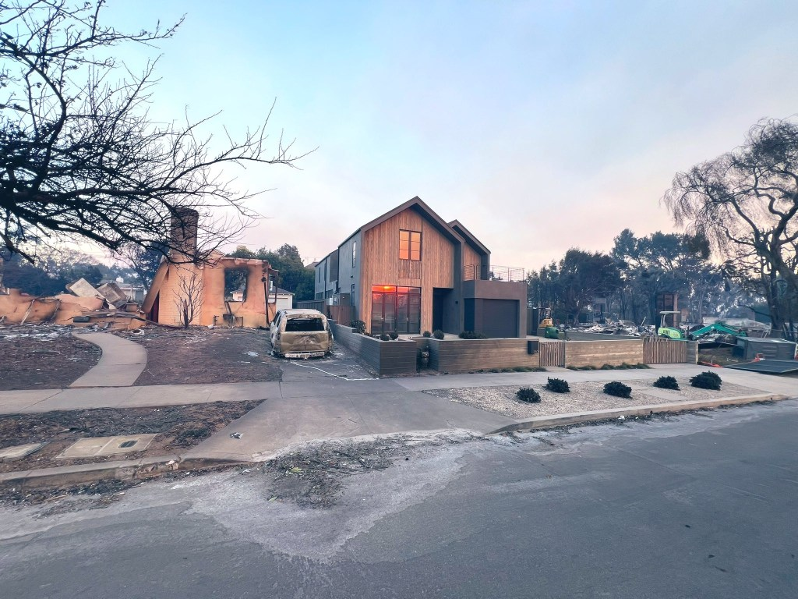
GRI Webinar Overview
Super Green
        100% Electric
        Net-Zero Energy (NZE)
        Solar Microgrid
Sustainable Design & Construction
  Embodied Impact
  Operational Impact
  Fire Resilience
  Smoke Resilience
Financial Incentives
  RISE: Rebuilding Incentives for Sustainable Electric Homes
  Super Green Economic Outcomes
Notes:
Greg Chasen’s house in Pacific Palisades, which he built in 2024

Slide 5
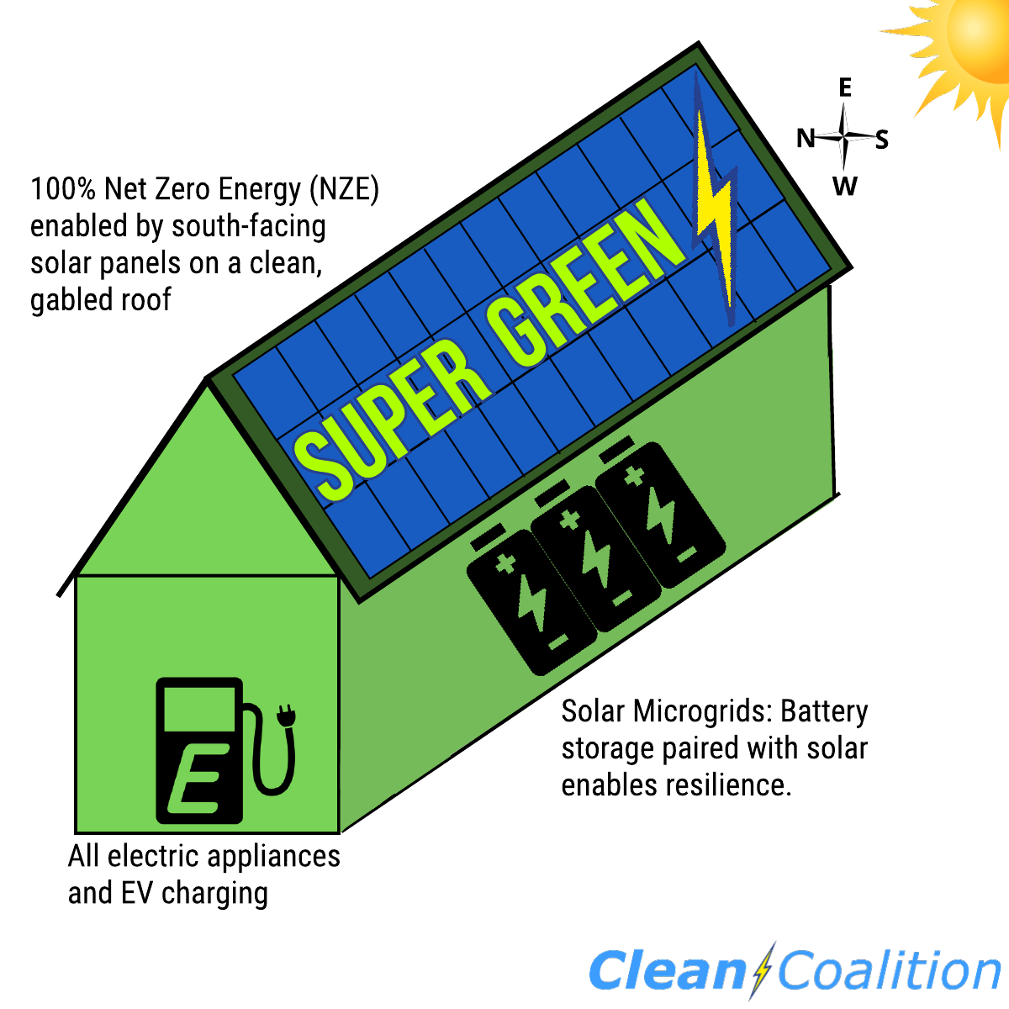
What is Super Green?
100% Electric: No gas service to the home and ideally an all-EV household.
Net Zero Energy (NZE): Onsite solar energy production at least equals the annual energy consumption across the premise, including to cover home EV charging.
Solar Microgrid: Combines a battery to the solar for economic optimization and achieving unparalleled energy resilience.

Slide 6
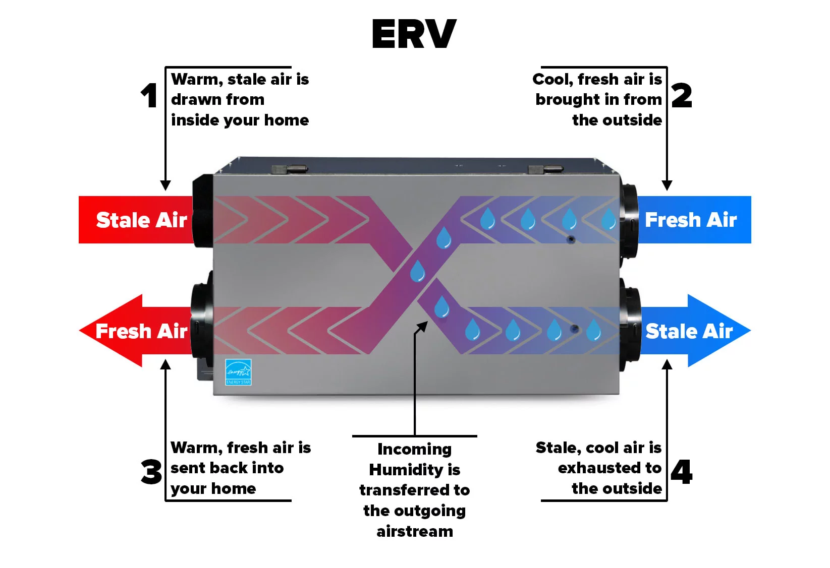
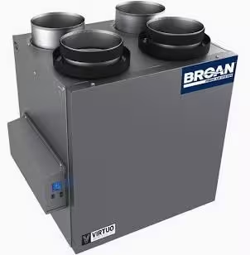
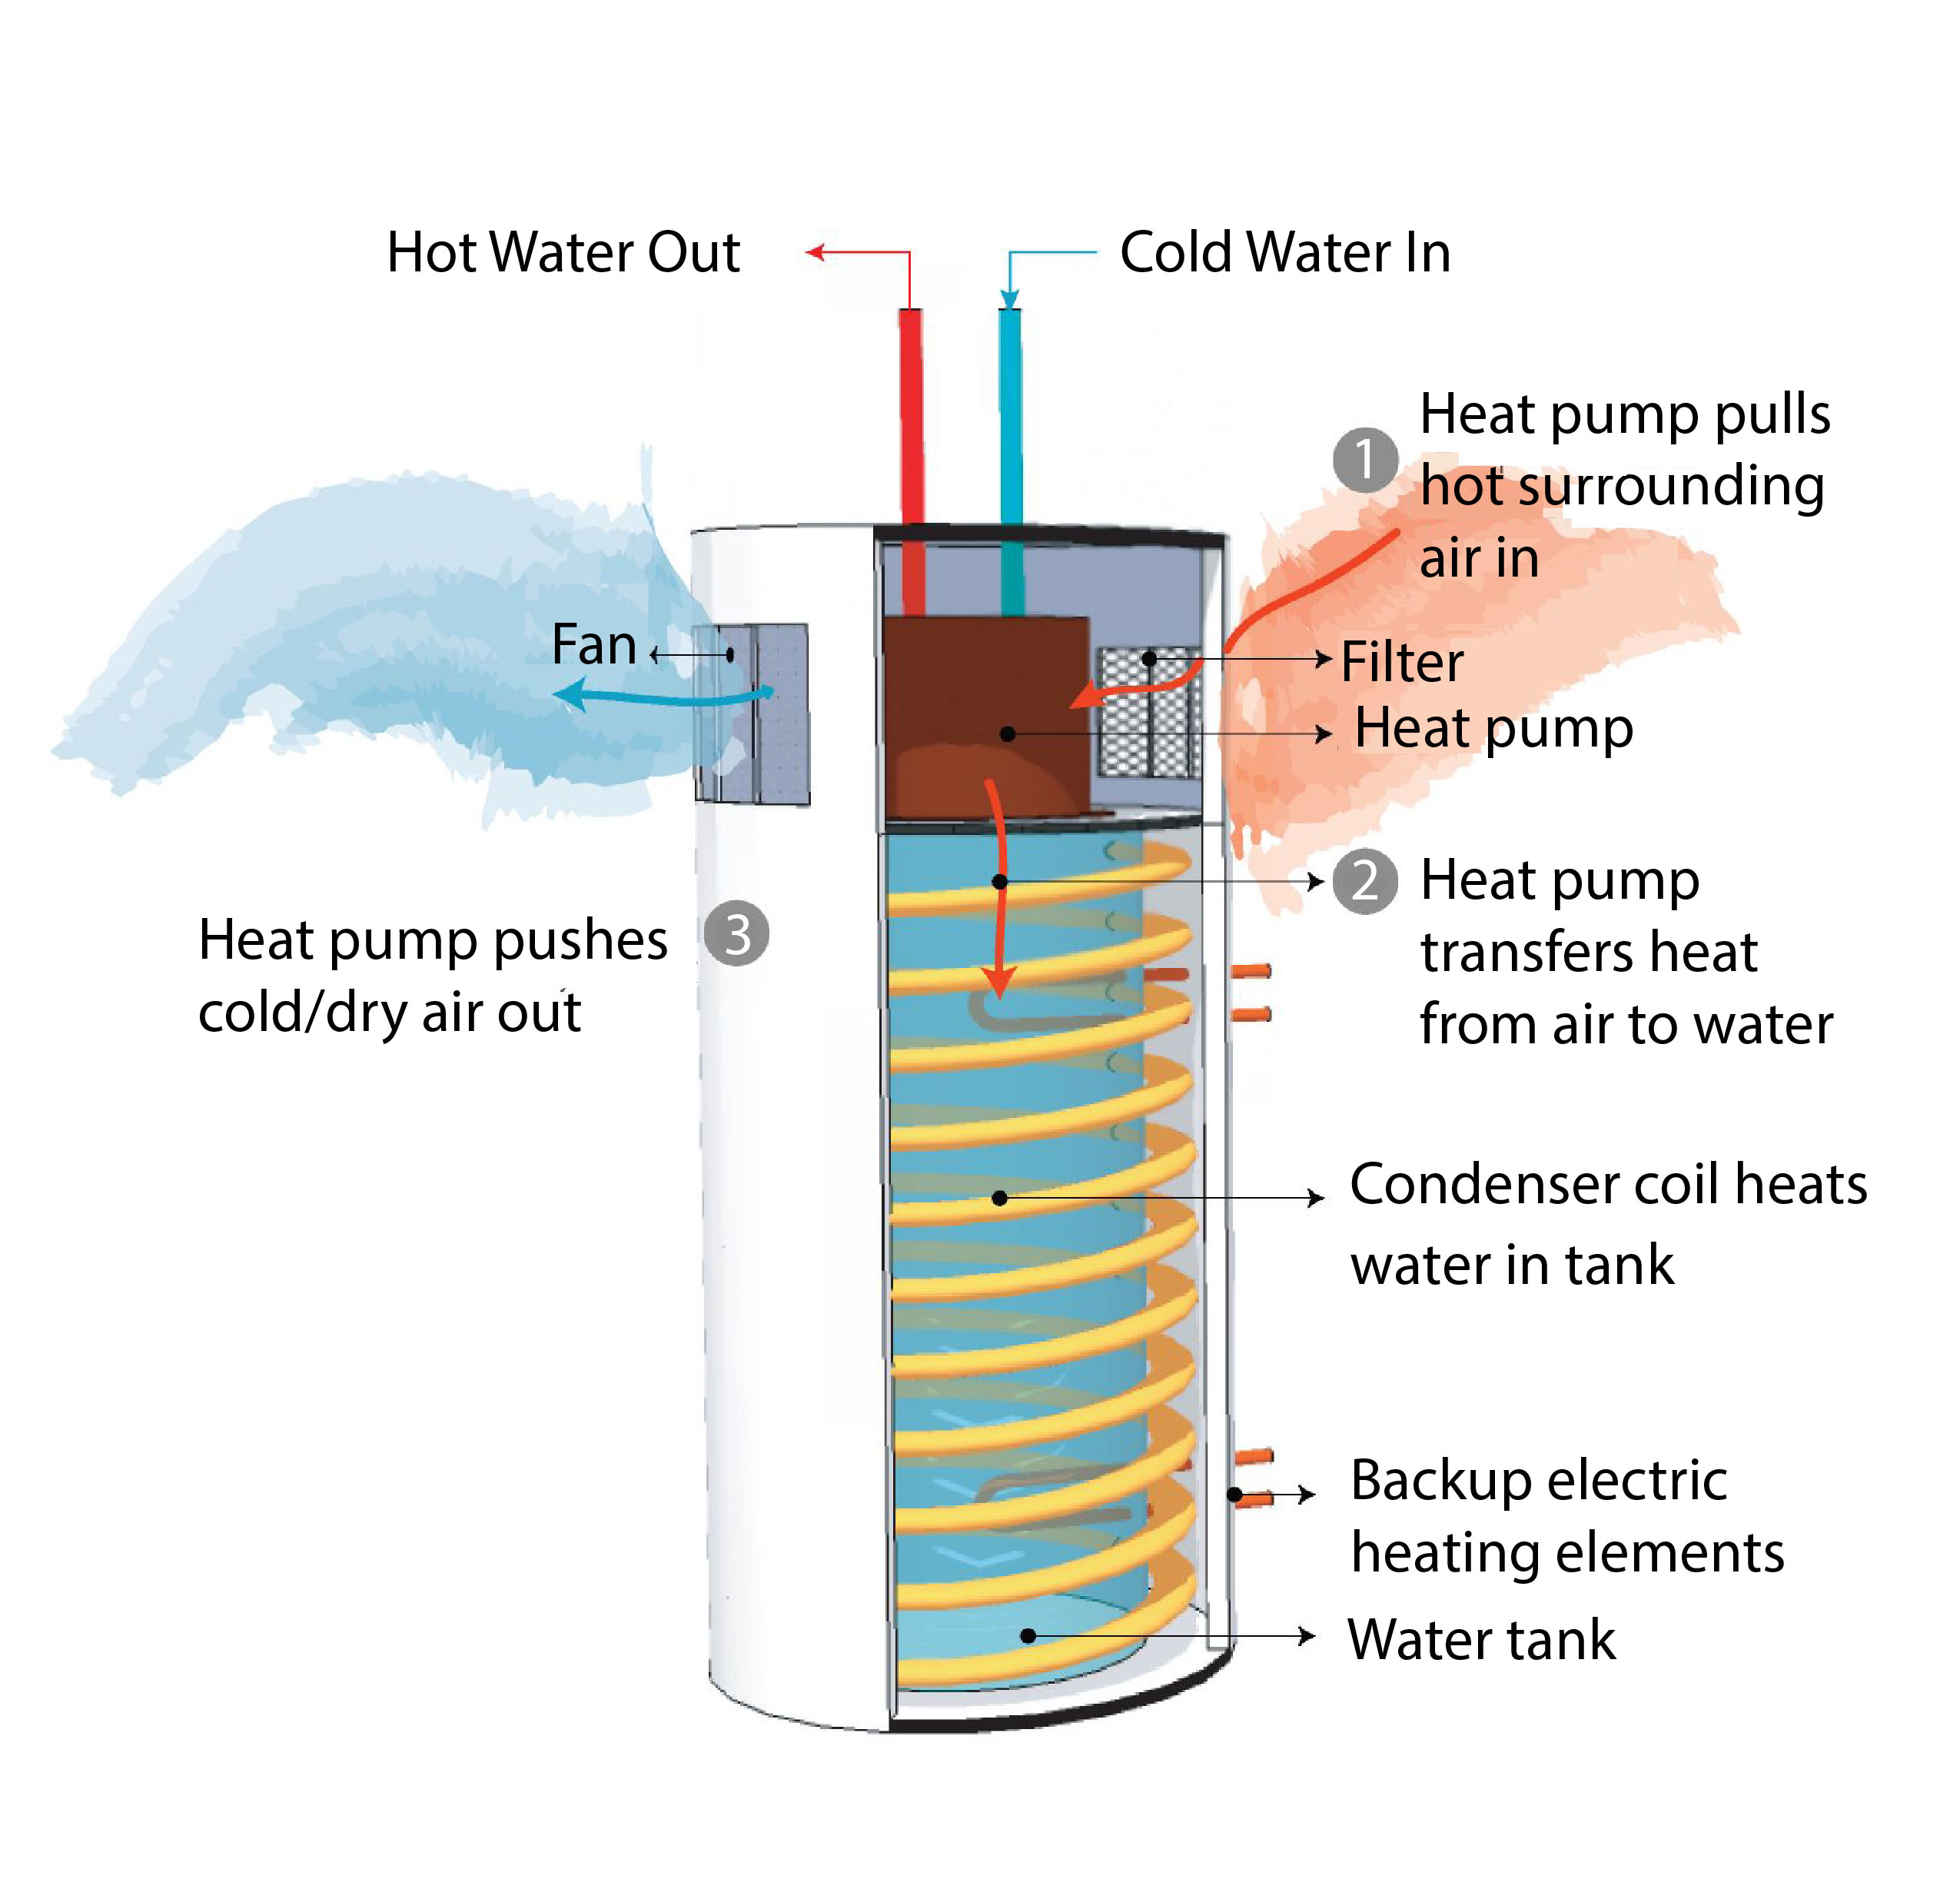
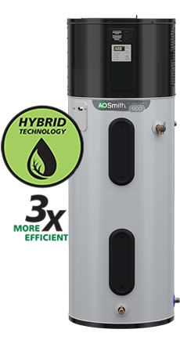

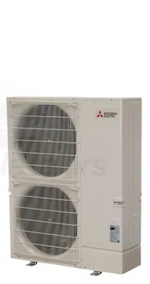
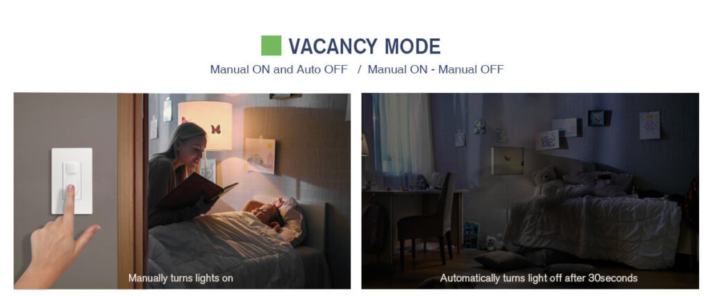
Super Green: 100% Electric
Specifications
Mechanical and Plumbing
  Heat Pump HVAC
  Heat Pump Water Heater
  ERV: Energy Recovery Ventilator
  E-Fireplace: Napoleon Alluravision 60” [Optional]
  Heat Pump Pool Water Heater [Optional]
Electrical
  LED Light Bulbs
  Occupancy/Vacancy Sensors
  Dimming Switches
  Span Panel [Optional]
Notes:
Sealed Ducting, No Flex Duct (G90 Zinc) w/ R6 Insulation
Wall and Ceiling Registers - Titus

Slide 7





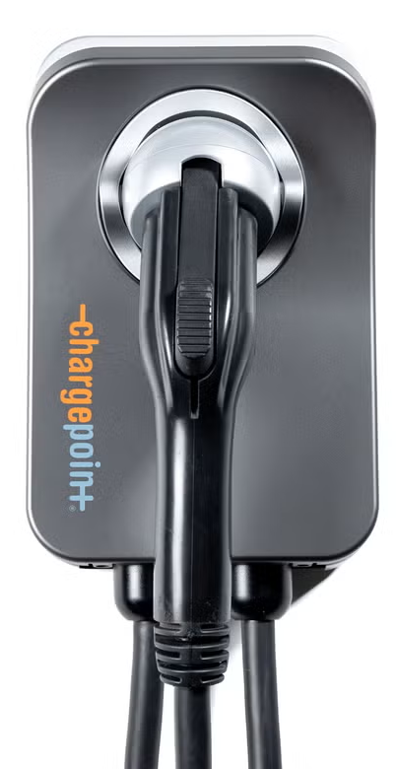
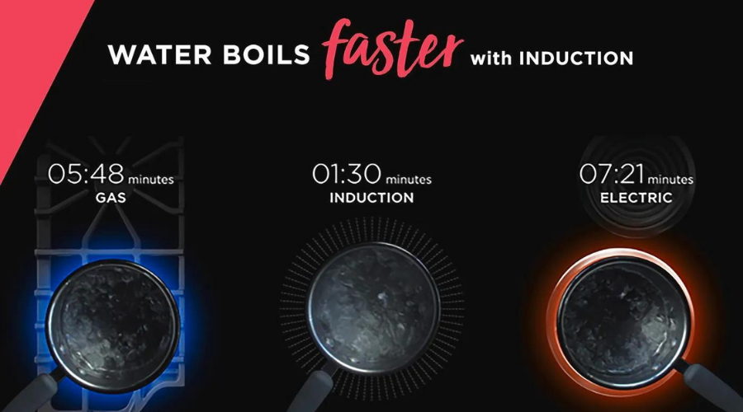
Super Green: 100% Electric
Appliances
  Induction Cooktop
  EnergyStar Refrigerator
  EnergyStar Dishwasher
  EnergyStar Washing Machine
  Energy Efficient Microwave
  Heat Pump Dryer
  EV Charging Outlet and/or Charger
  (Level 2 capable)
Energy Efficient
100% Electric
Induction Cooktops

Slide 8
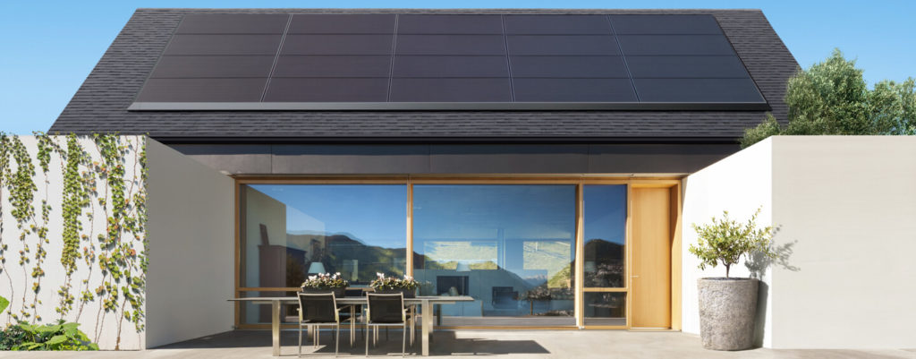
Super Green: Net Zero Energy (NZE)
NZE requires the solar to produce at least as much energy as the home consumes over the course of a year. Solar needed to achieve NZE for homes with Title 24 levels of energy efficiency and two EVs (22,000 miles of home EV charging per year):
1,500sf home requires 9.8kW of solar
(24 solar panels).
2,500sf home requires 14.8kW of solar
(36 solar panels).
California Energy Code Title 24 (Part 6) falls far short of NZE:
1,500sf home only requires 2kW
(5 solar panels)
2,500sf home only requires 3kW of solar
(7 solar panels).
Notes:
CalGreen Title 24 Building Code Compliance

Slide 9
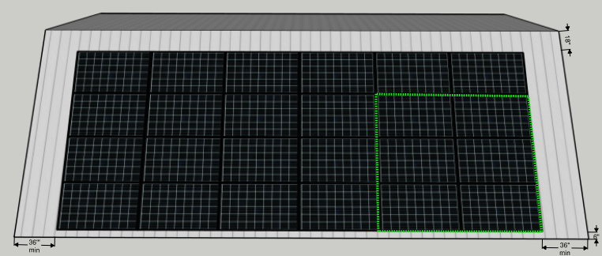
Super Green: Solar to achieve 1,500sf NZE home
Total single roof area required to achieve NZE for a 1,500 sf house is 700 sf, to accommodate 507 sf of solar (9.8 kW) plus setbacks
South-facing rooftop at a 30° pitch is ideal
6 solar panels needed to NZE one EV, assuming 12,000 miles of home charging per year
14,600 kWh per year is the estimated energy consumption for a typical 4-person household in a 1,500sf home.
A 9.8kW solar array (assuming 1,512kWh/kW-yr) is required to achieve Net Zero Energy (NZE), which includes charging two EVs
Note: an EV driving 12,000 miles per year will require 3,600kWh of energy per year to charge, which can be offset by 6 solar panels. This model also assumes there is a second EV using 10,000kWh per year.
Assumes QCELL 410W solar panels, each with dimensions of 6.2 ft x 3.4 ft (21.1 sf per panel).
24 solar panels required to achieve NZE, requiring 507 sf for the solar layout, and producing 14,808 kWh per year.
Total roof area required is 700 sf, including setbacks of 3 feet on side edges, 1.5 feet from the ridge, and 0.5 feet from the bottom edge (the bottom setback is needed to ensure proper rain drainage into a gutter).

Slide 10
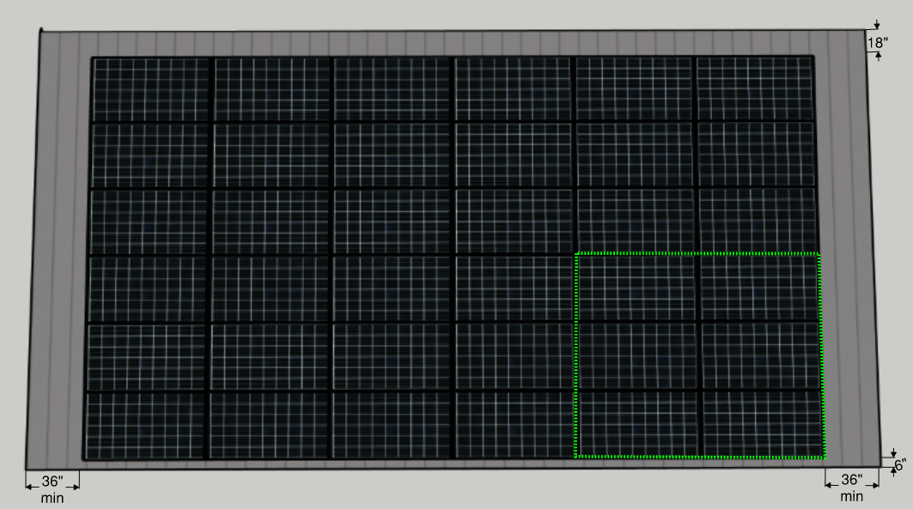
Super Green: Solar to achieve 2,500sf NZE home
Total single roof area required to achieve NZE for a 2,500 sf house is 1,000 sf, to accommodate 760 sf of solar (14.8 kW) plus setbacks
South-facing rooftop at a 30° pitch is ideal
6 solar panels needed to NZE one EV, assuming 12,000 miles of home charging per year
21,221 kWh per year is the estimated energy consumption for a typical 2,500sf 4-person household
A 14.8kW solar array (assuming 1,512kWh/kW-yr) is required to achieve Net Zero Energy (NZE), which includes charging two EVs
Note: an EV driving 12,000 miles per year will require 3,600kWh of energy per year to charge, which can be offset by 6 solar panels. This model also assumes there is a second EV using 10,000kWh per year.
Assumes QCELL 410W solar panels, each with dimensions of 6.2 ft x 3.4 ft = 21.1 square feet
36 solar panel required to achieve NZE, requiring 760 sf for the solar layout, and producing 22,223 kWh per year.
Total roof area required is 1,000 sf, including setbacks of 3 feet on side edges, 1.5 feet from the ridge, and 0.5 feet from the bottom edge (the bottom setback is needed to ensure proper rain drainage into a gutter).

Slide 11
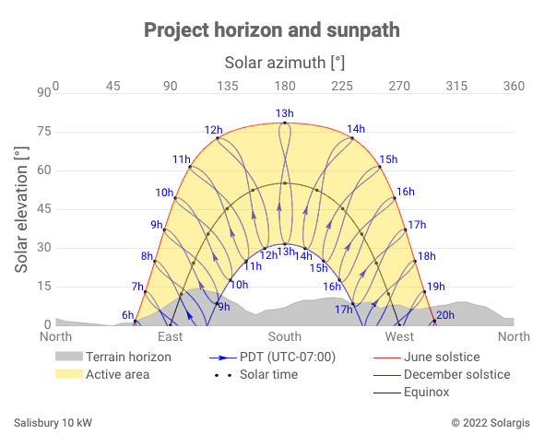
Solar should be as close to south-facing as possible

Slide 12
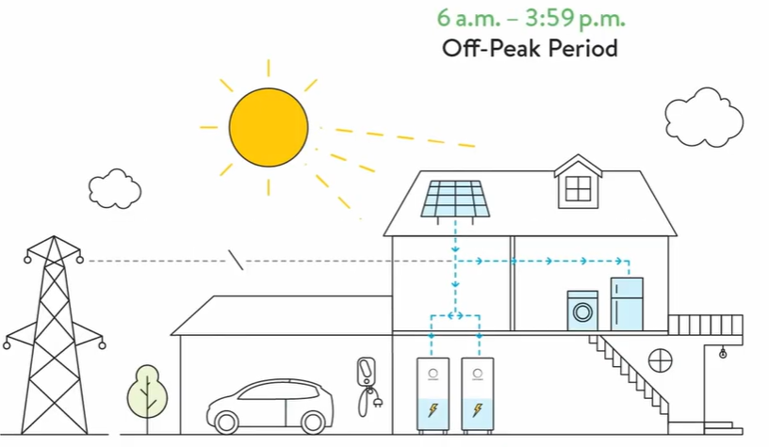
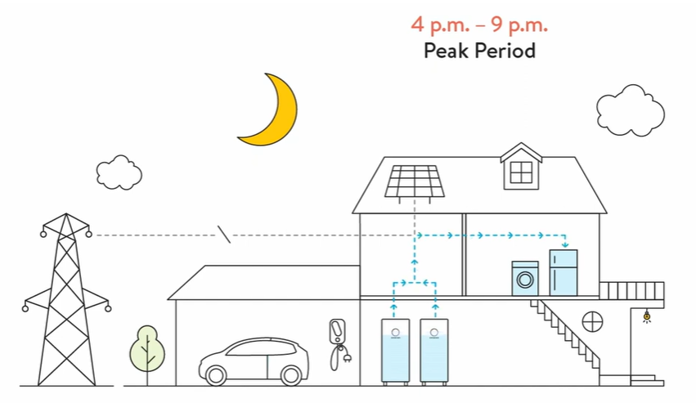
Super Green: Solar Microgrid
Off-Peak Period
Power from Sun
During the day the home draws power from its solar array and charges the home battery.
Peak Period
Power from Battery
Power is drawn from the home’s battery, and Peak Utility-based costs are avoided
© Sonnen
Notes:
Operate independently from the utility company

Slide 13
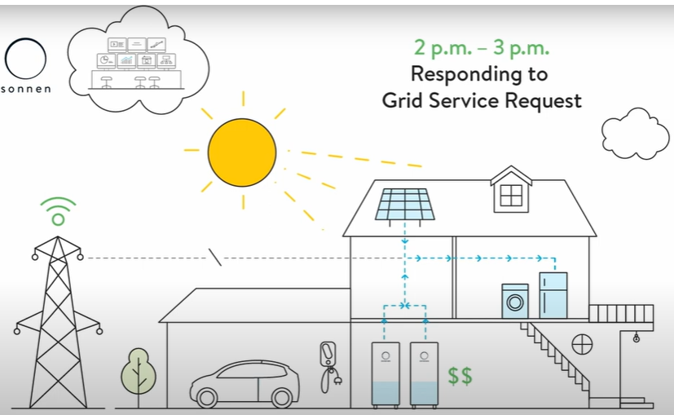
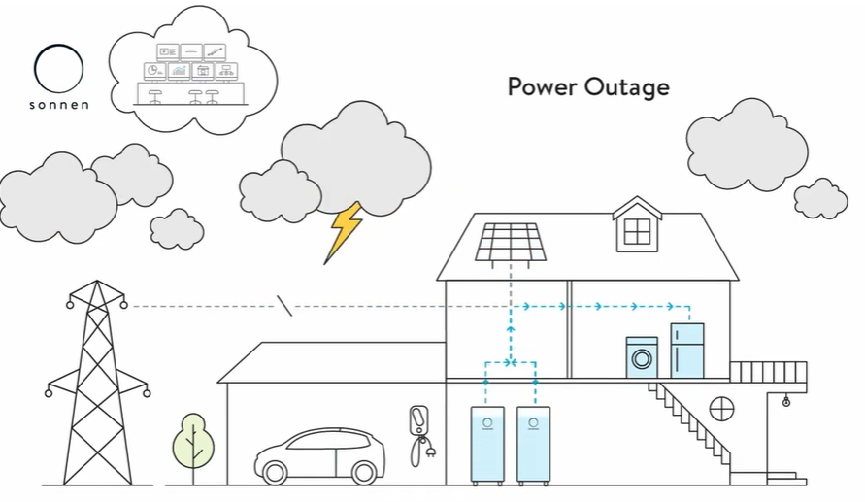
Super Green: Solar Microgrid
Grid Service Request
Earn Credits
Homeowner can earn credits from the utility company by providing excess power during a Grid Service Request. These credits can be used to offset future utility charges
Power Outage
Off-Grid Mode
During a planned and/or unexpected power outage, homeowners can shift consumption to Critical Loads and consume energy entirely from their solar + battery system. Critical Loads include only essential appliances and circuits, (Refrigerator, Microwave, WiFi, fire-life-safety devices and select outlets).
Whole-home Back Up Optional
© The Climate Center
© Sonnen
Notes:
Operate independently from the utility company

Slide 14
Value-of-Resilience (VOR) details
VOR123
VOR123 is the value-of-resilience (VOR) from Solar Microgrids methodology that the Clean Coalition has developed to normalize VOR across all types of facilities & geographies. The VOR normalization is founded in tiering loads into three categories: Tier 1 (critical), Tier 2 (priority), and Tier 3 (discretionary). Since each Tier has its own resilience requirement and VOR, this methodology is called VOR123.
VOR123 webinar
https://clean-coalition.org/news/webinar-valuing-resilience-solar-microgrids-thursday-5-nov-2020/
Notes:
14

Slide 15
Percentage of time online for Tier 1, 2, and 3 loads for a Solar Microgrid designed for the University of California Santa Barbara (UCSB) with enough solar to achieve net zero and 200 kWh of energy storage per 100 kW solar.
Typical load tier resilience from Solar Microgrids
Percentage of total load
Tier 3 = Discretionary load, ~75% of total load
Tier 2 = Priority load, ~15% of total load
Tier 1 = Critical, life-sustaining load, ~10% of total load
Percentage of time

Slide 16
A typical diesel generator is configured to maintain 25% of the normal load for two days. If diesel fuel cannot be resupplied within two days, goodbye. This is hardly a solution for increasingly necessary long-term resilience. In California, Solar Microgrids provide a vastly superior trifecta of economic, environmental, and resilience benefits.
Diesel generators are designed for limited resilience
Percentage of total load
Tier 3 = Discretionary load, ~75% of total load
Tier 2 = Priority load, ~15% of total load
Tier 1 = Critical, life-sustaining load, ~10% of total load
Percentage of time

Slide 17
Load Management is key to Solar Microgrids
SPAN Panels are king of residential Load Management
Control circuits from anywhere
Real-time on/off control over every circuit in the home from the SPAN Home App + scheduling with Amazon Alexa.
Learn from deep energy insights
360-degree view of your home’s energy from a smartphone or tablet helps you save more.
Save on energy bills
Quantify the impact of appliances on your energy bill, and make smarter decisions to save.
Set a powerful foundation
Future-proof your home for upgrades such as EV, solar, battery storage, heat pumps, induction cooktops, and more.
https://www.span.io/

Slide 18

Design and Construction Timeline
Conceptual Design: Architect
  Finalize home size:
    Square Footage
    Orientation
    # of Bedrooms
    # of Bathrooms
  Develop Conceptual Rendering (4-6 weeks)
  Energy Optimization (2-4 weeks):
  Design Solar Array + Battery System
    Size System for Microgrid Resilience
    Economic Analysis
Design Development: Architect
  SD: Schematic (2-4 Mo.)
      Site Survey (1-2 Weeks)
      Submit for Permit Review (4-6 Weeks)
  CD: Construction Documents (1-2 Mo.)
  Prefab/Modular Shop Drawings
Construction Schedule: Contractor
  Foundation (1-2 Month)
  Utility Tie-Ins (4-6 Weeks)
  Framing (1-2 Months)
  MEP (3-4 Months)
  Interior Finishes (3-4 Months)
  Exterior Finishes (1 Month)
  Certificate of Occupancy (2-4 Weeks)
Opportunity for PreFab or Modular Construction

Slide 19
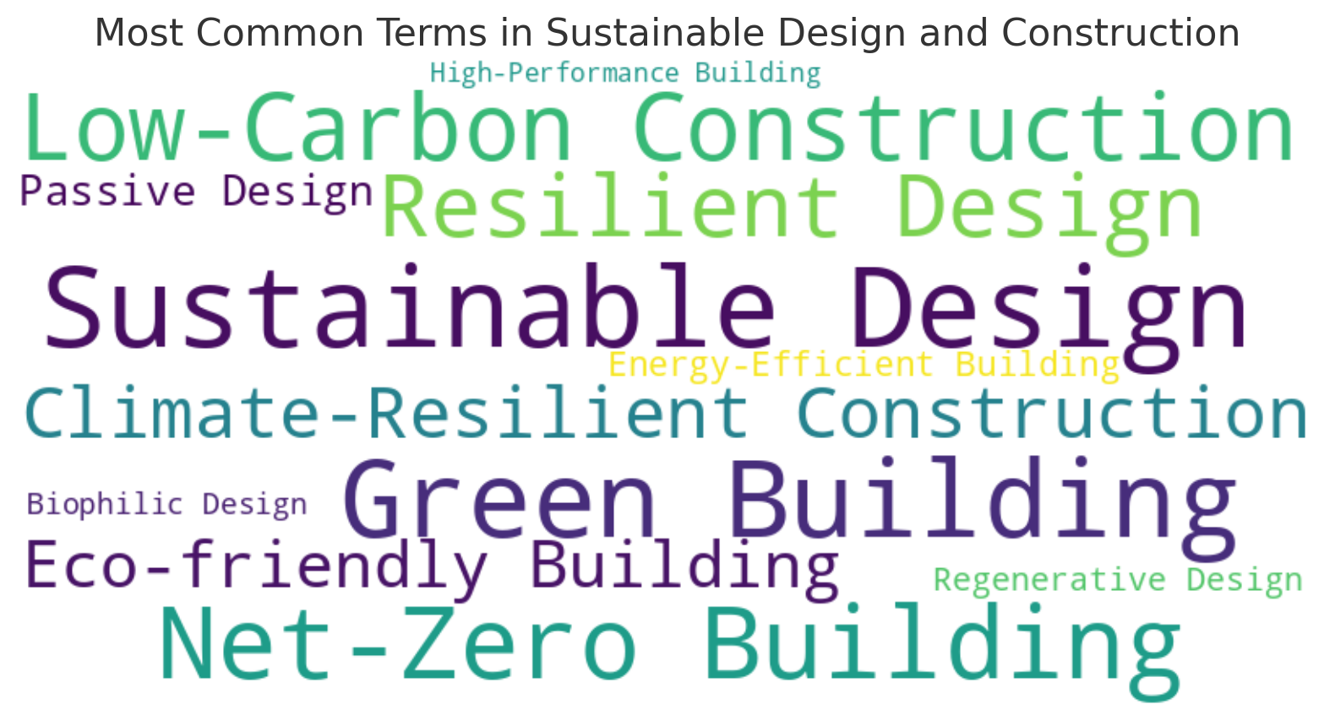
Sustainable Design and Construction
Notes:
Buzz Words

Slide 20
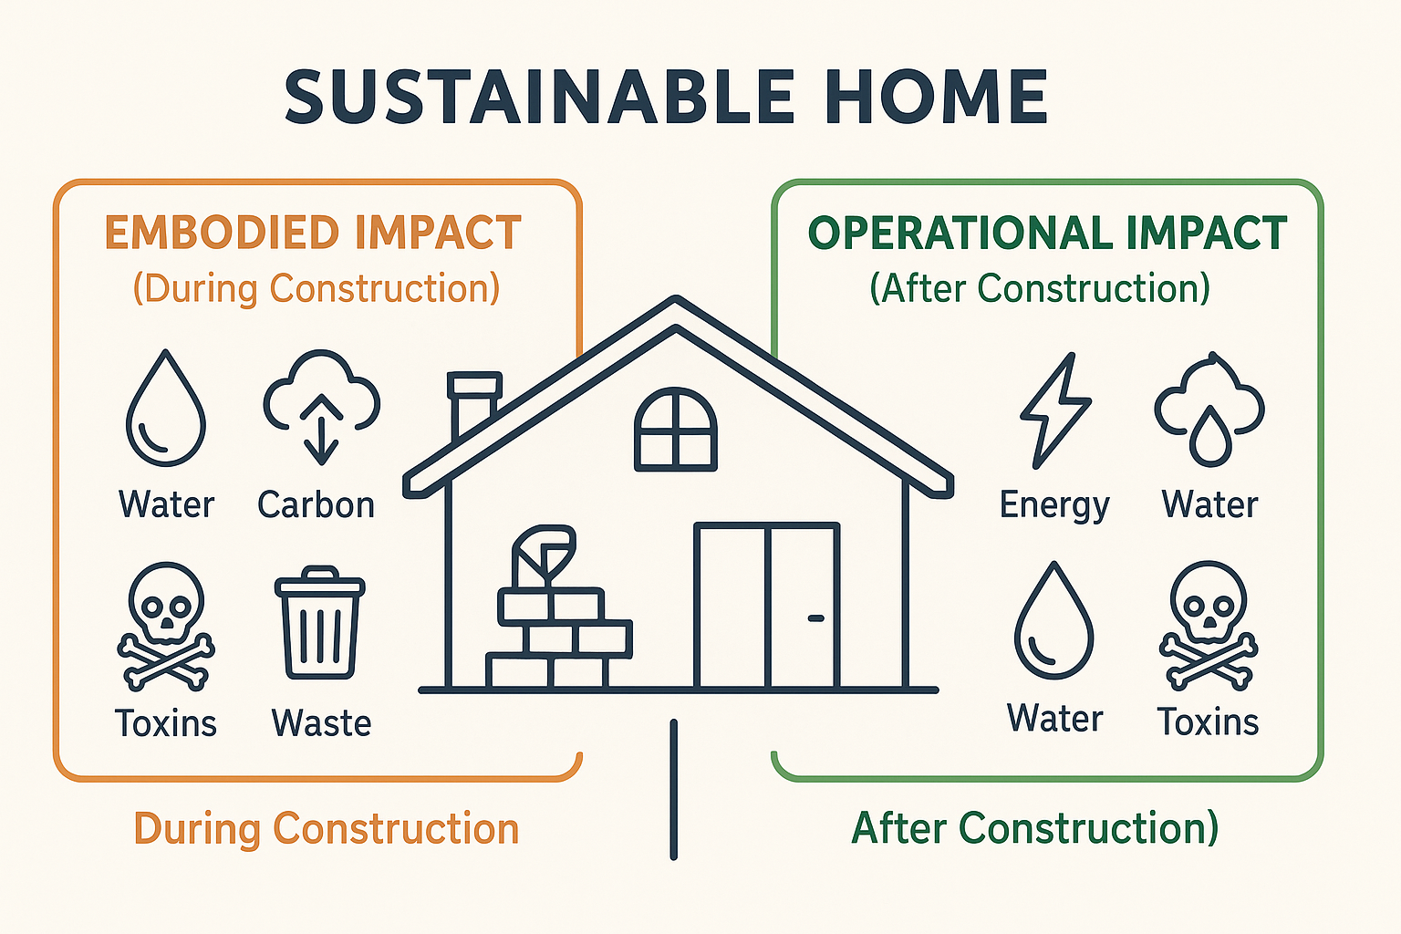
Sustainable Design and Construction
Sustainability: meeting present needs without compromising the ability of future generations to meet their own needs.
Sustainable Home: designed and built to minimize its environmental impact and promote a healthy living environment.

Slide 21
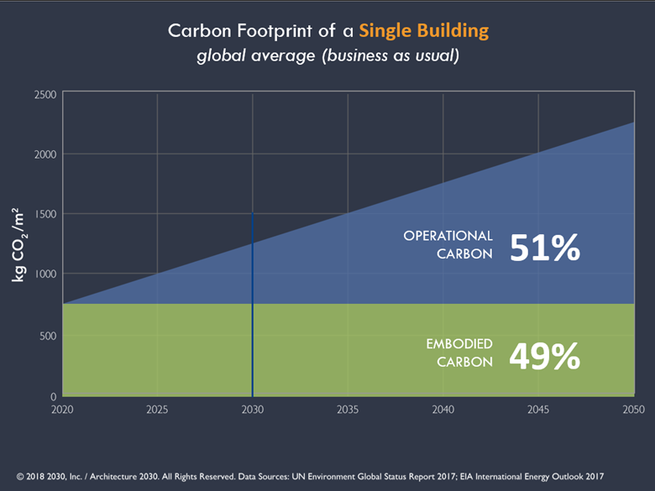



Embodied Impact
© Thrive Collaborative
AB 262
Notes:
January 1, 2019. Officially known as AB 262, establish a maximum acceptable global warming potential for certain materials used in public works projects. The materials covered under the Act include carbon steel rebar, flat glass, mineral wool board insulation, and structural steel.

Slide 22
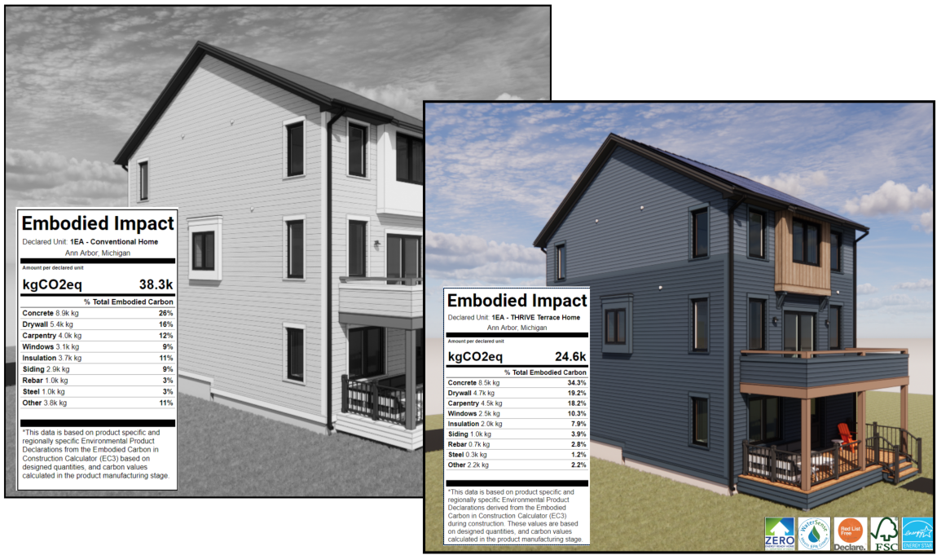

Embodied Impact
This Example compares the same style home built with sustainably-sourced materials vs. a conventionally built home of the same size.
© Thrive Collaborative
Embodied Carbon: all carbon expended during raw material extraction, manufacturing and transportation to the construction site (Cradle-to-Gate).

Slide 23

Embodied Impact

Slide 24













Embodied Impact
Third-Party Material Certifications
Notes:
Energy Star – Appliances
FSC & SCS – Lumber
Water Sense – Plumbing Fixtures
Red List Free – Chemical Composition of the Materials

Slide 25

Embodied Impact
Living Future Red List
Chemical | Where It’s Found | Environmental Impacts | Human Health Impacts
Flame Retardants (e.g., PBDEs) | Insulation, upholstery, electronics casings | Persistent organic pollutants; accumulate in wildlife | Thyroid disruption, neurodevelopmental harm, carcinogen
Formaldehyde | Composite wood, insulation, adhesives | Air pollutant, contributes to smog | Respiratory irritant
Isocyanates (e.g., MDI, TDI) | Spray foam insulation, paints, sealants | Contribute to smog, hazardous waste | Respiratory irritant, skin and eye irritation
PFAS | Paints, Stain-resistant carpets, sealants, coatings, membranes | Extremely persistent ('forever chemicals'), water pollution | Hormone disruption, carcinogen
PVC (Polyvinyl Chloride) | Vinyl flooring, pipes, windows, others | Toxic byproducts during manufacturing | Endocrine disruptor
Phthalates (e.g., DEHP) | Vinyl products, sealants, adhesives | Bioaccumulative through food chain | Hormone disruption, reproductive toxicity
VOCs | Paints, sealants, adhesives, flooring, cabinetry | Contributes to smog indoor air pollution | Eye/nose/throat irritation, liver/kidney damage, carcinogenic
The complete Red List includes 12,500 chemicals total
Including Asbestos, Lead, Mercury, and others
https://living-future.org/red-list/
Notes:
"worst-in-class" chemicals and materials that are known to be harmful to human and ecosystem health and should be avoided

Slide 26

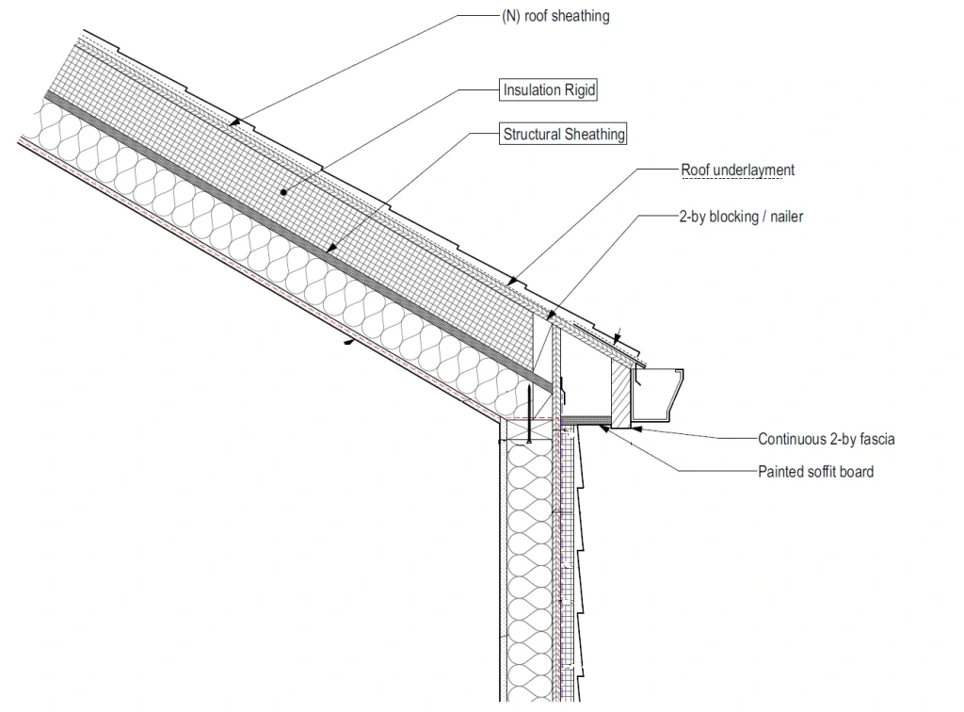
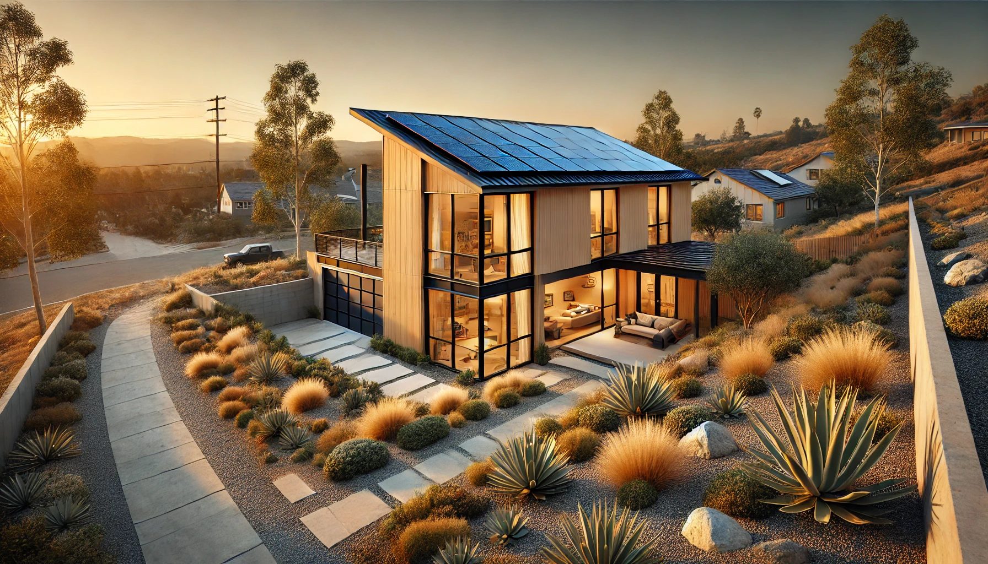

Fire Resilience
USGBC Wildfire Defense Toolkit
Defensive Perimeter
Class A Materials
Hot Roof (Non-Vented)
Tempered Triple-pane Windows
Heat Resistant Siding
Build back better once
Hot air and gases are deflected out away from the building
Timber HP: Class A (2-Hr Rated)
Reference:
https://usgbc-ca.org/wp-content/uploads/2025/04/USGBC-CA-Wildfire-Defense-Toolkit_2025-compressed.pdf

Slide 27
Rise

Slide 28

Economics: CALGreen Intro
CALGreen Building Code Title 24 Intro
Energy & Envelope Core Requirements
All-Electric Ready
  New homes must be wired and plumbed for future electric appliances.
High-Efficiency HVAC
  Ducts must be sealed and tested; heat pump space heating and cooling encouraged or required in some zones.
High-Efficiency Water Heating
  Mandatory heat pump water heater (HPWH) ready infrastructure; HPWH required in some cases.
Solar PV Requirement
  New single-family homes must include solar photovoltaic systems, (PV 1,500sf to 2,500sf Home = 2kW to 3kW min.)
High Performance Walls & Roofs
  Mandatory insulation values: R-13 to R-21 for walls, R-30 to R-38+ for ceilings (climate zone dependent).
Mandatory Air Sealing
  < 5.0 ACH50 blower door test or sealed envelope with visual verification.
High-Performance Fenestration
  Windows must meet U-factor ≤ 0.30 and SHGC ≤ 0.23 (varies by climate zone).
Cool Roofs (in applicable zones)
  Roofing must meet minimum solar reflectance and thermal emittance values.
Lighting & Controls
  All lighting must be high-efficacy (LED), with vacancy sensors and dimmers as required.
Verification & Documentation
  HERS verification for insulation quality, duct leakage, blower door test, refrigerant charge, etc.
Notes:
Annual Super Green Energy Bill (approximate): ~$36 × 12 = $432 per year for electricity. This includes ~$120 in minimum charges, ~$272 in PAC charges, and ~$40 in taxes. The solar overproduction has eliminated all volumetric energy charges

Slide 29
Economics: 1,500sf Home Comparison
Capital Costs
Gas vs. CALGreen Building Code Title 24 vs. Super Green
Notes:
Annual Super Green Energy Bill (approximate): ~$36 × 12 = $432 per year for electricity. This includes ~$120 in minimum charges, ~$272 in PAC charges, and ~$40 in taxes. The solar overproduction has eliminated all volumetric energy charges

Slide 30
Economics: 1,500sf Home
Super Green Incentives
CalEHP: California Electric Homes Program – currently active for all California Homeowners
ITC: Federal Investment Tax Credit, possibly will be eliminated at the end of 2025
RISE: CPUC Incentive, *pending final approval
RISE Equity: CPUC Incentive for low-income households, *pending final approval
CESHP: California Energy Smart Homes Program, available for SEC, PG&E and SDE&G customers only
Notes:
Annual Super Green Energy Bill (approximate): ~$36 × 12 = $432 per year for electricity. This includes ~$120 in minimum charges, ~$272 in PAC charges, and ~$40 in taxes. The solar overproduction has eliminated all volumetric energy charges

Slide 31
Economics: 1,500sf Home Comparison
Energy Costs
Gas vs. CALGreen Building Code Title 24 vs. Super Green
~$4,000 Estimated Savings on Annual Energy Costs!
Car Fuel (EV Charging) Costs are also Covered
Notes:
Annual Super Green Energy Bill (approximate): ~$36 × 12 = $432 per year for electricity. This includes ~$120 in minimum charges, ~$272 in PAC charges, and ~$40 in taxes. The solar overproduction has eliminated all volumetric energy charges

Slide 32
Economics: 1,500sf Home Example
Super Green Payback
Notes:
Annual Super Green Energy Bill (approximate): ~$36 × 12 = $432 per year for electricity. This includes ~$120 in minimum charges, ~$272 in PAC charges, and ~$40 in taxes. The solar overproduction has eliminated all volumetric energy charges

Slide 33
Economics: 2,500sf Home Example
Super Green Payback
Notes:
Annual Super Green Energy Bill (approximate): ~$36 × 12 = $432 per year for electricity. This includes ~$120 in minimum charges, ~$272 in PAC charges, and ~$40 in taxes. The solar overproduction has eliminated all volumetric energy charges

Slide 34
Current Collaborators
Architects
  Altadena Collective
    Tim Vordtreide
    Chris Corbett Design
  Bildsten Arch: Ellen Bildsten
  Union Studios: Ben Willis
  Garcia Architecture: Elisa Garcia
Landscape Architects
  Kiesel Design: Jack Kiesel
General Contractors
  Allen Construction: Dennis Allen
  Best Tech Contracting: Jason Scheurer
  Desert Estate Development: John Pedalino
Prefab/Modular Manufacturers
  Plant Prefab: Steve Glenn
  Joubert Homes: Darin Dusan & Steffen Andrews
  ReMo Homes: Ryan Blowers/ Vamsi Kotla
  BPublicPrefab
Other Collaborators
  Mayor of LA: Karen Bass
  USGBC LA: Ben Stapleton
  Bello Global Consulting: John Bello, P.E.
  Taft Office: Margie Taft
  Box Power: Fallon Vaughan
  Steadfast LA: Rick Caruso
  Permacity Foundation: Jonathan Port
  California Home+Design: Lauren Michele
  Direct Relief
  Habitat for Humanity

Slide 35
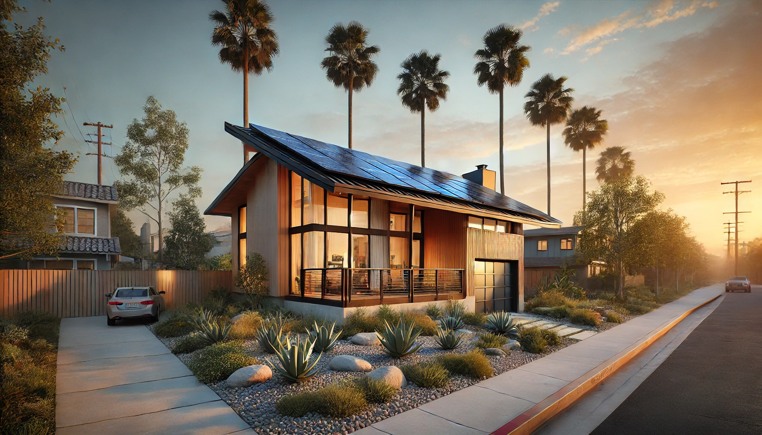


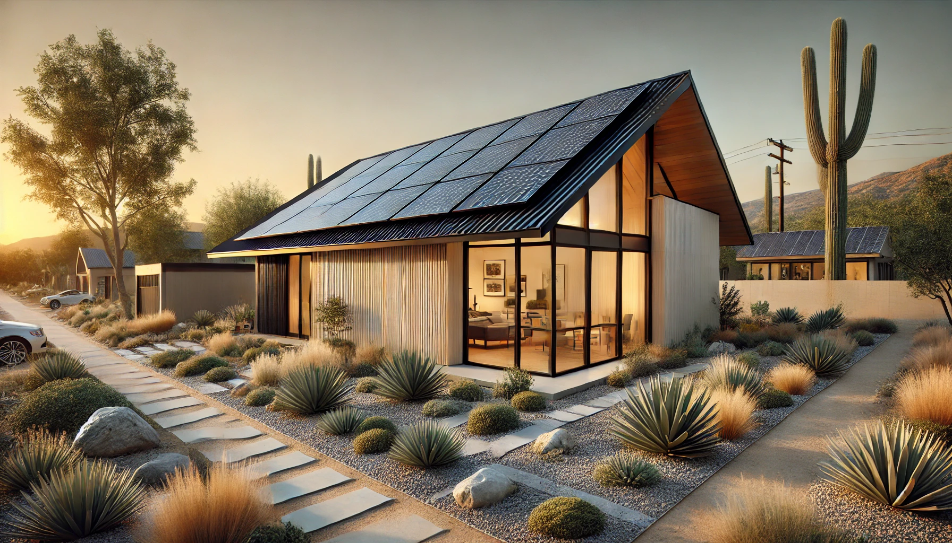

Conclusion and Q&A
Contact Us:
Craig Lewis
650-796-2353
Craig@Clean-Coaltion.org
Haley Weinstein
609-619-1781
Haley@Clean-Coalition.org
John Bello, P.E.,
347-786-1620
JTBELLO27@Outlook.com
Patrice Hicks
619-655-8438
Patrice.Hicks@ICF.com
https://clean-coalition.org/programs/green-rebuild-initiative/

