Slide 1


Ann Arbor’s Sustainable Energy Utility … Coming Soon
100% Clean, Reliable, Resilient, Locally Built and Owned, Optional, and Supplemental Utility

Slide 2
TABLE OF CONTENTS
Context
Vision
Next Steps and Timeline
Ann Arbor’s Sustainable Energy Utility

Slide 3
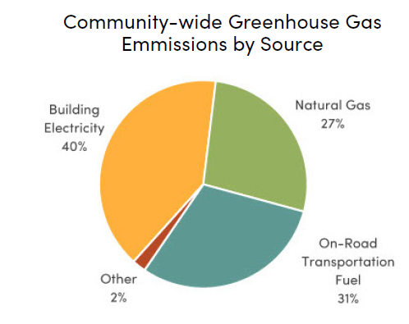
Emissions by Source
40% of community-wide emissions come from building electricity usage
  Nearly 70% come from buildings as an entire sector
Vehicle (and building) electrification is increasing this figure
Goal of a just transition to community-wide carbon neutrality by 2030 (A²ZERO)
Ann Arbor’s Sustainable Energy Utility

Slide 4
Ann Arbor Energy Profile
Renewable share of Ann Arbor’s power supply will increase due to State mandate, DTE plans, and current Ann Arbor initiatives, but will not reach 100%, without further interventions.
Ann Arbor’s Sustainable Energy Utility

Slide 5
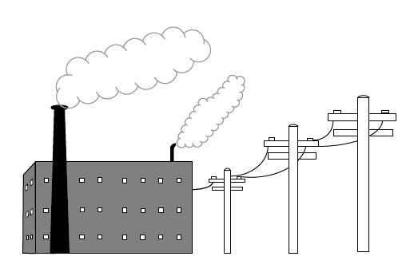
Michigan Energy Context
Ann Arbor has a pre-Foote Act franchise, meaning our current utility's franchise is considered perpetual.
Foote Act franchises are not exclusive; MI law gives cities and villages the right to compete, as well as the Constitutional right to take over an existing franchise. That means we could:
  Buy out DTE's infrastructure (traditional municipalization)
  Create a parallel utility to supplement DTE’s service (SEU).
  Continue the relationship we have.
  Push for new utility laws and policies.
  Other…
Ann Arbor’s Sustainable Energy Utility
Notes:
In addition to understanding where our energy comes from, we also need to understand how our system is structured. In Ann Arbor, we have what is known as a pre-Foote Act franchise. A franchise, in simple terms, provided an entity with the right to serve and use the public rights of way to provide said service. Because the City’s franchise is as old and predates the Michigan Foote Act, the courts have ruled that our electricity franchise is in perpetuity. This is not, however, true on our fossil gas franchise as this franchise was after the Foote Act and can be renegotiated … something that is actually happening now.
So, on the electric side, we have a franchise with what is now DTE Electric, that has been ruled by the courts as being a perpetual franchise.
However, Michigan law preserves the rights of Michigan cities and villages to compete, supplement, or pay to take over an existing franchise. What this means, more simply is that we have a few options when thinking about how to green our electrical system. We can:
Buy our DTE’s electrical infrastructure
Create a parallel utility to supplement the work of the incumbent utility
Continue the relationship we have
Push for new utility laws and policies (which we do)
Find alternative solutions or other ….

Slide 6
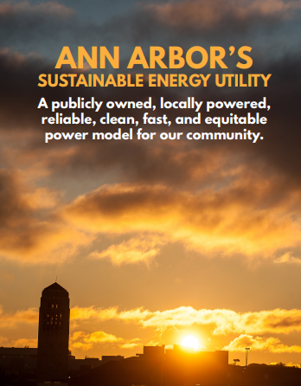
Sustainable Energy Utility
To close this gap while investing in local, resilient, reliable, and affordable energy, we can create the SEU:
A community owned energy utility that provides reliable and resilient electricity from local solar and battery storage systems installed on homes and businesses throughout the City.
A utility focused on generation – generating clean energy in our community, for our community.
A supplemental utility that offers sustainable ways to heat and cool your home or business, like from networked geothermal.
A utility that gives residents a choice for where they procure their energy.
A parallel utility that immediately reduces emissions and invests in the utility of the future.
Ann Arbor’s Sustainable Energy Utility

Slide 7
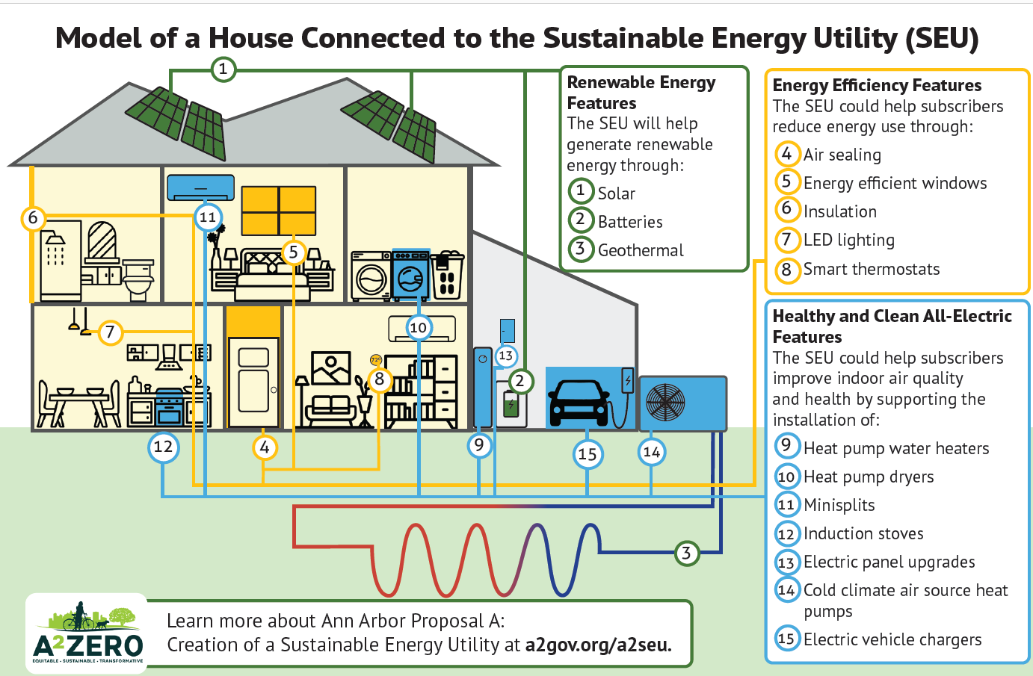
What services would an SEU provide?
Solar and energy storage to improve reliability.
Air source and ground source heat pumps, including networked geothermal.
Robust energy waste reduction efforts that improve indoor comfort, health, and safety, all while saving money.
Microgrids(ish) between neighboring households, to share solar and storage.
Support for beneficial electrification to support cleaner and safer homes and businesses.
On-bill financing to help lower the costs of beneficial electrification and efficiency improvements while increasing payment flexibility.
Over time, community solar programs and new community desired clean energy offerings.
Ann Arbor’s Sustainable Energy Utility

Slide 8
What do we need to do to start the SEU?
Ann Arbor’s Sustainable Energy Utility

Slide 9
SEU Launch Timeline
First 3 Months
Amend City charter
3-6 months
Develop SEU Comp. plan
6-12 months
Create technical specifications and standards
12-18 months
18+ months
Hire project manager
Create bylaws and finalize governance structures and staffing model
Fundraise and secure SEU financing (ongoing)
Hire ED
Ongoing stakeholder engagement (e.g., County, DTE, MPSC)
Create ED job description
Ongoing legal, regulatory, and administrative work
Develop customer recruitment and retention plan
Identify billing and customer service framework
Issue RFPs for contractors and equipment
Establish billing system
Finalize rate model
Create termination provisions
Finalize networked geothermal analysis
Finalize contracts
Finalize rates
Intentional customer recruitment
Finalize IT systems, billing, etc.
Hire remaining staff
Launch
Continued service expansion
Ongoing service delivery
Ann Arbor’s Sustainable Energy Utility

Slide 10
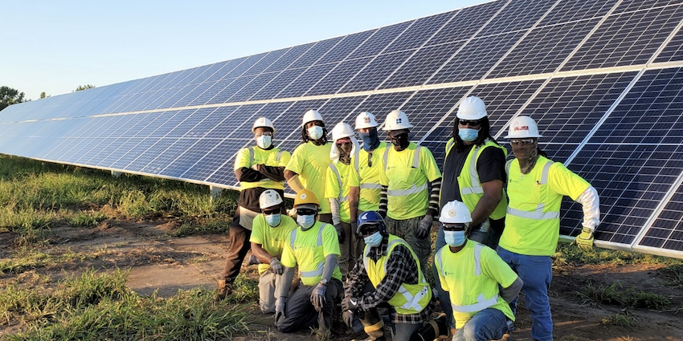
Ongoing Items
To succeed, the SEU must be cost-competitive with private solar leases.
Storage cannot be paid for by avoided energy costs but provides the customer resilience value (think generator).
Financing requirements for the SEU can be debt, grants, or provided by an equity partner.
Adoption rates matter!
Financing matters!
Ann Arbor’s Sustainable Energy Utility
Notes:
And the results won’t be surprising.
To succeed socially, we believe the SEU needs to be cost competitive with private solar leases and with existing utility bills. The rate analysis completed shows that it can be.
We also wanted to understand how batteries factor into the economics. Not surprisingly, the solar only option in the SEU is cheaper than what people currently pay for their electricity. However, adding in storage comes at a premium from what we pay today…however, when you compare apples to apples and look at the cost of a battery versus a cost for a generator, the analysis finds that the SEU can offer resilience through a battery storage system at rates cheaper than what one would pay for a generator.
And lastly, I’ll say more about this point on the next slide but we know that the cost of capital or how we fund the SEU matters a great deal. So we studied different pathways by which an SEU could be launched and found there the Ann Arbor SEU could work with debt, grants, a private equity partner, or a combination thereof.

Slide 11
Ongoing Items
Engagement and expectation management
Fundraising and financing
Correcting mis or incomplete information
Customer recruitment
  Interested in joining the waitlist: https://osi.a2gov.org/SEUwaitlist
Utility creation
Ann Arbor’s Sustainable Energy Utility
Notes:
And the results won’t be surprising.
To succeed socially, we believe the SEU needs to be cost competitive with private solar leases and with existing utility bills. The rate analysis completed shows that it can be.
We also wanted to understand how batteries factor into the economics. Not surprisingly, the solar only option in the SEU is cheaper than what people currently pay for their electricity. However, adding in storage comes at a premium from what we pay today…however, when you compare apples to apples and look at the cost of a battery versus a cost for a generator, the analysis finds that the SEU can offer resilience through a battery storage system at rates cheaper than what one would pay for a generator.
And lastly, I’ll say more about this point on the next slide but we know that the cost of capital or how we fund the SEU matters a great deal. So we studied different pathways by which an SEU could be launched and found there the Ann Arbor SEU could work with debt, grants, a private equity partner, or a combination thereof.

Slide 12
Next Steps
Ann Arbor’s Sustainable Energy Utility
Notes:
Now let’s close out with some examples of how the proposed SEU could work in practice.

Slide 13
Immediate Next Steps
Ongoing outreach and engagement with the public
Fundraising
Encouraging folk to join waitlist
City ordinance adoption
Hiring of ED!
SEU Comprehensive Plan
Ann Arbor’s Sustainable Energy Utility
Notes:
I know this was a lot to digest and if this is your first time hearing about the proposed SEU, thank you for taking the time to join us tonight. And if this wasn’t your first time, thank you for coming back to learn more.
As we close out tonight I want to point you to a few additional resources you can access to learn more and stay up to date with the proposed Ann Arbor Sustainable Energy Utility.

Slide 14
STAY UP TO DATE AT
www.a2gov.org/a2seu
Ann Arbor’s Sustainable Energy Utility

Slide 15
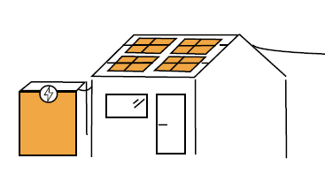
Examples: SEU-Owned Solar
Enroll in the SEU as a supplemental utility to DTE.
SEU places solar on roof, maximizing the generation potential, and sending the excess to SEU-owned storage (and eventually to neighbors).
SEU assists in electrification and efficiency improvements. Homeowner has option to finance upgrades with on-bill financing.
Can eventually connect to networked geothermal system.
Resident receives two bills, one for usage from DTE and one for usage from the SEU.
Scenario 1: SEU Owned Solar
Ann Arbor’s Sustainable Energy Utility
Notes:
I’m going to walk through four potential user cases for the SEU. The first is someone who does not have solar or energy storage but is a good candidate for both. This person would enroll in the SEU as a supplemental utility to what they currently have. The SEU would analyze their energy bills and solar viability and work with the resident to size a solar system for their roof (or ground). They would have the option of also enrolling in an energy storage solution. The constituent would also have the opportunity to partake in any relevant SEU related energy efficiency or beneficial electrification programs. Once networked geothermal became available in their neighborhood, the resident could enroll in this system, should they want to.
Overall, the resident / household / business would receive two bills. One from the SEU for the energy produced and used for their solar and storage system as well as any fees associated with onbill financing. And they’d receive their normal DTE bill for energy received from DTE.
The sizing of the solar system, the savings achieved, and the services subscribed to would be determined by the resident in collaboration with the SEU.

Slide 16
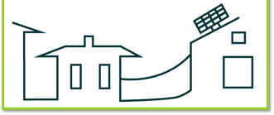
Example: SEU W/O On-site Solar
SEU assists in electrification and efficiency improvements. Resident has option to finance upgrades with on-bill financing.
Once micro grids become available, resident receives power from excess energy generated by neighbors or the SEU’s battery system.
Once available, resident can sign up for networked geothermal to heat and cool their home/business.
Resident receives two bills – for SEU financed improvements and/or SEU drawn solar and one from DTE.
Scenario 2: Homeowner/Business
with poor solar potential
Ann Arbor’s Sustainable Energy Utility
Notes:
In use case two, we have someone interested in subscribing to the SEU who does not have good solar potential. This household or business could still subscribe to the SEU and receive a battery, or they could take advantage of any SEU energy efficiency or beneficial electrification offerings. They would pay only for those services they subscribed to and, continue taking service from DTE.
However, once enough folk in their neighborhood subscribe to the SEU, a potential microgrid with limited distributed will be installed in the area so that residents can literally share power through the electrical lines. Once this happens, the resident/business can subscribe to receive clean energy from the SEU’s microgrid. The electrons they’ll be receiving will be generated on the roofs of their neighbors homes and businesses. In this way, the SEU can scale as more people come on board to provide the possibility of energy provision to most residents.

Slide 17
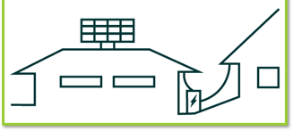
Example: Customer-owned solar
Resident enrolls in the SEU.
SEU assists in electrification and efficiency improvements. Resident has option to finance upgrades with on-bill financing.
Resident uses power from their solar system – any excess is sold to the SEU and distributed through the micro and/or nano grid to neighbors (once available) OR put onto the SEU battery system OR sold to DTE.
Can eventually connect to networked geothermal system.
Owner receives two bills, one from DTE and one from the SEU.
Scenario 3: Homeowner/Business
who owns their own solar
Ann Arbor’s Sustainable Energy Utility
Notes:
The third example is a resident that already owns their own solar system. We know a lot of the folk on the line tonight, and a lot of our friends and neighbors have taken advantage of some local programs to install solar. If you’ve got solar on your roof, you can still enroll in the SEU but you’d initially be looking at the SEU for services like those described on the last page – energy storage, energy efficiency, or beneficial electrification. You’d pay for only those services you take and not others.
You’d still receive two bills – one for the services you took from the SEU and the other from DTE.
Once a density of folk in your neighborhood or geographically area have signed up for the SEU, the microgridding possibilities get unlocked. Once established, you can then sell your excess solar directly to the SEU. That solar would be transported through the limited distribution network the SEU would operate to your neighbors. You’d be compensated for that excess generation.
In addition to the above, if you have an undersized solar system, you could always subscribe to the SEU to get additional panels placed on your roof. But it is important to remember that the SEU owns the panels it places on a roof. They are not owned by the resident. Residents only pay for unit of energy produced by those solar panels. In this way, the SEU removes the necessary upfront capital needed to build, deploy, and own renewable energy systems.

Slide 18
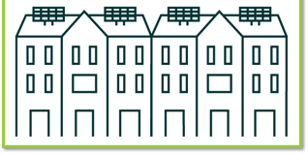
Example: Renters
Enrollment and programs are done in coordination with landlord.
Renters are eligible for all applicable SEU programs.
Green rental leases and on-bill financing enable the improvements to stay with the building, the financing to be spread over a longer period, and the benefits to be realized by current and future tenants.
Scenario 4: Renters and Multi-Family Units
Ann Arbor’s Sustainable Energy Utility
Notes:
The last example I want to highlight is a rental situation. We know that we have numerous rentals in the City of Ann Arbor so the SEU is structured so as to provide all the services to rental units. The condition here is that tenants have to have the permission fo the landlord to make improvements. But what is nice about the SEU as a public utility is that the landlord nor the tenant have to put the capital down to make the improvements. Instead, the SEU would, for example, install solar on the roof of the rental and whomever pays the bills continues to do so as they always have. They are just paying the SEU for the portion of the energy coming from the solar panels and DTE for the portion coming from the grid.
This approach actually helps ameliorate a lot of the split incentive that rentals face, helping clean energy products be accessible to more residents.

