Slide 1
Community Microgrids Development Pathways in California
Ben Schwartz
Policy Manager
626-232-7573 mobile
ben@clean-coalition.org
6 March 2025

Slide 2
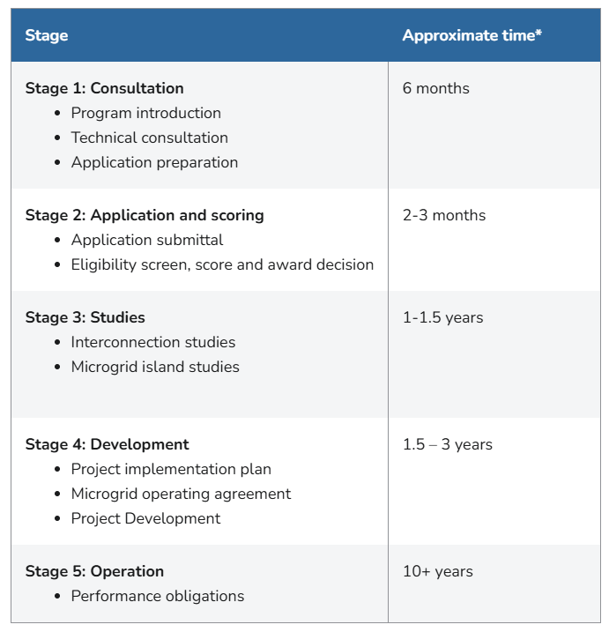
Stages of Community Microgrid Development in California
Conclusion: Maximizing certainty is critical for successful deployments. This includes should promoting process, design, and cost certainty.
**Image from PG&E’s Community Microgrids Webpage**
Notes:
There should be static timelines for each step of the process.
Streamlined FOM interconnection will increase the likelihood of timely Community Microgrid deployments.
Design certainty: whether grid isolation switch can be located on the low voltage side of the transformer
Updated unit cost guide for Community Microgrids and early point of budgetary certainty.

Slide 3
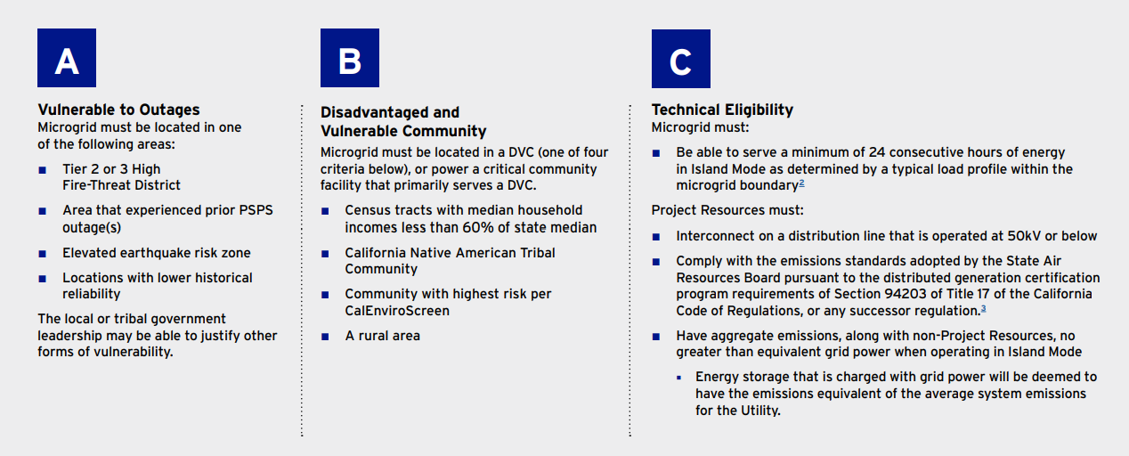
Microgrid Incentive Program (MIP)
$200 million for Community Microgrids at critical facilities in disadvantaged or tribal communities.
  PG&E – $87.2 million, SCE – $91.34 million, SDG&E – $21.46 million
Up to $14 million per project for design/engineering & $1 million to reimburse interconnection costs.
Funding is only eligible for front-of-meter assets. BTM assets can be included but will receive no funds.
Community Microgrid must be designed to serve 100% of load for at least 24 hours.
Scoring is divided by the amount of funds requested → More funding = lower score
Application Window #2:
  SCE: August-November 2025 / PG&E – Not Announced / SDG&E – Not Announced

Slide 4
Community Microgrid Enablement Tariff (CMET)
The CPUC adopted the Community Microgrid Enablement Tariff for all three IOUs.
  The CMET was designed by PG&E based on lessons learned from the Redwood Coast Airport Microgrid (RCAM).
The CMET is the framework required to study and connect a Community Microgrid, including a Microgrid Islanding Study and a Microgrid Operations Agreement.
No resilience duration requirement (like 100% of load for 24 hours in the MIP)
A few important changes were made to improve the viability from PG&E’s original design:
  Community Microgrids of all sizes are permitted (up from a 20 MW size limit)
  Community Microgrids may be deployed on distribution circuits of any voltage
  Standard application fee of $75,000 for the Microgrid Islanding Study

Slide 5
CMET Shortcomings
CMET treats Community Microgrids like a collection of individual resources, not a single controllable asset that can be used to provide additional value.
  A Community Microgrid is only allowed to island when the grid goes down (e.g., black sky conditions)
  No compensation provided for resilience or microgrid value.
  Interconnection timelines will make or break these projects! Resources must go through individual interconnections before study as a Microgrid.
CMET ignores the all-important issue of financing. Existing Community Microgrid projects are feasible due to grants.
No additional assistance is available to disadvantaged or vulnerable communities. (The MIP offers $25,000 grants.)

Slide 6
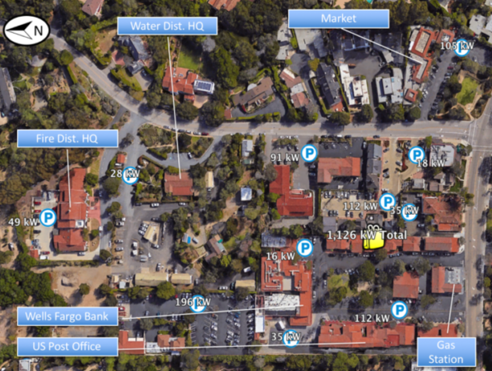
The Resilient Energy Subscription (RES) addresses three Community Microgrid financing challenges
The RES helps finance Community Microgrids while properly valuing their significant resilience benefits, addressing these three challenges:
Establishing initial Community Microgrids to provide resilience to Critical Community Facilities (CCFs).
Enhancing Community Microgrids to offer resilience opportunities within the initial Community Microgrid footprint.
Expanding Community Microgrids to larger footprints that can guarantee resilience to a wider list of facilities and include additional communities.
Some Critical Community Facilities (CCFs) in a Southern California community.

Slide 7
Resilient Energy Subscription (RES) defined
A straightforward fee-based market mechanism that finances the enhancement and expansion of Community Microgrids
  Community Microgrids provide guaranteed daily delivery of locally generated renewable energy during grid outages, ensuring unparalleled energy resilience.
Allows any facility within a Community Microgrid to procure this unparalleled energy resilience
  A facility pays a simple monthly $/kWh fee — separate from any existing rate tariffs — on top of their normal electricity rates for guaranteed daily delivery of locally generated renewable energy during grid outages.
  Usually reserved for a facility’s most critical loads.
Facilitates the deployment and expansion of Community Microgrids
  Allows the Community Microgrid owner-operators to recover the cost-of-service (COS) required to meet contracted RES obligations.
  COS is determined by the capital expenditures (capex) associated with Community Microgrid assets, operational expenditures (opex) associated with operations and maintenance (O&M), and an appropriate rate of return.
Notes:
In California, typical Community Microgrid assets include local solar, energy storage, and Monitoring, Communications, and Control (MC2) solutions — including BTM smart circuit panels, Advanced Metering Infrastructure (AMI, aka smart meters), and grid isolation switches. Anticipated rates of return should be bookended by standard COS calculations, which in California are about 8% for the return on equity (ROE) allowed for distribution grid infrastructure and the 12% ROE for transmission grid infrastructure. (The California Public Utilities Commission (CPUC) allows the 8% ROE for distribution grid infrastructure, and the Federal Energy Regulatory Commission (FERC) allows a 12% ROE for transmission grid infrastructure.

Slide 8
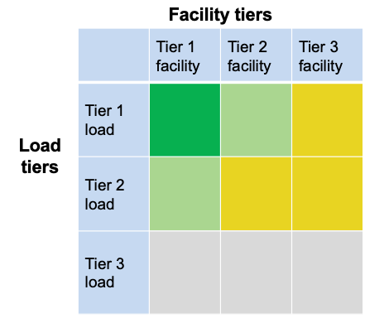
VOR123 for a Community Microgrid
The top emphasis is to provision 100% resilience for Tier 1 loads at Tier 1 facilities (the darker green square in the chart).
  Tier 1 facilities include CCFs such as fire stations and emergency shelters — and can also include grocery stores, data centers, pharmacies, gas stations, EV charging stations, & apartment complexes that can provide sheltering-in-place during grid outages.
The second emphasis is for Tier 1 loads at Tier 2 facilities and Tier 2 loads at Tier 1 facilities (the lighter green squares).
= Critical for the entire community, such as Tier 1 loads at
Tier 1 facilities like fire stations
= Priority for the entire community, such as Tier 2 loads at
Tier 1 facilities and Tier 1 loads at Tier 2 facilities like multi-
unit housing facilities that can provide safe and easy
sheltering in place
= Priority for individual facilities but not the entire community
= Discretionary loads that are not impactful to the community,
whether on or off

Slide 9
Extra Slides
Extra Slides

Slide 10
Case Study: Peak Shaving
PG&E is not expected to roll out DERMS for at least another year.
Community Microgrids optimize the distribution grid by effectively dispatching resources to shape load on local distribution circuits.
For example, the Borrego Springs microgrid provides peak-shaving capabilities to mitigate system constraints and enhance power quality, demonstrating the practical benefits of islanding in a community setting.
Clean Coalition work on a FOM BESS in downtown San Francisco shows demonstrated the ability to increase hosting capacity on a constrained feeder by 25% through optimized charging & discharging.
Islanding to reduce reliance on transmission at peak times reduces transmission congestion, increases optimal market outcomes, and reduces the need to spend further on additional transmission infrastructure.

