Slide 1
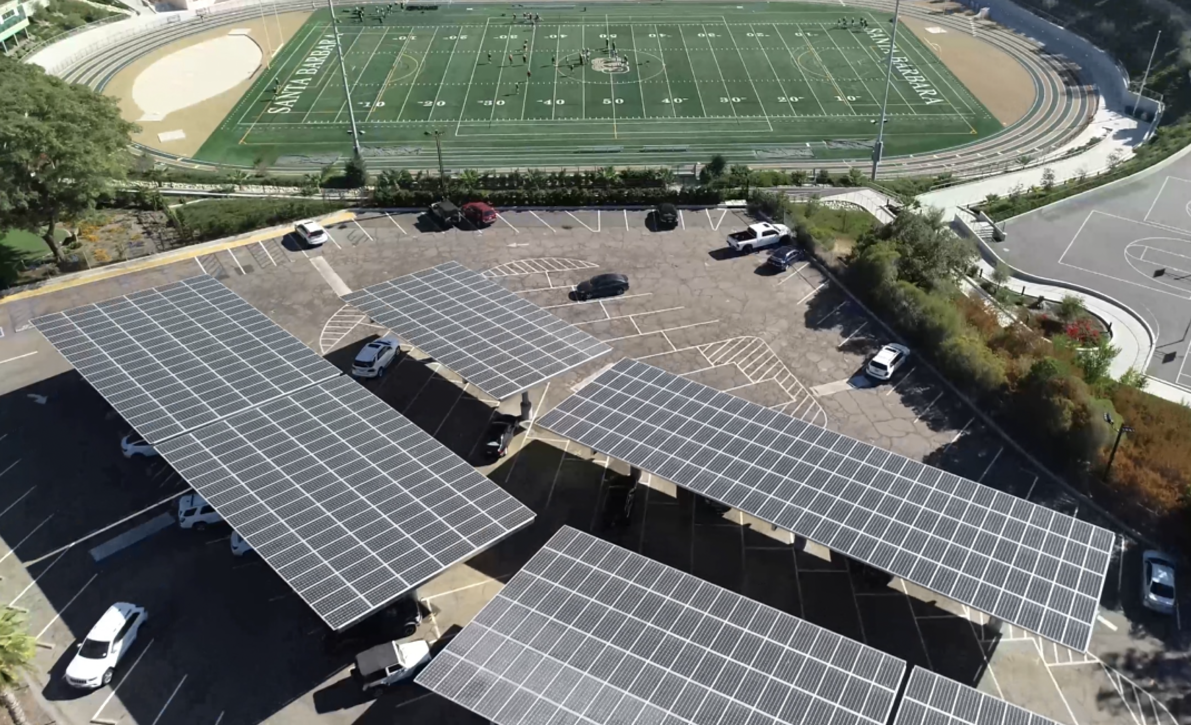
Renewables-driven Microgrids are
key to the Energy Future
Craig Lewis
Executive Director
650-796-2353 mobile
craig@clean-coalition.org
27 February 2024

Slide 2
Clean Coalition (nonprofit)
Mission
To accelerate the transition to renewable energy and a modern grid through
technical, policy, and project development expertise.
Renewable Energy End-Game
100% renewable energy; 25% local, interconnected within the distribution grid and ensuring resilience without dependence on the transmission grid; and 75% remote, fully dependent on the transmission grid for serving loads.
Notes:
2

Slide 3
Benefits of Renewables-driven Microgrids
Economic
  Reduces peak transmission usage, which is the biggest driver of increasing electricity rates.
  Provides value-of-resilience (VOR) that is simply unavailable from remote generation and that is superior compared to fossil-fueled generators.
  When behind-the-meter (BTM):
    Provides electricity costs savings compared to buying electricity from the utility.
    Provides a fixed cost of electricity compared to rapidly rising utility costs.
Environmental
  Provides solar electricity, a pure renewable energy resource.
  Optimizes grid citizenship by reducing peak usage of the grid when it is most stressed, during the peak periods, which in California are 4-9pm.
  Eliminates energy losses associated with traversing the transmission grid. An average, more than 10% of remote energy is lost over the transmission grid, due to a combination of resistance and congestion.
  Reduces the environmental impact of central generation, which typically consumes open space for the generation & transmission assets.
Resilience
  Provides 100% ride-through during grid outages of limited durations. Any ride-through duration can be accommodated with cost being correlated to duration.
  Provides optionality for indefinite resilience for at least the most critical loads, again with cost being correlated to the percentage of load being served with 100% resilience.
  Accommodates optional fossil generation as an emergency backup resource that can be minimized.

Slide 4
Various types of microgrids
A microgrid is a combination of energy resources, definitely including generation, that are coordinated to serve specified loads, including in an islanded fashion.
A Solar Microgrid is a behind-the-meter (BTM) microgrid that solely relies on solar for energy generation when islanded. A Solar Microgrid relies on energy storage to time-shift solar and ensure energy availability at night etc.
A Hybrid Solar Microgrid is a Solar Microgrid that includes additional sources of energy generation, beyond just solar.
A Community Microgrid a microgrid that covers a target grid area and relies on existing distribution feeders (ie, power lines) to operate when islanded. Community Microgrids typically include both front-of-meter (FOM) and BTM resources, including Solar Microgrids, and require effective participation from utilities, which have mostly erected barriers to date.

Slide 5
Value-of-Resilience (VOR)
Value-of-Resilience (VOR)

Slide 6
Value-of-Resilience (VOR) details
VOR123
VOR123 is the value-of-resilience (VOR) from Solar Microgrids methodology that the Clean Coalition has developed to normalize VOR across all types of facilities & geographies. The VOR normalization is founded in tiering loads into three categories: Tier 1 (critical), Tier 2 (priority), and Tier 3 (discretionary). Since each Tier has its own resilience requirement and VOR, this methodology is called VOR123.
VOR123 webinar
https://clean-coalition.org/news/webinar-valuing-resilience-solar-microgrids-thursday-5-nov-2020/
Notes:
6

Slide 7
Percentage of time online for Tier 1, 2, and 3 loads for a Solar Microgrid designed for the University of California Santa Barbara (UCSB) with enough solar to achieve net zero and 200 kWh of energy storage per 100 kW solar.
Typical load tier resilience from Solar Microgrids
Percentage of total load
Tier 3 = Discretionary load, ~75% of total load
Tier 2 = Priority load, ~15% of total load
Tier 1 = Critical, life-sustaining load, ~10% of total load
Percentage of time

Slide 8
A typical diesel generator is configured to maintain 25% of the normal load for two days. If diesel fuel cannot be resupplied within two days, goodbye. This is hardly a solution for increasingly necessary long-term resilience. In California, Solar Microgrids provide a vastly superior trifecta of economic, environmental, and resilience benefits.
Diesel generators are designed for limited resilience
Percentage of total load
Tier 3 = Discretionary load, ~75% of total load
Tier 2 = Priority load, ~15% of total load
Tier 1 = Critical, life-sustaining load, ~10% of total load
Percentage of time

Slide 9
Local renewables & storage optimize outcomes
Local renewables & storage
optimize outcomes

Slide 10
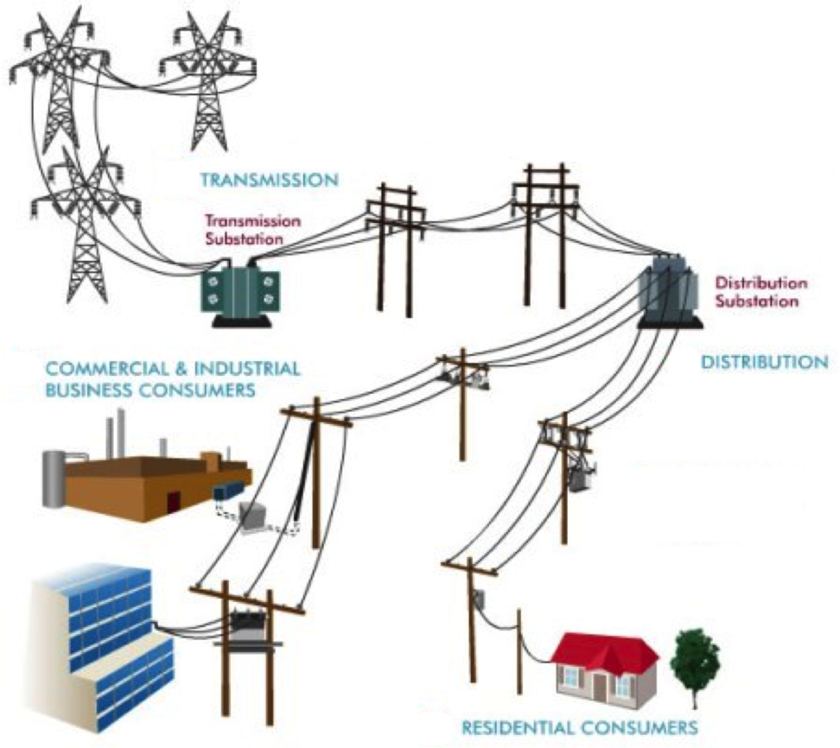
Local means within the distribution grid
High-Voltage
Transmission
grid
Low-Voltage
Transmission
grid
Distribution
grid
Notes:
Market distortions like the erroneous metering & assessment of Transmission Access Charges (TAC) for California IOUs creates massive market distortions that steal value from local generation, hurt ratepayers, and preempt energy resilience.
Non-PTO utilities (metered sub-systems) currently operate under the system we are proposing. The Clean Coalition TAC fix would bring consistent TAC treatment to DG resources in all utility service territories.

Slide 11
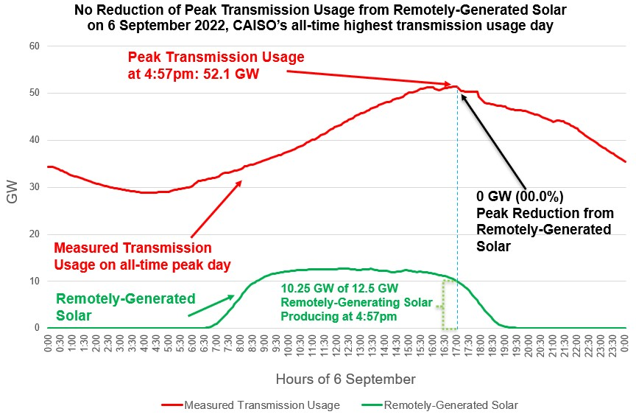
Transmission stress & cost is a massive problem

Slide 12
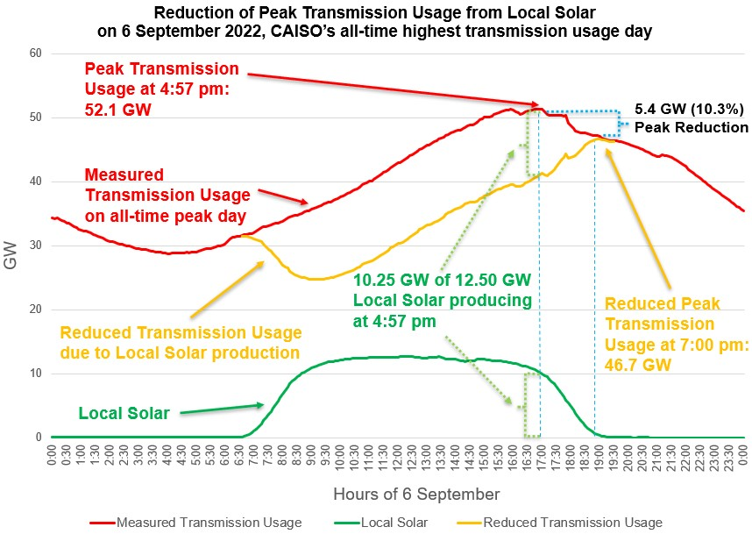
Local Solar reduces transmission stress & costs
Local Solar reduces Peak Transmission Usage by close to 50% of the installed capacity. The effect is amplified by energy storage.
Bringing down the peak with distributed generation and demand flexibility will reduce transmission investments, saving ratepayers hundreds of billions of dollars over the next two decades.
Reducing the Peak Transmission Usage by around 10% is enough to prevent most major outages.

Slide 13
Transmission-vulnerable case study
Transmission-vulnerable case study

Slide 14
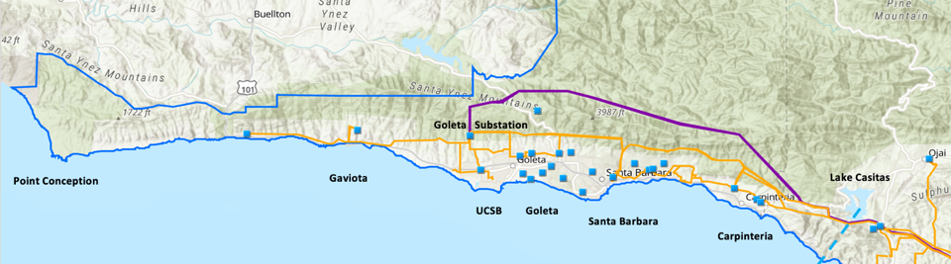
Goleta Load Pocket (GLP)
The GLP is the perfect opportunity for a comprehensive Community Microgrid
GLP spans 70 miles of California coastline, from Point Conception to Lake Casitas, encompassing the cities of Goleta, Santa Barbara (including Montecito), and Carpinteria.
GLP is highly transmission-vulnerable and disaster-prone (fire, landslide, earthquake).
200 megawatts (MW) of solar and 400 megawatt-hours (MWh) of energy storage will provide 100% protection to GLP against a complete transmission outage (“N-2 event”).
  200 MW of solar is equivalent to about 5 times the amount of solar currently deployed in the GLP and represents about 25% of the energy mix.
  Multi-GWs of solar siting opportunity exists on commercial-scale built-environments like parking lots, parking structures, and rooftops; and 200 MW represents about 7% of the technical siting potential.
  Other resources like energy efficiency, demand response, and offshore wind can significantly reduce solar+storage requirements.

Slide 15
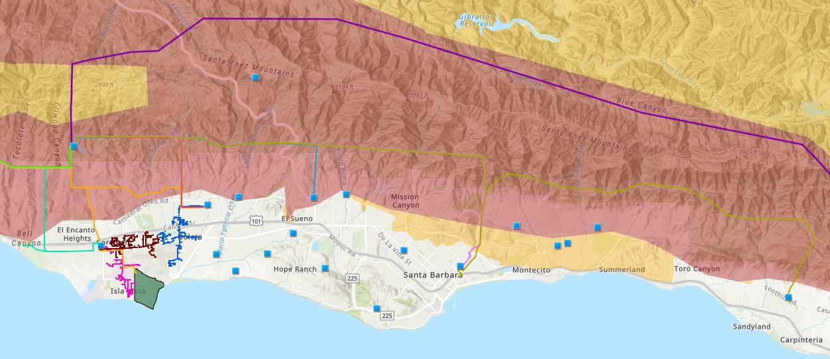

Core load area of the GLP
Legend
Feeder #4157
Feeder #4169
220 kV Transmission
Tier 3 Fire Threat
16kV Gladiola Feeder
Feeder #3556
Feeder #4227
Santa Barbara Airport
Tier 2 Fire Threat
16kV Gaucho Feeder
Feeder #4311
Feeder #3565
Substations
UCSB
16kV Professor Feeder
Feeder #3559

Slide 16
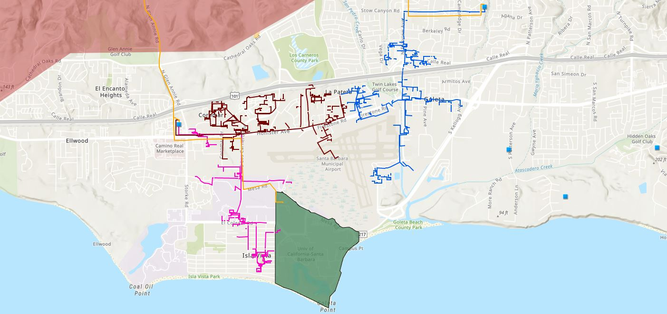








Target 66kV feeder serves critical GLP loads
Bella Battery Energy Storage Project (120 MWh)
Direct Relief (Solar Microgrid)
Vegas Substation
Dos Pueblos High School (Solar Microgrid)
Goleta Energy Storage Project
(240 MWh)
SB Airport
Fire Station # 8
Ellwood Gas Peaker Plant
Isla Vista Substation
UCSB
Fire Station # 17
Goleta Sanitary District
Legend
16kV Gladiola Feeder
University of California Santa Barbara
Goleta Valley Cottage Hospital
66 kV Feeder #4311
16kV Gaucho Feeder
Dos Pueblos High School
Direct Relief
Substations
16kV Professor Feeder
Fire Stations
Deckers
Tier 3 Fire Threat
Santa Barbara Airport
Goleta Sanitary District
Planned Battery Energy Storage

Slide 17
Target 66kV feeder grid area block diagram
Goleta Substation (220-to-66kV)
66kV distribution feeder #4311 with multiple branches
Vegas Substation (66-to-16kV)
Goleta Substation has eight feeders, seven 66 kV & one 16 kV, that serve the entire GLP
Fire Station #8
Direct Relief
+ Solar Microgrid
San Marcos
+ Solar Microgrid
66kV underground interconnection
Tier 2 & 3 facilities
Dos Pueblos
+ Solar Microgrid
Tier 2 & 3 facilities
Karl Storz + Solar Microgrid
Goleta Energy Storage Project (240 MWh)
City of Goleta
+ Solar
Isla Vista Substation (66-to-16kV)
Deckers
+ Solar
Goleta Cottage Hospital
Ellwood Gas Peaker Plant
GenOn Battery Energy Storage (120 MWh)
Tier 2 & 3 facilities
SBA (runway lights & ATC)
Diagram Elements
66 kV Distribution Feeder #4311
16 kV Gladiola Feeder
16 kV Gaucho Feeder
16 kV Professor Feeder
16 kV Los Carneros Feeder
16 kV Ace Feeder
16 kV Storke Feeder
Planned Battery Energy Storage
Ellwood Gas Peaker Plant
Grid isolation switch (open, closed)
Smart meter switch (open, closed)
Fire Station #17
SBA (Main Terminal)
Costco
+ Solar
Goleta Sanitary District
UCSB
+ Solar

Slide 18
SBUSD Solar Microgrids case study
Santa Barbara Unified School District (SBUSD)
Solar Microgrids case study

Slide 19
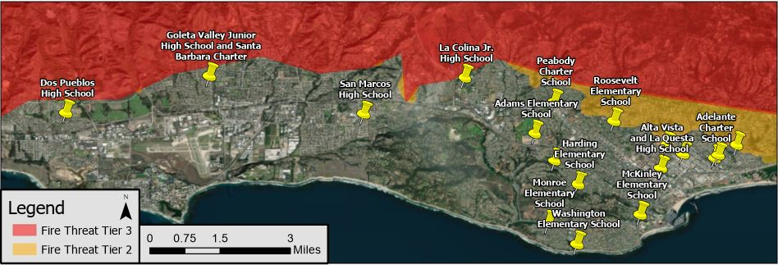
Santa Barbara Unified School District (SBUSD)
The entire Santa Barbara region is surrounded by extreme fire risk (earthquake & landslide risk too) and is extremely vulnerable to electricity grid outages.
The SBUSD is a major school district that increasingly recognizes the value-of-resilience (VOR) and has embraced the Clean Coalition’s vision to implement Solar Microgrids at a number of its key schools and other critical facilities.
SMHS is in the middle of the extensive SBUSD service area.

Slide 20
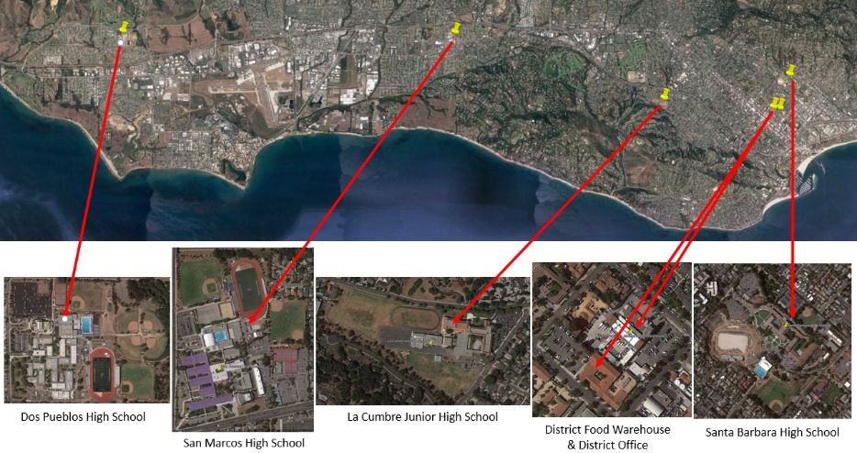
Six SBUSD Solar Microgrid sites

Slide 21
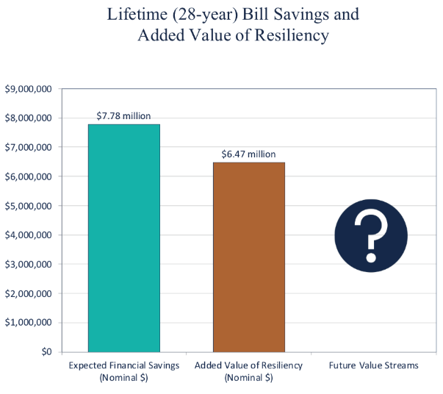
Guaranteed SBUSD bill savings and free VOR

