Slide 1
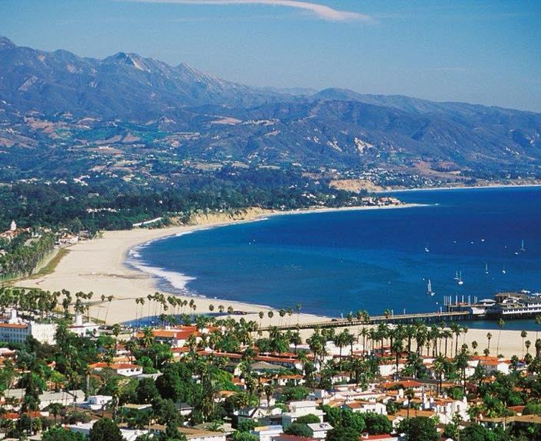
SANTA BARBARA UNIFIED SCHOOL DISTRICT
Solar & Microgrid
Resiliency Symposium
March 27, 2023
S A N T A B A R B A R A U N I F I E D S C H O O L D I S T R I C T
W W W . S B U N I F I E D . O R G
Notes:
Hello everyone. My name is Hilda Maldonado and I am the proud Superintendent of SBUnified and the amazing Desmond Ho he is the Project Manager and Sustainability Coordinator for Santa Barbara Unified School District.

Slide 2
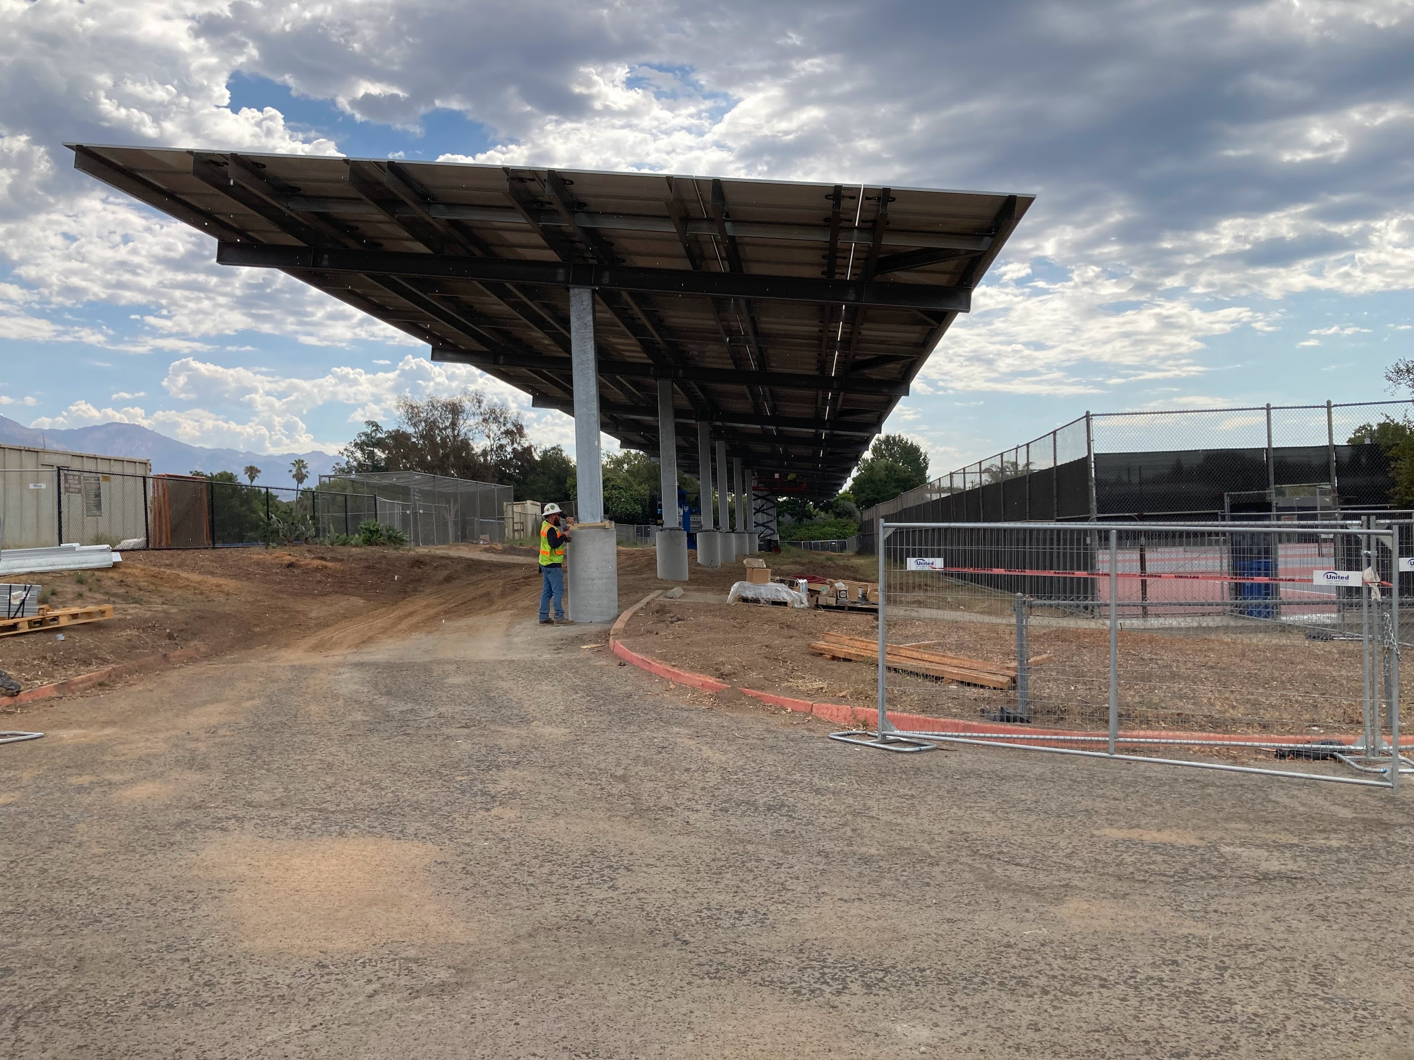
3rd Grader at McKinley Elementary
Overview
Grid vulnerability
Solar and microgrid project
Community resiliency
Financing - power purchase agreement
S A N T A B A R B A R A U N I F I E D S C H O O L D I S T R I C T
W W W . S B U N I F I E D . O R G
Notes:
In my presentation today, I will be talking about the impetus for why SBUnified went with a microgrid project - starting with understanding our grid vulnerability, going into some details about our solar and microgrid project, community resiliency, and finally the financing structure to incur minimal expenses.

Slide 3
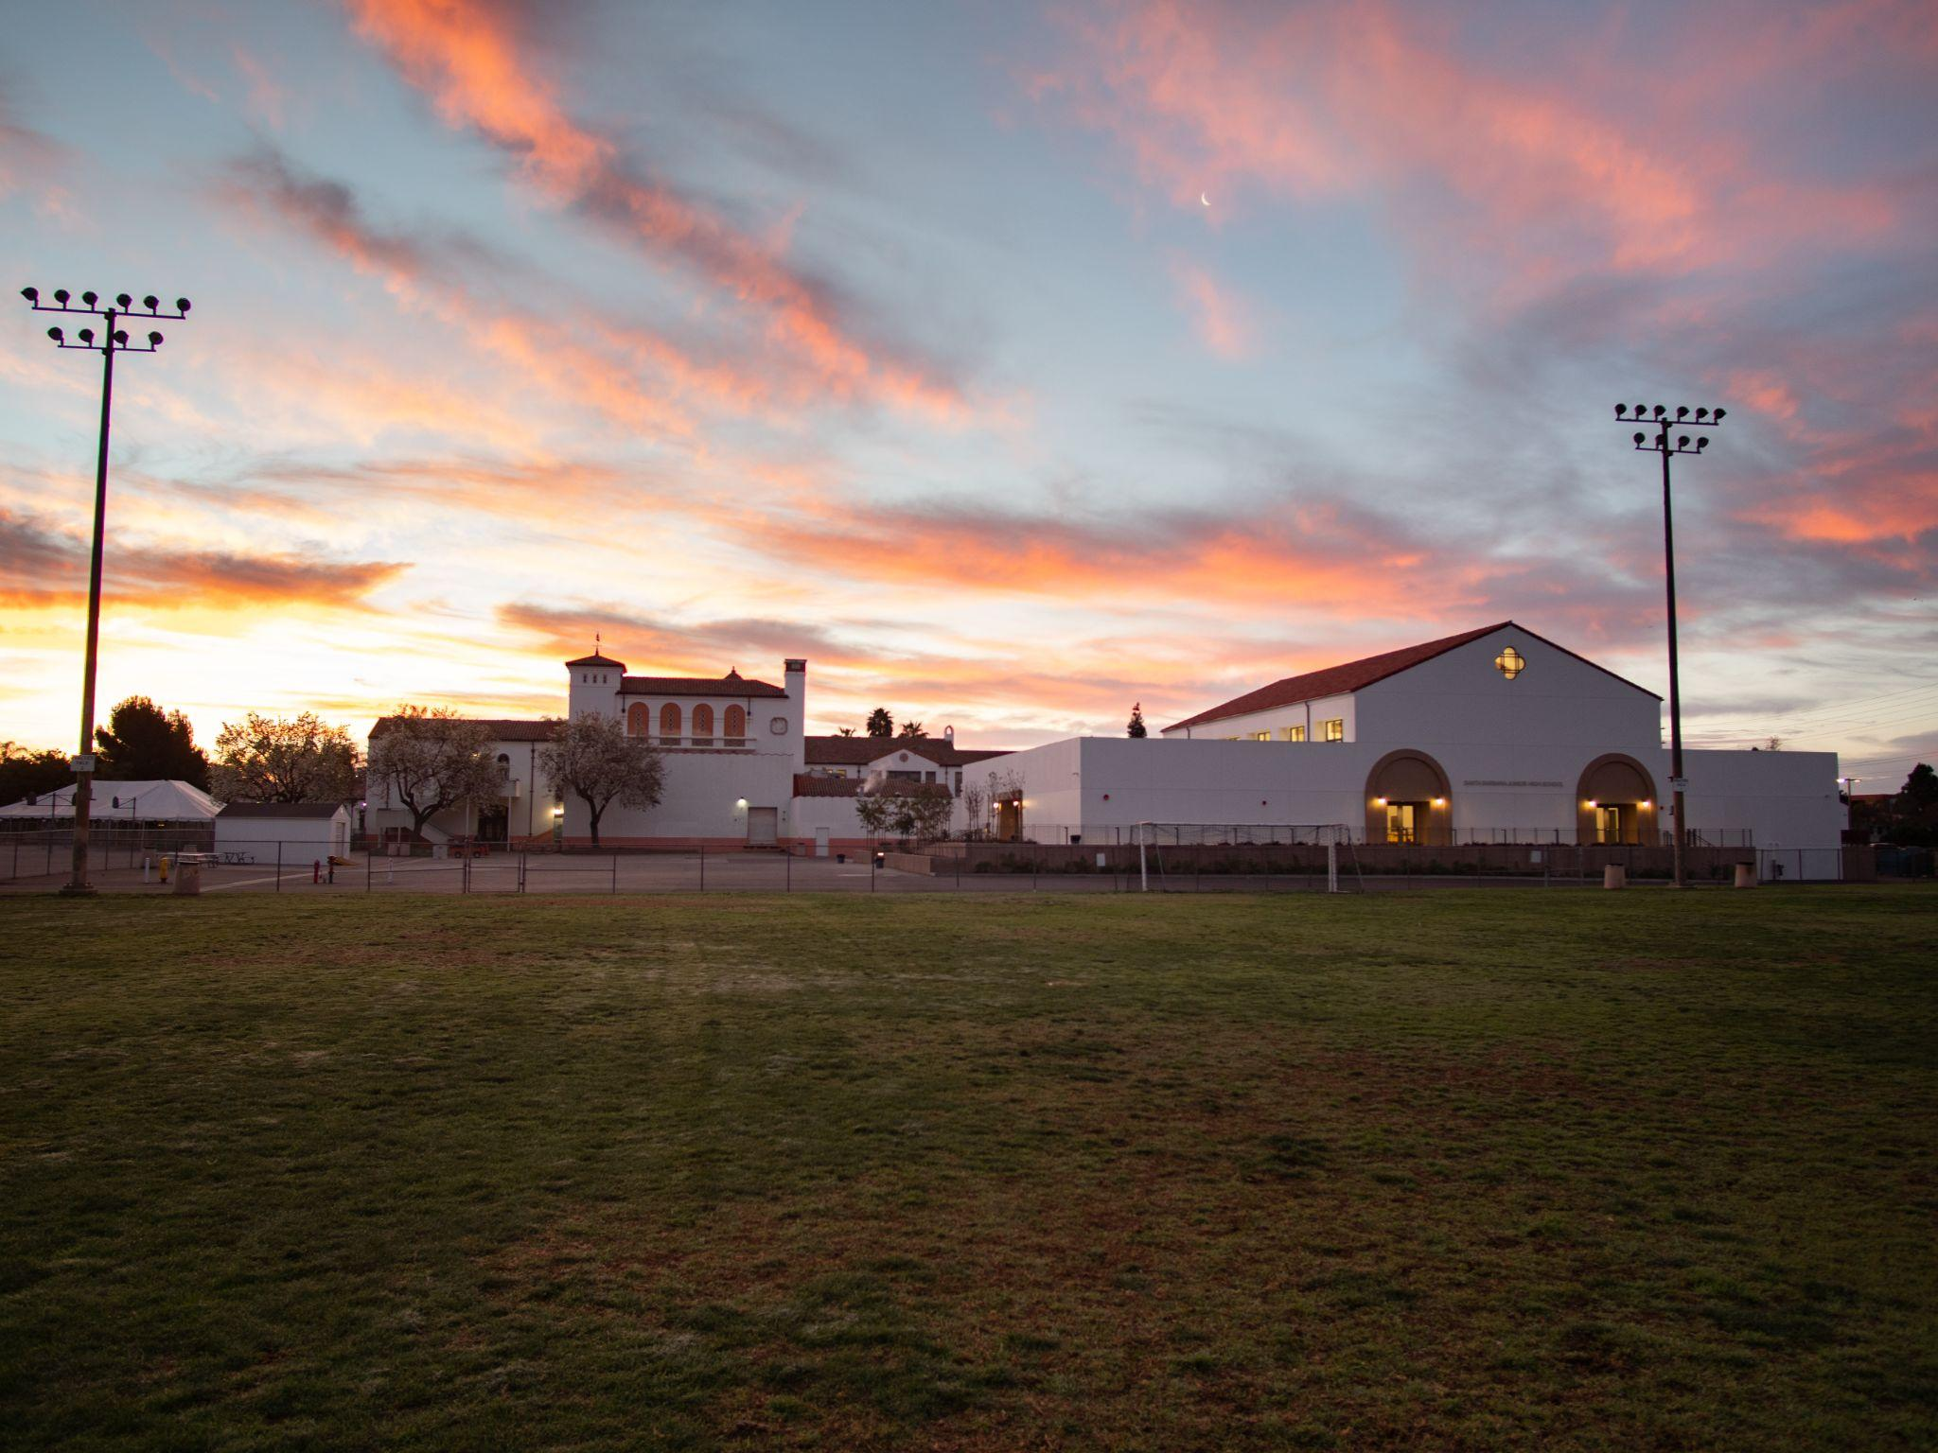
3rd Grader at McKinley Elementary
School District
Santa Barbara Unified School District
12 Elementary
4 Junior High
5 High Schools
Services 13,000 students
57.7% of students on free or reduced price meals
1700 staff
S A N T A B A R B A R A U N I F I E D S C H O O L D I S T R I C T
W W W . S B U N I F I E D . O R G
Notes:
SBUnified is a school District with 12 elementary schools, 4 junior highs, and five high schools. We service approximately 13,000 students with 57.7% of our students on free or reduced price meals. We employ approximately 1,400 staff

Slide 4
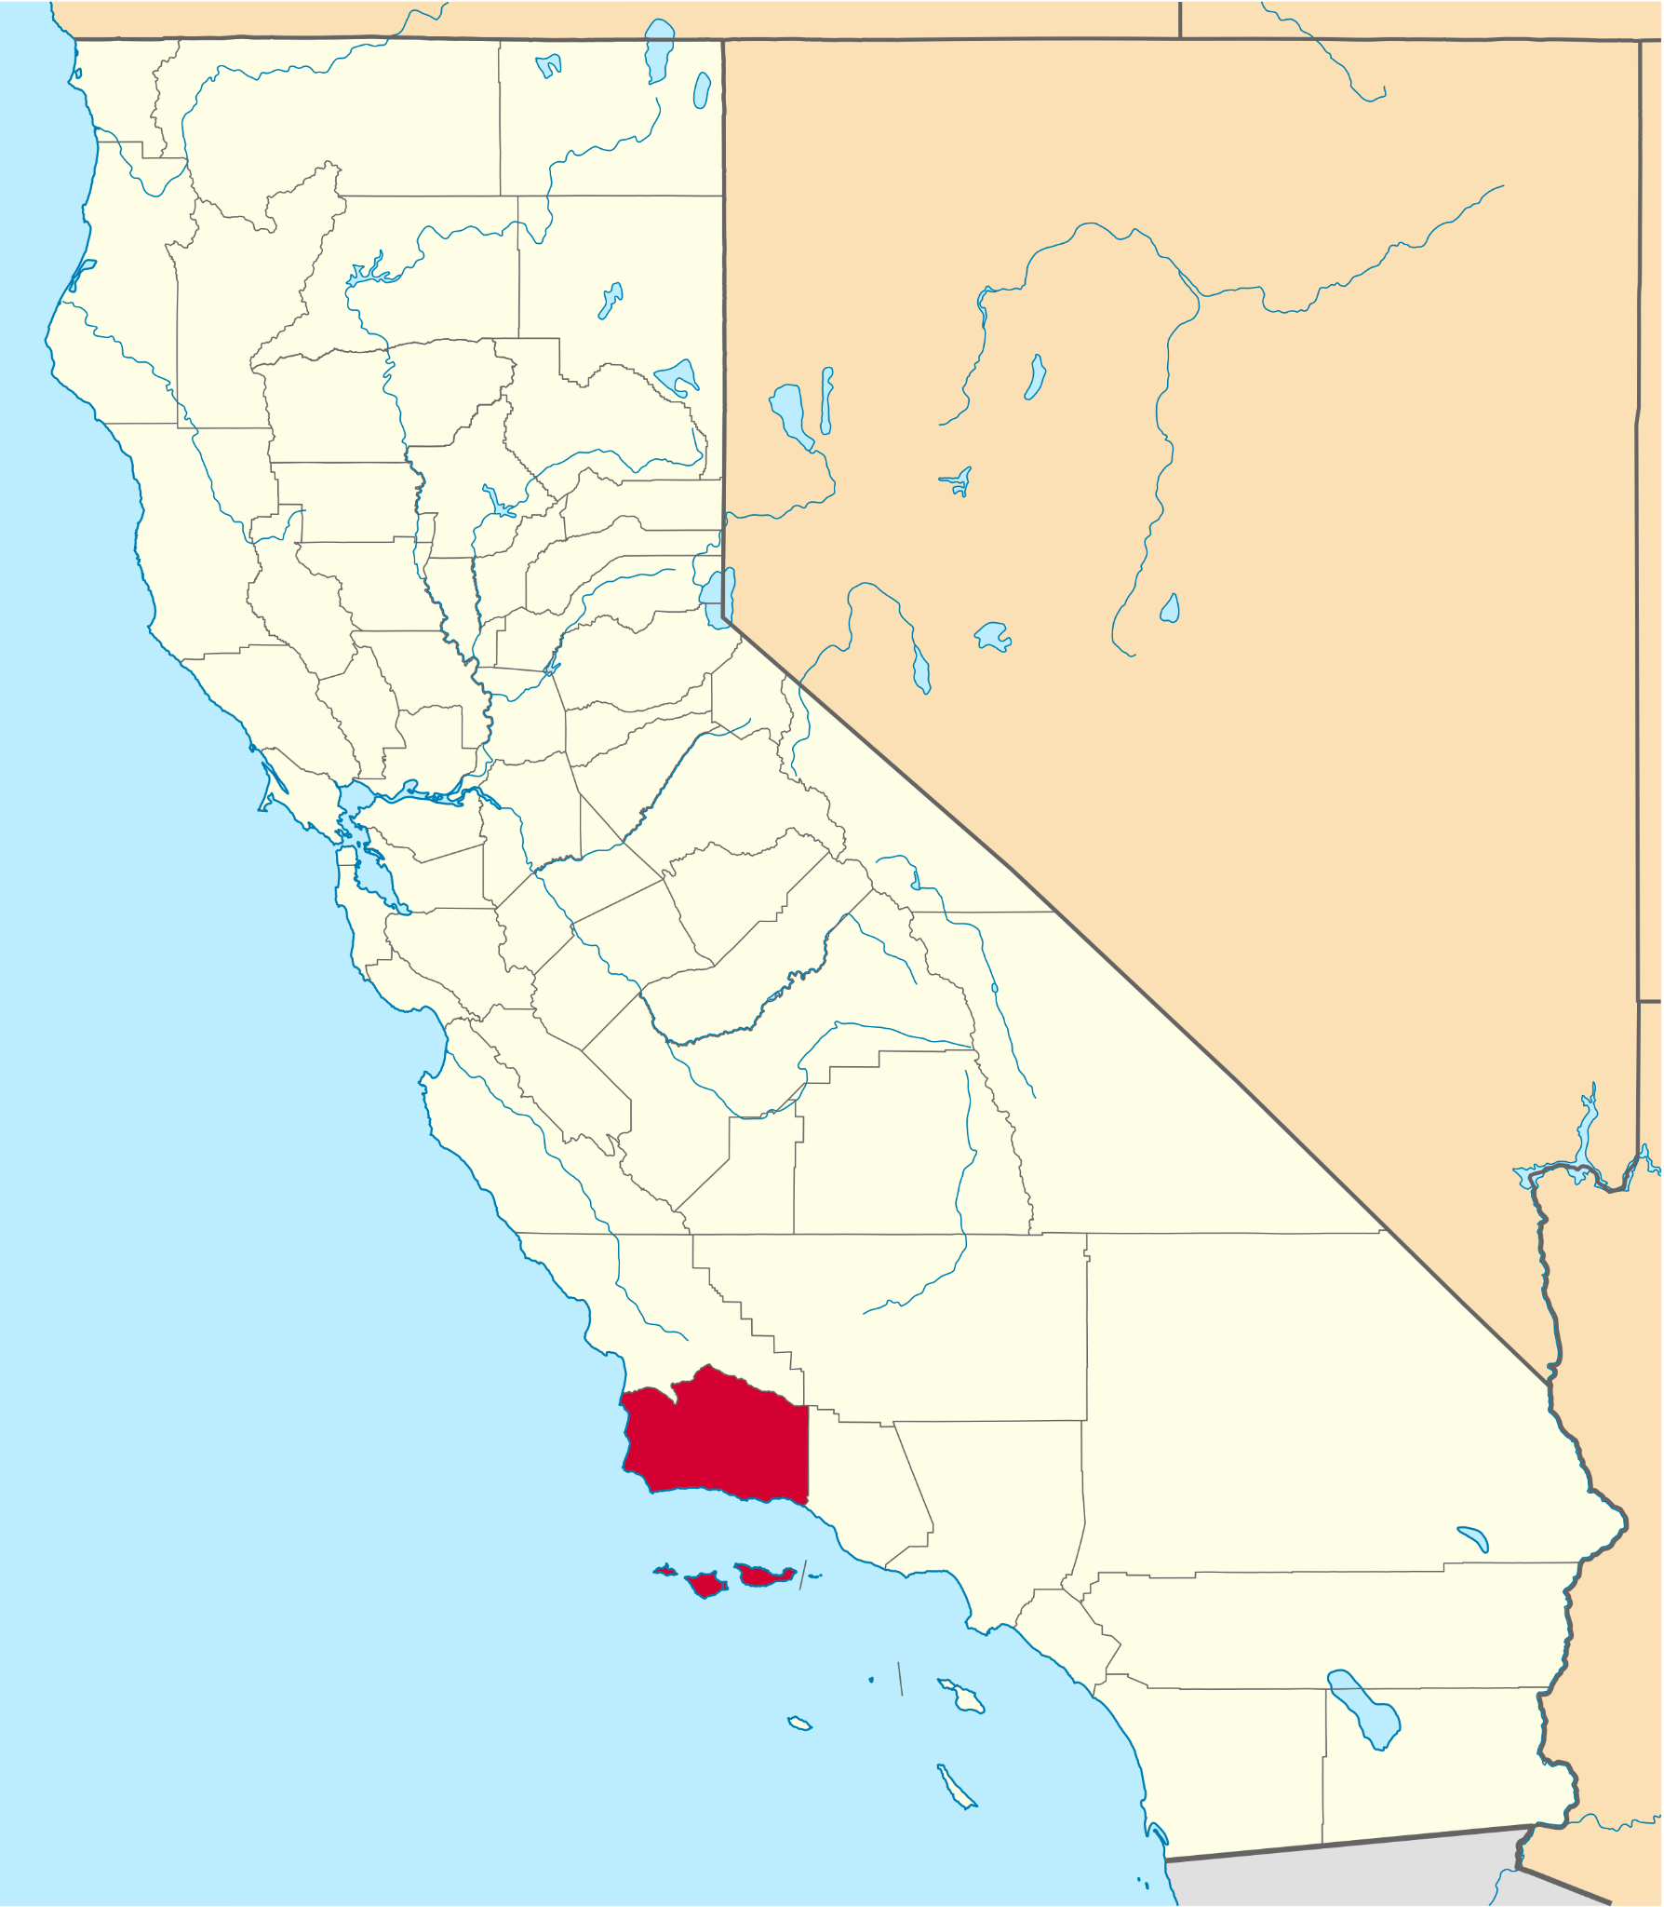
3rd Grader at McKinley Elementary
Grid Vulnerability
Location and nature of Santa Barbara County
No power generation within County
County split - mountain range splits power service
S A N T A B A R B A R A U N I F I E D S C H O O L D I S T R I C T
W W W . S B U N I F I E D . O R G
Notes:
For those of you unfamiliar with Santa Barbara and California in general, we are two counties West from Los Angeles County. We rely on our neighboring Counties to supply our electricity. Our county is different than most places in California in that we have a mountain range that runs East-West and the range splits the County in half, with one utility provider serving the North County, and another servicing the South County. SBUnified is in the southern portion of the County and services students from two cities as well as unincorporated areas.

Slide 5
3rd Grader at McKinley Elementary
Grid Vulnerability
S A N T A B A R B A R A U N I F I E D S C H O O L D I S T R I C T
W W W . S B U N I F I E D . O R G
Notes:
So why is our grid vulnerable? If you look at this image, the yellow lines indicate power lines that come from the County over - there is a purple line as well, this is a power line that runs through the wilderness of a national forest with very limited access - this is the east-west mountain range that I spoke about earlier. With the increased frequency of wildfires and flooding events, our utility provider estimates that if any natural disaster were to take down these power lines, it could be 1-3 months before they can repair the damage. We had the Thomas Fire in 2017, which at the time was the largest fire the state had seen, this fire got very close to taking out some of the power lines, therefore, it is not if something like that can happen but a matter of when.

Slide 6
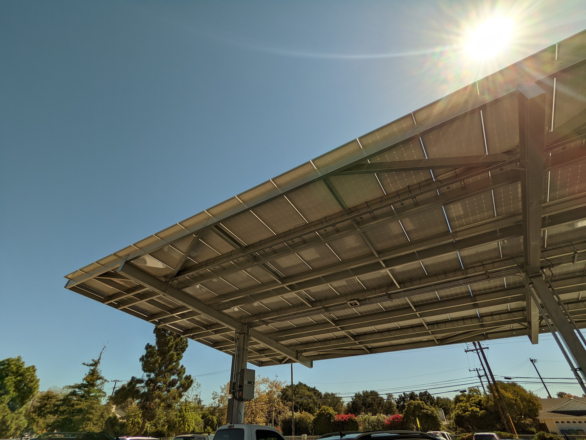
3rd Grader at McKinley Elementary
Solar
14 solar arrays & 6 microgrids
Parking lots where feasible
Play fields for shading
Provides 70% of SBUnified’s overall electricity use
Offsets 93% of GHG emissions from utility electricity use
Microgrids for the largest facilities
S A N T A B A R B A R A U N I F I E D S C H O O L D I S T R I C T
W W W . S B U N I F I E D . O R G
Notes:
Because of the close call in 2017 and having a better understanding of our vulnerability, SBUnified decided in 2019 to begin exploring the installation of a solar and more importantly, pair the solar with a battery storage system that incorporates smart load controls or commonly referred to as a microgrid. With the completion of the design, it was determined that there would be a total of 14 solar arrays with 6 of those sites having microgrids. The targeted areas for the solar arrays are parking lots where feasible for the high schools and junior highs, and play fields for shading for the elementary schools since their parking lots are generally too small. With the age and condition of our schools, rooftop installations were not feasible as we would have to redesign all roofing at the sites to accommodate the arrays. This project is going to provide at least 70% of SBUnified’s overall electricity use while offsetting 93% of our Green house gas emissions from utility electricity use. The 6 microgrids will be located at our high schools, one junior high, and our District office, which houses our communication equipment and critical food storage.
Project began in 2019, Board approval for feasibility study, and then Power Purchase Agreement in 2020.
Construction began in 2021, when complete, this would be the first microgrid for a school district in the nation

Slide 7
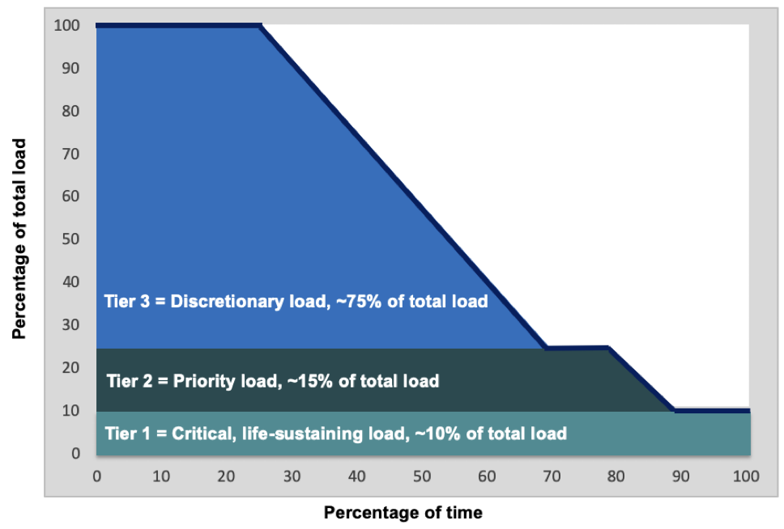
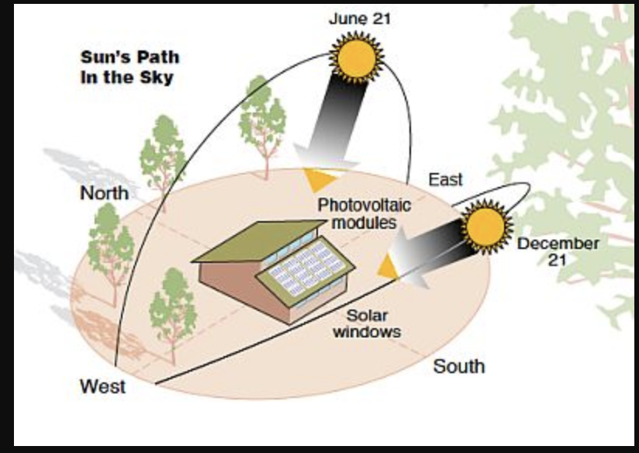
Microgrid
Tier 1 loads:
Freezers, refrigerators, emergency shelter facilities,comms equipment (internet, radio etc)
100% resilience expected
Tier 2 loads:
Multi-purpose rooms/gyms, site comms equipment
80% resilience expected
Tier 3 loads:
Discretionary, <25% uptime
Normal usage to Emergency use continuum
Illustration of resilience levels and loads for Tiers 1-2-3 load where (a) solar is sufficient to attain zero net energy (ZNE) and (b) storage capacity equals 2 hours of solar.
Source: Clean Coalition, analysis completed for UCSB
S A N T A B A R B A R A U N I F I E D S C H O O L D I S T R I C T
W W W . S B U N I F I E D . O R G
Notes:
So how are microgrids different than just solar with a battery? Microgrids have smart controllers that looks at the available battery power, current power demands, and switches on/off items based on their predetermined tiers. The model that we used had three tiers, tier 1 is our critical loads, where our freezers, refrigerators, and communication equipment at the District Office will have 100% uptime.
Tier 1 mission critical and life sustaining
Tier 2
This is dependent on season solar energy availale and load requirements (winter/summer)..lentth of time that emergency is expected to last….
If the controller determine that there is additional energy available, our multi-purpose rooms, gyms, and site communication equipment is expected to have 80% uptime. Anything else beyond that will be discretionary and is expected to have less than 25% uptime - for us, these are spare plugs within the kitchens and non-essential lighting. This model is based upon sunny conditions, which is the case most of the time in Santa Barbara.

Slide 8
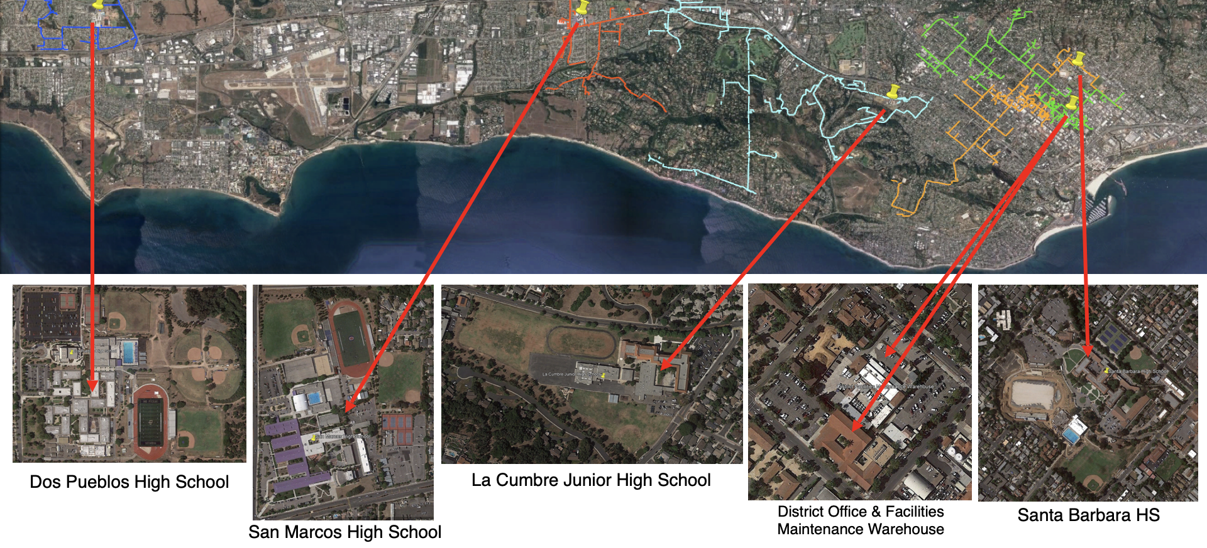
3rd Grader at McKinley Elementary
Microgrid
S A N T A B A R B A R A U N I F I E D S C H O O L D I S T R I C T
W W W . S B U N I F I E D . O R G
Notes:
Here is a map of our microgrid and the areas that they are serving. Over on the right is City of Santa Barbara, where we have our District Office, District warehouse, a high school, and a junior high school. Our remaining two high schools are in the County of Santa Barbara and City of Goleta. We purposely spread out the microgrid sites to serve different parts of our community. For instance, La Cumbre Junior High was chosen as a microgrid site not because they use the most amount of electricity but rather, the site sits in a lower income where 80+% of the students are on free or reduced priced meals. Additionally, the site’s kitchen actually provides food for four school sites.

Slide 9
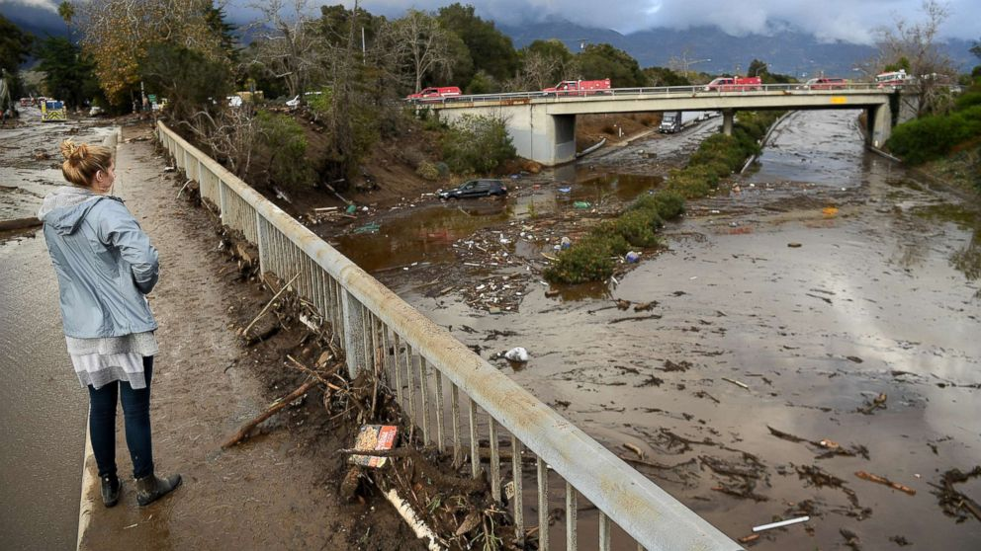
3rd Grader at McKinley Elementary
Community
SBUnified school sites serve as emergency shelters during natural disasters
Microgrids power largest kitchens
Gyms/MPRs shelter
Thomas Fire 2017, mudslides 2018, flooding 2023, etc.
S A N T A B A R B A R A U N I F I E D S C H O O L D I S T R I C T
W W W . S B U N I F I E D . O R G
Notes:
With regards to community resiliency, SBUnified school sites have served as emergency shelters during natural disasters. With our microgrids powering the largest kitchens, gyms, and multipurpose rooms, we have the ability to help feed and shelter the community when there is a need. This was the case during the Thomas Fire of 2017, the subsequent mudslides, and the flooding that just occurred in January 2023. Pictured is our only freeway going southbound from Santa Barbara that flooded in 2018 and 2023. When this freeway shuts down, it effectively cuts us off from most supplies as they come from neighboring counties from the south. Therefore, we believe that the microgrids will better position our District to assist the students, their families, and the community with the increasing frequency of disasters from climate change.

Slide 10
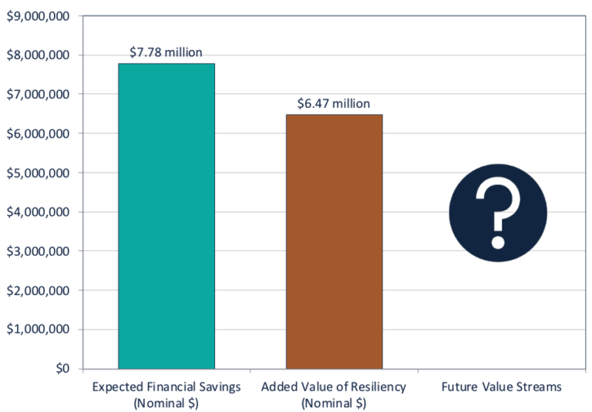
3rd Grader at McKinley Elementary
Finance
Power Purchase Agreement (PPA)
Flat rate for 28-year term
Traded slightly higher rates for $1.2 million contingency fund
No upfront capital costs
Anticipated savings of $7.7 million over term of project
S A N T A B A R B A R A U N I F I E D S C H O O L D I S T R I C T
W W W . S B U N I F I E D . O R G
Notes:
Let’s talk a little bit about the finances. Our District does not have the capital funds to pay for the installation of such a project, therefore, we decided to go with a power purchase agreement or a PPA, where we will pay our provider a flat, non-escalating rate for 28-years. We knew that there would be construction change order costs, consultant fees, and legal fees associated with the project, therefore, we negotiated with our PPA provider where we traded a slight higher rate in exchange for a $1.2 million contingency fund. With this model, we had no upfront capital costs for construction and we have almost exhausted the 1.2 million contingency fund. However, it is anticipated that we will save $7.7 million dollars over the term of the project. This was based upon pre-COVID electricity rates - those rates have gone up substantially and therefore, this figure will likely be significantly higher as a result.
Added value of resiliency---- insurance policy-
Craig will explain the value of resiliency
Contract Agreements
Power Purchase Agreement (PPA)
Battery Storage Guarantee (BSG)
Resiliency Services Agreement (RSA)
Site Lease
Third party owns and operates solar projects and solar microgrids on SBUnified’s behalf.
SBUnified purchases the produced electricity and solar microgrid services at a flat rate.
Agreement term is 28 years.
During the first seven years (when there is a modest annual cost to the District), the District stands to acquire a commensurate amount of value from the resiliency services that it receives.
And over the 28-year project lifetime, the project will produce a net savings to the District, plus a net value from resiliency services.
In addition, the savings may accelerate over time when SCE revises rates to encourage operations of battery storage systems in ways that can ease strain on the electric utility grid. These new opportunities are anticipated, but as-yet unquantifiable.

Slide 11
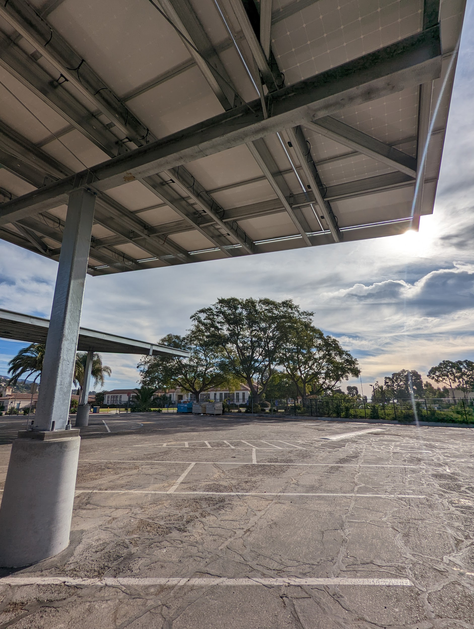
3rd Grader at McKinley Elementary
Status
Construction Status February 2023
Five sites completed
Three sites near online
Microgrid sites awaiting critical parts due to supply chain issues
Project completion anticipated end of 2023
S A N T A B A R B A R A U N I F I E D S C H O O L D I S T R I C T
W W W . S B U N I F I E D . O R G
Notes:
As for the status of the project. We have five sites that are completed with three sites coming online soon. All six of the microgrid sites are awaiting critical parts that have been delayed one year due to the supply chain issues. With most of those pieces coming in May, we anticipate that we should have them online by the end of summer. Therefore, this project should be completed by the end of the year.

Slide 12
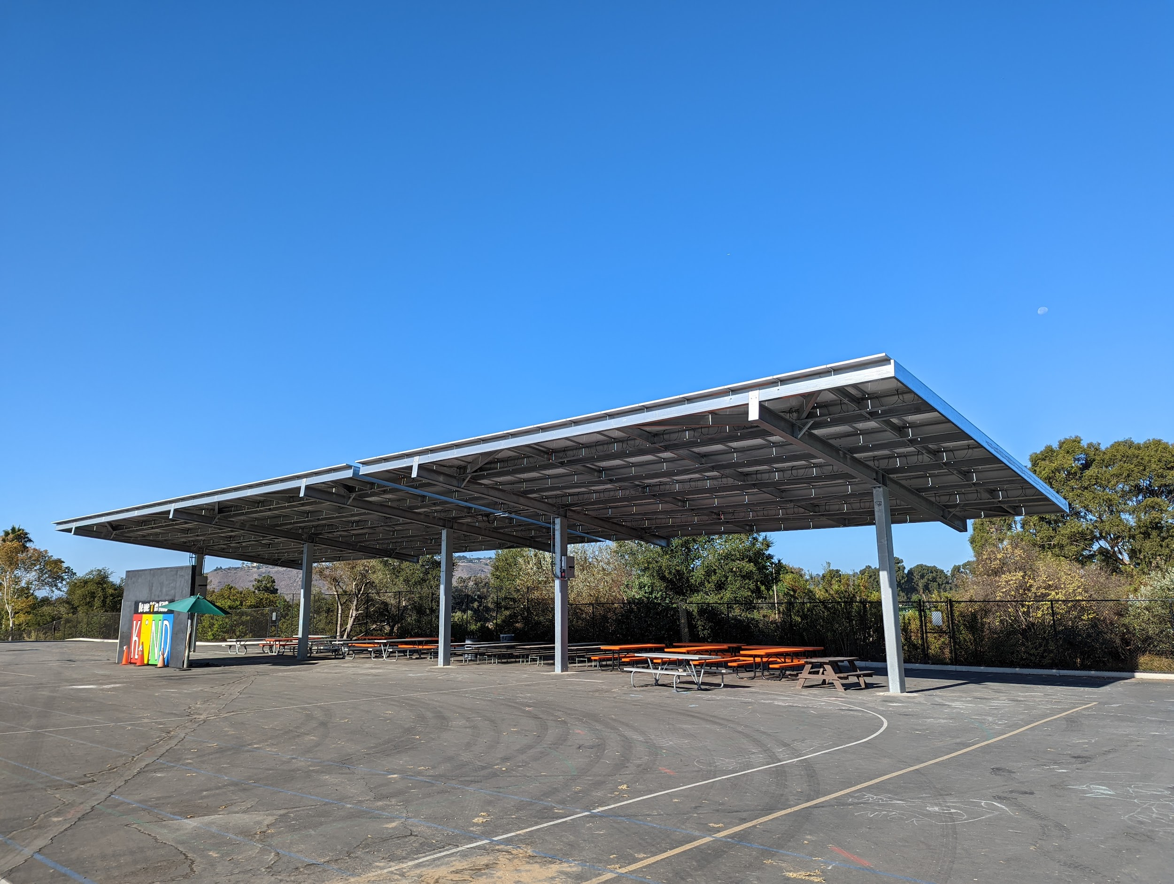
Thank You
Hilda Maldonado, Ed.D.
Superintendent
hmaldonado@sbunified.org
Desmond Ho
Operations and Sustainability Coordinator
DesmondHo@sbunified.org
S A N T A B A R B A R A U N I F I E D S C H O O L D I S T R I C T
W W W . S B U N I F I E D . O R G

