Slide 1
Solar Microgrids & Community Microgrids
Unparalleled energy resilience
Craig Lewis
Executive Director
Clean Coalition
650-796-2353 mobile
craig@clean-coalition.org
20 Jul 2021

Slide 2
Clean Coalition (nonprofit)
Mission
To accelerate the transition to renewable energy and a modern grid through
technical, policy, and project development expertise.
100% renewable energy end-game
  25% local, interconnected within the distribution grid and facilitating resilience without dependence on the transmission grid.
  75% remote, dependent on the transmission grid for serving loads.
Notes:
2

Slide 3
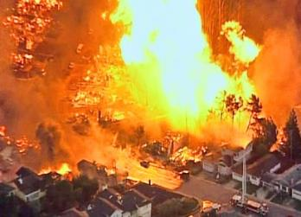
Natural gas infrastructure is not resilient
Assertion: Gas-driven generation is often claimed to be resilient.
Reality: Gas infrastructure is not resilient and takes much longer to restore than electricity infrastructure.
Threats: Gas infrastructure can be flat-out dangerous and is highly vulnerable to earthquakes, fires, landslides, and terrorism.
2010 San Bruno Pipeline Explosion
Source: The City and County of San Francisco Lifelines Study

Slide 4
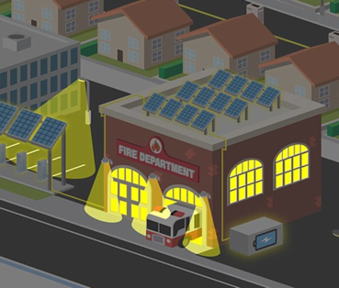
Value-of-resilience (VOR) depends on tier of load
Everyone understands there is significant value to resilience provided by indefinite renewables-driven backup power, especially for the most critical loads
  But, nobody has quantified this value of unparalleled resilience.
  Hence, there is a substantial economic gap for renewables-driven microgrids.
The Clean Coalition aims to establish a standardized value-of-resilience (VOR) for critical, priority, and discretionary loads that will help everyone understand that premiums are appropriate for indefinite renewables-driven backup power to critical loads and almost constant backup power to priority loads, which yields a configuration that delivers backup power to all loads a lot of the time
The Clean Coalition’s VOR approach aims to standardize resilience values for three tiers of loads:
  Tier 1 are mission-critical & life-sustaining loads and warrant 100% resilience. Tier 1 loads usually represent about 10% of the total load.
  Tier 2 are priority loads that should be maintained as long as long as doing so does not threaten the ability to maintain Tier 1 loads. Tier 2 loads usually represent about 15% of the total load.
  Tier 3 are discretionary loads make up the remaining loads, usually about 75% of the total load. Maintained when doing so does not threaten Tier 1 & 2 resilience.

Slide 5
Percentage of time online for Tier 1, 2, and 3 loads for a Solar Microgrid designed for the University of California Santa Barbara (UCSB) with enough solar to achieve net zero and 200 kWh of energy storage per 100 kW solar.
Typical load tier resilience from a Solar Microgrid
Percentage of total load
Tier 3 = Discretionary load, ~75% of total load
Tier 2 = Priority load, ~15% of total load
Tier 1 = Critical, life-sustaining load, ~10% of total load
Percentage of time

Slide 6
A typical diesel generator is configured to maintain 25% of the normal load for two days. If diesel fuel cannot be resupplied within two days, goodbye. This is hardly a solution for increasingly necessary long-term resilience. In California, Solar Microgrids provide a vastly superior trifecta of economic, environmental, and resilience benefits.
Diesel generators are designed for limited resilience
Percentage of total load
Tier 3 = Discretionary load, ~75% of total load
Tier 2 = Priority load, ~15% of total load
Tier 1 = Critical, life-sustaining load, ~10% of total load
Percentage of time

Slide 7
GLP Community Microgrid case study
Goleta Load Pocket (GLP)
Community Microgrid
case study

Slide 8
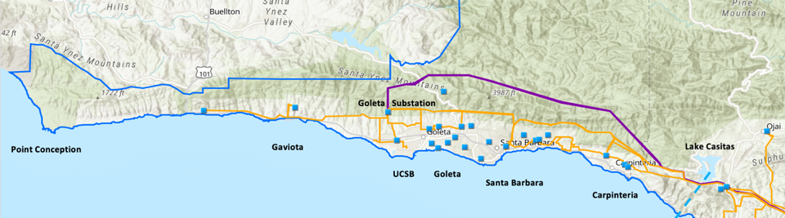
Goleta Load Pocket (GLP) and attaining resilience
The GLP is the perfect opportunity for a comprehensive Community Microgrid
GLP spans 70 miles of California coastline, from Point Conception to Lake Casitas, encompassing the cities of Goleta, Santa Barbara (including Montecito), and Carpinteria.
GLP is highly transmission-vulnerable and disaster-prone (fire, landslide, earthquake).
200 megawatts (MW) of solar and 400 megawatt-hours (MWh) of energy storage will provide 100% protection to GLP against a complete transmission outage (“N-2 event”).
  200 MW of solar is equivalent to about 5 times the amount of solar currently deployed in the GLP and represents about 25% of the energy mix.
  Multi-GWs of solar siting opportunity exists on commercial-scale built environments like parking lots, parking structures, and rooftops; and 200 MW represents about 7% of the technical siting potential.
  Other resources like energy efficiency, demand response, and offshore wind can significantly reduce solar+storage requirements.

Slide 9
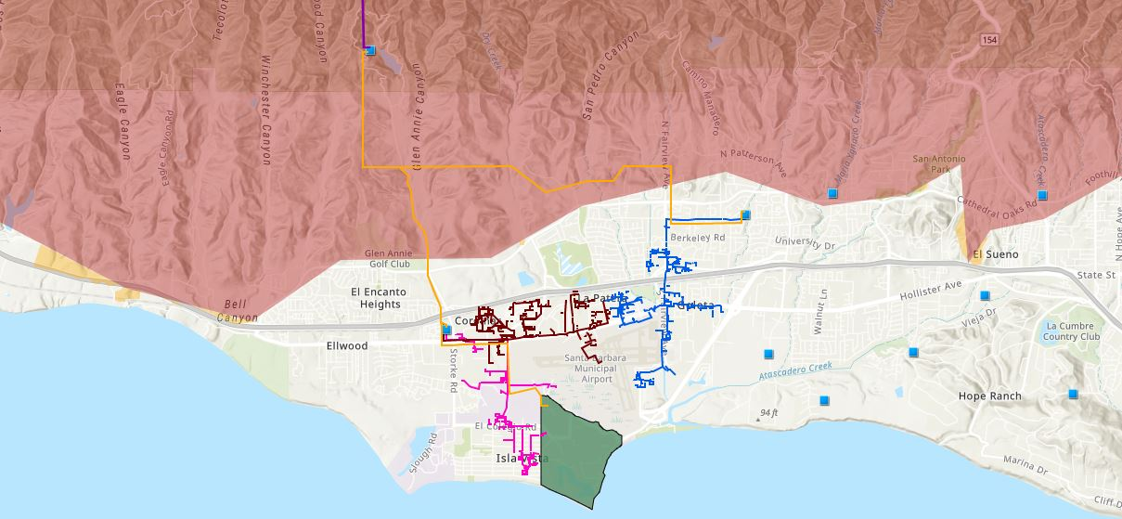


Target 66kV feeder at the core of the GLP
Goleta Substation
Goleta Water District West
Vegas Substation
Isla Vista Substation
UCSB
Legend
220 kV Transmission
16kV Gladiola Feeder
Tier 3 Fire Threat
Santa Barbara Airport
66 kV Feeder #4311
16kV Gaucho Feeder
Tier 2 Fire Threat
Sanitary or Water Districts
Substations
16kV Professor Feeder
University of California Santa Barbara (UCSB)

Slide 10
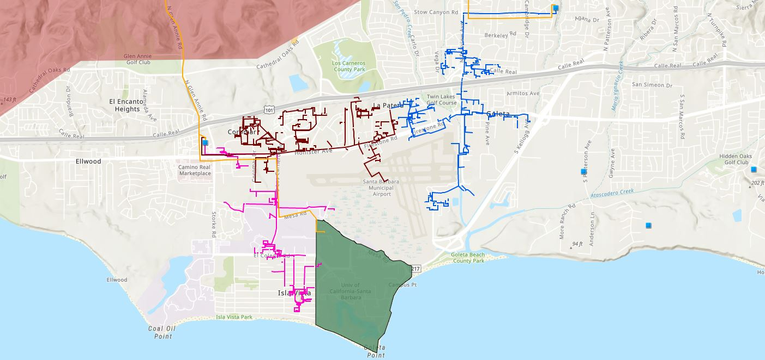





Target 66kV feeder serves critical GLP loads
Proposed 160-240 MWh Battery
Vegas Substation
Direct Relief
Isla Vista Substation
SB Airport
Fire Station # 8
Fire Station # 17
UCSB
Goleta Sanitary District
Legend
16kV Gladiola Feeder
Tier 3 Fire Threat
Goleta Valley Cottage Hospital
220 kV Transmission
16kV Gaucho Feeder
University of California Santa Barbara
Direct Relief
66 kV Feeder #4311
16kV Professor Feeder
Fire Stations
Deckers
Substations
Santa Barbara Airport
Sanitary or Water Districts
Proposed 160-240 MWh Battery

Slide 11

Target 66kV feeder grid area block diagram
Goleta Substation (220-to-66kV)
66kV distribution feeder #4311 with multiple branches
Vegas Substation (66-to-16kV)
Goleta Substation has eight feeders, all 66kV, that serve the entire GLP
Tier 2 & 3 facilities
66kV underground interconnection
Fire Station #8
Direct Relief
+ Solar Microgrid
Tier 2 & 3 facilities
Isla Vista Substation (66-to-16kV)
160+ MWh battery
Deckers
+ Solar Microgrid
SBA (runway lights & ATC)
Tier 2 & 3 facilities
Diagram Elements
66 kV Distribution Feeder #4311
16 kV Gladiola Feeder
16 kV Gaucho Feeder
16 kV Professor Feeder
Planned 160-240 MWh Battery
Grid isolation switch (open, closed)
Smart meter switch (open, closed)
Fire Station #17
SBA (Main Terminal)
Tier 2 & 3 facilities
Goleta Sanitary District
UCSB
+ Solar

Slide 12
SBUSD Solar Microgrids case study
Santa Barbara Unified School District (SBUSD)
case study

Slide 13
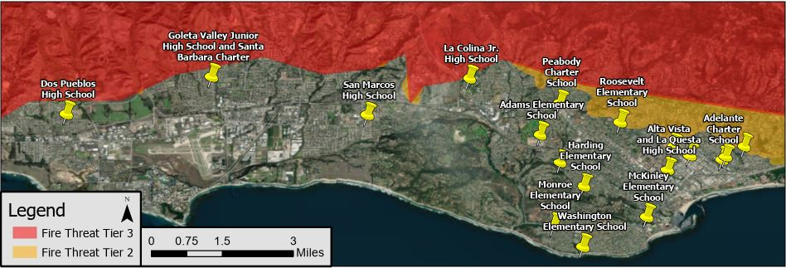
Santa Barbara Unified School District (SBUSD)
The entire Santa Barbara region is surrounded by extreme fire risk (earthquake & landslide risk too) and is extremely vulnerable to electricity grid outages.
The SBUSD is a major school district that increasingly recognizes the value-of-resilience (VOR) and has embraced the Clean Coalition’s vision to implement Solar Microgrids at a number of its key schools and other critical facilities.
SMHS is in the middle of the extensive SBUSD service area.

Slide 14
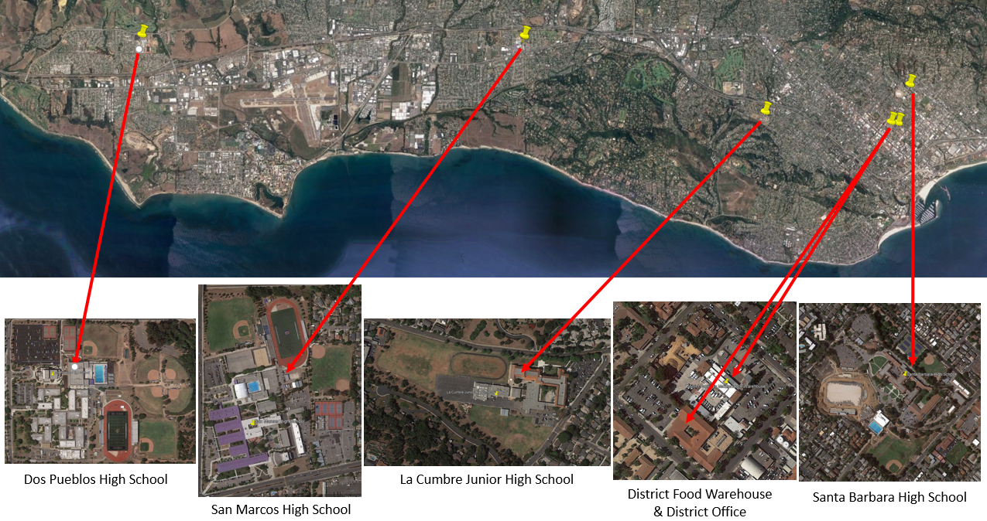
Six SBUSD Solar Microgrid sites

Slide 15
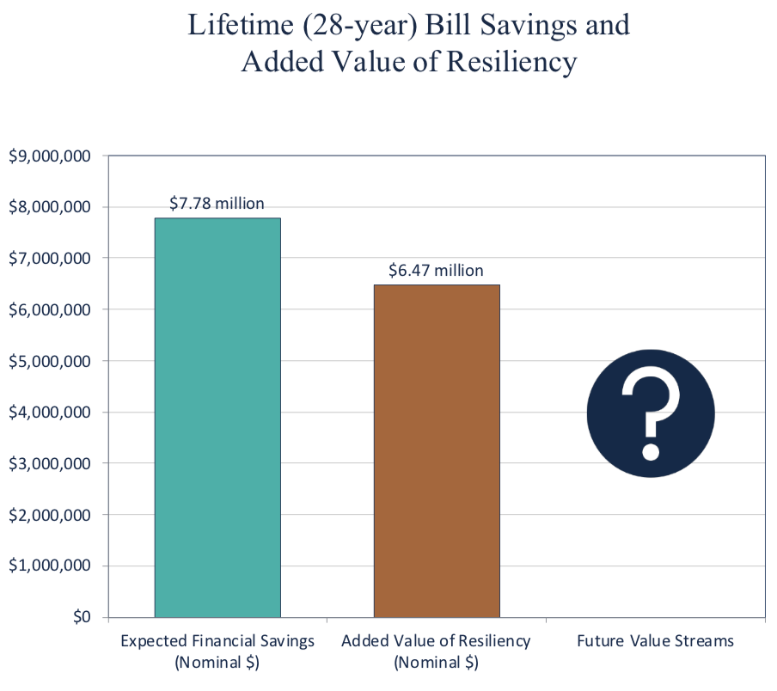
Guaranteed SBUSD bill savings and free VOR

Slide 16
San Marcos High School (SMHS) case study
San Marcos High School (SMHS)
case study

Slide 17
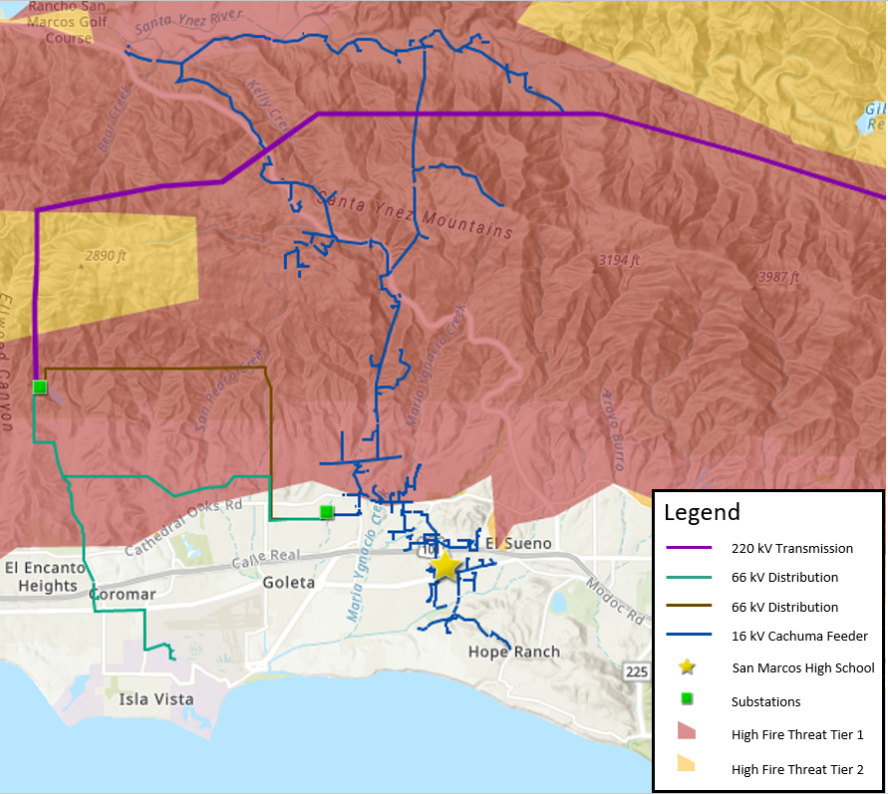
SMHS is vulnerable to distribution outages too

Slide 18
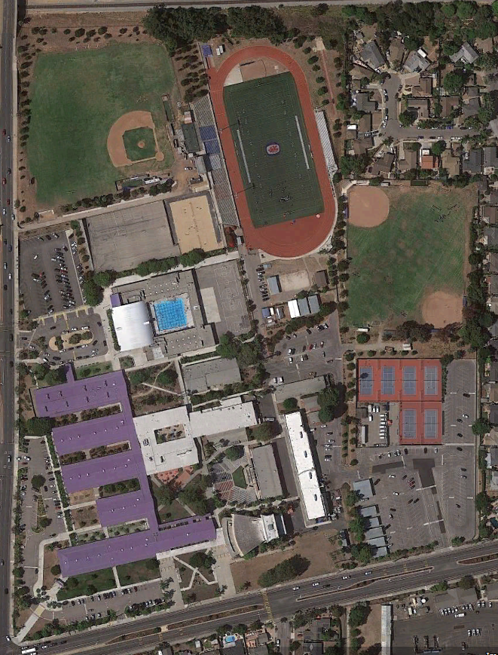
San Marcos High School (SMHS)
SMHS is a large public high school serving 2,000+ students in grades 9 through 12.
Red Cross designated facility.
School features include:
  Array of classroom buildings
  Large pool
  Gymnasium
  Football stadium
  Multiple baseball fields
  Cafeteria
  Outdoor Greek theater
  Auditorium
  Numerous tennis & basketball courts
Craig Lewis in the Class of 1981.

Slide 19
SMHS Solar Microgrid overview
The SMHS Solar Microgrid is intended to enable the school to operate independently during grid outages of any duration with indefinite resilience for the most critical loads and resilience for all loads for significant percentages of time.
Solar
  725 kWp
  Solar is entirely in the form of solar parking canopies
  Net Zero Energy (NZE) is exceeded at 101%
Battery Energy Storage System (BESS)
  700 kWh energy capacity
  350 kW power capacity
Critical (Tier 1) loads
  Food service refrigerators & freezers, maintained indefinitely
  4.36 kW of average load
  3.44% of total average load
Priority (Tier 2) loads
  Gym lights and Main Distribution Frame, maintained at least 80% of the time
  4.32 kW of average load
  3.41% of total average load

Slide 20
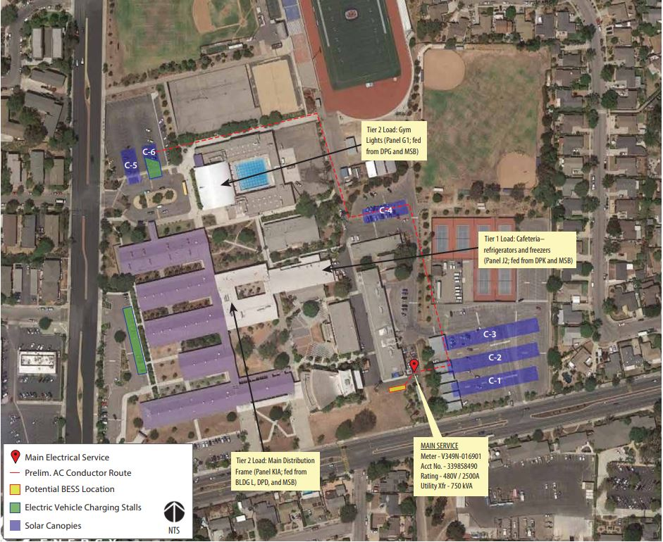
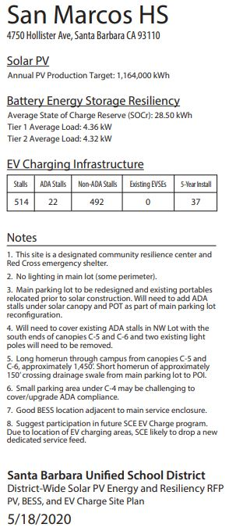
San Marcos High School – site layout

Slide 21
Solar Microgrids coming to Camarillo CCFs
Solar Microgrids coming to Camarillo Critical Community Facilities (CCFs)

Slide 22
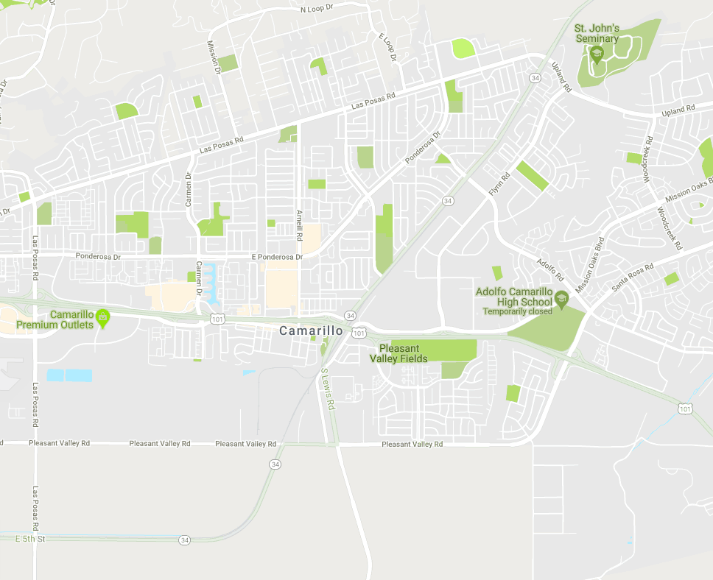
Solar Microgrids targeted for 5 Camarillo CCFs
Police Station
Library
City Hall
Corp Yard
Wastewater Treatment Plant
Notes:
This map shows an overview of the City of Camarillo with respect to each of the sites included in this microgrid feasibility Study
Total of 5 sites:
Police Station
Library
City Hall
Corp Yard
WWT
Detailed views of proposed new resource locations (solar and storage)will be shown later for each site.

