Slide 1
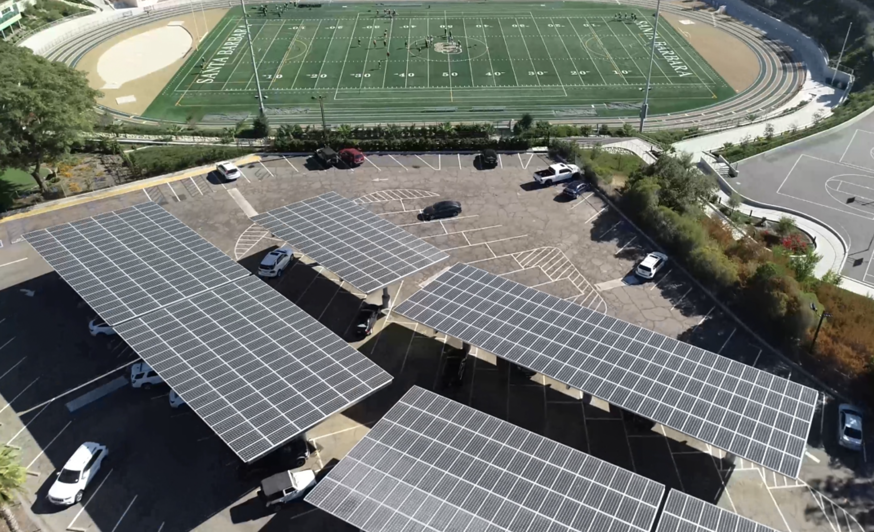
Renewables-driven Microgrids are Key
to Future Energy Systems
Craig Lewis
Executive Director
650-796-2353 mobile
craig@clean-coalition.org
1 April 2023

Slide 2
Clean Coalition (nonprofit)
Mission
To accelerate the transition to renewable energy and a modern grid through
technical, policy, and project development expertise.
Renewable Energy End-Game
100% renewable energy; 25% local, interconnected within the distribution grid and ensuring resilience without dependence on the transmission grid; and 75% remote, fully dependent on the transmission grid for serving loads.
Notes:
2

Slide 3
Renewables-driven Microgrids deliver a trifecta of benefits
Economic
  Savings via grid efficiency and lower bills
Environmental
  Sustainability via renewable energy
Resilience
  Safety via energy availability

Slide 4
Various configurations of Solar and/or Storage
Solar-only provides solar energy and delivers economic & environmental benefits. The solar will turn off during grid outages and there are no resilience benefits from solar-only.
Storage-only allows energy to be time-shifted and provides economic and limited resilience benefits. Because storage-only simply time-shifts grid energy, solar-only deployments deliver no substantial environmental benefits. The resilience benefits will only last as long as the amount of energy that was stored at the time of a grid outage allows – then it’s lights out.
Solar+Storage combines solar & storage to deliver economic, environmental, and limited resilience benefits.
Solar Microgrid combines to deliver economic, environmental, and indefinite resilience benefits. The solar provides an ongoing energy source, which is required for ongoing resilience.

Slide 5
Various types of Solar Microgrids
A microgrid is a combination of energy resources, definitely including generation, that are coordinated to serve specified loads, including in an islanded fashion.
A Solar Microgrid is a behind-the-meter (BTM) microgrid that solely relies on solar for energy generation when islanded.
A Hybrid Solar Microgrid is a Solar Microgrid that includes additional sources of energy generation, beyond just solar.
A Community Microgrid a microgrid that covers a target grid area and relies on existing distribution feeders (ie, power lines) to operate when islanded. Community Microgrids typically include both front-of-meter (FOM) and BTM resources, including Solar Microgrids, and require effective participation from utilities, which have mostly erected barriers to date.

Slide 6
Storage, Resilience, VOR, and Load Management
Storage, Resilience, Value-of-Resilience (VOR), and Load Management

Slide 7
Storage is optimized for economics & resilience
Top owner reserve is often in place to absorb battery energy storage system (BESS) degradation over time, while still delivering the contracted daily cycling energy capacity.
Owner reserve
SOCr = the minimum state-of-charge (SOC) that is reserved for provisioning resilience. The SOCr can be dynamic and/or resized to between 0% and 100% of the contracted BESS energy capacity. A lower SOCr facilitates BESS operations that optimize daily economic performance, while a higher SOCr facilitates the provisioning of greater resilience.
Contracted BESS energy capacity (kWh) that must be available for daily cycling over the contract duration for achieving specified economic & resilience performance.
SOCr
Bottom owner reserve is often required to meet BESS warranty requirements that are imposed by BESS vendors.
Owner reserve

Slide 8
Percentage of time online for Tier 1, 2, and 3 loads for a Solar Microgrid designed for the University of California Santa Barbara (UCSB) with enough solar to achieve net zero and 200 kWh of energy storage per 100 kW solar.
Typical load tier resilience from Solar Microgrids
Percentage of total load
Tier 3 = Discretionary load, ~75% of total load
Tier 2 = Priority load, ~15% of total load
Tier 1 = Critical, life-sustaining load, ~10% of total load
Percentage of time

Slide 9
A typical diesel generator is configured to maintain 25% of the normal load for two days. If diesel fuel cannot be resupplied within two days, goodbye. This is hardly a solution for increasingly necessary long-term resilience. In California, Solar Microgrids provide a vastly superior trifecta of economic, environmental, and resilience benefits.
Diesel generators are designed for limited resilience
Percentage of total load
Tier 3 = Discretionary load, ~75% of total load
Tier 2 = Priority load, ~15% of total load
Tier 1 = Critical, life-sustaining load, ~10% of total load
Percentage of time

Slide 10
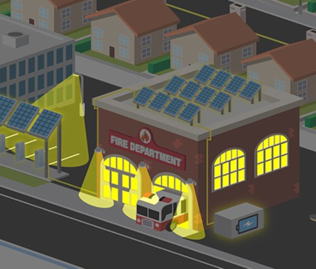
Value-of-Resilience (VOR) depends on tier of load
Everyone understands there is significant value to resilience provided by indefinite renewables-driven backup power, especially for the most critical loads
  But, this value-of-resilience (VOR) has yet to be quantified in a straightforward methodology.
  Hence, VOR is often given no value, leaving a dangerously short-sighted economic gap.
The Clean Coalition aims to establish a standardized value-of-resilience (VOR) for critical, priority, and discretionary loads that will help everyone understand that premiums are appropriate for indefinite renewables-driven backup power to critical loads and almost constant backup power to priority loads, which yields a configuration that delivers backup power to all loads a lot of the time
The Clean Coalition’s VOR approach standardizes resilience values for three tiers of loads:
  Tier 1 are mission-critical & life-sustaining loads and warrant 100% resilience. Tier 1 loads usually represent about 10% of the total load with a 3x energy value.
  Tier 2 are priority loads that should be maintained as long as doing so does not threaten the ability to maintain Tier 1 loads. Tier 2 loads usually represent about 15% of the total load and get a 1.5x energy value.
  Tier 3 are discretionary loads comprising the remaining loads, usually about 75%. Tier 3 loads possess no extra value and are only maintained when Tier 1 & 2 are secure.

Slide 11
Value-of-Resilience (VOR) details
VOR123
VOR123 is the value-of-resilience (VOR) from Solar Microgrids methodology that the Clean Coalition has developed to normalize VOR across all types of facilities & geographies. The VOR normalization is founded in tiering loads into three categories: Tier 1 (critical), Tier 2 (priority), and Tier 3 (discretionary). Since each Tier has its own resilience requirement and VOR, this methodology is called VOR123.
VOR123 webinar
https://clean-coalition.org/news/webinar-valuing-resilience-solar-microgrids-thursday-5-nov-2020/
Notes:
11

Slide 12
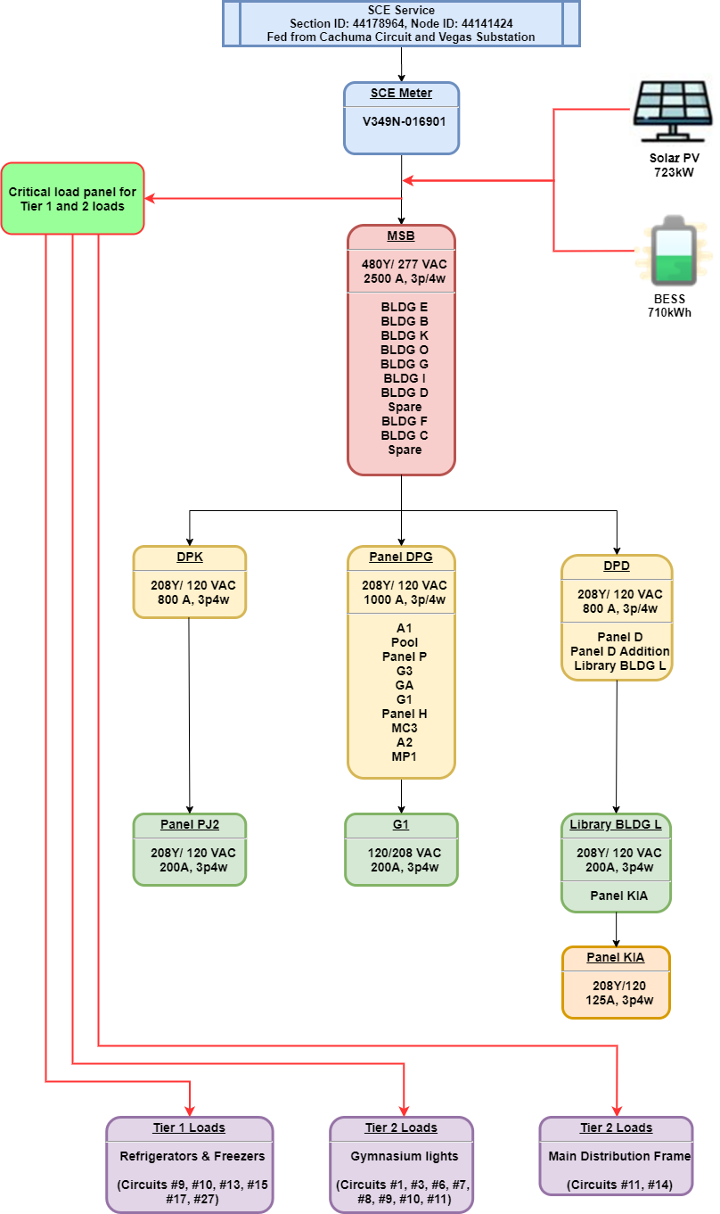
Load Management is fundamental to VOR123
Although there are multiple potential Load Management configurations, the minimal functionality anticipated to be cost-effectively implemented is referred to as the Critical Load Panel (CLP) approach.
The CLP name reflects the requirement for a smart critical load panel that maintains Tier 1 loads indefinitely and toggles Tier 2 loads. In the CLP approach, Tier 3 loads will be toggled as a group by toggling power to the Main Service Board (MSB). Figure 9 illustrates the CLP approach for SMHS, with Tier 1 and Tier 2 loads being served by new dedicated wire runs that connect to a new smart critical load panel.

Slide 13
Getting things done = aligning stakeholders
Getting things done = aligning stakeholders

Slide 14
Community Microgrid stakeholders
Municipalities
Property Owners
Policymakers
Residents
Community Microgrid
Utilities
Philanthropic
Funders
Solution Providers
Financiers

Slide 15
Remember that all stakeholders are human
Humans like things to be simple
  Make sure that objectives & analyses are effectively presented.
Most humans are capitalists
  Economics are fundamental to all stakeholder decisions.
  With utilities, follow the money.
  With policymakers, hold them accountable.
Success requires multi-pronged action combined with courageous & relentless pursuit
  Perform comprehensive analyses.
  Tell the story effectively – which usually means colorfully.
  Repeat the messaging courageously and ad nauseum.
Notes:
http://ewh.ieee.org/r6/san_francisco/ias/archive/pdf/archived_presentations/2009_11_IAS_Presentation.pdf

Slide 16
Think Vertical for maximizing winter solar
Think Vertical for maximizing winter solar

Slide 17
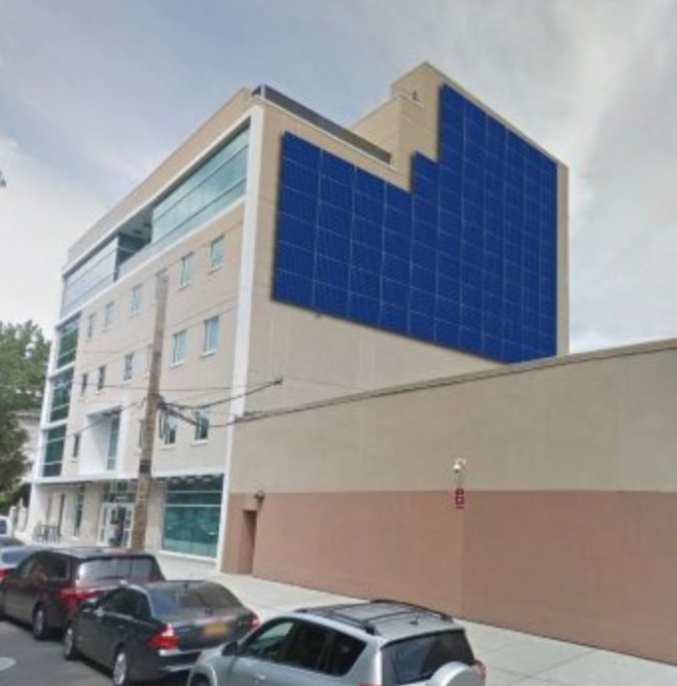
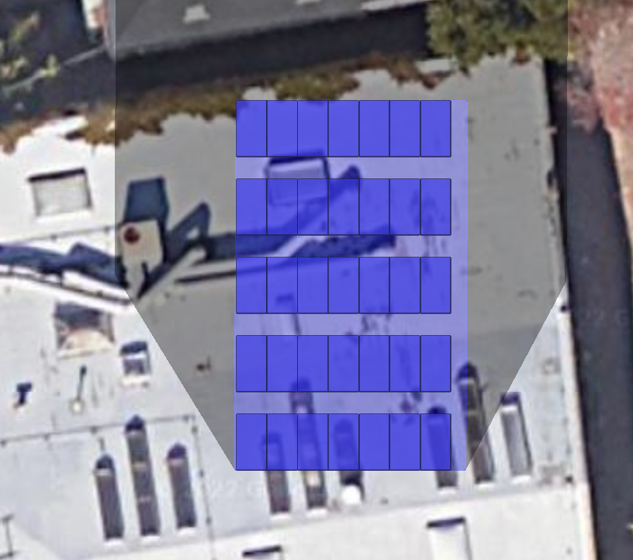
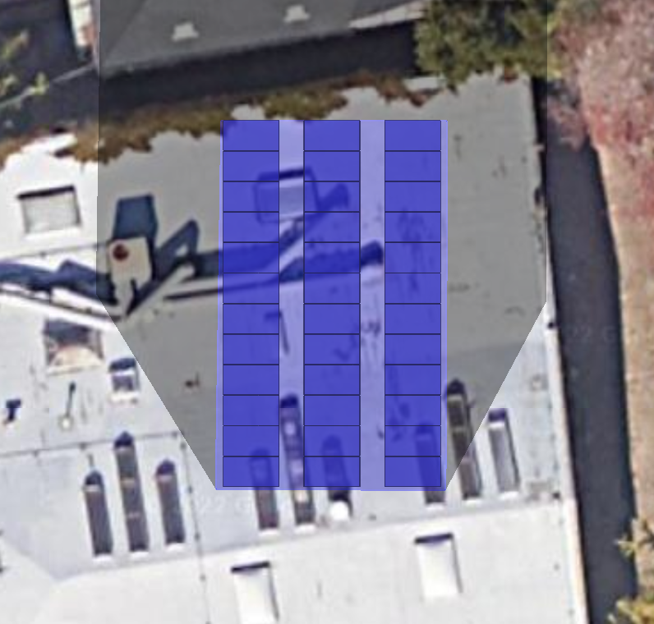
Solar sizing and generation per 1,000 sf by orientation type
Example Façade (Not as shown in table)
Fixed Tilt South Facing
Fixed Tilt West Facing

Slide 18
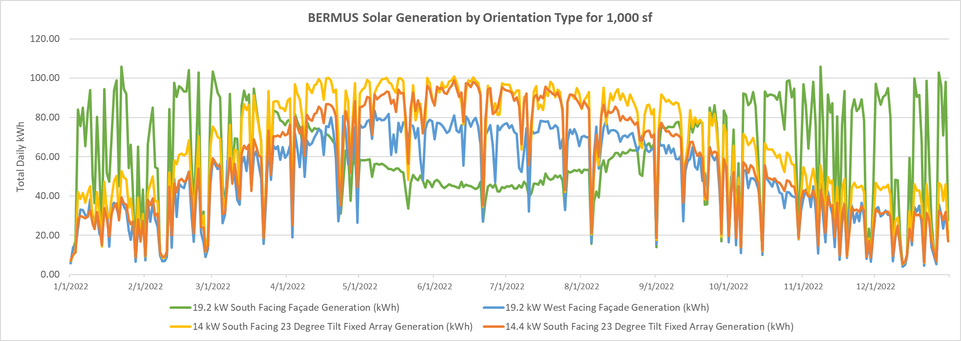
Daily generation by orientation type

Slide 19
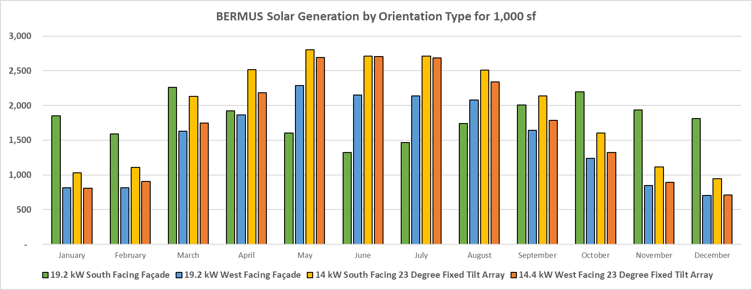
Monthly generation by orientation type

Slide 20
Solar Microgrids for Schools need support
Solar Microgrids for Schools need support

Slide 21
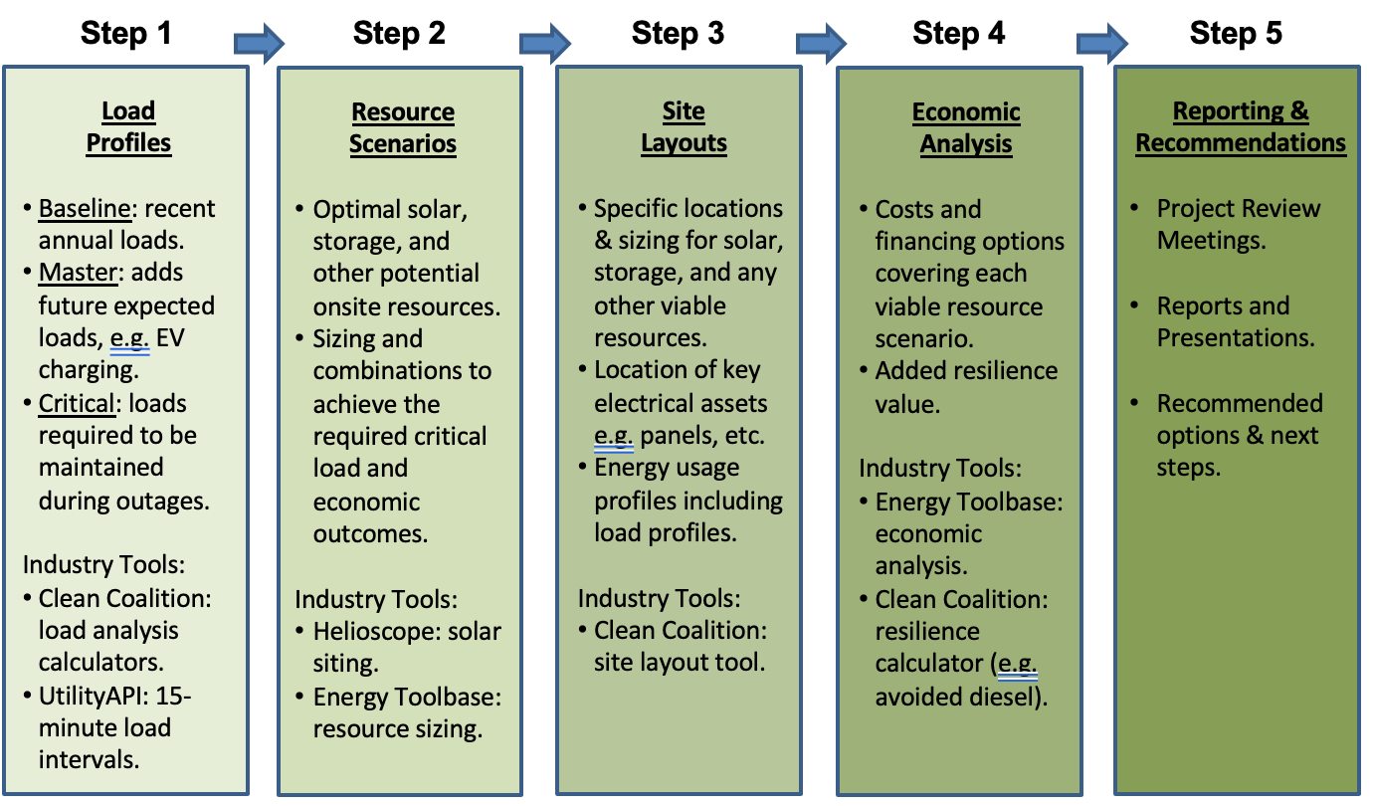
Solar Microgrid Methodology for feasibility studies
Notes:
21

Slide 22
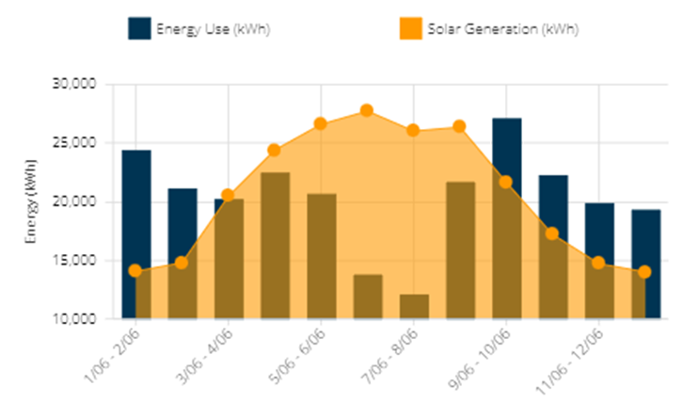
137 kW solar only billing analysis
200,000 kWh annual load.
50,000 kWh from new anticipated EV chargers.
250,000 kWh modeled load.
175 kW modeled peak load with EV chargers.
$21,000 modeled annual bill (more than 50% demand charges)

Slide 23
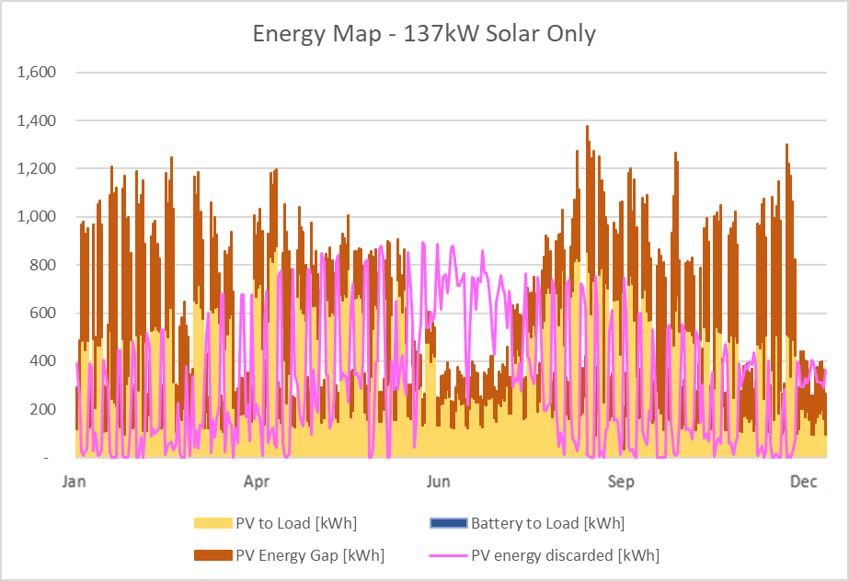
Energy Flow for 137 kW solar

Slide 24
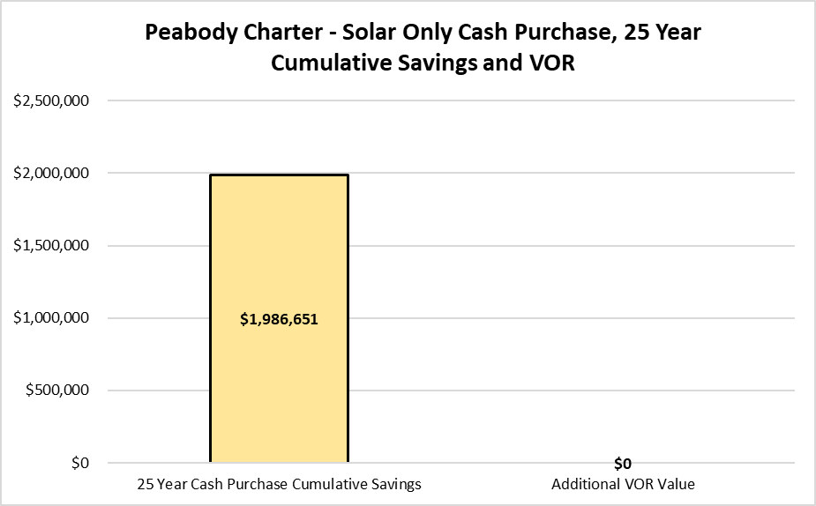
137 kW solar, 25-year cash purchase economics
SoCal elementary

Slide 25
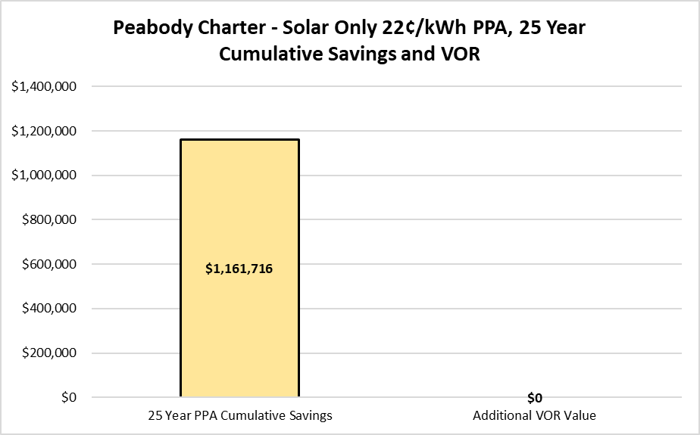
137 kW solar, 25-year PPA economics
SoCal elementary

Slide 26
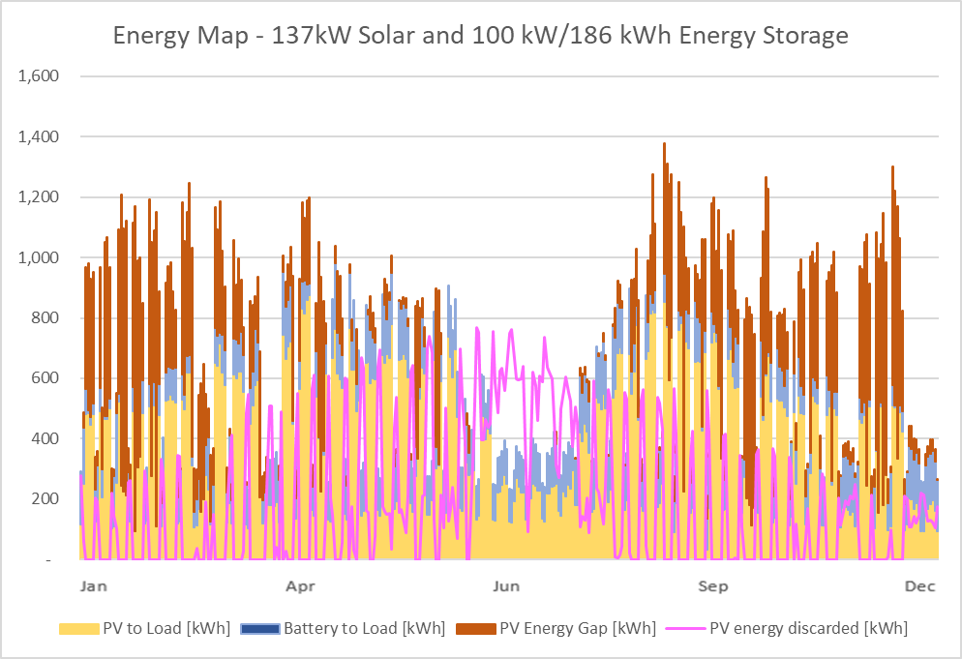
Energy Flow for 137 kW solar and 100 kW / 186 kWh storage Solar Microgrid

Slide 27
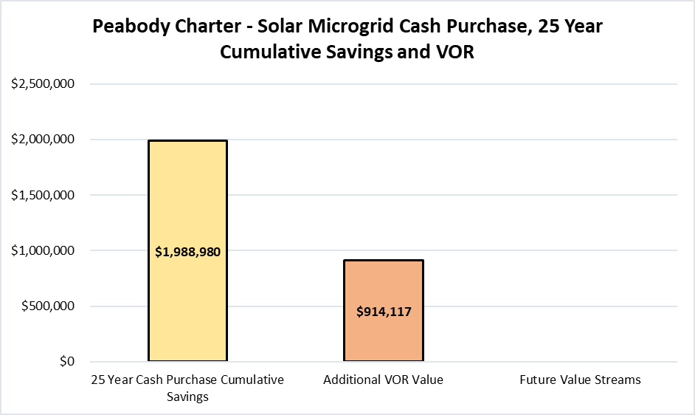

Solar Microgrid 25-year cash purchase economics
SoCal elementary

Slide 28
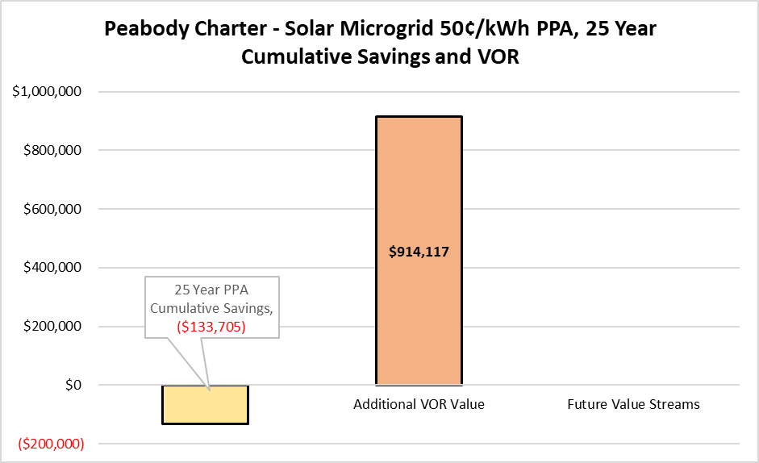
Solar Microgrid 25-year PPA economics
SoCal elementary

Slide 29
Solar Microgrids for off-grid facilities
Solar Microgrids for off-grid facilities

Slide 30
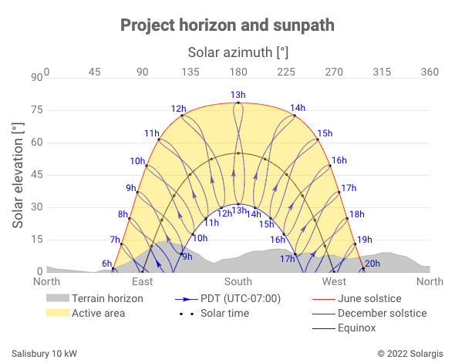
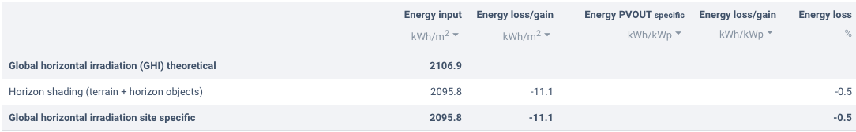
Bull Ridge horizon profile
The image above depicts the terrain at Bull Ridge Ranch and its impact on the active annual solar area available for solar pv production. The total loss of solar energy production due to surrounding terrain is estimated to be 0.5%

Slide 31
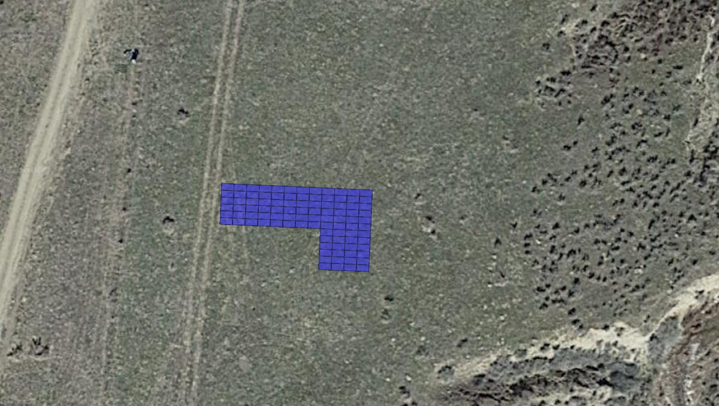
Bull Ridge solar layout– 38.4 kW
Bull Ridge Solar Microgrid
Address: 100 Salisbury Canyon Road
Off-grid
Total annual load and peak demand:
Baseline load: 8,532 kWh
Average daily energy use: 23.38 kWh
Baseline load peak demand: 5.67 kW
Average load: 0.97 kW
Total solar recommended
38.4 kWdc
67,901 kWh
Battery energy storage options:
20 kW/ 52 kWh

Slide 32
Bull Ridge Solar Microgrid – resilience matrix

Slide 33
Solar Microgrids for grid-constrained load growth
Solar Microgrids for grid-constrained
load growth

Slide 34


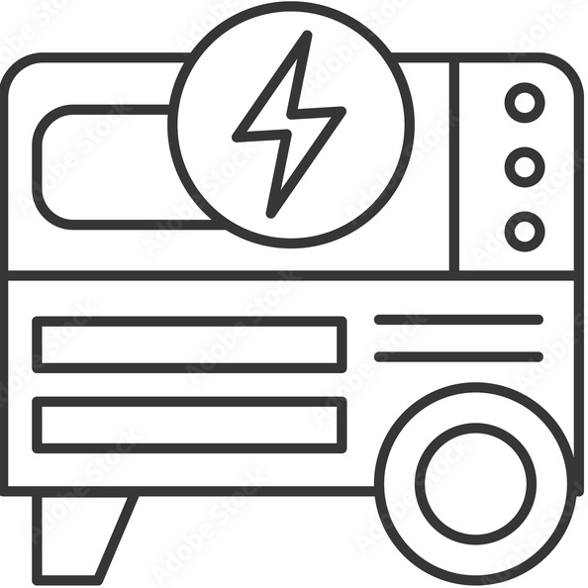
DC-coupled Solar Microgrid to serve 2.5 MWdc of added DC loads to GH2 meter
Solar
Battery
1.5 MWdc
6 MWh
350-500 Vdc LEDs
4-6 hr/day, Oct-Mar
Converter
Converter
DC Loads
Peak: 2.5 MWdc
800 Vdc
DC bus
Converter
Inverter 530 kW
Diesel Generator
Main Circuit Breaker
AC Loads
Peak: 291 kWac
MCB
Line Side Taps
480 Vac
3-phase
ATS
Automatic Transfer Switch
M
SCE Meter (limit of 665 kWac)
800 A, 480 Vac, 3-phase
SCE Grid
Transformer
500 kVA

Slide 35
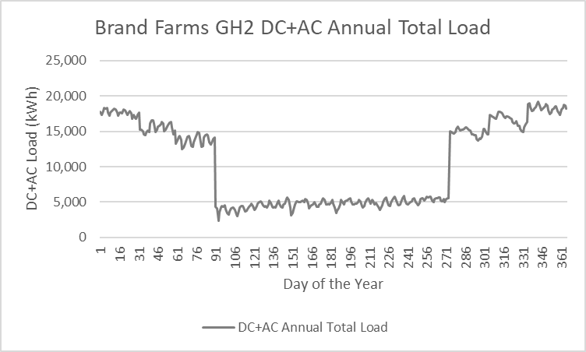
GH2 economics assuming all future AC & DC loads can be served by the grid

Slide 36
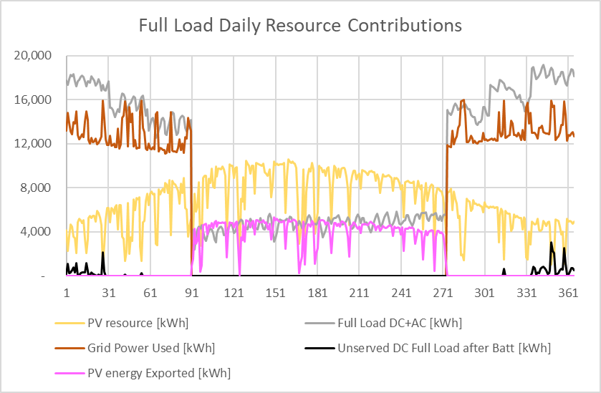
Greenhouse 2 Energy Flow after addition of DC-coupled Solar Microgrid and 2.5 MWdc of DC loads
Energy Flow Diagram
1.5 MW solar and 3 MW / 6 MWh energy storage

Slide 37
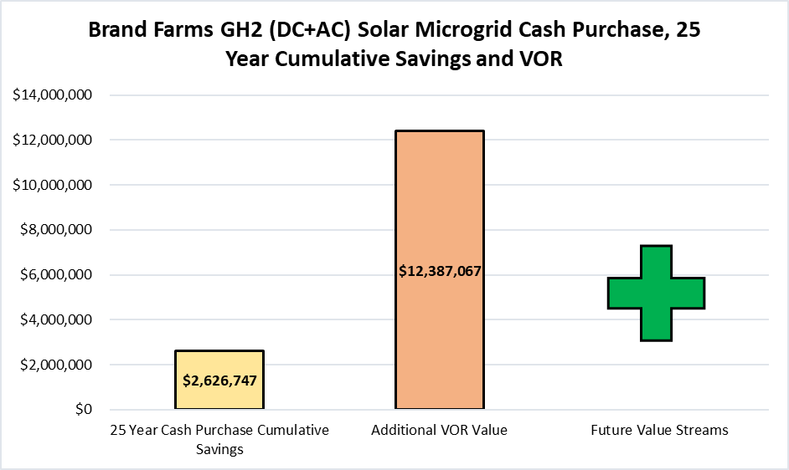
Solar Microgrid 25 year cash purchase economics
Cash purchase economics use $2.50/W for solar, $750/kWh for storage, 5% annual utility escalator, 30% ITC, and Federal & California MACRS

Slide 38
Community Microgrids need policy innovation
Community Microgrids need
policy innovation

Slide 39
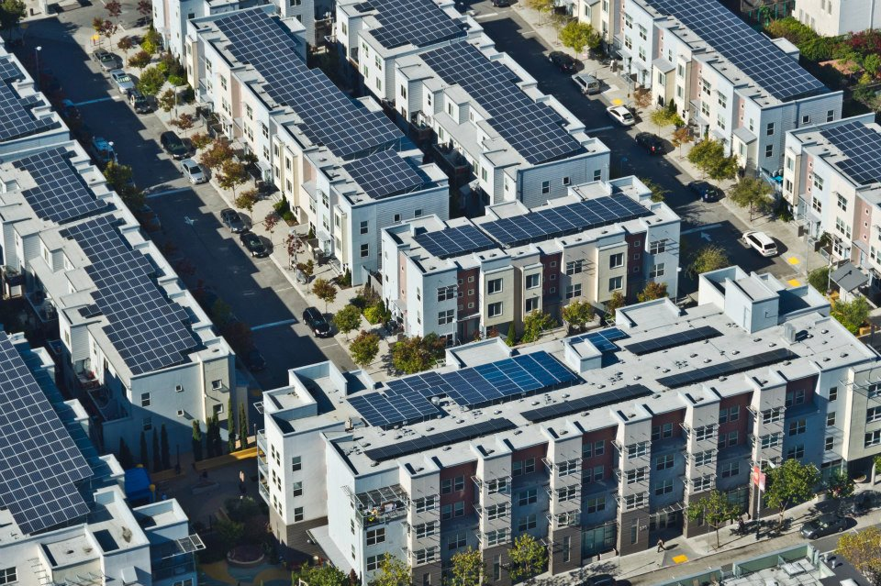
Valencia Gardens Apartments in San Francisco

Slide 40
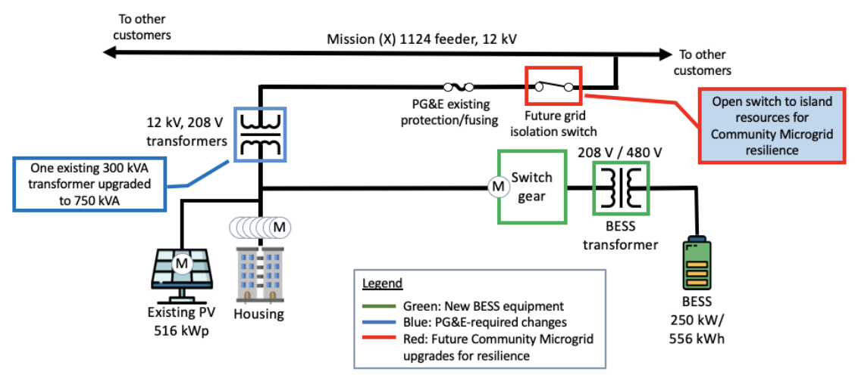
Future VGES Community Microgrid opportunity

Slide 41
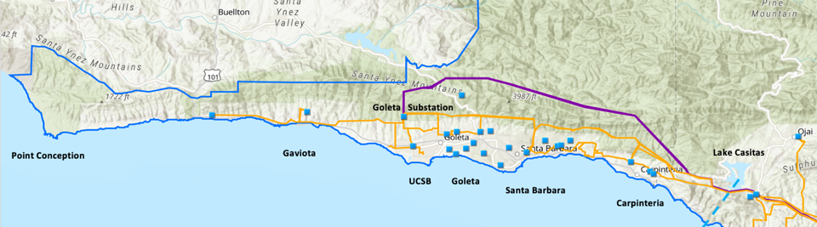
Goleta Load Pocket (GLP)
The GLP is the perfect opportunity for a comprehensive Community Microgrid
GLP spans 70 miles of California coastline, from Point Conception to Lake Casitas, encompassing the cities of Goleta, Santa Barbara (including Montecito), and Carpinteria.
GLP is highly transmission-vulnerable and disaster-prone (fire, landslide, earthquake).
200 megawatts (MW) of solar and 400 megawatt-hours (MWh) of energy storage will provide 100% protection to GLP against a complete transmission outage (“N-2 event”).
  200 MW of solar is equivalent to about 5 times the amount of solar currently deployed in the GLP and represents about 25% of the energy mix.
  Multi-GWs of solar siting opportunity exists on commercial-scale built-environments like parking lots, parking structures, and rooftops; and 200 MW represents about 7% of the technical siting potential.
  Other resources like energy efficiency, demand response, and offshore wind can significantly reduce solar+storage requirements.

Slide 42
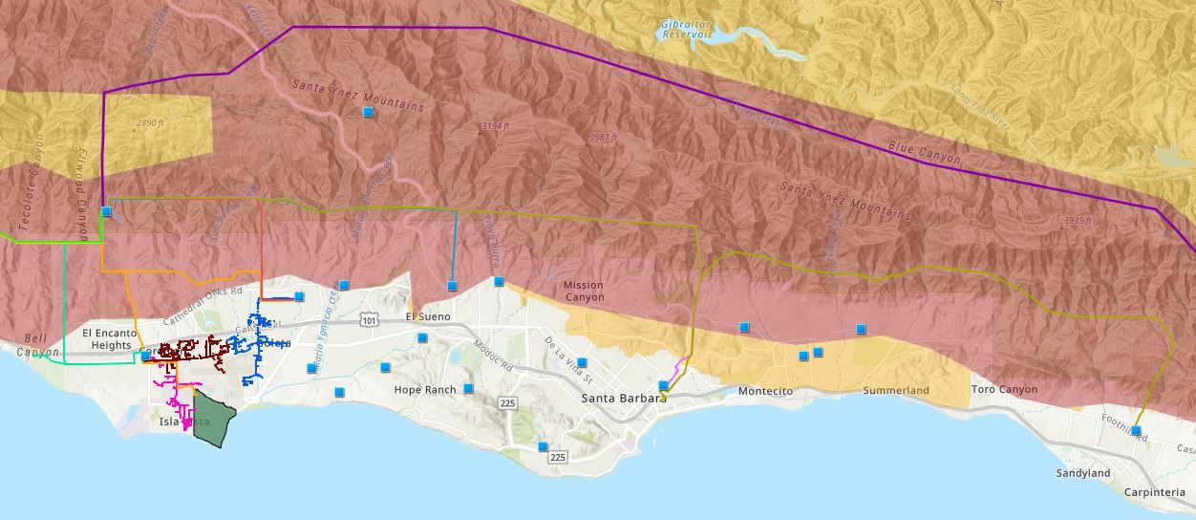

Core load area of the GLP
Legend
Feeder #4157
Feeder #4169
220 kV Transmission
Tier 3 Fire Threat
16kV Gladiola Feeder
Feeder #3556
Feeder #4227
Santa Barbara Airport
Tier 2 Fire Threat
16kV Gaucho Feeder
Feeder #4311
Feeder #3565
Substations
UCSB
16kV Professor Feeder
Feeder #3559

Slide 43
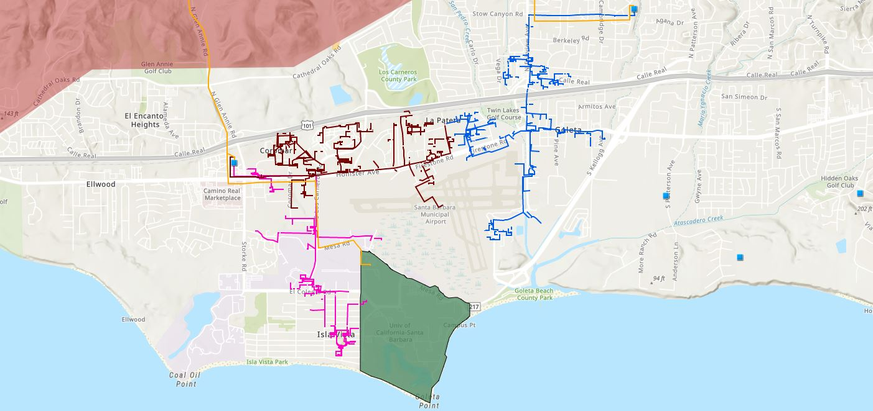








Target 66kV feeder serves critical GLP loads
Bella Battery Energy Storage Project (120 MWh)
Direct Relief (Solar Microgrid)
Vegas Substation
Dos Pueblos High School (Solar Microgrid)
Goleta Energy Storage Project
(240 MWh)
SB Airport
Fire Station # 8
Ellwood Gas Peaker Plant
Isla Vista Substation
UCSB
Fire Station # 17
Goleta Sanitary District
Legend
16kV Gladiola Feeder
University of California Santa Barbara
Goleta Valley Cottage Hospital
66 kV Feeder #4311
16kV Gaucho Feeder
Dos Pueblos High School
Direct Relief
Substations
16kV Professor Feeder
Fire Stations
Deckers
Tier 3 Fire Threat
Santa Barbara Airport
Goleta Sanitary District
Planned Battery Energy Storage

Slide 44
Target 66kV feeder grid area block diagram
Goleta Substation (220-to-66kV)
66kV distribution feeder #4311 with multiple branches
Vegas Substation (66-to-16kV)
Goleta Substation has eight feeders, seven 66 kV & one 16 kV, that serve the entire GLP
Fire Station #8
Direct Relief
+ Solar Microgrid
San Marcos
+ Solar Microgrid
66kV underground interconnection
Tier 2 & 3 facilities
Dos Pueblos
+ Solar Microgrid
Tier 2 & 3 facilities
Karl Storz + Solar Microgrid
Goleta Energy Storage Project (240 MWh)
City of Goleta
+ Solar
Isla Vista Substation (66-to-16kV)
Deckers
+ Solar
Goleta Cottage Hospital
Ellwood Gas Peaker Plant
GenOn Battery Energy Storage (120 MWh)
Tier 2 & 3 facilities
SBA (runway lights & ATC)
Diagram Elements
66 kV Distribution Feeder #4311
16 kV Gladiola Feeder
16 kV Gaucho Feeder
16 kV Professor Feeder
16 kV Los Carneros Feeder
16 kV Ace Feeder
16 kV Storke Feeder
Planned Battery Energy Storage
Ellwood Gas Peaker Plant
Grid isolation switch (open, closed)
Smart meter switch (open, closed)
Fire Station #17
SBA (Main Terminal)
Costco
+ Solar
Goleta Sanitary District
UCSB
+ Solar

Slide 45
Backup slides
Backup slides

Slide 46
DignityMoves Santa Maria
Load Profiles

Slide 47
DignityMoves SM – load profiles
Baseline Load Profile
Using LifeMoves Mountain View as proxy, the baseline load profile is calculated based on the ratio between the LifeMoves Mountain View total annual load and the forecasted DignityMoves Santa Maria total annual load as provided by DignityMoves.
  LifeMoves Mountain View’s total 2021 actual annual load was 207,122 kWh
  DignityMoves Santa Maria’s forecasted total annual load (per DignityMoves) is 333.97 estimated daily kWh, equaling 121,899 kWh annually.
Thus, DignityMoves Santa Maria is expected to be roughly 58% of LifeMoves Mountain View’s total annual load.
58% of every 15-minute interval for LifeMoves Mountain View was taken to form DignityMoves Santa Maria’s baseline load profile.

Slide 48
DignityMoves SM – critical load profile
Key Points:
LifeMoves Mountain View Critical Load Profile was used as the basis for Santa Maria and would include the following critical loads: food and community services, bathrooms, restrooms, security lighting, exterior lights, office lights, reception lights, parking lot lights.
See actual critical load breakdown for Mountain View in next slide, as example for Santa Maria.
HOWEVER: Note that for the on-grid scenario with 2 BESS containers, the total percentage of loads kept on indefinitely is 35%, much higher than 11.4%.

Slide 49
Example for Santa Maria – LifeMoves MV Critical load profile and tiering
Legend
X: Clean Coalition choice based on new loads discovered during site walk
x: LifeMoves original choice
Notes:
What we can do now:
-Move Panel B microwave from Tier 2 to Tier 1
What we need to know:
-Is the EV charging station on the main meter?
-What panel and breaker serves the kitchen/dining food warmers and fridges. These should be marked as Tier 1.
-What room should be a cooling room? What breaker serves the PTAC in this room?
-What room has the server/security in it? What breaker serves these loads?

Slide 50
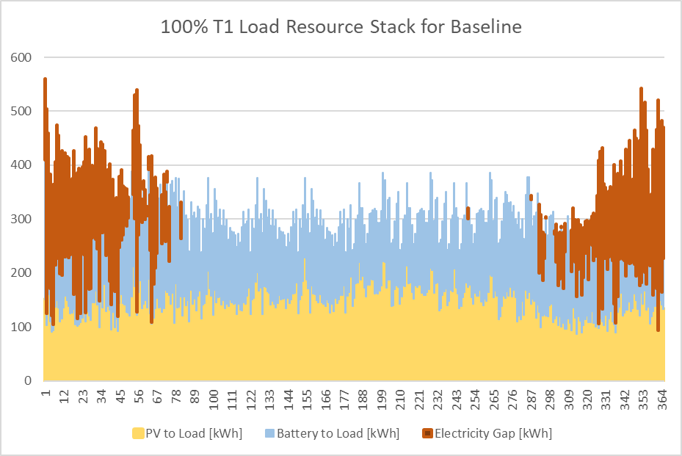
DignityMoves SM – Battery sizing (2 BESS) with solar on Boss Cubez units
The total annual energy gap is 22,159 kWh. When on-grid, this energy gap is supplied by the grid. When off-grid, this energy gap would require 1,773 gallons of diesel fuel for 1 year – see diesel generator details in next slide.
For mid-March through October, solar and storage should be enough to cover 100% of the site’s electrical load, except for the following three days:
Date – 22 March (67 kWh)
Date – 7 September (20 kWh)
Date – 14 October (8 kWh)

