Slide 1
Community and Multi-User Microgrids for Resilience: Implementation Challenges and Perspectives from Puerto Rico and Washington
Microgrid Global Innovation Forum
Lee Shaver | Slipstream Jared Leader | SEPA
Ben Schwartz | Clean Coalition Carlos Alberto Velázquez | IREC
5 December 2023

Slide 2
Climate + Clean
Energy Solutions
for everyone.
The knowledge, people, and resources to solve our biggest energy challenges.
Notes:
Optional “about us” slide. Edit for your needs.

Slide 3
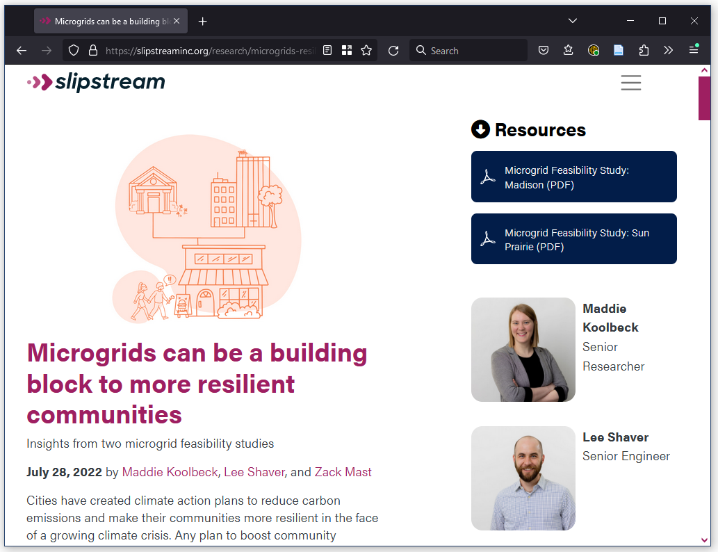
Slipstream’s microgrid work
Microgrid feasibility studies
Community resilience centers
Critical municipal infrastructure
Multi-user microgrids
Develop RFPs/OPRs for microgrid design and implementation
Stakeholder engagement for community energy and resilience plans
Field demonstration, program design and implementation, M&V

Slide 4
Agenda
Intro
Panelists
Jared: Multi-user microgrid basics and strategic considerations
Ben: Market pathways to establishing community microgrids in the highly-regulated West Coast market
Carlos: Solar Energy Multi-Facility Microgrids in Puerto Rico for community resilience
Q&A

Slide 5
Multi-user, multi-facility, or community?
Basic concept
A microgrid where assets are located in different facilities and/or owned and managed by different entities
Resilience needs and cost/benefit analysis vary for each participant
Typically does not include utility owned and operated microgrids that are transparent to their customers

Slide 6
Setting the context: State and territory rankings
Think Microgrid: State Scorecard
IREC and Vote Solar: Freeing the Grid
Three of five metrics (Policy, Deployment, and Equity) address multi-user microgrids specifically
Focus on overall interconnection policy for DERs, considering equitable interconnection

Slide 7
Three contexts for developing multi-user microgrids
 | DERs and microgrids well-supported | DERs well-supported, microgrid support developing | Microgrid and DER support developing
Overview | The state has adopted several DER interconnection best practices and has established market design components, policy reform, and program solutions that support microgrid development. | The state has adopted several DER interconnection best practices but exhibits only limited or passive program and policy-level activity supporting microgrids. | The state has adopted few to no interconnection best practices, and exhibits limited meaningful activity that accommodates microgrid development.
Biggest challenge for MUMs | Existing laws prohibit non-utility wires from crossing property lines. Market pathways developing. | Limited market pathways and/or infrastructure improvement and regulatory reform not keeping pace with policy and market design. | Costly, complicated, and/or slow processes for connecting energy sources for even basic microgrids.
Examples | CA, HI, WA, PR | AZ, IL, MN, PR | GA, ID, KS, TN

Slide 8
Community and Multi-user Microgrids for Resilience
SEPA Research and Industry Strategy
Jared Leader, Senior Director, Resilience
December 2023

Slide 9
SEPA Overview
Vision
A net-zero carbon energy system
that is safe, affordable, reliable,
resilient and equitable
Mission
To accelerate the transformation to a carbon-free electricity system through actionable solutions
9
9

Slide 10
Who Are We?
A membership organization
Unbiased
Research, Education, Collaboration and Standards
Staff of ~65
No Advocacy – 501c3
Technology Agnostic
Local, State and National Focus
Founded in 1992
10
10

Slide 11
5 x 2025 Initiative
SEPA recognizes the attentive need for solutions and alignment in five specific focus areas that will drive our partnerships with utilities, industry, regulators, legislators, customers, and other energy stakeholders By solving the challenges in these areas, we can drive industry progress.
Resilience
Transportation
Energy Storage
Emerging Technology
Policy
11
11

Slide 12
SEPA Working Groups
Peer Collaboration Across 8 Diverse Communities
350+ Member Organizations, 1500+ Individual Members
Practical challenges and best practices
Utility deployment and strategies
New business models and requirements
Expand customer choice innovatively
Issue-Oriented Project-Oriented
Challenges for data and connected-hardware
Utilization that enables high DER penetration
Risk mitigation with grid and IT architecture
Smart grid standards and interoperability
How-to Questions? WorkingGroups@SEPApower.org
Notes:
SEPA’s Groups are a peer-led, member benefit with approximately 1,500 active members across every type of company and organization.
Group members value their participation in these communities to hear from experts, access to educational resources and reports, networking opportunities and engaging discussions.
If you’re interested, we have an easy way to learn more at our upcoming Working Group Virtual Open House from November 13-16th.
Information is available on our website.You can direct Group-related questions to workinggroups@sepapower.org
Next, let’s look at the opportunities for executives

Slide 13
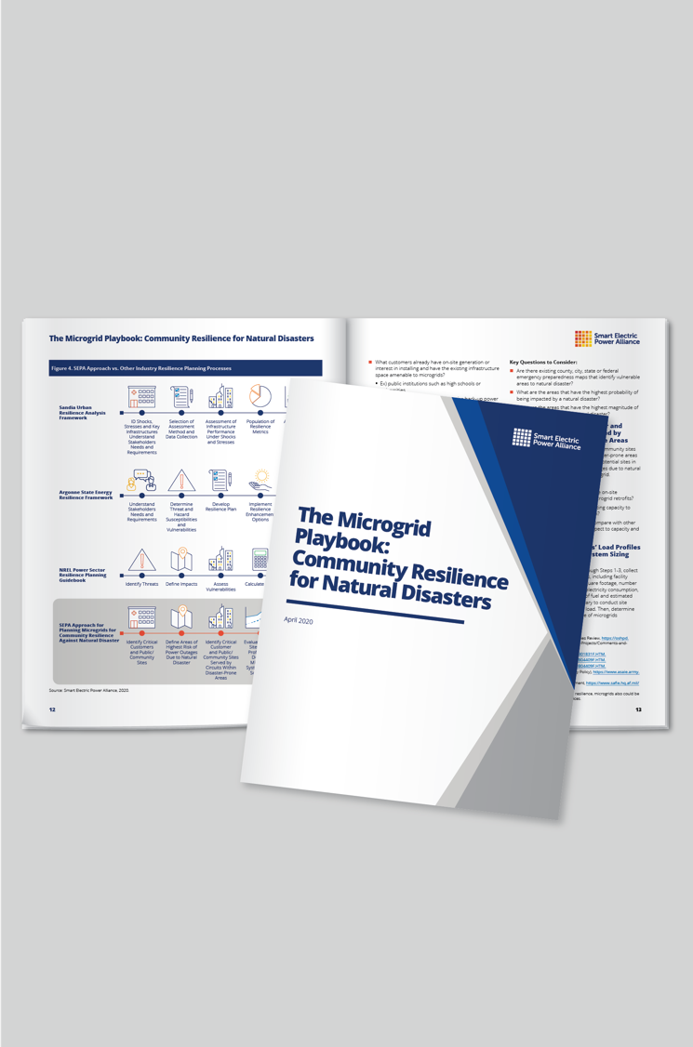
Perspectives for Today…
13
13

Slide 14
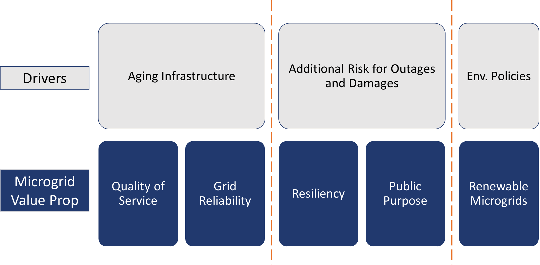
Where Do Microgrids Fit in?

Slide 15
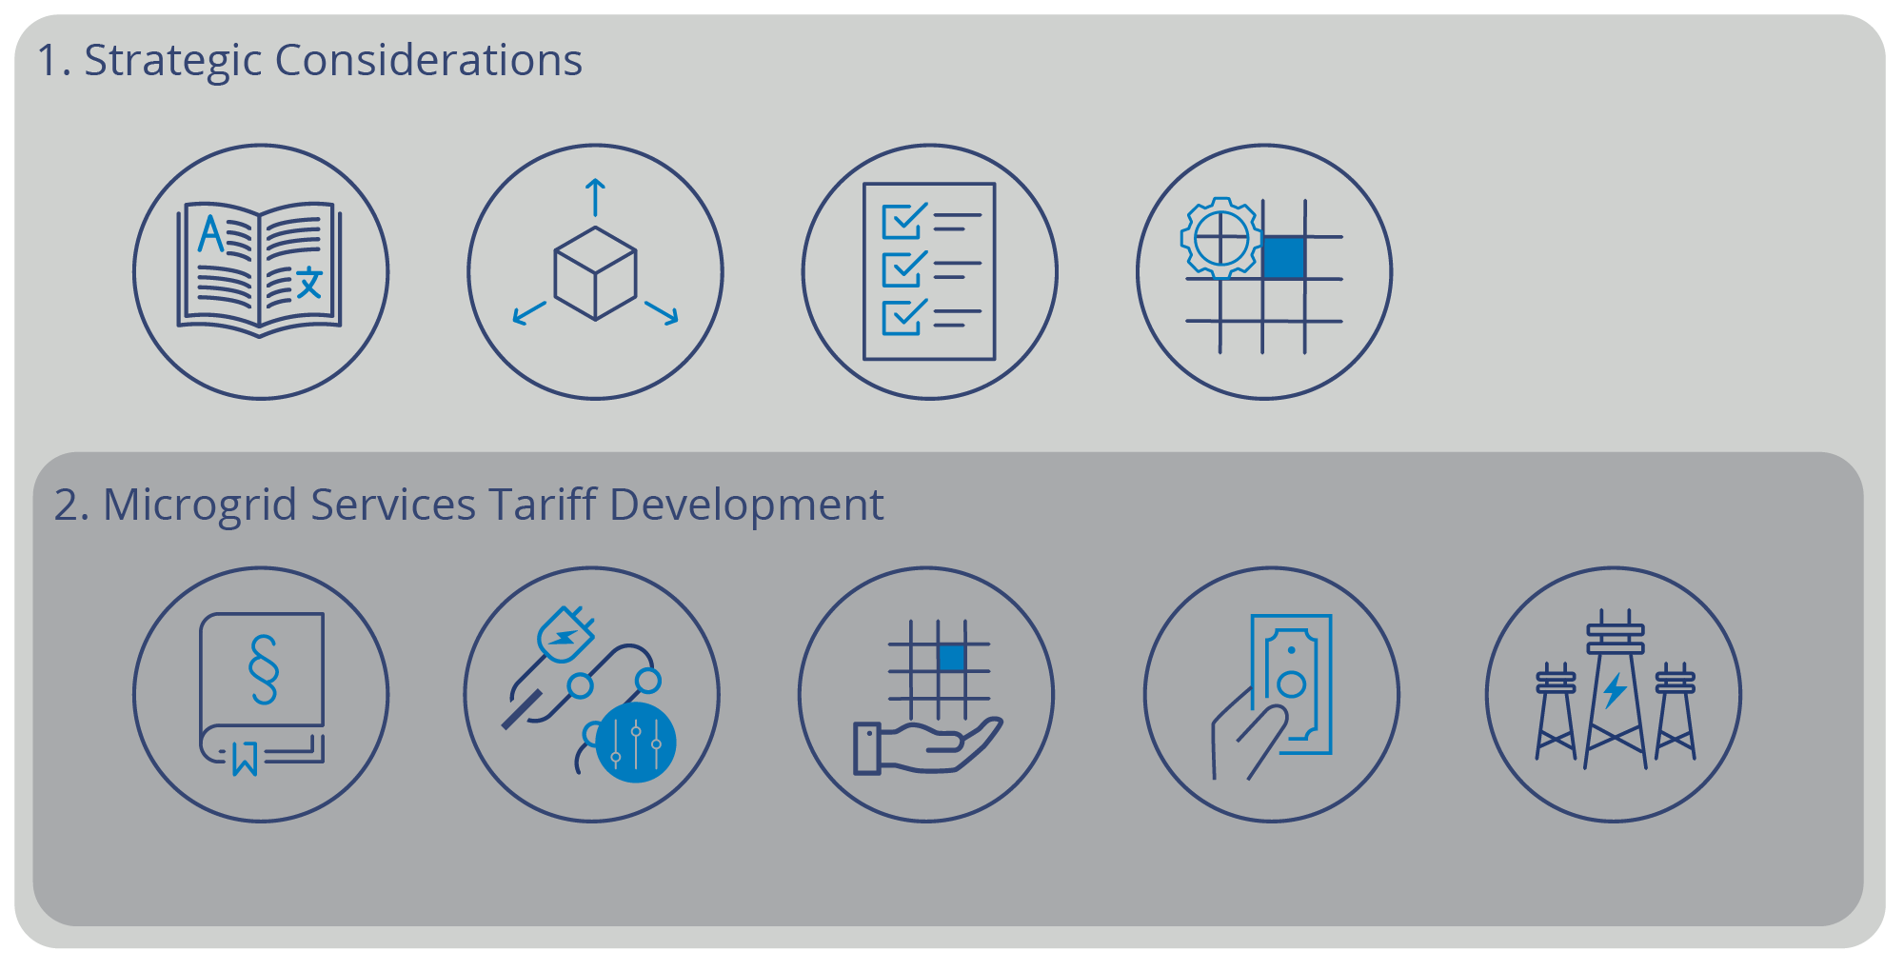
A Framework for Consideration…
Notes:
Strategic Considerations – guidance to determine what’s in and out of scope, identify microgrid objectives and archetypes, appropriate operational structures and services to address in the tariff.
Microgrid Services Tariff Development – guidance on elements to include and how to structure the tariff, including interconnection processes, services agreements and compensation mechanisms for utility and microgrid services provided.

Slide 16
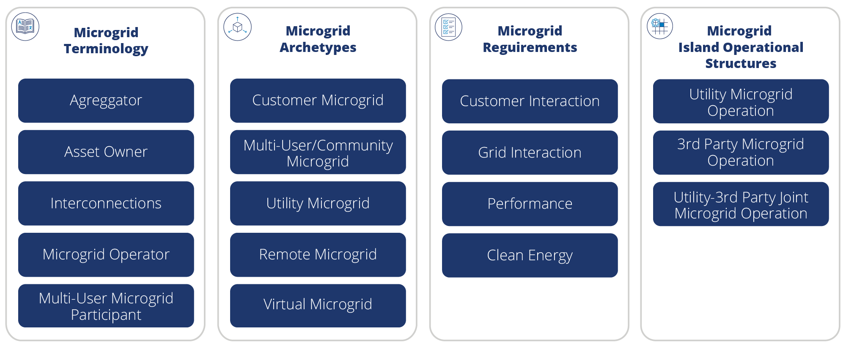
#1, Strategic Considerations
Other Considerations Necessary: RPS and Emissions Requirements, Distribution Upgrades, Purview of PUC, Community Interest, and Societal Benefits / Cross-Subsidization
Notes:
Other Considerations Necessary: Clean Energy, Distribution Upgrades,

Slide 17
Microgrid Terminology
Aggregator operates DER portfolio for others. Provides energy, ancillary and/or grid services in blue-sky normal conditions as well as during island operation.
Asset Owner owns distributed generation, storage or demand management resources, or electric infrastructure used to form and operate a microgrid.
Interconnections: two key reference points for microgrid interconnection: Point of Connection and Point of Common Coupling defined in IEEE Standard 1547-2018 and related standards such as IEEE 2030.7/8.
Microgrid Operator is an independent entity or utility customer responsible for the safe operation of a multi-user or customer microgrid consistent. May also act as aggregator for wholesale markets and utility grid services in normal blue-sky mode.
Multi-User Microgrid Participant is an entity or person that contributes to and/or uses the services provided by the microgrid.
Notes:
Aggregator operates a portfolio of distributed energy resources on behalf of others to provide energy, ancillary and/or grid services in blue-sky normal conditions as well as during island operation.
Asset Owner is an entity or person that owns distributed generation, storage or demand management resources, or electric infrastructure used to form and operate a microgrid.
Interconnections: There are two key reference points for microgrids when considering interconnection requirements and operational boundaries with the utility grid, Point of Connection and Point of Common Coupling defined in IEEE Standard 1547-2018 and related standards such as IEEE 2030.7/8.
Microgrid Operator is an independent entity or utility customer that is responsible for the safe operation of a multi-user or customer microgrid consistent with
applicable interconnection rules and any operating agreement. A microgrid operator may also act as an aggregator for the purpose of providing services from
the microgrid related DER to wholesale markets and/or utility grid services in normal blue-sky mode.
Multi-User Microgrid Participant is an entity or person that contributes to and/or uses the services provided by the microgrid.

Slide 18
Microgrid Archetypes
Customer Microgrid is an independently developed microgrid with distributed energy resources and loads wholly within a single customer’s site
Multi-User / Community Microgrid is an independently developed microgrid using a utility distribution grid to link DER with multiple specific customer loads or a community.
Utility Microgrids are usually multi-user/community scale projects. Utility takes the lead in independent development or partners with a resource provider.
Remote Microgrid is a resilient power system for a facility/campus that is not grid connected. It is an effective solution for certain circumstances but not in scope of grid-connected microgrids sought by state policies for community resilience.
Virtual Microgrid (aka Virtual Power Plant) is not able to island and so is not within scope for microgrids based on jurisdictions to date. Virtual microgrids provide blue-sky services.

Slide 19
Microgrid Archetypes
Source: Smart Electric Power Alliance and Paul DeMartini, 2020
Notes:
Slam these two together to create one graphic that shows all of it.

Slide 20
Microgrid Island Operational Structures
 | Utility Operation | 3rd Party Operation | Joint Operation
Operational Responsibility & Controls | Full utility operational responsibility and controls of distribution system and microgrid controller | Microgrid operator ownership of distribution system segment and microgrid controller. | Utility operational ownership w/ grid-side controller
Energy & Load Operations | Utility issues signals to third parties, who control the energy producing and load modifying resources (resource operator) | Microgrid operator has control. Coordinates with utility distribution operator. | Customer or third party has control when in islanded mode
Separate Resilience Contracts? | Yes for resource operator | Yes for microgrid operator | N/A
Notes:
Utility Microgrid Operation
Utility retains operational responsibility and controls for distribution system as well as microgrid controller
Utility issues dispatch signals to customer and/or third-party who has operational control of the energy producing and load modifying resources
Resource operator may have separate resilience service contracts with microgrid customers, if permitted.
3rd Party Microgrid Operation
Microgrid operator assumes the utility’s operational responsibility and controls segment of the distribution system used in the microgrid and microgrid controller.
Microgrid operator has operational control of energy producing and load modifying resources and is responsible for safe operation of the distribution system and coordinating operations and maintenance with the utility distribution operator.
Microgrid operator may have separate resilience service contracts with microgrid customers, if permitted.
Utility-3rd Party Joint Microgrid Operation
Utility retains operational responsibility and controls for distribution system employing a grid-side controller
Customer or third party (microgrid aggregator) has operational control of the energy producing rsources as well as a controller to control energy producing and demand resources when in islanded mode. They are responsible for maintaining frequency and voltage in response to signals from utility grid controller

Slide 21
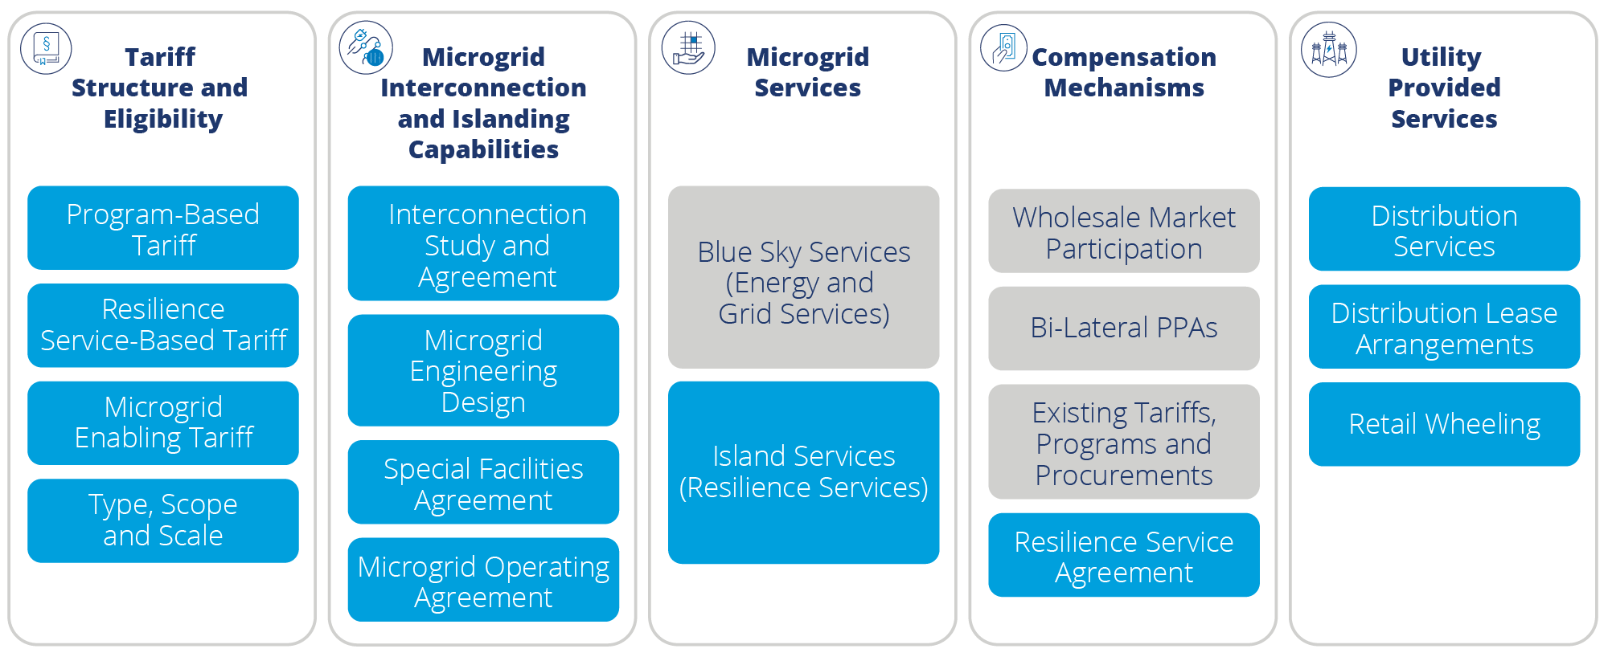
#2, Tariff Development

Slide 22
Tariff Structure
Program based-tariff designed to enable the specific elements of a microgrid enabling program that is intended to incentivize microgrid development.
Resilience service-based tariff designed to compensate a microgrid operator for providing microgrid forming service that provides frequency, voltage and other power quality services necessary to maintain electric service to customers.
Microgrid enabling tariff designed to enable the development and operation of a multi-user microgrid, but does not include any microgrid service provision or compensation.

Slide 23
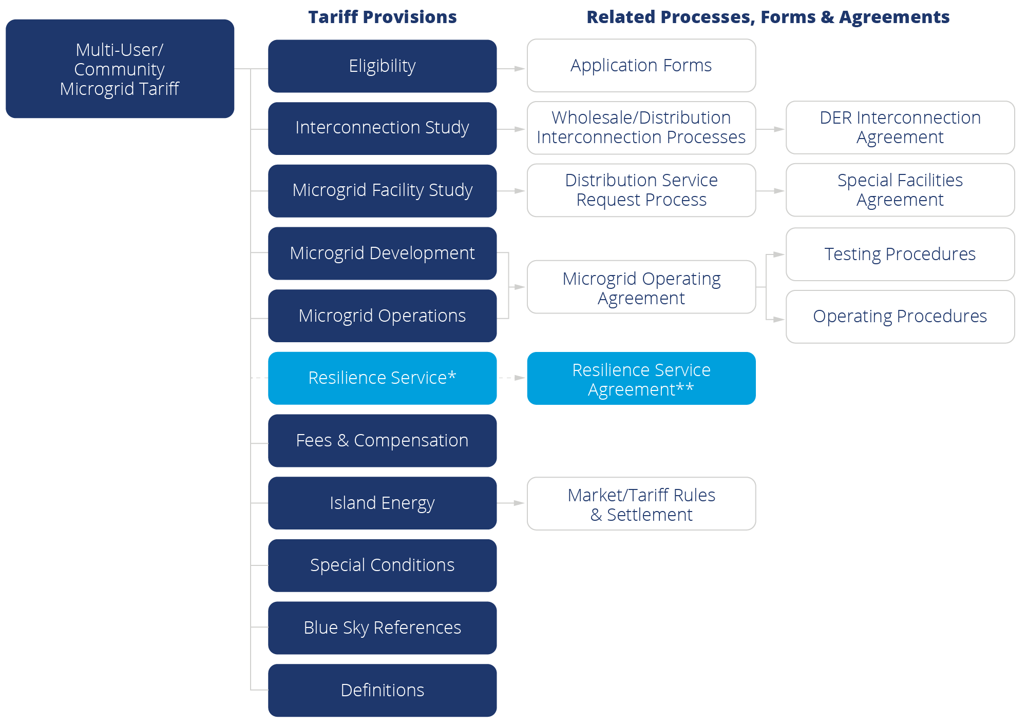
Tariff Structure
Notes:
Each tariff element (see Figure 7) should be considered in relation to existing processes, blue-sky tariffs, and pro forma agreements that may be relevant.

Slide 24
Microgrid Services and Compensation Mechanisms
Notes:
Blue sky services often involve wholesale market participation and/or bi-lateral power purchase contracts.
Island services can provide customer resilience services to customers within the microgrid boundary via separate bi-lateral service agreements outside the scope of the tariff.
Island services can also provide grid resilience services of microgrid forming services to provide societal value by the operator to the distribution utility and community and can be compensated through avoided cost, cost of service and/or avoided loss value.

Slide 25
Key Takeaways
Start with a common vocabulary for any stakeholder discussions
Begin discussions around the structured process provided by the framework to effectively engage stakeholders
Focus tariff on customer demand and commercial readiness of microgrids
Develop tariff on lifecycle of a microgrid from eligibility through commercial operations and related enabling agreements (e.g. interconnection, special facilities and operating/service agreements)
Focus tariff on island mode operations and interrelationship with existing tariffs, programs, procurements and wholesale opportunities under blue sky mode operations
Services that microgrid operator provides microgrid participants are typically not covered under a tariff and can be handled through separate contracts
Regulators will need to consider appropriate oversite of 3rd party – customer contracts
Utilities need to work across functional areas to develop a tariff

Slide 26
Download for Free
To get the full visit sepapower.org and search, “microgrid tariff design.”

Slide 27
Financing and Deploying Community Microgrids via the Resilient Energy Subscription (RES):
Lessons learned from policy in California and projects in Washington
Ben Schwartz
Policy Manager
Clean Coalition
626-232-7573 mobile
ben@clean-coalition.org
5 December 2023

Slide 28
Clean Coalition (non-profit)
Mission
To accelerate the transition to renewable energy and a modern grid through
technical, policy, and project development expertise.
Renewable Energy End-Game
100% renewable energy; 25% local, interconnected within the distribution grid and ensuring resilience without dependence on the transmission grid; and 75% remote, fully dependent on the transmission grid for serving loads.
Notes:
28

Slide 29
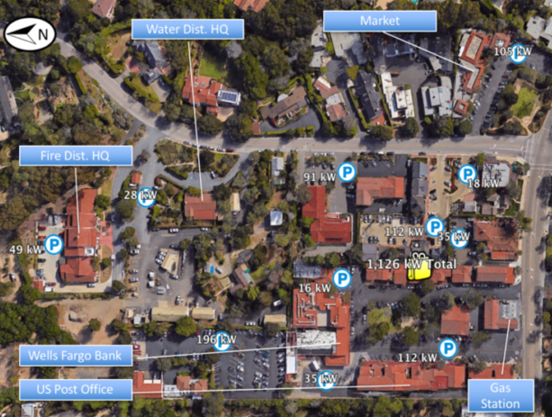
The Resilient Energy Subscription (RES) addresses three Community Microgrid financing challenges
The RES helps finance Community Microgrids while properly valuing their significant resilience benefits, addressing these three challenges:
Establishing initial Community Microgrids to provide resilience to Critical Community Facilities (CCFs).
Enhancing Community Microgrids to offer resilience opportunities within the initial Community Microgrid footprint.
Expanding Community Microgrids to larger footprints that can guarantee resilience to a wider list of facilities and include additional communities.
Critical Community Facilities (CCFs) in a Southern California community.

Slide 30
Resilient Energy Subscription (RES) defined
A straightforward fee-based market mechanism that finances the enhancement and expansion of Community Microgrids
Community Microgrids provide guaranteed daily delivery of locally generated renewable energy during grid outages, ensuring unparalleled energy resilience.
Allows any facility within the footprint of a Community Microgrid to procure this unparalleled energy resilience
A facility pays a simple monthly $/kWh fee — separate from any existing rate tariffs — on top of their normal electricity rates for guaranteed daily delivery of locally generated renewable energy during grid outages.
Usually reserved for a facility’s most critical loads.
Facilitates the deployment and expansion of Community Microgrids
Allows the Community Microgrid owner-operators to recover the cost-of-service (COS) required to meet contracted RES obligations.
COS is determined by the capital expenditures (capex) associated with Community Microgrid assets, operational expenditures (opex) associated with operations and maintenance (O&M), and an appropriate rate of return.
Notes:
In California, typical Community Microgrid assets include local solar, energy storage, and Monitoring, Communications, and Control (MC2) solutions — including BTM smart circuit panels, Advanced Metering Infrastructure (AMI, aka smart meters), and grid isolation switches. Anticipated rates of return should be bookended by standard COS calculations, which in California are about 8% for the return on equity (ROE) allowed for distribution grid infrastructure and the 12% ROE for transmission grid infrastructure. (The California Public Utilities Commission (CPUC) allows the 8% ROE for distribution grid infrastructure, and the Federal Energy Regulatory Commission (FERC) allows a 12% ROE for transmission grid infrastructure.

Slide 31
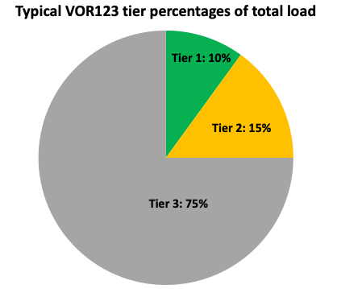
VOR123 depends on tiering electricity loads
The Clean Coalition’s VOR123 approach standardizes resilience values for three tiers of loads, regardless of facility type or location:
Tier 1, usually about 10% of the total load, are mission-critical, life-sustaining loads that warrant 100% resilience.
Tier 2, or priority loads, usually about 15% of the total load, should be maintained as long as doing so does not threaten the ability to maintain Tier 1 loads.
Tier 3 are discretionary loads that make up the remaining loads, usually about 75% of the total load. Maintained when doing so does not threaten Tier 1 & 2 resilience.

Slide 32
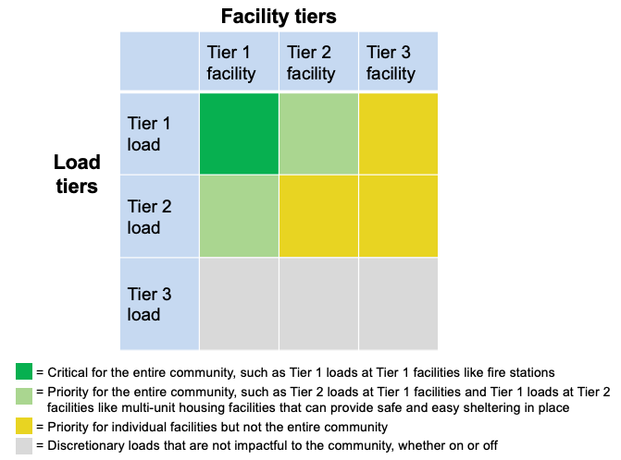
VOR123 for a Community Microgrid
The VOR123 principles for an individual facility can also be applied to a larger grid area by tiering facilities, in addition to tiering loads:
Notes:
Community Microgrids have the same solar+storage ratios as individual Solar Microgrids.
Facilities in a grid area can be tiered in a similar manner to loads, based on how critical a facility is to a community.
For Critical Community Facilities (CCFs), the Community Microgrid costs should be rate-based, on a cost-of-service basis, just like the cost of every other grid asset that serves the community at large.

Slide 33
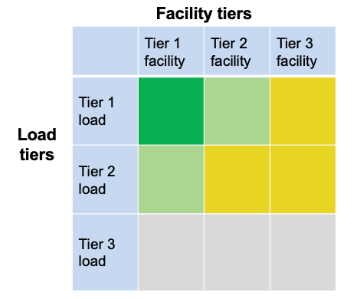
VOR123 for a Community Microgrid
The top emphasis is to provision 100% resilience for Tier 1 loads at Tier 1 facilities (the darker green square in the chart).
Tier 1 facilities include CCFs such as fire stations and emergency shelters — and can also include grocery stores, data centers, pharmacies, gas stations, EV charging stations, & apartment complexes that can provide sheltering-in-place during grid outages.
The second emphasis is for Tier 1 loads at Tier 2 facilities and Tier 2 loads at Tier 1 facilities (the lighter green squares).
= Critical for the entire community, such as Tier 1 loads at Tier 1 facilities like fire stations
= Priority for the entire community, such as Tier 2 loads at Tier 1 facilities and Tier 1 loads at Tier 2 facilities like multi- unit housing facilities that can provide safe and easy sheltering in place
= Priority for individual facilities but not the entire community
= Discretionary loads that are not impactful to the community, whether on or off

Slide 34
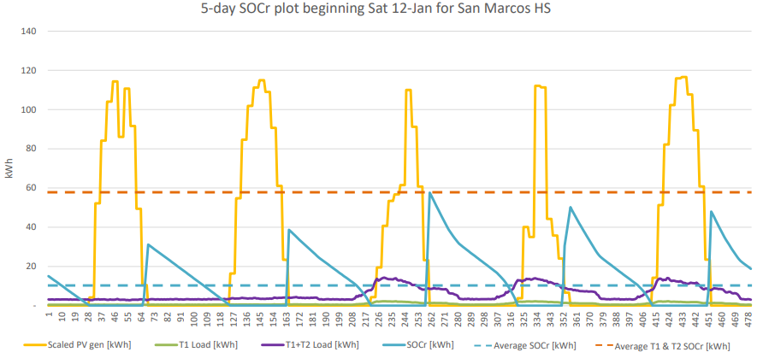
RES feasibility: Community Microgrid owner-operator perspective
ROE for the Community Microgrid owner depends on the following factors:
Microgrid financial inflows:
RES fees*
Energy sold to the utility on an everyday basis
Solar and battery energy storage system (BESS) financial incentives
Microgrid financial outflows:
Microgrid capital expenditures (capex)
Microgrid operational expenditures (opex)
* Income from RES fees depends on the maximum guaranteed daily energy from the Community Microgrid. The Clean Coalition calculates this quantity using its state-of-charge for resilience (SOCr) methodology, which analyzes BESS capacity against actual solar generation and site load profiles.

Slide 35
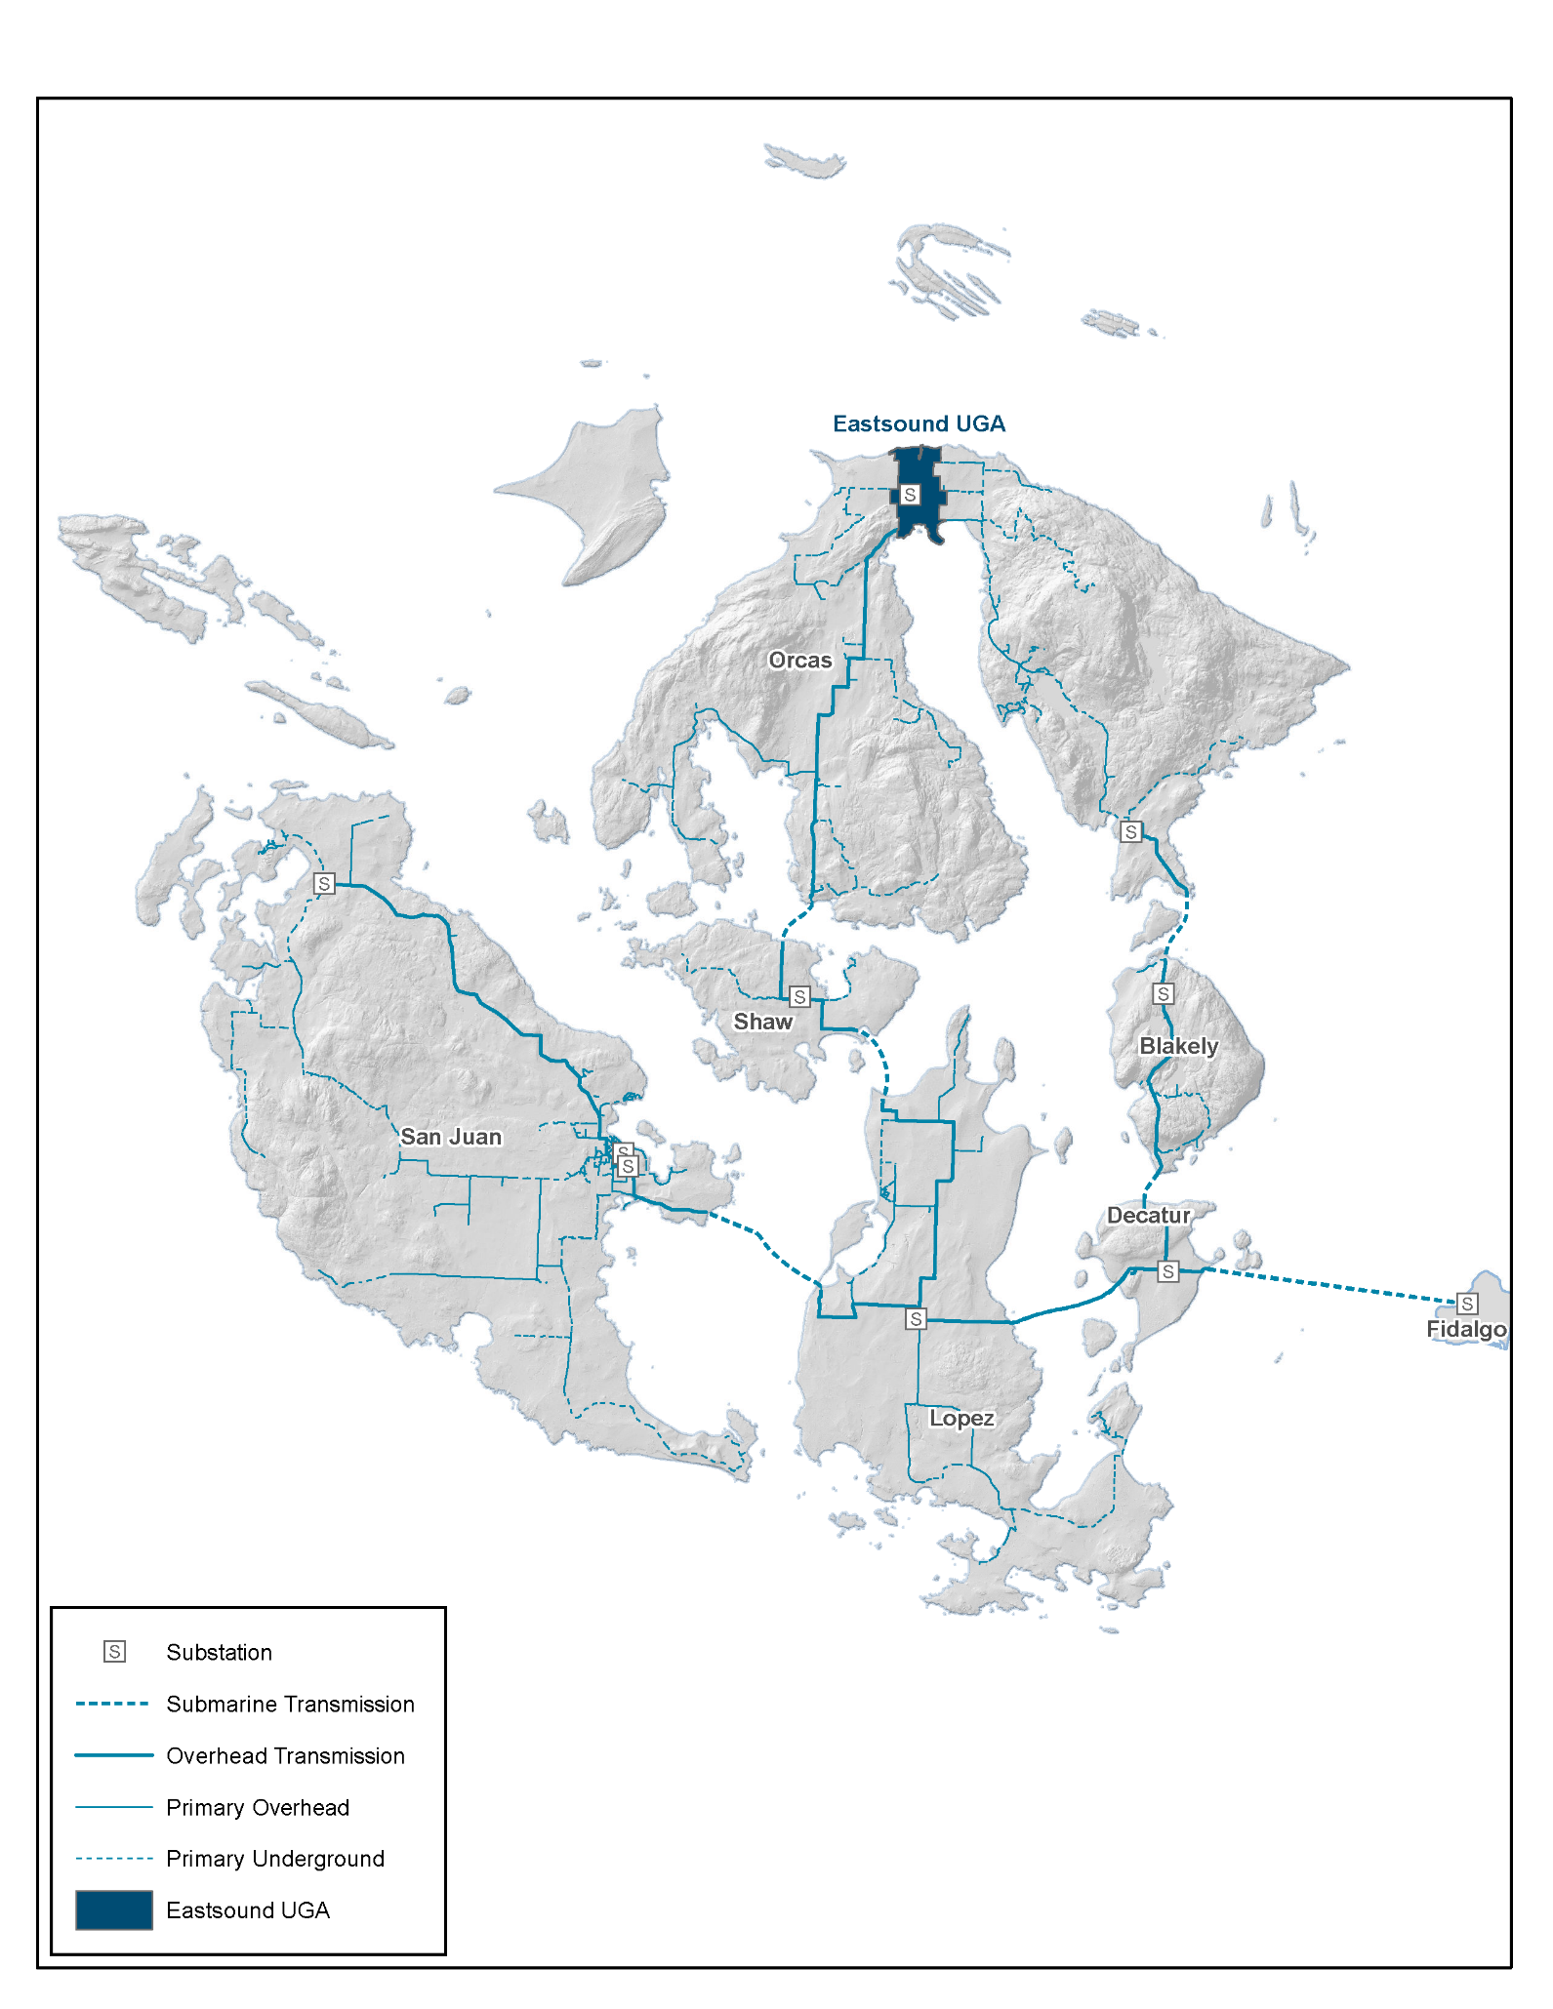
Grand Orcas Community Microgrid plan for the entire OPALCO territory
Figure 1: OPALCO’s service territory covers San Juan County and includes 20 islands. Eastsound is shaded towards the top of Orcas Island and represents the initial Orcas Community Microgrid location. Over time, the Community Microgrid will expand to cover all of Orcas and then eventually the entire OPALCO service territory.

Slide 36
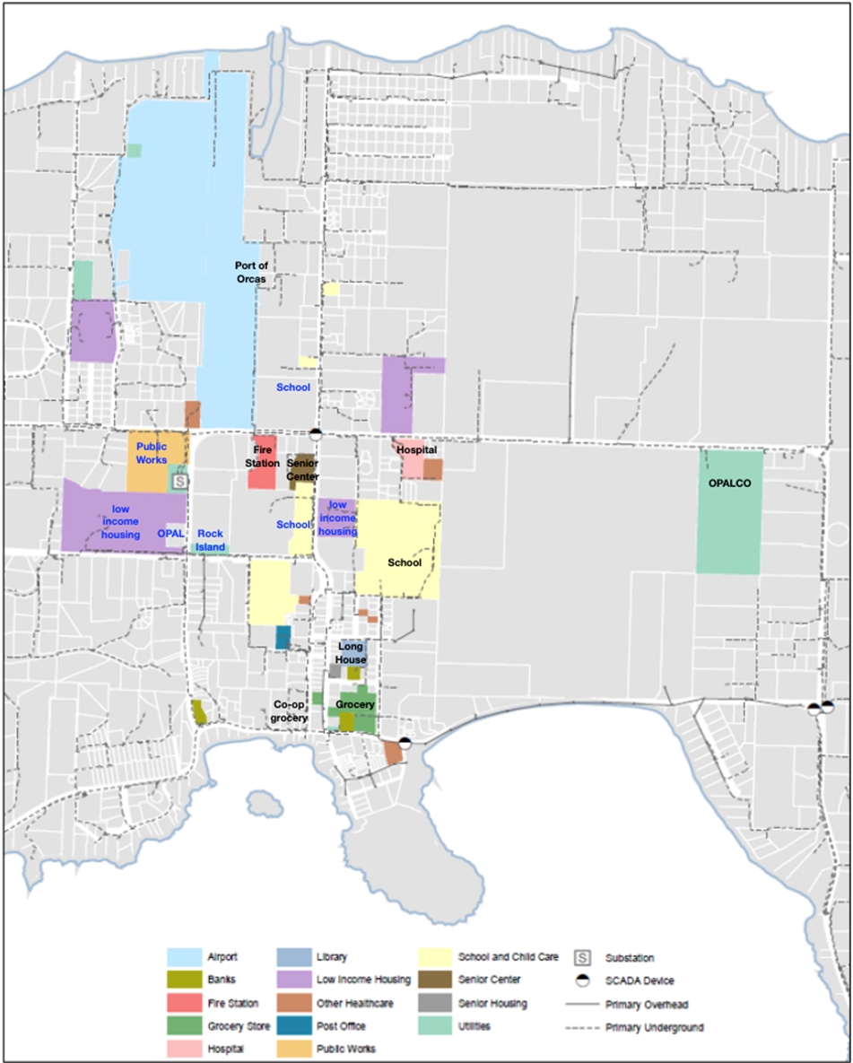
Eastsound Tier 1 & 2 facilities map
Figure 2: Eastsound facilities that are being provisioned with priority Community Microgrid resilience in the initial Orcas Community Microgrid design are shaded. Tier 1 Critical Community Facilities (CCFs) are shaded and labeled with black text, while Tier 2 CCFs are shaded in blue text. Figures 3 and 4 further depict the initial Orcas Community Microgrid in block diagram form.

Slide 37
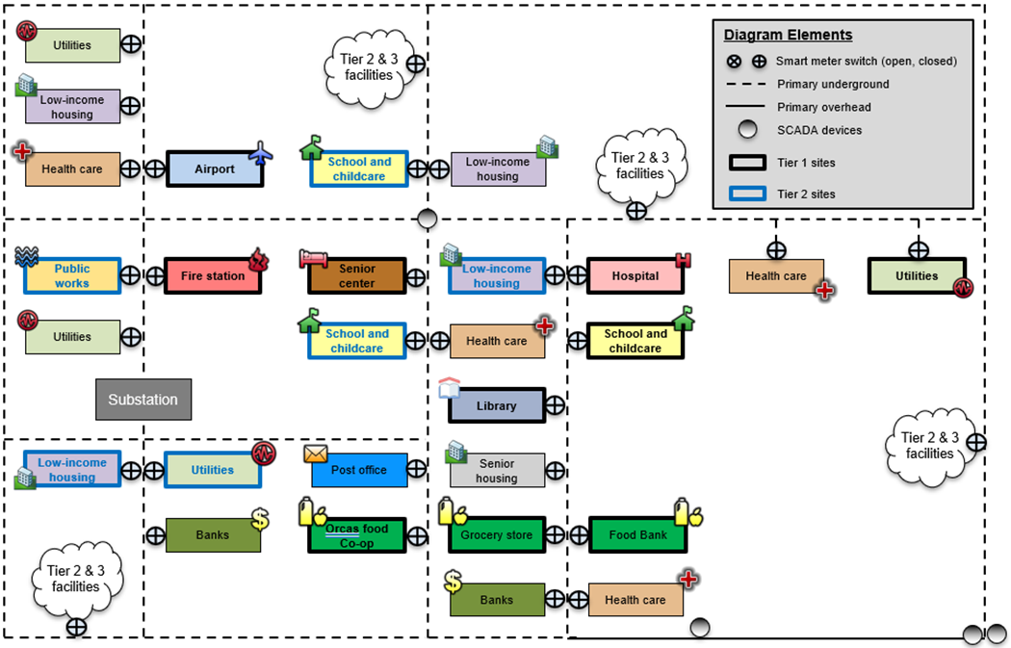
Eastsound Tier 1 & 2 facilities block diagram
Figure 3: Noteworthy facilities in Eastsound and within the target grid area of the initial Orcas Community Microgrid. This figure reflects the block diagram version of the grid area shown in Figure 2.

Slide 38
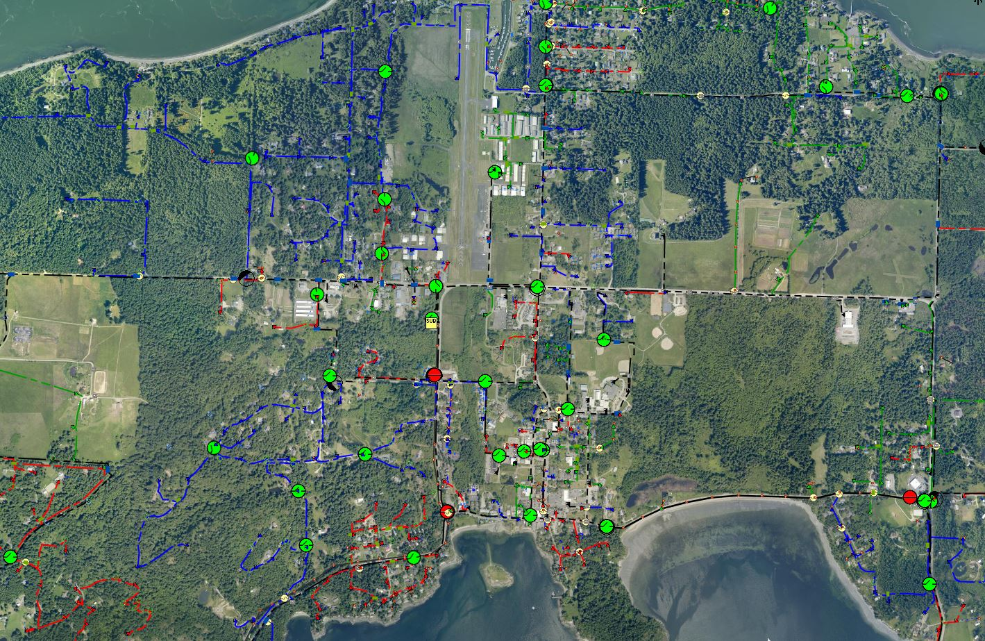
OCM map for Orcas Island
Feeder (A phase)
Feeder (B phase)
Feeder (C phase)
Underground feeder (Three phase)
Overhead feeder (Three phase)
Manual existing grid switches (open)
Manual existing grid switches (closed)
Microgrid area
Eastsound Substation
OPALCO headquarters
2.7 MWh battery (primary location)
New 1-phase GIS
New 3-phase GIS
Upgraded 3-phase GIS
Existing 69 kV transmission
1 MW biopower facility
1 MW Biopower facility

Slide 39
RES feasibility: Community Microgrid owner-operator perspective
Analysis factors from a 2021 design for a Community Microgrid in Southern California:
Microgrid financial outflows: Microgrid financial Inflows:
 | Year: | Capex | Opex |  |  | RES fees |  |  | Sales to utility
PV |  | $3,000,000 | $7,000
BESS |  | $1,400,000 | $5,000 |  | RES fee ($/kWh) | $0.20 |  | Tariff to utility | $0.10
Microgrid hardware + MC2 |  | $500,000 | $15,000 |  | Guaranteed daily load (kWh) | 2,300 |  | Annual PV sold (kWh) | 2,400,000
PV+BESS incentives |  | -$1,800,000
Total annual expense: | 1 | $3,100,000 | $27,000 |  | Total annual income: | $165,000 |  |  | $236,000
 | 2 | $- | $27,000 |  |  | $165,000 |  |  | $236,000
 | 3 | $- | $27,000 |  |  | $165,000 |  |  | $236,000
 | 4 | $- | $27,000 |  |  | $165,000 |  |  | $236,000
30-year analysis
With these expenses and income, the Community Microgrid owner will see an internal rate of return (IRR) of at least 9%.

Slide 40
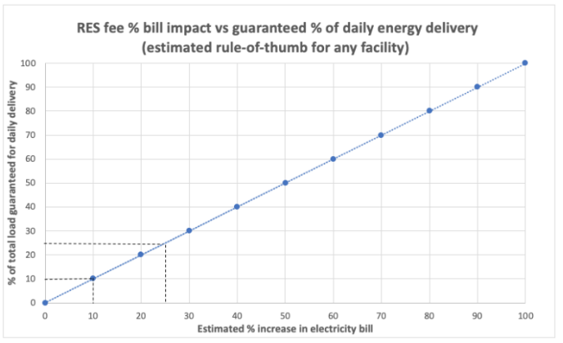
RES feasibility analysis results
The Clean Coalition’s analysis shows:
A value-appropriate RES subscription ratio of 1.0 (1% bill increase per 1% guaranteed load coverage) for the subscriber is feasible.
A positive IRR of 9% for the Community Microgrid owner is feasible.
Therefore, the RES is financially feasible for all stakeholders.
Key Takeaways:
RES allows Community Microgrids to be deployed at scale and expanded, as more facilities desire resilient energy guarantees.
RES provides a revolutionary and straightforward approach for financing Community Microgrids and delivering unparalleled resilience to communities.
RES enables a greater harmonization between local energy needs and societal planning in a way that helps put the people first.

Slide 41
Backup Slides
Backup Slides

Slide 42
Percentage of time online for Tier 1, 2, and 3 loads for a Solar Microgrid designed for the University of California Santa Barbara (UCSB) with enough solar to achieve net zero and 200 kWh of energy storage per 100 of kW solar.
Typical load tier resilience from a Solar Microgrid
Percentage of total load
Tier 3 = Discretionary load, ~75% of total load
Tier 2 = Priority load, ~15% of total load
Tier 1 = Critical, life-sustaining load, ~10% of total load
Percentage of time

Slide 43
A typical diesel generator is configured to maintain 25% of the normal load for two days. If diesel fuel cannot be resupplied within two days, goodbye. This is hardly a solution for increasingly necessary long-term resilience. In California, Solar Microgrids provide a vastly superior trifecta of economic, environmental, and resilience benefits.
Diesel generators are designed for limited resilience
Percentage of total load
Tier 3 = Discretionary load, ~75% of total load
Tier 2 = Priority load, ~15% of total load
Tier 1 = Critical, life-sustaining load, ~10% of total load
Percentage of time

Slide 44
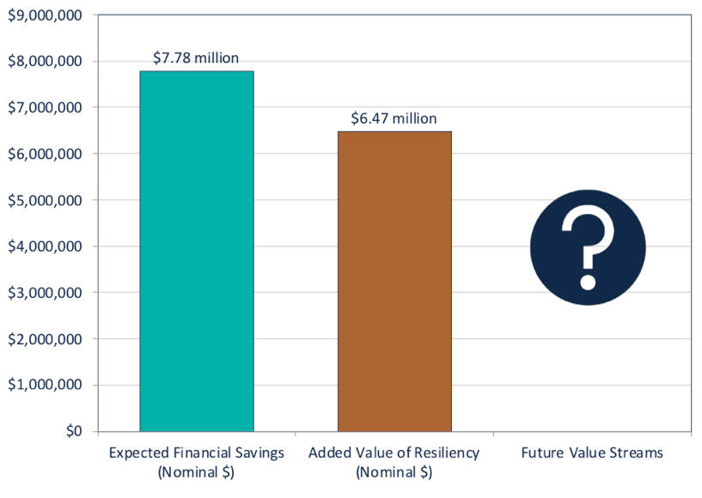
VOR123 yields a 25% typical adder
Based on this tiering system, the Clean Coalition arrived at 25% as the typical VOR123 adder that a site should be willing to pay for resilience.
The Clean Coalition has validated the 25% adder using four approaches: Cost-of-service, Department of Energy multiplier, market-based, and avoided diesel generator cost (see https://clean-coalition.org/disaster-resilience/#adder).
We also applied VOR123 to the Solar Microgrids for the Santa Barbara Unified School District (SBUSD), which is getting significant resilience benefits for free:
Bill savings and resilience value accruing to the SBUSD from six Solar Microgrid sites plus eight additional solar-only sites.

Slide 45
COS for expanding a Community Microgrid via RES
Once an initial Community Microgrid is established for serving the CCFs, incremental COS will be low for expanding the Community Microgrid via the market-based RES.
Each 1% of load that a facility secures via a RES will result in an approximately 1% electricity bill increase:

Slide 46
RES feasibility: Community Microgrid owner perspective
Analysis factors from a real-world design for a Community Microgrid in Southern California:
Factor | Amount | Units
RES fee | 0.20 | $/kWh
Tariff for energy sold to utility | 0.10 | $/kWh
Daily site load guaranteed by RES | 2,300 | kWh
PV+BESS financial incentives | 1,800,000 | $
PV size | 1,500 | kW
PV capex | 3,000,000 | $
BESS size | 2,000 | kWh
BESS capex | 1,400,000 | $
Microgrid hardware + MC2* | 500,000 | $
PV annual opex | 7,000 | $/year
BESS annual opex | 5,000 | $/year
Microgrid MC2 annual opex | 15,000 | $/year
* MC2 = Monitoring, Communications, and Controls for a microgrid.

Slide 47
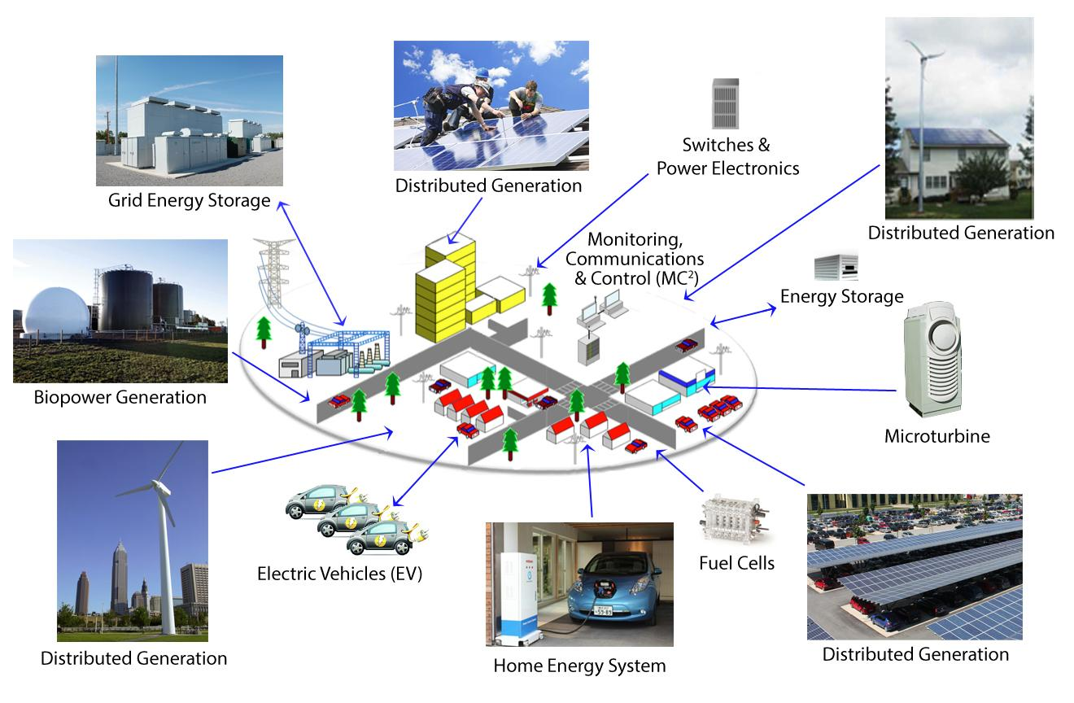
Heading
Notes:
47

Slide 48
Solar Energy Multi-Facility Microgrids: Puerto Rico experience
Dec 5, 2023

Slide 50
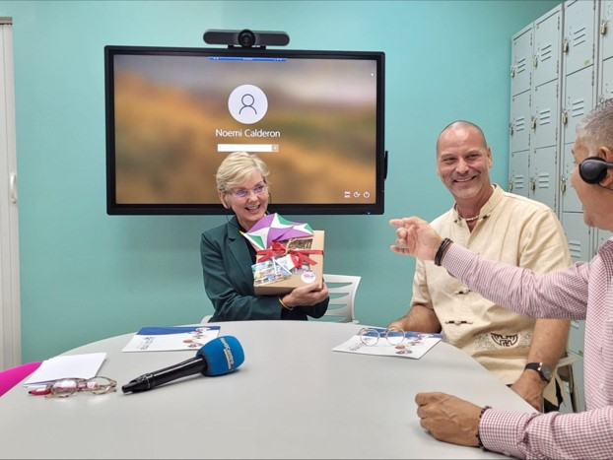
IREC in Puerto Rico
.

Slide 51
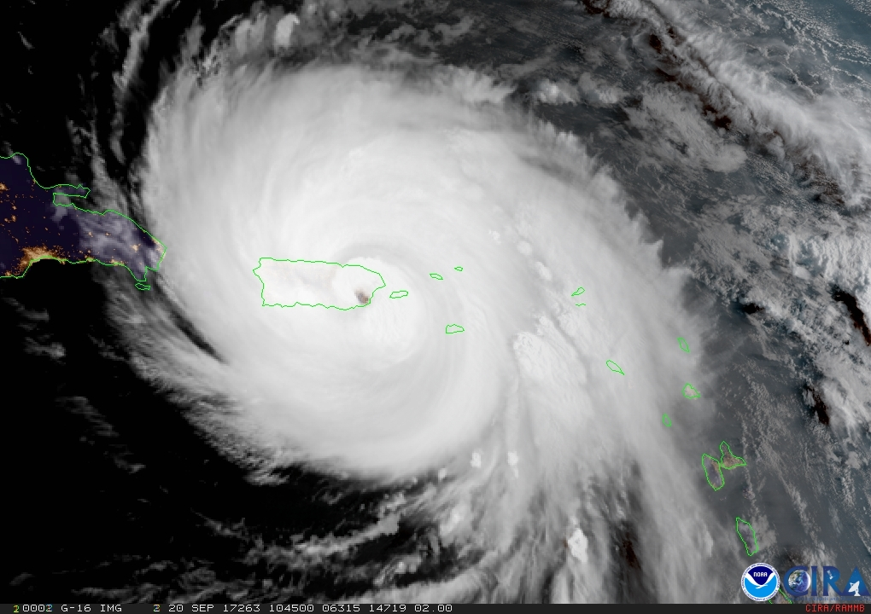

Slide 52
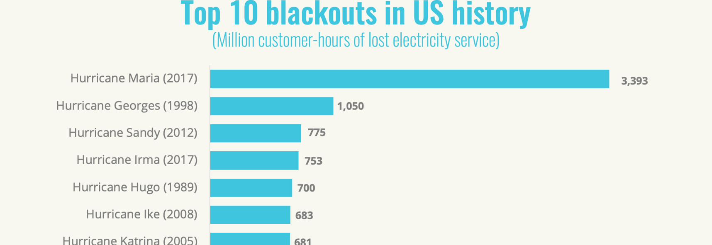
Longest electrical outage in U.S. history

Slide 53
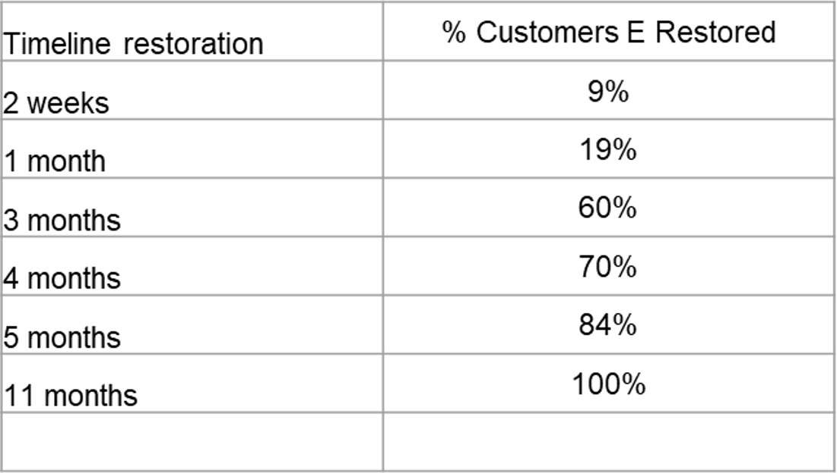
% households without power

Slide 54
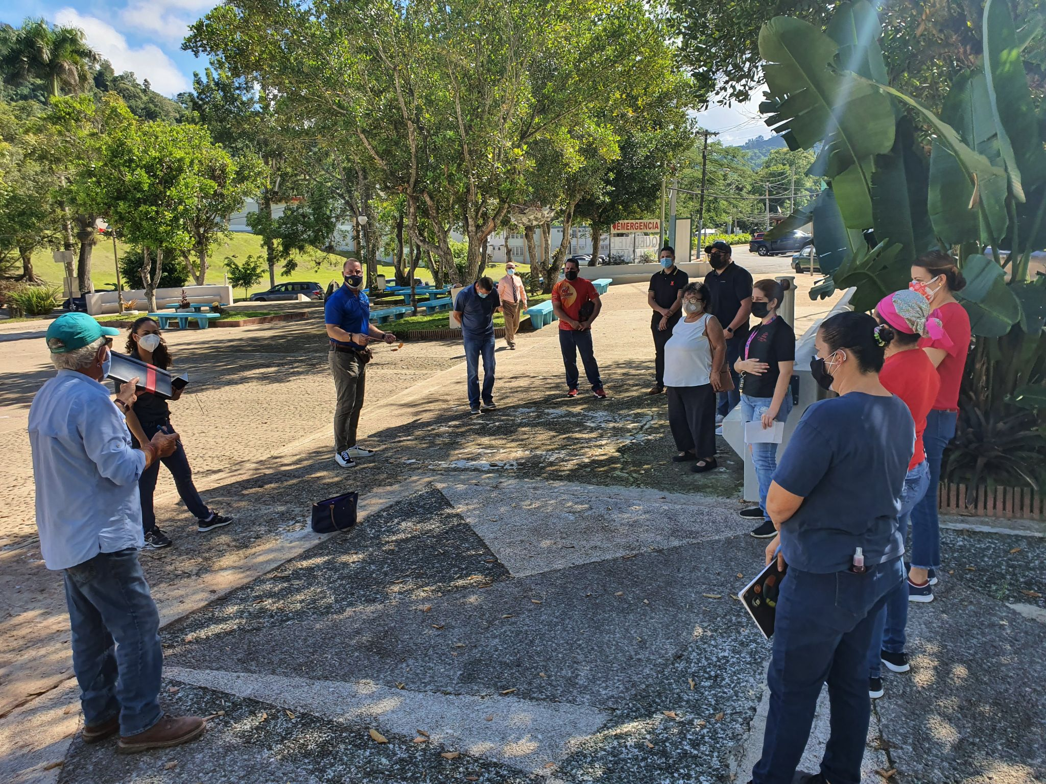

Slide 55
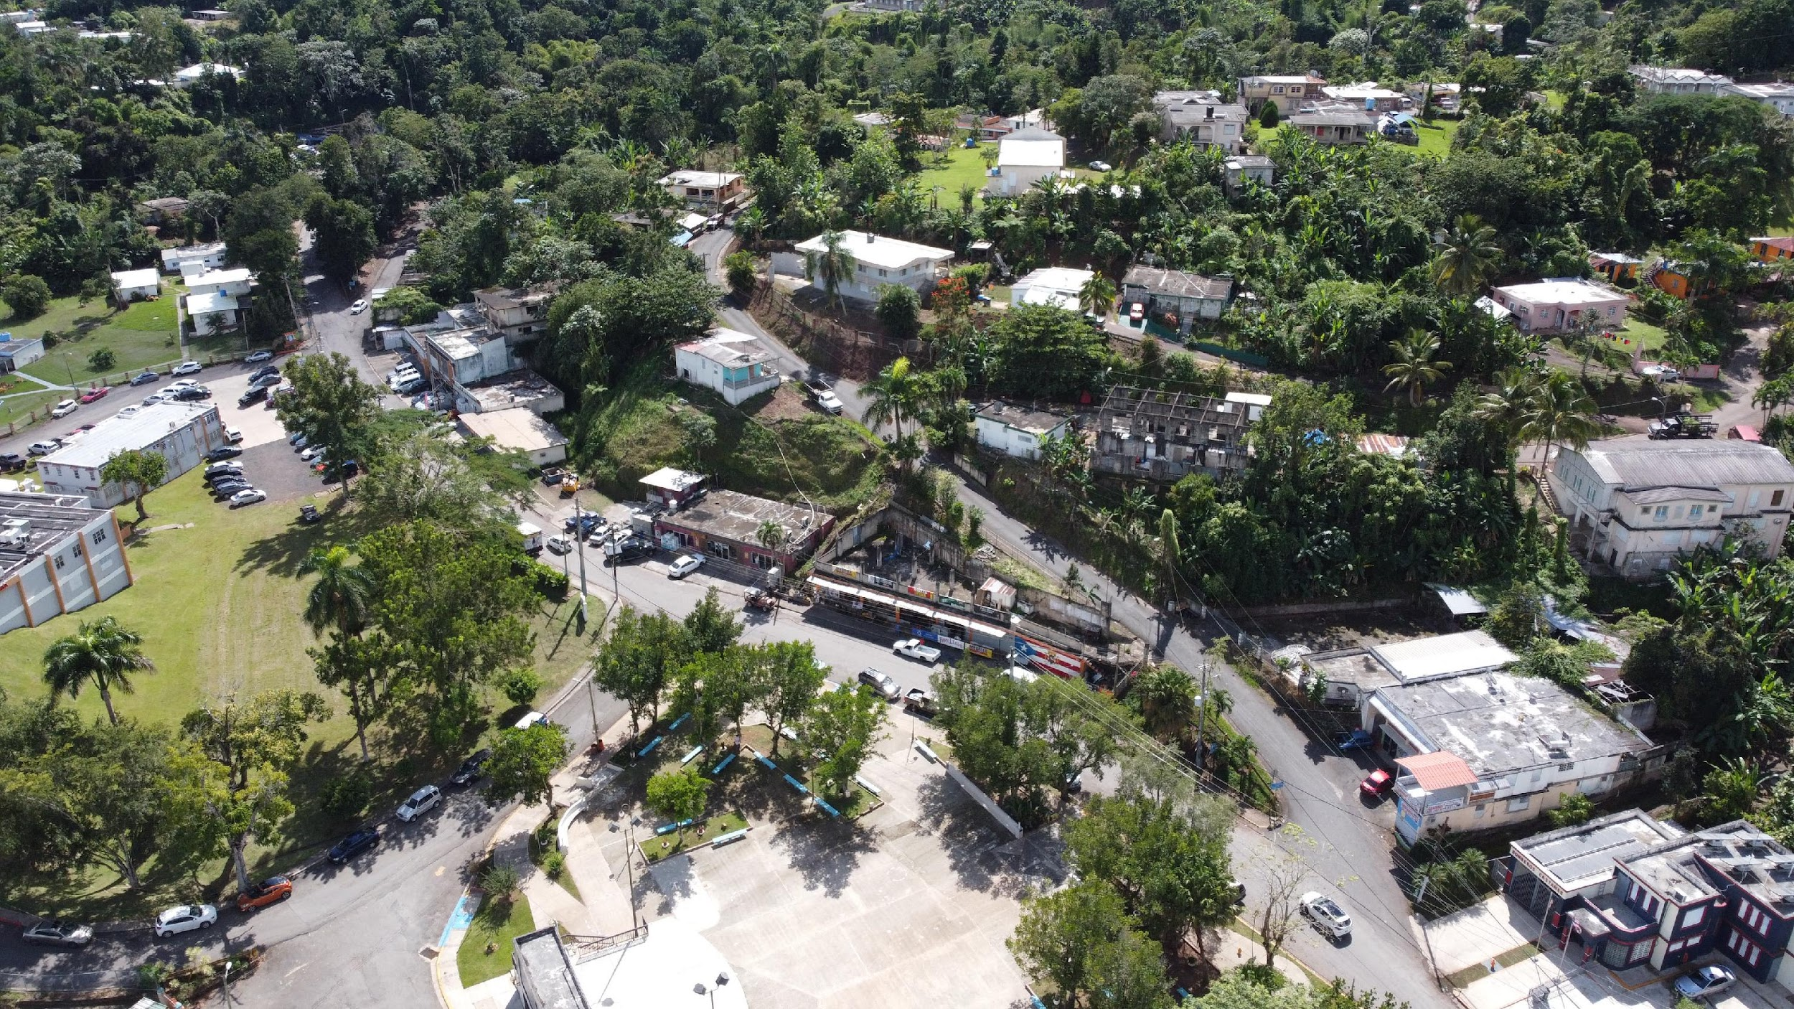

Slide 56
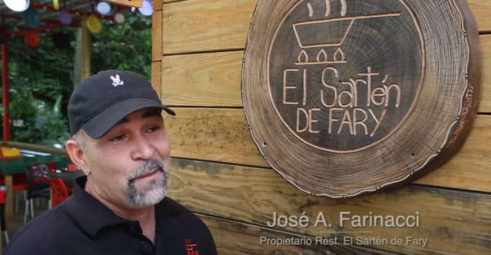
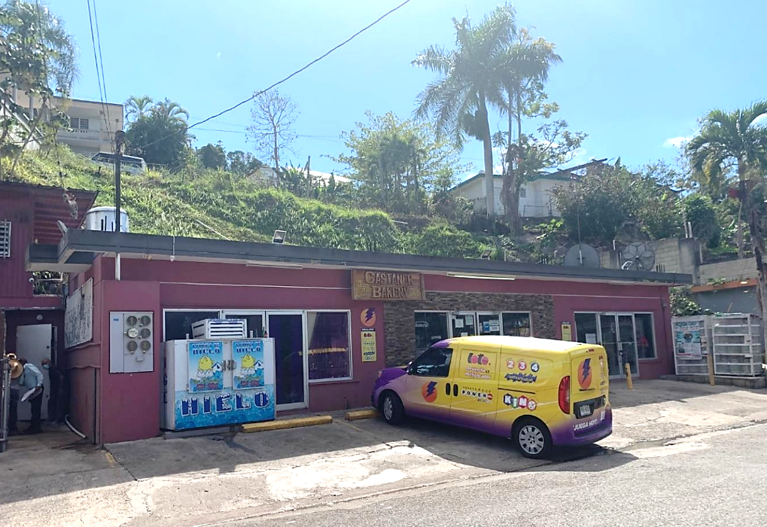
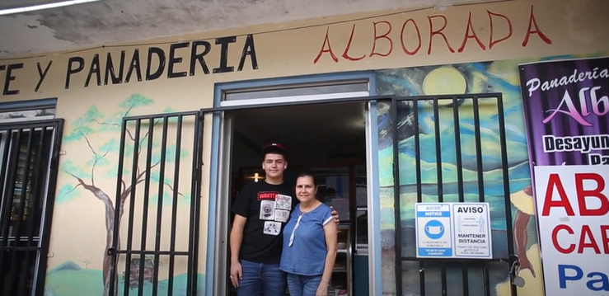

Slide 57
Castañer Project Details
 | Phase 1 | Total Project
Customers | 6 | 10
Number of interconnections | 2 | 3
PV Capacity | 56 kW | 120 kW
Storage Capacity | 127 kWh | 259 kWh

Slide 58
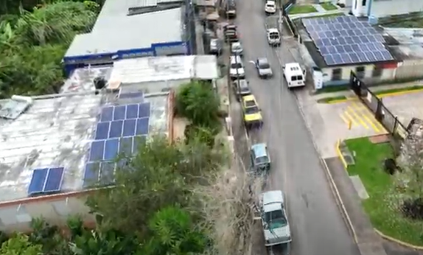

Slide 59
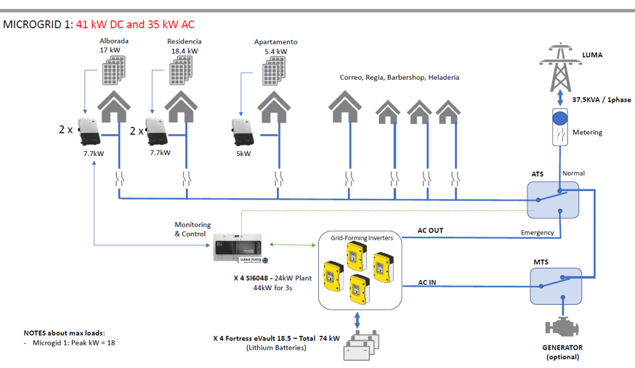

Slide 60
Interconnection of Castañer MG
At the time the MG was commissioned LUMA did not have a procedure in place to interconnect a multiple facility microgrids
Provisional approval was granted via email
Electronic portal for project submittal did not have corresponding screens to input the project 7 physical structures, so a parallel process was created by LUMA to input by email.
Interconnection dept formed a team to handle this project specifically
As of 6 Dec 2022, LUMA has all the necessary documents and the project is under review for final approval and/or determination of some distribution system upgrade before granting Net Metering

Slide 61
Multi-Facility Interconnection: The Need for Island-Wide Regulation
Final Microgrid Regulation approved by the Puerto Rico Energy Commission in 2018
PREPA was ordered to develop a regulation to govern the interconnection of multi-facility microgrid systems. Neither PREPA nor its successor, LUMA, has done so.
PREB has taken up again MG regulation, via Resolution, and is currently in the process comment period to revise the MG regulation

Slide 62
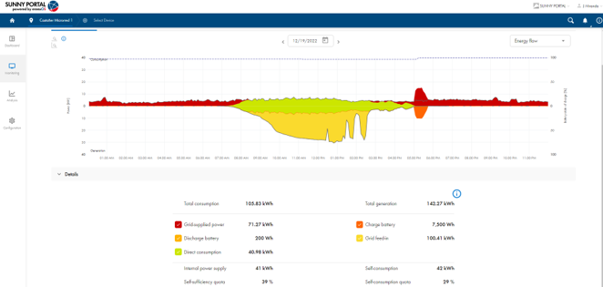
Blue Sky day, without Net Metering a substantial loss of kwh

Slide 63
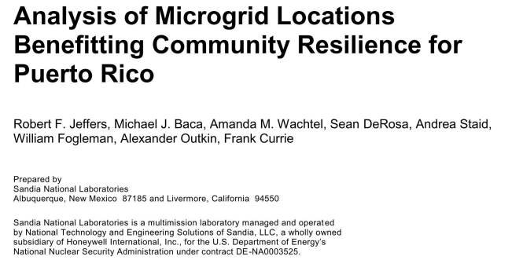
Microgrids: From community bootstrap to institutional - A key part of Puerto Rico’s Energy Future
The PR-100 report established that distributed generation and storage microgrids are important and beneficial components of the electrical grid.

Slide 64
64
Stay in the loop!
Follow us
Interstate Renewable Energy Council (IREC)
Interstate Renewable Energy Council (IREC)
@IRECUSA
@irec_usa
Contact Us: CarlosV@irecusa.org

Slide 65
65
Stay in the loop!
Follow us
Interstate Renewable Energy Council (IREC)
Interstate Renewable Energy Council (IREC)
@IRECUSA
@irec_usa
Contact Us: CarlosV@irecusa.org

Slide 66
Questions and discussion
Lee Shaver
Senior Energy Engineer
Jared Leader
Senior Director, Resilience
Ben Schwartz
Policy Manager
Carlos Alberto Velazquez
Slipstream
lshaver@slipstreaminc.org
SEPA
jleader@sepapower.org
Clean Coalition
ben@clean-coalition.org
Program Director
IREC
carlosv@irecusa.org

