Slide 1
Financing and Deploying Community Microgrids via the Resilient Energy Subscription (RES):
Lessons learned from policy in California and projects in Washington
Ben Schwartz
Policy Manager
Clean Coalition
626-232-7573 mobile
ben@clean-coalition.org
5 December 2023

Slide 2
Clean Coalition (non-profit)
Mission
To accelerate the transition to renewable energy and a modern grid through
technical, policy, and project development expertise.
Renewable Energy End-Game
100% renewable energy; 25% local, interconnected within the distribution grid and ensuring resilience without dependence on the transmission grid; and 75% remote, fully dependent on the transmission grid for serving loads.
Notes:
2

Slide 3
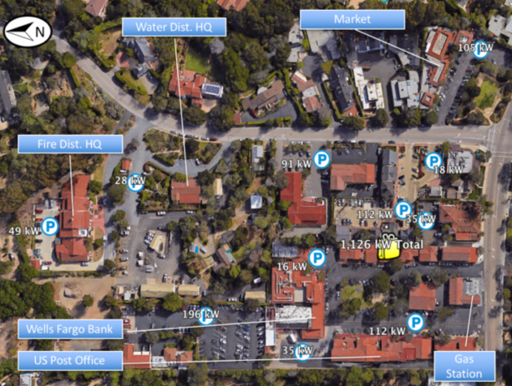
The Resilient Energy Subscription (RES) addresses three Community Microgrid financing challenges
The RES helps finance Community Microgrids while properly valuing their significant resilience benefits, addressing these three challenges:
Establishing initial Community Microgrids to provide resilience to Critical Community Facilities (CCFs).
Enhancing Community Microgrids to offer resilience opportunities within the initial Community Microgrid footprint.
Expanding Community Microgrids to larger footprints that can guarantee resilience to a wider list of facilities and include additional communities.
Critical Community Facilities (CCFs) in a Southern California community.

Slide 4
Resilient Energy Subscription (RES) defined
A straightforward fee-based market mechanism that finances the enhancement and expansion of Community Microgrids
Community Microgrids provide guaranteed daily delivery of locally generated renewable energy during grid outages, ensuring unparalleled energy resilience.
Allows any facility within the footprint of a Community Microgrid to procure this unparalleled energy resilience
A facility pays a simple monthly $/kWh fee — separate from any existing rate tariffs — on top of their normal electricity rates for guaranteed daily delivery of locally generated renewable energy during grid outages.
Usually reserved for a facility’s most critical loads.
Facilitates the deployment and expansion of Community Microgrids
Allows the Community Microgrid owner-operators to recover the cost-of-service (COS) required to meet contracted RES obligations.
COS is determined by the capital expenditures (capex) associated with Community Microgrid assets, operational expenditures (opex) associated with operations and maintenance (O&M), and an appropriate rate of return.
Notes:
In California, typical Community Microgrid assets include local solar, energy storage, and Monitoring, Communications, and Control (MC2) solutions — including BTM smart circuit panels, Advanced Metering Infrastructure (AMI, aka smart meters), and grid isolation switches. Anticipated rates of return should be bookended by standard COS calculations, which in California are about 8% for the return on equity (ROE) allowed for distribution grid infrastructure and the 12% ROE for transmission grid infrastructure. (The California Public Utilities Commission (CPUC) allows the 8% ROE for distribution grid infrastructure, and the Federal Energy Regulatory Commission (FERC) allows a 12% ROE for transmission grid infrastructure.

Slide 5
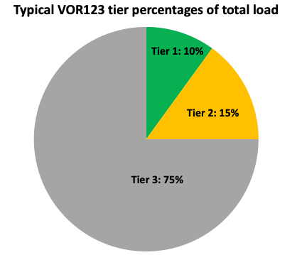
VOR123 depends on tiering electricity loads
The Clean Coalition’s VOR123 approach standardizes resilience values for three tiers of loads, regardless of facility type or location:
Tier 1, usually about 10% of the total load, are mission-critical, life-sustaining loads that warrant 100% resilience.
Tier 2, or priority loads, usually about 15% of the total load, should be maintained as long as doing so does not threaten the ability to maintain Tier 1 loads.
Tier 3 are discretionary loads that make up the remaining loads, usually about 75% of the total load. Maintained when doing so does not threaten Tier 1 & 2 resilience.

Slide 6
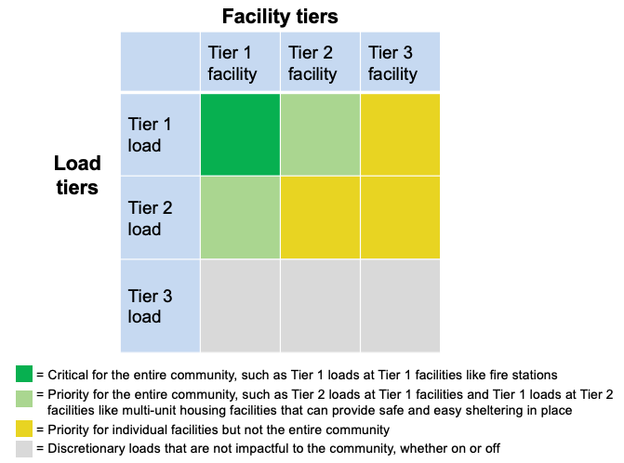
VOR123 for a Community Microgrid
The VOR123 principles for an individual facility can also be applied to a larger grid area by tiering facilities, in addition to tiering loads:
Notes:
Community Microgrids have the same solar+storage ratios as individual Solar Microgrids.
Facilities in a grid area can be tiered in a similar manner to loads, based on how critical a facility is to a community.
For Critical Community Facilities (CCFs), the Community Microgrid costs should be rate-based, on a cost-of-service basis, just like the cost of every other grid asset that serves the community at large.

Slide 7
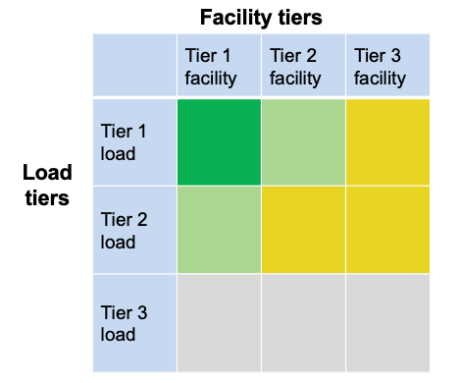
VOR123 for a Community Microgrid
The top emphasis is to provision 100% resilience for Tier 1 loads at Tier 1 facilities (the darker green square in the chart).
Tier 1 facilities include CCFs such as fire stations and emergency shelters — and can also include grocery stores, data centers, pharmacies, gas stations, EV charging stations, & apartment complexes that can provide sheltering-in-place during grid outages.
The second emphasis is for Tier 1 loads at Tier 2 facilities and Tier 2 loads at Tier 1 facilities (the lighter green squares).
= Critical for the entire community, such as Tier 1 loads at Tier 1 facilities like fire stations
= Priority for the entire community, such as Tier 2 loads at Tier 1 facilities and Tier 1 loads at Tier 2 facilities like multi- unit housing facilities that can provide safe and easy sheltering in place
= Priority for individual facilities but not the entire community
= Discretionary loads that are not impactful to the community, whether on or off

Slide 8
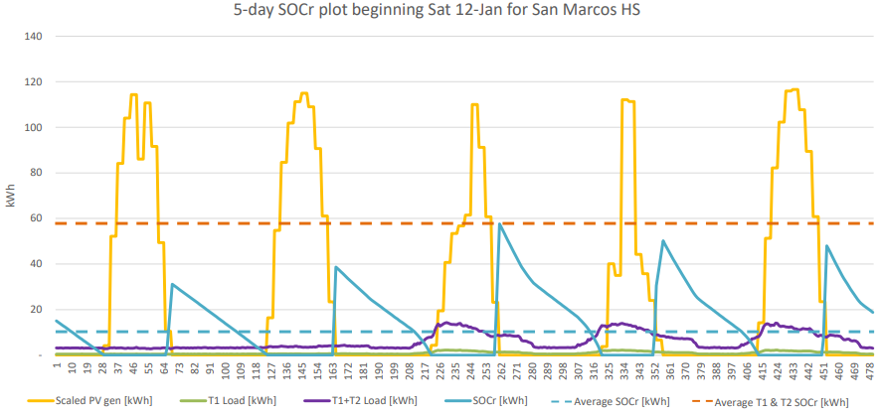
RES feasibility: Community Microgrid owner-operator perspective
ROE for the Community Microgrid owner depends on the following factors:
Microgrid financial inflows:
RES fees*
Energy sold to the utility on an everyday basis
Solar and battery energy storage system (BESS) financial incentives
Microgrid financial outflows:
Microgrid capital expenditures (capex)
Microgrid operational expenditures (opex)
* Income from RES fees depends on the maximum guaranteed daily energy from the Community Microgrid. The Clean Coalition calculates this quantity using its state-of-charge for resilience (SOCr) methodology, which analyzes BESS capacity against actual solar generation and site load profiles.

Slide 9
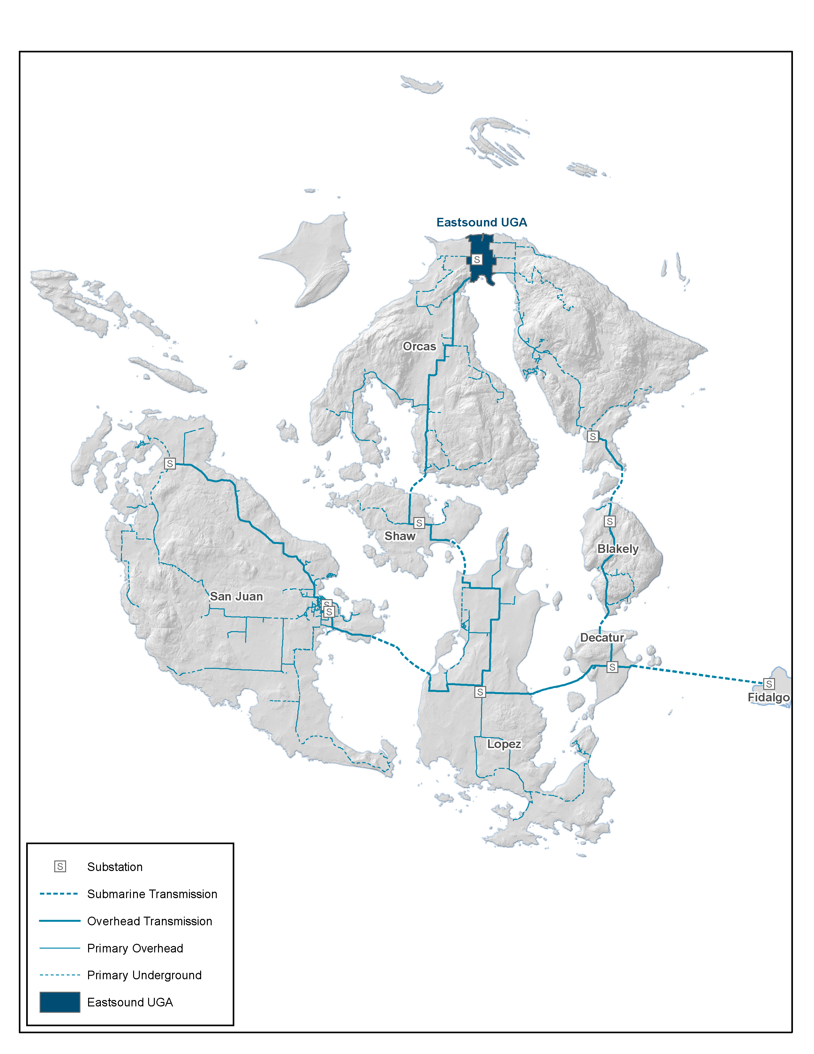
Grand Orcas Community Microgrid plan for the entire OPALCO territory
Figure 1: OPALCO’s service territory covers San Juan County and includes 20 islands. Eastsound is shaded towards the top of Orcas Island and represents the initial Orcas Community Microgrid location. Over time, the Community Microgrid will expand to cover all of Orcas and then eventually the entire OPALCO service territory.

Slide 10
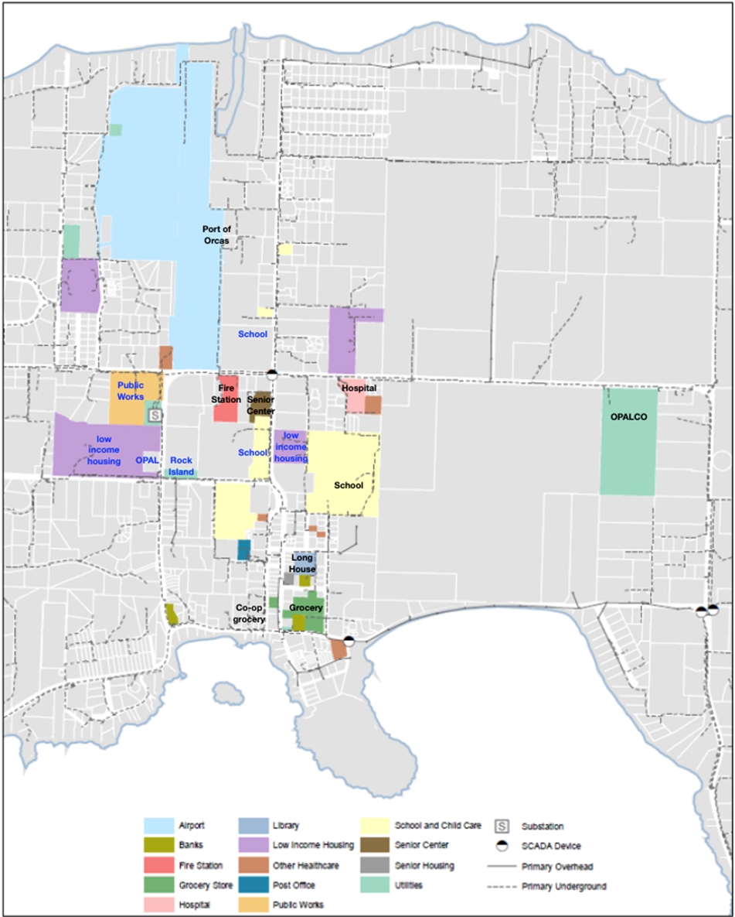
Eastsound Tier 1 & 2 facilities map
Figure 2: Eastsound facilities that are being provisioned with priority Community Microgrid resilience in the initial Orcas Community Microgrid design are shaded. Tier 1 Critical Community Facilities (CCFs) are shaded and labeled with black text, while Tier 2 CCFs are shaded in blue text. Figures 3 and 4 further depict the initial Orcas Community Microgrid in block diagram form.

Slide 11
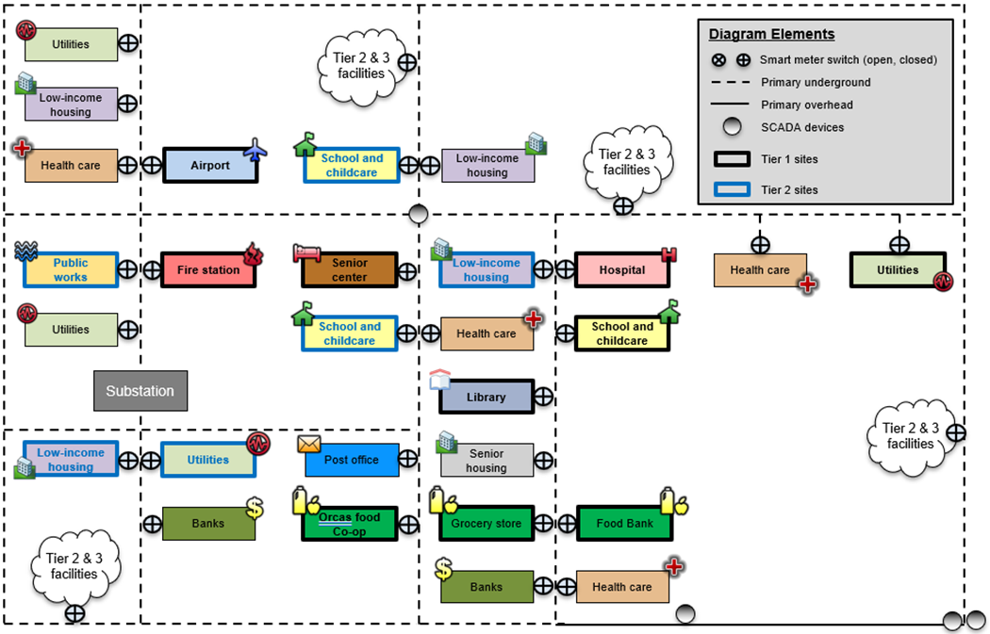
Eastsound Tier 1 & 2 facilities block diagram
Figure 3: Noteworthy facilities in Eastsound and within the target grid area of the initial Orcas Community Microgrid. This figure reflects the block diagram version of the grid area shown in Figure 2.

Slide 12
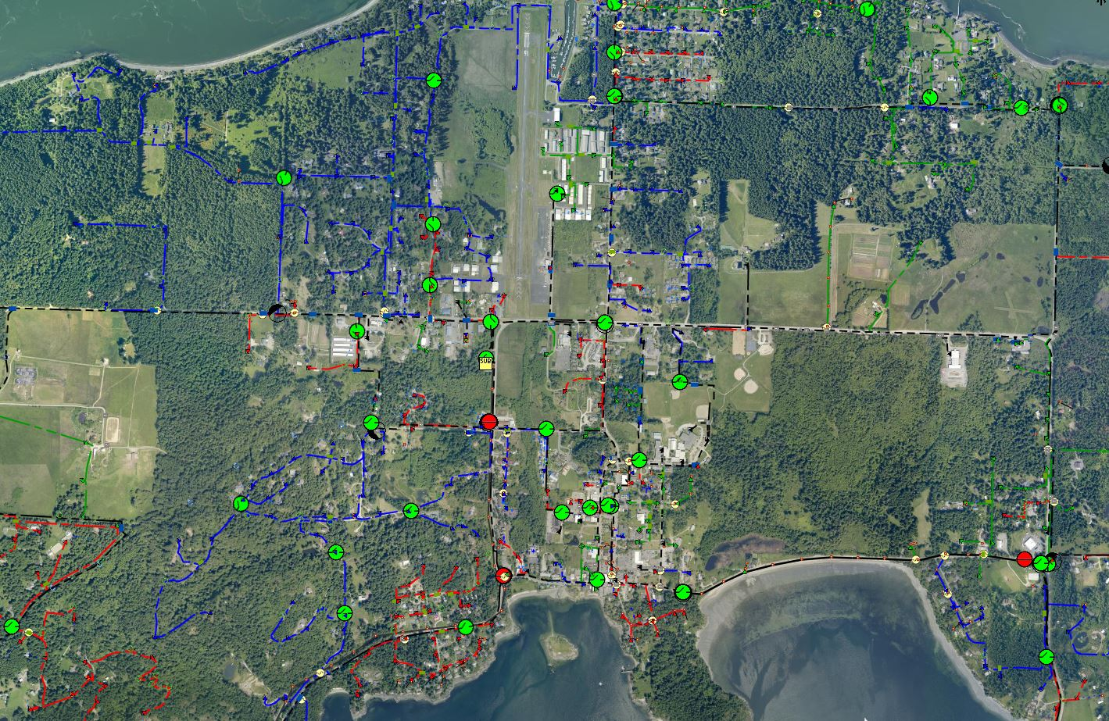
OCM map for Orcas Island
Feeder (A phase)
Feeder (B phase)
Feeder (C phase)
Underground feeder (Three phase)
Overhead feeder (Three phase)
Manual existing grid switches (open)
Manual existing grid switches (closed)
Microgrid area
Eastsound Substation
OPALCO headquarters
2.7 MWh battery (primary location)
New 1-phase GIS
New 3-phase GIS
Upgraded 3-phase GIS
Existing 69 kV transmission
1 MW biopower facility
1 MW Biopower facility

Slide 13
RES feasibility: Community Microgrid owner-operator perspective
Analysis factors from a 2021 design for a Community Microgrid in Southern California:
Microgrid financial outflows: Microgrid financial Inflows:
 | Year: | Capex | Opex |  |  | RES fees |  |  | Sales to utility
PV |  | $3,000,000 | $7,000
BESS |  | $1,400,000 | $5,000 |  | RES fee ($/kWh) | $0.20 |  | Tariff to utility | $0.10
Microgrid hardware + MC2 |  | $500,000 | $15,000 |  | Guaranteed daily load (kWh) | 2,300 |  | Annual PV sold (kWh) | 2,400,000
PV+BESS incentives |  | -$1,800,000
Total annual expense: | 1 | $3,100,000 | $27,000 |  | Total annual income: | $165,000 |  |  | $236,000
 | 2 | $- | $27,000 |  |  | $165,000 |  |  | $236,000
 | 3 | $- | $27,000 |  |  | $165,000 |  |  | $236,000
 | 4 | $- | $27,000 |  |  | $165,000 |  |  | $236,000
30-year analysis
With these expenses and income, the Community Microgrid owner will see an internal rate of return (IRR) of at least 9%.

Slide 14
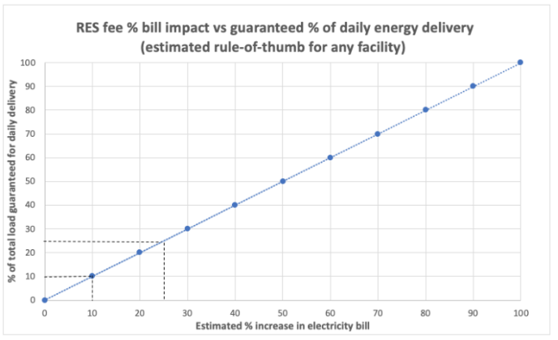
RES feasibility analysis results
The Clean Coalition’s analysis shows:
A value-appropriate RES subscription ratio of 1.0 (1% bill increase per 1% guaranteed load coverage) for the subscriber is feasible.
A positive IRR of 9% for the Community Microgrid owner is feasible.
Therefore, the RES is financially feasible for all stakeholders.
Key Takeaways:
RES allows Community Microgrids to be deployed at scale and expanded, as more facilities desire resilient energy guarantees.
RES provides a revolutionary and straightforward approach for financing Community Microgrids and delivering unparalleled resilience to communities.
RES enables a greater harmonization between local energy needs and societal planning in a way that helps put the people first.

Slide 15
Backup Slides
Backup Slides

Slide 16
Percentage of time online for Tier 1, 2, and 3 loads for a Solar Microgrid designed for the University of California Santa Barbara (UCSB) with enough solar to achieve net zero and 200 kWh of energy storage per 100 of kW solar.
Typical load tier resilience from a Solar Microgrid
Percentage of total load
Tier 3 = Discretionary load, ~75% of total load
Tier 2 = Priority load, ~15% of total load
Tier 1 = Critical, life-sustaining load, ~10% of total load
Percentage of time

Slide 17
A typical diesel generator is configured to maintain 25% of the normal load for two days. If diesel fuel cannot be resupplied within two days, goodbye. This is hardly a solution for increasingly necessary long-term resilience. In California, Solar Microgrids provide a vastly superior trifecta of economic, environmental, and resilience benefits.
Diesel generators are designed for limited resilience
Percentage of total load
Tier 3 = Discretionary load, ~75% of total load
Tier 2 = Priority load, ~15% of total load
Tier 1 = Critical, life-sustaining load, ~10% of total load
Percentage of time

Slide 18
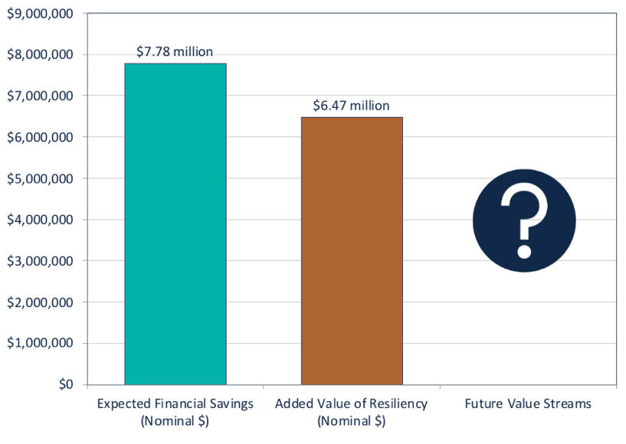
VOR123 yields a 25% typical adder
Based on this tiering system, the Clean Coalition arrived at 25% as the typical VOR123 adder that a site should be willing to pay for resilience.
The Clean Coalition has validated the 25% adder using four approaches: Cost-of-service, Department of Energy multiplier, market-based, and avoided diesel generator cost (see https://clean-coalition.org/disaster-resilience/#adder).
We also applied VOR123 to the Solar Microgrids for the Santa Barbara Unified School District (SBUSD), which is getting significant resilience benefits for free:
Bill savings and resilience value accruing to the SBUSD from six Solar Microgrid sites plus eight additional solar-only sites.

Slide 19
COS for expanding a Community Microgrid via RES
Once an initial Community Microgrid is established for serving the CCFs, incremental COS will be low for expanding the Community Microgrid via the market-based RES.
Each 1% of load that a facility secures via a RES will result in an approximately 1% electricity bill increase:

Slide 20
RES feasibility: Community Microgrid owner perspective
Analysis factors from a real-world design for a Community Microgrid in Southern California:
Factor | Amount | Units
RES fee | 0.20 | $/kWh
Tariff for energy sold to utility | 0.10 | $/kWh
Daily site load guaranteed by RES | 2,300 | kWh
PV+BESS financial incentives | 1,800,000 | $
PV size | 1,500 | kW
PV capex | 3,000,000 | $
BESS size | 2,000 | kWh
BESS capex | 1,400,000 | $
Microgrid hardware + MC2* | 500,000 | $
PV annual opex | 7,000 | $/year
BESS annual opex | 5,000 | $/year
Microgrid MC2 annual opex | 15,000 | $/year
* MC2 = Monitoring, Communications, and Controls for a microgrid.

Slide 21
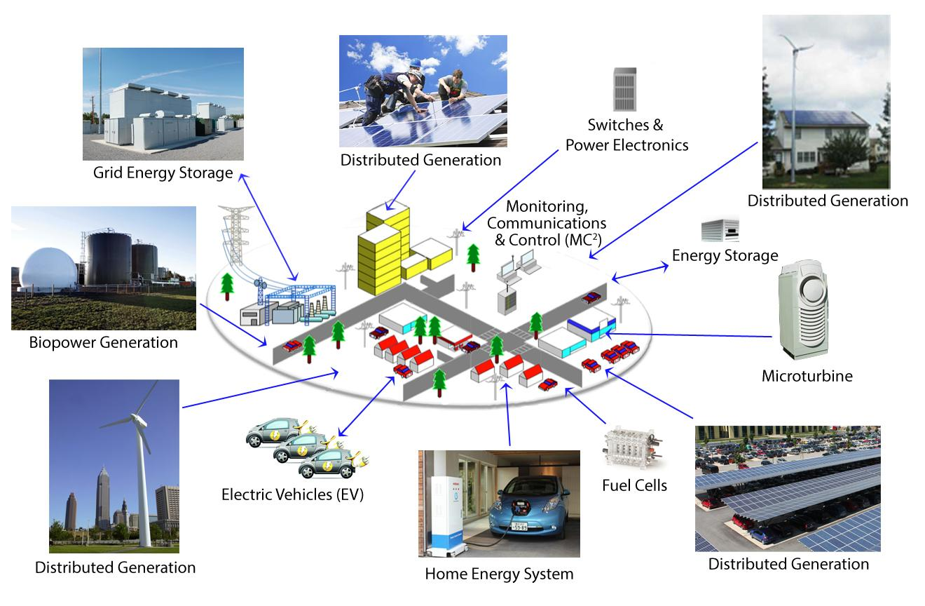
Heading
Notes:
21

