Slide 1
Humidor Battery Energy Storage System
Enhancing renewables & resilience for Los Angeles region
Bryan Murray
Senior Engineer
Clean Coalition
757-774-2530 mobile
bryan@clean-coalition.org
Craig Lewis
Executive Director
Clean Coalition
650-796-2353 mobile
craig@clean-coalition.org
Gregory Young
Program Manager
Clean Coalition
805-350-2931 mobile
gregory@clean-coalition.org
19 June 2024

Slide 2
Clean Coalition (nonprofit)
Mission
To accelerate the transition to renewable energy and a modern grid through
technical, policy, and project development expertise.
Renewable Energy End-Game
100% renewable energy; 25% local, interconnected within the distribution grid and ensuring resilience without dependence on the transmission grid; and 75% remote, fully dependent on the transmission grid for serving loads.
Notes:
2

Slide 3
Humidor BESS summary
400 MW / 1,200 MWh Battery Energy Storage System (BESS)
Installed by Hecate Grid, a leading independent power producer focused on developing, building, owning, and operating stand-alone energy storage projects in the US.
Hecate Grid has a pipeline of over 6 GW of BESS throughout the US with 3 GW in California.
Located in Acton, CA, about midway between Glendale and Lancaster.
Closest neighborhood will be 4,000 feet from the Humidor project site.
Will enhance grid reliability, including during times of AC-driven stress and during extreme weather events and other disasters that threaten the broader grid.
Utilizes disturbed and industrial zoned land buffered by roadways, rail lines, and industrial facilities.
Will not use any groundwater and will only use LA County Public Works water.
Will create approximately 100 high paying union jobs during construction and employ several workers for ongoing operations.
For every 1 MW of capacity in operation, Hecate Grid will invest $250 annually in local community initiatives, totaling $100,000 annually at full capacity.

Slide 4
About Hecate Grid

Slide 5
Five key reasons to support Humidor Energy Storage Project
Important location to provide reliability and meet energy demand
Significant distances from other facilities, including housing
Same safe BESS technology that is already deployed across the United States
Respect for environmental & cultural resources, and supportive to private property owners
Significant economic benefits to the local community

Slide 6
Important location to provide reliability and meet energy demand
Important location to provide reliability and meet energy demand

Slide 7
Three primary benefits
Reduce grid congestion by storing excess solar energy from the Antelope Valley (and beyond) in the Humidor BESS and discharging it during peak demand hours to alleviate grid congestion.
Maximize solar and other renewable energy that can reach the Los Angeles region, while minimizing the use of gas peaker plants, which are mostly located in highly impacted Los Angeles communities.
Improve reliability system-wide including during the hottest hours of the year when AC is exacerbating the grid.

Slide 8
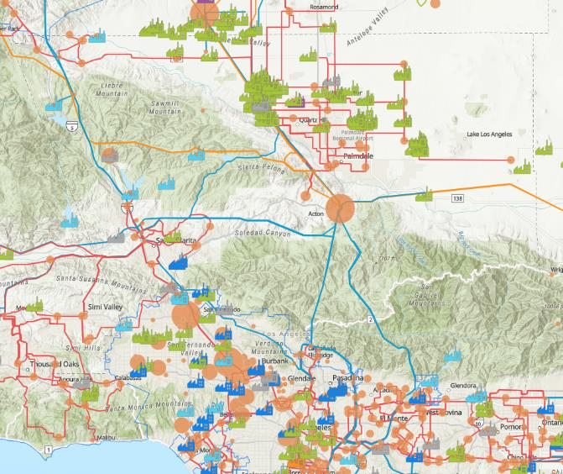
Humidor will maximize solar while enhancing grid reliability
There is a significant amount of solar in the central valley that is attempting to flow down into Los Angeles (LA).
CAISO is careful about adding more solar in the central valley due to grid congestion, so it is slowing down the deployment of additional solar. Too much grid congestion can cause grid outages.
The Humidor Battery Storage Project will address multiple challenges: deliver solar energy to Los Angeles, prevent curtailment, meet peak grid demand, and alleviate congestion. This will help smooth supply and demand, reducing blackout risks.
Humidor Battery Storage

Slide 9
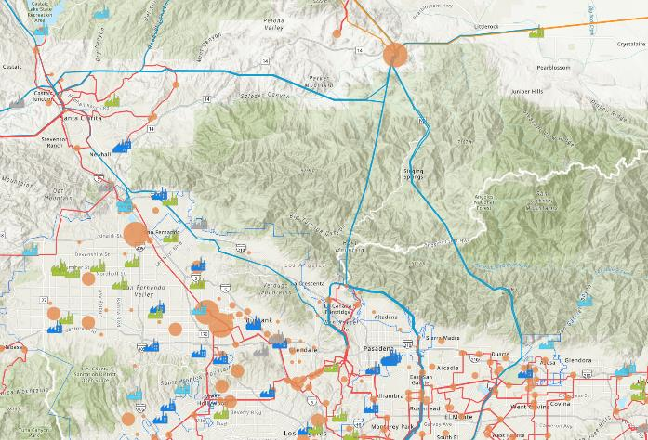
Humidor will reduce pollution from especially dirty gas-fired peaker plants
Acton
Humidor Battery Storage
Many gas-fired plants to the south and west
Humidor will help minimize how often dirty gas-fired plants need to run to top off the grid when demand is high. This will keep pollution from those gas-fired plants out of nearby communities.

Slide 10
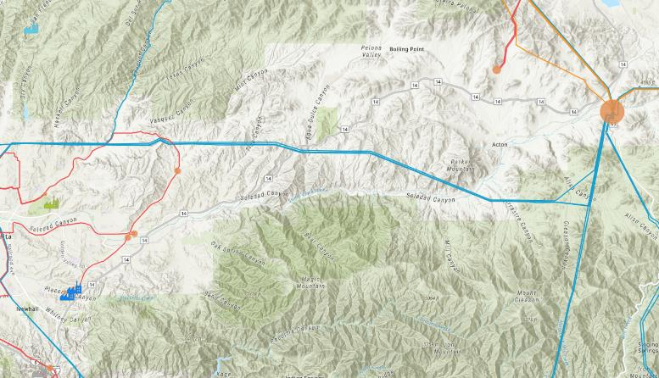
Humidor will reduce pollution from especially dirty gas-fired peaker plants (continued)
Humidor Battery Storage
Acton
Two gas-fired plants (CES Placerita Power Plant & Berry Placerita Cogen Power Plant)
Humidor Battery Storage
Humidor will help minimize how often dirty gas-fired plants need to run to top off the grid when demand is high. This will keep pollution from those gas-fired plants out of nearby communities.

Slide 11
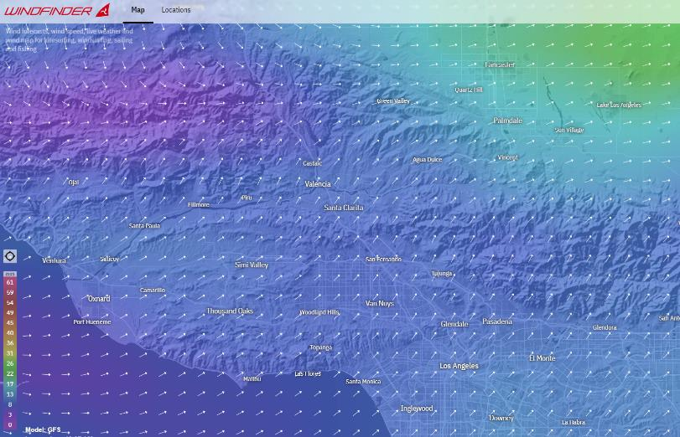
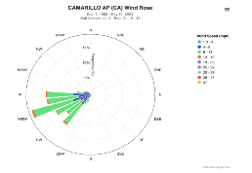
Coastal winds push pollution from gas-fired plants through Acton
Humidor Battery Storage
Two gas-fired plants
Acton
Predominant Winds
Acton is downwind of gas-fired plants, while Humidor is downwind of Acton

Slide 12
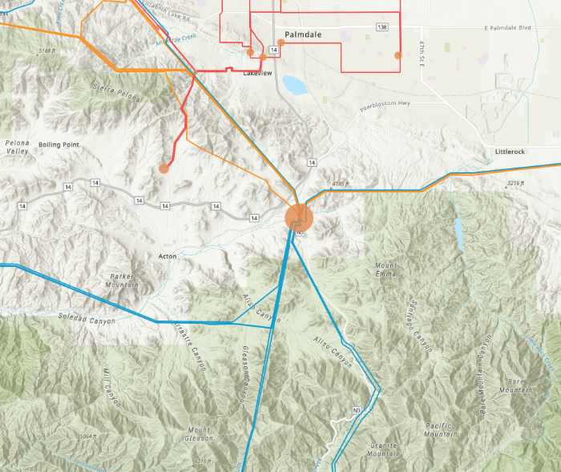
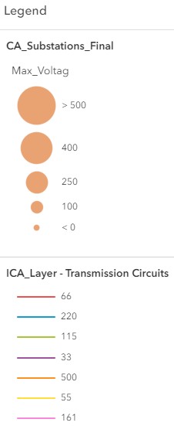
Humidor energy storage is located at a major grid intersection
Humidor Battery Storage
Vincent Substation (500 kV)

Slide 13
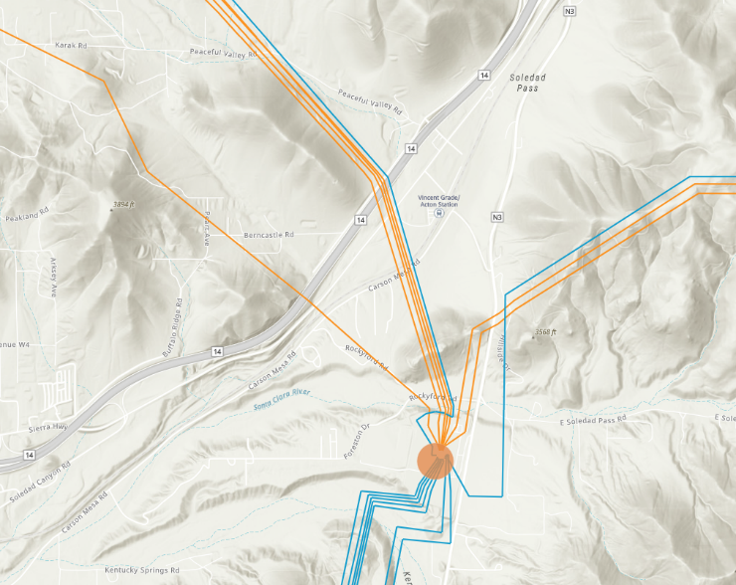
Humidor is located at a major grid intersection, less than one mile from the massive Vincent Substation
Humidor Battery Storage (interconnected at 220 kV)
Vincent Substation (500 kV)

Slide 14
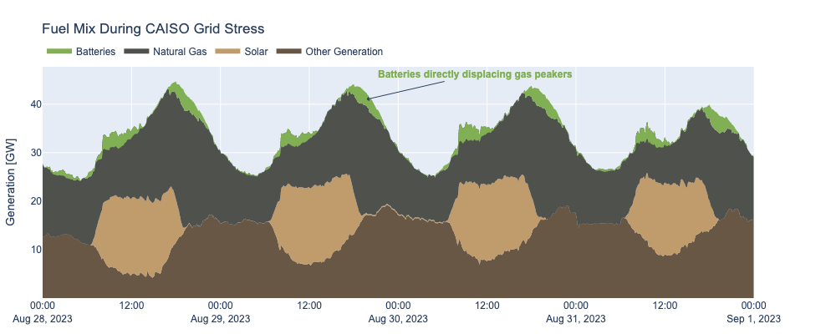
Time-shifting solar generation helps prevent blackouts

Slide 15
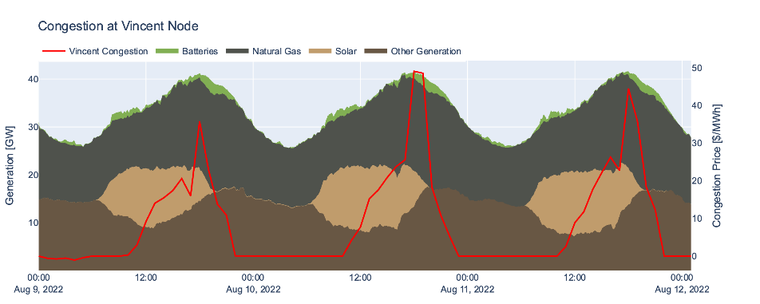
Congestion follows a daily pattern…
1. Solar generation peaks in the early afternoon
2. Load peaks in the late afternoon
3. Congestion price spikes as load persists and solar production falls
As electricity demand grows and congestion keeps new generation off the grid, reliability degrades and state-wide blackouts become more likely!

Slide 16
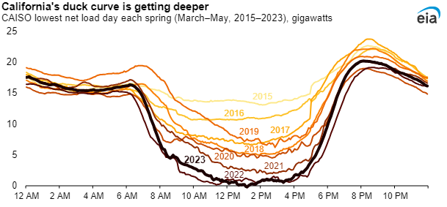
California duck curve is getting deeper

Slide 17
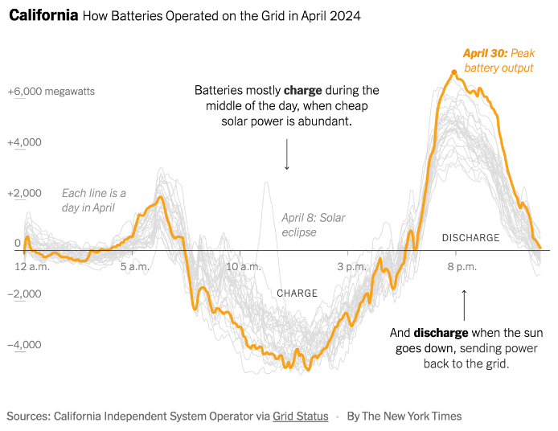
Batteries help midday solar serve evening load

Slide 18
Significant distances from other facilities, including housing
Significant distances from other facilities, including housing

Slide 19
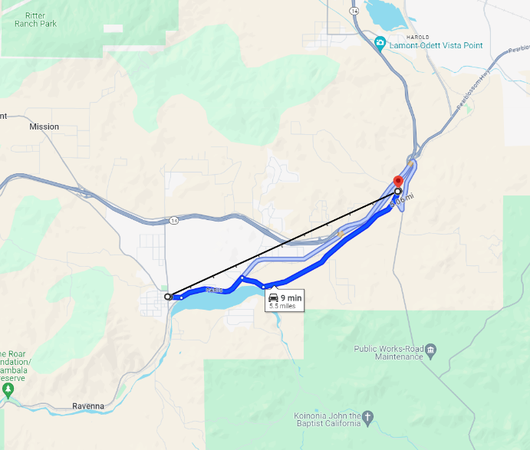
Humidor will be located over 5 miles northeast of Acton, CA

Slide 20
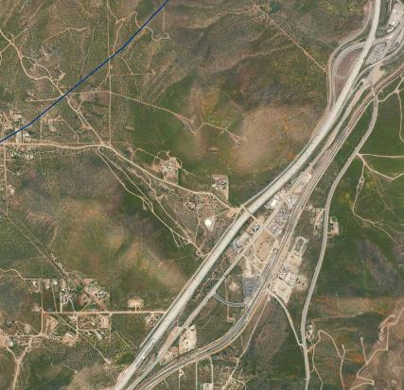
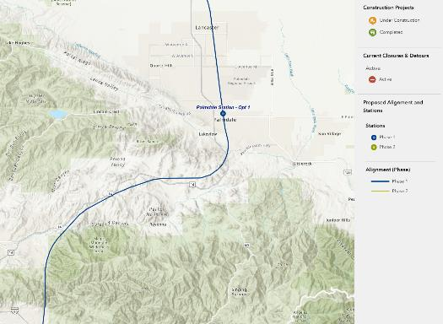
Utilize already disturbed industrial land
California High Speed Rail
Humidor Battery Storage
Humidor Battery Storage
Planned California High Speed Rail route
Source: https://buildhsr.com/map/
Humidor will utilize already disturbed industrial land recently used for a commercial trucking and an electrical subcontractor yard.
Humidor will also be located near the planned California High Speed Rail.

Slide 21
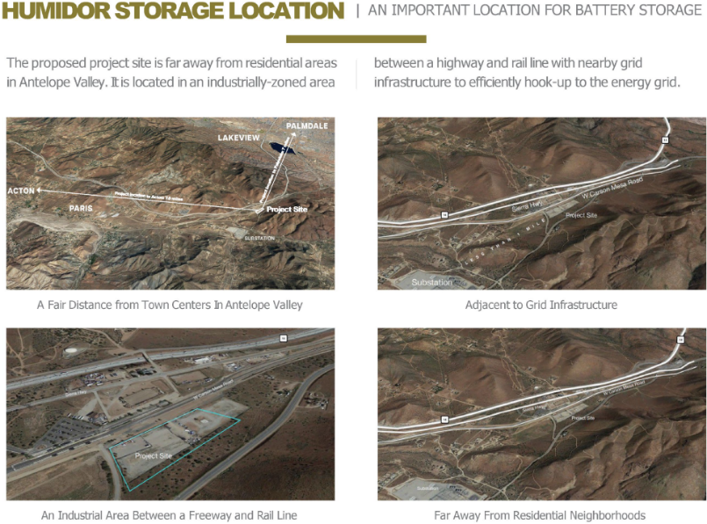
Humidor is in an industrially-zoned area

Slide 22
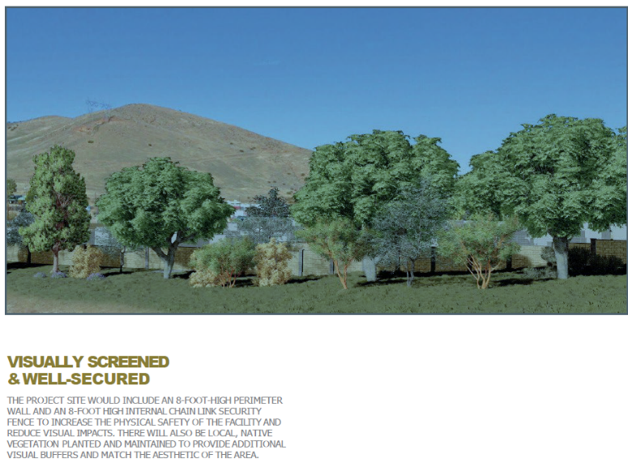
Visually screened and secured

Slide 23
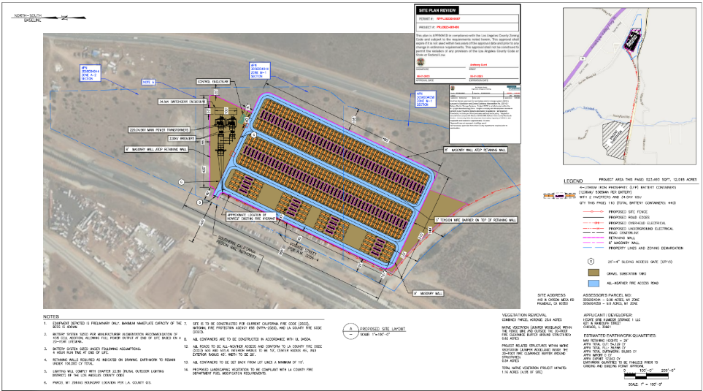
Humidor site plan

Slide 24
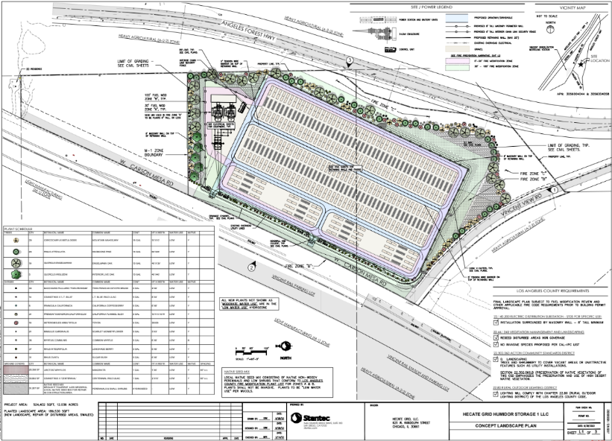
Humidor site plan (continued)

Slide 25
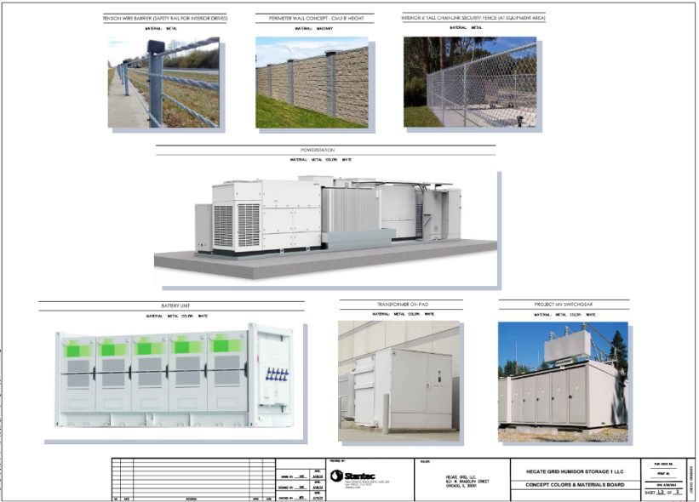
Humidor concept materials and colors

Slide 26
Same safe BESS technology that is already deployed across the United States
Same safe BESS technology that is already deployed across the United States

Slide 27
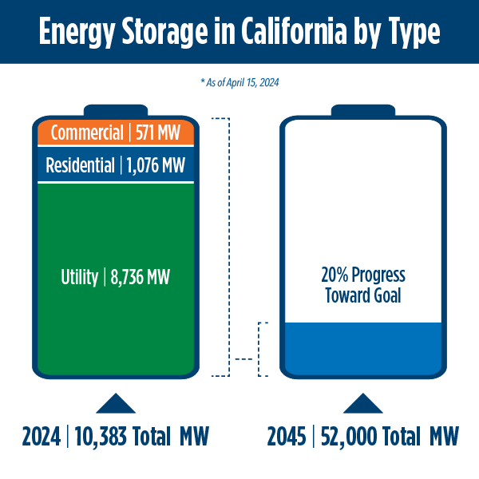
California energy storage system survey
From 2018 to 2024, battery storage capacity in California increased from 500 megawatts (MW) to more than 10,300 MW, with an additional 3,800 MW planned to come online by the end of 2024.
The state projects 52,000 MW of battery storage will be needed by 2045.
Source: CEC, California Energy Storage System Survey

Slide 28
Proactive safety measures
Hecate Grid is working with the LA County Fire Department to meet or exceed code requirements at Humidor and develop a site-specific emergency response plan to train on the project equipment.
A joint study by the Electric Power Research Institute, Pacific Northwest National Laboratory, and TWAICE, determined that problems with system components other than battery cells and modules were responsible for most BESS failures. That the “common storyline…that failures are almost all attributable to battery modules”, is inaccurate.
Hazard studies from similar battery projects concluded that the probability is very low that a battery failure would ever require a Fire Department response. The specific probability is that such an event would occur once every 10,989 years. It was also determined that any conceivable fire-related event would be of less cocern than a Class A Fire, which is a fire involving ordinary combustibles such as wood, paper, fabric, and plastic.
Other hazard studies revealed that risks from any potential exhaust from a battery issue would be of little concern beyond 15 feet from the source battery cabinet. In part, this is due to the simple fact that warm exhaust rises and quickly scatters.

Slide 29
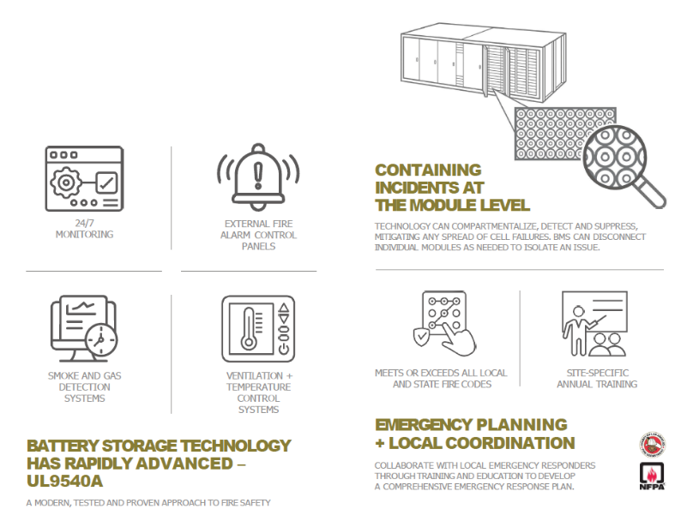
Same safe battery storage technology that is being deployed across the United States

Slide 30
Same safe battery storage technology that is being deployed across the United States

Slide 31
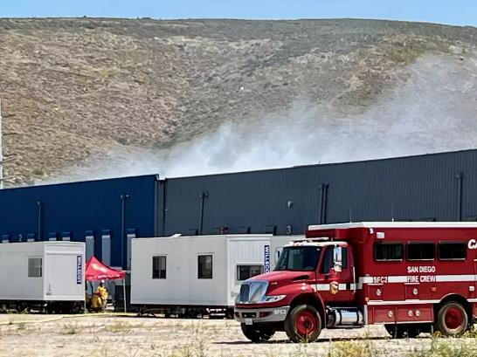
Recent Otay Mesa battery fire is not as bad as headlines would indicate
Is being controlled
Includes 4-year old battery technology
Batteries are located in an enclosed building, providing more flammable material, while Humidor would not be
The cause of the fire has not yet been determined
Source: The San Diego Union-Tribune

Slide 32
Respect for environmental & cultural resources, and supportive to private property owners
Respect for environmental & cultural resources, and supportive to private property owners

Slide 33
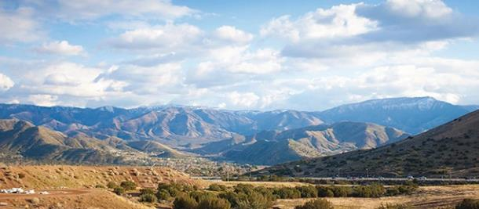
Respect for environmental & cultural resources, and supportive to private property owners
No groundwater will be used, and the site will utilize LA County public water
Humidor site avoids protected areas, cultural resources or artifacts, and species
Landowners will leverage their land to earn income from other sources that increase grid reliability

Slide 34
Significant economic benefits to the local community
Significant economic benefits to the local community

Slide 35
Significant economic benefits to the local community
Will create approximately 100 union construction jobs
Will employ 2 to 3 full time staff in addition to a 24/7 remote operations team
Up to $100,000/year to local area initiatives throughout the operating life of the project and approximately $2,000,000/year in annual tax benefits to LA County

Slide 36
Backup
Backup

Slide 37
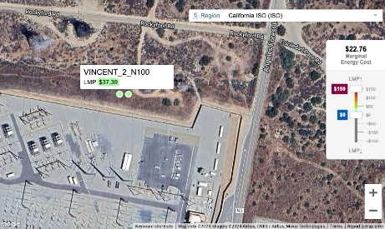
Humidor is connecting at one of these two nodes “Vincent_2_N100” or “Vincent_2_N101”
Vincent_2_N101 node has a Local Marginal Price for energy of $38.15/MWh (17 May 2024)
Source: CAISO’s Locational Marginal Price (LMP) map page

Slide 38
California relies on renewables

Slide 39
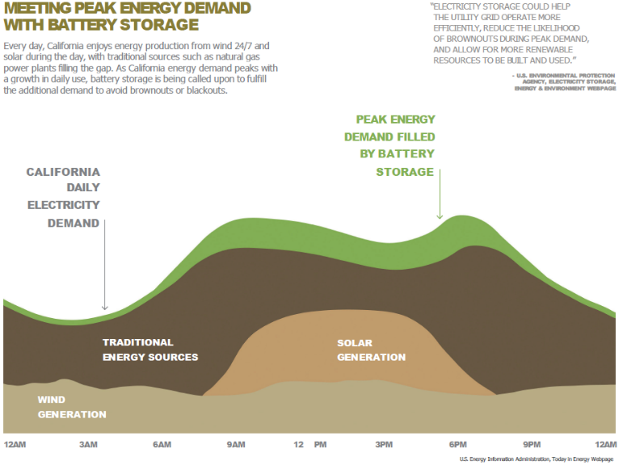
Effects of energy storage on peak demand

