Slide 1
Solar Microgrid Methodology
Curriculum
Gregory Young
Program Manager
805-350-2931 mobile
gregory@clean-coalition.org
12 Nov2024

Slide 2
Clean Coalition (non-profit)
Mission
To accelerate the transition to renewable energy and a modern grid through
technical, policy, and project development expertise.
Renewable Energy End-Game
100% renewable energy; 25% local, interconnected within the distribution grid and ensuring resilience without dependence on the transmission grid; and 75% remote, fully dependent on the transmission grid for serving loads.
Notes:
2

Slide 3
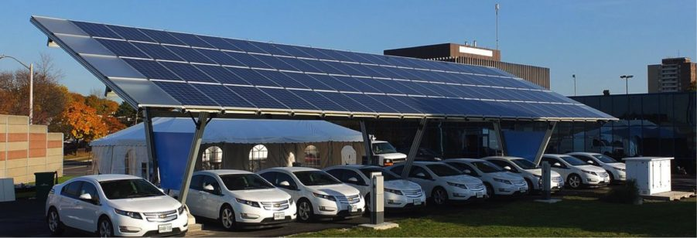
Clean Coalition Community & Solar Microgrids
Creating Groundbreaking Models
The Clean Coalition designs and stages cutting-edge Community Microgrid & Solar Microgrid projects that can be replicated in any utility service territory. By showcasing the value and feasibility of these projects, and the vast potential for siting distributed energy resources in the built environment, we’re helping proliferate clean local energy and community resilience.
Facilitating Real-World Projects
At the Clean Coalition, we base our work on concrete project experience. The projects we design highlight the regulatory and policy issues that are impeding the development of clean local energy projects, and the tools and best practices needed to overcome those barriers.
Notes:
3

Slide 4
Benefits of a Solar Microgrid
Economic
  Provides electricity costs savings compared to buying electricity from the utility.
  Provides value-of-resilience (VOR) compared to implementing & operating a fossil-fueled generator.
  Provides a fixed cost of electricity compared to rapidly rising utility costs.
Environmental
  Provides solar electricity, a pure renewable energy resource.
  Optimizes grid citizenship by reducing peak usage of the grid when it is most stressed, during the peak periods, which throughout California are currently 4-9pm.
  Eliminates energy losses associated with traversing transmission & distribution grids. Losses are due to resistance and congestion, both of which are generally exacerbated by distance. Typically, 15% of remotely generated energy is lost.
  Reduces the environmental impact of central generation, which typically consumes open space for the generation & transmission assets.
Resilience
  Provides 100% ride-through during grid outages of limited durations. Any ride-through duration can be accommodated with cost being correlated to duration.
  Provides optionality for indefinite resilience for at least the most critical loads, again with cost being correlated to the percentage of load being served with 100% resilience.
  Accommodates optional fossil generation as an emergency backup resource that can be minimized.

Slide 5
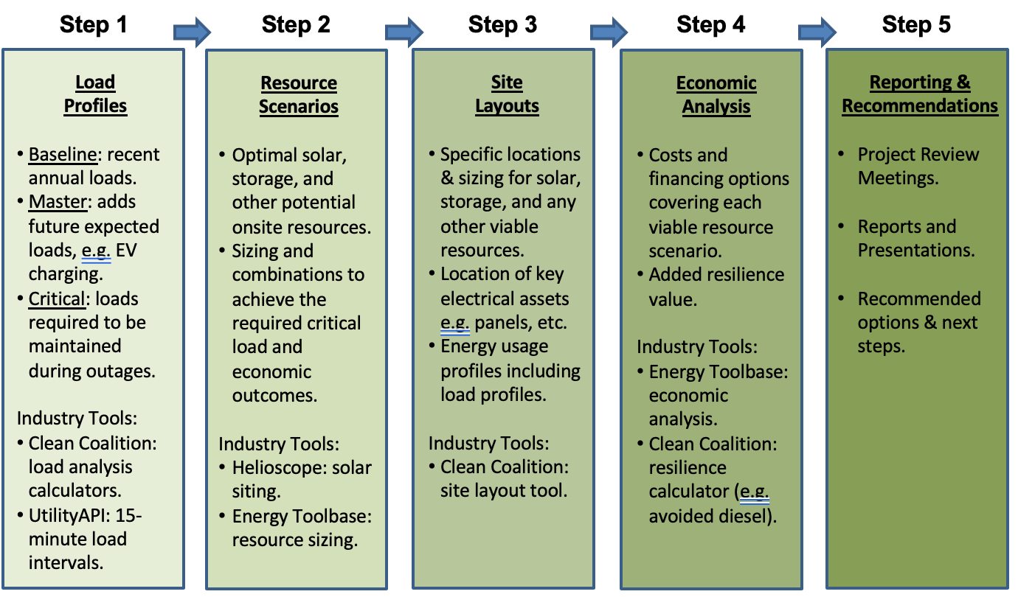
Solar Microgrid Methodology for feasibility studies
Notes:
5

Slide 6
Solar Microgrid Methodology Curriculum overview
Solar Microgrid Methodology Curriculum overview

Slide 7
Solar Microgrid Methodology Curriculum overview
Who: Taught by Professor Bill Dinklage during his Energy and Natural Resources course, including 16 students, Clean Coalition tools and support, and other industry standard tools.
What: Six-week curriculum based on the Clean Coalition’s Solar Microgrid Methodology
When: Fall 2023 semester. With two classes per week, an hour and twenty minutes per class, and one class for a holiday, this calculates to just under 15 hours of class time.
Where: Santa Barbara City College (SBCC)
Why: To provide students with a unique combination of practical challenges and professional guidance in order to transform the classroom into a vibrant launchpad for their careers, equipping them with not just theoretical knowledge, but the tangible skills and confidence to thrive in the burgeoning field of clean energy.

Slide 8
Solar Microgrid Methodology Curriculum overview
Solar Microgrid Methodology Curriculum outline

Slide 9
Solar Microgrid Methodology Curriculum outline
Week 1: Electricity interval data and billing details
Week 2: Solar design details and modeling
Week 3: Value of Resilience 123 (VOR123) and sizing the BESS
Week 4: Economic analysis
Week 5: Project table creation and presentation preparations
Week 6: Review & Presentations

Slide 10
Week 1: Analyzing Electricity Interval Data and Billing Details
Topics covered:
  Distinguishing between power and energy, kilowatt (kW) and kilowatt hour (kWh).
  Understanding what electricity usage data looks like.
  Interpreting and cleaning electricity data to establish a full calendar year's Baseline Load Profile.
  Calculating the total annual load and peak demand from the Baseline Load Profile.
  Deciphering electric utility bills and meter rate schedules.
  Developing an Adjustments Load Profile based on the anticipated addition of electric vehicle (EV) charging stations.
  Combining the Baseline Load Profile and Adjustments Load Profile at every 15-minute interval to create the Master Load Profile.
Tools used:
  The Clean Coalition's Solar Microgrid Analysis Processor (SMAP) Utility Data Cleaner: This tool simplifies the cleaning of electricity data downloaded from UtilityAPI, a secure, third party utility data service.
  The Clean Coalition's EV charging profile creator: This tool assists in constructing an Adjustments Load Profile based on specified EV charging station quantities and usage patterns.

Slide 11
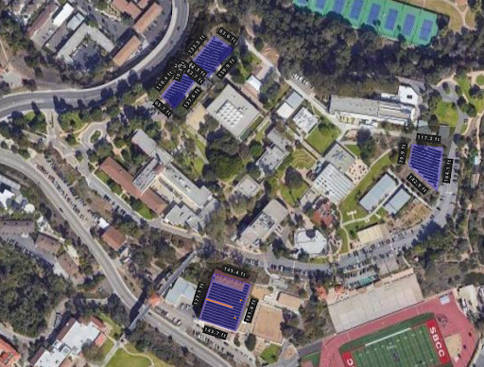
Week 2: Mastering Solar Modeling with HelioScope
Topics covered:
  Solar panel and inverter operation: Conversion of sunlight to direct current (DC) electricity and subsequent DC-to-AC (alternating current) transformation for grid integration.
  Impact of tilt, azimuth, spacing, and shading: Understanding how these factors influence a system's energy output.
  Mounting system options: Differentiating between fixed tilt racking, flush mount, ground mount, and carport structures.
  Net Zero Energy (NZE) calculation: Determining the percentage of NZE achievable based on solar system design.
Equipped with the industry-standard HelioScope, students embarked on designing their own solar systems. This involved:
  Drawing the system layout: Accurately mapping the physical constraints of the East Campus site.
  Defining obstructions and shading: Placing virtual "keepouts" for existing structures and trees.
  Selecting optimal components: Choosing suitable solar panels and inverters for efficient energy generation.
  Leveraging Light Detection and Ranging (LiDAR) data: Utilizing LiDAR technology to map building and tree heights for accurate shading analysis.

Slide 12
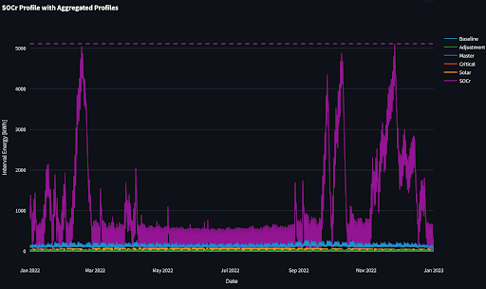
Week 3: Value of Resilience (VOR) 123 and BESS Sizing
Topics covered:
  Clean Coalition’s VOR123: This methodology tiers electrical loads into three categories — critical, priority, and discretionary loads — across all facility types. The level of resilience anticipated from a Solar Microgrid at a facility where the Tier 1 load is 10%, Tier 2 load is 15% and Tier 3 load is 75% and where enough solar can be included onsite to net-zero the site’s annual electricity consumption. The average anticipated resilience, in terms of percentage of time online, is as follows:
    Tier 1: 100%
    Tier 2: 80% (at least)
    Tier 3: 25% (at least)
Tools used:
  The Clean Coalition's Solar Microgrid Analysis Processor (SMAP) Aggregated Profile Spreadsheet (APS) Builder: This tool takes user-defined inputs (Baseline Load Profile, Adjustments Load Profile, Critical Load Profile or percentage of critical load, and solar generation profile) to generate the Master Load Profile and an APS. The APS comprises:
    Baseline Load Profile
    Adjustments Load Profile
    Master Load Profile
    Critical Load Profile
  The Clean Coalition’s SMAP State of Charge reserved for resilience (SOCr) calculator: When fed the APS, this calculator sizes a BESS to indefinitely cover (with the help of the solar system) the user-specified critical load percentage or profile.

Slide 13
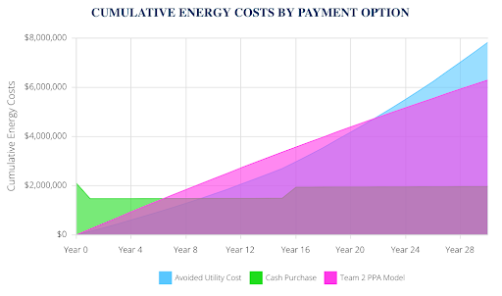
Week 4: Solar Microgrid Financial Analysis
Topics covered:
  Capital and operational costs for installing solar panels and BESS
  Incentives for Solar Microgrid components
  Discount rates and electricity escalation rates
  Demand charge management and energy arbitrage strategies
  Cash purchase versus power purchase agreement (PPA) options
  Electrical bill savings and 25 year cash flow projections
Leveraging Energy Toolbase, students meticulously conducted a financial analysis of their Solar Microgrid designs. This comprehensive process involved:
  Data Integration: Importing the Master Load Profile and aligning it with the specific rate schedule of the East Campus meter.
  Solar Generation: Entering their HelioScope solar generation profile and defining a $/W value.
  BESS Configuration: Selecting a standard BESS option and specifying its operational strategy, encompassing demand charge management, energy arbitrage, or both. Additionally, they set a $/kWh value for the BESS.
  Cost Accounting: Establishing Operations and Maintenance (O&M) expenses and costs associated with system component replacements.
  Rate Analysis: Comparing the available solar- and BESS-friendly rate schedules and performing rate switches to understand their economic impact.
  Financial Scenarios: Selecting a transaction type, such as cash purchase or PPA, to explore different financing options.

Slide 14
Week 5: Project Table Creation and Presentation Preparations
Week 5 of the Solar Microgrid Methodology curriculum consisted of students compiling their hard work into project tables and presentations. These tables summarized their actions and key findings from the previous four weeks, including analysis steps, system sizing, resilience benefits, and economic results.
Students were guided on formatting their Solar Microgrid Feasibility Study presentations using Google Slides to:
  Start by presenting compelling key economic results and details on system sizing.
  Provide a concise overview of the analysis steps taken.
  Go in-depth into each major step of the process.
  Conclude with clear recommendations and next steps.

Slide 15
Week 6: Review & Presentations
The culminating week of the Solar Microgrid Methodology curriculum saw student groups polishing their presentations and confidently showcasing their completed Solar Microgrid Feasibility Studies to a distinguished audience of SBCC, Santa Barbara Foundation, and Clean Coalition personnel. Key members in attendance or who were involved in the curriculum included:
  Erika Endrijonas, SBCC Superintendent/President
  Jens Uwe-Kuhn, SBCC Dean of Sciences
  Erik Fricke, SBCC Director of Campus Safety and Emergency Response
  Maria Villagómez, SBCC Assistant Superintendent/VP of Academic Affairs
  Dr. Bill Dinklage, SBCC Professor Dept. of Earth and Planetary Sciences
  Brian Morales, SBCC Director of Campus Safety and Emergency Response
  Mark Broomfield, SBCC Facilities Supervisor
  Craig Lewis, Clean Coalition Executive Director
  Gregory Young, Clean Coalition Program Manager

Slide 16
Reactions and feedback
“I really appreciated the opportunity to see Professor Bill Dinklage's Fall ENVS 116 students present the potential applications of microgrids and microgrid technology on the SBCC campus. Our campus needs to be more "green" in its practices, especially as we begin to explore programs to support the "blue" economy here in Santa Barbara.” - Erika Endrijonas, Superintendent/President of SBCC
"Working with the Clean Coalition to guide my Energy and Natural Resources class through their solar microgrid methodology was a fabulous professional development opportunity for me and gave the students a very practical and eye-opening taste of what it is like to apply the concepts of solar energy and energy storage they learned in class to the real world. The Clean Coalition was there for me 100% to make the project a success." - Bill Dinklage, Professor Dept. of Earth and Planetary Sciences and Teacher of the Solar Microgrid Methodology Curriculum
“The Solar Microgrid curriculum was a truly eye-opening process. Learning about the intricacies of developing a solar microgrid while using the professional software that we had access to through the Clean Coalition in the real-world setting of our own campus made for an incredibly hands-on experience. I really enjoyed this curriculum, and both the technical skills we learned and a fascination with solar microgrid technology are things that will stay with me for a long time.” - Nick Parker, Student of SBCC Solar Microgrid Methodology Curriculum

Slide 17
Backup slides
Backup slides

