Slide 1
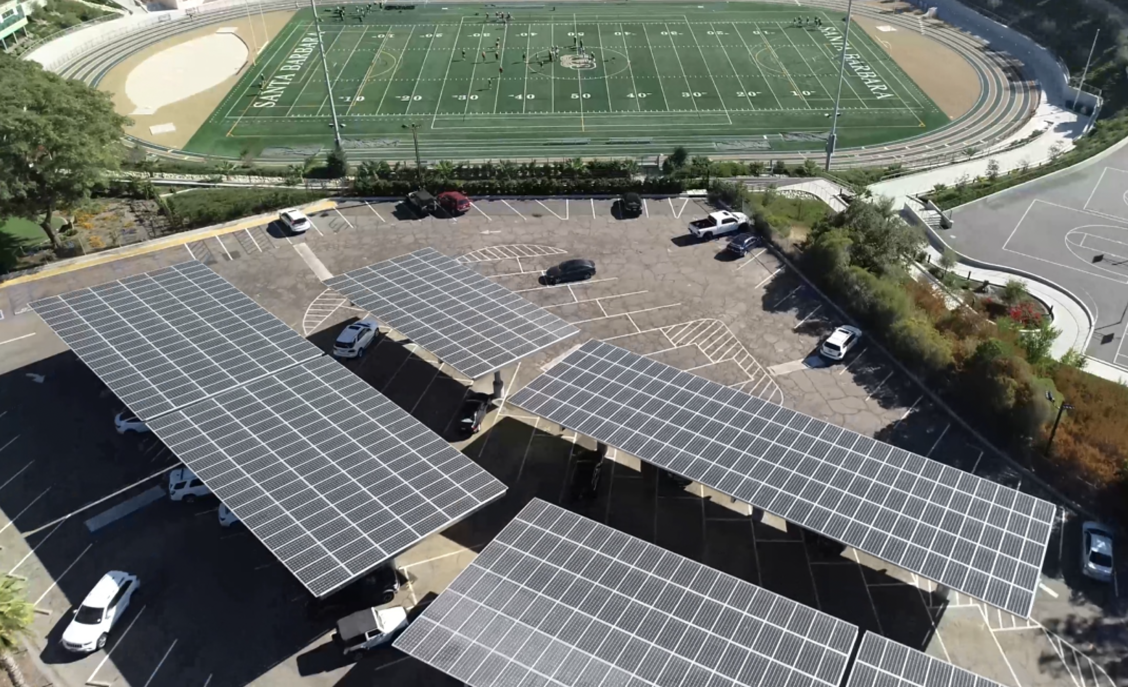
Solar-driven microgrids
deliver unparalleled economic, environmental, and resilience benefits
Craig Lewis
Executive Director
650-796-2353 mobile
craig@clean-coalition.org
25 September 2024

Slide 2
Clean Coalition (nonprofit)
Mission
To accelerate the transition to renewable energy and a modern grid through
technical, policy, and project development expertise.
Renewable Energy End-Game
100% renewable energy; 25% local, interconnected within the distribution grid and ensuring resilience without dependence on the transmission grid; and 75% remote, fully dependent on the transmission grid for serving loads.
Notes:
2

Slide 3
Various types of Solar Microgrids
A microgrid is a combination of energy resources, definitely including generation, that are coordinated to serve specified loads, including in an islanded fashion.
A Solar Microgrid is a behind-the-meter (BTM) microgrid that solely relies on solar for energy generation when islanded. A Solar Microgrid relies on energy storage to time-shift solar and ensure energy availability at night etc.
A Hybrid Solar Microgrid is a Solar Microgrid that includes additional sources of energy generation, beyond just solar.
A Community Microgrid a microgrid that covers a target grid area and relies on existing distribution feeders (ie, power lines) to operate when islanded. Community Microgrids typically include both front-of-meter (FOM) and BTM resources, including Solar Microgrids, and require effective participation from utilities, which have mostly erected barriers to date.

Slide 4
Solar Microgrid Methodology
Solar Microgrid Methodology

Slide 5
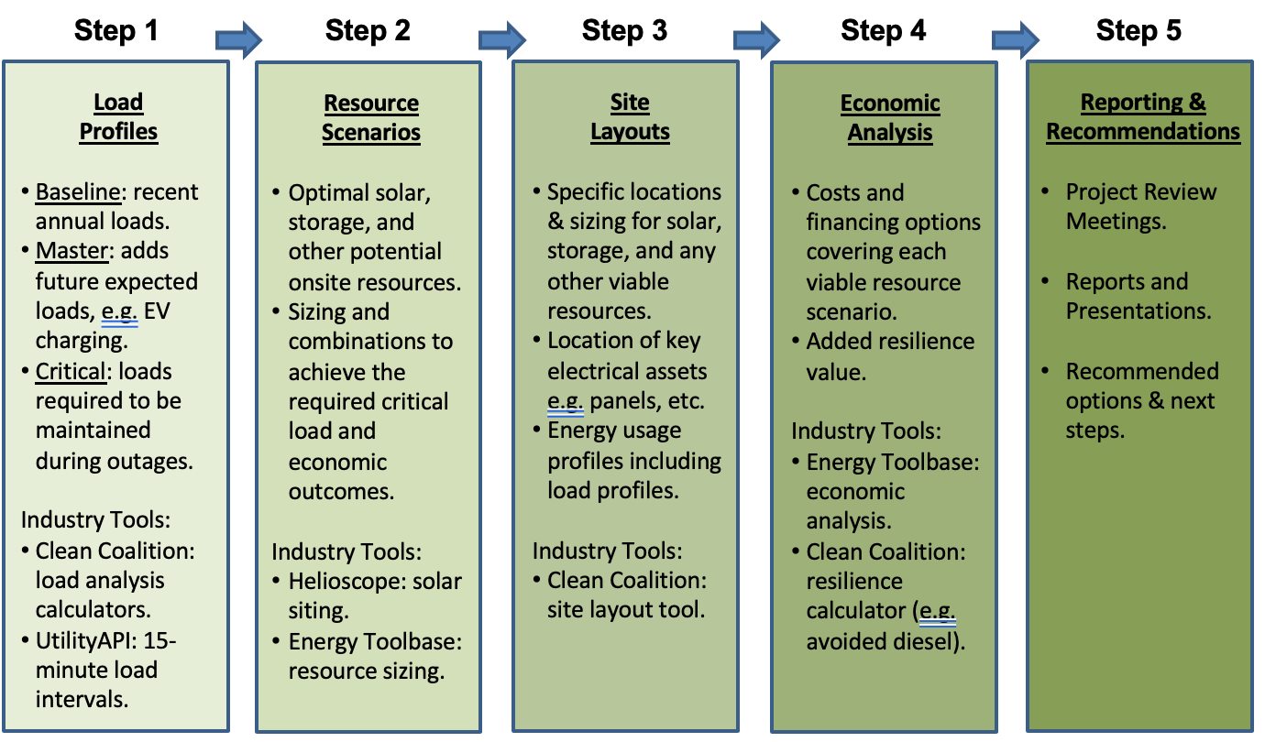
Solar Microgrid Methodology for feasibility studies
Notes:
5

Slide 6
Value-of-Resilience (VOR)
Value-of-Resilience (VOR)

Slide 7
Percentage of time online for Tier 1, 2, and 3 loads for a Solar Microgrid designed for the University of California Santa Barbara (UCSB) with enough solar to achieve net zero and 200 kWh of energy storage per 100 kW solar.
Typical load tier resilience from Solar Microgrids
Percentage of total load
Tier 3 = Discretionary load, ~75% of total load
Tier 2 = Priority load, ~15% of total load
Tier 1 = Critical, life-sustaining load, ~10% of total load
Percentage of time

Slide 8
A typical diesel generator is configured to maintain 25% of the normal load for two days. If diesel fuel cannot be resupplied within two days, goodbye. This is hardly a solution for increasingly necessary long-term resilience. In California, Solar Microgrids provide a vastly superior trifecta of economic, environmental, and resilience benefits.
Diesel generators are designed for limited resilience
Percentage of total load
Tier 3 = Discretionary load, ~75% of total load
Tier 2 = Priority load, ~15% of total load
Tier 1 = Critical, life-sustaining load, ~10% of total load
Percentage of time

Slide 9
Value-of-Resilience (VOR) details
VOR123
VOR123 is the value-of-resilience (VOR) from Solar Microgrids methodology that the Clean Coalition has developed to normalize VOR across all types of facilities & geographies. The VOR normalization is founded in tiering loads into three categories: Tier 1 (critical), Tier 2 (priority), and Tier 3 (discretionary). Since each Tier has its own resilience requirement and VOR, this methodology is called VOR123.
VOR123 webinar
https://clean-coalition.org/news/webinar-valuing-resilience-solar-microgrids-thursday-5-nov-2020/
Notes:
9

Slide 10
Local solar & storage optimize grid outcomes
Local solar & storage
optimize grid outcomes

Slide 11
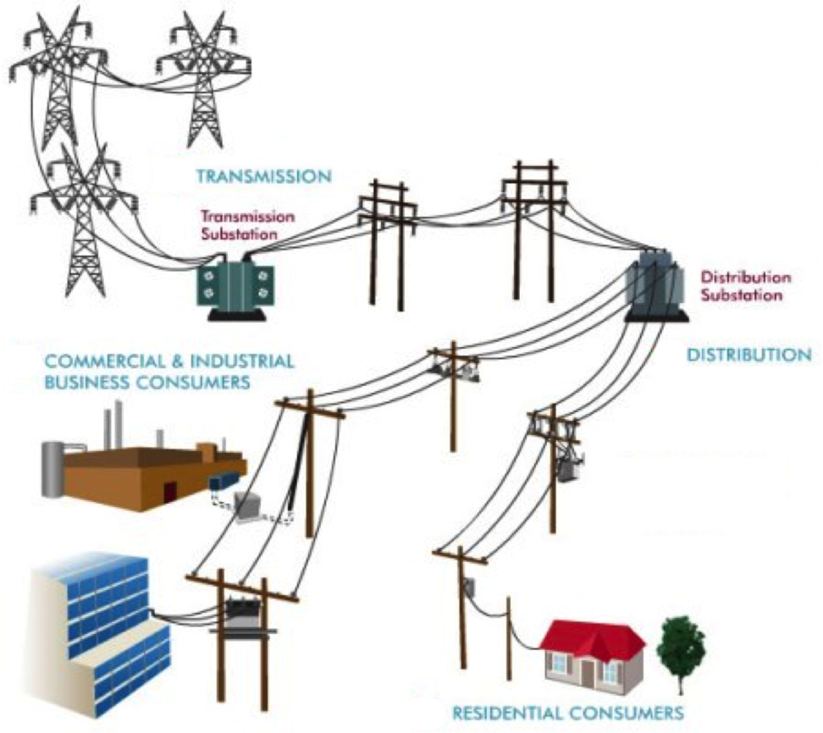
Local means within the distribution grid
High-Voltage
Transmission
grid
Low-Voltage
Transmission
grid
Distribution
grid
Notes:
Market distortions like the erroneous metering & assessment of Transmission Access Charges (TAC) for California IOUs creates massive market distortions that steal value from local generation, hurt ratepayers, and preempt energy resilience.
Non-PTO utilities (metered sub-systems) currently operate under the system we are proposing. The Clean Coalition TAC fix would bring consistent TAC treatment to DG resources in all utility service territories.

Slide 12
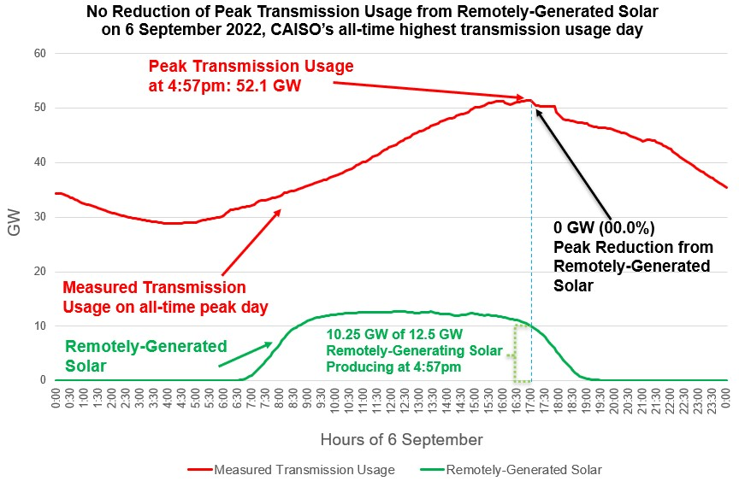
Transmission stress & cost is a massive problem

Slide 13
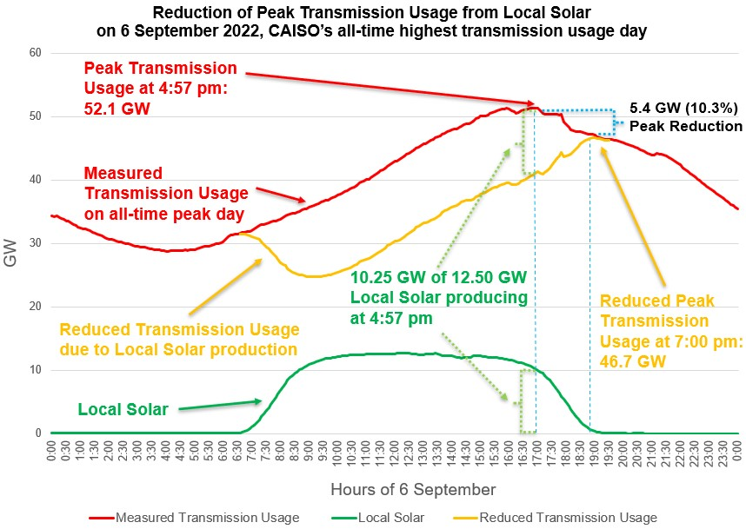
Local Solar reduces transmission stress & costs
Local Solar reduces Peak Transmission Usage by close to 50% of the installed local solar capacity. The effect is amplified by energy storage.
Bringing down the peak with distributed generation and demand flexibility will reduce transmission investments, saving ratepayers hundreds of billions of dollars over the next two decades.
Reducing the Peak Transmission Usage by around 10% is enough to prevent most major outages.

Slide 14
SBUSD Solar Microgrids case study
Santa Barbara Unified School District (SBUSD)
Solar Microgrids case study

Slide 15
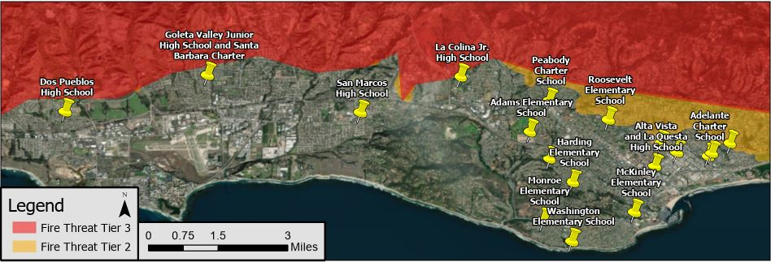
Santa Barbara Unified School District (SBUSD)
The entire Santa Barbara region is surrounded by extreme fire risk (earthquake & landslide risk too) and is extremely vulnerable to electricity grid outages.
The SBUSD is a major school district that increasingly recognizes the value-of-resilience (VOR) and has embraced the Clean Coalition’s vision to implement Solar Microgrids at a number of its key schools and other critical facilities.
SMHS is in the middle of the extensive SBUSD service area.

Slide 16
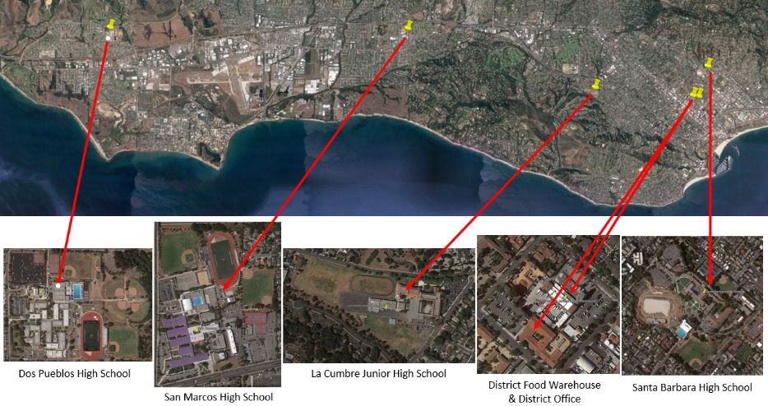
Six SBUSD Solar Microgrid sites

Slide 17
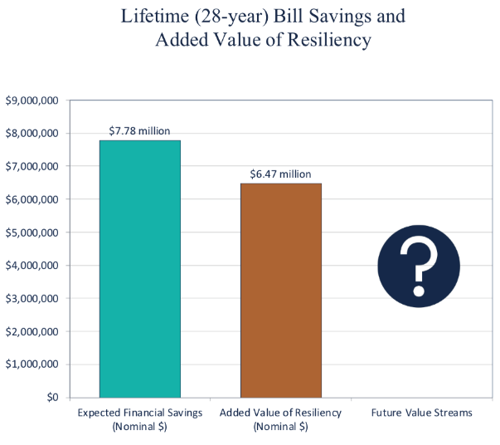
Guaranteed SBUSD bill savings and free VOR

Slide 18
Large farm case study in Carpinteria, CA
Large farm case study in Carpinteria, CA
Notes:
18

Slide 19
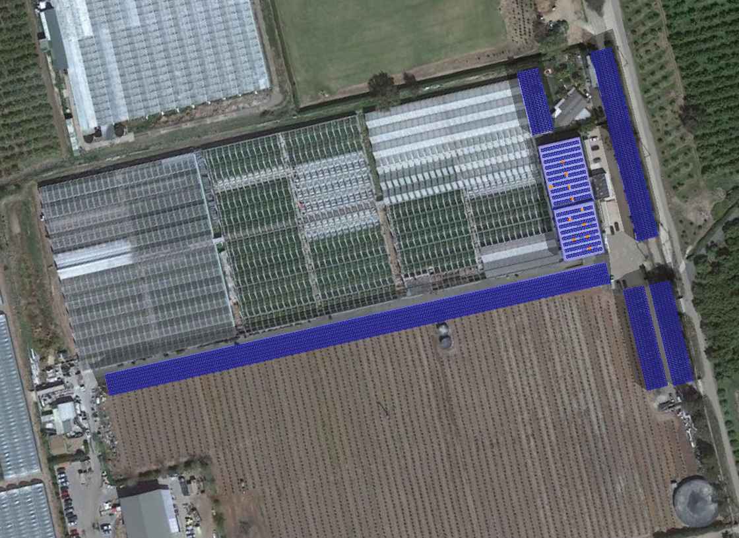


1.5 MWdc of solar for GH2 meter
Brand Farms
Greenhouse #2 Meter
Solar Microgrid Site Layout
C-5
Service Meter
#259000-062804
C-4
3 MW / 6 MWh BESS
Potential Location
R-1
Potential Solar Siting Locations:
C-1
710 kW Solar Canopy
R-2
C-2
142 kW Solar Canopy
C-3
142 kW Solar Canopy
C-4
89 kW Solar Canopy
C-5
269 kW Solar Canopy
C-2
R-1
84 kW Rooftop Solar
R-2
66 kW Rooftop Solar
Total Solar Siting Potential: 1,500 kW
Annual Generation: 2,492,565
Total Annual Loads:
Master Load Profile: 3,804,085 kWh
C-1
C-3

Slide 20

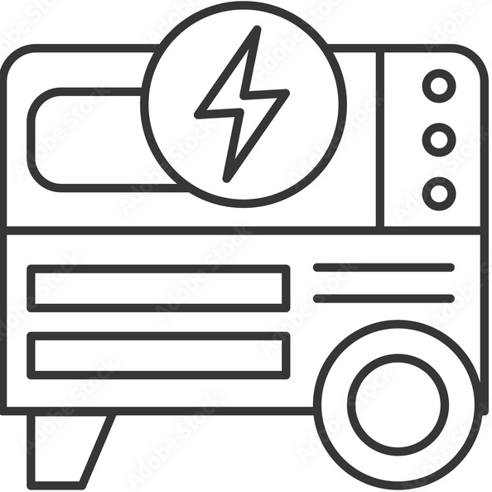
DC-coupled Solar Microgrid to serve 2.5 MWdc of added DC loads to Greenhouse2 meter
Solar
Battery
1.5 MWdc
6 MWh
350-500 Vdc LEDs
4-6 hr/day, Oct-Mar
Converter
Converter
DC Loads
Peak: 2.5 MWdc
800 Vdc
DC bus
Converter
Inverter 530 kW
Diesel Generator
Main Circuit Breaker
AC Loads
Peak: 291 kWac
MCB
480 Vac
3-phase
Line Side Taps
ATS
Automatic Transfer Switch
M
SCE Meter (limit of 665 kWac)
800 A, 480 Vac, 3-phase
SCE Grid
Transformer
500 kVA

Slide 21
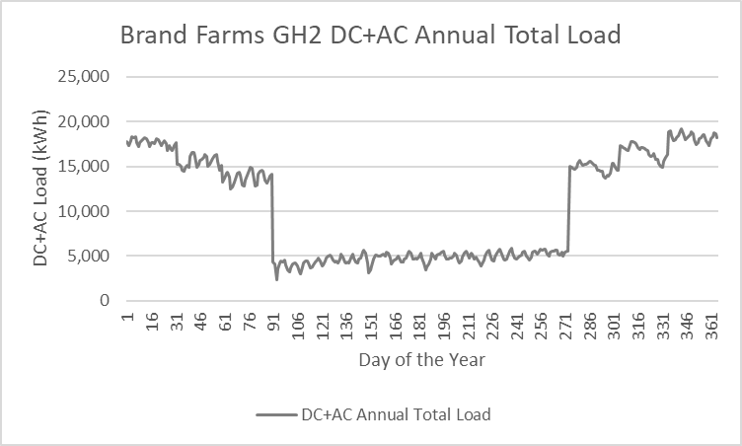
Greenhouse2 economics assuming all future
AC & DC loads can be served by the grid

Slide 22
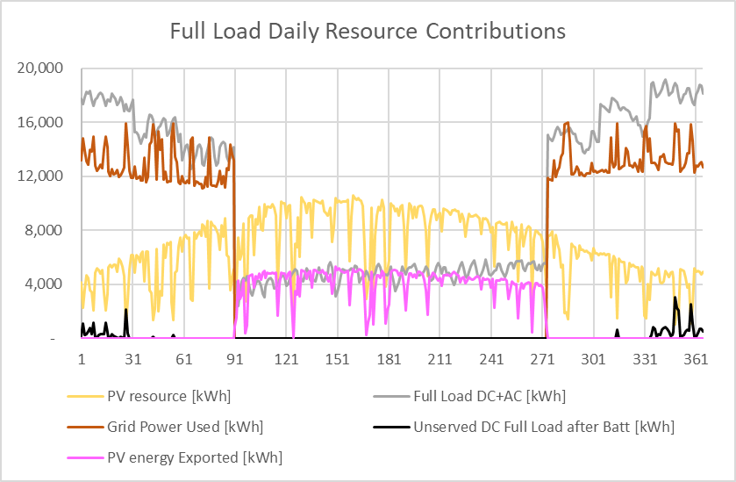
Greenhouse2 Energy Flow after addition of $10 million Solar Microgrid and 2.5 MWdc of DC loads
Energy Flow Diagram
1.5 MW solar and 3 MW / 6 MWh energy storage

Slide 23

Sierra Blanca
Community & Solar Microgrids
Craig Lewis
Executive Director
650-796-2353 mobile
craig@clean-coalition.org
31 Aug 2023

Slide 24
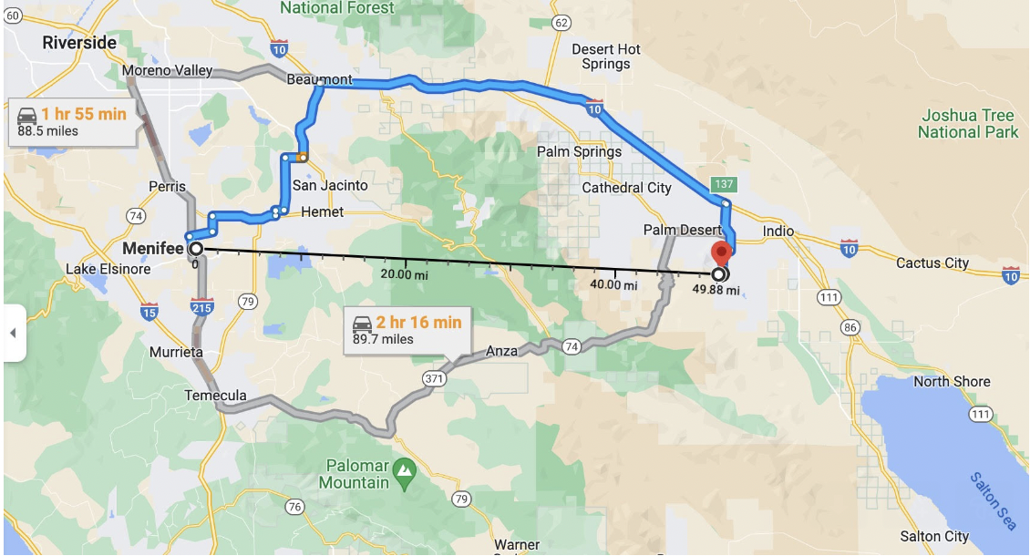
Menifee solar community provides local example
https://www.latimes.com/opinion/story/2023-07-09/la-home-electrification-new-construction-menifee-microgrid
https://www.cbsnews.com/losangeles/news/menifees-microgrid-community-offers-energy-self-sufficiency/?intcid=CNM-00-10abd1h

Slide 25
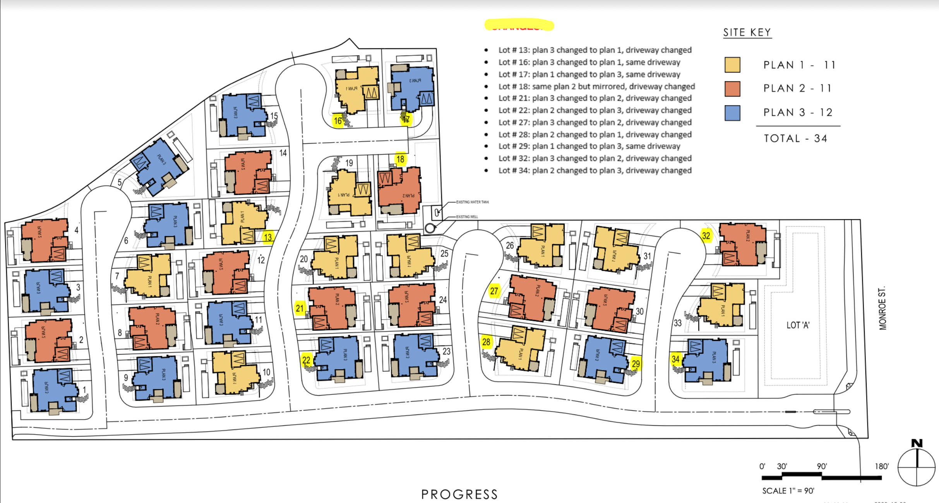
34-home Sierra Blanca community

Slide 26
Sierra Blanca energy system scenarios
Scenario A - Individual Solar Microgrids (solar+storage) at each home electrically connected by a private electricity grid to form a Community Microgrid
654 kW of solar across the community
  19.25 kW of solar on the average home. This includes an extra 90 kW of solar across the community where an average of 6 kW is added to 15 homes with the worst solar performance, by modifying the following roof plans that each apply to 5 homes:
    P1-B
    P2-B
    P3-B
1,340 kW & 2,898 kWh Battery Energy Storage System (BESS) across the community
  10 kWac & 26.4 kWh battery at each of the 34 homes
  Two 500 kW & 1,000 kWh BESS’s
Scenario B – Individual Solar Microgrids (solar+storage) at each home and electrically connected by a private electricity grid to form a Community Microgrid. Also includes two central BESS systems and a central gas generator
564 kW of solar across the community
  16.6 kW of solar on the average home
1,170 kW & 2,450 kWh BESS across the community
  5 kWac & 13.2 kWh battery at each of the 34 homes
  Two 500 kW & 1,000 kWh BESS’s
230 kWac gas generator
Scenario C – Individual Hybrid Solar Microgrids (solar+storage+gas generator) at each home and connected by a SoCalGas line
564 kW of solar across the community
  16.6 kW of solar on the average home
170 kW & 448.8 kWh BESS across the community
  5 kWac & 13.2 kWh battery at each of the 34 homes
884 kWac gas generation across the community
26 kWac gas generator at each of the 34 homes

Slide 27
Sierra Blanca energy system layout – Scenario A
Legend
Average house with average Solar Microgrid:
19.25 kWdc solar
10 kWac / 26.4 kWh battery
20’x10’ battery container hosting 500 kW & 1 MWh
Private electricity grid

Slide 28
Sierra Blanca energy system layout – Scenario B
Legend
Average house with average Solar Microgrid:
16.6 kWdc solar
5 kWac / 13.2 kWh battery
20’x10’ battery container hosting 500 kW & 1 MWh
Private electricity grid
230 kWac gas generator
SoCalGas line

Slide 29
Sierra Blanca energy system layout – Scenario C
Legend
Average house with average Solar Microgrid plus standard gas generator:
16.6 kWdc solar
5 kWac / 13.2 kWh battery
26 kWac gas generator
SoCalGas line

Slide 30
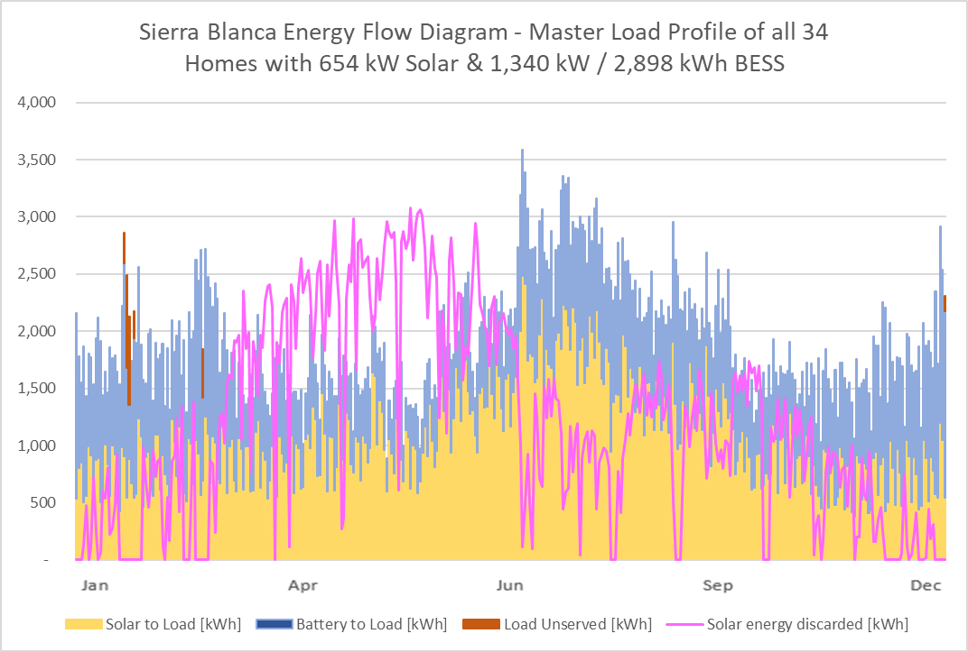
Scenario A: 654 kW solar and 1,340 kW & 2,898 kWh BESS across the community

Slide 31
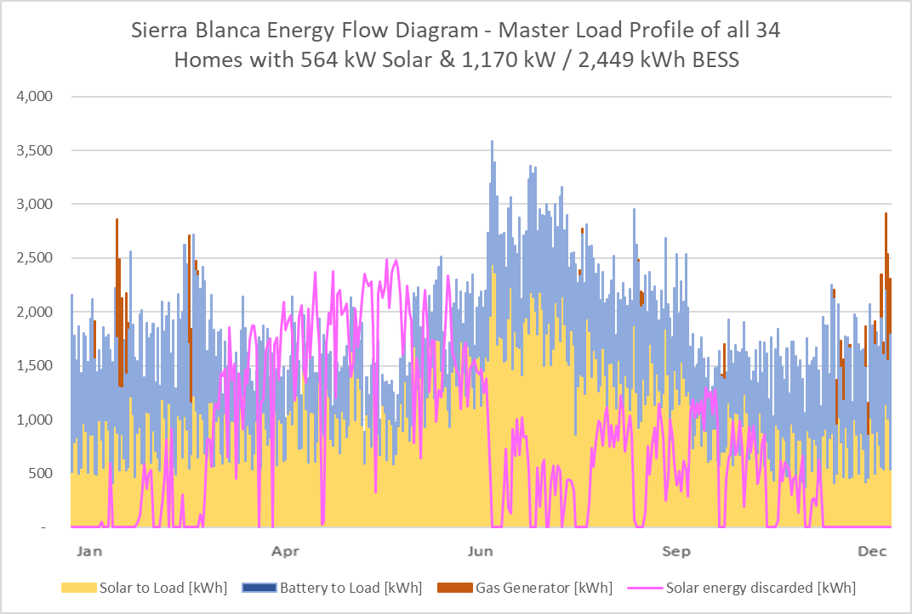
Scenario B: 564 kW solar and 1.17 MW & 2.45 MWh BESS across the community

Slide 32
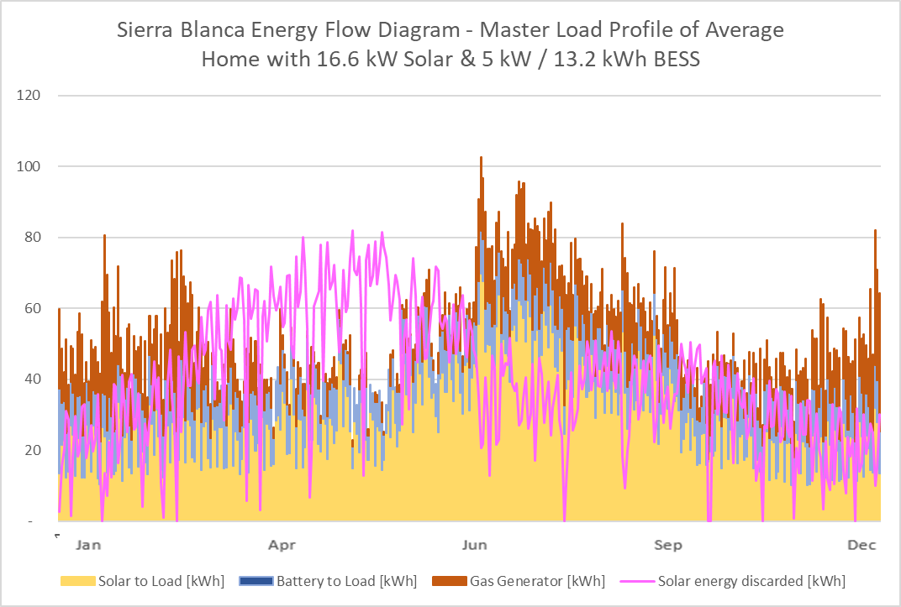
Scenario C: 16.6 kW solar (average), 5 kW & 13.2 kWh BESS, and 26 kW gas generator per home

Slide 33
Berkeley Efficient & Resilient Mixed-Use Showcase
(BERMUS)
Berkeley Efficient & Resilient Mixed-Use Showcase (BERMUS)
Notes:
33

Slide 34

Key BERMUS features
All-electric, 8-story, commercial and permanently affordable housing community.
65 units of 100% affordable housing with ground floor commercial offices and retail spaces.
Affordable home ownership via condominiums that provide homeownership benefits from original tenancy, with all being disadvantaged and low-income.
Net Zero Energy (NZE) building with a solar canopy covering the entire roof area, including a large rooftop patio and roof-mounted mechanical equipment for HVAC etc.
GridOptimal with the Solar Microgrid providing all energy during the 4-9pm grid-constrained period daily.
Solar Microgrid resilience ensuring indefinite resilience for the critical loads during grid outages of any duration, with significant resilience to all other loads based on solar energy availability and battery state-of-charge. Meets the full performance requirements of the CEC-recommended VOR123 value-of-resilience (VOR) methodology.

Slide 35
Orcas Community Microgrid (OCM)
Orcas Community Microgrid (OCM)

Slide 36
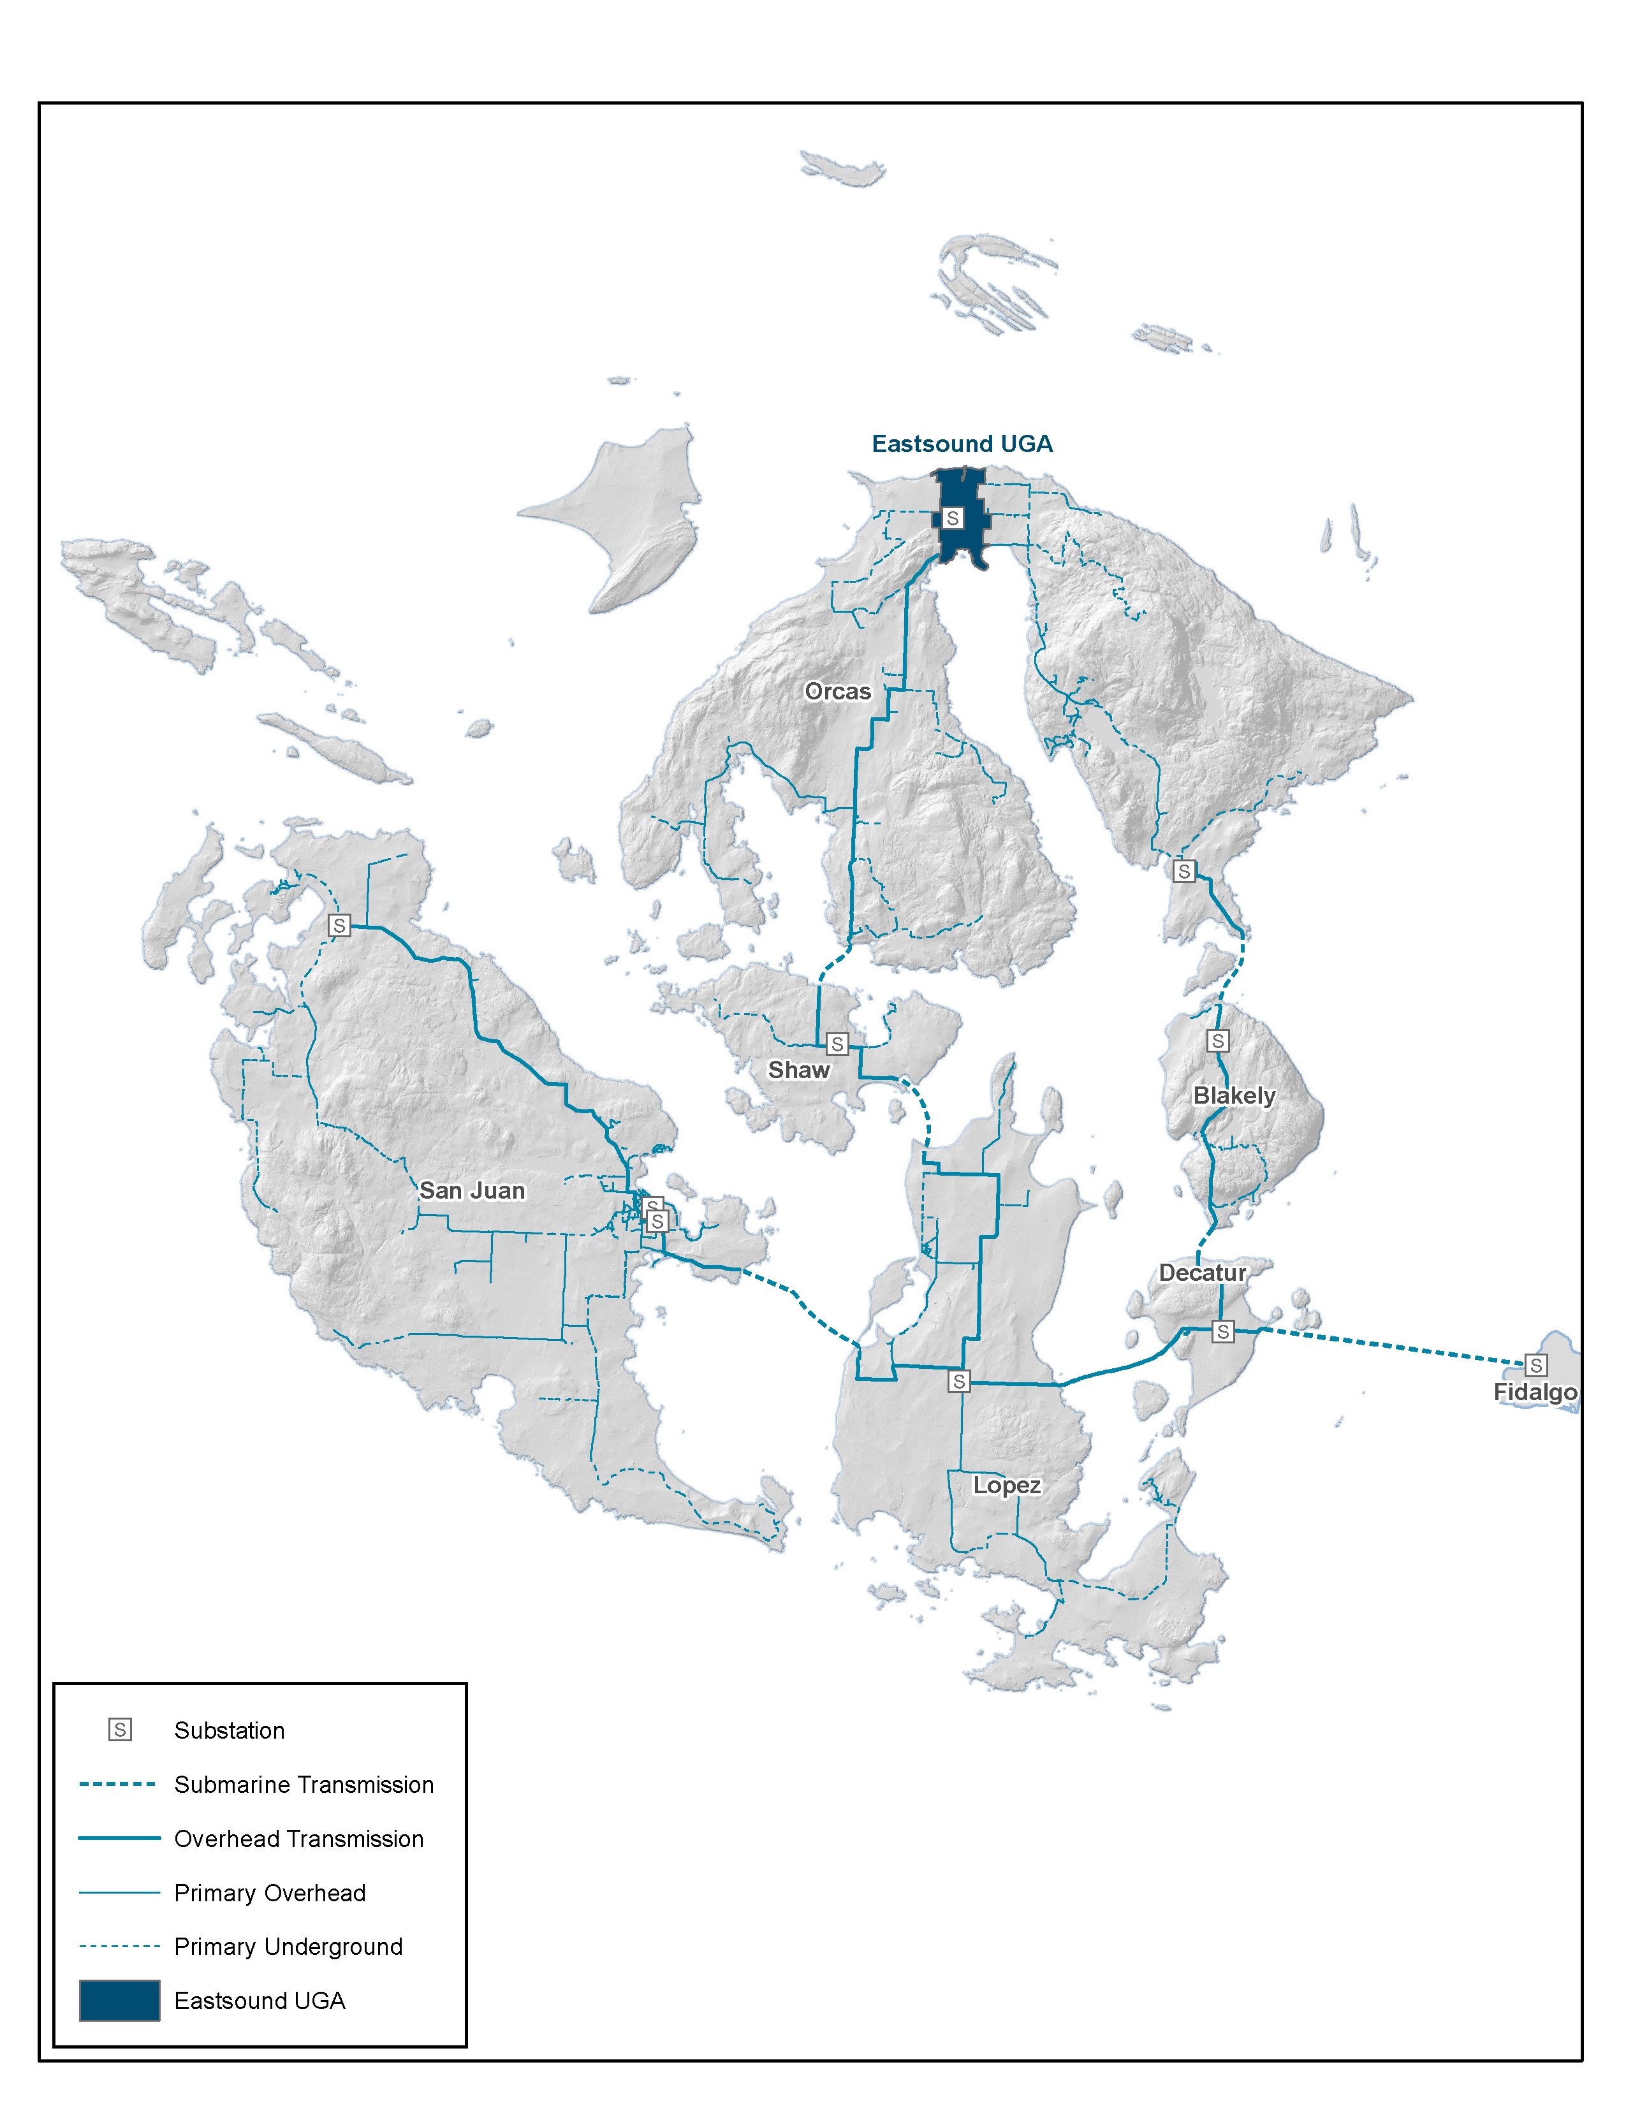
Grand OCM plan for the entire San Juan Islands
Figure 1: OPALCO’s service territory covers San Juan County and includes 20 islands. Eastsound is shaded towards the top of Orcas Island and represents the initial Orcas Community Microgrid location. Over time, the Community Microgrid will expand to cover all of Orcas and then eventually the entire OPALCO service territory.

Slide 37
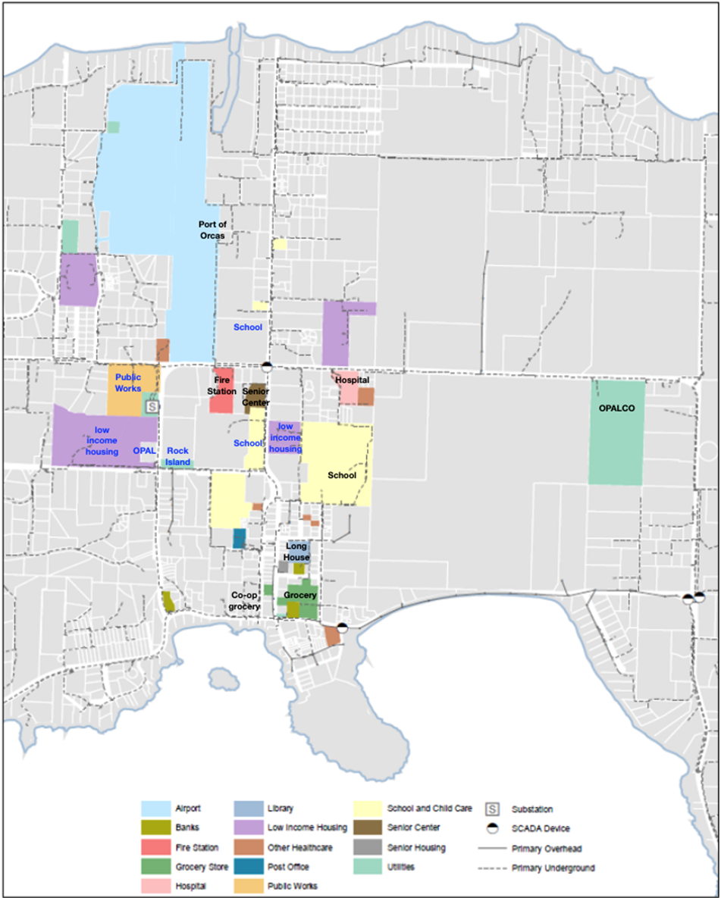
Eastsound Tier 1 & 2 facilities map
Figure 2: Eastsound facilities that are being provisioned with priority Community Microgrid resilience in the initial Orcas Community Microgrid design are shaded. Tier 1 Critical Community Facilities (CCFs) are shaded and labeled with black text, while Tier 2 CCFs are shaded in blue text. Figures 3 and 4 further depict the initial Orcas Community Microgrid in block diagram form.

Slide 38
Key OCM innovations
Three levels of Load Management:
  Grid Isolation Switches.
  Smart customer meters.
  Behind-the-meter (BTM) smart circuit panels.
Resilient Energy Subscription (RES) market mechanism to harness market-driven expansion.
New technology opportunities:
  Relatively novel renewable energy generation (biopower & tidal).
  Multi-month green hydrogen storage.
  eleXsys grid optimization (study being offered immediately for free)

Slide 39
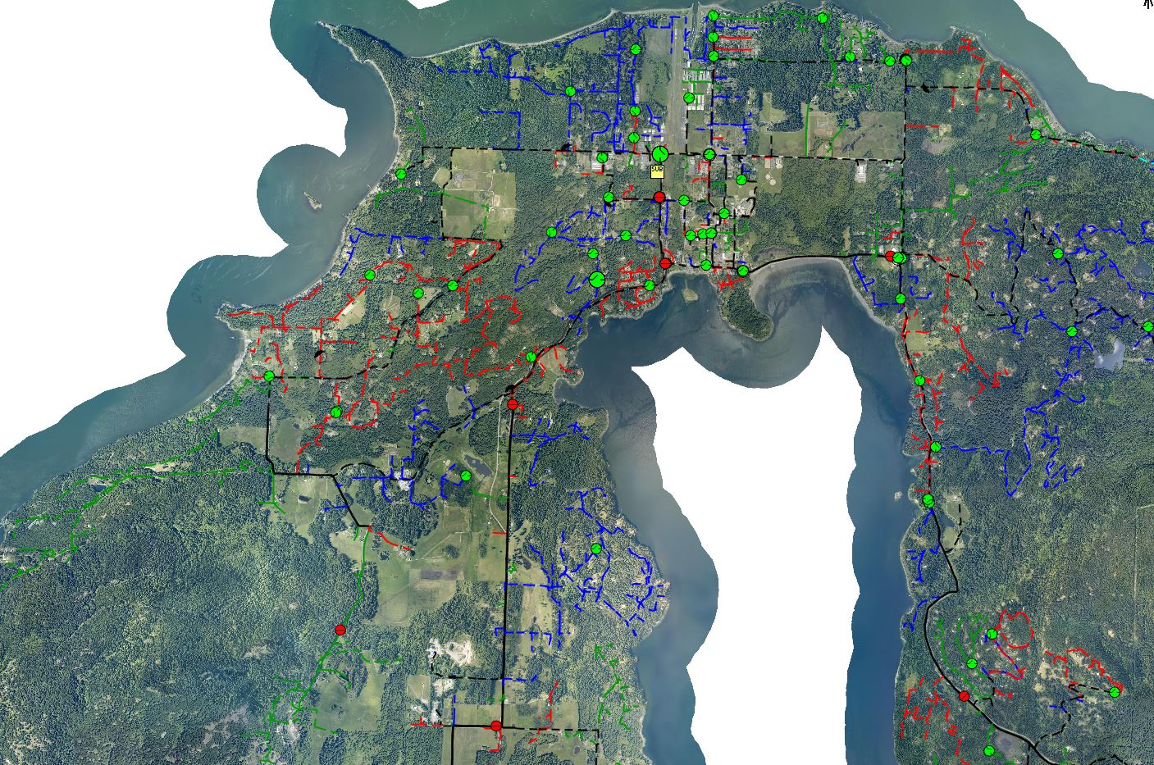


OCM map for Orcas Island
Feeder (A phase)
Feeder (B phase)
Feeder (C phase)
Underground feeder (Three phase)
Overhead feeder (Three phase)
Manual existing grid switches (open)
Manual existing grid switches (closed)
Microgrid area
Eastsound Substation
OPALCO headquarters
2.7 MWh battery (primary location)
New 1-phase GIS
New 3-phase GIS
Upgraded 3-phase GIS
Existing 69 kV transmission line
1 MW biopower facility
1 MW Biopower facility
Notes:
L shaped microgrid area instead of square
ATP – EMTP is a PLS CAD
Real time dynamic simulator

Slide 40
OCM project budget

Slide 41
Transmission-vulnerable case study
Transmission-vulnerable case study

Slide 42
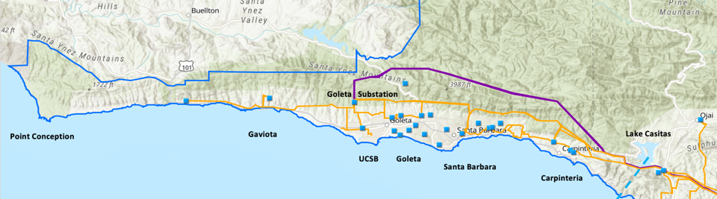
Goleta Load Pocket (GLP)
The GLP is the perfect opportunity for a comprehensive Community Microgrid
GLP spans 70 miles of California coastline, from Point Conception to Lake Casitas, encompassing the cities of Goleta, Santa Barbara (including Montecito), and Carpinteria.
GLP is highly transmission-vulnerable and disaster-prone (fire, landslide, earthquake).
200 megawatts (MW) of solar and 400 megawatt-hours (MWh) of energy storage will provide 100% protection to GLP against a complete transmission outage (“N-2 event”).
  200 MW of solar is equivalent to about 5 times the amount of solar currently deployed in the GLP and represents about 25% of the energy mix.
  Multi-GWs of solar siting opportunity exists on commercial-scale built-environments like parking lots, parking structures, and rooftops; and 200 MW represents about 7% of the technical siting potential.
  Other resources like energy efficiency, demand response, and offshore wind can significantly reduce solar+storage requirements.

Slide 43
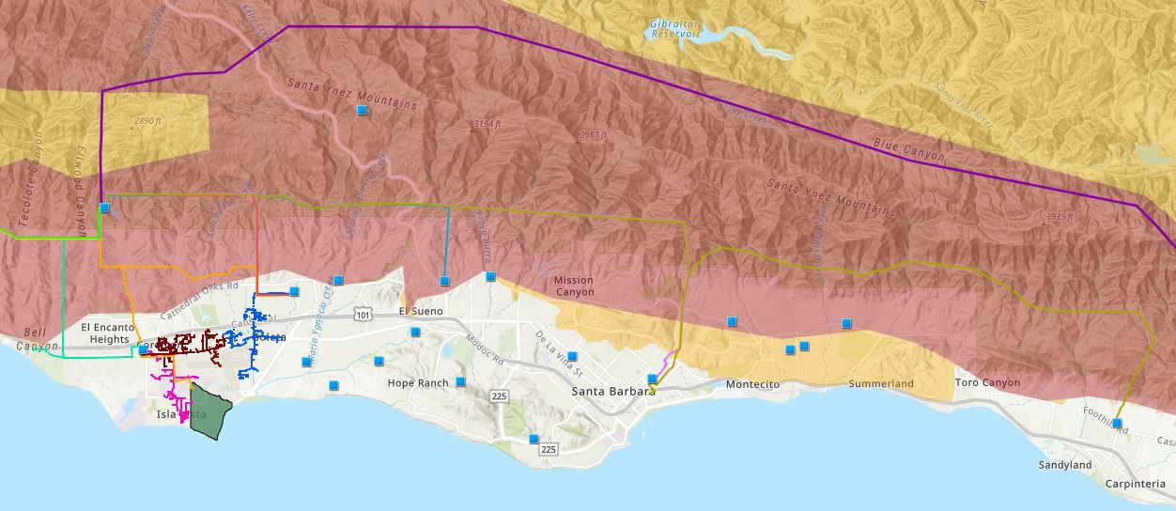

Core load area of the GLP
Legend
Feeder #4157
Feeder #4169
220 kV Transmission
Tier 3 Fire Threat
16kV Gladiola Feeder
Feeder #3556
Feeder #4227
Santa Barbara Airport
Tier 2 Fire Threat
16kV Gaucho Feeder
Feeder #4311
Feeder #3565
Substations
UCSB
16kV Professor Feeder
Feeder #3559

Slide 44
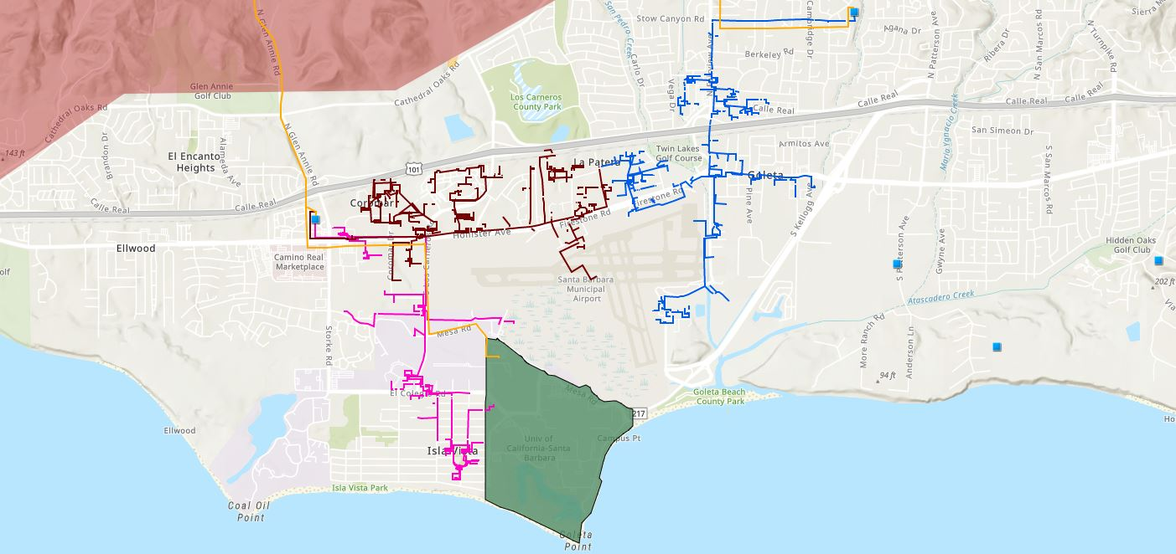








Target 66kV feeder serves critical GLP loads
Bella Battery Energy Storage Project (120 MWh)
Direct Relief (Solar Microgrid)
Vegas Substation
Dos Pueblos High School (Solar Microgrid)
Goleta Energy Storage Project
(240 MWh)
SB Airport
Fire Station # 8
Ellwood Gas Peaker Plant
Isla Vista Substation
UCSB
Fire Station # 17
Goleta Sanitary District
Legend
16kV Gladiola Feeder
University of California Santa Barbara
Goleta Valley Cottage Hospital
66 kV Feeder #4311
16kV Gaucho Feeder
Dos Pueblos High School
Direct Relief
Substations
16kV Professor Feeder
Fire Stations
Deckers
Tier 3 Fire Threat
Santa Barbara Airport
Goleta Sanitary District
Planned Battery Energy Storage

Slide 45
Target 66kV feeder grid area block diagram
Goleta Substation (220-to-66kV)
66kV distribution feeder #4311 with multiple branches
Vegas Substation (66-to-16kV)
Goleta Substation has eight feeders, seven 66 kV & one 16 kV, that serve the entire GLP
Fire Station #8
Direct Relief
+ Solar Microgrid
San Marcos
+ Solar Microgrid
66kV underground interconnection
Tier 2 & 3 facilities
Dos Pueblos
+ Solar Microgrid
Tier 2 & 3 facilities
Karl Storz + Solar Microgrid
Goleta Energy Storage Project (240 MWh)
City of Goleta
+ Solar
Isla Vista Substation (66-to-16kV)
Deckers
+ Solar
Goleta Cottage Hospital
Ellwood Gas Peaker Plant
GenOn Battery Energy Storage (120 MWh)
Tier 2 & 3 facilities
SBA (runway lights & ATC)
Diagram Elements
66 kV Distribution Feeder #4311
16 kV Gladiola Feeder
16 kV Gaucho Feeder
16 kV Professor Feeder
16 kV Los Carneros Feeder
16 kV Ace Feeder
16 kV Storke Feeder
Planned Battery Energy Storage
Ellwood Gas Peaker Plant
Grid isolation switch (open, closed)
Smart meter switch (open, closed)
Fire Station #17
SBA (Main Terminal)
Costco
+ Solar
Goleta Sanitary District
UCSB
+ Solar

Slide 46
Microgrid Incentive Program
Microgrid Incentive Program

Slide 47
Microgrid Incentive Program (MIP)
In January 2021, the Commission authorized the Microgrid Incentive Program, with a $200 million budget, to fund clean energy microgrids to support the critical needs of vulnerable communities impacted by grid outages and to test new technologies or regulatory approaches to inform future action.
The Microgrid Incentive Program is intended to provide funding for community, local and tribal government-driven, reliability and resilience projects with benefits including:
  Increased electricity reliability and resiliency in communities that may be at higher risk of electrical outages.
  Increased reliability for critical infrastructure facilities such as fire stations, schools, and nursing homes that keep communities safe.
  Reduced impacts of power outages and minimized disruptions for low-income households, individuals who rely on un-interrupted power, utilize assistive and/or medical equipment, or experience other access and functional needs.
  Reduced Greenhouse Gas emissions by deploying clean generation technologies and expanding the market for resiliency solutions that do not rely upon diesel generation.
MIP Timeline
  April 14, 2023 - Commission Decision approving the MIP Implementation Plan issued.
  Early October 2023 - The utilities made the Microgrid Incentive Program Handbook available on their respective websites.
  Early July 2024 - The first MIP application window opens no later than nine (9) months after the publication of the MIP Handbook.

Slide 48
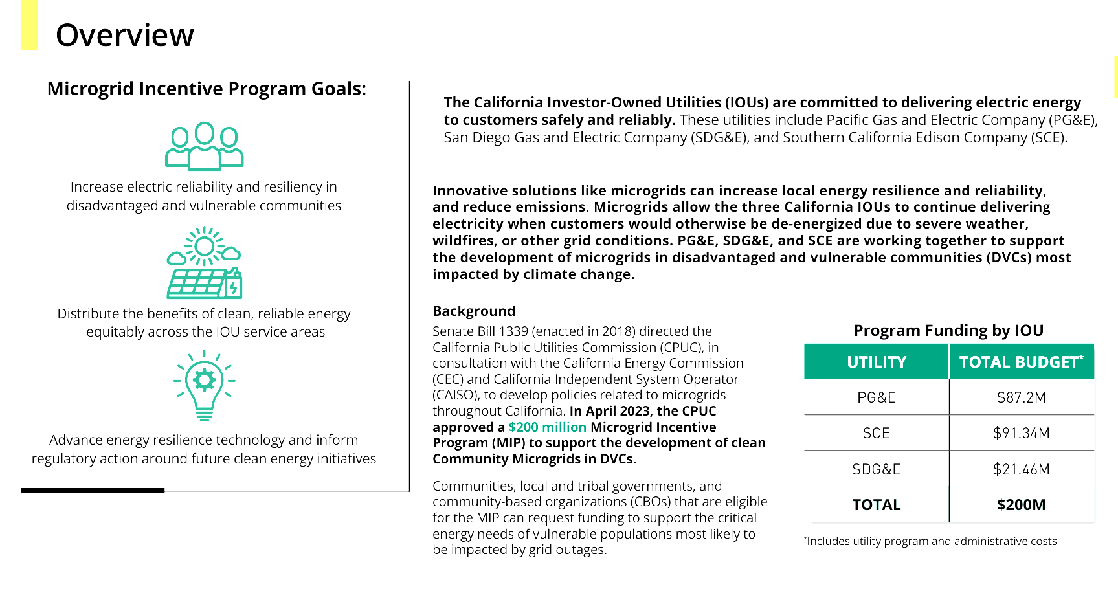
Microgrid Incentive Program (MIP) overview
Approved Decision & MIP websites
Approved decision
SCE’s MIP website
PG&E’s MIP website
SDG&E’s MIP website
MIP Timeline
Early July 2024 - The first MIP application window opens no later than nine (9) months after the publication of the MIP Handbook.

Slide 49
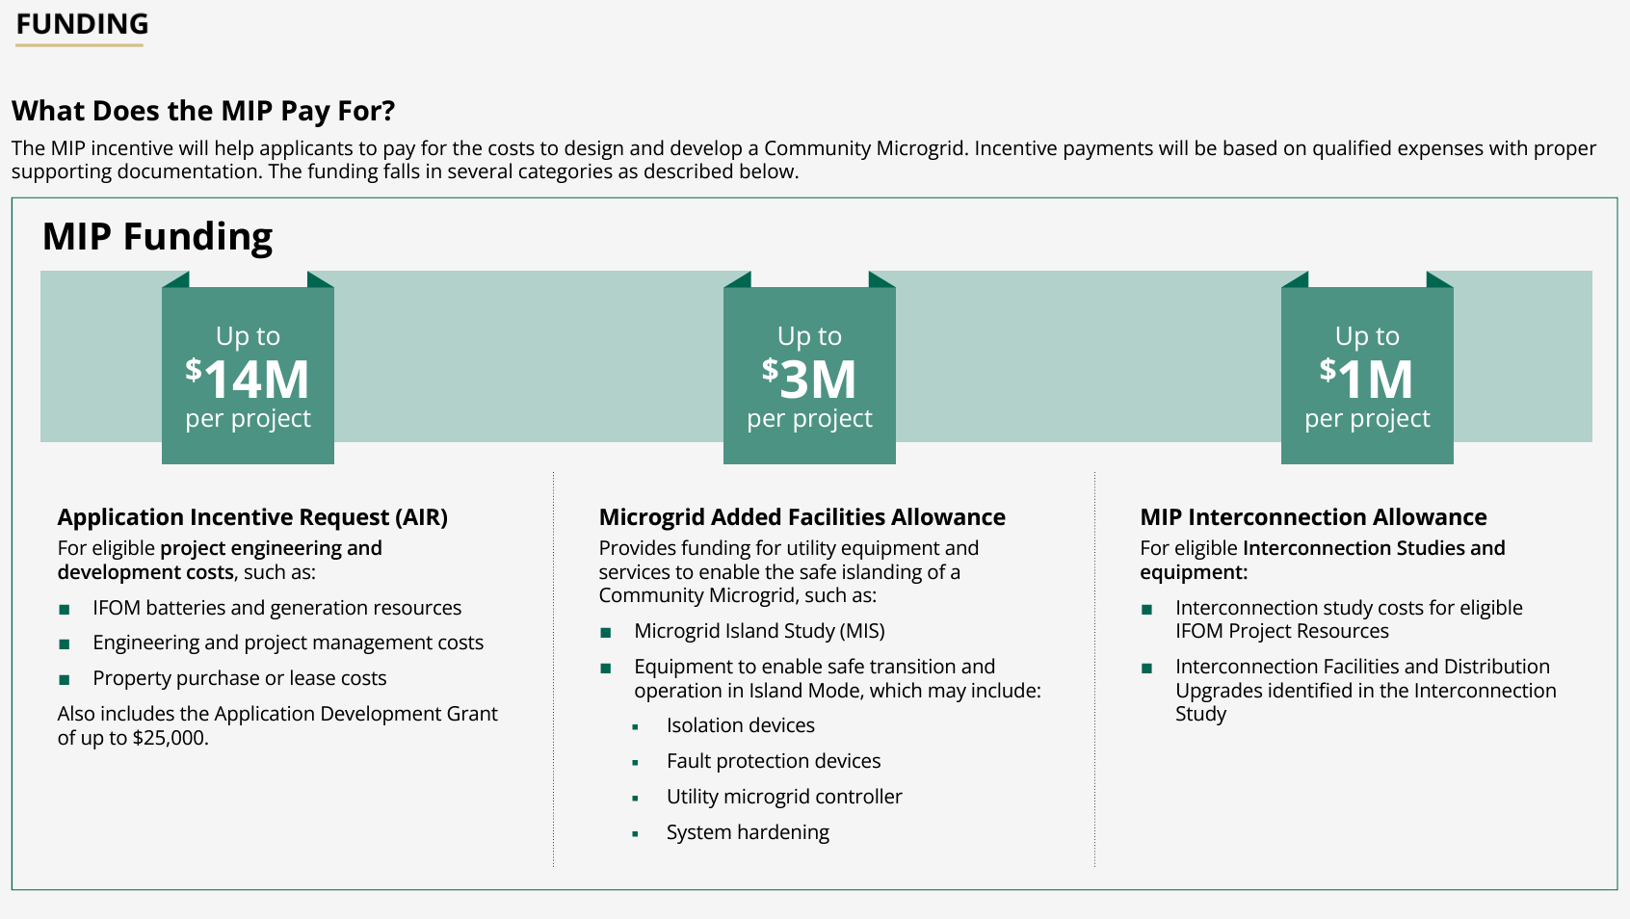
MIP funding

Slide 50
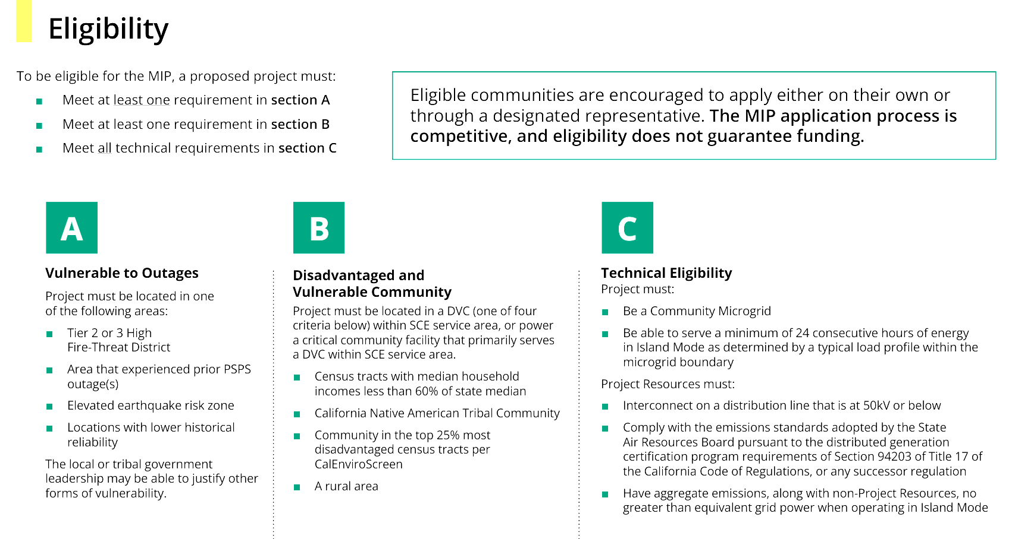
MIP eligibility

Slide 51

MIP eligibility

Slide 52
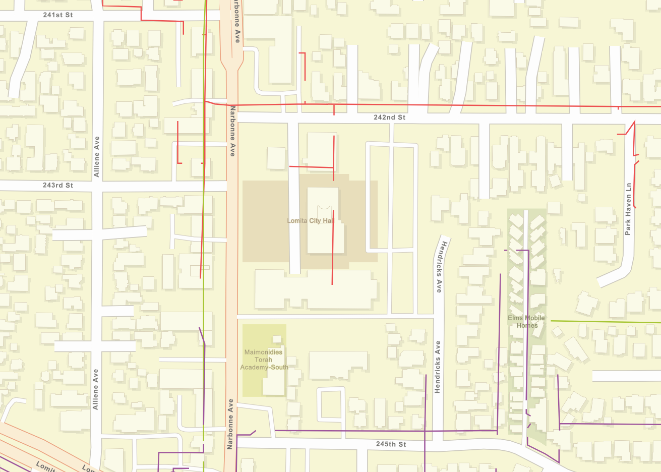





Lomita Community Microgrid project area
Lomita Library
Lomita City Hall
LA County Regional Offices
Learning Center
Preschool
Map Elements
16kV Blocker Feeder
4kV Narbonne Feeder
16kV Zepher Feeder

Slide 53


MIP eligibility for the Lomita project area
MIP Eligibility Map (all layers apply to the entire state of California, not just PG&E territory).
  Section A: Vulnerable to Outages
    Located within Tier 2 & 3 HFTD
    Area that experienced prior PSPS outage(s)
    Elevated earthquake risk zone
    Locations with lower historical reliability
  Section B: Disadvantaged and Vulnerable Community
    Census tracts with median household incomes less than 60% of state median
    California Native American Tribal Community
    Community in the top 25% most disadvantaged census tracts per CalEnviroScreen
    A rural area
  Section C: Technical Eligibility
    Be a Community Microgrid
    Be able to serve a minimum of 24 consecutive hours of energy in Island Mode as determined by a typical load profile within the microgrid boundary
    Project Resources must:
      Interconnect on a distribution line that is at 50kV or below
      Comply with the emissions standards adopted by the State Air Resources Board pursuant to the distributed generation certification program requirements of Section 94203 of Title 17 of the California Code of Regulations, or any successor regulation
      Have aggregate emissions, along with non-Project Resources, no greater than equivalent grid power when operating in Island Mode

Slide 54
RES for financing Community Microgrids
Resilient Energy Subscription for financing Community Microgrids

Slide 55
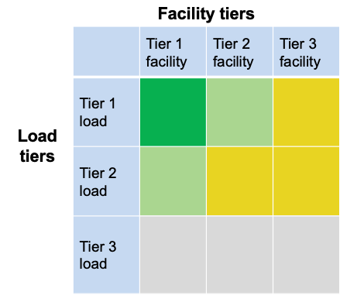
Tiering for Community Microgrids
The top emphasis is to provision 100% resilience for Tier 1 loads at Tier 1 facilities (the darker green square in the chart).
  Tier 1 facilities include CCFs such as fire stations and emergency shelters — and can also include grocery stores, data centers, pharmacies, gas stations, EV charging stations, & apartment complexes that can provide sheltering-in-place during grid outages.
The second emphasis is for Tier 1 loads at Tier 2 facilities and Tier 2 loads at Tier 1 facilities (the lighter green squares).
= Critical for the entire community, such as Tier 1 loads at
Tier 1 facilities like fire stations
= Priority for the entire community, such as Tier 2 loads at
Tier 1 facilities and Tier 1 loads at Tier 2 facilities like multi-
unit housing facilities that can provide safe and easy
sheltering in place
= Priority for individual facilities but not the entire community
= Discretionary loads that are not impactful to the community,
whether on or off

Slide 56
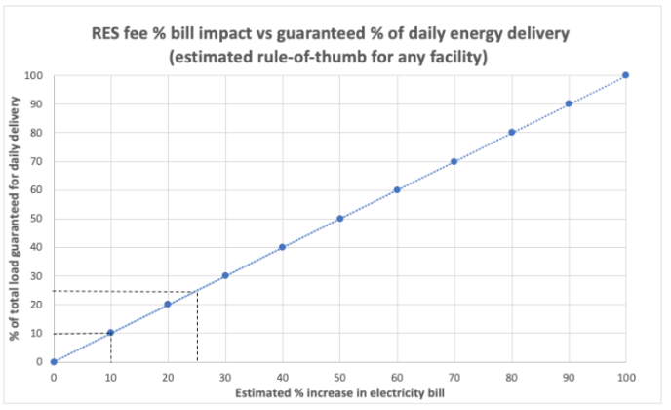
RES costs 1% bill increase per 1% load coverage
The Clean Coalition’s analysis shows:
  A value-appropriate RES subscription ratio of 1.0 (1% bill increase per 1% guaranteed load coverage) for the subscriber is feasible.
  A positive IRR of 9% for the Community Microgrid owner is feasible.
Therefore, the RES is financially feasible for all stakeholders.
Key Takeaways:
RES allows Community Microgrids to be deployed at scale and expanded, as more facilities desire resilient energy guarantees.
RES provides a revolutionary and straightforward approach for financing Community Microgrids and delivering unparalleled resilience to communities.
RES enables a greater harmonization between local energy needs and societal planning in a way that helps put the people first.

