Slide 1

Infill Solar maximizes the value of
Community Solar for communities
Ben Schwartz
Policy Manager
Clean Coalition
626-232-7573 mobile
ben@clean-coalition.org
5 September 2023

Slide 2
Write a PD that properly compensates Infill Solar
The PD must compensate Infill Solar for the additional value created.
Work with the ALJ to write a PD that properly compensates for the full value of Infill Solar.
  Make changes that include the value of TAC and PCIA if these are not included in the PD.
If the PD fails to properly value Infill Solar, it will only result in in ground mount solar. In this case, the PD should be pulled and revised (like was done with the Net Billing Tariff).

Slide 3
Making Community Solar work in California for Infill Solar
To ensure that Infill Solar deployments are maximized, Infill Solar must be compensated for the full value it delivers to ratepayers
Infill Solar (on buildings, parking lots, and parking structures) creates far greater value than remote solar.
  Avoids stressing transmission infrastructure that drives the need for exorbitantly expensive transmission investments that increase electricity costs for all ratepayers – whether rich, poor, or anywhere between.
  Maximizes energy efficiency by avoiding the 10% of energy lost in transmission line & congestion losses.
  Preserves pristine environments and open spaces.
  Provides direct & indirect economic stimulation to communities, with 50% of installed costs delivered as economic stimulation to the communities in which the DER are deployed.
The NVBT fails to properly compensate Infill Solar for its enhanced value.
  The extra value from Infill Solar should be compensated in the form of avoided Transmission Access Charges (TAC) and Power Charge Indifference Adjustment (PCIA) costs.
Unbundled (virtual) storage will maximize Infill Solar opportunities and optimize economics for ratepayers.
  Better Project Financials. Since storage is the main cost driver of solar+storage projects, virtual storage will enable larger deployments, taking advantage of economies of scale.
  Siting Potential. Infill Solar requires no dedicated space while onsite storage does, and this creates a problem that preempts many sites from hosting Infill Solar – given that there would not be room for storage.
Allow Infill Solar projects to interconnect via Rule 21 rather than be subjected to multi-year WDAT interconnection processes. A Rule 21 interconnection will save projects roughly $0.02/kWh compared to WDAT (and multiple years)
New Jersey Community Solar (Infill Solar requirement): Since 2018, contracted with 150 projects, for a total of 243 MW.
Notes:
A straw poll done by BPU in New Jersey suggested that NJ should target 750 MW over the next five years for the Community Solar Program.
https://www.greenbaumlaw.com/insights-alerts-New-Jersey-BPU-Establishes-Permanent-Community-Solar-Program.html
https://www.perchenergy.com/blog/industry/new-jersey-community-solar-policy-legislation-asset-owners-developers

Slide 4
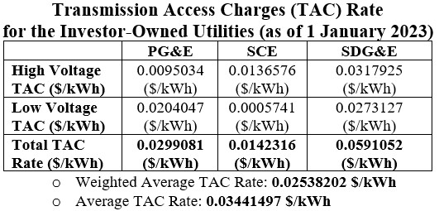
The Case for Avoiding Transmission Costs and PCIA
Infill projects — deployed within the same distribution substation area as the subscribers — will deliver energy without using the transmission grid, benefitting the ratepayers.
Reduced reliance on the transmission grid leads to reduced congestion & lines losses and more efficient system outcomes.
This additional value should be compensated by avoiding TAC, which recover present and historical investments in transmission.
  TAC are 100% volumetric fees for using the transmission system, which is how the IOUs pay for them. TAC are assessed properly by municipal utilities, at the T-D substation.
Avoiding TAC is not the same as the avoided transmission value in the Avoided Cost Calculator (ACC).
  TAC cover sunk costs that include capex — and opex and returns, which are almost 10x more than the capex.
The ACC values the reduction in avoided future transmission from distributed generation.
Infill projects should also receive and exemption from the PCIA. The PCIA recovers costs for legacy (remote) contracts; no costs are shifted by distribution-level projects.

Slide 5
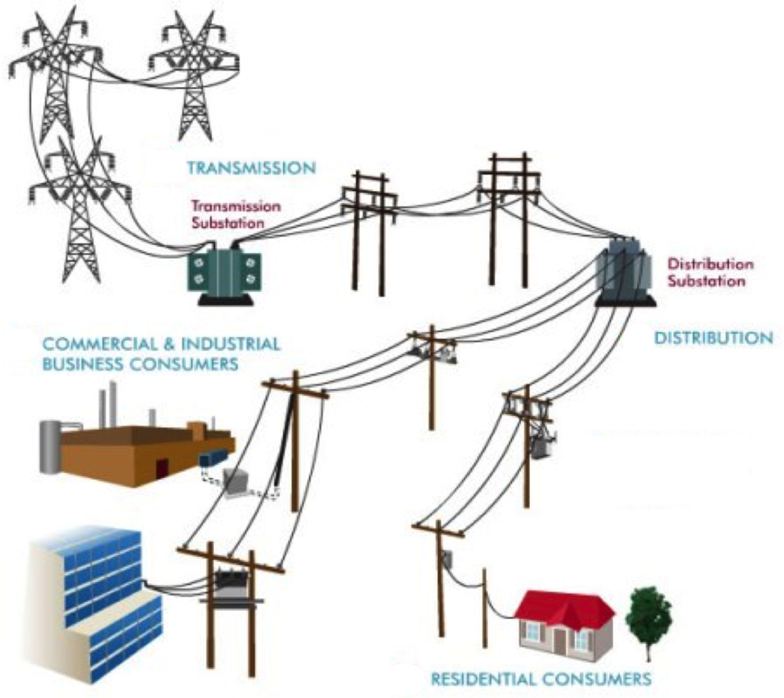
Local Solar = within the same distribution substation area as subscribers
Projects should be located within the same grid area as the subscribers. The defining point should be the nearest distribution substation, ensuring that the benefits stay local.
Infill projects sited primarily on rooftops, parking lots, and parking structures.
Subscribers are primarily residential customers located in disadvantaged communities.

Slide 6
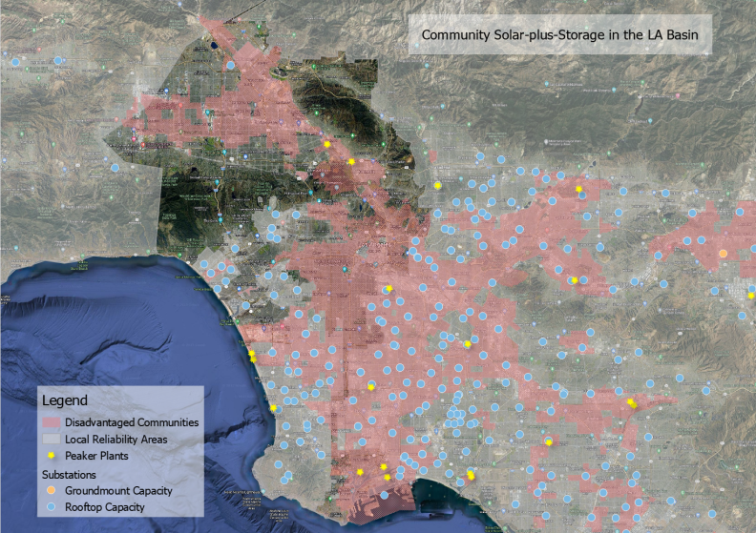
Ground mount will not be sited near DACs: the real siting potential is in Infill Solar
Notes:
Image by Brandon Smithwood
https://laist.com/news/climate-environment/with-rooftop-solar-energy-out-of-reach-for-many-heres-what-community-solar-could-do-for-us

Slide 7
Conclusions on siting opportunities for Local Solar
The vast majority of Community Solar siting potential is on built environments.
44% of residents are tenants and do not have access to their roofs.
The state is estimating around 12,000 MW of new customer-sited solar will need to be sited by 2030.
“California has more warehouse roof potential than any other state, boasting over 66,000 eligible commercial roofs that could power 4.9 million households with solar. ” – Solar Landscapes
Maximizing the opportunity for Infill Solar is in the best interest of the state. (See the NJ Community Solar program as an example of the success when infill projects are properly promoted)
An on-site energy storage requirement makes it difficult to maximize the size of the solar deployment.
  It could restrict a majority of sites otherwise capable of hosting a sizeable solar array from participating.
  It would ultimately make projects more expensive, avoiding economies of scale.

Slide 8
Virtual (unbundled) storage enables economies of scale
With a 4-hour paired storage requirement, storage will be the main cost driver.
Unbundling and increasing the size of the storage will lead to cost reductions from economies of scale.
Infill Solar can subscribe to a larger Infill Storage project that is sited closer to a distribution substation, where space is plentiful and additional (LCR) value can be provided.
Example: 500 kW Rooftop Solar with 2 MWh on-site storage versus 500 kW with 2 MWh allocation of 40 MWh unbundled storage.
        With on-site storage, the solar+storage price is nearly $0.34/kWh. The same sized solar system with unbundled storage results in a PPA price of $0.25/kWh, a cost reduction of 25%.
          Cost reductions from increased sizing potential make unbundled storage essential.
Notes:
8

Slide 9
The Avoided Cost Calculator (ACC) is the correct way to value exports
Using Least Cost Best Fit (LCBF) would guarantee a failed program. LCBF lacks transparency and is intended for evaluating transmission interconnected projects.
Community Solar is a policy-mandated program to allow target groups to realize the benefits of renewable energy deployments. It is unrelated to procuring the state resource portfolio.
  LCBF has historically been used to rank RPS projects in a way that minimizes costs to the ratepayers.
  PURPA contracts are not an appropriate comparison. While inexpensive, very few PURPA projects are being contacted/built.
Least cost to the ratepayers is not the same thing as greatest benefits over the lifetime of the project to the subscribers and the ratepayers.
The ACC is designed for use in all DER programs and is improved (each update) to increase harmonization with the IRP.

Slide 10
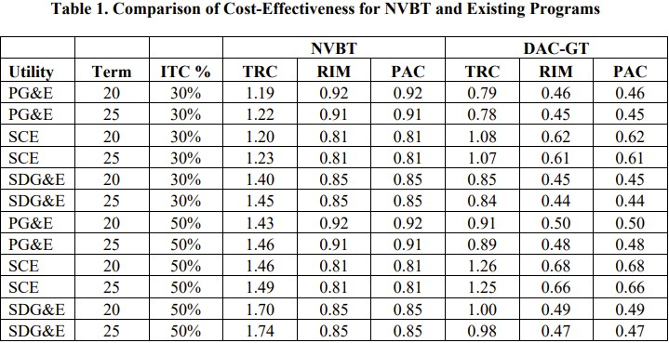
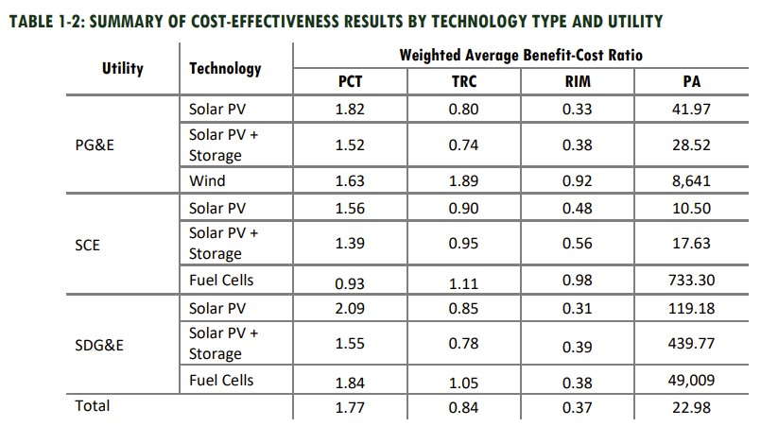
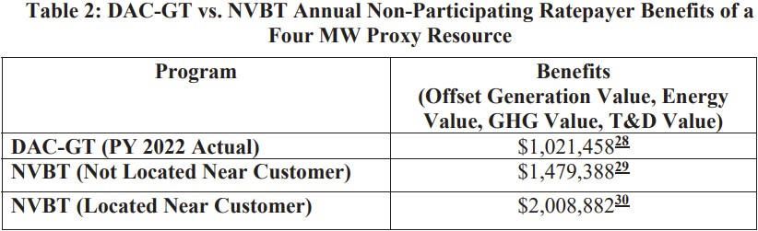
Existing programs are not cost-effective (scores closer to 1 are better for RIM/PAC and greater than 1 is best for the TRC)
With clearly inferior cost-effectiveness scores, the existing programs do not meet the requirements of AB 2316 on their own.
DAC-GT has closer cost-effectiveness test scores to NEM 2.0 than the NVBT.
NVBT projects located near subscribers (infill projects) create far more benefits than projects deployed under the existing programs.
Notes:
Table 1 is from CCSA’s Opening Comments on Cost-Effectiveness
Table 1-2 is from Verdant’s NEM 2.0 Lookback Study
Table 2 is from Cal Advocates’ Opening Comments on Cost-Effectiveness

Slide 11
The existing Green Tariff programs are not sufficient
Infill programs, like the New Jersey program, have been very successful. In comparison, California has lagged.
Projects should utilize Rule 21 for a fast interconnection process. Existing programs require usage of WDAT, which takes years.
Existing programs only result in infill deployments due to DAC siting requirements. This has limited the number of Infill Solar deployments outside DACs and reduced siting potential.
Existing programs struggle with enrollment. A new program with autoenrollment will solve that issue.
“The investor-owned utilities (“IOUs”) want to maintain these [DAC-GT and CSGT) programs at their current size - meaning only 50,000 CARE customers (1.6% of current CARE enrollees) can participate in these two programs” (CCSA Opening Comments at p. 4)

Slide 12
Key Takeaways for promoting infill Community Solar
Compensation
Equal pricing for all types of solar will likely result in a program where only remote ground mount projects are deployed (because they have the lowest installed cost).
Appropriate compensation for Infill Solar projects should include additional value created (as compared to ground mount projects), on top of the base pricing.
  Beyond the proposed NVBT, the proper way to value Infill Solar is by adding the avoided TAC and the PCIA.
Compensation should be based on the full value stack.
  There are additional non-energy benefits that the Commission could include (and should in a SCT).
Siting
Many benefits from Local Solar accrue in the same distribution area as subscribers. Transmission is not used.
Built environments represent the greatest siting opportunity, especially for projects located near DACs.
  Infill Solar is key to meeting ESJ/DER Action Plan goals to increase DER deployments and resilience for disadvantaged Californians.
Allow unbundled storage. With virtual storage agreements, the solar and storage can be deployed optimally within the same distribution substation area without being co-located, increasing value and cost-effectiveness.
Unbundling storage enables economies of scale by maximizing the size of the storage, reducing the cost and increasing the grid benefits.
Overall Asks
Write a Proposed Decision (PD) that compensates the full value of Infill Solar.
Make amendments or remove the PD if the initial PD would only lead to deployments of remote ground mount projects.

Slide 13
Conclusion: Write a PD that properly compensates Infill Solar
The PD must compensate Infill Solar for the additional value created.
Work with the ALJ to write a PD that properly compensates for the full value of Infill Solar.
  Make changes that include the value of TAC and PCIA if these are not included in the PD.
If the PD fails to properly value Infill Solar, it will only result in in ground mount solar. In this case, the PD should be pulled and revised (like was done with the Net Billing Tariff).

Slide 14
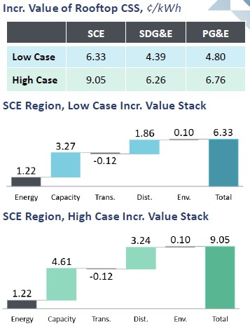
Other value adders
The proposed value stack does not consider the full set of benefits of DER because it is limited to the values considered in the Avoided Cost Calculator (ACC).
No PCIA ($0.04439 based on SDG&E’s 2023 residential vintage) should be allocated.
No TAC (0.014-0.059$/kWh) should be allocated.
Brownfield adders
Dispatchability adder
Built environment adder
Disadvantaged Community adder
Brattle Group Infill Value Stack Results

Slide 15
TAC rates as of January 2023

Slide 16
TAC rates over time
Transmission costs are the leading driver of rising electric rates and continue to rise significantly, as can be
from the chart below, which shows the average TAC rate over the last 11 years.

Slide 17
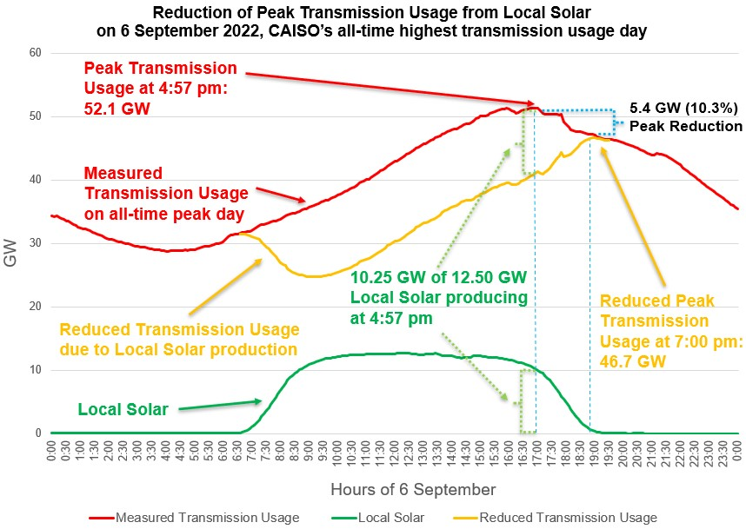
Case study on the reliability benefits of Local Solar

Slide 18
Local Reliability and Resilience Benefits
NEM projects are relatively small and can provide significant value to the grid when aggregated.
On the other hand, each Community Solar+Storage project will provide value on its own, in terms of both reliability and adding community resilience.
  Local solar+storage can fulfill Local RA requirements.
  Each local solar or solar+storage projects sets the stage for the deployment of a Community Microgrid.
  There is additional locational value to be captured beyond what is considered in the ACC.

Slide 19
Ideal pricing to match the Cost of Service (COS)
Pricing for local solar needs to be sufficient to yield market response:
Consider the COS for solar only
Consider the COS for solar+storage (with a 4-hour battery requirement)
Consider location-specific costs and interconnection costs in both cases.
Conclusions
There are additional values that should be considered by the Commission in addition to the proposed pricing.
There is a market benefit to moving quickly and implementing a new Community Solar program as soon as possible (assuming the program is well-designed).
  California needs projects that are ready to move forward as soon as possible to take advantage of federal incentives. Some of these incentives (specifically the low-income adder to the ITC) will disappear over time and cannot be the final piece that makes the NVBT economically feasible. Other values adders need to be considered in the interim so that the program is economically viable as a standalone compensation structure.

Slide 20
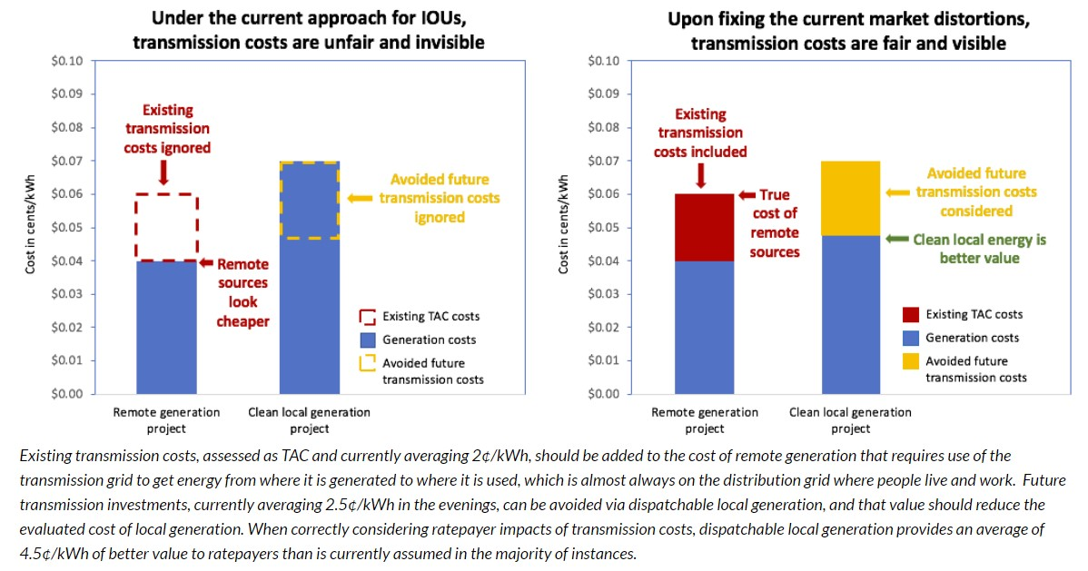
Avoiding Transmission Access Charges (TAC)

Slide 21
Infill community solar complements NEM
Statute, PUC Section 2827.1.(a)(1): Customer-sited renewables must continue to grow sustainably.
  Infill Community Solar projects will be essential to ensuring that this statute is met.
  Following the deadline of the Net Billing Tariff (NEM 3.0), it is likely that the number of systems being deployed will be reduced.
Statute, AB 2316, Section 1: Community Solar should provide similar value to NEM for customers that do not qualify for NEM (cannot host a solar system).
  This requires a full accounting of DER benefits that ensures appropriate value is available to customers not eligible for NEM.
Image created by Brattle Group

Slide 22
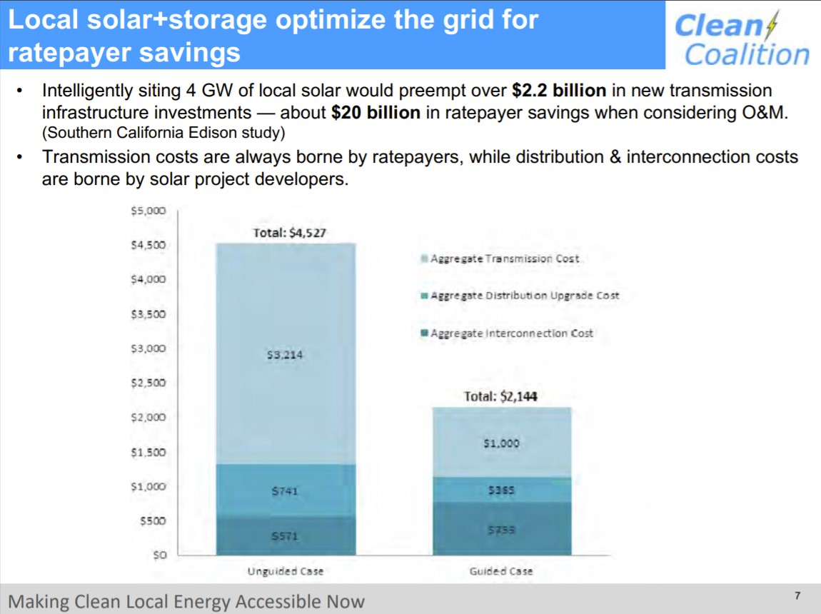

Slide 23
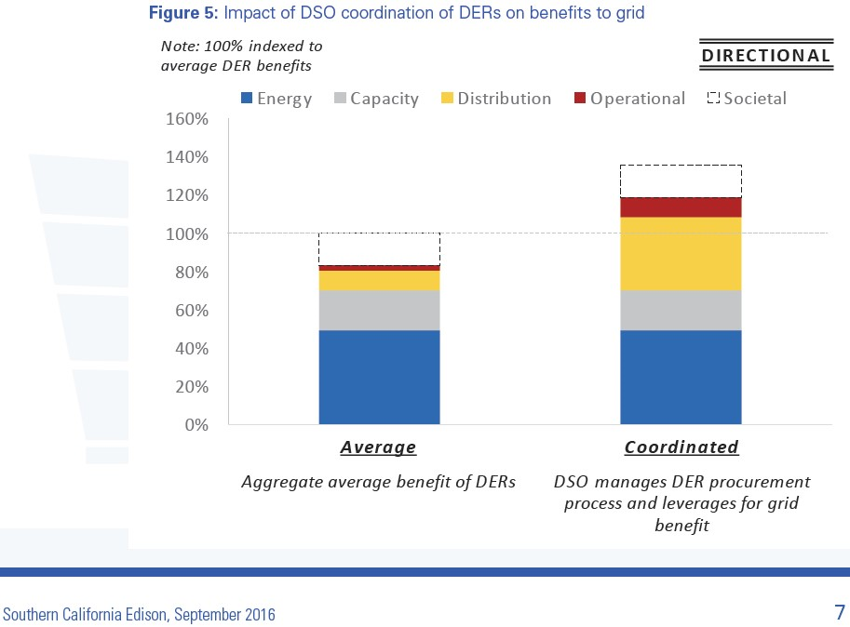
A DSO will increase the value from DER

Slide 24
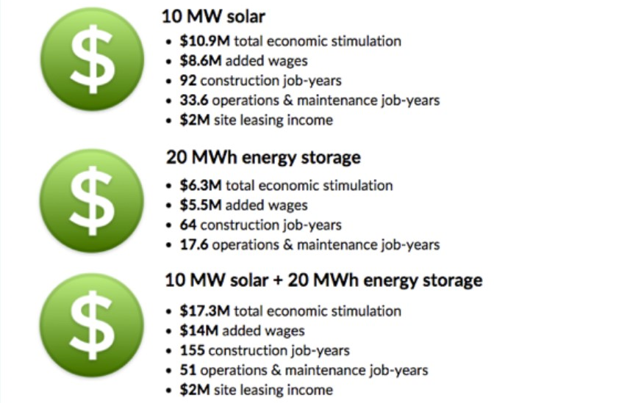
Benefits of Local Solar and Solar+Storage
20-Year Benefits of Deploying Local Solar and Solar+Storage
Unparalleled economic and environmental benefits.
Added benefit of setting the stage for resilience, via a Community Microgrid.
Land use benefits (saving California’s pristine lands).
Opportunity to use brownfield sites.
Reliability benefits, including dispatchability (when paired with storage).
Avoiding Transmission Access Charges (TAC)
Avoiding the Power Charge Indifference Adjustment (PCIA)
Quick project timelines.

