Slide 1

A high Fixed Charge disproportionately punishes low-income households, apartments, duplexes and small homes (and conservation/energy efficiency)
Ben Schwartz
Policy Manager
Clean Coalition
626-232-7573 mobile
ben@clean-coalition.org
Josh Plaisted
Principal
Flagstaff Research
510-459-7970 mobile
jplaisted@flagstaffresearch.com
15 October 2023

Slide 2
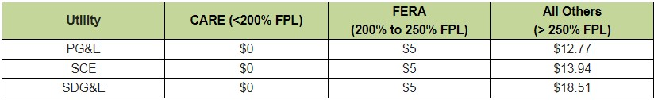
The Clean Coalition’s modest Fixed Charge proposal
The Clean Coalition’s proposed Fixed Charge is modest and will not burden any ratepayers.
All low-income ratepayers will save money on their electricity bills each month.
Transparent incentives for efficiency, conservation, and self-generation are maintained.
This proposal incorporates all the costs included in electricity that are truly “fixed”. Since rates are primarily collected on a volumetric basis ($/kWh) very few cost components are fixed.

Slide 3
Why is a high Fixed Charge a bad option?
A Fixed Charge is not the silver bullet solution that will solve the crisis of unaffordable electricity rates in California. Reducing rates is only a temporary respite if the utilities continue to request rate increases that outpace inflation.
Prices are high and low-income customers are not the only ones struggling to make ends meet in California. There are millions of renters, historically disenfranchised groups, and residents located in disadvantaged communities that could see bill increases from a high Fixed Charge.
A one-time rate reduction will not solve the underlying causes of increasing rates.
              PG&E raised rates by 9% earlier this year and could increase rates by as much as 32% by 2026.
              SDG&E is proposing an 8% rate increase for this year.
              Imposing a high Fixed Charge will have significant unintended consequences.
Other issues to consider that are related to rates include:
Energy consumption patterns
Sustainable growth of Local Solar
Electrification/Decarbonization
GHG reduction and environmental justice
Affordability
Notes:
Many things to think about when reforming rates: electrification/decarbonization (policy goals), affordability, and grid safety.
3

Slide 4
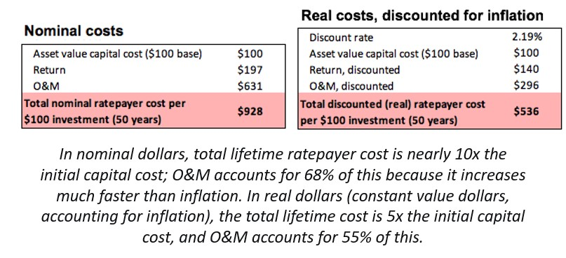
Cost drivers leading to increases in electricity rates
Transmission: $30 billion over 20-years and $9 billion for 2023-2024.
Wildfire Mitigation Costs: PG&E was granted over $1 billion (for 2023).
Wildfire Victim Payouts: So far for payouts to victims in 2015, 2017, and 2018 PG&E has paid $10 billion and is expected to pay a further $8 billion.
Wildfire Insurance Costs: This cost is getting so high (>$1 billion/year) that SCE has chosen to self-insure.
Undergrounding: PG&E’s cost to underground 10,000 miles will likely be close to $25 billion.
Legacy Generation & Nuclear Decommissioning Costs
Notes:
https://www.firevictimtrust.com/#:~:text=%2410%20Billion%20Paid%20to%20Claimants,as%20of%20July%2031%2C%202023.
https://www.kcra.com/article/moving-pge-power-lines-underground-cost-who-foots-the-bill/39960842#:~:text=%22In%202022%20we're%20looking,10%2C000%20miles%20of%20power%20lines.
4

Slide 5
Methodology behind the Clean Coalition’s proposal pt. 1
Covers the Marginal Customer Costs (e.g., the minimum bill for NEM customers).
  No transmission, generation, or public purpose charge components.
Results in savings for low-income customers on day 1 and a decrease in overall rates.
Three income tiers based on existing low-income subsidy programs.
  CARE: California Alternate Rates for Energy (30-35% bill credit)
  FERA: Family Electric Rate Assistance (18% bill credit)
CARE customers do not pay any Fixed Charge. FERA customers, of whom there are fewer, still see a savings.
All other customers pay as much or slightly more than they currently are.
Notes:
Explain what CARE and FERA are (what customer groups make them up).

Slide 6
Methodology behind the Clean Coalition’s proposal pt. 2
Redistributes the cost of existing minimum bills without increasing the total amount of money being collected from ratepayers.
This is similar to the way CAISO collects Transmission Access Charges (TAC). Each Participating Transmission Owner has a set Transmission Revenue Requirement. However, that is modified based on gross load to determine the final TAC rate.

Slide 7
Key Takeaways
High Fixed Charges don’t help the people that proponents say that they do.
  They reduce the transparency of rates, making it easier for the IOUs to raise rates or request a higher Fixed Charge in the future.
  Monthly electricity bills will become even less affordable for a majority of Californians, without any change in energy consumption patterns
Reallocating costs is not the same as permanently lowering rates by addressing the main cost drivers (transmission costs).
The best way to increase affordability is by deploying Distributed Energy Resources (DER), like Local Solar.
  DER have the potential to save the ratepayers hundreds of billions of dollars in avoided costs over the next few decades.
  The benefits from DER accrue locally: 50% of the installed cost of a resource return to the community through direct/indirect benefits.
  DER have a variety of benefits, including environmental, economic, and resilience benefits when utilized properly (e.g., a microgrid).
  DER are essential to removing polluting peaker plants sited within communities. Reducing DER compensation further perpetuates existing inequities.

Slide 8




Assessment of Fixed Charge Proposals
US DoE open-source toolchains were used to perform the analysis
Proposals on fixed charges were assessed from: CPUC Public Advocates Office (PAO), TURN/NRDC, and the Clean Coalition.
US DoE EnergyPlus simulation software (from USDoE) was used to model dwellings for each utility in the corresponding climate: PG&E - CZ12 Sacramento, SCE - CZ9 Los Angeles, and SDG&E - CZ7 San Diego.
Hourly home load profiles were monetized using NREL System Advisor Model (SAM) with both current and proposed tariffs for each proposal under three separate tariffs representing the following tariff types: flat, TOU, and electrification/EV.
Impacts on homeowner annual electric bills as compared to existing rate structures were assessed for each proposal across regions and housing types.
There is no single ‘typical’ residential dwelling in California, there are several
Three separate dwellings were modeled to asses the impact of annual usage & load shape:
  Low Use: 1,250 ft² home or apartment with light efficiency upgrades
  Average Use: 2,500 ft² home built to 2016 Title 24 standards.
  High Use: 3,750 ft² larger and older home with low insulation & older appliances
Average
High
Low
CEC 2019 RASS Survey - Annual Energy Consumption by dwelling type, profile, and representation in population

Slide 9
Impacts by Dwelling Type - PG&E Example
NRDC/TURN: $84,000 Annual Household Income
Cal Advocates: $84,000 Annual Household Income
Clean Coalition: $84,000 Annual Household Income
Multifamily
(Low Use)
Single Family
(High Use)
NRDC/TURN: $150,000 Annual Household Income
Cal Advocates: $150,000 Annual Household Income
Clean Coalition: $150,000 Annual Household Income

Slide 10
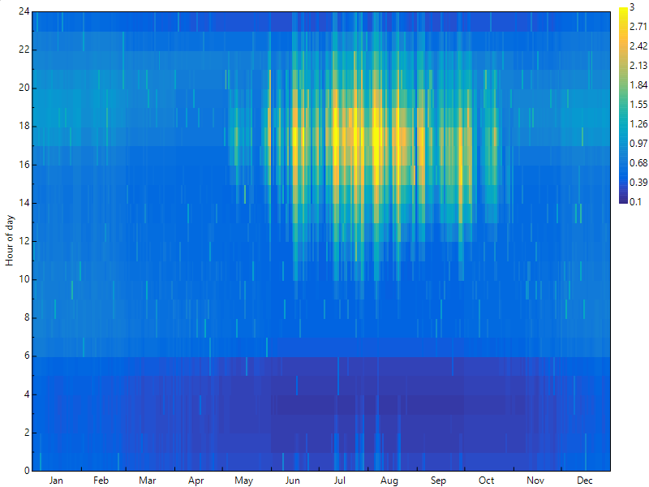
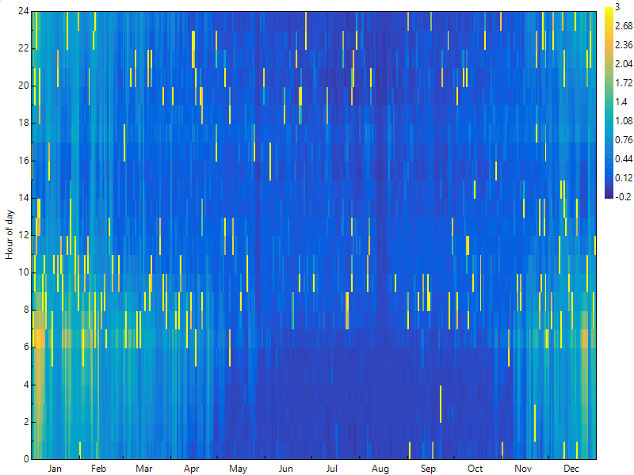
Breakeven Rates & Bill Impacts for Electrification
Fixed Charge proposals do not enable electrification
Breakeven Rates reflect the blended rate where electrification does not increase customer bills
Achieving electrification requires rates below these levels to provide meaningful savings for existing households
Breakeven rates depend on the efficiency of the gas heating equipment, but can be as low as $0.15 - $0.18/kWh for modern gas appliances installed in the last 10-15 years
The proposals do not achieve rate reductions that enable customer savings and in almost all cases result in annual bill increases
Highly Differentiated TOU’s can be much more effective
Highly differentiated TOU’s offer a much more surgical and effective way to enable electrification
The largest energy consumers in electrification are space and water heating. 2/3^{rds} of overall consumption is in the low cost winter off-peak period. Only 3% of usage is high cost summer on-peak.
Dropping off-peak winter rates towards $0.05 - $0.10/kWh yet still above the utility avoided cost, and raising the on-peak rates to compensate can enable electrification below the breakeven rate
Home Baseline: 6,310 kWh
Electrification Adder: 4,080 kWh

Slide 11
Backup Slides
Backup Slides

Slide 12
Links and extra information
Clean Coalition’s streamlined Fixed Charge proposal
Blog Post on the Clean Coalition’s proposal and methodology: https://clean-coalition.org/news/clean-coalitions-streamlined-fixed-charge-proposal-satisfies-legal-requirements-while-preempting-another-attack-by-the-utilities-on-local-solar
Clean Coalition webinar on our streamlined proposal: https://clean-coalition.org/news/webinar-a-fixed-charge-solution-that-satisfies-legal-requirements-while-preempting-another-attack-by-the-utilities-on-local-solar-tuesday-15-august-2023/
Clean Coalition’s Rebuttal Testimony and Flagstaff Research Report: https://clean-coalition.org/wp-content/uploads/2023/06/R.-22-07-005-Clean-Coalition-Rebuttal-Testimony.pdf

Slide 13
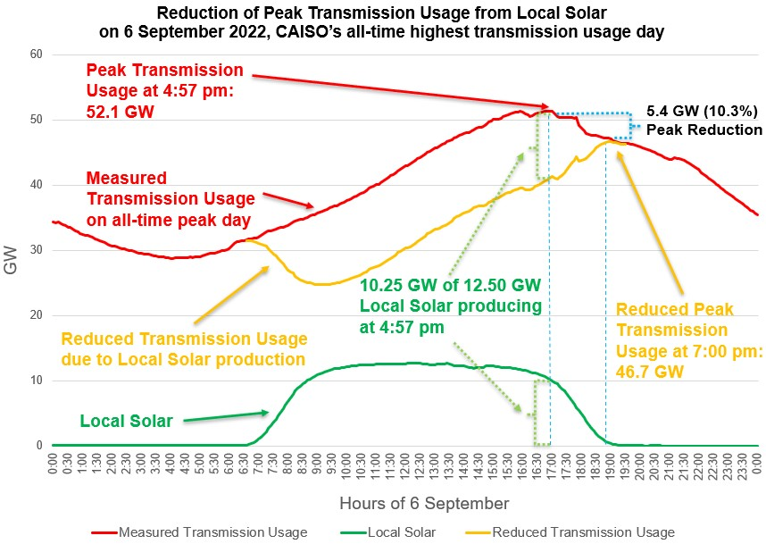
Local Solar is extremely valuable to the grid
Local Solar reduces Peak Transmission Usage by close to 50% of the installed capacity. The effect is amplified by energy storage.
Bringing down the peak with distributed generation and demand flexibility will reduce transmission investments, saving ratepayers hundreds of billions of dollars over the next two decades.
Reducing the Peak Transmission Usage by around 10% is enough to prevent most major outages.

