Slide 1
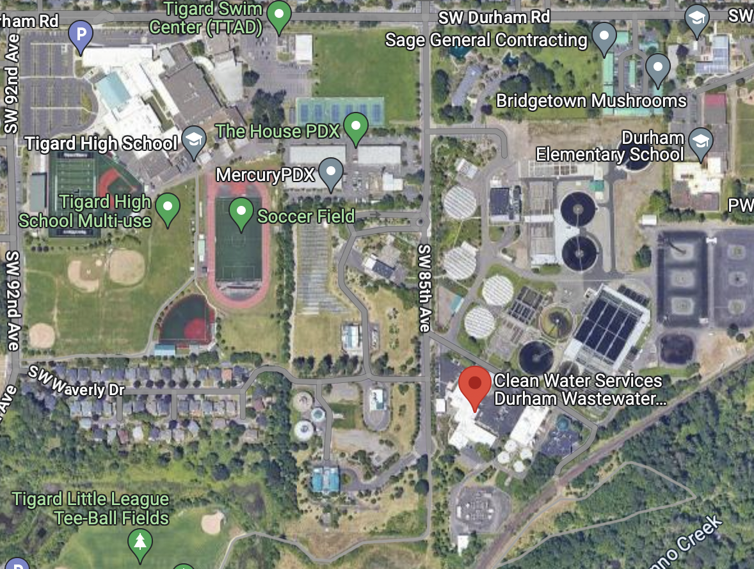
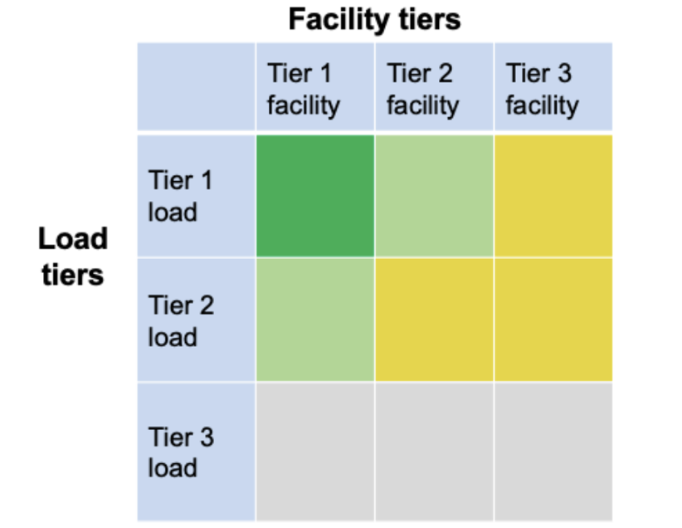
Assessing the Feasibility of Renewables-driven Microgrids
and determining the Value-of-Resilience
Craig Lewis
Executive Director
650-796-2353 mobile
craig@clean-coalition.org
5 December 2023

Slide 2
Clean Coalition (nonprofit)
Mission
To accelerate the transition to renewable energy and a modern grid through
technical, policy, and project development expertise.
Renewable Energy End-Game
100% renewable energy; 25% local, interconnected within the distribution grid and ensuring resilience without dependence on the transmission grid; and 75% remote, fully dependent on the transmission grid for serving loads.
Notes:
2

Slide 3
Benefits of a Solar Microgrid
Economic
  Provides electricity costs savings compared to buying electricity from the utility.
  Provides value-of-resilience (VOR) compared to implementing & operating a fossil-fueled generator.
  Provides a fixed cost of electricity compared to rapidly rising utility costs.
Environmental
  Provides solar electricity, a pure renewable energy resource.
  Optimizes grid citizenship by reducing peak usage of the grid when it is most stressed, during the peak periods, which throughout California are currently 4-9pm.
  Eliminates energy losses associated with traversing transmission & distribution grids. Losses are due to resistance and congestion, both of which are generally exacerbated by distance. Typically, 15% of remotely generated energy is lost.
  Reduces the environmental impact of central generation, which typically consumes open space for the generation & transmission assets.
Resilience
  Provides 100% ride-through during grid outages of limited durations. Any ride-through duration can be accommodated with cost being correlated to duration.
  Provides optionality for indefinite resilience for at least the most critical loads, again with cost being correlated to the percentage of load being served with 100% resilience.
  Accommodates optional fossil generation as an emergency backup resource that can be minimized.

Slide 4
Various types of Solar Microgrids
A microgrid is a combination of energy resources, definitely including generation, that are coordinated to serve specified loads, including in an islanded fashion.
A Solar Microgrid is a behind-the-meter (BTM) microgrid that solely relies on solar for energy generation when islanded.
A Hybrid Solar Microgrid is a Solar Microgrid that includes additional sources of energy generation, beyond just solar.
A Community Microgrid a microgrid that covers a target grid area and relies on existing distribution feeders (ie, power lines) to operate when islanded. Community Microgrids typically include both front-of-meter (FOM) and BTM resources, including Solar Microgrids, and require effective participation from utilities, which have mostly erected barriers to date.

Slide 5
Preparing for a Renewables-driven Microgrid
Preparing for a Renewables-driven Microgrid

Slide 6
Preparing for Renewables-driven Microgrid success
Prioritize basic goals
  Resilience (Tiering loads: critical, priority, and discretionary).
  Environmental (Net Zero Energy, emissions, electric vehicles, etc).
  Economic (energy costs, community economic stimulation, etc).
  Education (curriculum, workforce preparation, practical skills, etc).
Answer key questions beyond the basic goals
  What forms of renewables are available?
  Which buildings, parking lots, and/or ponds are available for solar siting?
  Are there anticipated changes to the load, incuding from new Electric Vehicle Charging Infrastructure (EVCI)?
  Is third-party ownership desired to eliminate capital costs, optimize tax benefits, and to limit obligations & risks – and to simply pay for delivered energy?
  What is the timing of planning & construction phases?
  Are sufficiently skilled resources (staff, consultants, and/or contractors) in place for the Feasibility Study, Request for Proposals (RFP), contracting, construction management, and Monitoring & Verification (M&V)?
  Can the Clean Coalition help?
Get started – set the next few steps & assignments and execute!!!

Slide 7
Solar Microgrid Methodology
Solar Microgrid Methodology

Slide 8
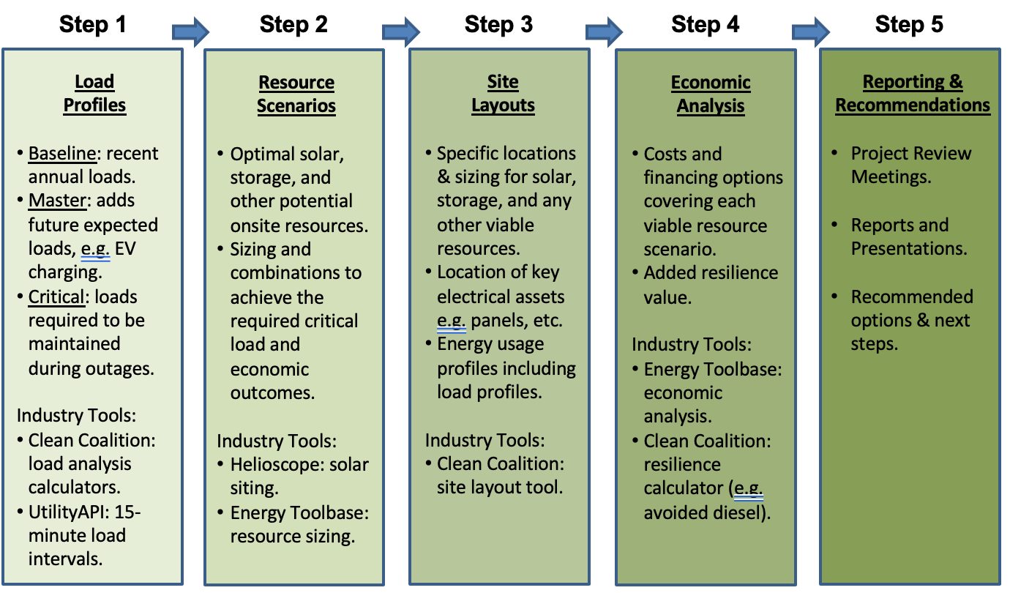
Solar Microgrid Methodology for feasibility studies
Notes:
8

Slide 9
Determining the Value-of-Resilience (VOR)
Determining the Value-of-Resilience (VOR)

Slide 10
Value-of-Resilience (VOR) details
VOR123
VOR123 is the value-of-resilience (VOR) from Solar Microgrids methodology that the Clean Coalition has developed to normalize VOR across all types of facilities & geographies. The VOR normalization is founded in tiering loads into three categories: Tier 1 (critical), Tier 2 (priority), and Tier 3 (discretionary). Since each Tier has its own resilience requirement and VOR, this methodology is called VOR123.
VOR123 webinar
https://clean-coalition.org/news/webinar-valuing-resilience-solar-microgrids-thursday-5-nov-2020/
Notes:
10

Slide 11
Percentage of time online for Tier 1, 2, and 3 loads for a Solar Microgrid designed for the University of California Santa Barbara (UCSB) with enough solar to achieve net zero and 200 kWh of energy storage per 100 kW solar.
Typical load tier resilience from Solar Microgrids
Percentage of total load
Tier 3 = Discretionary load, ~75% of total load
Tier 2 = Priority load, ~15% of total load
Tier 1 = Critical, life-sustaining load, ~10% of total load
Percentage of time

Slide 12
A typical diesel generator is configured to maintain 25% of the normal load for two days. If diesel fuel cannot be resupplied within two days, goodbye. This is hardly a solution for increasingly necessary long-term resilience. In California, Solar Microgrids provide a vastly superior trifecta of economic, environmental, and resilience benefits.
Diesel generators are designed for limited resilience
Percentage of total load
Tier 3 = Discretionary load, ~75% of total load
Tier 2 = Priority load, ~15% of total load
Tier 1 = Critical, life-sustaining load, ~10% of total load
Percentage of time

Slide 13
VOR123 methodology yields a 25% typical adder
There are different VOR multipliers for each of the three load tiers. The following valuation ranges are typical for most sites:
Tier 1: 100% resilience is worth 3 times the average price paid for electricity. In other words, indefinite energy resilience for critical loads is worth 3 times the average price paid for electricity. Given that the typical facility has a Tier 1 load that is about 10% of the total load, applying the 3x VOR Tier 1 multiplier warrants a 20% adder to the electricity bill.
Tier 2: 80% resilience is worth 1.5 times the normal price paid for electricity. In other words, energy resilience that is provisioned at least 80% of the time for priority loads is worth 1.5 times the average price paid for electricity. Given that the typical facility has a Tier 2 load that is about 15% of the total load, applying the 1.5x VOR Tier 2 multiplier warrants a 7.5% adder to the electricity bill.
Tier 3: Although a standard-size Solar Microgrid can provide backup power to Tier 3 loads a substantial percentage of the time, Tier 3 loads are by definition discretionary, and therefore, a Tier 3 VOR multiplier is negligible and assumed to be zero.
Taken together, the Tier 1 and Tier 2 premiums for a standard load tiering situation yields an effective VOR of between 25% and 30%. Hence, the Clean Coalition uses 25% as the typical VOR123 adder that a site should be willing to pay, including for indefinite renewables-driven backup power to critical loads — along with renewables-driven backup for the rest of the loads for significant percentages of time.

Slide 14
Validating VOR123 – four confirming approaches
Importantly, the Clean Coalition has resolved on the general 25% premium figure after conducting numerous analytical approaches, including the following three primary methodologies:
Cost-of-service (COS): This is the cost that suppliers will charge in order to offer the Solar Microgrid VOR across the Tier 1, 2, and 3 loads (VOR123). As evidenced by a case study of the Santa Barbara Unified School District (SBUSD), a COS that reflects a 25% resilience adder is sufficient to attract economically viable Solar Microgrids even the small school sites – larger sites yield pure bill savings.
Department of Energy (DOE) Multiplier: The DOE researched VOR and determined that the overall value of critical load that is missed due to grid outages over an annual period is $117/kWh. While the Clean Coalition stages Solar Microgrids to provide indefinite solar-driven backup power to critical loads, and considers 30 consecutive days to be a proxy for indefinite, the Clean Coalition assumed a conservative annual cumulative outage time of 3 days for the DOE Multiplier VOR analysis. The SBUSD case study yielded an overall 30% VOR adder to the 2019 electricity spend, as indicated in the table below.
DOE Multiplier results for SBUSD prototype schools

Slide 15
Validating VOR123 – four confirming approaches
Market-Based: This is essentially the market price, where supply meets demand, and the Direct Relief Solar Microgrid provides a local case study. Direct Relief has deployed a 320 kW PV and 676 kWh BESS Solar Microgrid, and while the PV is purchased via a roughly breakeven PPA, the BESS is leased at an annual cost of $37,500. While the size of the Direct Relief BESS (676 kWh) is a bit smaller than the size of the San Marcos Solar Microgrid BESS (710 kWh), Direct Relief is paying a bit more ($37,500/year) than the DOE Multiplier would value the San Marcos BESS ($36,729/year, as shown in Table 2-2).
Direct Relief Solar Microgrid

Slide 16
Validating VOR123 – four confirming approaches
Avoided Diesel Generator Cost: This approach is analogous to the previous cost-of-service (COS) approach, except it calculates the adder needed for a diesel generator to fulfill the VOR123 level of resilience. For this calculation, we equate “indefinite backup” to 30 days, and assume such a grid outage occurs once per year, during which the loads need to be maintained according to the standard VOR123 profile. The result, for a diesel backup system sized for a 1 million kWh/year site in Santa Barbara, is a 21 % adder to the electricity bill.
Site Load Inputs
Total Site Annual Load (kWh) | 1,000,000
Outage Duration (days) | 30
Number of outages/year | 1
Average cost of utility-purchased electricity ($/kWh) | $0.18
Average Site Power (kW) | 114
Yearly cost of utility-purchased electricity | $180,000
VOR123 Parameters
Tier 1 % of time | 100%
Tier 2 % of time | 80%
Tier 3 % of time | 30%
Tier 1 % of load | 10%
Tier 2 % of load | 15%
Tier 3 % of load | 75%
TCLR (kWh) | 36,575
Diesel Genset Size Check
Diesel genset size (kW) | 200
Peak load (kW) | 171
Diesel Tank Capacity Check
Diesel genset tank capacity (gallons) | 3,000
Diesel used for TCLR (gallons) | 3,040
Financials
Diesel Genset Depreciation Life (years) | 15
Diesel Genset Capex | $350,000
Diesel Genset Opex ($/year) | $14,694
Diesel Genset Depreciated Capex ($/year) | $23,333
Diesel Genset Total Yearly Cost | $38,027
Cost of Diesel Genset backup energy ($/kWh) | $1.04
% adder of Diesel backup cost on top of utility-purchased electricity | 21%

Slide 17
MLK Community Center case study in Spokane, WA
MLK Community Center case study in Spokane, WA
Notes:
17

Slide 18
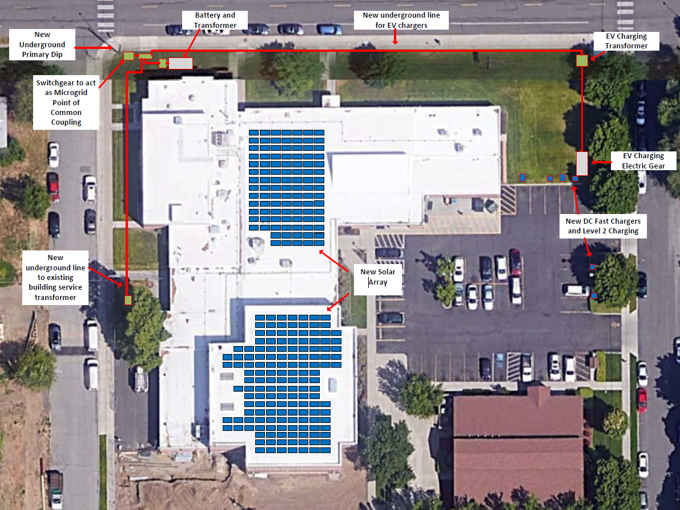
MLK Solar Microgrid site plan
Notes:
18

Slide 19
MLK Solar Microgrid scenarios
Scenario A: Grant-covered plan-of-record
  99 kWac of behind-the-meter (BTM) solar.
  500 kW & 1.1 MWh of front-of-meter (FOM) Battery Energy Storage System (BESS).
Scenario B: Double the BESS energy capacity from Scenario A
  99 kWac of BTM solar.
  500 kW & 2.2 MWh of FOM BESS.
Scenario C: 2.3x the solar of Scenario A
  230 kWac of BTM solar.
  500 kW & 1.1 MWh of FOM BESS.
Scenario D: 2.3x the solar and double the BESS energy capacity of Scenario A
  230 kWac of BTM solar.
  500 kW & 2.2 MWh of FOM BESS.
Scenario E: Add a 150 kW gas generator to Scenario A
  99 kWac of BTM solar.
  500 kW & 1.1 MWh of FOM BESS.
  150 kW gas generator

Slide 20


Circuit Flow Diagram concept for MLK
SCE Service ID
Fed from 13.2kv 13.2 kV OH 3HT 12F5
Service Meter 69002135
Indefinite load support
32% of total Baseline Load Profile (BLP) in winter
Tier 1 loads
(ie, Critical Loads)
MSB
480/277 VAC
Panels
A, B, C, G, E, M, Q, P, R
MSB
480/277 VAC
Addition A, B
MSB
480/277 VAC
Gym,
Sub, C,
MSB
480/277 VAC
Main
E, M, Q, P, R
Gym
Panel G
Breakers 1,3,5,7,9,13,12, 24,26
Mech Room
Panel M
1,3,9,13,15,17,19,26
Kitchen
Panel C
13,15
Food bank
Panel Q & R
1,3,42,43

Slide 21
MLK Critical Load Profile (T1%) estimation method

Slide 22
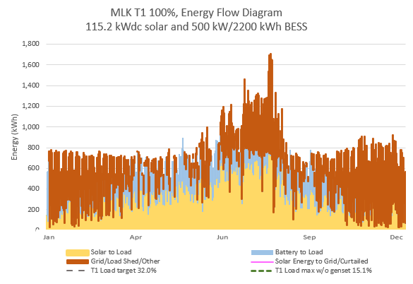
Energy Flow Diagram (EFD) for Scenario A, normal
Current MLK Load
Daily average: 782kWh
Yearly: 285,463 kWh
Solar Production
Daily average: 436kWh
Yearly: 159,340 kwh
Solar shortfall
Daily average: 346 kWh
Yearly:126.123kWh

Slide 23
Large farm case study in Carpinteria, CA
Large farm case study in Carpinteria, CA
Notes:
23

Slide 24
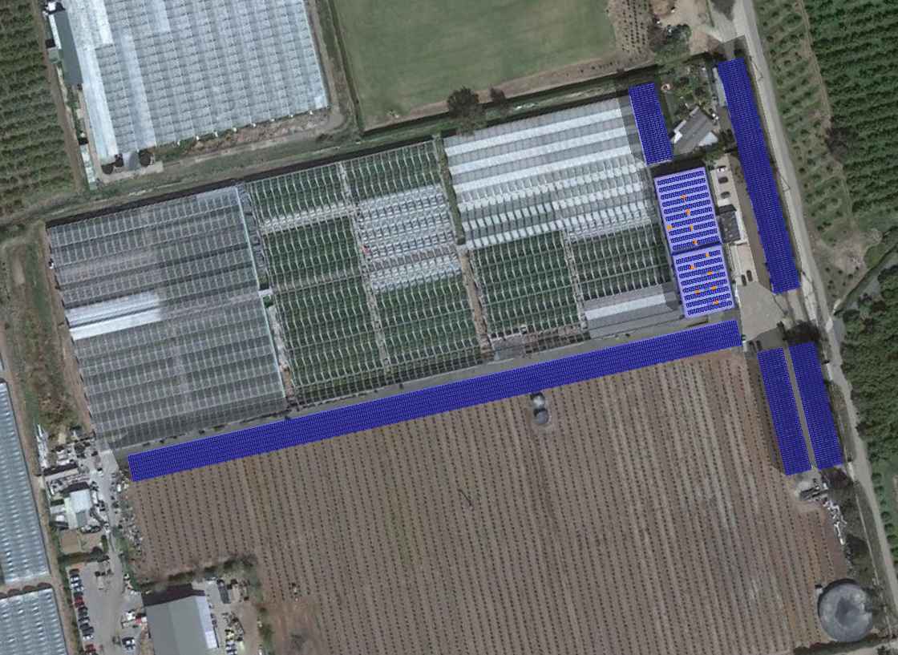


1.5 MWdc of solar for GH2 meter
Brand Farms
Greenhouse #2 Meter
Solar Microgrid Site Layout
C-5
Service Meter
#259000-062804
C-4
3 MW / 6 MWh BESS
Potential Location
R-1
Potential Solar Siting Locations:
C-1
710 kW Solar Canopy
R-2
C-2
142 kW Solar Canopy
C-3
142 kW Solar Canopy
C-4
89 kW Solar Canopy
C-5
269 kW Solar Canopy
C-2
R-1
84 kW Rooftop Solar
R-2
66 kW Rooftop Solar
Total Solar Siting Potential: 1,500 kW
Annual Generation: 2,492,565
Total Annual Loads:
Master Load Profile: 3,804,085 kWh
C-1
C-3

Slide 25

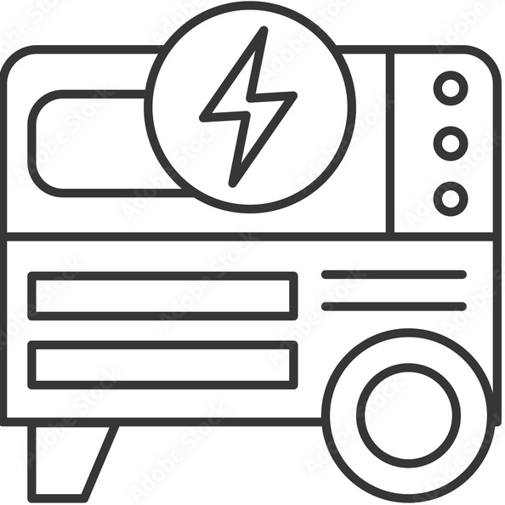
DC-coupled Solar Microgrid to serve 2.5 MWdc of added DC loads to Greenhouse2 meter
Solar
Battery
1.5 MWdc
6 MWh
350-500 Vdc LEDs
4-6 hr/day, Oct-Mar
Converter
Converter
DC Loads
Peak: 2.5 MWdc
800 Vdc
DC bus
Converter
Inverter 530 kW
Diesel Generator
Main Circuit Breaker
AC Loads
Peak: 291 kWac
MCB
480 Vac
3-phase
Line Side Taps
ATS
Automatic Transfer Switch
M
SCE Meter (limit of 665 kWac)
800 A, 480 Vac, 3-phase
SCE Grid
Transformer
500 kVA

Slide 26
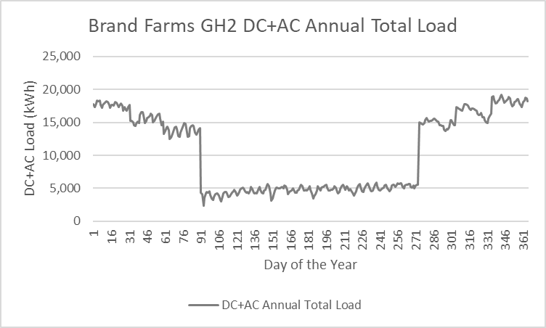
Greenhouse2 economics assuming all future
AC & DC loads can be served by the grid

Slide 27
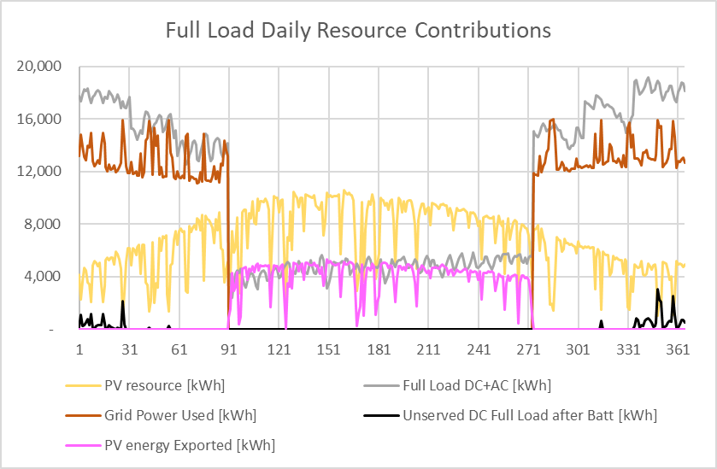
Greenhouse2 Energy Flow after addition of $10 million Solar Microgrid and 2.5 MWdc of DC loads
Energy Flow Diagram
1.5 MW solar and 3 MW / 6 MWh energy storage

Slide 28
Santa Barbara region is vulnerable to grid outages
Santa Barbara region is vulnerable to
grid outages

Slide 29
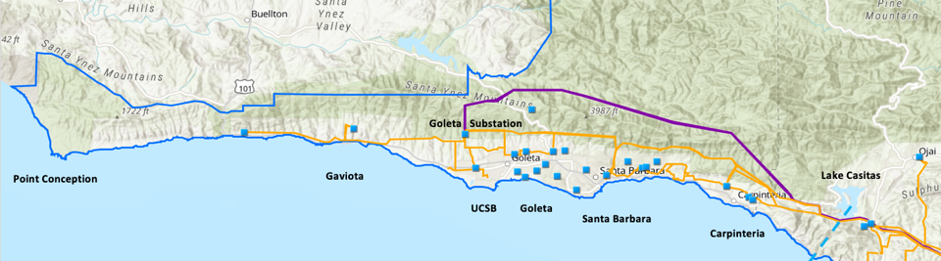
Goleta Load Pocket (GLP)
The GLP is the perfect opportunity for a comprehensive Community Microgrid
GLP spans 70 miles of California coastline, from Point Conception to Lake Casitas, encompassing the cities of Goleta, Santa Barbara (including Montecito), and Carpinteria.
GLP is highly transmission-vulnerable and disaster-prone (fire, landslide, earthquake).
200 megawatts (MW) of solar and 400 megawatt-hours (MWh) of energy storage will provide 100% protection to GLP against a complete transmission outage (“N-2 event”).
  200 MW of solar is equivalent to about 5 times the amount of solar currently deployed in the GLP and represents about 25% of the energy mix.
  Multi-GWs of solar siting opportunity exists on commercial-scale built-environments like parking lots, parking structures, and rooftops; and 200 MW represents about 7% of the technical siting potential.
  Other resources like energy efficiency, demand response, and offshore wind can significantly reduce solar+storage requirements.

Slide 30
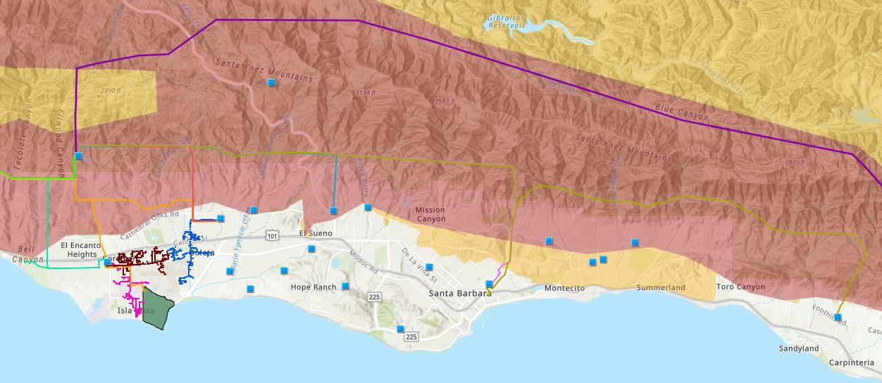

Core load area of the GLP
Legend
Feeder #4157
Feeder #4169
220 kV Transmission
Tier 3 Fire Threat
16kV Gladiola Feeder
Feeder #3556
Feeder #4227
Santa Barbara Airport
Tier 2 Fire Threat
16kV Gaucho Feeder
Feeder #4311
Feeder #3565
Substations
UCSB
16kV Professor Feeder
Feeder #3559

Slide 31
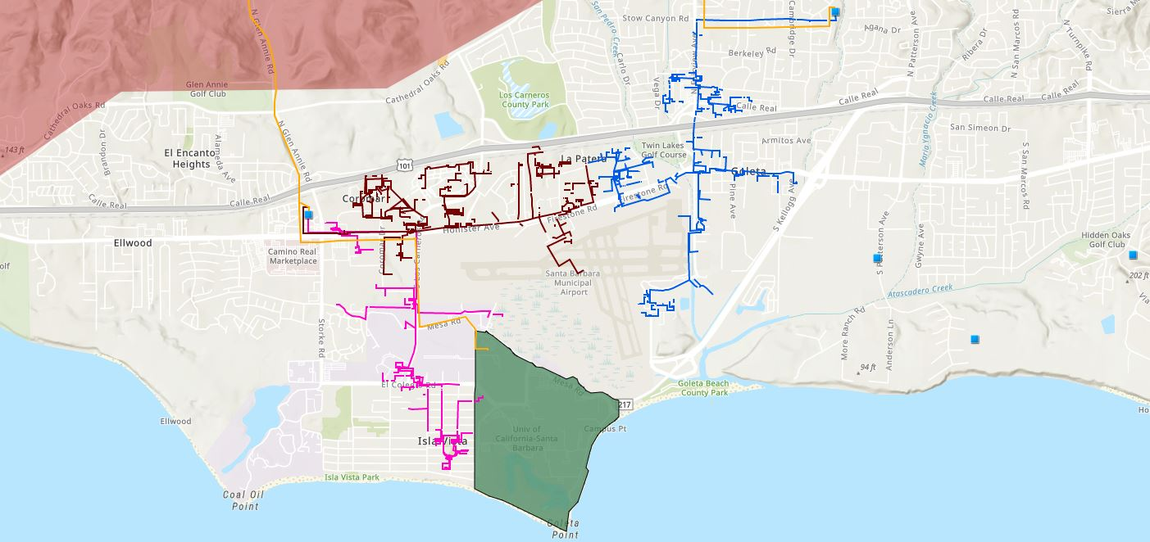








Target 66kV feeder serves critical GLP loads
Bella Battery Energy Storage Project (120 MWh)
Direct Relief (Solar Microgrid)
Vegas Substation
Dos Pueblos High School (Solar Microgrid)
Goleta Energy Storage Project
(240 MWh)
SB Airport
Fire Station # 8
Ellwood Gas Peaker Plant
Isla Vista Substation
UCSB
Fire Station # 17
Goleta Sanitary District
Legend
16kV Gladiola Feeder
University of California Santa Barbara
Goleta Valley Cottage Hospital
66 kV Feeder #4311
16kV Gaucho Feeder
Dos Pueblos High School
Direct Relief
Substations
16kV Professor Feeder
Fire Stations
Deckers
Tier 3 Fire Threat
Santa Barbara Airport
Goleta Sanitary District
Planned Battery Energy Storage

Slide 32
Target 66kV feeder grid area block diagram
Goleta Substation (220-to-66kV)
66kV distribution feeder #4311 with multiple branches
Vegas Substation (66-to-16kV)
Goleta Substation has eight feeders, seven 66 kV & one 16 kV, that serve the entire GLP
Fire Station #8
Direct Relief
+ Solar Microgrid
San Marcos
+ Solar Microgrid
66kV underground interconnection
Tier 2 & 3 facilities
Dos Pueblos
+ Solar Microgrid
Tier 2 & 3 facilities
Karl Storz + Solar Microgrid
Goleta Energy Storage Project (240 MWh)
City of Goleta
+ Solar
Isla Vista Substation (66-to-16kV)
Deckers
+ Solar
Goleta Cottage Hospital
Ellwood Gas Peaker Plant
GenOn Battery Energy Storage (120 MWh)
Tier 2 & 3 facilities
SBA (runway lights & ATC)
Diagram Elements
66 kV Distribution Feeder #4311
16 kV Gladiola Feeder
16 kV Gaucho Feeder
16 kV Professor Feeder
16 kV Los Carneros Feeder
16 kV Ace Feeder
16 kV Storke Feeder
Planned Battery Energy Storage
Ellwood Gas Peaker Plant
Grid isolation switch (open, closed)
Smart meter switch (open, closed)
Fire Station #17
SBA (Main Terminal)
Costco
+ Solar
Goleta Sanitary District
UCSB
+ Solar

Slide 33
SBUSD Solar Microgrids case study
Santa Barbara Unified School District (SBUSD)
Solar Microgrids case study

Slide 34
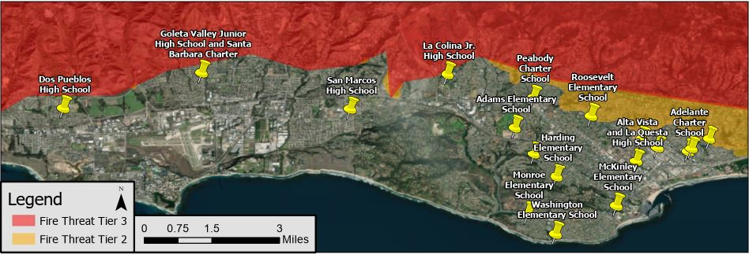
Santa Barbara Unified School District (SBUSD)
The entire Santa Barbara region is surrounded by extreme fire risk (earthquake & landslide risk too) and is extremely vulnerable to electricity grid outages.
The SBUSD is a major school district that increasingly recognizes the value-of-resilience (VOR) and has embraced the Clean Coalition’s vision to implement Solar Microgrids at a number of its key schools and other critical facilities.
SMHS is in the middle of the extensive SBUSD service area.

Slide 35
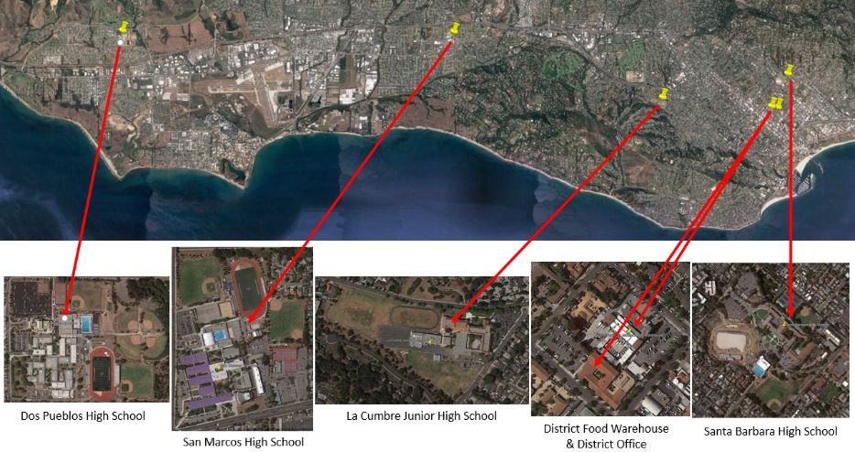
Six SBUSD Solar Microgrid sites

Slide 36
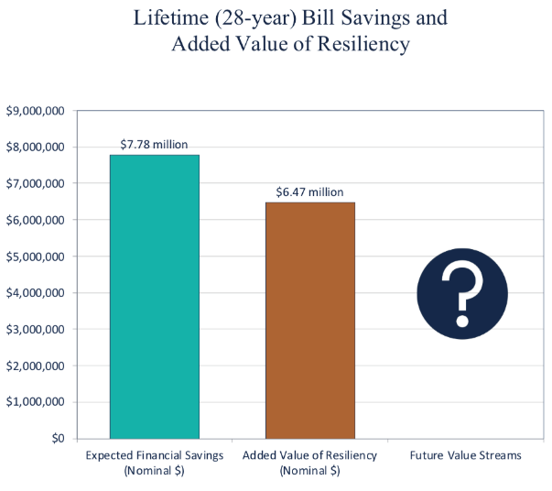
Guaranteed SBUSD bill savings and free VOR

Slide 37
East LA Solar Microgrids case study
East LA Solar Microgrids
case study

Slide 38
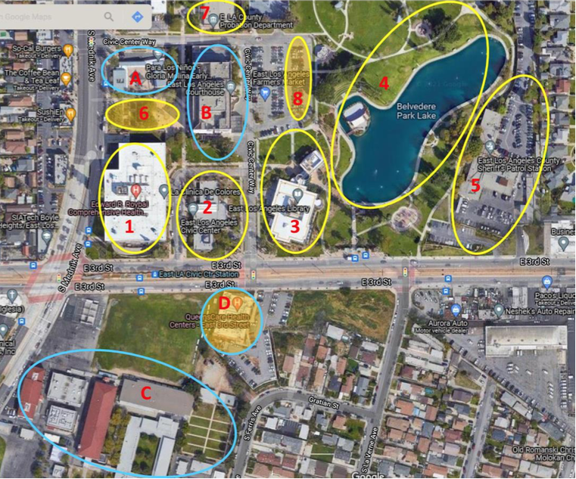
East Los Angeles hub of critical community facilities
County facilities:
Health Center
Civic Center
Library
Belvedere Park Lake
Sheriff Patrol Station
Probation Department
Vaccination site
Food distribution site
Other noteworthy facilities:
Early Childhood Education Center
State Superior Courthouse with many county operation within
Middle School
Health Center
Notes:
4801 E 3rd Street, Los Angeles

Slide 39
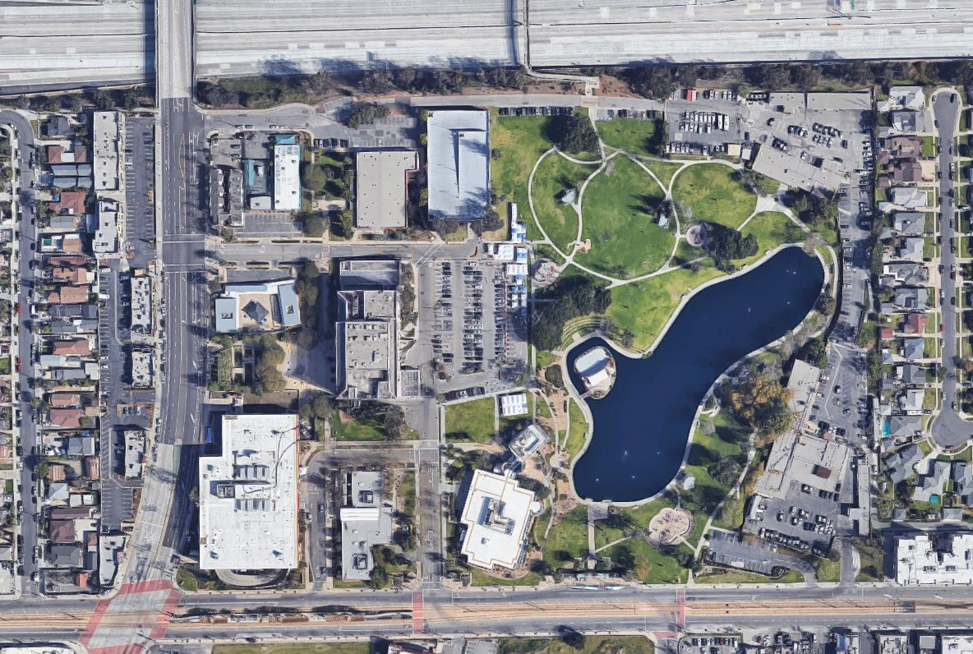



East LA hub
Parking garage
Parking lot/auxiliary services
Civic Center
Edward R. Roybal Health Center
Library

Slide 40
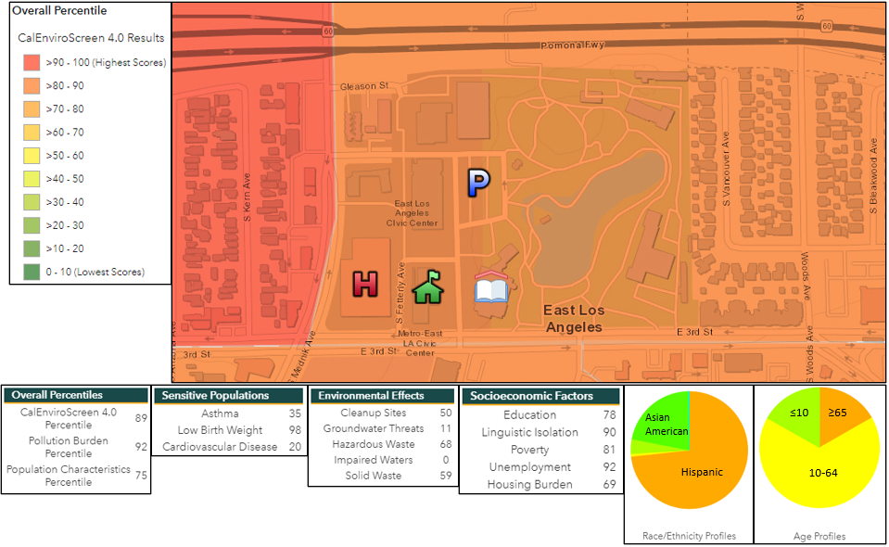
East LA hub in disadvantaged community (89 CES score)

Slide 41
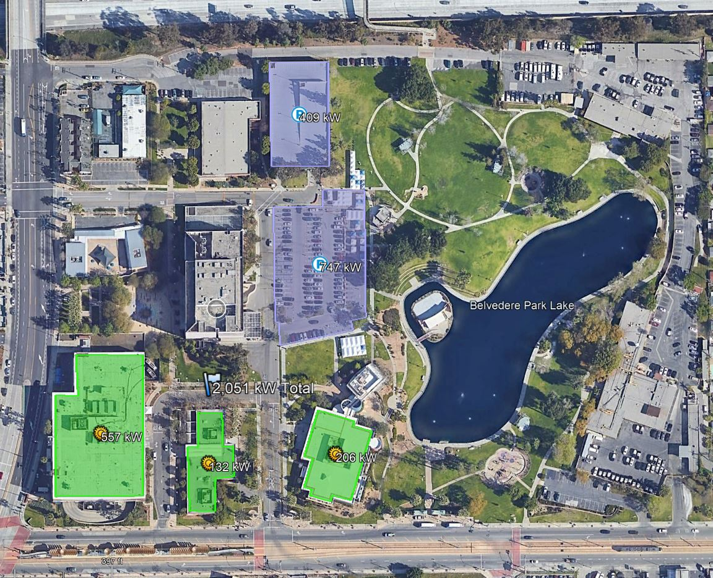
Solar siting potential on initial facilities is 2.5 MW

Slide 42
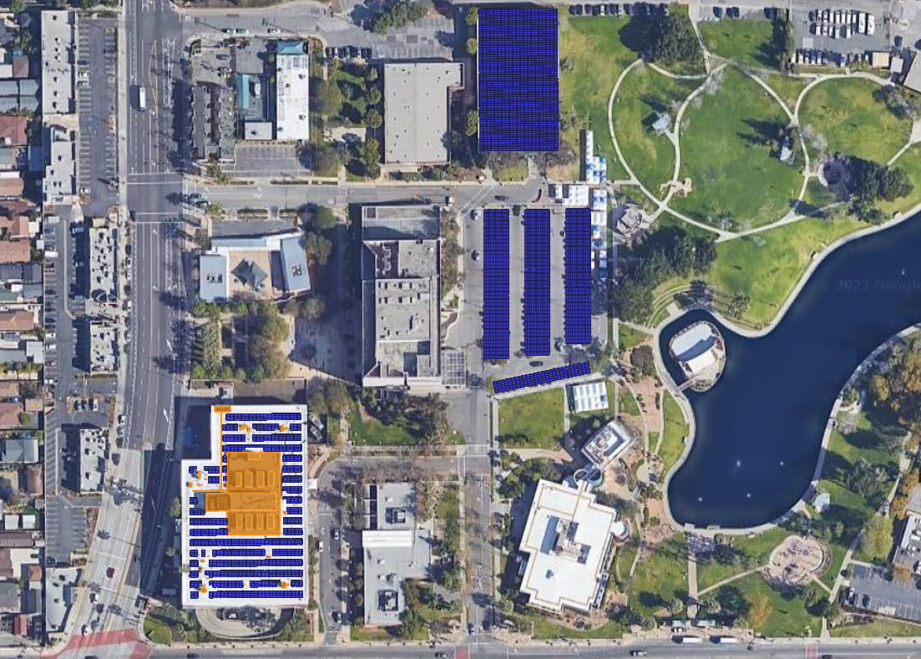
Edward R. Roybal Health Center – site layout
Edward R. Roybal Health Center
Address: 245 S. Fetterly Ave.
Meter: V349N-016268
Current rate schedule: TOU-8-D (CPA-Clean)
Suggested new rate schedule: TOU-8-E (CPA-Clean)
Total annual load and peak demand:
Baseline load profile: 2,637,146 kWh
Master load profile: 2,714,395 kWh
Peak demand: 603 kW
Total solar recommended
1,268 kWdc
Solar recommended by location:
R-1: 317 kWdc
C-1: 154 kWdc
C-2: 150 kWdc
C-3: 139 kWdc
C-4: 46 kWdc
G-1: 462 kWdc
Solar to NZE:
Baseline load profile: 1,599 kWdc
Master load profile: 1,646 kWdc
Battery energy storage recommended:
500 kW/ 2,230 kWh
Electric vehicles:
EV-1: Ten new L2 ports
Estimated annual load of ten L2 charging ports - 77,249 kWh
Critical loads
20% of total load is critical
Net TCLR: 4,119 kWh
Notes
Solar on the parking lot and parking garage will be routed to Health Center meter.
G-1
EV-1
C-1
C-2
C-3
Emergency Distribution Switch
C-4
R-1
Main electrical service
Prelim conduit route
Potential BESS location
EVCI
Diesel Generator
Notes:
Behind the meter EV charging of 10 ports. Doesn't matter what floor, all tied behind health center meter.
EDS on roof, diesel generator on south side of building.
Send Adel close up image of the health center rooftop solar, he will run it by facilities.
Mingh needs to check whether or not the solar on the parking garage and parking lot can be routed to the health center. Proprietorship Question. Interagency Agreements?

Slide 43
East Los Angeles Civic Center – site layout
East Los Angeles Civic Center
Address: 4801 E. 3rd St.
Meter: 259000-010515
Current rate schedule: GS-2-TOU-D (CPA – Clean)
Suggested rate schedule: GS-2-TOU-E (CPA – Clean)
Total annual load and peak demand:
Master load profile: 202,941 kWh
Peak demand: 83 kW
Total solar recommended
65 kWdc
Solar to NZE:
Master load profile: 124 kWdc
Battery energy storage
250 kW/ 1,120 kWh
Critical loads
Net TCLR: 683 kWh
41% of total load can be kept online indefinitely.
Main electrical service
Prelim conduit route
Potential BESS location

Slide 44
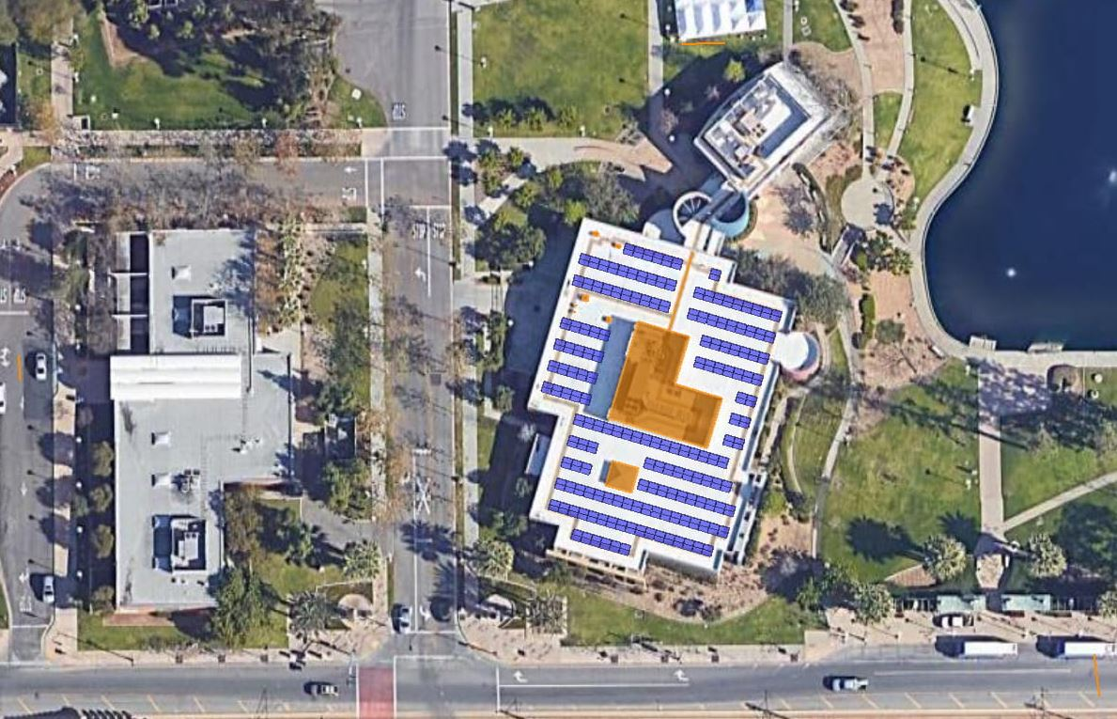
East Los Angeles Library – site layout
East Los Angeles Library
Address: 4837 E. 3rd St.
Meter: 259000-010517
Current rate schedule: GS-2-TOU-D (CPA – Clean)
Suggested rate schedule: GS-2-TOU-E (CPA – Clean)
Total annual load and peak demand:
Master load profile: 403,627 kWh
Peak demand: 117 kW
Total solar recommended
117 kWdc
Solar to NZE:
Master load profile: 245 kWdc
Battery energy storage
300 kW/ 1,670 kWh
Critical loads
Net TCLR: 1,207 kWh
37% of total load can be kept online indefinitely in Year 1.
Main electrical service
Prelim conduit route
Potential BESS location

Slide 45
Retirement community case study
Retirement community case study

Slide 46
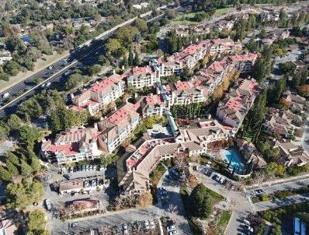
Overview of The Forum in Cupertino, CA
The Forum is a 350-unit retirement community in Cupertino California that is staged for 92 Solar Microgrids, which will be deployed in coordination with a major re-roofing project:
  There will be 9 commercial-scale Solar Microgrids, each interconnected behind a single commercial meter serving the Community Building and the five apartment-style buildings (Buildings 1-5) that will be re-roofed.
  Additionally, there will be 83 residential-scale Solar Microgrids, each attached to an individually metered residential Villa that is essentially a single-family residence sited along the property perimeter. There are two vintages of Villas, 60 Originals and 23 New.
  Total estimated solar is just over 1.25 MWdc and the total estimated energy storage is just over 2.85 MWh.
  Installations of the solar should be anticipated in two Phases: 1) rooftop solar of 1,038 kW and storage of 2,862 kWh, and 2) addition of 223 kW solar parking canopies (no added storage).
A roofing company has been selected and the selected EPC needs to be tightly coordinated with the re-roofing process.
The Forum plans to pay the roofing costs directly, but a a single master PPA is desired across all 92 Solar Microgrids, which incorporate 100% of the solar & storage being specified.

Slide 47
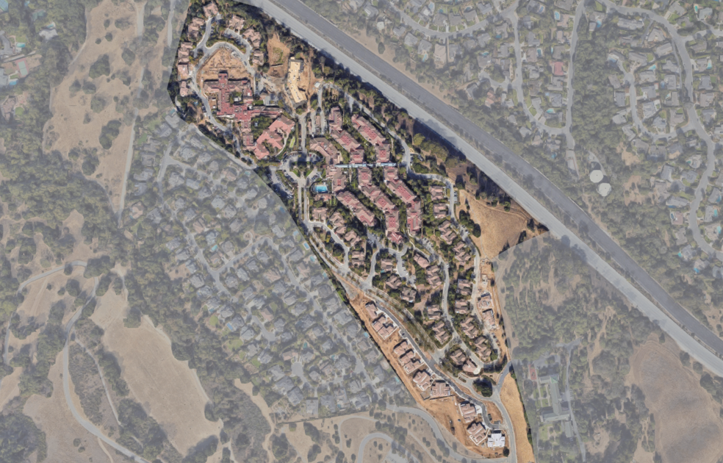
Full view of The Forum site
Original Villas
Memory Care
Skilled Nursing
Building 2
Building 4
Health Care Center
Building 5
Community Building
New Villas
Building 1
Building 3
Original Villas
New Villas

Slide 48
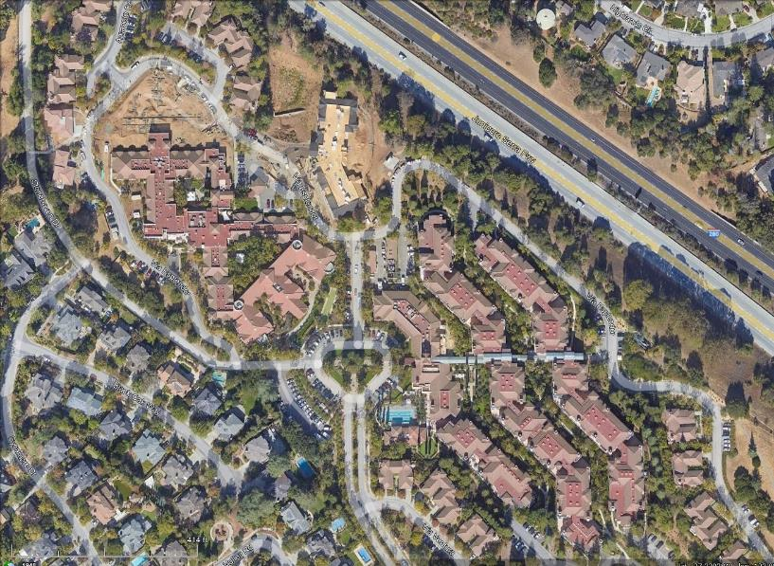
Electrical room locations & number of meters in each
Skilled Nursing
Memory Care
Bldg 2a – 1 commercial & 25 residential meters
Bldg 2b – 1 commercial & 24 residential meters
Health Care Center generator
Bldg 4 – 1 commercial & 52 residential meters
Bldg 5a – 1 commercial & 15 residential meters
Health Care Center
Community Bldg – 1 commercial & 3 residential meters
Bldg 5b – 1 commercial & 43 residential meters
Bldg 3a – 1 commercial & 27 residential meters
Bldg 1 – 1 commercial & 33 residential meters
Bldg 3b – 1 commercial & 37 residential meters

Slide 49
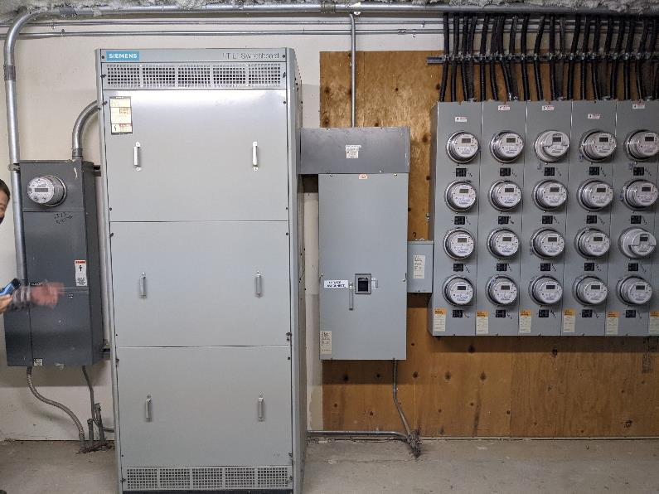
Typical electrical room meter layout: Building 3a with 1 commercial meter (left) and an array of 27 residential meters (right)

Slide 50
Solar & storage sizing across all targeted meters
Total estimated solar of 1,261 kW is anticipated to deploy over two Phases, starting with 1,038 kW on rooftops and following with 223 kW on added solar parking canopies.
The average estimated solar per Villa is 5.6 kW, achieving an estimated 135% of Net Zero at each based on approximated average existing loads. The oversizing prepares for significantly increased loads from expected shifts to Electric Vehicles (EVs) and other electrification measures like heat pumps, electric dryers, and induction cooktops.
All 223 kW of solar parking canopies is anticipated to be added to the Solar Microgrid serving the Community Building and raise the expected Net Zero achievement on the Community Building from 15% to 40%.
All of the estimated 2,862 kWh of storage is anticipated to deploy in Phase 1, along with the rooftop solar.

Slide 51
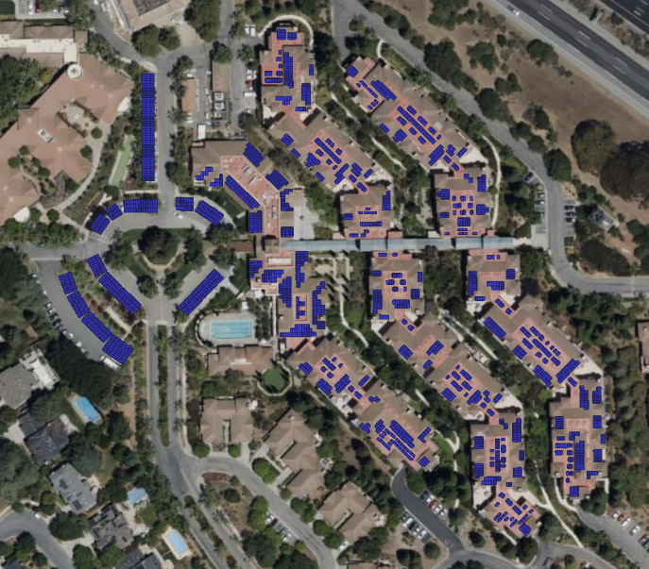
Rooftop solar & solar parking canopies serving Community Building and Buildings 1-5
B2a
Community
Building
B4
B2b
B5a
B3a
B5b
B1
B3b
Commercial Meters

Slide 52
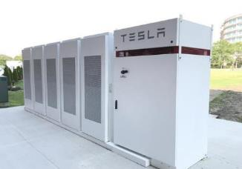
Battery sizing and resilience for Community Building
Tesla Megapack
All battery sizes are configured for TOU arbitrage & demand charge management.
Optimal battery sizes are based on resilience benefits. In order to cover all loads during an outage, a battery’s power capacity needs to be at or above a meter’s peak demand.

Slide 53
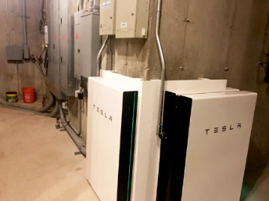
Battery sizing and resilience for Buildings 1-5
Except for the Community Building, all battery storage sizes are based on some multiple of Tesla Powerwalls with each Powerwall having a power capacity of 5 kW and energy capacity of 13.2 kWh.
All battery sizes are configured for TOU arbitrage & demand charge management.
Optimal battery sizes are based on resilience benefits. In order to cover all loads during an outage, a battery’s power capacity needs to be at or above a meter’s peak demand.

Slide 54
Policy innovations needed
Policy innovations needed

Slide 55
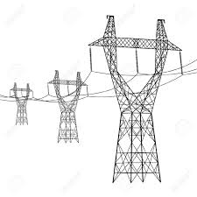


Existing barriers preventing the widespread deployment of Microgrids
The electric grid was designed with 20th century principles about a grid with a one-way flow of energy. Remotely-generated energy is transmitted across long distance transmission lines and delivered to end users located in load centers (on the distribution grid).
Unique/Complicated Configurations: Microgrids, particularly Community Microgrids are complicated since they require generation, storage, and software to control and optimize the resources for use in real time and for resilience in the event of a grid outage.
Rule 218(b), called the “Over-the-fence” rule: Any entity that transmits energy to more than one facility and/or uses the distribution grid must register as an electrical corporation (making them subject to the same requirements as the large Investor-Owned Utilities).
Lack of a standard value of resilience: One of the biggest benefits a microgrid provides is resilience. Without a standard methodology to value resilience, it is difficult to deploy a microgrid without multiple sources of funding.
Lack of Value Stacking: Microgrids provide a range of benefits (economic, environmental, and resilience) where they are deployed, including on the facility level, for the community, and the broader grid. Ensuring that markets and off-takers exist is key to commercializing the technology.
  The grid does not fully value the benefits of distributed energy resources, making it difficult to value stack and create multiple bankable revenue streams for a single resource.
Interconnection: A lack of streamlined interconnection procedures for distributed energy resources and microgrids makes deploying a microgrid a significant time investment.
Transmission Grid
Distribution Grid
Remote Power
Long Range Transmission Lines
Local Load Growth
Substation
Notes:
This slide can mostly be skipped for CCL. The purpose is to quickly show that these are some of the main barriers to microgrid deployment (without going into too much detail).

Slide 56
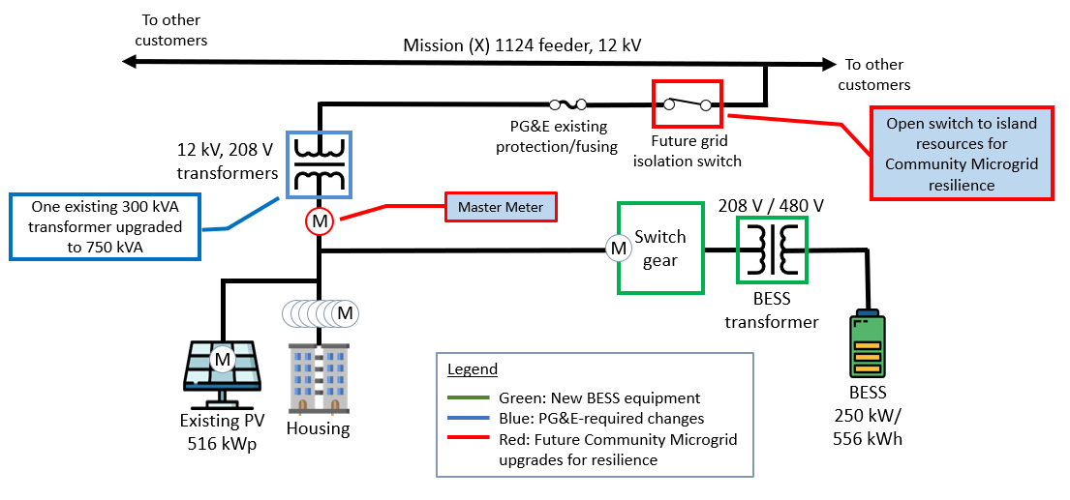
Multi-family housing needs Master Metering
Currently, master metering is prohibited in multi-family housing, including apartment buildings.
This blocks opportunities for resilience, because existing Virtual Net Energy Metering (VNEM) programs, including SOMAH, require solar to be interconnected front-of-meter (FOM).
While it is technically possible to install a behind-the-meter (BTM) microgrid at every residential meter, it is not practical due to overwhelming costs & space requirements associated with such slicing.
What is needed is a “master meter” that serves the entire community and has a single utility meter.
            The utilities were able to make Master Metering illegal in the early 2000s, prior to the opportunities presented by renewables-driven microgrids.
            A legislative solution is needed to allow master metering for microgrid deployments and clarify how the utilities should treat mixed-use developments.
Diagram of the Valencia Gardens Energy Storage (VGES) project provisioned for resilience
Notes:
Choose whether to use the master metering example based on time and the perceived interest/expertise of the audience.
56

Slide 57
Transmission costs are driving up electric rates
Transmission costs are the number one driver of increasing electric rates.
Other drivers include grid hardening costs for Wildfire Mitigation (including more transmission costs) and wildfire insurance/criminal liability payouts for fires caused by utility infrastructure.
The graph below shows the increase in Transmission Access Charges, which recover historical transmission costs. TAC does not include current spending or projected spending.
          As a reference, the most recent Transmission Planning Process estimated that $30 billion in investments will be needed over the next 20 years, which will result in astronomically high TAC costs.

Slide 58
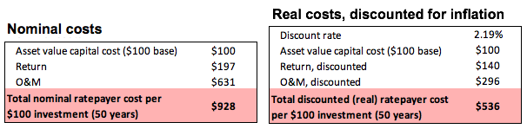
Transmission costs higher than they seem due to O&M driving ~10x increase to upfront costs
Capital costs of transmission infrastructure represent a fraction of total transmission costs.
Operations and maintenance (O&M) and ROE drive up transmission costs significantly over asset lifetime, with those excessive costs borne by ratepayers.
In nominal dollars, total lifetime ratepayer cost is nearly 10x the initial capital cost; O&M accounts for 68% of this because it increases much faster than inflation. In real dollars (constant value dollars, accounting for inflation), the total lifetime cost is 5x the initial capital cost, and O&M accounts for 55% of this.

Slide 59
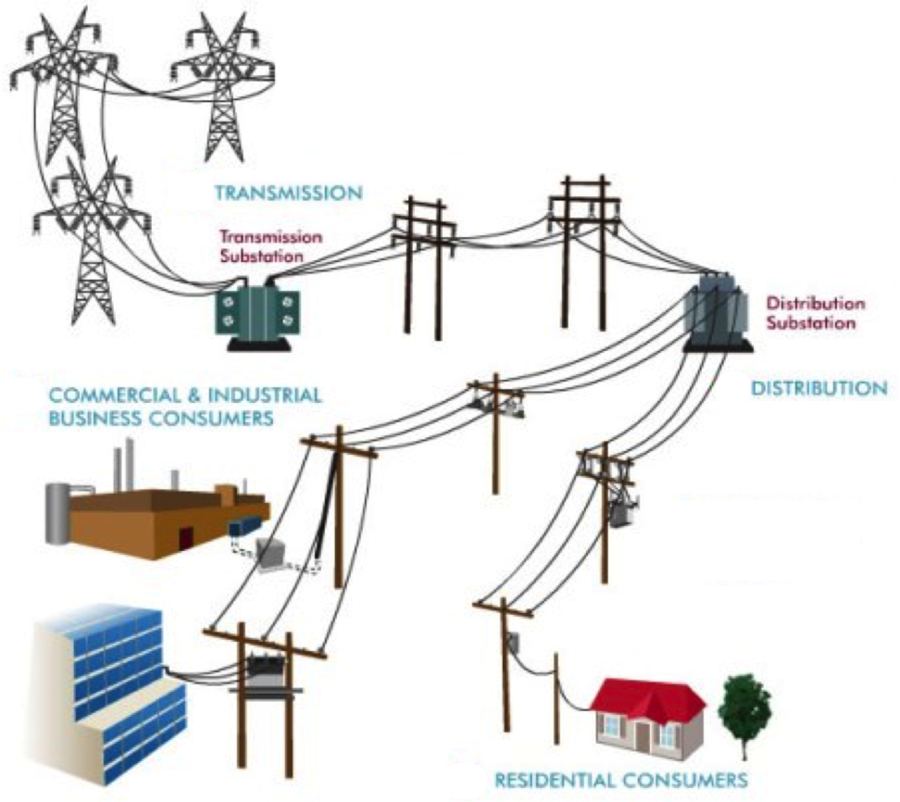
TAC cause massive market distortions — the real cost shift happening in California
Proper interface for metering & assessing all high-voltage TAC (done properly for municipal utilities but not for IOUs)
Proper interface for metering all
low-voltage TAC (done properly for municipal utilities but not for IOUs)
Current interface for metering TAC in IOU service territories
(at customer meters, with no distinction of energy from next door vs 1,000 miles away)
Notes:
Market distortions like the erroneous metering & assessment of Transmission Access Charges (TAC) for California IOUs creates massive market distortions that steal value from local generation, hurt ratepayers, and preempt energy resilience.
Non-PTO utilities (metered sub-systems) currently operate under the system we are proposing. The Clean Coalition TAC fix would bring consistent TAC treatment to DG resources in all utility service territories.

