Slide 1
Battery Energy Storage Systems (BESS)
Pros & Cons
Craig Lewis
Executive Director
Clean Coalition
650-796-2353 mobile
craig@clean-coalition.org
11 December 2024

Slide 2
Background
Background

Slide 3
Clean Coalition (nonprofit)
Mission
To accelerate the transition to renewable energy and a modern grid through
technical, policy, and project development expertise.
Renewable Energy End-Game
100% renewable energy; 25% local, interconnected within the distribution grid and ensuring resilience without dependence on the transmission grid; and 75% remote, fully dependent on the transmission grid for serving loads.
Notes:
3

Slide 4
Key terms associated with BESS
Battery Energy Storage System (BESS): A system that stores electrical energy using rechargeable batteries, allowing for energy to be stored and discharged on demand.
Power Capacity: The maximum power output a battery system can deliver at a given time.
Megawatt (MW): The dimension used to measure the power of an electrical system, representing how much electricity is being produced at any given moment – or the peak power that could be produced.
Energy Capacity: The total amount of energy a battery can store, measured in watt-hours (kWh).
Megawatt-hour (MWh): The dimension used to measure electrical energy. In the context of a BESS, a MWh represents how much energy a BESS can store. MWh and MW are related by time with 1 MWh being the amount of energy associated with a BESS charging or discharging at a constant 1 MW for 1 hour.
Peak Shaving: Utilizing a BESS to reduce peak demand on the grid by discharging energy that is stored during non-peak periods during peak periods, when the grid is most stressed, typically in the 4-9pm timeframe daily.
Curtailment: Deliberate reduction of the energy output of an energy resource to balance the grid or forced reduction due to reaching the capacity of transmission infrastructure.
State-of-Charge (SOC): The current level of charge stored in a battery, typically expressed as a percentage.
Li-ion: The fundamental chemistry of the most common BESS deployed in the world today.
Lithium Ferrous Phosphate (LFP): A Li-ion chemistry, also referred to as Lithium Iron Phosphate, that is the new standard for Li-ion BESS. LFP has superior safety performance compared to other Li-ion chemistries and LFP is also less expensive than prior chemistries.

Slide 5
Clean Coalition experience with BESS
The Clean Coalition is a leading proponent of Solar Microgrids and Community Microgrids to deliver an unparalleled trifecta of economic, environmental, and resilience benefits to communities.
The Clean Coalition has supported supported several grid-scale BESS that are thoughtfully sited, including to deliver key benefits to the grid.
Craig Lewis serves on the Board of Advisors of a flow battery technology company called BioZen, which is developing solutions that are founded in biomimicry – using naturally occurring materials and mimicking natural systems.

Slide 6
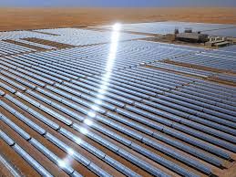
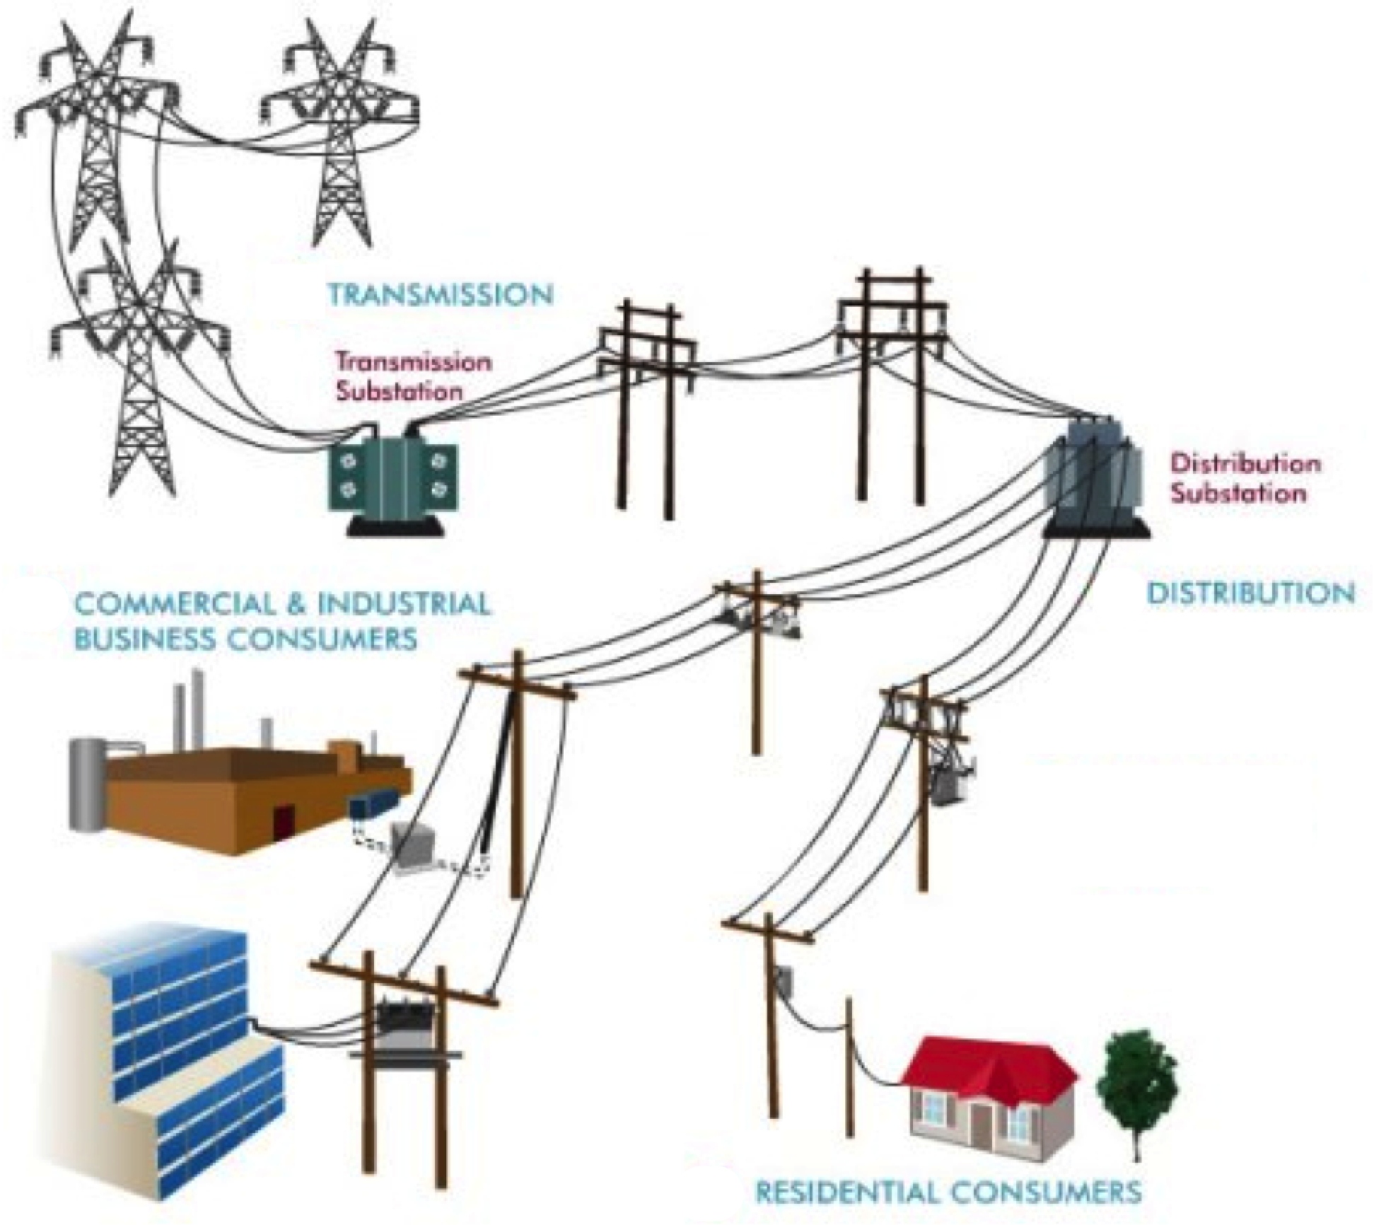
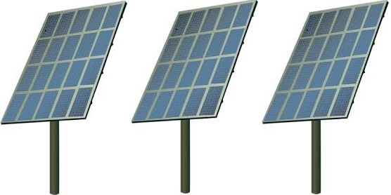
Overview of the grid and where BESS play
Grid balances energy, voltage, and frequency

Slide 7
The future is hard to predict, but do extreme technophiles really want to live under the sea?

Slide 8
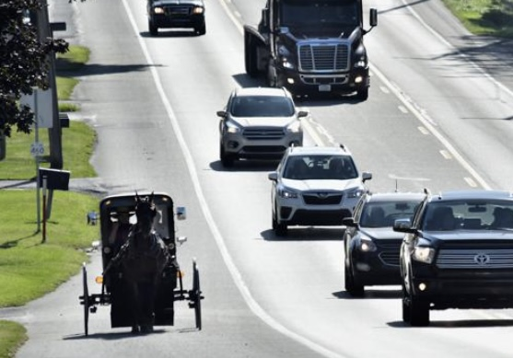
Similarly, do extreme technophobes want to revert to horse & buggy?

Slide 9
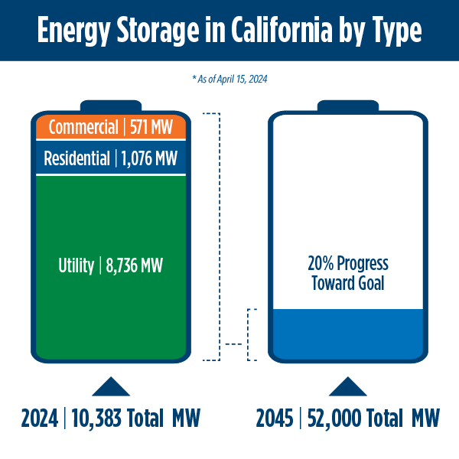
BESS are proliferating rapidly
From 2018 to 2024, battery storage capacity in California increased from 500 megawatts (MW) to more than 10,300 MW, with an additional 3,800 MW planned to come online by the end of 2024.
The state projects 52,000 MW of battery storage will be needed by 2045.
Source: California Energy Commission, April 2024

Slide 10
BESS Pros & Cons
BESS Pros & Cons

Slide 11
BESS Pros
Enabling intermittent renewables by storing solar & wind energy to be spread 24x7.
Saving ratepayers money by preempting much more expensive investments in the grid. Location matters, and interconnecting at load, substations, and generation can all provide high value.
Providing grid services by balancing energy, voltage, and frequency – and staging to do so even when the broader grid
Yielding economic benefits in the form of direct and indirect economic stimulation where the BESS are located, including via job creation and tax benefits to the local jurisdictions, and enhancing the grid to enable other forms of economic expansion.

Slide 12
BESS deliver a bevy of grid services

Slide 13
BESS Cons
Safety questions that experience is indicating are equivalent to Class A fires, same class as house fires.
Land use concerns that can impact the natural and/or cultural environments.
Lifecycle considerations that span from mineral extraction to recycling etc.

Slide 14
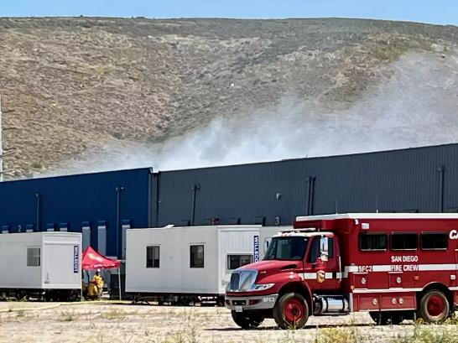
BESS are relatively new, and caution is sensible
Otay Mesa was one of the first large BESS deployed.
Used BESS technology & designs from 7 years ago.
Batteries are enclosed in a building, allowing gases to accumulate.
Source: The San Diego Union-Tribune, 26 May 2024

Slide 15
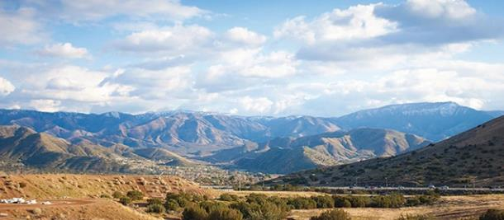
BESS have impacts on the environment, as do all developments

Slide 16
BESS examples
BESS examples

Slide 17
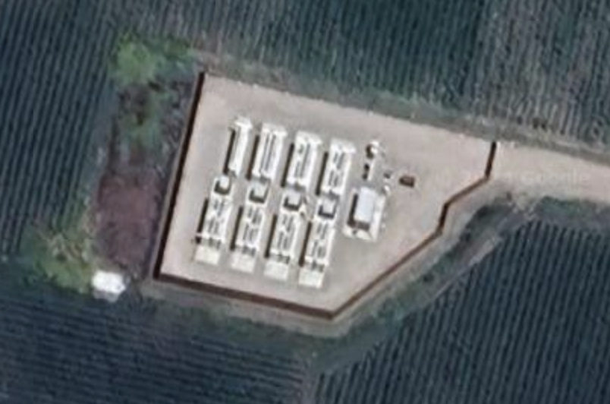
Valecito Energy Storage Resilience (VESR)
VESR is the first grid-scale BESS in Santa Barbara County, on 1 acre of leased agricultural land and 200 feet from a residential neighborhood and 1,000 feet from Carpinteria High School.
Tesla BESS, 10MW & 40MWh, successfully operating since January 2021.
Providing reliability & resilience to an extremely grid-constrained community.

Slide 18
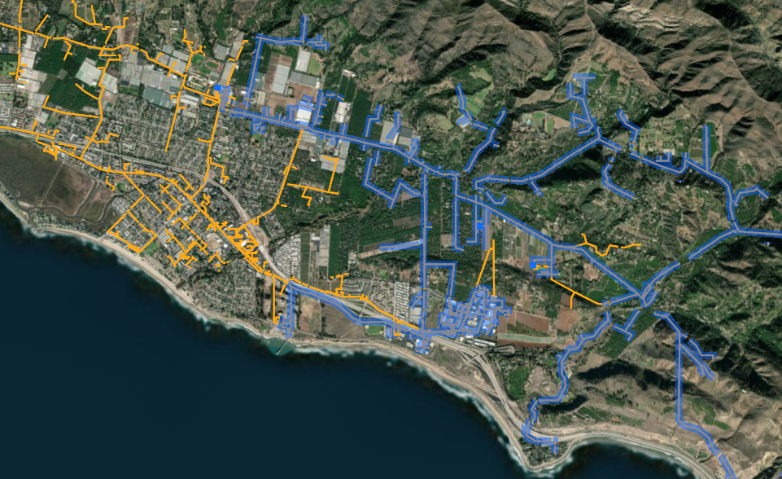
VESR enables resilience for the community
Carpinteria High School with 3MW of solar siting potential
Carpinteria Substation
VESR
Commercial cluster with more than 10MW of solar siting potential.
Legend
Seacliff Feeder (16 kV)
Other Carpinteria Substation Feeders

Slide 19
Goleta Load Pocket (GLP)
The GLP is the perfect opportunity for a comprehensive Community Microgrid
GLP spans 70 miles of California coastline, from Point Conception to Lake Casitas, encompassing the cities of Goleta, Santa Barbara (including Montecito), and Carpinteria.
GLP is highly transmission-vulnerable and disaster-prone (fire, landslide, earthquake).
200 megawatts (MW) of solar and 400 megawatt-hours (MWh) of energy storage will provide 100% protection to GLP against a complete transmission outage (“N-2 event”).
200 MW of solar is equivalent to about 5 times the amount of solar currently deployed in the GLP and represents about 25% of the energy mix.
Multi-GWs of solar siting opportunity exists on commercial-scale built-environments like parking lots, parking structures, and rooftops; and 200 MW represents about 7% of the technical siting potential.
Other resources like energy efficiency, demand response, and offshore wind can significantly reduce solar+storage requirements.

Slide 20
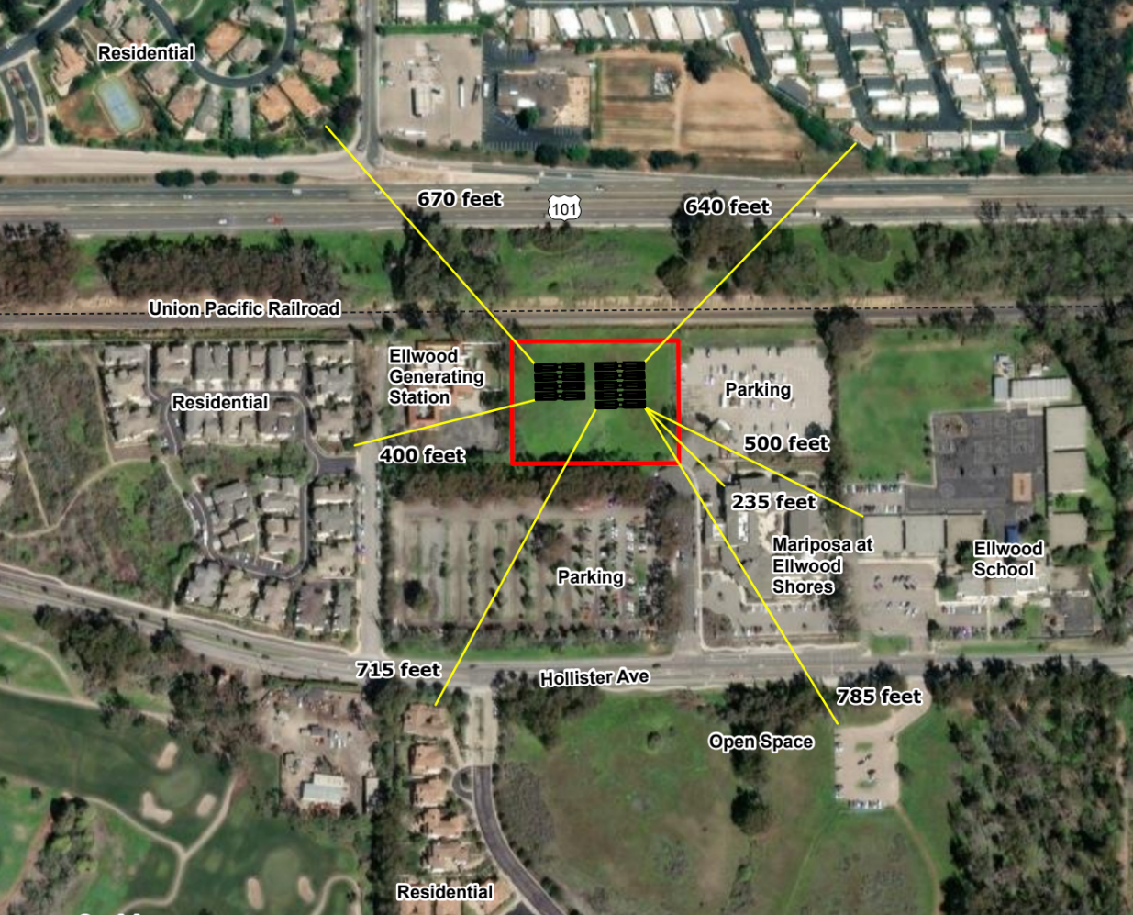
Greenbark will be the third BESS in the GLP

Slide 21
Greenbark will provide five key benefits
Perfect location adjacent to the Ellwood gas peaker plant such that resilience can be provided across the entire Goleta Load Pocket (GLP) – and retirement of the gas peaker will be accelerated.
Significant distances from other facilities, including housing (235 feet to the closest housing).
Same safe BESS technology that is already deployed in multiple GLP locations.
Negligible traffic & noise impacts.
Significant economic benefits to the local community.

Slide 22
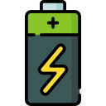
Greenbark in perfect location to serve entire GLP
40-mile pair of 220 kV transmission lines
(backside of mountains)
Santa Clara Substation (in Ventura)
Goleta Substation (220-to-66kV)
Greenbark (30 MW &
120 MWh)
Ellwood Gas Peaker Plant (54 MW)
Gaviota Coast
Carpinteria
Santa Barbara
Diagram Elements
66 kV Feeder to Greenbark
66 kV Feeder to Isla Vista
66 kV Feeders
16 kV Feeder to Goleta
Tie-line connection
220 kV Transmission
Smart meter switch (open, closed)
Isla Vista Substation (66-to-16kV)
Goleta
Goleta
Energy
Storage (60 MW &
160 MWh)

Slide 23
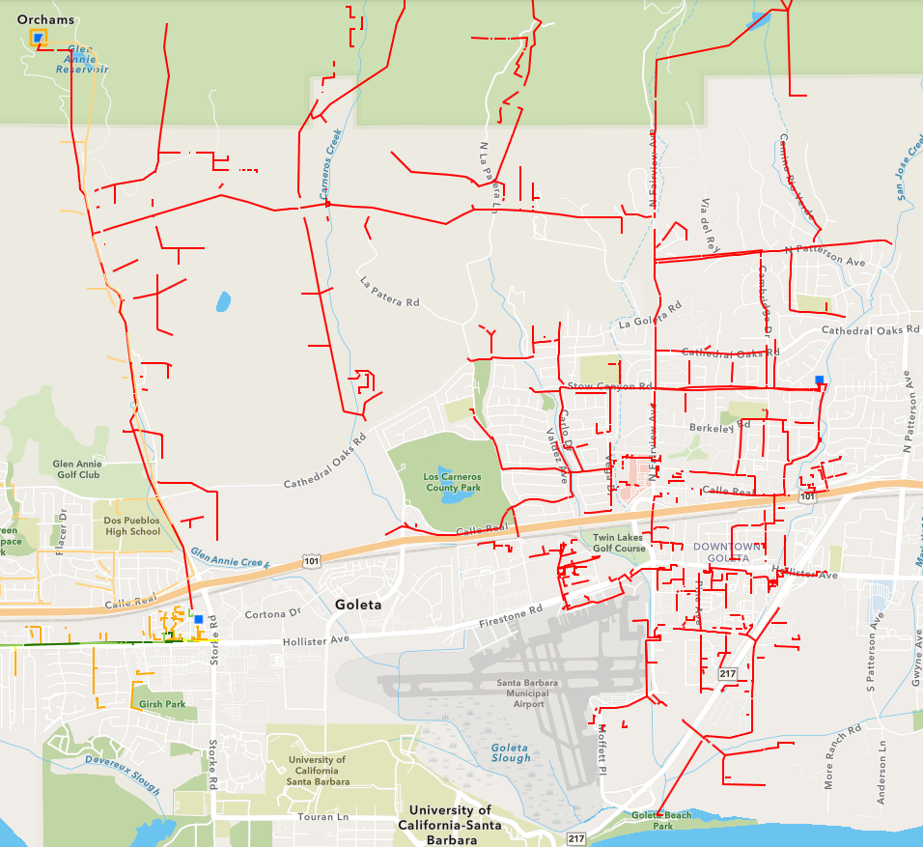
Backfeeding energy to the Goleta Substation from other Goleta locations is highly constrained
Goleta Substation
Isla Vista Substation
Goleta Energy Storage

Slide 24
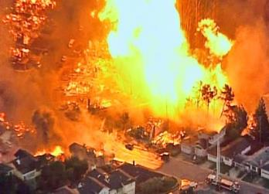
Natural gas infrastructure is not resilient
Assertion: Gas-driven generation is often claimed to be resilient.
Reality: Gas infrastructure is not resilient and takes much longer to restore than electricity infrastructure.
Threats: Gas infrastructure can be flat-out dangerous and highly vulnerable to earthquakes, fires, landslides, and terrorism.
2010 San Bruno Pipeline Explosion
Source: The City and County of San Francisco Lifelines Study

Slide 25
Humidor is a major BESS to serve California grid
400 MW & 1,200 MWh Battery Energy Storage System (BESS)
Located on 12 acres in North Los Angeles County, about midway between Glendale and Lancaster, and interconnecting to a major substation.
Designed to enhance grid reliability across California and to bridge renewables into the Los Angeles basin, the State’s largest load pocket and one of the dirtiest.
Utilizes disturbed land on industrial zoning, surrounded by roadways, rail lines, and industrial facilities.
Generates substantial economic benefits:
$2 million per year in tax revenue for LA County.
100 high paying union jobs during construction and several ongoing jobs once operational.
$100,000 of annual benefits to be paid for local community initiatives

Slide 26
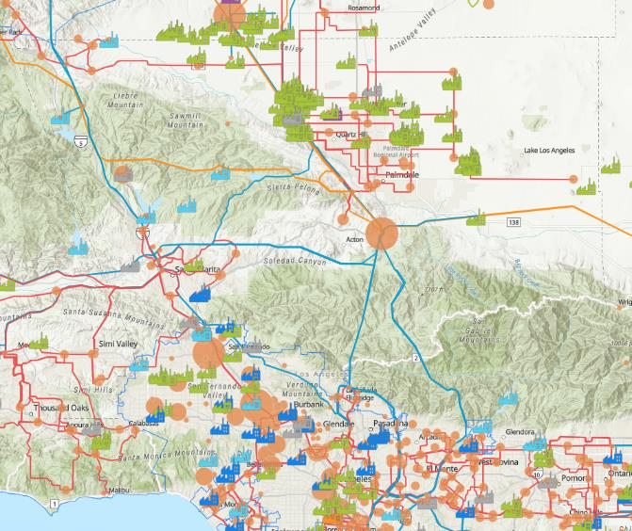
Humidor will enhance California grid reliability while maximizing solar and preempting the dirtiest gas
There is a significant amount of solar in the central valley that is attempting to flow down into Los Angeles (LA).
CAISO is careful about adding more solar in the central valley due to grid congestion, so it is slowing down the deployment of additional solar. Too much grid congestion can cause grid outages.
The Humidor Battery Storage Project will address multiple challenges: deliver solar energy to Los Angeles, prevent curtailment, meet peak grid demand, and alleviate congestion. This will help smooth supply and demand, reducing blackout risks.
Humidor Battery Storage

Slide 27
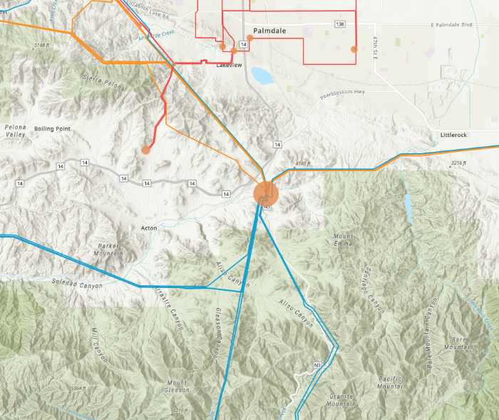
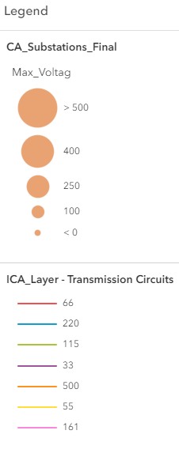
Humidor energy storage is located at a major California grid intersection
Humidor Battery Storage
Vincent Substation (500 kV)

Slide 28
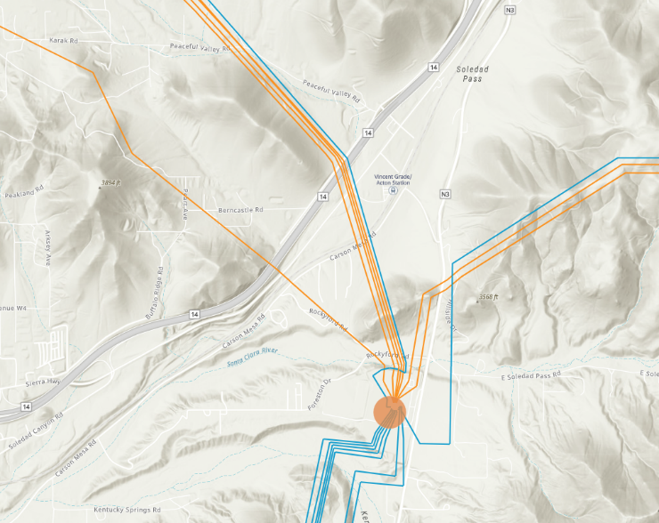
Humidor is located at a major grid intersection, less than one mile from the massive Vincent Substation
Humidor Battery Storage (interconnected at 220 kV)
Vincent Substation (500 kV)

Slide 29
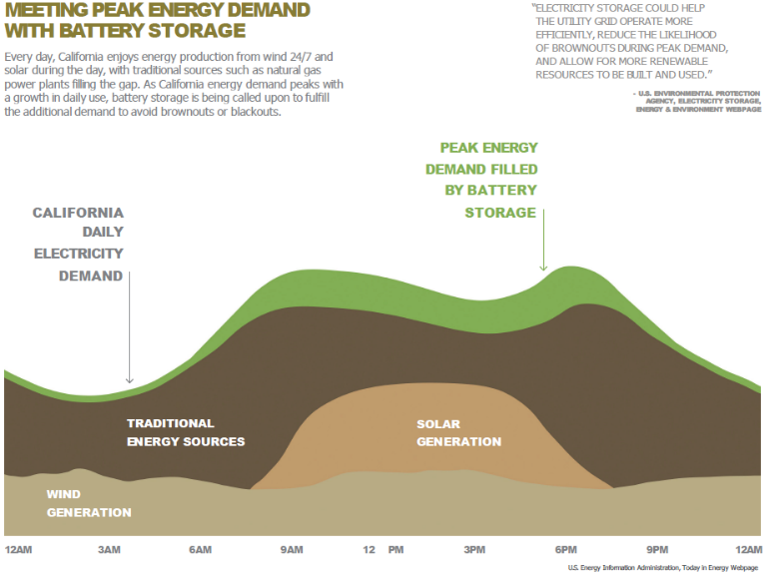
Effects of energy storage on peak demand

Slide 30
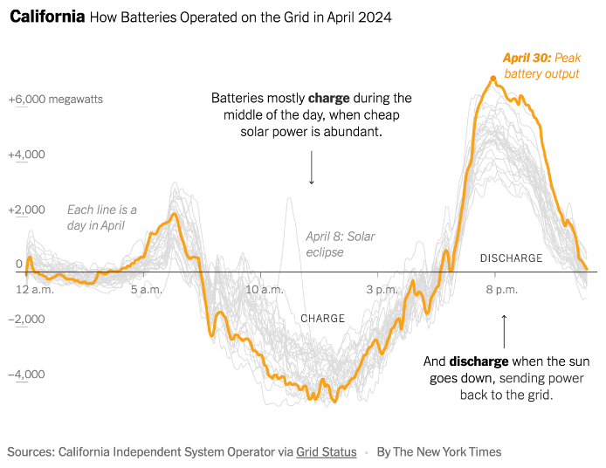
Batteries help midday solar serve evening load

Slide 31
Irwindale-specific considerations for local BESS
Irwindale-specific considerations for local BESS

Slide 32
Irwindale Fire Chief testifies in support of BESS
Los Angeles County Fire Chief Anthony Marrone (ie, the Irwindale Fire Chief) provided full confidence about the safety of BESS in his testimony at the recent Los Angeles County Board of Supervisor hearing that fully approved the Humidor BESS. Details of this 26 November 2024 hearing can be found at Item 65 in the agenda, which is accessible at this link and which provides additional links that lead to lots of excellent fire safety and other useful information:
https://assets-us-01.kc-usercontent.com/0234f496-d2b7-00b6-17a4-b43e949b70a2/bc1fc18b-a867-45c3-b1e5-5beed480d46b/Agenda%20112624_links.pdf

Slide 33
Gateway BESS will reduce pollution in Irwindale
Based on the comprehensive Environmental Impact Report associated with the two options for the Gateway project that were approved by the Irwindale Planning Commission last month, the option that includes the BESS will significantly reduce pollution in Irwindale. This is primarily due to the reduction in truck traffic with about a third of the Gateway warehouse space being utilized for the Gateway BESS.

Slide 34
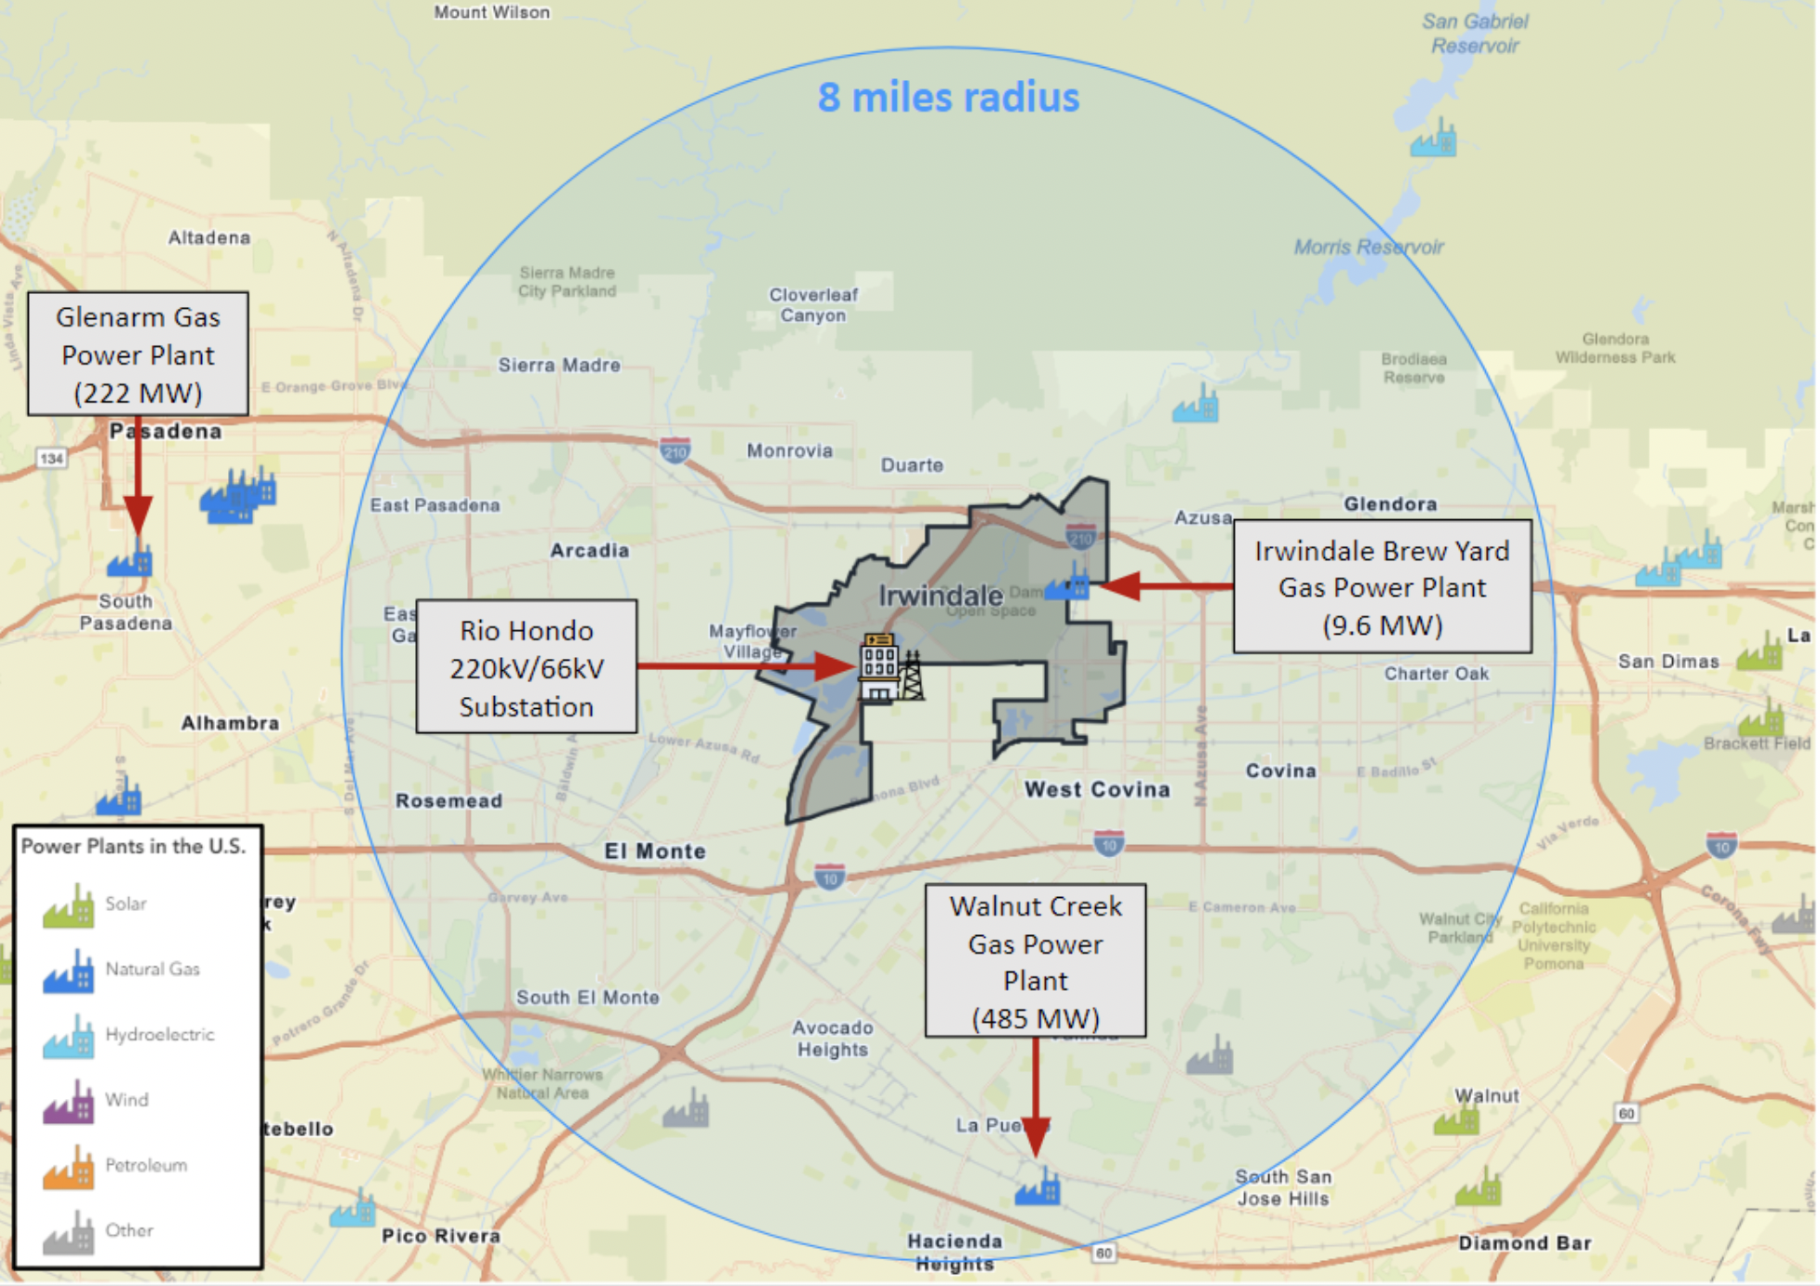
Any BESS in Irwindale will reduce pollution from gas power plants that are prevalent in the region

Slide 35
Gateway BESS delivers significant economic benefits to Irwindale
Based on the comprehensive economic analysis that was included in the Irwindale Planning Commission meeting last month that approved the two options for the Gateway project, the Gateway BESS will deliver significant economic benefits to Irwindale. At about 20 pages, the report is extensive – and it is consistent with other reports I have reviewed.
The economic analyses were performed by DTA and reported in the 14 November Irwindale Planning Commission package on pages 146-163.

Slide 36
Local grid benefits from BESS connecting to the Rio Hondo Substation in Irwindale
Local grid benefits from BESS connecting to the Rio Hondo Substation in Irwindale

Slide 37
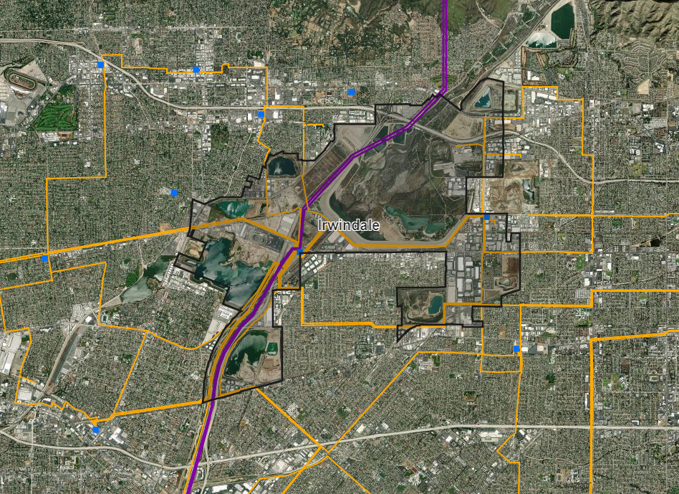
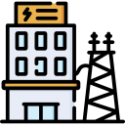
Transmission and high voltage distribution feeders near Irwindale
Rio Hondo 220kV/66kV Substation
Legend
220-500 kV Feeders
66 kV Feeders

Slide 38
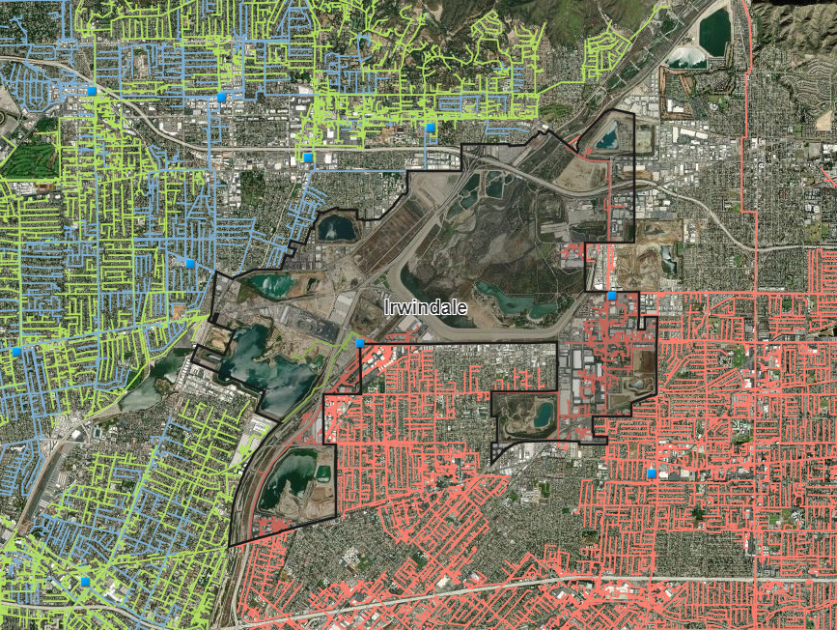
Distribution feeders near Irwindale
Rio Hondo 220kV/66kV Substation
Legend
4 kV Feeders
16kV Feeders
12kV Feeders

Slide 39
Community Benefits possibility for Irwindale
Community Benefits possibility for Irwindale

Slide 40
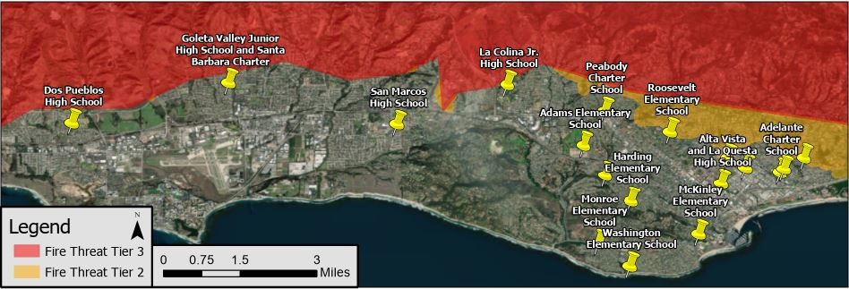
Santa Barbara Unified School District (SBUSD)
The entire Santa Barbara region is surrounded by extreme fire risk (earthquake & landslide risk too) and is extremely vulnerable to electricity grid outages.
The SBUSD is a major school district that increasingly recognizes the value-of-resilience (VOR) and has embraced the Clean Coalition’s vision to implement Solar Microgrids at a number of its key schools and other critical facilities.
SMHS is in the middle of the extensive SBUSD service area.

Slide 41
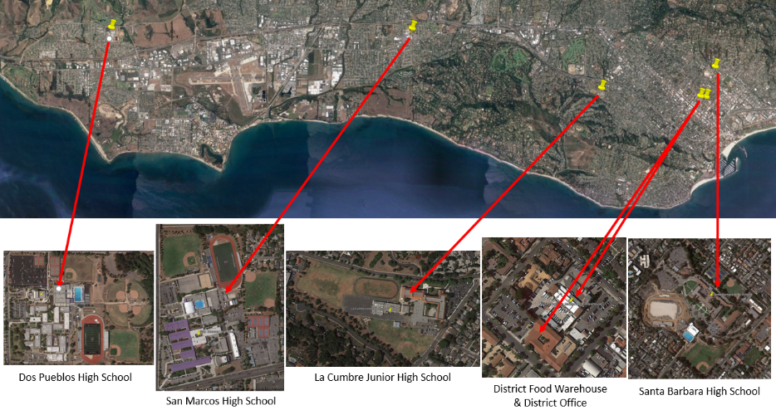
Six SBUSD Solar Microgrid sites

Slide 42
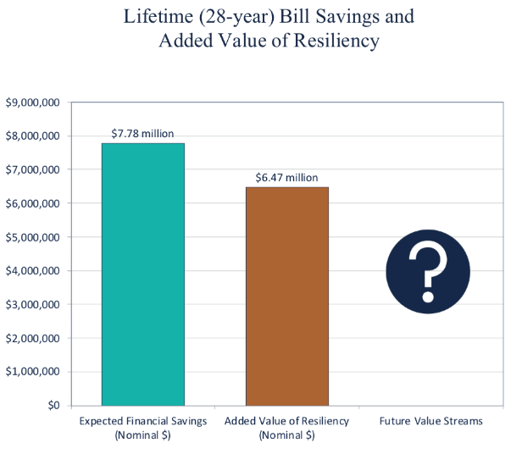
Guaranteed SBUSD bill savings and free VOR

Slide 43
Backup
Backup

Slide 44
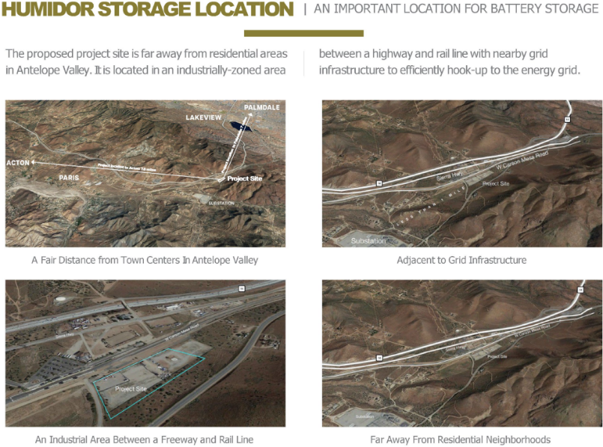
Humidor is in an industrially-zoned area

Slide 45
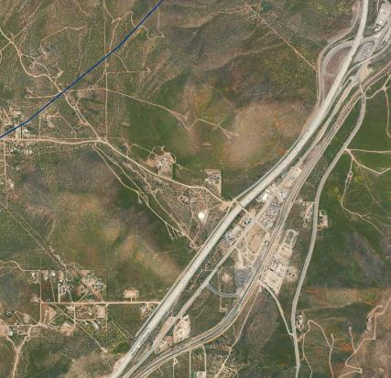
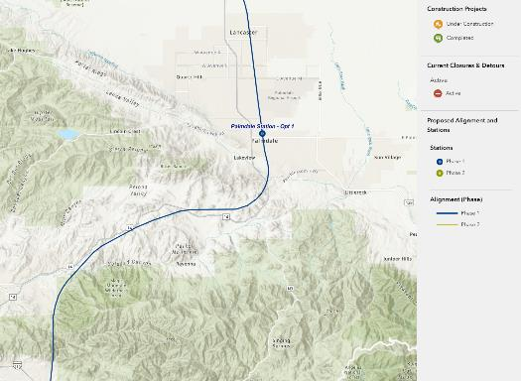
Utilize already disturbed industrial land
California High Speed Rail
Humidor Battery Storage
Humidor Battery Storage
Planned California High Speed Rail route
Source: https://buildhsr.com/map/
Humidor will utilize already disturbed industrial land recently used for a commercial trucking and an electrical subcontractor yard.
Humidor will also be located near the planned California High Speed Rail.

Slide 46
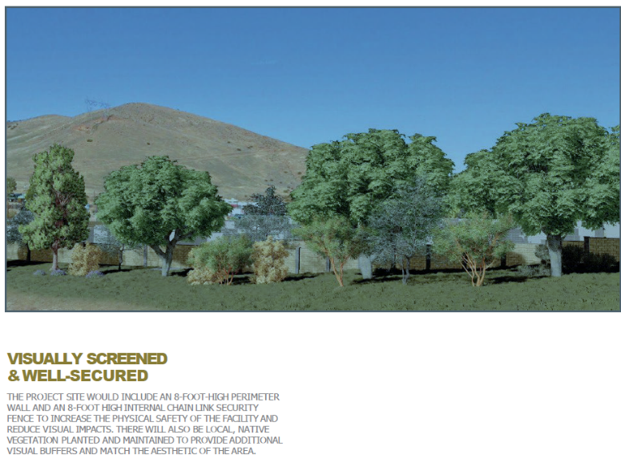
Visually screened and secured

Slide 47
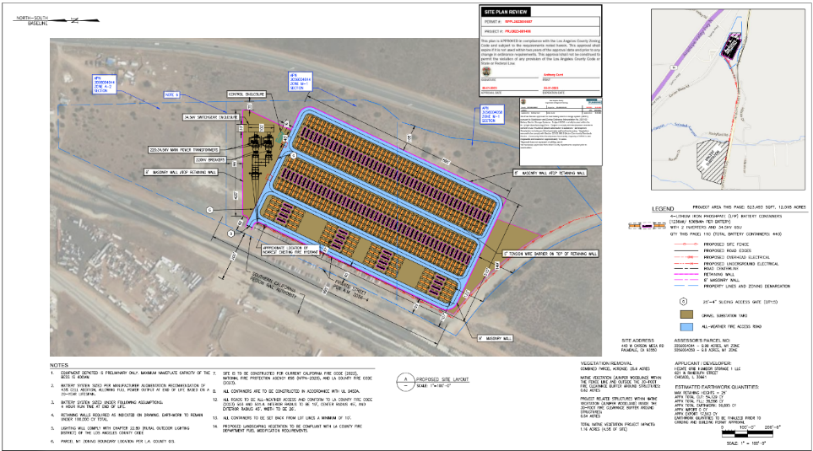
Humidor site plan

Slide 48
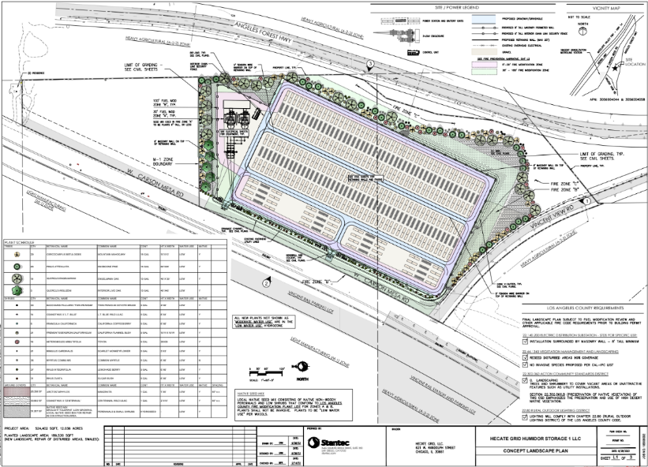
Humidor site plan (continued)

Slide 49
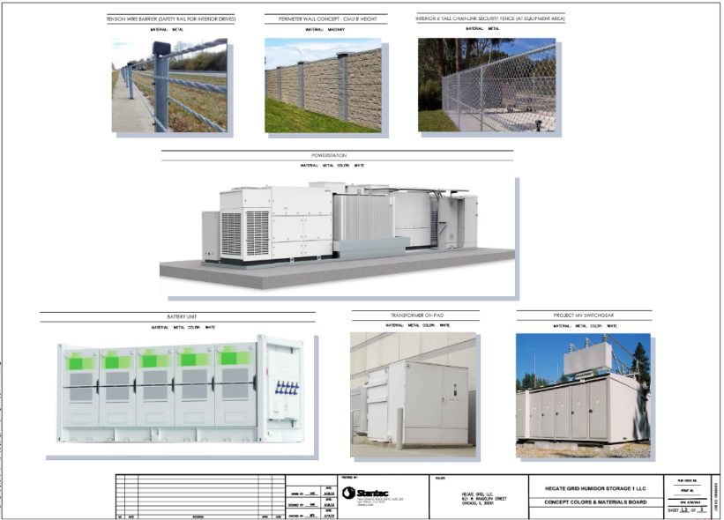
Humidor concept materials and colors

