Slide 1
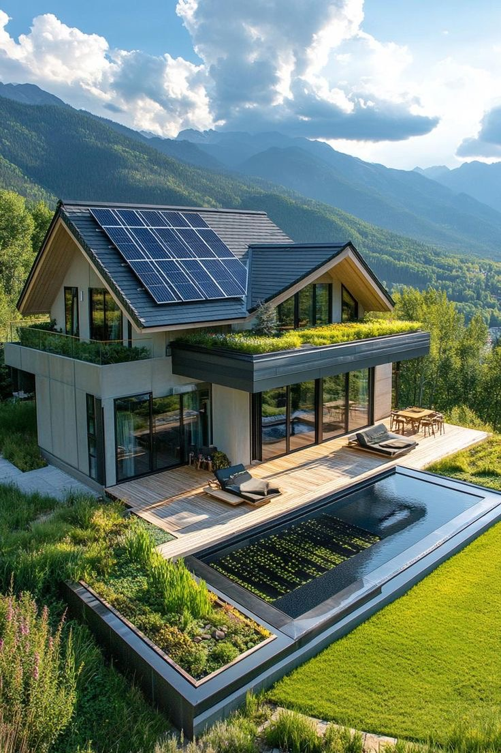
Green Palisades Campaign (GPC)
Facilitating 100% Electric, Net Zero Energy Rebuilding with full Solar Microgrid resilience
Optimizing the trifecta of Economic, Environmental, and Resilience benefits
4 February 2025

Slide 2
GPC Mission & Plan
Mission:
To establish a handful of super green rebuild designs for property owners that lost their homes in the recent Palisades Fire, with the intention that these designs will be widely publicized to facilitate other property owners in Pacific Palisades, Altadena, and way beyond to rebuild in a super green fashion. Super green designs are 100% electric and Net Zero Energy (NZE), with Solar Microgrids that ensure an unparalleled trifecta of economic, environmental, and resilience benefits.
Plan:
Identify a handful of property owners who are committed to rebuilding in a super green fashion.
Establish initial renderings and identify recommended appliances.
Perform load analysis and size solar & storage for meeting NZE and resilience preferences.
Coordinate with a Tiger Team of designers, architects, and builders to facilitate comprehensive super green rebuilding designs – and subsequent construction plans for the new homes.
Publicize the designs widely:
Media (eg: Sammy Roth @ LA Times)
Collaborations with other parties like Rick Caruso, Mayor Bass and Steve Soboroff, Green Building Council, Direct Relief, and others.
Webinars to educate everybody about the GPC’s super green showcase designs.
Notes:
‹#›

Slide 3
Key Collaborators
Collaborating with designers, architects, and builders to ensure super green rebuilds in Pacific Palisades, Altadena, and way beyond.
Confirmed collaborators:
Fallon Vaughan, Developer that built 10 super green homes in Paradise, CA following the wildfire disaster there (Nov 8, 2018).
Dennis Allen, Founder of Allen Construction, a leading green building home builder.
Tim Hade, Co-Founder of Scale Microgrids, a leading solar-driven microgrid solutions provider.
Target collaborators:
Rick Caruso, Leading Steadfast LA, a non-profit focused on accelerating the rebuilding efforts in Palisades.
Karen Bass and Steve Soboroff, Karen Bass appointed Steve Soboroff to lead LAs recovery and expedite rebuilding strategies.
Steve Glenn, CEO, Plant Prefab, Pioneering sustainable and efficient housing solutions.
Colin Mangham, Director of Innovation, USGBC California, driving advancements in green building practices.
Vamsi Kotla, CEO, ReMo Homes, Zero-Carbon Steel Modular Homes (won $3 million from the California Energy Commission Grant)
Direct Relief, leading disaster response organization.

Slide 4
Electric Appliances
Heating & Cooling
Heat Pump HVAC System – Provides both heating and cooling efficiently.
Electric Radiant Floor Heating – Optional for additional comfort.
Energy Recovery Ventilator (ERV) or Heat Recovery Ventilator (HRV) – Improves indoor air quality and efficiency.
Ceiling Fans – Helps reduce HVAC energy use.
Water Heating
Heat Pump Water Heater – Highly efficient alternative to gas water heaters for domestic water.
Pool & Jacuzzi Heat Pumps – Highly efficient alternative to gas heating.
Kitchen Appliances
Induction Cooktop & Stove – More efficient and safer than traditional electric coil or gas stoves.
Electric Oven – Convection or standard electric oven.
Microwave – A quick and efficient cooking option.
Electric Toaster Oven/Air Fryer – Helps reduce energy use compared to a full oven.
Electric Coffee Maker/Kettle – For boiling water efficiently.
Electric Refrigerator & Freezer – ENERGY STAR-rated for efficiency.
Dishwasher – Preferably an energy-efficient model.
Garbage Disposal – If needed, an electric-powered option.

Slide 5
Electric Appliances
Laundry & Cleaning
Heat Pump Clothes Dryer – Uses less energy than a conventional electric dryer.
Electric Washer – ENERGY STAR-rated front-load preferred.
Lighting & Power
LED Lighting – High-efficiency lighting throughout the home.
Smart Thermostat – Helps optimize heating/cooling energy use.
Smart Power Strips & Outlets – Helps prevent phantom energy loads.
Renewable Energy & Storage (For Energy Independence)
Solar Panels (Photovoltaic System) – Generates electricity from the sun.
Home Battery Storage System – Stores solar energy for nighttime or outages (e.g., Tesla Powerwall, Enphase, LG Chem).
Other Home Systems
Electric Car Charger (EV Charger) – Level 2 charger for electric vehicles.
Electric Lawn Equipment – Mower, trimmer, blower (battery or corded).
Electric Fireplace (Optional) – Alternative to a gas fireplace.
Electric Water Pumps – If the home has a well or irrigation system.

Slide 6
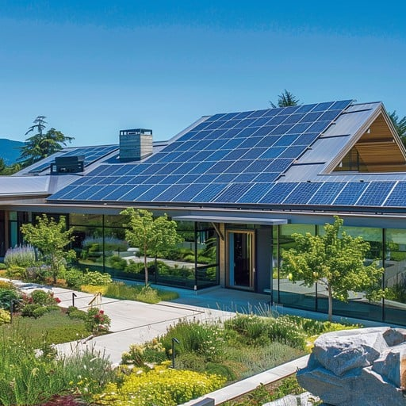
Meet the Team Leading the GPC
Lollie Kuhl
Architectural designer focused on empowering homeowners with actionable guidance for rebuilding sustainably.
Craig Lewis
Founder of Clean Coalition, a nonprofit organization dedicated to accelerating the transition to clean energy and resilient communities.
Fallon Vaughan
Developer that built 10 super green homes in Paradise, CA following the wildfire disaster there in late-2018.
Dennis Allen
A pioneer in sustainable architecture and construction with decades of experience designing energy-efficient homes.
Recognized for integrating green technologies into high-performance buildings.
Tim Hade
A pioneer in Solar Microgrids and backup power solutions more generally.

Slide 7
NZE Home Design: Key Components
Site Planning: Orientation for passive solar gain, wind mitigation, and natural shading.
Energy Generation:
Solar PV systems designed to meet or exceed home energy demands.
Battery storage for reliability and peak energy management.
Building Envelope:
High-performance insulation (walls, roof, floors).
Triple-pane, low-E windows for energy efficiency.
Airtight construction to minimize heat loss.
HVAC Systems:
Heat pumps for heating, cooling, and water heating.
Energy Recovery Ventilation (ERV) systems for air quality and energy savings.
Lighting and Appliances:
LED lighting throughout the home.
Water Efficiency:
Low-flow fixtures, dual-flush toilets, and rainwater harvesting systems.
Greywater recycling for irrigation and non-potable uses.
Smart Home Integration:
Energy monitoring systems for real-time energy use insights.
Programmable thermostats and smart appliances.

Slide 8
Plan Overview
Piloting Sustainable Rebuilds
Assisting a select group of homeowners in conceptualizing and designing NZE homes as demonstration projects.
Showcasing these homes as models to encourage broader adoption across the community.
Advocacy and Awareness
Promoting NZE and solar-powered rebuilding efforts through community outreach, social media campaigns, and public forums. Why This Matters:
For Homeowners: Lower energy costs, improved safety, and future-proof homes with an unparalleled trifecta of economic, environmental, and resilience benefits.
For the Community: A resilient, energy-secure neighborhood that stands as a model for others.
For the Environment: A significant reduction in carbon emissions and a commitment to renewable energy solutions.
Additional Initiatives:
Offering homeowners tailored recommendations for passive design strategies like optimal window placement, insulation, and shading.
Providing a directory of vetted suppliers and contractors specializing in NZE and solar technology.
Exploring partnerships to fund or subsidize renewable energy installations, making NZE solutions accessible to all.

Slide 9
Plan Overview
Conclusion: Clean Coalition is committed to ensuring communities achieve resilient energy solutions and an unparalleled trifecta of economic, environmental, and resilience benefits. Our plan bridges innovation and community action, turning the tragedy of the fires into an opportunity to create a sustainable, resilient, and thriving Palisades. Together, we can lead the way toward a future built on renewable energy and environmental responsibility.

