Slide 1

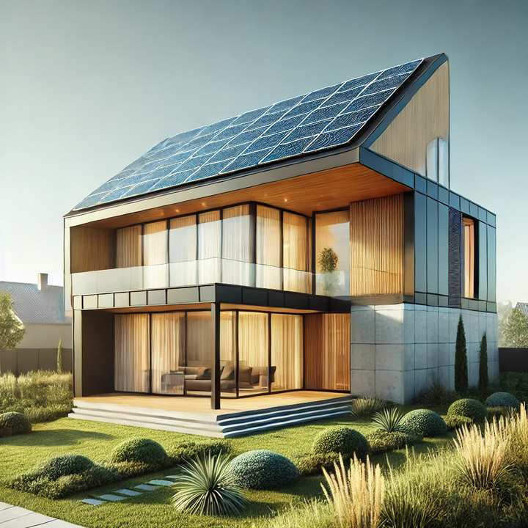
Green Palisades Campaign (GPC)
Facilitating 100% Electric, Net Zero Energy Rebuilding with full Solar Microgrid resilience
Optimizing the trifecta of Economic, Environmental, and Resilience benefits
March 2025

Slide 2
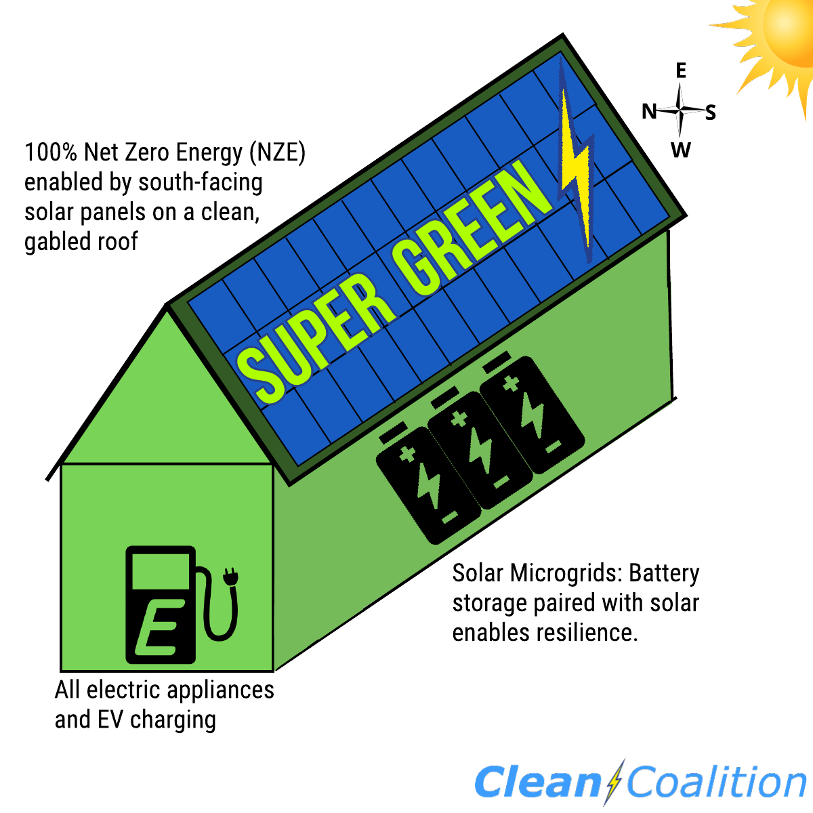
Green Rebuild Initiative (GRI)
The GPC is an initial step of the larger Green Rebuild Initiative (GRI), which ensures that disaster-stricken communities are rebuilt in a super green fashion.
What is ”super green”?
1. 100% electric (no gas service to the home and ideally be an all-EV household).
2. Hosts enough solar to achieve Net Zero Energy (will require about 35 solar panels for a typical 2,500 square foot all-electric home with about 10,000 miles of home EV charging per year).
3. Includes a Solar Microgrid that combines the solar to a battery.
Notes:
2

Slide 3
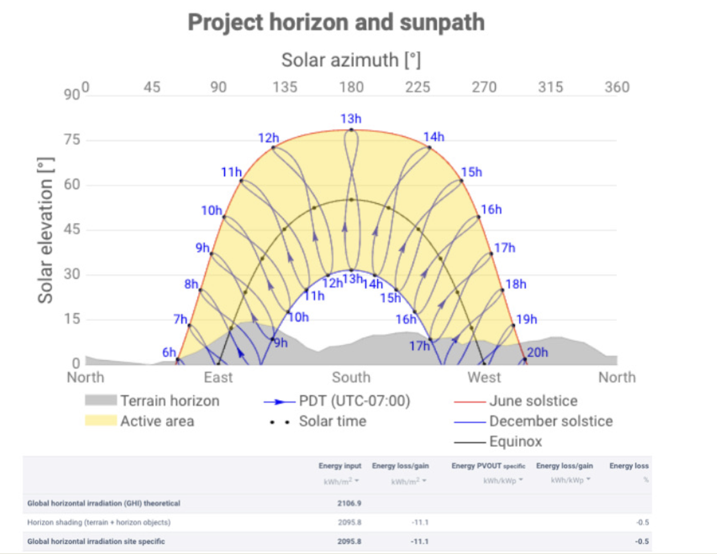
The importance of south-facing panels:
Notes:
3

Slide 4
GPC Mission & Plan
Mission:
To establish a handful of super green rebuild designs for property owners that lost their homes in the recent Palisades Fire, with the intention that these designs will be widely publicized to facilitate other property owners in Pacific Palisades, Altadena, and way beyond to rebuild in a super green fashion. Super green designs are 100% electric and Net Zero Energy (NZE), with Solar Microgrids that ensure an unparalleled trifecta of economic, environmental, and resilience benefits.
Plan:
Identify a handful of property owners who are committed to rebuilding in a super green fashion.
Establish initial renderings and identify recommended appliances.
Perform load analysis and size solar & storage for meeting NZE and resilience preferences.
Coordinate with a Tiger Team of designers, architects, and builders to facilitate comprehensive super green rebuilding designs – and subsequent construction plans for the new homes.
Publicize the designs widely:
  Media (eg: Sammy Roth @ LA Times)
  Collaborations with other parties like Rick Caruso, Mayor Bass and Steve Soboroff, Green Building Council, Direct Relief, and others.
  Webinars to educate everybody about the GPC’s super green showcase designs.
Notes:
4

Slide 5
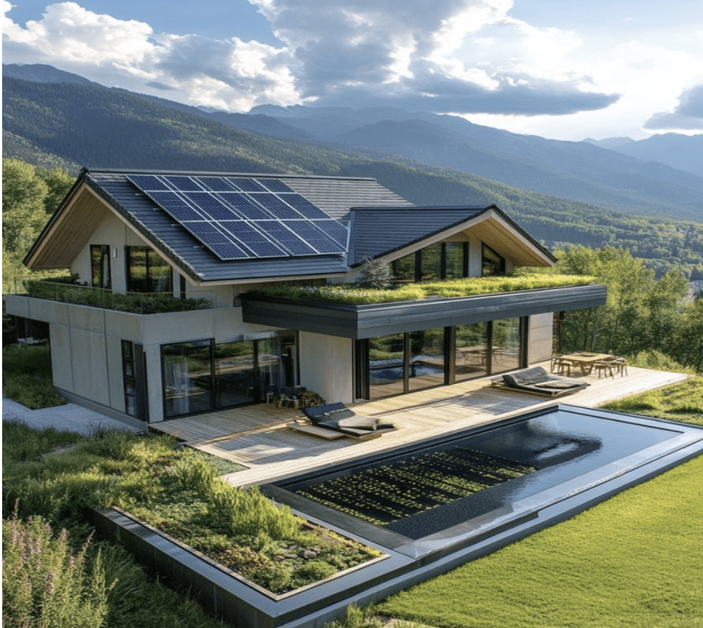
GPC Mission & Plan
A typical 2,500 sq ft all-electric house that provides about 10,000 miles of home EV charging annually will need about 15kW of solar to achieve Net Zero Energy (NZE), which requires about 35 standard-sized solar panels, requiring about 700 sq ft of clean (no protrusions) south-facing roof surface.
Importantly, achieving Super Green for a new 2,500 sq ft house adds about $100k to the construction cost, but about half of that can be recovered via tax benefits, rebates, and other incentives -- and the net investment will generally earn a 10%+ tax-free, risk-free return-on-investment (ROI), via reduced energy bills. There is no other type of investment anywhere that provides such a high return for what is essentially equivalent to a long-term certificate-of-deposit (CD) that pays a 15%+ annual-percentage-rate (APR).
Notes:
5

Slide 6
Confirmed Collaborators
Confirmed collaborators:
Fallon Vaughan, Developer that built 10 super green homes in Paradise, CA following the wildfire disaster there (Nov 8, 2018).
Dennis Allen, Founder of Allen Construction, a leading green building home builder.
Tim Hade, Co-Founder of Scale Microgrids, a leading solar-driven microgrid solutions provider.
Lauren Michelle, Lauren Michele, Owner & Sustainability Consultant, California Home Designs. Lauren combines her expertise in urban planning, climate policy, and sustainable development to create resilient homes and communities. Specializing in net-zero energy and wildfire-resilient home design, she focuses on innovative strategies through building decarbonization, energy-efficient systems, and climate-adaptation solutions.
John Bello, P.E., President at Bello Global Consulting.
Ellen Bildsten, Architect and member of the American Institute of Architects.
Elisa Garcia, Architect with Garcia Architects.

Slide 7
Target Collaborators
Target collaborators:
Rick Caruso, Leading Steadfast LA, a non-profit focused on accelerating the rebuilding efforts in Palisades.
Karen Bass and Steve Soboroff, Karen Bass appointed Steve Soboroff to lead LAs recovery and expedite rebuilding strategies.
Steve Glenn, CEO, Plant Prefab, Pioneering sustainable and efficient housing solutions.
Colin Mangham, Director of Innovation, USGBC California, driving advancements in green building practices.
Vamsi Kotla, CEO, ReMo Homes, Zero-Carbon Steel Modular Homes (won $3 million from the California Energy Commission Grant)
Direct Relief, leading disaster response organization.
Habitat for Humanity, nonprofit organization that helps families build and improve places to call home.
US Green Building Council, nonprofit that promotes sustainability in building design, construction, and operation.
California Insurance Commission

Slide 8
Electric Appliances
Heating & Cooling
Heat Pump HVAC System – Provides both heating and cooling efficiently.
Electric Radiant Floor Heating – Optional for additional comfort.
Energy Recovery Ventilator (ERV) or Heat Recovery Ventilator (HRV) – Improves indoor air quality and efficiency.
Ceiling Fans – Helps reduce HVAC energy use.
Water Heating
Heat Pump Water Heater – Highly efficient alternative to gas water heaters for domestic water.
Pool & Jacuzzi Heat Pumps – Highly efficient alternative to gas heating.
Kitchen Appliances
Induction Cooktop & Stove – More efficient and safer than traditional electric coil or gas stoves.
Electric Oven – Convection or standard electric oven.
Microwave – A quick and efficient cooking option.
Electric Toaster Oven/Air Fryer – Helps reduce energy use compared to a full oven.
Electric Coffee Maker/Kettle – For boiling water efficiently.
Electric Refrigerator & Freezer – ENERGY STAR-rated for efficiency.
Dishwasher – Preferably an energy-efficient model.
Garbage Disposal – If needed, an electric-powered option.

Slide 9
Electric Appliances
Laundry & Cleaning
Heat Pump Clothes Dryer – Uses less energy than a conventional electric dryer.
Electric Washer – ENERGY STAR-rated front-load preferred.
Lighting & Power
LED Lighting – High-efficiency lighting throughout the home.
Smart Thermostat – Helps optimize heating/cooling energy use.
Smart Power Strips & Outlets – Helps prevent phantom energy loads.
Renewable Energy & Storage (For Energy Independence)
Solar Panels (Photovoltaic System) – Generates electricity from the sun.
Home Battery Storage System – Stores solar energy for nighttime or outages (e.g., Tesla Powerwall, Enphase, LG Chem).
Other Home Systems
Electric Car Charger (EV Charger) – Level 2 charger for electric vehicles.
Electric Lawn Equipment – Mower, trimmer, blower (battery or corded).
Electric Fireplace (Optional) – Alternative to a gas fireplace.
Electric Water Pumps – If the home has a well or irrigation system.

Slide 10
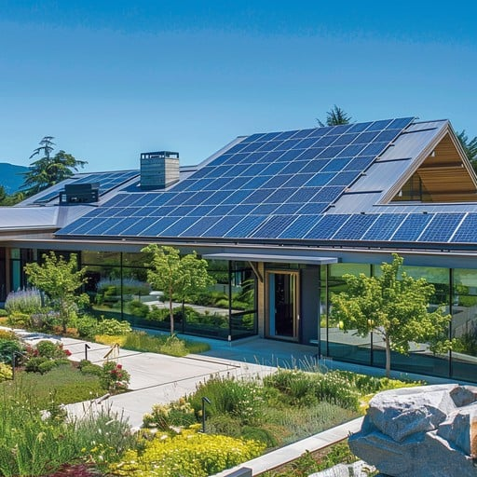

Meet the Team Leading the GPC
Lollie Kuhl
Architectural designer focused on empowering homeowners with actionable guidance for rebuilding sustainably.
Haley Weinstein
Communications lead at Clean Coalition.
Craig Lewis
Founder of Clean Coalition, a nonprofit organization dedicated to accelerating the transition to clean energy and resilient communities.
Fallon Vaughan
Developer that built 10 super green homes in Paradise, CA following the wildfire disaster there in late-2018.
Dennis Allen
A pioneer in sustainable architecture and construction with decades of experience designing energy-efficient homes.
Recognized for integrating green technologies into high-performance buildings.
Tim Hade
A pioneer in Solar Microgrids and backup power solutions more generally.

